Slide 1
Chapter 17
Price Concepts
with Duane Weaver

Slide 2
Outline
Price & the Law
Pricing Objectives
Profitability Objectives
Volume Objectives
Meeting Competition Objectives
Prestige Objectives
Determining Price
Elasticity and Pricing
Breakeven Analysis
Yield Management
Global Issues

Slide 3
Pricing and the Law
Price The exchange value of a good or service
Competition Act
Federal legislation prohibiting price discrimination, price fixing, bid rigging, predatory pricing, false or misleading ordinary selling price representations, and other anti-competitive practices

Slide 4
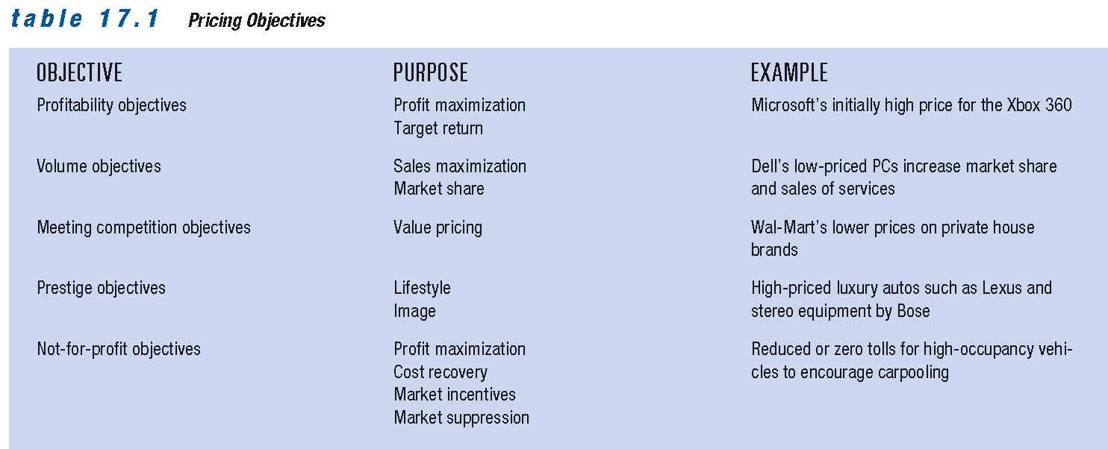
Pricing Objectives

Slide 5
Profitability Objectives
Consumers must be convinced they are receiving good value for their money
Intense competition results from competition for leadership position
Basic formula for profit and revenue:
Profit = Revenue ― Expenses
Total Revenue = Price X Quantity Sold

Slide 6
The PIMS Studies
The Profit Impact of Market Strategies (PIMS) Project Research that discovered a strong positive relationship between a firm’s market share and product quality and its return on investment
Firms with market share more than 40 percent have average return on investment of 32 percent
Explanation: Firms with large shares accumulate operating experience and lower overall costs relative to competitors with smaller market shares

Slide 7
Meeting Competition Objectives
Firms sometimes set prices to match industry leaders
Shifts marketing mix to focus on non-price factors
Example: Some airlines focus competition on factors such as service and comfort
Value pricing Pricing strategy emphasizing the benefits derived from a product in comparison to the price and quality levels of competing offerings
Typically works best for relatively low-priced goods and services
Challenge is convincing customers that low-priced brands offer quality comparable to that of higher-priced product

Slide 8
Prestige Objectives
Prestige objectives Establishing a relatively high price to develop and maintain an image of quality and exclusiveness that appeals to status-conscious consumers
Example: Tiffany jewellery

Slide 9
Methods for Determining Prices
Prices traditionally determined in two basic ways:
Supply and demand
Cost-oriented analysis
Customary prices Traditional prices that consumers expect to pay for a good or service
Companies try to balance consumer pricing expectations with the realities of rising costs

Slide 10
Cost and Revenue Curves
Product’s total cost =
Total variable cost + total fixed cost
Variable costs change with the level of production
Include raw materials and labour costs
Fixed costs remain stable at any production level within a certain range
Include lease payments or insurance costs
Average total cost =
(variable + fixed costs) / no. of units produced
Marginal cost Change in total cost that results from producing one additional unit of output

Slide 11
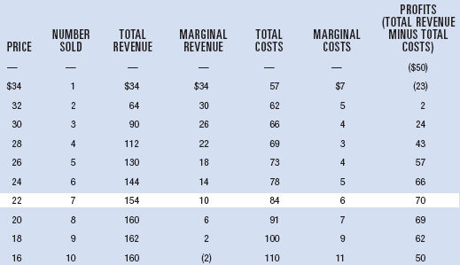
Price Determination using Marginal Analysis
Price that brings the highest profit

Slide 12
The Concept of Elasticity in Pricing Strategy
Elasticity Measure of responsiveness of purchasers and suppliers to changes in price
Elasticity of demand Percentage change in the quantity of a good or service demanded divided by the percentage change in its price
Elasticity of supply Percentage change in the quantity of a good or service supplied divided by the percentage change in its price
Greater than 1.0 = elastic supply or demand
Less than 1.0 = inelastic supply or demand
Example: 10 percent increase in cigarette prices results in 3 percent sales decline = inelastic

Slide 13
Determinants Of Elasticity
Availability of Substitutes or complements
If many are available, demand tends to be elastic
Role as complement to another product
Example: Demand for motor oil is relatively inelastic
Increasing number of online business transactions
Increases demand elasticity as consumers have more choice
Whether product seen as necessity or luxury
Example: Price change has little effect on gas demand
Portion of a person’s budget spent on an item
Larger the portion, more elastic the demand
Demand often shows less elasticity in the short run than in the long run

Slide 14
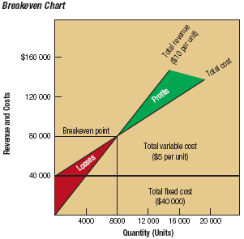
Breakeven Chart

Slide 15
Yield Management
Yield Management Pricing strategy that allows marketers to vary prices based on such factors as demand, even though the cost of providing those goods or services remains the same
Example: Varying prices for tickets to a play based on day, time, and seat location
Example: Varying availability of restricted and non-restricted airline tickets in the months and weeks before the flight to maximize revenues

Slide 16
Global Issues in Price Determination
Prices must support the firm’s broader goals
Use four strategies same as in domestic markets:
Profitability―if company is a price leader
Volume―expose foreign markets to competition when trade barriers are lowered
Meeting competition―important in Europe where common currency has led to price convergence
Prestige―valid when products are associated with intangible benefits (quality, exclusivity, design)
Also a fifth objective―price stability
Especially important for producers of commodities who are more susceptible to fluctuating prices than producers of value-oriented products

