Slide 1
Chapter 15 Basic Version
Advertising and Public Relations

Slide 2
Outline
Objectives of Advertising
Ad Strategies
Ad Messages
Ad Appeals
Media Selection & Scheduling
Public Relations
Measuring Effectiveness

Slide 3
Objectives of Advertising
Informative advertising Promotion that seeks to develop initial demand for a good, service, organization, person, place, idea, or cause
Persuasive advertising Promotion that attempts to increase demand for an existing good, service, organization, person, place, idea, or cause
Reminder advertising Advertising that reinforces previous promotional activity by keeping the name of a good, service, organization, person, place, idea, or cause before the public

Slide 4
Advertising Strategies
Comparative
Celebrity testimonials
Retail advertising
Cooperative
Interactive

Slide 5
Advertising Messages
Ads must be meaningful, believable, and distinctive
Creator must decide whether to focus on
A practical appeal (i.e., price), or
Emotional responses like fear, humour, or fantasy
Advertising campaign Series of different but related ads that use a single theme and appear in different media within a specified time period

Slide 6
Advertising Appeals
Appeals can provide information or appeal to emotion
Emotional appeals can involve:
Fear
Humour
Sex

Slide 7
Media Selection
Could Include:
Television
Radio
Newspapers
Magazines
Direct mail
Outdoor
Interactive

Slide 8
Media Scheduling
After selecting media, marketers determine the most effective timing and sequence for a series of advertisements
Influenced by a variety of factors:
Seasonal sales patterns
Repurchase cycles
Competitors’ activities
Measure effectiveness in three ways:
Reach—the number of people exposed to an advertisement
Frequency—the number of times an individual is exposed to an advertisement. Minimum of three exposures is recommended
Gross rating point—the product of the reach times the frequency GRP=RxF

Slide 9
Public Relations
Firm’s communications and relationships with its various publics, including customers, employees, stockholders, suppliers, and government agencies
Nonmarketing public relations A company’s messages about general management issues
Example: An announcement to close a production facility
Marketing public relations (MPR) Narrowly focused public relations activities that directly support marketing goals
Example: Sending out press releases about new products

Slide 10
Measuring Advertising Effectiveness
Media research—assesses how well particular medium delivers message, where and when to place the message, and the size of the audience
Methods used include:
Focus groups
Sales conviction test
Blind product tests
Tests using mechanical devices
Message research—tests consumer reactions to an advertisement’s creative message through pretesting and posttesting

Slide 11
Pretesting
Assessing an advertisement’s likely effectiveness before it is completed
Use focus groups, consumer testing, and mechanical devices to evaluate possible advertising
Posttesting
Assessing advertisement’s effectiveness after it has appeared
Useful for adjusting current advertising programs and planning future ones
Specific tests can be used to analyze consumer recognition, recall, and inquiries to measure and effectiveness
Split runs allow advertisers to test the relative effectiveness of two ads

Slide 12
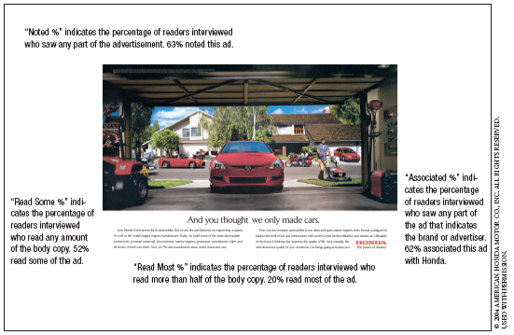
Magazine Advertisements With Starch Scores

Slide 13
Evaluating Interactive Media
Measurements include
Hits―user requests for a file
Impressions―number of times of viewers sees an ad
Click-throughs―user clicks on the ad for more information
View-through—measure response over time

Slide 14
THANK YOU For Your Time!

