Slide 1
Chapter 7
Marketing Research, Decision Support Systems, and Sales Forecasting
with Duane Weaver

Slide 2
Chapter Objectives
Marketing Research Function
The Marketing Research Process
Conducting International Marketing Research
Computer Technology in Marketing Research
Sales Forecasting – Qualitative & Quantitative

Slide 3
The Marketing Research Function
Marketing research Process of collecting and using information for marketing decision-making
Marketers use data from a variety of sources to understand customers, target customer segments, and develop long-term customer relationships
Research is the primary source of information used to make effective marketing decisions

Slide 4
Who Conducts Marketing Research
The size and organizational form of the marketing research function is typically tied to a given company’s structure
Many firms outsource research needs
Syndicated services– Organizations that regularly provide a standardized set of data to all customers
Full-service research suppliers― Organizations that conduct complete marketing research projects
Limited-service research suppliers― Firms that specialize in selected activities, such as conducting field interviews or performing data processing

Slide 5
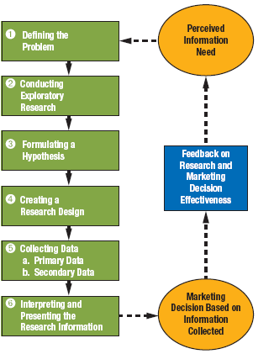
The Marketing Research Process

Slide 6
Step 1: Define the Problem
Well-defined problems are half-solved
Avoid confusing symptoms with problem itself
Loss of market share is a symptom; reason for the loss is the problem
Step 2: Conduct Exploratory Research
Exploratory research Process of discussing a marketing problem with informed sources both within and outside the firm and examining information from secondary sources

Slide 7
Using Internal Data
Research from past customer surveys and demographic data
Sales analysis can compare expected sales with actual sales and be analyzed in a variety of ways, such as by customer type, sales method, and others
Accounting data provides information about financial issues
Marketing cost analysis evaluates expenses for a variety of costs

Slide 8
Step 3: Formulate a Hypothesis
Tentative explanation for some specific event
Sets the stage for more in-depth research
Not all marketing research tests specific hypotheses
Step 4: Create a Research Design
Master plan or model for conducting marketing research
Must ensure that it will measure what researchers intend to measure

Slide 9
Step 5: Collect Data
Secondary data (Data from previously published or compiled sources)
Primary data (Refers to data collected for the first time specifically for a marketing research study)
Step 6: Interpret and Present Research Information
Present in a format that allows managers to make effective judgments
Researchers and end users must collaborate to ensure effectiveness of research
Reports must be clear and concise
Must explain technical terminology

Slide 10
Sampling Techniques
Sampling Process of selecting survey respondents or other research participants
Probability: Random, Stratified, Clustered
Non-Probability: Convenience, Quota
Population (universe) Total group that researchers want to study
Census A collection of data on all possible members of a population or universe

Slide 11
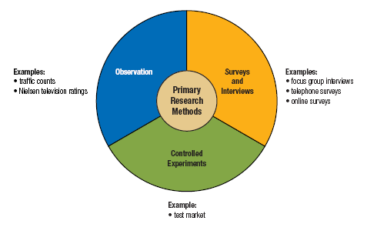
Types of Primary Research

Slide 12
Conducting International Marketing Research
Follow same basic steps as for domestic marketing research
Researchers must be aware of cultural and legal environments
May have to adapt research methods to local conditions
Example: Focus groups may be difficult to organize in countries where violence and kidnapping are common

Slide 13
Computer Technology in Marketing Research
Marketing information system (MIS)
Marketing decision support system (MDSS)
Data mining
Business intelligence
Competitive intelligence

Slide 14
Sales Forecasting
Sales Forecast Estimate of company or product revenue for a specified future period

Slide 15
Qualitative Forecasting Techniques
These techniques rely on subjective data that reports opinions rather than exact historical data
Jury of Executive Opinion
Combines and averages the outlooks of top executives from such areas as marketing, finance, production, and purchasing
Delphi Technique
Solicits opinions from several people, but it also gathers input from experts outside the firm rather than relying completely on company executives

Slide 16
Qualitative Forecasting Techniques (continued)
Sales Force Composite
Develops forecasts based on the belief that organization members closest to the marketplace offer the best insights concerning short-term future sales
Survey of Buyer Intentions
Gathers input through mail-in questionnaires, online feedback, telephone polls, and personal interviews to determine the purchasing intentions of a representative group of present and potential customers

Slide 17
Quantitative Forecasting Techniques
This method uses statistical computations such as trend extensions, computer simulations, and economic models
Market Tests
Gauges consumer responses to a new product under actual marketplace conditions
Allows researchers to evaluate the effects of different prices, alternative promotional strategies, and other marketing mix variations
Trend Analysis
Develops forecasts for future sales by analyzing the historical relationship between sales and time

Slide 18
Quantitative Forecasting Techniques (CONTINUED)
Exponential Smoothing
Sophisticated method of trend analysis that weighs each year’s sales data, giving greater weight to results from the most recent years

Slide 19
Thank You
Utilize market research to your advantage.
Databases (in our library)
Euromonitor
GDMI database
Conference Board
Financial Sources
SEDAR – Canadian Securities Publically Traded with Annual Reports (competitors too)
Exchanges
All annual reports

