Slide 1
PMBA 502 - Chapter 2
Strategic Planning and the Marketing Process
with Duane Weaver

Slide 2
Chapter Objectives
Marketing Planning
Strategic vs. Tactical
Porter’s Five Forces Model
Mover Strategies
SWOT
Elements of Marketing Strategy
Other Tools

Slide 3
Marketing Planning: The Basics for Strategy and Tactics
Planning:
process of anticipating future events and conditions and of determining the best way to achieve organizational goals
Continuous process that creates a blueprint for everyone in the organization
Important for large and small companies

Slide 4
Strategic Planning versus Tactical Planning
Strategic planning
Process of determining an organization’s primary objectives and adopting courses of action that will achieve these objectives
Provides long-term direction for decision makers
Tactical planning
Process that guides the implementation of activities specified in the strategic plan
Typically addresses shorter-term actions that focus on current or near-term activities

Slide 5
Successful Strategies: Tools and Techniques
Porter’s Five Forces Model
Developed by strategy expert Michael Porter that identifies five competitive forces that influence planning strategies:
The threat of new entrants
The bargaining power of buyers
The bargaining power of suppliers
The threat of substitute products
Rivalry among competitors

Slide 6
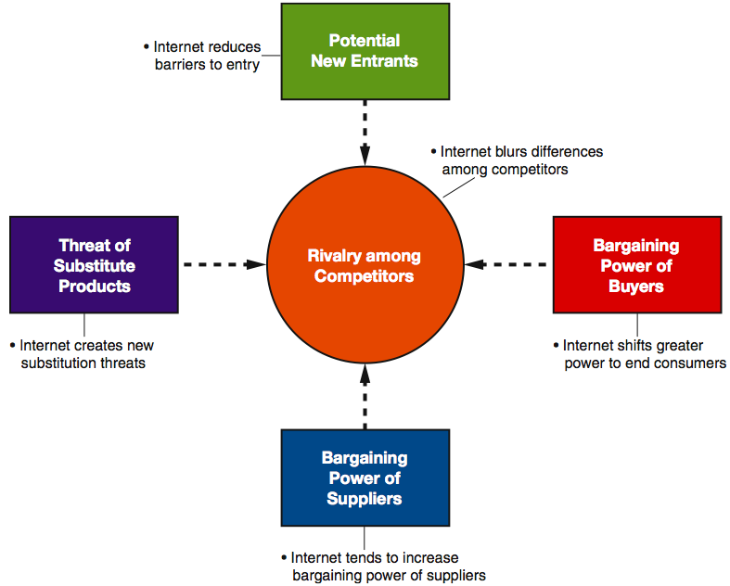

Slide 7
First Mover and Second Mover Strategies
First mover strategy Theory advocating that the company that is first to offer a product in a marketplace will be the long-term market winner
Second mover strategy Theory that advocates observing closely the innovations of first movers and then improving on them to gain advantage in the marketplace

Slide 8
SWOT Analysis
SWOT analysis Analysis that helps planners compare internal organizational strengths and weaknesses with external opportunities and threats
WHO | STRENGTHS | WEAKNESSES | OPPORTUNITIES | THREATS | STRATEGIES
Us
Competitor
Competitor

Slide 9
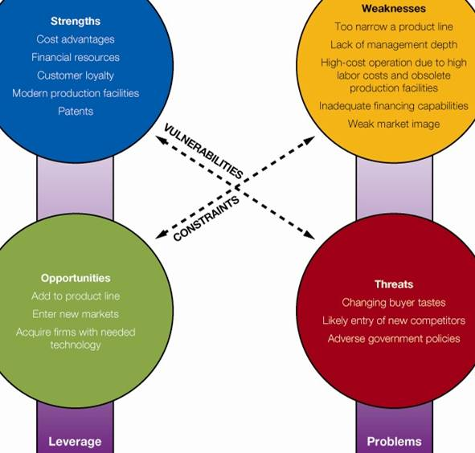
SWOT Analysis

Slide 10
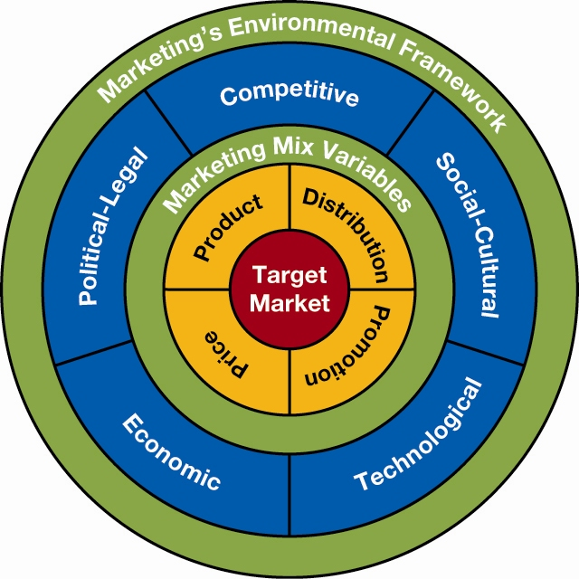
Elements of a Marketing Strategy
Two basic elements: Target market and marketing mix variables

Slide 11
Other Tools for Marketing Planning and Analysis
Business Portfolio Analysis
An evaluation of a company’s products and divisions to determine the strongest and weakest ones
Strategic business units (SBUs) Key business units within diversified firms
Each has its own managers, resources, objectives, and competitors
Help focus the attention of managers
Example: Hewlett-Packard’s iPaq unit for its handheld computer

Slide 12
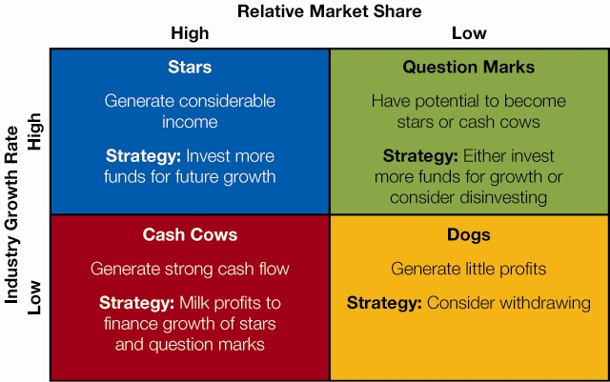
Other Tools for Marketing Planning and Analysis
BCG Analysis
Developed by the Boston Consulting Group
A market share/market growth matrix that plots market share against market growth potential

Slide 13
THANK YOU
Let’s use these concepts to help us analyze Burlington’s UPF Clothing case.
Please make sure you are sitting in your teams and place your tent card with your name in front of you.

