Slide 1
PMBA 502 - Chapter 1
Marketing: The Art and Science of Satisfying Customers
with Duane Weaver

Slide 2
OUTLINE
What is Marketing?
The 4 Ps of Marketing
Eras in Marketing
Needs vs. Wants
Maslow’s Hierarchy of Needs
Not-for-profit Marketing
Avoiding Marketing Myopia

Slide 3
What is Marketing
Production and marketing together create utility—the want-satisfying power of a good or service (can be in the form of a product, service, idea or experience)
Type of Utility | Description | Examples | Organizational Function Responsible
Form | Conversion of raw materials and components into finished goods and services | Dinner at Swiss Chalet; iPod; shirt from Mark’s Work Wearhouse | Production
Time | Availability of goods and services when consumers want them | Dental appointment; digital photographs; LensCrafters eyeglass guarantee; Canada Post Expresspost | Marketing
Place | Availability of goods and services at convenient locations | Soft-drink machines outside gas stations; on-site day care; banks in grocery stores | Marketing
Owner-ship | Ability to transfer title to goods or services from marketer to buyer | Retail sales (in exchange for currency or credit-card payment) | Marketing

Slide 4
Definition of Marketing
Marketing Companywide consumer orientation with the objective of achieving long-run success
Does it have to be “long run”?
Involves:
Analyzing customer needs
Obtaining the information necessary for design and production that match customer expectations
Satisfying customer preferences
Creating and maintaining relationships with customers and suppliers

Slide 5
The 4 P’s of Marketing
LET’S PROVIDE EXAMPLES FOR EACH
PRODUCT
PLACE
PRICE
PROMOTION

Slide 6
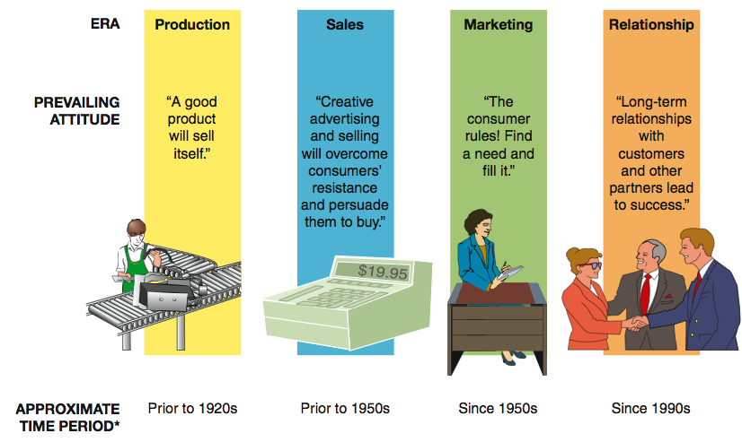
Four Eras in the History of Marketing
Exchange process—activity in which two or more parties give something of value to each other to satisfy perceived need

Slide 7
Emergence of the Marketing Concept
Created the need for greater consumer orientation—business philosophy incorporating the marketing concept that emphasizes first determining unmet consumer needs and then designing a system to satisfy them

Slide 8
Converting Needs to Wants
Effective marketing focuses on the benefits resulting from goods and services
Example: Need for water to satisfy thirst converted to a desire for CocaCola
Companies must pay attention to what consumers want
Example: Demand for smarter cell phones and wireless services
In your case study groups provide an example of a need and a want. Be prepared to discuss your choices with the class. (5 minutes)

Slide 9
Maslow’s Hierarchy of Needs
Source: Solomon, et. al, 2009

Slide 10
Characteristics of Not-for-profit Marketing
Purpose is to generate revenue to support their causes
Must compete with other organizations for donor’s dollars
Must often market to multiple audiences
EVEN THOUGH the goal is not profit, they still must MARKET themselves.

Slide 11
Avoiding Marketing Myopia
Marketing myopia—management’s failure to recognize the scope of its business

Slide 12
From Transaction-Based Marketing to Relationship Marketing
Focus is on developing customers into repeat, loyal customers—increasing the lifetime value of the customer
Goal is to move customer up the loyalty ladder:
Repeat customers are a source of “word-of-mouth” marketing
Advocate
Loyal supporter
Regular purchaser
New customer

Slide 13
Developing Partnerships and Strategic Alliances
Relationship marketing also applies to business-to-business relationships with suppliers, distributors, and other partners
Strategic alliances Partnerships in which two or more companies combine resources and capital to create competitive advantages in the market
Example: Yahoo! and TiVo blending some of their services
Not-for-profits often raise awareness and funds through strategic partnerships

Slide 14
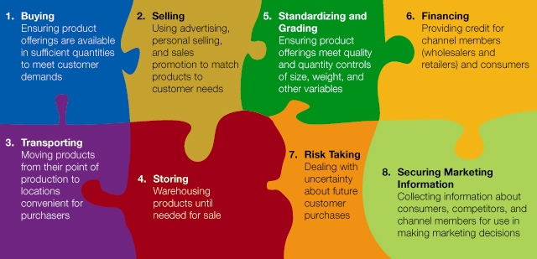
Eight Universal Marketing Functions

Slide 15
THANKYOU for Your Time!
Let’s look at Strategic Planning and the Marketing Process next

