Slide 1
Chapter 11
Developing and Managing Brand and Product Categories

Slide 2
Outline
What is a Brand?
Brand Loyalty
Types of Brands
Brand Equity
Brand Extensions
Brand Licensing
New Product Planning
Consumer Adoption Process
Application of Knowledge

Slide 3
Managing Brands for Competitive Advantage
Brand Name, term, sign, symbol, design, or some combination that identifies the products of one firm while differentiating them from the competition’s

Slide 4
Brand Loyalty
Measured in three stages:
Brand recognition Consumer awareness and identification of a brand
Brand preference Consumer reliance on previous experiences with a product to choose that product again
Brand insistence Consumer refusals of alternatives and extensive search for desired merchandise

Slide 5
Types of Brands
Generic product
Manufacturers’ or National brand
Private brand
Captive brand
Family brand
Individual brand

Slide 6
Brand Equity
Brand equity
Added value that a respected, well-known brand name gives to a product in the marketplace
Strong brand equity
Increases likelihood customers will recognize firm’s product or product line
Can contribute to buyers’ perceptions of product quality
Can reinforce customer loyalty and repeat purchases
Facilitates expansion into international markets

Slide 7
Brand Extensions
Strategy of attaching a popular brand name to a new product in an unrelated product category
Development by Mattel of Barbie-branded high-end clothing and accessories for women from their teens through their 30s

Slide 8
Brand Licensing
Authorizing other companies to use a firm’s brand name
Brand’s owner receives royalties, typically four to eight percent of wholesale revenues
Can hurt a brand if the licensed product is poor quality or ethically incompatible with the brand
Another risk is overextending the brand

Slide 9
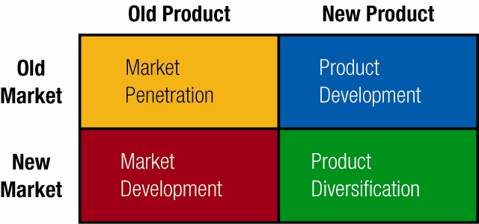
New Product Planning
As a firm’s offerings enter the maturity and decline stages of the product life cycle, it must add new items to continue to prosper
Product Development Strategies

Slide 10
Consumer Adoption Process
Adoption process Stages that consumers go through in learning about a new product, trying it, and deciding whether to purchase it again
Consumers go through five stages:
Awareness—individuals first learn of the new product, but they lack full information about it
Interest—potential buyers begin to seek information about it
Evaluation—they consider the likely benefits of the product
Trial—they make trial purchases to determine its usefulness
Adoption/rejection—decide whether to use the product regularly

Slide 11
The New-Product Development Process

Slide 12
Thank You Application of Knowledge
In your teams answer question 4 on page 378 under CRITICAL THINKING EXERCISES.
Be prepared to share you answers with the class.

