Slide 1
Chapter 10 Basic Version
Product and Service Strategies

Slide 2
OUTLINE
Marketing Mix
Products
Goods & Services Continuum
Product Categories and Classifications
Product Lines
Product Life Cycle
Applying the knowledge learned

Slide 3
Marketing mix Blending of the four strategy elements product, distribution, promotion, and price—to fit the needs and preferences of a specific target market

Slide 4
What is a Product?
People buy want satisfaction, not objects
Example: Consumers buy televisions because they want entertainment, not because they want a box with a screen
Product Bundle of physical, service, and symbolic attributes designed to enhance buyers’ want satisfaction
What are Goods and Services?
Goods Tangible products that customers can see, hear, smell, taste, or touch
Services Intangible tasks that satisfy the needs of consumer and business users

Slide 5
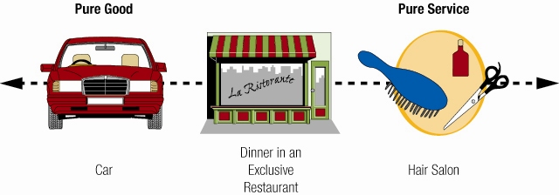
Goods-Services continuum―device that helps marketers to visualize the differences and similarities between goods and services

Slide 6
Consumer Product Categories
Convenience products
Shopping products
Specialty products
Unsought products

Slide 7
Business Product Classifications
Installations
Accessory equipment
Component parts and materials
Raw materials
Supplies
Business services

Slide 8
Development of Product Lines
Product line Series of related products offered by one company
Motivation:
Desire to Grow
Enhance company’s position in the marketplace
Make optimal use of company resources
Desire to Grow
Growth potential limited if company focuses on a single product
Example: Roots began selling a single style of shoes but has grown by selling a variety of products

Slide 9
Enhance Company’s Position in the Marketplace
Entire lines of products make a company more important to consumers and marketing intermediaries
Make Optimal Use of Company Resources
Spreading operations costs over a series of product lines reduces the average production and marketing costs of each product

Slide 10
The Product Mix
Product mix Assortment of product lines and individual offerings
Product width―the number of product lines offered
Product length―the number of different products a firm sells
Product depth―variations in each product that a firm markets in its mix

Slide 11
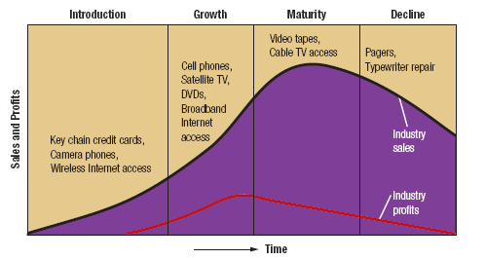
The Product Life Cycle
Product life cycle Progression of a product through introduction, growth, maturity, and decline stages

Slide 12
Extending the Product Life Cycle
Product life cycles can stretch indefinitely as a result of marketers’ decisions
Increasing Frequency of Use
Convincing current customers to buy a product more frequently boosts total sales even if no new buyers enter the market
Example: Custom printed M&Ms that allow consumers to order their own initial or sayings

Slide 13
Increasing the Number of Users
Attracting new customers who have not previously used the product
Example: Walt Disney markets its theme parks to adults
Finding New Uses
New applications extend a product’s life cycle
WD-40 identified the top 2000 uses of its oil
Changing Package Sizes, Labels, or Product Quality
Example: Kraft’s 100-calorie Snack Packs, which package snacks in 100 calorie amounts

Slide 14
Thank You Applying the Knowledge learned
Turn to page 348 and in your team answer question 5 of CRITICAL THINKING EXERCISES.
Be prepared to share your solutions with the class.

