Slide 1
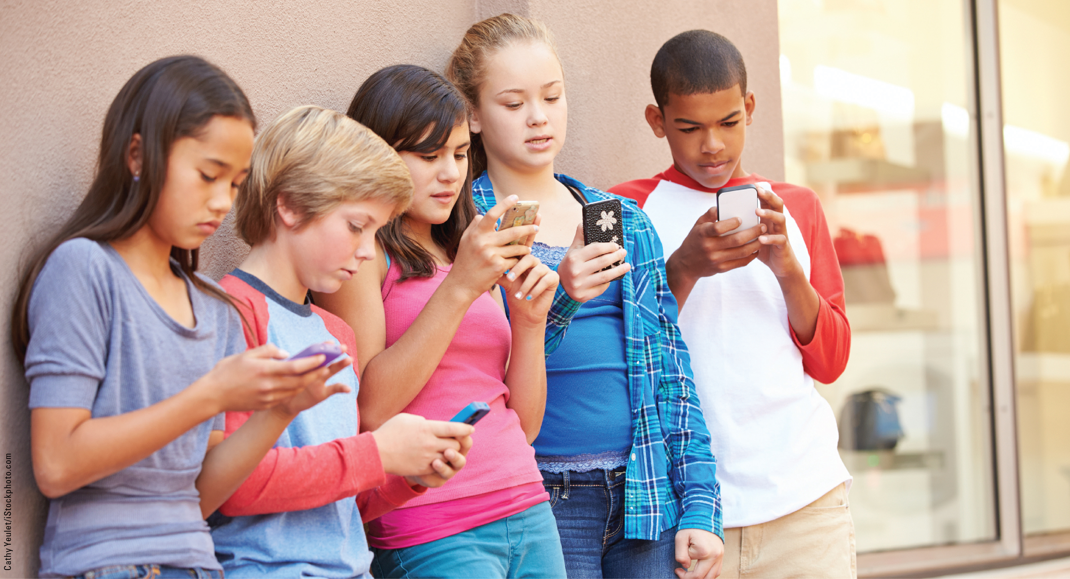
BABIN / MURRAY CB
PART 3
CHAPTER 10
Group and
Interpersonal Influence

Slide 2
Learning Objectives
LO¹
Understand the different types of reference groups that influence consumers and how reference groups influence value perceptions.
Describe the various types of social power that reference groups exert on members.
Comprehend the difference between informational, utilitarian, and value-expressive reference group influence.
Understand the importance of word-of-mouth communications in consumer behaviour.
Comprehend the role of household influence in consumer behaviour.
LO²
LO³
LO⁴
LO⁵

Slide 3
Reference Group
LO¹
A group of individuals that has significant relevance for a consumer and that impacts the consumer’s evaluations, aspirations, and behaviour
10-3

Slide 4
Types of Groups
LO¹
Primary and Secondary (Brand community)
Formal and Informal
Aspirational and Dissociative
Notes:
Ask students to discuss groups they belong to, and analyze whether they are primary or secondary, formal or informal. Does anyone consider him- or herself a member of a brand community? How might some of these groups influence consumption choices?

Slide 5
Conformity
LO¹
Conformity
A result of group influence in which an individual yields to the attitudes and behaviour of others
Peer Pressure
The extent to which group members feel pressure to behave in accordance with group expectations

Slide 6
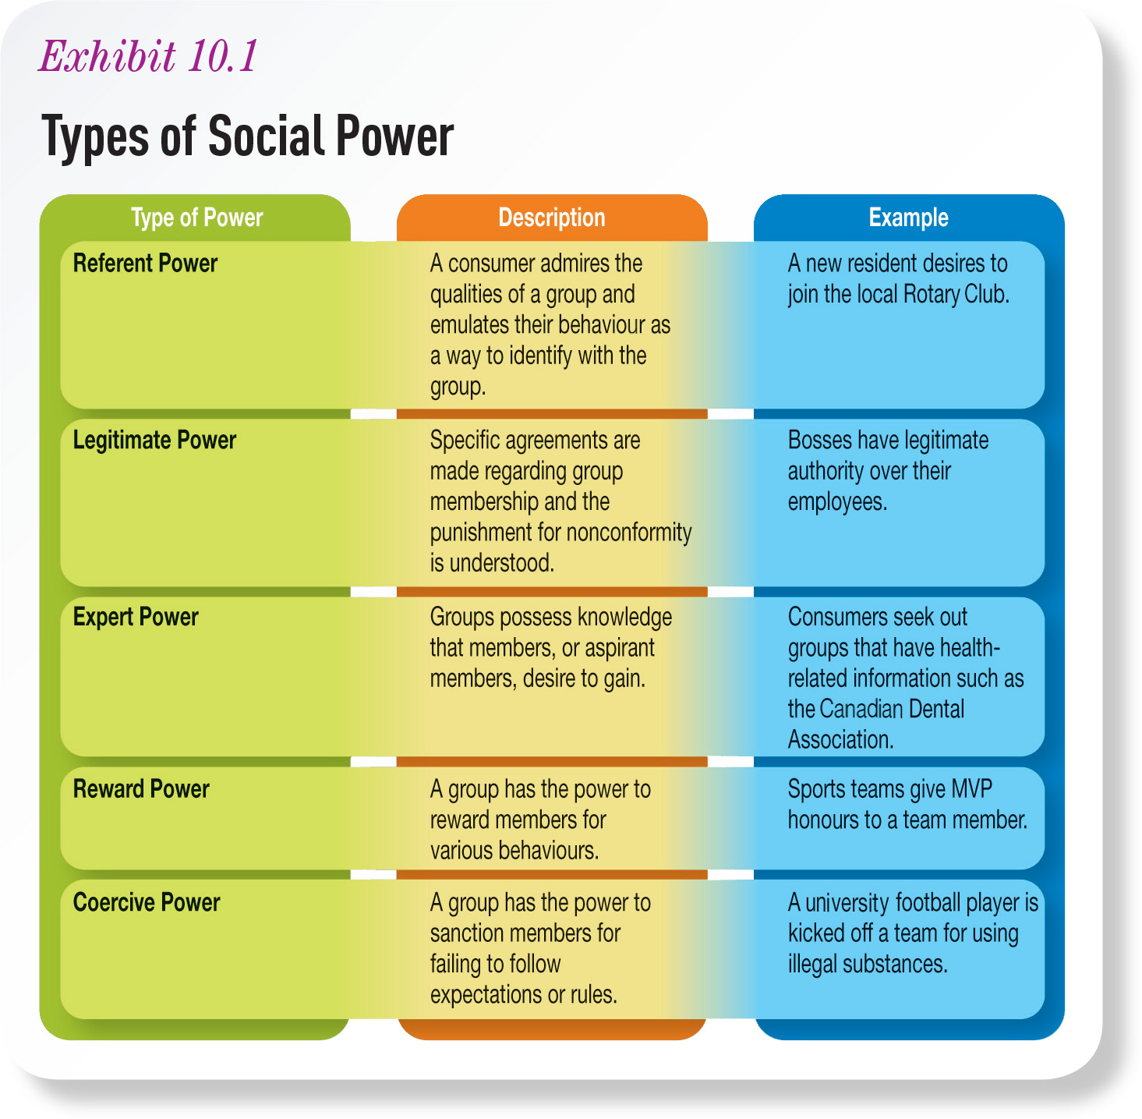
Exhibit 10.1 Types of Social Power
LO²
Notes:
Ask students to think of advertisements they have seen that use the different types of social power to influence consumers.

Slide 7
Reference Group Influence
LO³
Informational influence—Consumers use the behaviours and attitudes of reference groups as information when making their own decisions.
Utilitarian influence—Consumers conform to group expectations to receive a reward or to avoid punishment.
Value-expressive influence—Consumers internalize a group’s values or join groups to express their own values and beliefs.
Notes:
Ask students to think about their first semester at university and the influence of groups. Did they need referrals on where to eat or get their hair cut? Did they dress differently in order to fit in? Have they joined any cause-based clubs or organizations on campus?

Slide 8
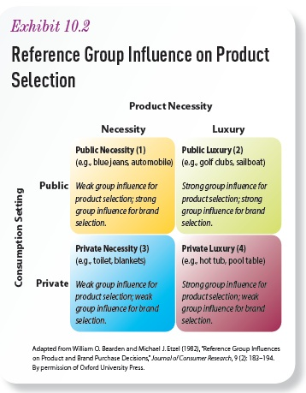
Exhibit 10.2 Reference Group Influence on Product Selection
LO³

Slide 9
Individual Difference in Susceptibility to Group Influence
LO³
Susceptibility to interpersonal influences
Attention to social comparison information
Separateness - connectedness
Social influence and embarrassment

Slide 10
Exhibit 10.3 Sample Items from Attention to Social Comparison Information Scale
LO³

Slide 11
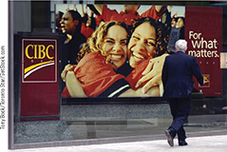
Togetherness
LO³
Consumers with connected self-schemas respond favourably to advertisements promoting togetherness.

Slide 12
Word-of-Mouth (WOM)
LO⁴
Amplified
Information about products, services, and experience that is transmitted from consumer to consumer
Organic
Notes:
Encourage discussion about the influence of WOM. Ask students for examples of companies encouraging WOM; for example, Amazon urges readers to review books on its website, while other companies reward consumers for referring their friends.

Slide 13
Digital WOM
LO⁴
Marketers may encourage digital WOM in order to help build brand communities.
Notes:
Many companies actively encourage WOM by including discussion boards on their own websites, which allows them to assist in the development and maintenance of brand communities. They may also hire their customers to blog about their products.
Marketers need to be mindful of the spread of negative WOM in the online world: negative WOM can be so influential, it is important for companies to monitor the content that is posted on various websites.

Slide 14
Buzz Marketing
LO⁴
Tactic for generating excitement that is spread from consumer to consumer
Guerilla marketing—the marketing of a product using unconventional means
Viral marketing—uses online technologies to facilitate WOM by having consumers spread marketing messages through their online conversations
Notes:
Examine an example of a recent viral phenomenon like KONY 2012. Ask students to assess what made it so successful.

Slide 15
Stealth Marketing
LO⁴
A guerilla marketing tactic that is similar to buzz marketing, but consumers are completely unaware that they are being marketed to
Often considered unethical, along with practices called “shilling” and “infiltrating”
Notes:
How do students feel about paid employees posing as consumers to create buzz (online or off)?

Slide 16
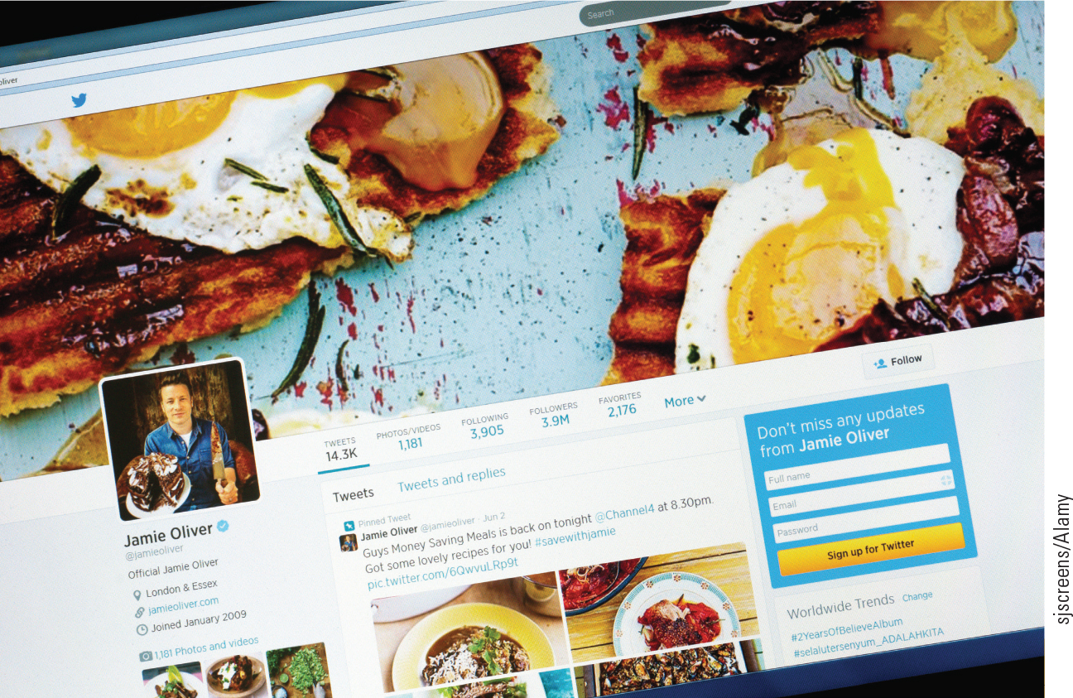
Consumer Influencers
LO⁴
Market Maven
Opinion Leaders
Surrogate Consumer
Notes:
Market maven: a consumer who spreads information about all types of products and services
Opinion leaders: consumers who have great influence on the behaviour of others relating to product adoption and purchase
Surrogate consumer: hired by another consumer to provide input into a purchase decision

Slide 17
Diffusion Process
LO⁴
The way in which new products are adopted and spread throughout a marketplace

Slide 18
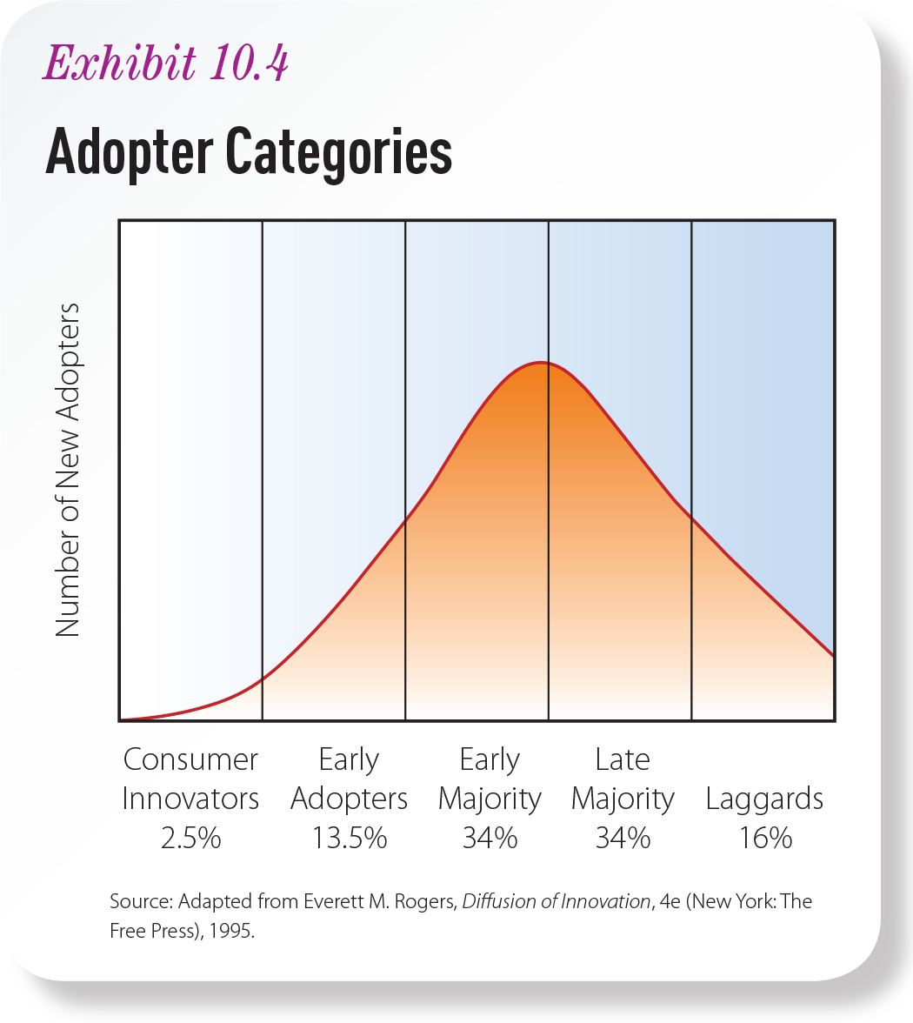
Exhibit 10.4 Adopter Categories
LO⁴
Notes:
Ask students if anyone considers him- or herself an innovator or early adopter. How involved is the student with the product category? Where does the student get his or her information about new products or trends? Has a company in the sector ever tried to contact the student directly?

Slide 19
Traditional Family Household
LO⁵
At least two people who are related by blood or marriage who occupy a housing unit
Nuclear family
Extended family
Notes:
The extended family has experienced some growth in Canada as many “sandwich generation” baby boomers have both boomerang kids and aging parents in the household.

Slide 20
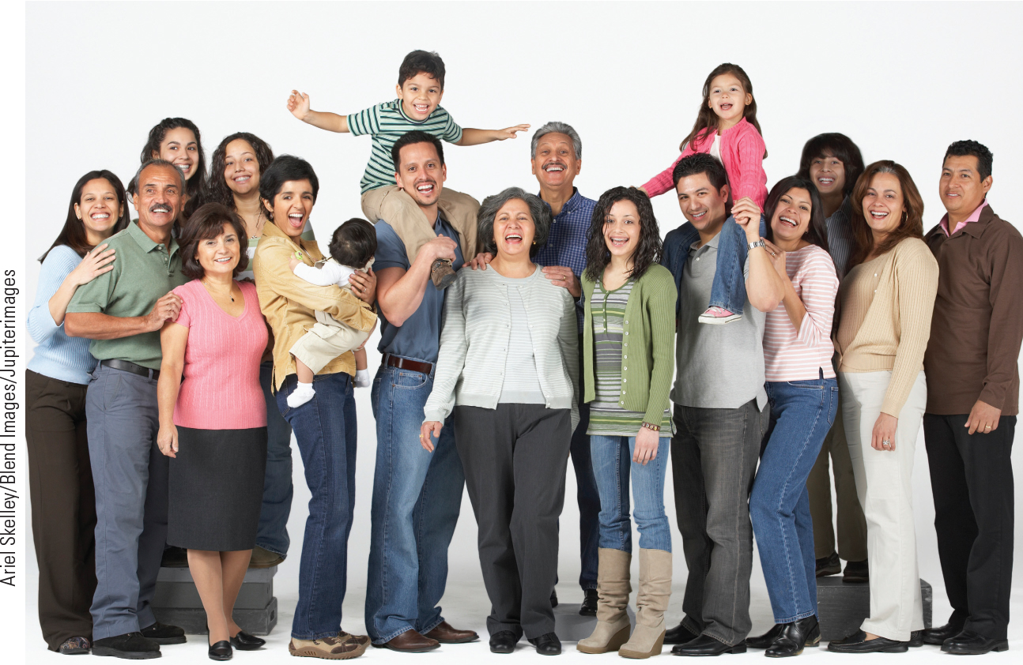
Emerging Trends in Family Structure
LO⁵
“Non-traditional” household arrangements
Blended families
Single-parent households
Notes:
Family members greatly influence one another.
What are the marketing implications of these trends? Do blended families make decisions differently? Are there more influencers? Non-traditional decision makers? What do advertisers need to think about when depicting a “family” in their advertising?

Slide 21
The Family Life Cycle
Dollar value of durables increases as nest empties or parents age
Modern – exercise – go out to bars,concerts, movies..etc
Age of Head of Household
 | Under 35 yrs | 35-64 yrs | Over 64 yrs
One adult in household | Bachelor I | Bachelor II | Bachelor III
Two adults in household | Young couple | Childless couple | Older couple
Two adults plus children in household | Full nest I* Full nest II* | Delayed full nest* Full nest III*
Full Nest I: youngest child is younger than 6 yrs
Full Nest II: youngest child is older than 6 yrs
Full Nest III: youngest child is older than 6 yrs and the parents are middle aged
Delayed Full Nest: parents are middle-aged but the youngest child is younger than 6 yrs
Adapted from: Mary C. Gilly and Ben M. Enis

Slide 22
Family Decision Making Consensual vs. Accomodative
Consensual purchase decision
the group agrees on the desired purchase
differ on how it will be achieved
Accommodative purchase decision
reaching agreement among group members by bargaining, coercing, compromising and wielding power

Slide 23
Family Decision Roles
1) Initiator
6) Buyer
2) Information Gatherer
7) Preparer
3) Gatekeeper
8) User
4) Influencer
9) Maintainer
5) Decision Maker
10) Disposer

Slide 24
THANK YOU

