Slide 1
INTRODUCTION TO “BUYER BEHAVOUR And Its Impact On Marketing”
Prepared By: Duane Weaver

Slide 2
PERCEPTION IS REALITY

Slide 3
Introduction to Buyer Behaviour
Buyer vs. Consumer
Defining Buyer Behaviour
Market Segmentation
Two Paradigms of Consumer Research
What affects Buyer Behaviour
Using the Case Preparation Tool

Slide 4
Buyer vs. Consumer
Course Title: Buyer Behaviour
Anyone engaged in buyer behaviour including: business, government or consumers
Text Title: Consumer Behaviour
Has come to refer to “consumer” market, someone who consumes products or services versus organizational buyer behaviour.

Slide 5
What is Buyer (consumer) Behavior
“It is the study of the processes involved when individuals or groups select, purchase, use or dispose of products, services, ideas or experiences to satisfy needs and desires”
(Solomon, White, Dahl, p. 4)

Slide 6
Buyer Behavior
Actors – Role Theory – decision criteria vary from role to role.
Ongoing Process – not just a “moment of truth” focus (“the exchange”). Buyer Behaviour Focuses on the entire consumption process.
Different Actors of focus: Buyer, Decision Maker, Influencer…

Slide 7
Two Paradigms of Consumer Research
POSITIVISM
(a.k.a modernism) objective, tangible, single, predictable, time free, context independent, existence of real causes, separation between researcher and subject
Ordered
INTERPRETISM
(a.k.a postmodernism) socially constructed, multiple, focus in understanding, time bound, context dependent, simultaneous shaping events, interactive and cooperative researcher as part of phenomenon under study

Slide 8
Building Bonds with Consumers
Relationship Marketing – lifetime link to brands and customers
E.g.’s?
Database Marketing – tracking buying habits and crafting tailored products/services and messages
E.g.’s?
Experiential Marketing – making the transaction and process meaningful, memorable, and desirable
E.g.’s?

Slide 9
Market Segmentation (reviewed)
What is a Market Segment?
What is a Target Market?
What are the four primary forms of Market Segmentation?
D….
P….
G….
B….
How Can you as a business person use these to your advantage?

Slide 10
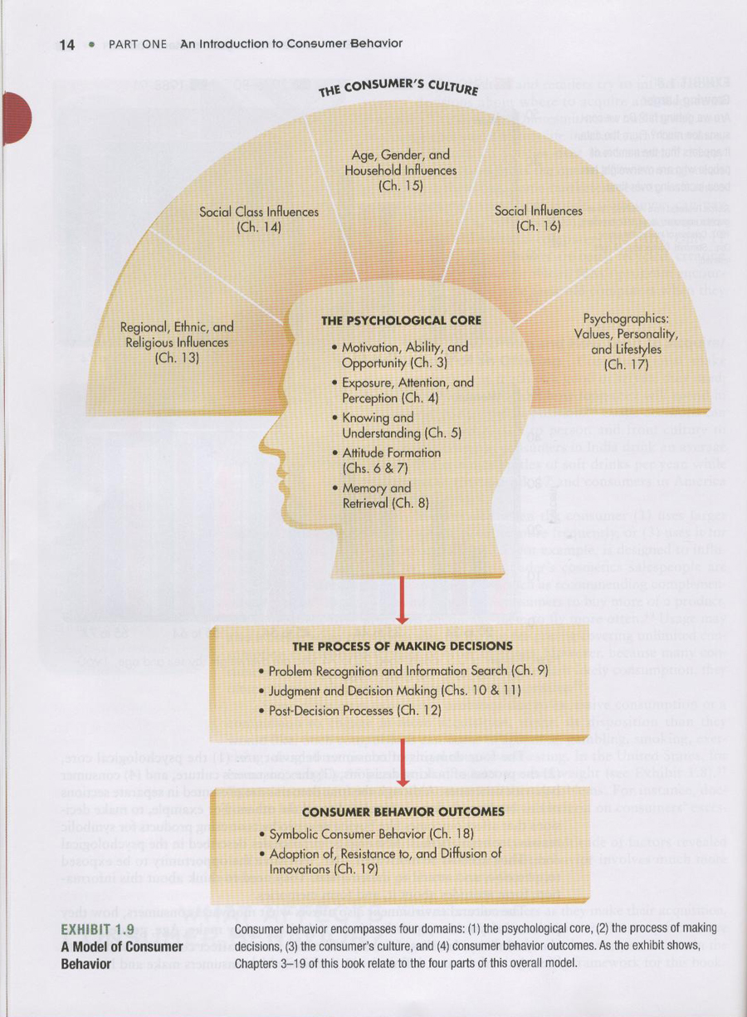
What affects Buyer Behaviour?
Consumer Behavior, 3rd Edition, Hayer/MacInnis, p. 14

Slide 11
What affects Buyer Behaviour
Consumer’s Culture
Psychological Core
Process of Making Decisions
Buyer Behaviour Outcomes

Slide 12
CASE PREPARATION TOOL Let’s Discuss
HOW TO READ FOR SHORT CYCLE
WHAT GOES IN SHORT CYCLE
HOW TO READ FOR LONG CYCLE
WHERE TO GET MISSING INFORMATION
WHAT KIND OF DATA ANALYSIS IS PERTINENT
DECISION CRITERIA and HOW TO SELECT

Slide 13
THANK YOU FOR YOUR TIME
SEE YOU ALL NEXT CLASS

Slide 14
PERCEPTION IS REALITY

