Slide 1
MARKETING 160
With Duane Weaver
Please take 10 minutes to read the course outline

Slide 2
MODULE ONE Course oVerview, Brands, ChP. 1 and MARKETING PLAN STRUCTURE
Course Outline Read and Review
Practice iRAT
Form Teams
Introductions with Brand and Team Name
Practice tRAT
Write Appeals
Debrief and questions
BREAK (you should review Chp. 1 if have not done so yet)
Chp. 1 iRAT, tRAT, Appeals, Debrief, In Class Team Activities
SUMMARY
Please take 10 minutes to read the course outline

Slide 3
COURSE OUTLINE AND practice i-rAT
Having Taken 10 minutes to read the course outline let’s do a practice individual Readiness Assessment Test (iRAT)
Academic Integrity is expected: please no talking or looking at others work during the test or you will earn “0” for that iRAT
You will have 7 minutes to complete the iRAT

Slide 4
i-RAT
4:30
4:00
6:00
5:30
1:30
2:00
TIMES UP!
2:30
5:00
3:30
1:00
6:30
0:30
3:00
7:00

Slide 5
Team formation
Line up by all those who have another degree already
Of those remaining, line up by all of those who are taking business as an elective or minor (not part of the Faculty of Management BBA, BRTM, BHOSP)
Of those remaining, line up by all of those who have previously studied in a country outside of Canada from farthest from Canada to closest.
Of those remaining, line up by years of paid work experience (from most to least)
All those remaining line up by how far your place of birth is from the Bastion in downtown Nanaimo

Slide 6
Introductions with brand and TEAM NAME
Take 10 minutes to:
Introduce yourself to your team mates
Create a team Name
Share the sample brands you brought with you and select one that best represents your team (be prepared to explain why)

Slide 7
Practice t-RAT Team readiness Assurance Test

Slide 8
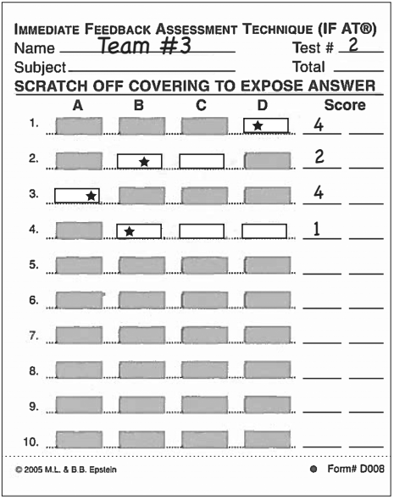
Practice t-RAT Take test again—as a team
Still CLOSED BOOK!!!
Designate team scratcher – use coin or key
Scratch ONLY when team reaches consensus
Revealing star indicates right answer
Keep discussing and scratching until you find the star!
Record scores and total (see next slide)
10
5
2
10
2

Slide 9
Decremental Scoring of Team RAT
Remember time is limited!
Right answer on:
1st try = 10 points
2nd try = 5 points
3rd try = 2 points
4th or 5th try = 0 points
Don’t find the correct answer on the first try?
Keep discussing and scratching to earn partial credit

Slide 10
T-RAT
8:00
6:00
5:00
7:00
4:00
1:00
TIMES UP!
2:30
7:30
5:30
2:00
3:00
0:30
1:30
4:30
6:30
3:30

Slide 11
T-RAT
TIMES UP!

Slide 12
Scoring your Team Rat
Right answer on first try = 10 points
Right answer on second try = 5 points
Right answer on third try = 2 points
Right answer on fourth or fifth try = 0 points

Slide 13
During the t-RAT…
I had time to mark your iRATs

Slide 14
Keeping Track
Please enter your iRAT and tRAT scores on the sheet provided in your team folder

Slide 15
Did anyone’s individual score
beat your team’s score?

Slide 16
10 minutes
Appeals Process
You can appeal AS A TEAM any questions that you believe were misleading, unfair, or inaccurate.
OPEN BOOK
Appeal must be IN WRITING (see appeals forms in your folder)
Include reasons and CITE EVIDENCE from the text to support your argument…OR…
If your appeal is based on misleading language in the question, you must include ALTERNATE QUESTION WORDING.
Notes:
Appeals form in your folder

Slide 17
We now have a few minutes for “Clarification”
Reflecting on the course outline… What is still murky about the rationale, purpose and structure of the course?
Student Preparedness (pre-reading)
Readiness Assurance Tests (individual and team)
Team application tasks
Team Marketing Plan
Individual assessments
Student Agency and Accountability
Notes:
Summary part one

Slide 18
BREAK TIME
TODAY we will BREAK for 20 minutes before the next iRAT
Please use some of this extra long break time to review Chp. 1 before we return (I have copies for anyone who has not yet picked up their text book).

Slide 19
MODULE ONE Chapter one and Brands I-RAT
Having Read and then Reviewed Chapter 1 during the break, please take let’s do a another individual Readiness Assessment Test (iRAT)
Academic Integrity is expected: please no talking or looking at others work during the test or you will earn “0” for that iRAT
You will have 7 minutes to complete the iRAT

Slide 20
i-RAT
4:30
4:00
6:00
5:30
1:30
2:00
TIMES UP!
2:30
5:00
3:30
1:00
6:30
0:30
3:00
7:00

Slide 21
Chapter one and brands t-RAT

Slide 22
Chapter one and brands t-RAT
Still CLOSED BOOK!!!
Designate team scratcher – use coin or key
Scratch ONLY when team reaches consensus
Revealing star indicates right answer
Keep discussing and scratching until you find the star!
Record scores and total (see next slide)
10
5
2
10
2

Slide 23
Decremental Scoring of Team RAT
Remember time is limited!
Right answer on:
1st try = 10 points
2nd try = 5 points
3rd try = 2 points
4th or 5th try = 0 points
Don’t find the correct answer on the first try?
Keep discussing and scratching to earn partial credit

Slide 24
T-RAT
8:00
6:00
5:00
7:00
4:00
1:00
TIMES UP!
2:30
7:30
5:30
2:00
3:00
0:30
1:30
4:30
6:30
3:30

Slide 25
10 minutes
Appeals Process
You can appeal AS A TEAM any questions that you believe were misleading, unfair, or inaccurate.
OPEN BOOK
Appeal must be IN WRITING (see appeals forms in your folder)
Include reasons and CITE EVIDENCE from the text to support your argument…OR…
If your appeal is based on misleading language in the question, you must include ALTERNATE QUESTION WORDING.
Notes:
Appeals form in your folder

Slide 26
We now have a few minutes for “Clarification”
Reflecting on Chapter One What is still murky about what marketing is all about?
Notes:
Summary part one

Slide 27
CHAPTER ONE AND BRANDS
COMPLETE TEAM ACTIVITY:
Culture and individual personality shape human needs into wants. What transforms wants into demands?
From the choices listed (A<B<C<D) select which one your team feels is the BEST answer. Be prepared to REVEAL you answer at the same time.
THE QUESTION IS IN YOUR TEAM FOLDERS. You have 5 minutes to decide.

Slide 28
MODULE ONE SUMMARY
What did we learn today?

Slide 29
THANK YOU FOR YOUR TIME
For next class:
please have read CHP 3, the PINK RIBBON campaign, and related link to be posted on http://web.viu.ca/weaverd under MARK 160 by January 11th (PM) and Chapter 5 (pp. 157-177)
Think about and be prepared to argue FOR the PINK RIBBON campaign or AGAINST in a debate.

