Slide 1
Marketing: An Introduction Sixth Canadian Edition Armstrong, Kotler, Trifts, Buchwitz
Chapter Eleven
Marketing Channels

Slide 2
Outline
Define marketing channels and describe the main types of marketing channels for business and consumer products.
Explain the role of the members of the marketing channel, and how they add value to the marketing process.
List the types and forms of retailing, and the major marketing decisions retailers make.
Describe the major channel design decisions, including international channels.
Define and describe supply chain management.

Slide 3
Marketing or Distribution Channel
A set of interdependent organizations involved in the process of making a product or service available for use or consumption by the consumer or business user.
A well designed channel provides value to customers and provides a competitive advantage to the organization.

Slide 4
Why Use Channel Members
The use of intermediaries results from their greater efficiency in making goods available to target markets. (e.g.: ECONOMIES OF SCALE)
Offers the firm more than it can achieve on its own through the intermediaries:
Contacts.
Experience.
Specialization.
Scale of operation.

Slide 5
How Channel Partners Add Value
in-class notes
Reduce the number of transactions
Information functions
Help customize marketing offers
Handle logistics
After sales services
Support in promotional activities

Slide 6
Members of the Marketing Channel
in-class notes
Direct marketing channel
A channel that has no intermediary levels: direct from manufacture to the consumer
Indirect marketing channel
Distributors
Wholesalers
Jobbers, Drop Shippers, Agents, Brokers
Retailers

Slide 7
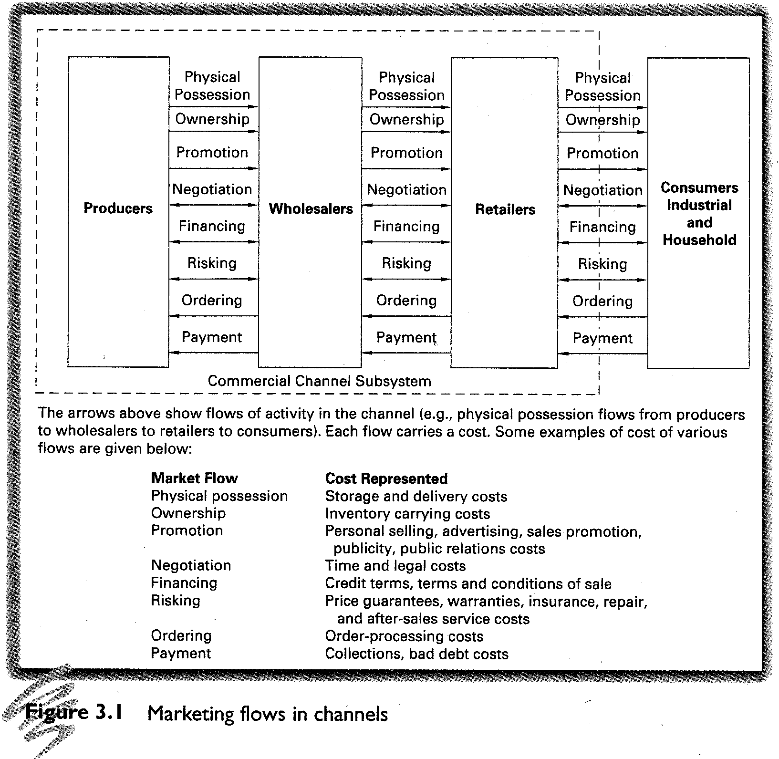
Image source: Coughlan, et. al, 2006, p. 74

Slide 8
Distributors and Wholesalers
A distributor is a company that physically distributes or moves the product from one geographical location to another. Usually from the manufacturer to the wholesaler or retailer
The distributor also carries out the function of a wholesaler
A wholesaler usually buys goods on bulk from the manufacturer or the distributor, and sells products in relatively smaller quantities to retailers

Slide 9
Jobbers, Agents and Brokers
Jobbers & Drop Ship Jobbers & Rackers A marketing intermediary that delivers inventory to retailers, sets it up in the store, and removes unsold items (the latter taking possession of the goods)
Agent A marketing intermediary that acts on behalf of the buyer (retailer) or seller (manufacturer or wholesaler), but who does not take ownership of the product
Broker A marketing intermediary that negotiates deals between buyer and seller, but who does not take ownership of the product

Slide 10
Retailers
All activities involved in selling goods or services directly to final consumers for their personal (not business) use.
Performs important functions in the channel.
This is the closest channel to the final consumer.
They are classified in many ways.

Slide 11
Classification of Retailers
in-class notes
By level of service: self service, limited service, full service
By price: discount, off-price, independent, factory outlet, warehouse club
By product line: specialty store, department store, supermarket, convenience store, superstore
By retailer organization: chain store, franchise

Slide 12
Classification by Level of Service
Self-service retailers:
Serve customers who are willing to perform their own “locate-compare-select” process to save money.
Limited-service retailers:
Provide more sales assistance because they carry more shopping goods about which customers need information.
Full-service retailers:
Usually carry more specialty goods for which customers like to be “waited on.”

Slide 13
Classification by Product Lines They Carry
Specialty stores.
Narrow product line, deep assortment.
Department stores.
Wide variety of product lines.
Supermarkets.
Wide variety of food, laundry, household products.
Convenience stores.
Limited line of high-turnover goods.

Slide 14
Based on Product Lines They Carry
Superstores.
Large assortment of food and non-food items.
Category killer.
Big box specialty store.
Service retailers.
Provide services rather than tangible goods.

Slide 15
Based on Price Classification
Discount stores.
Sells standard merchandise at lower prices by accepting lower margins and selling at higher volume.
Off-price retailers.
Buys at below wholesale, sells at less than retail.
Independent retailers – owned by single owners
Factory outlets – operated by the manufacturer
Warehouse clubs – limited selection at discounts to membership.

Slide 16
Based on Retailer Organization
Chain Stores
Two or more outlets that owned and controlled by corporation and centrally managed.
Franchise organizations.
Contractual association between a manufacturer, wholesaler and independent business people.

Slide 17
Retailer Marketing Decisions
Retailer strategy.
Segmentation
Target market.
Differentiation
Retail store positioning.
Retailer marketing mix.
Product assortment.
Prices.
Promotion.
Place (location).

Slide 18
Channel Conflict
Disagreement between members over goals and roles.
Horizontal conflict.
Conflict between firms on the same level.
Vertical conflict.
Conflict between firms on different levels.
Disintermediation.
Displacement of a traditional member from the marketing channel.
Selling direct via the Internet.
Notes:
Chapter 11, page 434-35

Slide 19
Organization of Marketing Channels
in-class notes
Vertical Marketing Channel
A distribution channel structure in which producers, wholesalers and retailers act as a unified system.
Horizontal Marketing System
A channel arrangement in which two or more companies at one level join together to follow a new marketing opportunity.
Multichannel distribution system
Is where a single form sets up two or more channels to reach one or more customer segments
Disintermediation
the cutting out of marketing channel intermediaries by product or service producers or the displacement of traditional resellers by radical new types of intermediaries

Slide 20
Disintermediation
The use of internet as a marketing channel created the gradual disintermediation of physical channels
Presents both opportunities an well as threats
Opportunities could be to develop innovative channels.
Threats would be for traditional channels if not adopt some new formats may eventually will run out of business.

Slide 21
Designing Marketing Channels
in-class notes
Analyzing customer needs
Setting channel objectives
Selecting channel alternatives
Types of intermediaries
Number of intermediaries (intensive, exclusive or selective)

Slide 22
How Many Intermediaries
Intensive distribution.
As many distributors as possible.
Exclusive distribution.
Only one distributor in a given territory.
Selective distribution.
A select few distributors in a given territory.

Slide 23
Designing International Marketing Channels
in-class notes
Has the option of using 3 entry strategies
Exporting
Joint venturing
Licensing
Contract manufacturing
Management contracting
Joint ownership
Direct investment

Slide 24
Critical Marketing Management: Logistics and Supply Chain
The tasks involved in planning, implementing, and controlling the physical flow of materials, final goods, and related information from points of origin to points of consumption to meet customer requirements at a profit.

Slide 25
Logistics and Supply Chain Management
in-class notes
Major supply chain management tasks include
Managing warehouses
Managing inventory
Transportation of goods
Managing logistics information
Order processing
Managing just in time logistics systems

Slide 26
THANK YOU FOR YOUR TIME

