Slide 1
http://web.viu.ca/marchante
ID: discovery/yourname
Password: yourpassword
Outline

Slide 2
Question 1. Are drug dealers lacing all different types of street drugs with Fentanyl?
Yes
No

Slide 3
Question 2. When a type of drugs is targeted by law enforcement, it is often replaced by more dangerous drugs and often cheaper drug?
True
False

Slide 4
Question 3. Dying from a fentanyl overdose on the street is an example of a pharmacological effect of a drug?
True
False

Slide 5
Question 4. Street drugs are commonly laced with dangerous chemicals like strychnine and formalin?
True
False
If false what are they laced with most commonly?

Slide 6
Question 5. People who want to get high don’t care what drug they take as long as they can tune out?
True
False
It depends on the individual

Slide 7
Question 6. Should fentanyl be banded as a pain killer?
Yes
No
Why or why not?

Slide 8
Question 7. Providing quick and easy drug testing for Fentanyl will reduce Fentanyl overdose.
True
False

Slide 9
Propaganda is ... the deliberate attempt by some individual or group to form, control, or alter the attitudes of other groups by the use of instruments of communication, with the intention that in any given situation the reaction of those so influenced will be that desired by the propagandist. Qualter (1962) in Taylor (1979)
Propaganda
is deliberate
aims to control or alter people's attitudes
aims to produce predictable behaviour by those who have had their attitudes controlled or altered
does not depend on violence or bribery

Slide 10
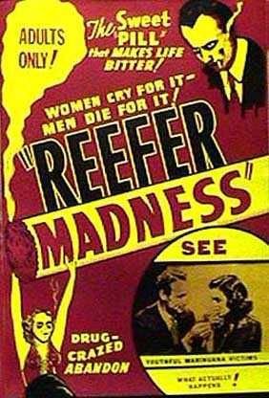
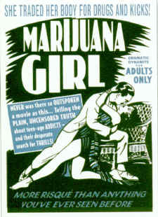

Slide 11
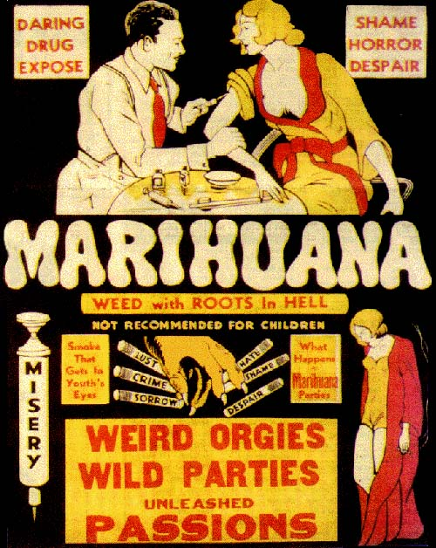

Slide 12
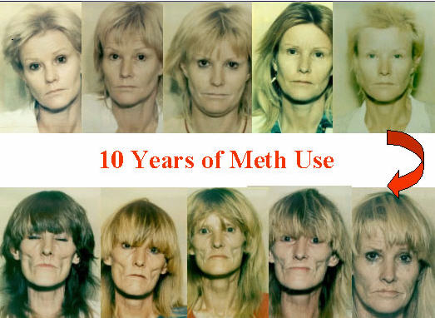

Slide 14
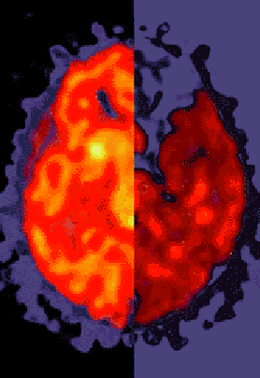
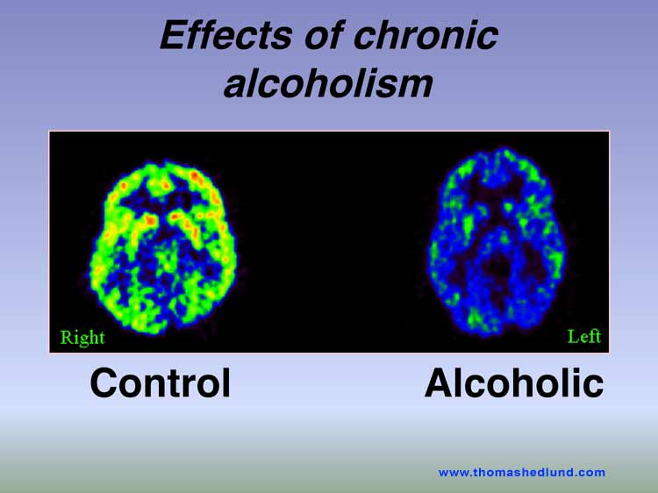
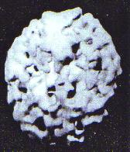
Drug War Propaganda
Don’t Trust Neuroimaging
Brain on Ecstasy or Meth, Crack or LSD
Take your pick…it is OK to lie if you are protecting kids….right?

Slide 15
Ask…..How would/could you know that?
How could you design an experiment that would allow you to reach said conclusion?
What other explanations might exist that might explain it?
What assumptions are being made by the claim….are they supported?
Principle #1: Challenge
Challenging the new idea at its most basic level is the most important of the Three Cs, and it's one that many people so often fail to do. When we challenge the idea, we're essentially asking whether it's even true. We want to challenge not just the new claim, but any assumptions that it appears to make.
Principle #2: Consider
For any ideas that survive our initial challenge, it makes sense to proceed to consider alternate explanations. To do this, we need to gather alternate explanations. We're usually given one to start with, so then we need to ask an expert, or even just go online and do some searching, to find out what other people have had to say on this same subject.
Principle #3: Conclude
Once we have all of our ducks in a row, we've verified the claim is a real one, and we have some possible explanations for each, we're able to conclude what fits best. We use tools like Occam's Razor to see which explanation can work within the confines of the world as we know it, compared to those that would require something magical be added to the world to make it possible.

Slide 16
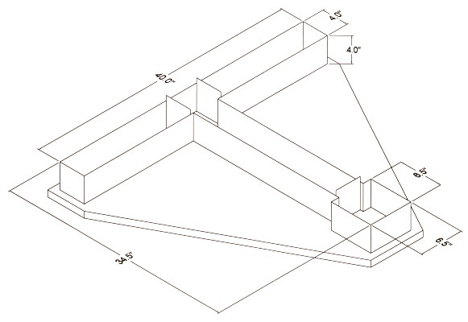
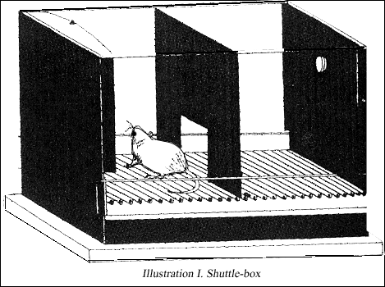
Animal Use in Research on Drug Abuse Liability
How can we use animals to tell us about the abusive liability of various drugs?
Condition Place Preference

Slide 17
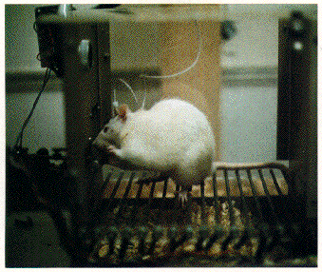
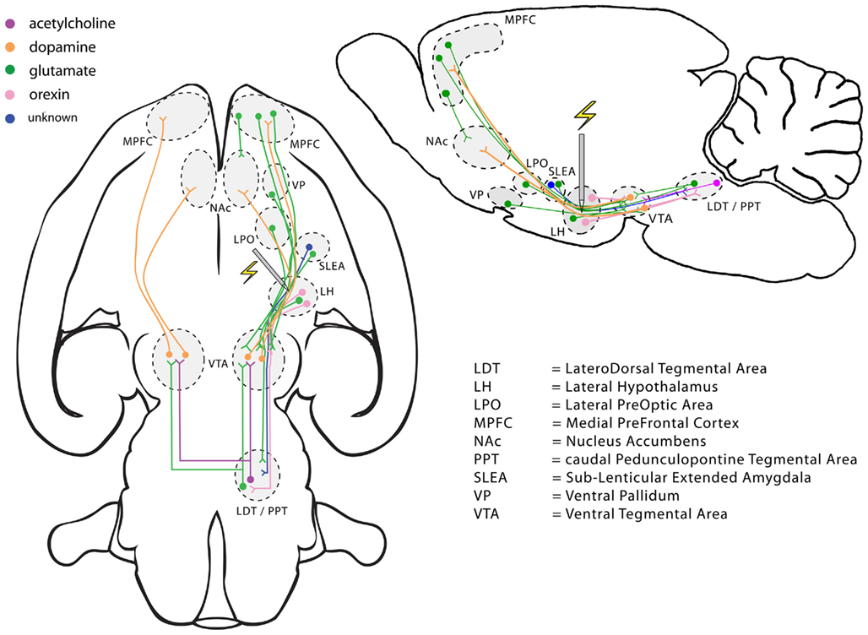
Direct Self-Administration
Olds & Milner

Slide 18
Rat Park – Why do rats take drugs?
Rat Park by Cartoon

Slide 19
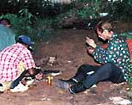
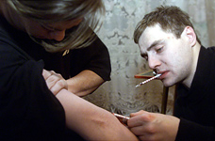
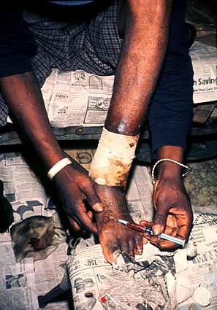
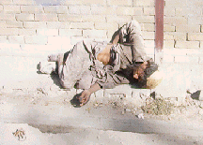

Slide 20
Pharmacological Effects of Drugs -how a drug alters the physiological function of cells, particularly neurons
Societal Effects of Drugs - How society effects the user of (illicit) drugs, examples include crime and violence, overdose, deprived financial situation, HIV, Hep….societal effects are real physiological effects but cause is not from the drug itself
Make sure you understand the difference!

Slide 22
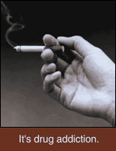
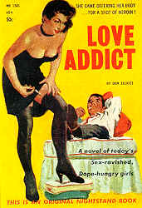
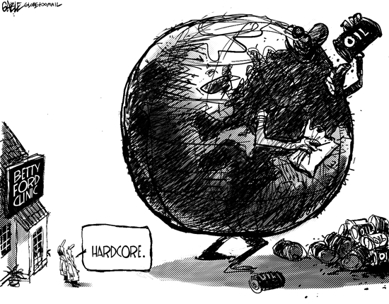
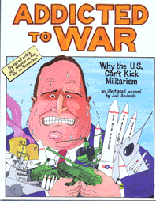
Addiction

Slide 23
Criticism of the Word Addiction
Levi Bryant has criticized the term and concept of addiction as counterproductive in psychotherapy as it defines a patient's identity and makes it harder to become a non-addict. "The signifier 'addict' doesn't simply describe what I am, but initiates a way of relating to myself that informs how I relate to others.“
A stronger form of criticism comes from Thomas Szasz, who denies that addiction is a psychiatric problem. In many of his works, he argues that addiction is a choice, and that a drug addict is one who simply prefers a socially taboo substance. Szasz postulates that humans always have a choice, and it is foolish to call someone an 'addict' just because they prefer a drug induced euphoria to a more popular and socially welcome lifestyle. Therefore, being 'addicted' to a substance is no different from being 'addicted' to a job at which you work everyday.
Professor John Booth Davies at the University of Strathclyde has argued in his book The Myth of Addiction that 'people take drugs because they want to and because it makes sense for them to do so given the choices available' as opposed to the view that 'they are compelled to by the pharmacology of the drugs they take'. He uses an adaption of attribution theory (what he calls the theory of functional attributions) to argue that the statement 'I am addicted to drugs' is functional. Stanton Peele has put forward similar views.
Bruce K. Alexander used the classic experiment “Rat Park” showed that 'addicted' behaviour in rats only occurred when the rats had no other options. When other options and behavioural opportunities were available, the “addicted” rats changed their behavior.

Slide 24
The term addiction (derived from the Latin root addicere, meaning “to adore or surrender oneself to a master”)
The term originally comes from the Latin word addictio which was "a formal award or assignment of a person or thing to another"; such as an award made by a magistrate or a debtor to his creditor. The Latin word comes from the combination of the prefix ad (meaning "to" or "toward") and the word dictus, meaning "say" or "speak" Thus, the term literally means "to say" or make a declaration.
The implication of this is that the "addict" was verbally given over to another without his or her consent or choice. In fact, addiction is considered to be the opposite of freedom or choice.

Slide 25
Addiction as a brain disease
Addiction is a primary, chronic disease of brain reward, motivation, memory and related circuitry. Dysfunction in these circuits leads to characteristic biological, psychological, social and spiritual manifestations. This is reflected in the individual pursuing reward and/or relief by substance use and other behaviours. The addiction is characterized by impairment in behavioural control, craving, inability to consistently abstain, and diminished recognition of significant problems with one’s behaviours and interpersonal relationships. Like other chronic diseases, addiction can involve cycles of relapse and remission. Without treatment or engagement in recovery activities, addiction is progressive and can result in disability or premature death. (American Society of Addiction Medicine) | This considers addiction as a brain disease which implies that it requires treatment. It neglects environmental and social forces at play, the fact that it involves a continuum and that many individuals ‘recover’ without treatment.

Slide 26
Addiction as compulsive behaviour
Addiction is a compulsive, uncontrollable dependence on a chemical substance, habit, or practice to such a degree that either the means of obtaining or ceasing use may cause severe emotional, mental, or physiologic reactions (Mosby’s Medical Dictionary 8th ed) | The use of the term ‘uncontrollable’ rules out cases where an individual is struggling successfully (for the time being at least) to control the behaviour

Slide 27
Addiction as choice
Addiction involves strong preferences to engage in activities that have significant potential for harm because of the immediate pleasure, satisfaction or relief that they provide (e.g. Heyman) | The focus on choice fails to take account of impulsive and compulsive nature of much addiction

Slide 28
Addiction as a context-sensitive disorder of motivation
Addiction involves repeated powerful motivation to engage in a purposeful behaviour that has no survival value, acquired as a result of engaging in that behaviour, with significant potential for unintended harm. | Brings in motivation, purpose, acquisition through engagement, and harm; makes no unnecessary assumptions

Slide 29
Seven things about addiction that need explaining
Most people who are exposed to the addictive substance/behaviour do not become addicted, but low impulse control and/or mood disturbance can increase vulnerability, as can adverse life circumstances
Even determined attempts to cease addictive behaviours have a low probability of success, but unaided recovery does occur
When ‘addicts’ attempt recovery, momentary risk of relapse is greatest in the first few days or weeks
Prevalence of a given addictive behaviour in populations is influenced by price and availability
Social norms substantially influence the chances of becoming addicted and recovery from addiction
Drugs that seek to reduce addictive urges can increase the chances of recovery but often do not
Behavioural interventions that seek to address addictive motivation and/or self-regulatory skills and capacity can increase the chances of recovery but often do not

Slide 30
In the fifth edition of the Diagnostic and Statistical Manual of Mental Disorders (DSM-5), the revised chapter of “Substance-Related and Addictive Disorders” includes substantive changes to the disorders grouped there plus changes to the criteria of certain conditions.
Substance Use Disorder
Substance use disorder in DSM-5 combines the DSM-IV categories of substance abuse and substance dependence into a single disorder measured on a continuum from mild to severe. Each specific substance (other than caffeine, which cannot be diagnosed as a substance use disorder) is addressed as a separate use disorder (e.g., alcohol use disorder, stimulant use disorder, etc.), but nearly all substances are diagnosed based on the same overarching criteria. In this overarching disorder, the criteria have not only been combined, but strengthened. Whereas a diagnosis of substance abuse previously required only one symptom, mild substance use disorder in DSM-5 requires two to three symptoms from a list of 11. Drug craving will be added to the list, and problems with law enforcement will be eliminated because of cultural considerations that make the criteria difficult to apply internationally.
In DSM-IV, the distinction between abuse and dependence was based on the concept of abuse as a mild or early phase and dependence as the more severe manifestation. In practice, the abuse criteria were sometimes quite severe. The revised substance use disorder, a single diagnosis, will better match the symptoms that patients experience.
Additionally, the diagnosis of dependence caused much confusion. Most people link dependence with “addiction” when in fact dependence can be a normal body response to a substance.

Slide 31
Addictive Disorders
The chapter also includes gambling disorder as the sole condition in a new category on behavioral addictions. DSM-IV listed pathological gambling but in a different chapter. This new term and its location in the new manual reflect research findings that gambling disorder is similar to substance-related disorders in clinical expression, brain origin, comorbidity, physiology, and treatment.
Recognition of these commonalities will help people with gambling disorder get the treatment and services they need, and others may better understand the challenges that individuals face in overcoming this disorder.
While gambling disorder is the only addictive disorder included in DSM-5 as a diagnosable condition, Internet gaming disorder will be included in Section III of the manual. Disorders listed there require further research before their consideration as formal disorders. This condition is included to reflect the scientific literature on persistent and recurrent use of Internet games, and a preoccupation with them, can result in clinically significant impairment or distress. Much of this literature comes from studies in Asian countries. The condition criteria do not include general use of the Internet, gambling, or social media at this time.

Slide 32
2 • Substance-Related and Addictive Disorders
Other Disorders of Interest
DSM-5 will not include caffeine use disorder, although research shows that as little as two to three cups of coffee can trigger a withdrawal effect marked by tiredness or sleepiness. There is sufficient evidence to support this as a condition, however it is not yet clear to what extent it is a clinically significant disorder. To encourage further research on the impact of this condition, caffeine use disorder is included in Section III of DSM-5.

Slide 33
Substance Use Disorders
In the substance use disorder chapter the biggest change from the dependence and abuse diagnosis is the move to Mild, Moderate, and Severe. To determine the severity of the disorder, a criteria 1-11 has been established.
The presence of 2-3 symptoms out of the 11 is defined as Mild.
The presence of 4-5 symptoms is defined as Moderate.
The presence of 6 or more symptoms is defined as Severe.

Slide 34
Substance Use Disorder
A. A problematic pattern of substance use leading to clinically significant impairment or distress, as manifested by at least two of the following, occurring within a 12 month period:
1. The substance is often taken in larger amounts or over a longer period than was intended.
2. There is a persistent desire or unsuccessful efforts to cut down or control the substance use.

Slide 35
3. A great deal of time is spent in activities necessary to obtain the substance, use the substance, or recover from it’s effects.
4. Craving, or a strong desire or urge to use the substance.
5. Recurrent substance use resulting in a failure to fulfill major role obligations at work, school, or home.
6. Continued Substance use despite having persistent or recurrent social or interpersonal problems caused or exacerbated by the effects of the substance.

Slide 36
7. Important social, occupational, or recreational activities are given up or reduced because of substance use.
8. Recurrent substance use in situations in which it is physically hazardous.
9. Substance use is continued despite knowledge of having a persistent or recurrent physical or psychological problem that is likely to have been caused or exacerbated by the substance.

Slide 37
10. Tolerance, as defined by either of the following:
a. A need for markedly increased amounts of the substance to achieve intoxication or desired effect.
b. A markedly diminished effect with continued use of the same amount of the substance.

Slide 38
11. Withdrawal, as manifested by either of the following:
a. The characteristic withdrawal syndrome for the substance (refer to criteria A and B of the criteria set for alcohol or other substances withdrawal)
b. Substance (or closely related substance, such as benzodiazepine with alcohol) is taken to relieve or avoid withdrawal symptoms.

Slide 39
Taxonomy of models of addiction

Slide 40
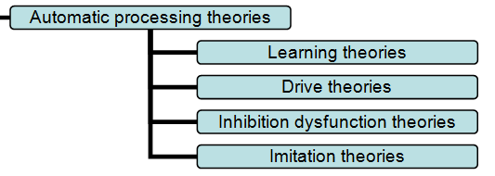
Automatic process theories
Notes:
Addicts acquire addictive behaviours through mechanisms that shape human behaviours without the need for conscious decisions or intentions and/or influence our capacity for self-regulation. Prevention and promotion of recovery involve changing the environment to alter exposure to cues and/or reinforcers, cueing and reinforcing competing behaviours and/or improving the efficiency of inhibitory mechanisms
Learning Theories - Addiction involves learning associations between cues, responses and powerful positive or negative reinforcers (pleasant or noxious stimuli).
Drive Theories - Addiction involves the development of powerful drives underpinned by homeostatic mechanisms.
Inhibition Dysfunction Theories - Addiction involves impairment of the mechanisms needed to control impulses.
Imitation Theories - Addiction involves, or at least begins with, imitation of behaviour patterns and assimilation of ideas and identities.

Slide 41
Reflective choice theories
Notes:
Addicts choose to engage in the addictive behaviour, and recovery involves choosing not to engage in it. The choice may be rational or biased, but always involves a comparison of the costs and benefits. Prevention and promotion of recovery involves altering the actual or perceived costs and benefits and/or improving the decision-making process.
Rational Choice - Addiction involves making a rational (in the sense that preferences are decided using reason and analysis and then acted upon) choice that favours the benefits of the addictive behaviour over the costs.
Biased Choice - Addiction arises at least in part from the influence of emotional and other biases on the process by which options to engage or not engage in addictive behaviours are compared.

Slide 42
Goal focused theories
Notes:
Addiction arises out of pleasure seeking or avoidance of distress or discomfort or, at least in part, out of identification with others engaging in the addictive behaviour. Prevention and promotion of recovery involves limiting access to the sources of these goals, reducing their reward value, meeting the needs in other ways or boosting the impact of conflicting goals.
Addiction arises out of the pleasure and satisfaction caused by the activity. The greater the pleasure and satisfaction, the greater the risk of addiction.
Addiction involves the development of physiological or psychological needs, as a result of engaging in the addictive behaviour, which are then met by the addictive behaviour.
Addiction involves engaging in behaviours that meet important pre-existing needs.

Slide 43
Integrative theories
Notes:
Addiction arises out of pleasure seeking or avoidance of distress or discomfort or, at least in part, out of identification with others engaging in the addictive behaviour. Prevention and promotion of recovery involves limiting access to the sources of these goals, reducing their reward value, meeting the needs in other ways or boosting the impact of conflicting goals.
Self-regulation Theories - Addiction involves a failure of an individual’s strategies, skills and capacity for self-control to counter the immediate impulses and desires underlying the addictive behaviour; this failure can in part be caused by ‘ego depletion’.
Broader Integrative Theories - Addiction involves a wide range of processes for different behaviours, populations, contexts and individuals. Social and environmental factors interact with different pre-existing dispositions to trigger initiation of the behaviour and this leads, through an interactive process, to changes in the personal environment and personal dispositions to increase the strength of motivation to engage in the behaviour relative to competing behaviours.

Slide 44
Process of change and biological theories
Notes:
Initial enactment of the addictive behaviour, development of addiction, attempts at recovery and success or failure of those attempts involve different processes that can be delineated and influenced by different interventions.
Addiction is primarily a ‘brain disease’ in which neural pathways of executive function become disordered and particular motivational processes become amplified as a result of an interaction between behaviours and their effects on the brain, particularly ingestion of some drugs

Slide 45
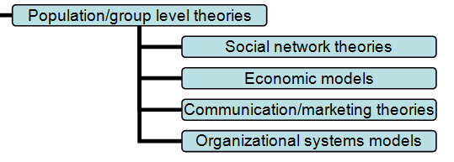
Population and group-level theories
Notes:
Addiction can be understood in terms of the interplay between population-level parameters. In many cases these can be modelled quantitatively as functions.
Social Network Theories - The rates of transition into and out of addiction on the part of individuals within a group or population are a function of the social connections between individuals who are and are not promoters of addiction or non-addiction, and the nature of those connections.
Economic Models - The prevalence, incidence and/or rate of addictive behaviours in populations can be predicted by functions from economic theory, including current and future financial and other costs relating to the behaviour and/or competing/alternative behaviours.
Communication/Marketing Theories - The development of and recovery from addiction is influenced by the persuasive communications and marketing activities of those promoting or seeking to combat the behaviours concerned.
Organizational System Models - Addictive behaviours can be understood in terms of systems of mutually interacting components at a societal level (e.g. government, tobacco industry, public). The effects of innovation introduced into the system can be nullified by compensatory changes in another or can propagate through the system or even be amplified.

Slide 46
Why are some drugs illegal and other are legal?
Is it based on the pharmacology?
Is it based on how people act when they are taking the drug?
Is it based on physical or psychological harm?
Or is it based on who uses the drug?

Slide 47
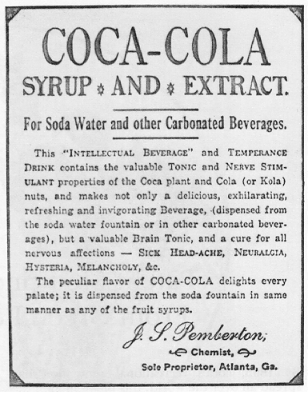
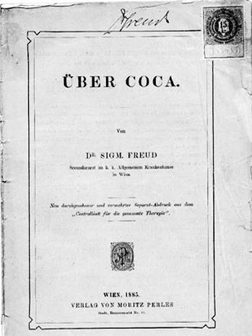
Sigmund Freud described those effects in his July, 1884 paper Uber Coca:
Exhilaration and lasting euphoria person...you perceive an increase of self-control and possess more vitality and capacity for work. In other words, you are simply normal, and it is soon hard to believe that you are under the influence of any drug.... Long intensive mental or physical work is performed without any fatigue.... This result is enjoyed without any of the unpleasant aftereffects that follow exhilaration brought about by alcohol.... Absolutely no craving for the further use of cocaine appears after the first, or even repeated, taking of the drug; one feels rather a certain curious aversion to it (Byck, 1974:48).

Slide 48
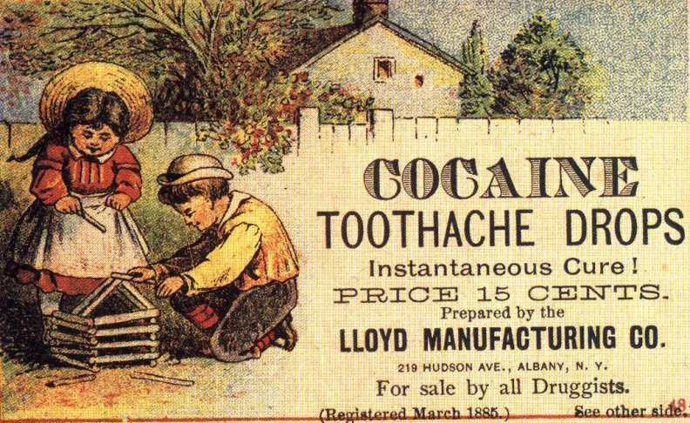

Slide 49
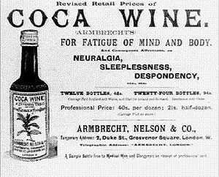

Slide 50
The rating scale is from 1 to 6. 1 denotes the drug with the strongest addictive tendencies, while 6 denotes the drug with the least addictive tendencies.
HENNINGFIELD RATINGS
Substance Withdrawal Reinforcement Tolerance Dependence Intoxication
Nicotine 3 4 2 1 5
Heroin 2 2 1 2 2
Cocaine 4 1 4 3 3
Alcohol 1 3 3 4 1
Caffeine 5 6 5 5 6
Marijuana 6 5 6 6 4
BENOWITZ RATINGS
Substance Withdrawal Reinforcement Tolerance Dependence Intoxication
Nicotine 3* 4 4 1 6
Heroin 2 2 2 2 2
Cocaine 3* 1 1 3 3
Alcohol 1 3 4 4 1
Caffeine 4 5 3 5 5
Marijuana 5 6 5 6 4
*equal ratings

Slide 51
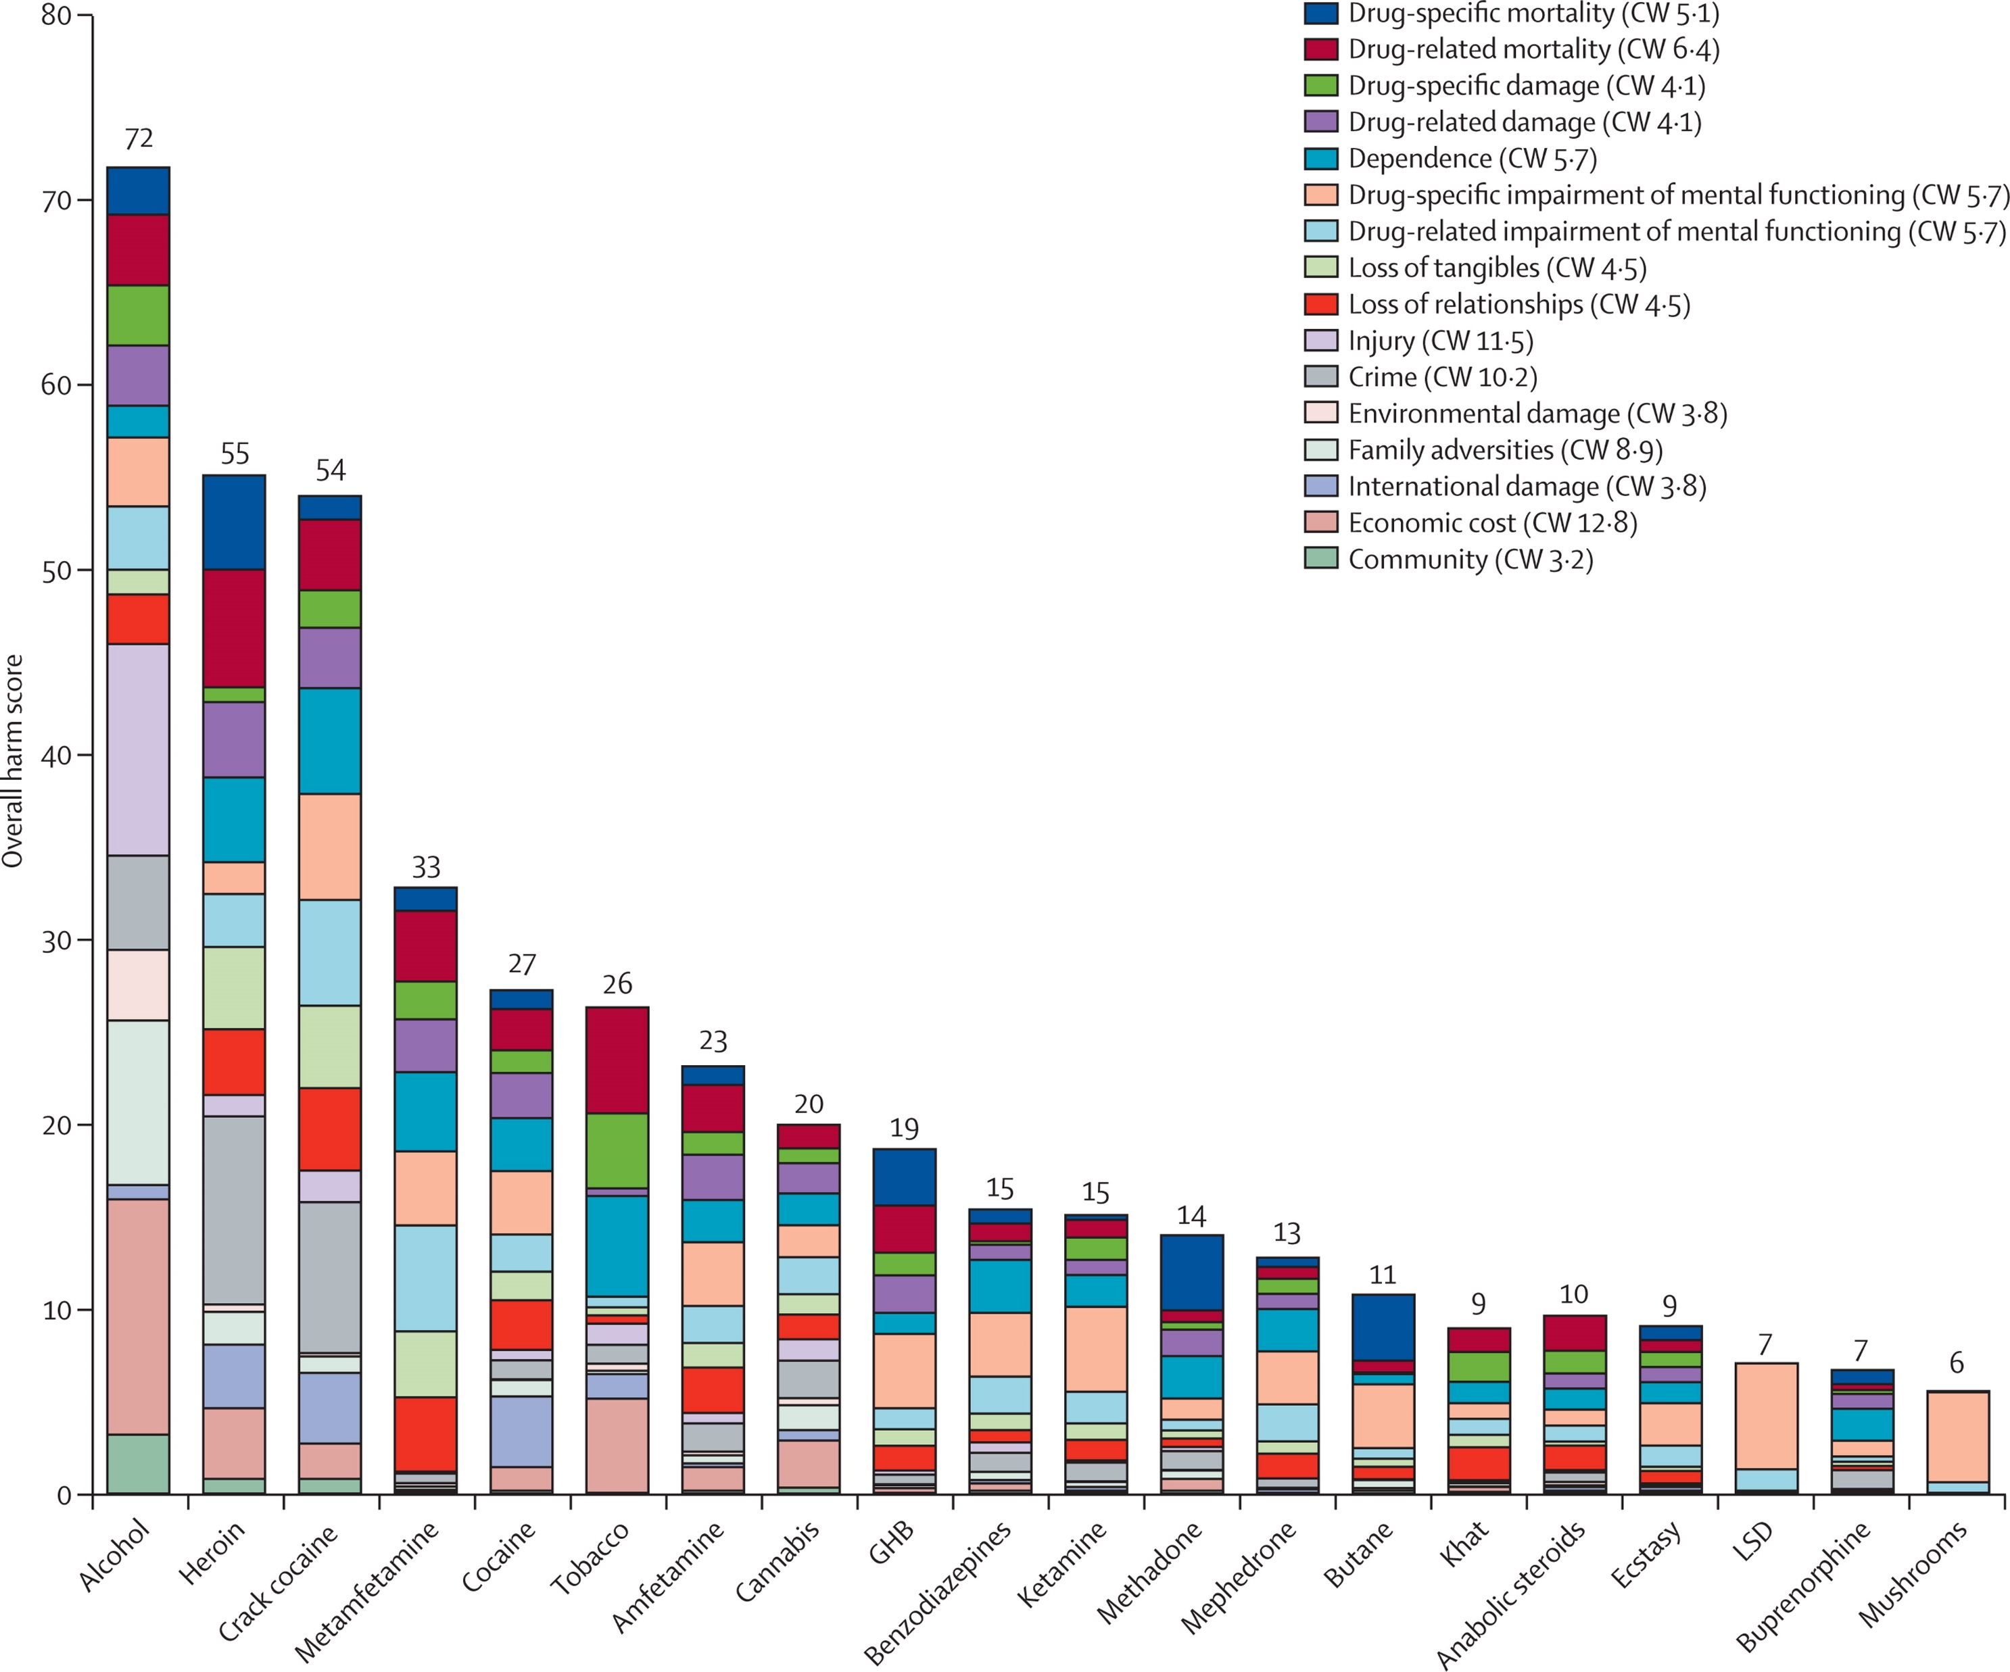

Slide 52
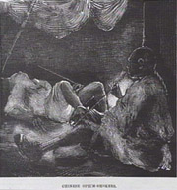
Racial fear changed that.
The first anti-drug law was passed in 1875 in San Francisco , California . Opium smoking was outlawed because local officials feared Chinese men were using it to “lure white women into their opium dens and to their ruin” as prostitutes or into sexual debauchery. A Federal law followed which made it illegal “for anyone of Chinese origin” to traffic in opium. (They were a bit more open with their racism in those days.) And a state law came in 1909.
Cocaine was next. In the early 1900’s, a series of stories began to circulate that Southern black men were getting high on cocaine and were going out and raping white women. Even the New York Times eventually fell for the false hysteria and published an article on February 11, 1914 alleging, “Most of the attacks upon white women of the South are the direct result of the ‘cocaine crazed Negro brain.’” That phrase “cocaine crazed Negro” swept the nation. And a host of anti-cocaine laws followed. This was also when police departments around the nation began adopting the .38 caliber revolver. Southern police departments were telling their fellow officers that black men high on cocaine could not be stopped by the then standard .32 caliber revolver.

Slide 53
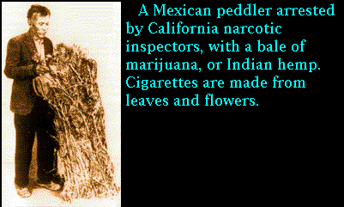
Marijuana was outlawed in 1937 as a repressive measure against Mexican workers who crossed the border seeking jobs during the Depression. The specific reason given for the outlawing of the hemp plant was its supposed violent "effect on the degenerate races." (Testimony of Bureau of Narcotics Commissioner Harry J. Anslinger, in testimony before Congress in hearings on the Marijuana Tax Act of 1937). The American Medical Association specifically testified that they were opposed to the law.
KILLS SIX IN A HOSPITAL.; Mexican, Crazed by Marihuana, Runs Amuck With Butcher Knife. New York Times

Slide 54
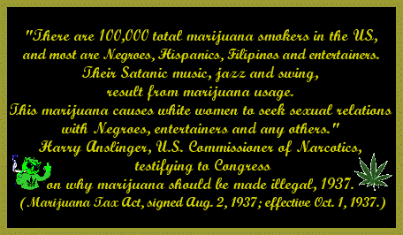

Slide 55
Drug Laws are Fairly Applied Across Race?
The growing rate of incarceration for drug offenses is not borne equally by all members of society. African Americans are disproportionately incarcerated for drug offenses in the U.S., though they use and sell drugs at similar rates to whites.8 As of 2003, twice as many African Americans as whites were incarcerated for drug offenses in state prisons in the U.S.9 African Americans made up 13 percent of the total U.S. population, but accounted for 53 percent of sentenced drug offenders in state prisons in 2003.
Whites and African Americans report using and selling drugs at similar rates, but African Americans go to prison for drug offenses at higher rates than whites. Survey research shows that whites and African Americans report illicit drug use and illicit drug sales at similar rates.12 However, at the local level, African Americans are admitted to prison for drug offenses at much higher rates than whites. In 2002, African Americans were admitted to prison for drug offenses at 10 times the rate of whites in the 1980 largest population counties in the country.13 Ninety seven percent (193 out of 198) of large-population counties have racial disparities in drug admission rates.

Slide 56
Go find out if our (Canadian) drug laws are fair and racially unbiased!
I dare you!

Slide 57
Until 1908 the use of narcotics, opiates especially, in Canada was unregulated. From the 1850s onwards, Chinese immigrants came to British Columbia in droves, establishing opium dens in their isolated communities. Canadian employers saw the Chinese immigrants as a source of cheap labour, and the government viewed opium consumption as another way to gain revenue, imposing a tax on opium factories in 1871. However, with the decline of the gold rush in the 1880s resentment towards the Chinese grew, as unemployed Canadians could not compete with cheap Chinese labour. Additionally, Japanese immigration to Canada began to rise sharply, resulting in demonstrations against Asian labour. In 1907, there was a particularly large demonstration against Asian immigrants in Vancouver's Chinatown.^{[4]} In response to the demonstrations, Deputy Minister of Labour Mackenzie King travelled to British Columbia and interviewed two opium merchants. King was concerned with the growing numbers of white opium users and believed that Canada had to set the precedent on drug use worldwide. The following year the government enacted the Opium Act of 1908, which made it an offence to import, manufacture, possess or sell opium, while not making it an imprisonable offence. The same year, Parliament passed the Proprietary and Patent Medicine Act 1908, prohibiting the use of cocaine in medicines and requiring pharmaceutical companies to list on the label the ingredients of any medicine if heroin, morphine, or opium was part of the contents.

Slide 59
Fentanyl Crisis
Global News
Vancouver Sun
Hat
Salome

Slide 61
