Slide 1
Questions….
Q1. What does GWAS stand for?
Q2. Is there such a thing as addictive personality?
Q3. What does SNP stand for?
Q4. In terms of identifying addiction risk genes, have we had any success?

Slide 2
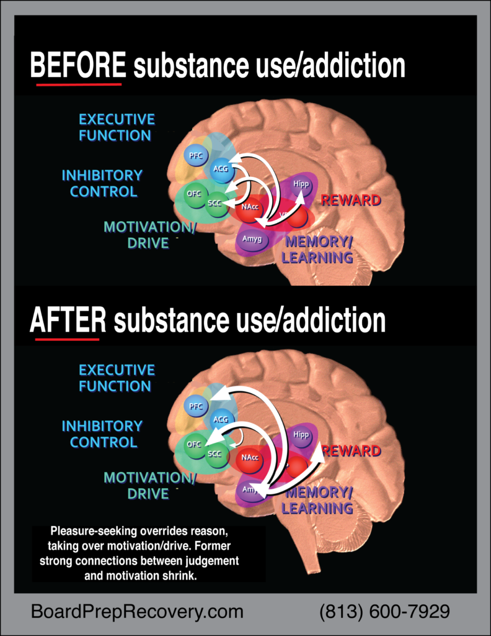
Do drugs “hijack the brain” robbing the user of their free will?
Are drugs that change cognition different than drugs that don’t?
Ramifications….
Drugs….
Lower dopamine (tolerance)
Less pleasure
Poor judgement
Less inhibition
Stronger Motivation
More Drugs
Hijack Fallacy

Slide 3
Staging Addiction?
Experimentation
Genetic predisposition
Recreational use
Regular use
Need
Compulsion

Slide 4
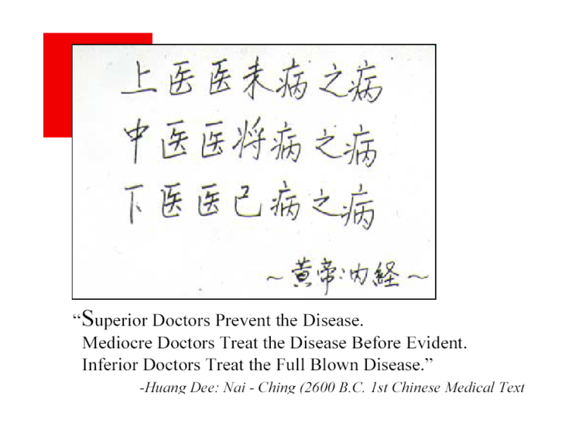
-combined estimate of heritability of AUD in the twin studies was 0.49 + .03
-variance from shared environment .10 + .06
-heritability of depression .37 + 06
-heritability of schizophrenia .81 + .09
-.82 for correlation between illicit and licit substances
Twin Studies Adopted Children Combined Studies Meta-analysis

Slide 6
Linkage studies are performed when you have pedigrees of related individuals and a phenotype (such as breast cancer) that is present in some but not all of the family members. These individuals could be humans or animals; linkage in humans is studied using existing families, so no breeding is involved. For each locus, you tabulate cases where parents and children who do or don't show the phenotype also have the same allele. Linkage studies are the most powerful approach when studying highly penetrant phenotypes, which means that if you have the allele you have a strong probability of exhibiting the phenotype. They can identity rare alleles that are present in small numbers of families, usually due to a founder mutation. Linkage is how you find an allele such as the mutations in BRCA1 associated with breast cancer.
Association studies are used when you don't have pedigrees; here the statistical test is a logistic regression or a related test for trends. They work when the phenotype has much lower penetrance; they are in fact more powerful than linkage analysis in those cases, provided you have enough informative cases and matched controls. Association studies are how you find common, low penetrance alleles such as the variations in FGFR2 that confer small increases in breast cancer susceptibility. This is much like a correlation and suffers from similar problems
In The Old Days, neither association tests nor linkage tests were "genome-wide"; there wasn't a technically feasible or affordable way to test the whole genome at once. Studies were often performed at various levels of resolution as the locus associated with the phenotype was refined. Studies were often performed with a small number of loci chosen because of prior knowledge or hunches. Now the most common way to perform these studies in humans is to use SNP chips that measure hundreds of thousands of loci spread across the whole genome, thus the name GWAS.
Association vs Linkage Genetic Studies

Slide 7
The Dopamine Receptor D2 (DRD2) SNP rs1076560 is Associated with Opioid Addiction
Summary
The risk for drug addiction is partially heritable. Genes of the dopamine system are likely candidates to harbour risk
variants, as dopamine neurotransmission is involved in mediating the rewarding effects of drugs of abuse. One functional
single nucleotide polymorphism in dopamine receptor D2 (DRD2), rs1076560, is involved in regulating splicing of the
gene and alters the ratio of DRD2 isoforms located pre- and postsynaptically. rs1076560 has been previously associated
with cocaine abuse and we set out to confirm this association in a sample of European American (EA) (n = 336) and
African American (AA) (n = 1034) cocaine addicts and EA (n = 656) and AA (n = 668) controls. We also analysed the
role of rs1076560 in opioid dependence by genotyping EA (n = 1041) and AA (n = 284) opioid addicts. rs1076560 was
found to be nominally associated with opioid dependence in EAs (p = 0.02, OR = 1.27) and AAs (p = 0.03, OR = 1.43).
When both opioid-addicted ancestral samples were combined, rs1076560 was significantly associated with increased risk
for drug dependence (p = 0.0038, OR = 1.29). This association remained significant after correction for multiple testing.
No association was found with cocaine dependence. These data demonstrate the importance of dopamine gene variants
in the risk for opioid dependence and highlight a functional polymorphism that warrants further study.

Slide 8
SNP
GWAS

Slide 9
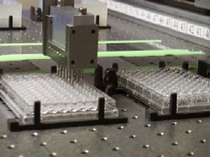
16-pin microarrayer

Slide 10
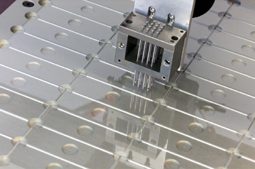

Slide 11
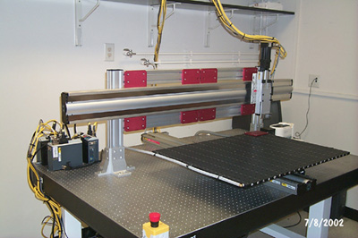
Microarrayer

Slide 12
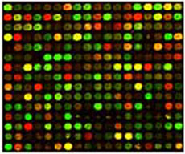
Stanford microarrays
SAMPLE
CONTROL
mRNA
mRNA
cDNA
cDNA
Cy5-cDNA
Cy3-cDNA

Slide 13
Affymetrix GeneChip® oligonucleotide array
• 11 to 20 oligonucleotide probes for each gene
On-chip synthesis of 25 mers
~20,000 genes per chip
good quality data
280-500 K features to play with

Slide 14
Photolithography
in situ synthesis
Mask #1
Spacers bound to surface with photolabile protection groups

Slide 15
Photolithography
in situ synthesis
Mask #1
Spacers bound to surface with photolabile protection groups

Slide 16
Photolithography
in situ synthesis
Spacers bound to surface with photolabile protection groups

Slide 17
Photolithography
in situ synthesis
Mask #2
Spacers bound to surface with photolabile protection groups

Slide 18
Photolithography
in situ synthesis
Mask #2
Spacers bound to surface with photolabile protection groups

Slide 19
Photolithography
in situ synthesis
Spacers bound to surface with photolabile protection groups

Slide 20
Photolithography
in situ synthesis
Spacers bound to surface with photolabile protection groups
DNA Array

Slide 21
Genome-wide association analysis of lifetime cannabis use (N=184,765) identifies new risk loci, genetic overlap with mental health, and a causal influence of schizophrenia on cannabis use
Abstract
Cannabis use is a heritable trait [1] that has been associated with adverse mental health outcomes. To identify risk variants and improve our knowledge of the genetic etiology of cannabis use, we performed the largest genome-wide association study (GWAS) meta-analysis for lifetime cannabis use (N=184,765) to date. We identified 4 independent loci containing genome-wide significant SNP associations. Gene-based tests revealed 29 genome-wide significant genes located in these 4 loci and 8 additional regions. All SNPs combined explained 10% of the variance in lifetime cannabis use. The most significantly associated gene, CADM2, has previously been associated with substance use and risk-taking phenotypes [2-4]. We used S-PrediXcan to explore gene expression levels and found 11 unique eGenes. LD-score regression uncovered genetic correlations with smoking, alcohol use and mental health outcomes, including schizophrenia and bipolar disorder. Mendelian randomisation analysis provided evidence for a causal positive influence of schizophrenia risk on lifetime cannabis use.

Slide 22
Epigenetics
Are these big effects? Bdnf, Dat, Pomc
Do all drugs of abuse share the ability to elevate dopamine?
Childhood experience moderate the effects of several genes on addiction, including polymorphisms in the serotonin transporter, D2, MOA and corticotrophin releasing hormones
-divorce, moving & comorbid psychiatric illness
-protective marriage, religiosity, parental involvement
Imaging studies of addicted people show decrease in D2/3 receptor binding striatum and decrease activity in PFC (area involved in top-down executive control)
Decrease D2/3 reliably shown to be associated with novelty seeking and impulsivity
Increase mesolimbic DA activity in cue-reactivity

Slide 25
Addictive Personality…no but maybe?
What about characteristics that may increase initiation…
neuroticism
externalizing phenotype
Traits to increase the chances of moving to compulsive use…..
trait impulsivity (aka disinhibition)
Traits that decrease the chances of absences
cue reactivity

Slide 26
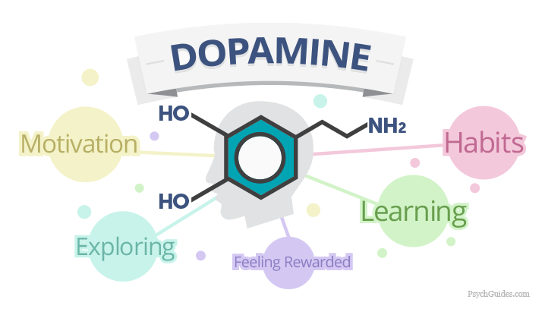
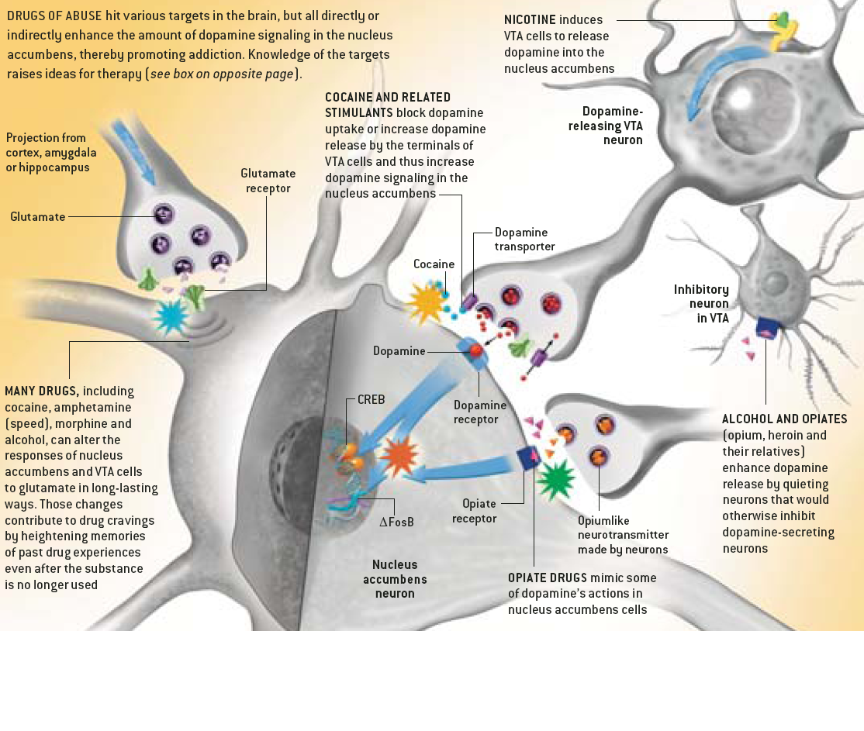
What is the Dopamine Dogma?

Slide 27
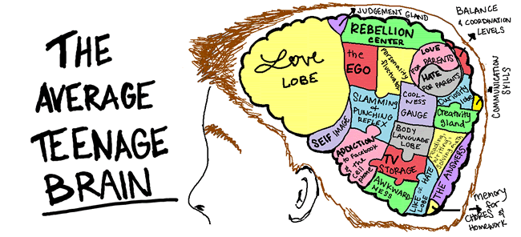
Childhood Stress/trauma/Risk Taking
Increased sensitivity to future stress
Polymorphisms in the serotonin transporter, D2 receptors, MOA, & Corticotropin releasing hormone receptor 1
Importance of timing of stress due to uneven brain development
Typically teenage use drops when a drug is decriminalized

Slide 30
Genes and environment affect liability to SUD in three major ways…
Developmental inter-relationships – exposure during critical periods encourages substance use
-once exposed genotype confers vulnerability to rewards &
increases insensitivity to negative effects
2. Gene-environmental correlations -people with high genetic risk also tend to have high environment
Two pathways…inside the skin (drug receptor interactions, secondary messengers, hedonic and motivational pathways Outside the skin pathways genetically mediate personality traits impacts the degree that the individual selects themselves into drug predisposing protective social environments
3. Gene-environment interactions
-religiosity seems to moderate genetic influences on alcohol use
-stress
Is it important to develop measures of addiction propensity? Traits and states related to reward, punishment, motivation, stress, impulsivity, externalizing and social behavior are most useful..
Generally environmental factors are more important for the initiation of an less important for the progression to dependence, whereas genetic contributions are the reverse.

Slide 31
Addiction Industry

