Slide 1
Trauma & Addiction Louise Stern MSW, PhD

Slide 2
Experiencing trauma does not mean a person will develop an ‘addiction’, but research shows that trauma underlies addictive behaviours

Slide 3
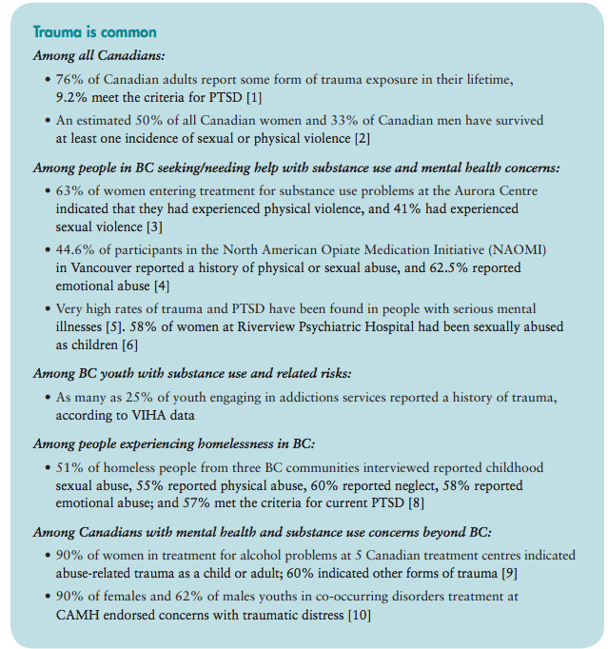
Single incident
Complex
Repetitive
Developmental
Historical
Intergenerational

Slide 4
What is trauma?
Substance use found to manage emotional distress, decrease impacts of trauma symptoms, and manage impacts of trauma
Trauma is not the thing that happened …. It is the sum of the event, the experiences and the effect
It is culmulative and additive
There are multiple causes and outcomes

Slide 5
Psychological Trauma
ACES
Childhood Maltreatment and Abuse (developmental and peri-natal)
Sexual Assault/Abuse
PTSD

Slide 6
Adverse Childhood Experiences Study

Slide 7
PTSD
Diagnostic criteria (DSM 5) for PTSD include a history of exposure to a traumatic event that meets specific stipulations and symptoms from each of four symptom clusters: intrusion, avoidance, negative alterations in cognitions and mood, and alterations in arousal and reactivity
Co-morbidity established between PTSD and substance misuse
Presence of PTSD complicates recovery process
Exposure to trauma or triggers increases cravings
When treated separately, relapse is more likely
Treatment should address both but…..

Slide 8
Collective/Historical Trauma
Collective trauma is trauma that happens to large groups of individuals and can be transmitted trans-generationally and across communities. War, genocide, slavery, terrorism, and natural disasters can cause collective trauma, which can be further defined as historical, ancestral, or cultural.
Historical trauma is a cumulative emotional and psychological wounding over the lifespan and across generations emanating form massive group trauma (Braveheart, 1998)
Intergenerational or multi-generational trauma happens when the effects of trauma are not resolved in one generation.
Transmission of historical trauma can be:
Social
Cultural
Biological/Genetic
Ongoing structural violence and discrimination impacts ability of some groups to heal or alter the transmission (Kirmayer, Gone & Moses, 2014)

Slide 9
Often people who have experienced trauma view their use of substances
beneficial in coping with trauma related stress.
This adaptive coping mechanism can
make them more vulnerable to substance misuse.
Given that the experience of trauma is associated with substance misuse, to meaningfully facilitate change and healing requires helping to make those connections.
Don’t treat the trauma, but instead approach the work with the understanding of how common trauma is and how it is manifested in peoples lives.

Slide 10
Trauma Informed Practice and Care
An approach to care and services that take into account an understanding of trauma in all aspects of service delivery and place priority on the individual’s safety, choice, and control.
Helps:
Appreciate context
Changes how we understand behaviour
Helps with engagement of clients – choice and control
Provides safety
Prevents re-traumatization
Builds on strengths
Acknowledges role of vicarious trauma
WHAT HAPPENED TO YOU?

Slide 11
Key Principles of TIP
ACKNOWLEDGEMENT (building awareness)
TRUSTWORTHINESS (power)
SAFETY (physical and emotional)
CHOICE & CONTROL (starting where the client is at; harm reduction)
RELATIONAL & COLLABORATIVE (working together)
STRENGTH BASED & EMPOWERMENT (develop resilience and coping skills)
GENDER & CULTURE (different groups experience trauma differently + oppression at multiple level)

Slide 12
References
http://jeantweed.com/wp-content/themes/JTC/pdfs/Highlights%20-%20TI%20Practices%2037.pdf (Jean Tweed Centre)
http://bccewh.bc.ca/wp-content/uploads/2012/05/2013_TIP-Guide.pdf BC Trauma Informed Practice Guide
https://trauma-informed.ca/wp-content/uploads/2013/10/Trauma-informed_Toolkit.pdf The Trauma Toolkit
https://www.ihs.gov/telebehavioral/includes/themes/newihstheme/display_objects/documents/slides/historicaltrauma/htalcoholdrugabuse_041213.pdf (Maria Braveheart IGT and Alcohol & Drug Use)

