Slide 1
Visualizing the Nervous System Structure

Slide 2
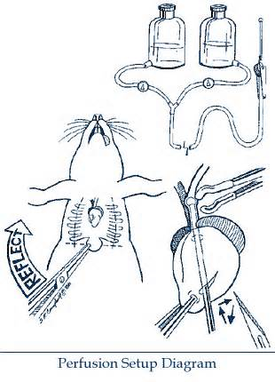
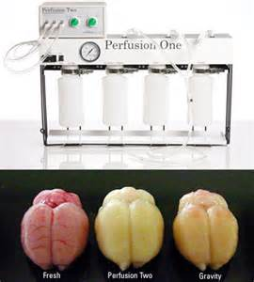
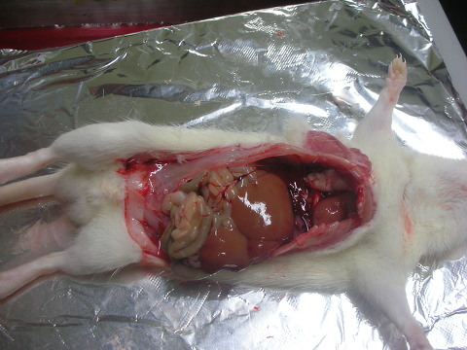
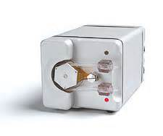
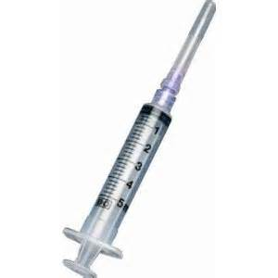

Slide 3
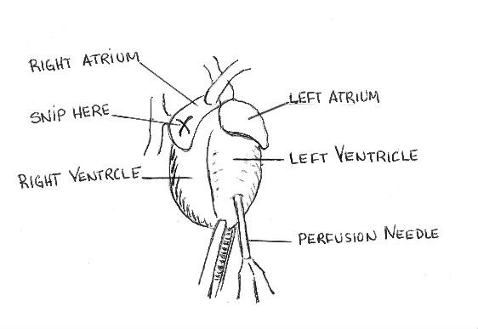
Perfusion Method
anaesthetize the rat.
Lay the rat on dorsal surface on a rack above a sink.
Make a lateral incision of about 6 cm just below the sternum.
Attach a pair of haemostatic forceps to the Xyphoid process.
Pull up on the forceps to view the diaphragm.
Using scissors poke a hole in the diaphragm close to the Xyphoid process. Then cut the diaphragm away from the ribs. You should be able to see into the thoracic cavity.
Using heavy shears,make two longtitdinal cuts, one on each side of and about 1 cm lateral to the haemostatic forcips. Be careful to avoid damaging the heart or lungs. The chest can be exposed by pulling the haemostatic forceps up over the head.
The heart is covered with a membrane, the pericardium. Use forceps to tear away the pericardium.
With blunt forceps, grab the heart at the apex.

Slide 4
Perfusion Fix:
For 1000 ml Total:
Begin with 500 ml of dH20 and heat to 60°-65°C (~104° F) on a heater/ magnetic stirrer.
Add the sucrose.
Create a deep vortex using a magnetic stirrer bar. Gradually sprinkle the finely powdered paraformaldehyde onto the vortex surface. The solution will be quite milky.
Allow to cool to room temperature
Bring the total volume to 1000 ml with 0.2M Phosphate Buffer and verify the pH.
Filter the solution using a qualitative paper.
Paraformaldehyde | For 1000 ml Total 40 g | For 2000 ml Total 80 g | For 4000 ml Total 160 g | Final % 4%
Sucrose | 40 g | 80 g | 160 g | 4%
Phosphate Buffer 0.2M; pH 7.2 | 500 ml | 1000 ml | 2000 ml | ---

Slide 5
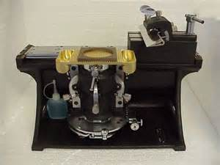
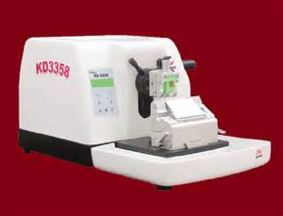
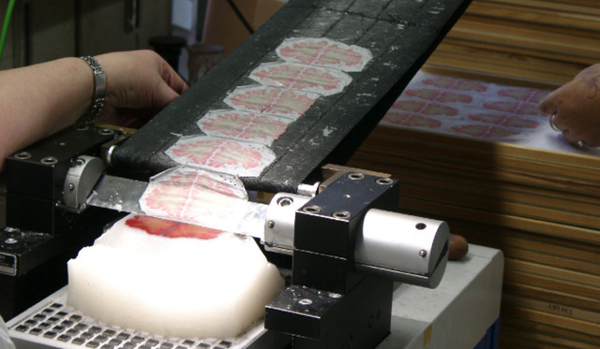

Slide 6
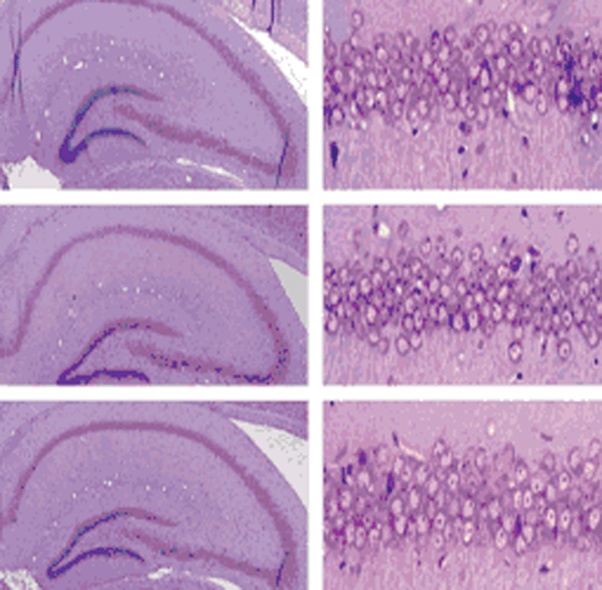

Slide 7
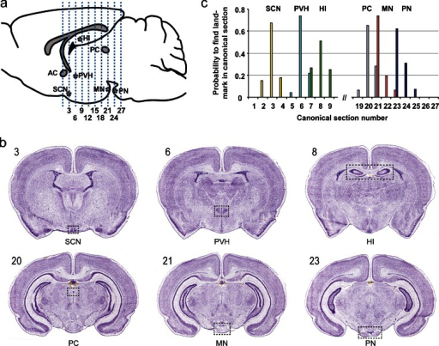

Slide 8
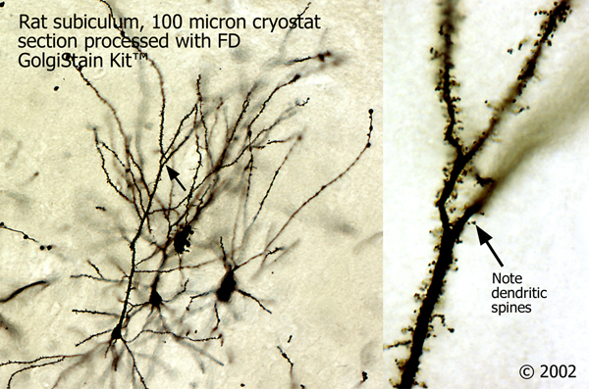
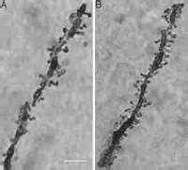
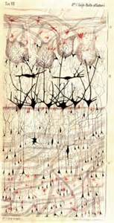
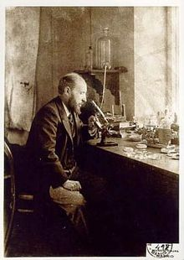
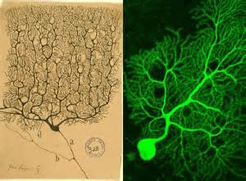
1906 – how the brain looked

Slide 9
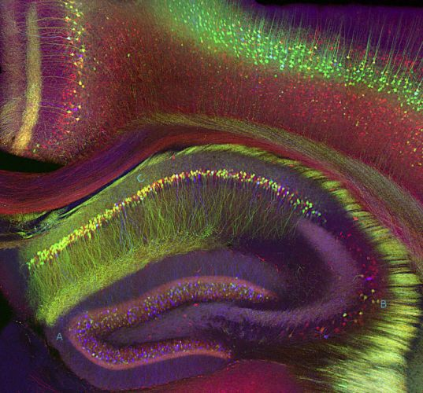
Hippocampus (Photomicrograph, 2005) | Genetically-encoded fluorescent proteins illuminate neurons in different colors in a modern version of the Golgi stain, a simple chemical coloring traditionally done with silver nitrate

Slide 10
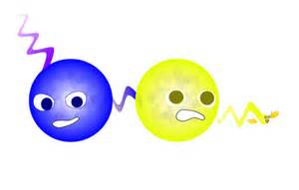
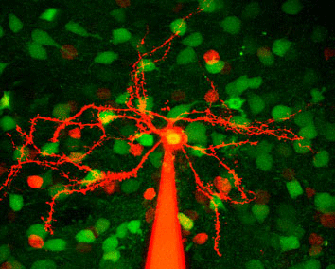

Slide 11
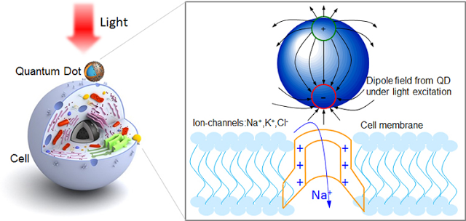
Quantum Dots Used to Stimulate Neurons
Quantum Dots Used to Stimulate Neurons

Slide 12
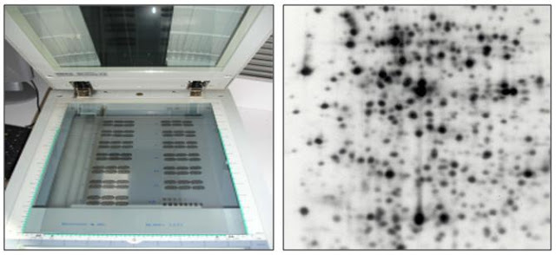
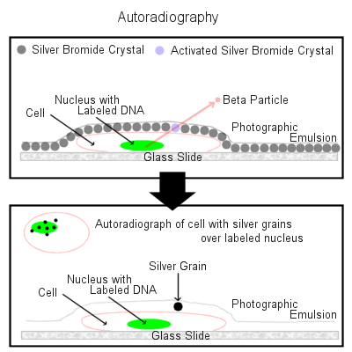
How Autoradiography Works
Rays emitted by the isotope act on a photographic emulsion containing silver bromide crystals in a gelatin matrix. Beta particles activate Ag⁺ ions when the particles interact with the silver ions.
During development, the activated Ag⁺ ions are reduced to Ag_{(s)}. These small grains of silver can be seen under a microscope as black grains.
The unaffected Ag⁺ ions are removed by fixation, leaving grains of Ag_{(s)} to mark the path of the beta particles.

Slide 13
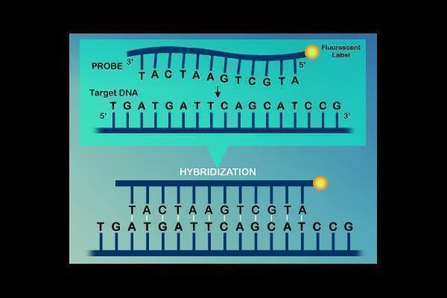
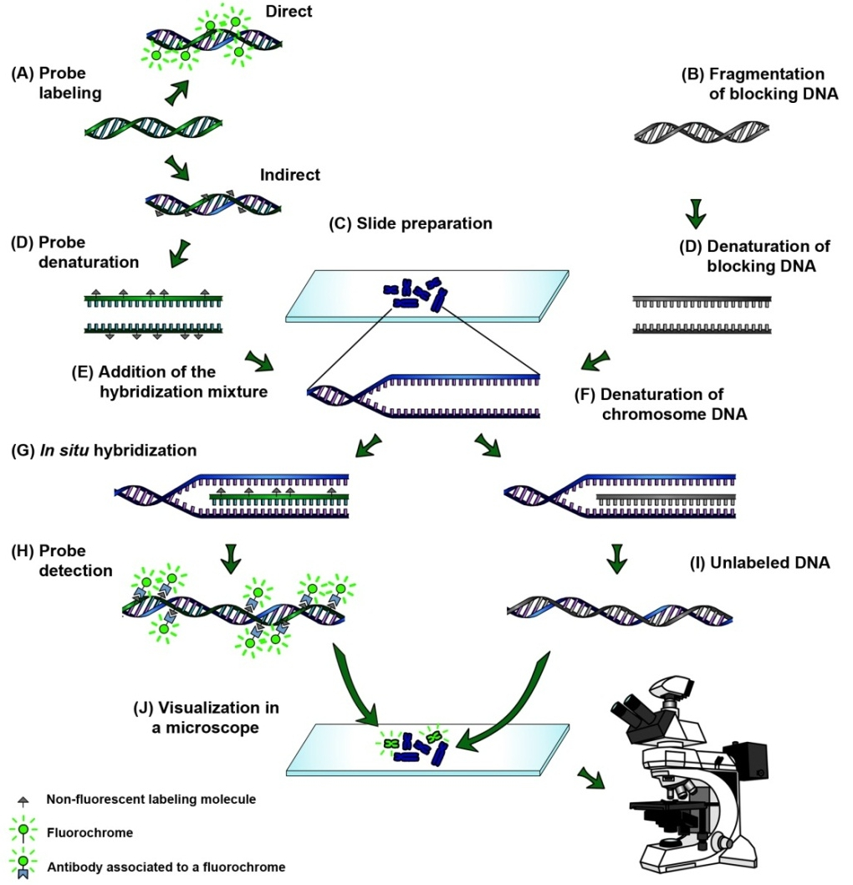
FISH

Slide 14
https://www.youtube.com/watch?v=41P3hJEa96w

Slide 15
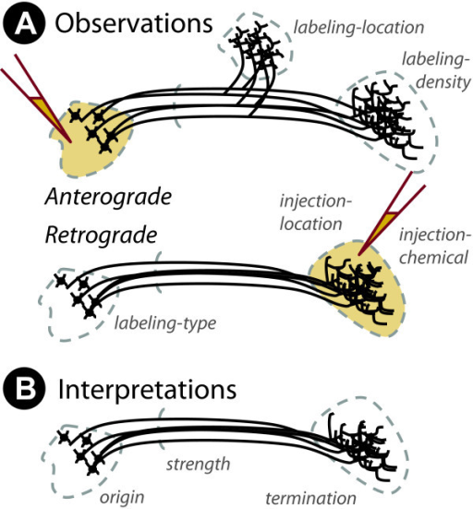

Slide 16
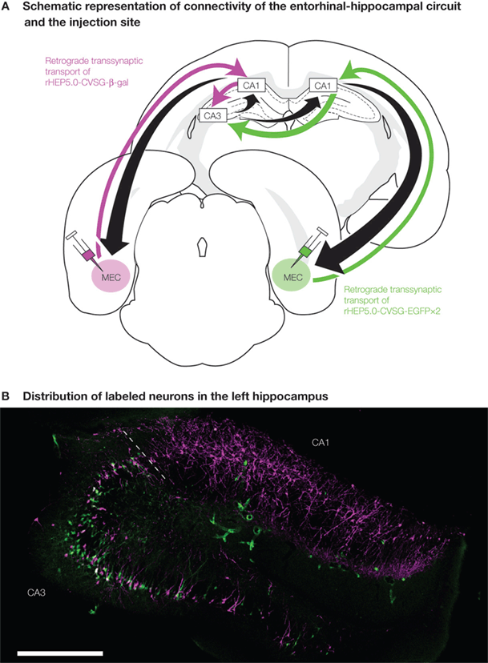

Slide 17
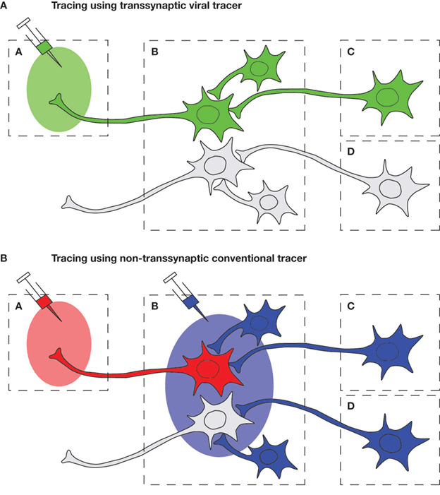

Slide 18
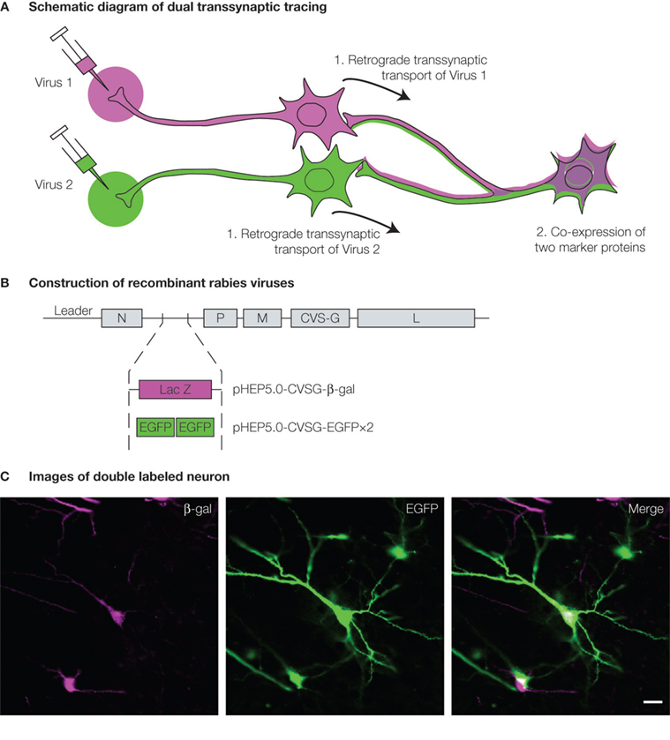

Slide 19
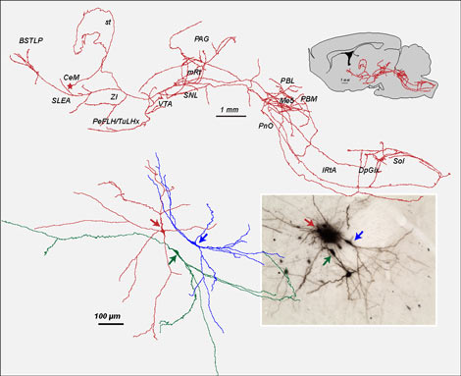
Anterograde (BDA, PhaL) and retrograde (Fluorogold, CTb) neuronal tract-tracing, combination of tracers.
Iontophoretic microinjections.
Juxtacellular labeling.
Stereotaxic viral-mediated gene transfer in brain structures.
Unitary reconstructions, 2D and 3D (Neurolucida plateform).
Immunohistochemistry, immunofluorescence.
In vivo extracellular electrophysiology.

Slide 20
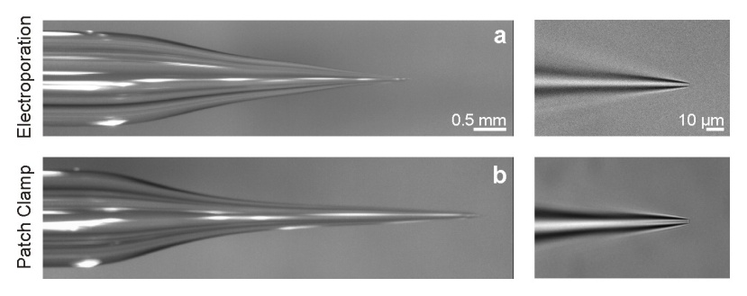
The juxtacellular technique:
The single-cell juxtacellular recording-labeling technique makes it possible to label the neuron recorded extracellularly. It is a very useful tool for achieving single-cell structure-function correlation studies in living, intact neural networks and for determining their phenotype and genotype. It can reveal the overall picture of the smallest neurons, including interneurons. It can be combined with other electrophysiological techniques (e.g, electro-encephalographic recordings and intracerebral electrical stimulation), electron microscope, immunohistochemical, molecular and/or genetic techniques. Its principle consists in applying, under electrophysiological monitoring, stimulating current pulses (0.5-8 nA) onto the membrane of the neuron being recorded with a micropipette (tip diameter: ~1 µm) containing a neuronal tracer (e.g, biocytin, Neurobiotin, biotin-dextran) dissolved in a saline solution (e.g, NaCl, KAc). The juxtacellular nano-stimulation and nano-iontophoresis induce increased firing and internalization of the tracer through a reversible micro-electroporation, respectively. This non-invasive single-cell filling procedure allows keeping alive the recorded and stimulated neuron and to retrieve it labeled in 80-100% of attempts. Since this procedure allows single neurons to be recorded for long periods, many electrophysiological features can be collected, and the finest and remotest axonal ramifications can be marked. In spite of some limitations and pitfalls, the juxtacellular technique remains the high standard for investigating the genetic, molecular, physiological and architectural bases of cell-cell communication. It is also a very versatile and useful tool when it comes to decipher, for instance, the molecular, cellular and network mechanisms of brain state, physiological and pathological oscillations.

Slide 21
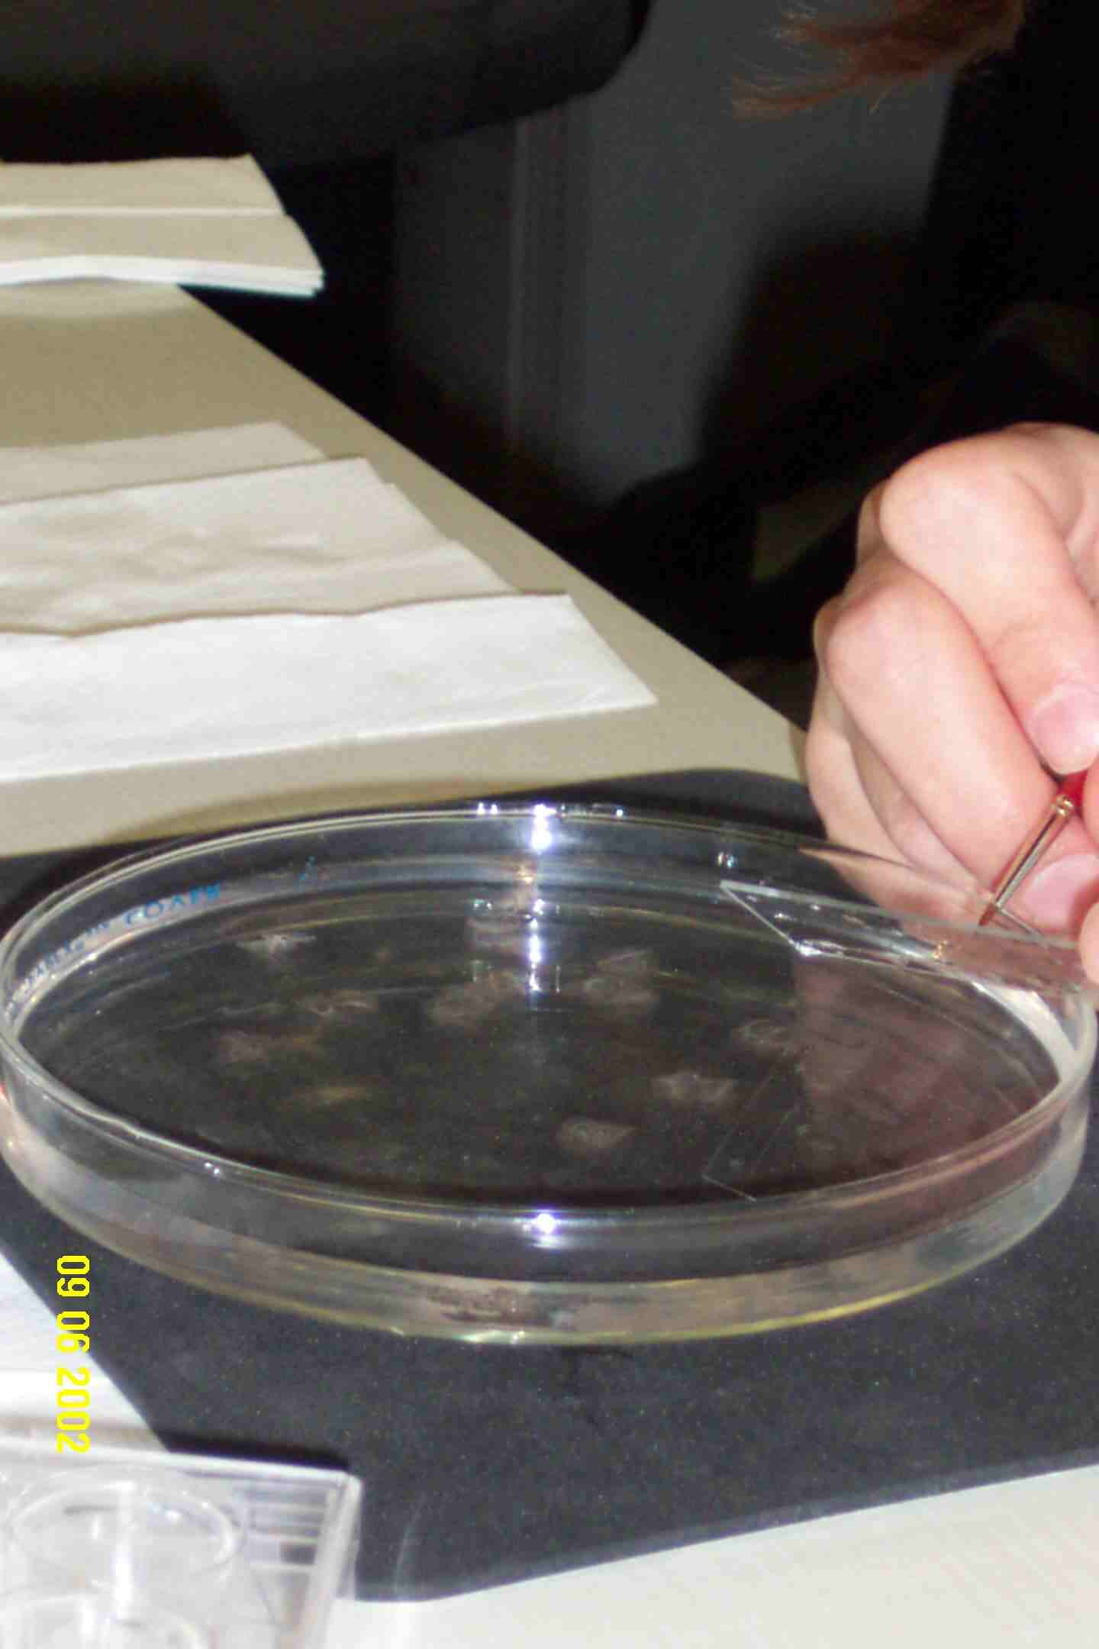
A combination of retrograde tracing techniques and immunohistochemistry reveals which neurons within the ventral tegmental area are activated (fos) by a given treatment. In Panel B, dopaminergic neurons are identified (TH). In Panel C, prefrontal cortex-projecting neurons are identified (FG). Double-labeled cells are indicated by the *.

Slide 22
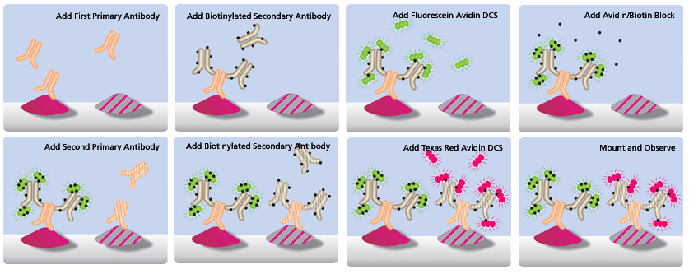

Slide 23
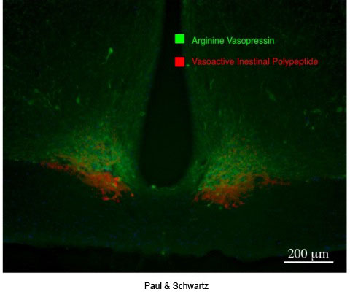
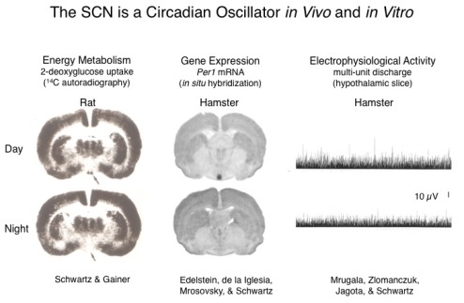

Slide 24
Design – Let the Project Determine Design
Questions – To think about…..
Model
a) What is the most common paradigms in the area?
b) Is there debate about the models …which is the best?
c) Can you learn different things with each of the different models?
d) Validity and reliability or model
d) Is there a cost difference with the models?
Pick the best model possible!
2. Procedures
What is the most design details to investigate your phenomena
think about everything you learned (or should have) in Psyc 204
Repeated measures or between subjects?
Common errors (recognized or not) in prior publications /can you address
Are there time issues and or space issues?

Slide 25
Writing your Introduction…..
Look at published papers on the same topic
Draft out an outline for you based those papers
-structure

