Slide 1
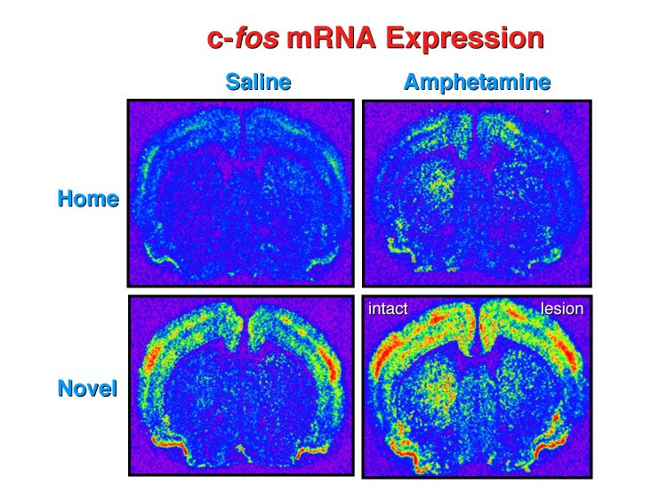
Visualizing Nervous System Function

Slide 2
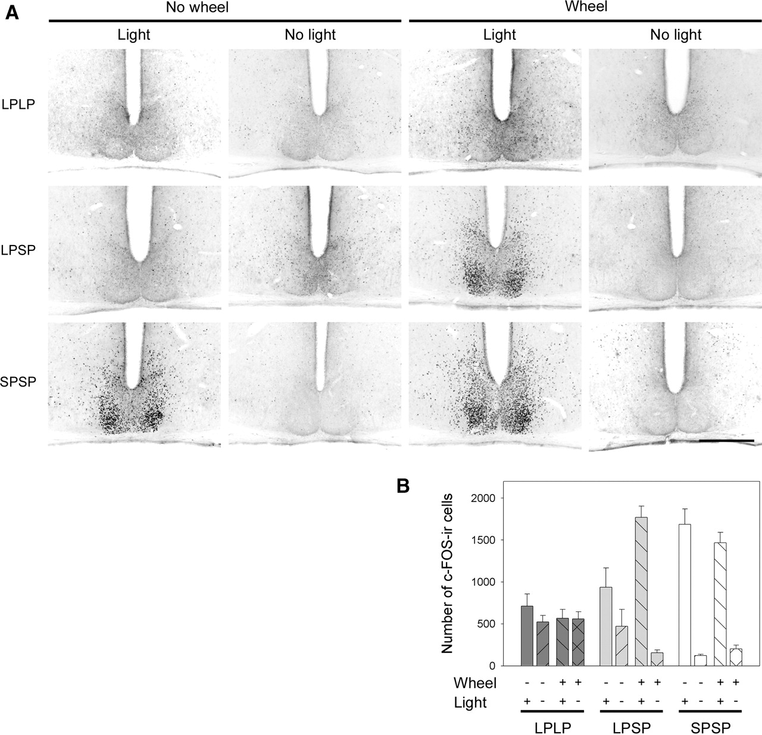
Effects of wheel-running activity on the integration of a photoperiodic change by the suprachiasmatic nucleus (SCN). Hamsters were exposed to the short photoperiod [10:14-h light-dark cycle (LD10:14)] for only 1 day (LPLP groups), for 4 wk (LPSP groups), or for 12 wk (SPSP groups). Some hamsters had free access to a running wheel for 4 wk before death, and some hamsters were light stimulated at the end of the night. See materials and methods for details. A: representative photomicrographs of c-Fos immunoreactivity within the SCN. Scale bar = 250 μm. B: quantification of c-Fos immunoreactivity (ir) within the SCN of hamsters exposed to different light-dark conditions, with or without a wheel, and light stimulated or not (n = 5 in each group). Values are mean ± SE.

Slide 3
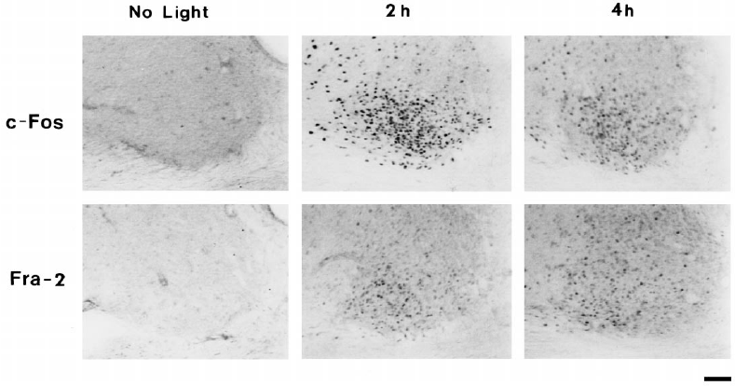

Slide 4
Static Markers of Activity
Assaying Neural Activity in Fixed Tissue
Immediate Early Genes (IEGs)
Encode diverse range of proteins, not often used as a stand-alone indicator of activity
Assaying Cellular Function in Fixed Tissue
Cell proliferation
Thymidine Analogs
BrdU (bromo-deoxyuridine), a synthetic analog of the
DNA base thymidine, or radioactive tritiated thymidine (3H-thymidine)
KI67 - During interphase, the antigen can be exclusively detected within the nucleus, whereas in mitosis most of the protein is relocated to the surface of the chromosomes. The fact that the Ki-67 protein is present during all active phases of the cell cycle (G(1), S, G(2), and mitosis), but is absent from resting cells (G(0)), makes it an excellent marker for determining the so-called growth fraction of a given cell population

Slide 5
Visualizing Neural Activity
Protein Trafficking
Pulse-chase Labeling
Imaging Voltage
Voltage-Sensitive Dye Imaging (VSDI)
Primary method to visualize changes in voltage
These dyes shift their absorption based on membrane potential
Able to detect subthreshold synaptic potentials
Imaging Synaptic Transmission
FM dyes
Lipophilic styryl dyes that fluoresce when bound to membranes. Useful for exocytosis and endocytosis
Neurotransmitters
Release examined using genetically encoded synaptic transmission reporter synapto-pHluorin, which uses pH-sensitive mutants of GFP

Slide 6
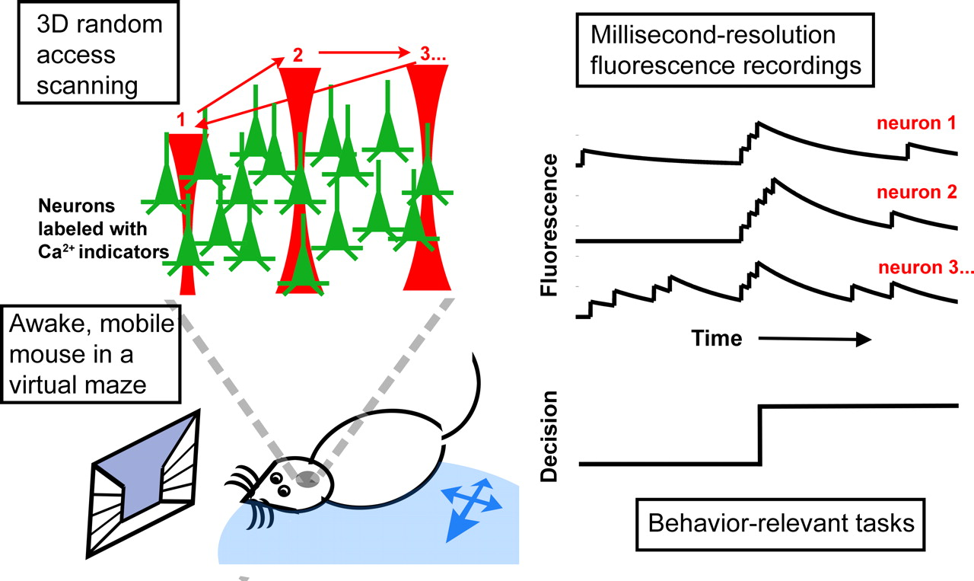
Visualizing Neural Activity
Imaging Calcium
Calcium central to many physiological processes
Calcium dynamics link electrical activity and biochemical events
Indicator dyes are organic molecules that change their spectral properties when bound to Ca 2+

Slide 7
Optically Manipulating Neural Activity
Stimulation through Uncaging Molecules
https://www.youtube.com/watch?v=MWCoz_ghNtQ
Light-Activated Channels
SPARK (synthetic photoisomerizable azobenzene-regulated K+) channels are potassium channels fused to a molecular tether containing an ion that can block the channel pore. Long wavelengths (500nm green) block the channel pore, short wavelengths (380nm blue) allow efflux of K ions out.
Using light instead of electrical stimulation is beneficial because it eliminates artifacts.

Slide 8
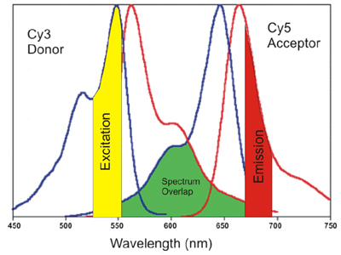
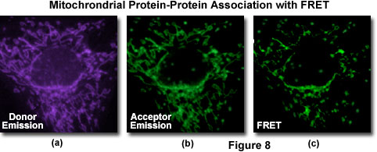
Visualizing Protein Function
Time-Lapse Imaging with Reporter Genes
Non-endogenous gene encoding an enzyme or fluorescent protein whose expression is controlled by a promoter for a separate gene of interest
Fluorescence Resonance Energy Transfer (FRET)
Used to monitor interactions between proteins
Two molecules of interest labeled with different fluorophore, each chosen such that the emission spectrum of one overlaps with the absorption of the other

Slide 9
Visualizing Protein Function
Biomolecular Fluorescence Complementation (BiFC)
Similar to FRET, but rather than two separate fluorophores, two halves of a single fluorophore is fused to one protein and does not fluoresce. When two halves are close enough, they fold and form a single functional fluorophore
Fluorescence Recovery after Photobleaching (FRAP)
Limitation of fluorophores is that photobleaching results in decreased fluorescence intensity over time
This technique uses strong laser illumination to bleach the fluorescent molecules in a particular region
Then measures the time-course of fluorescence returning to the bleached region

Slide 10
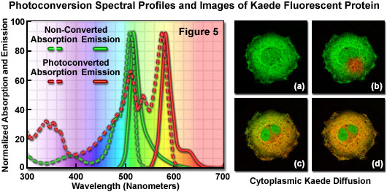
Visualizing Protein Function
Photoactivation & Photoconversion
Photoactivation
When some fluorescent proteins only activate when hit with a specific wavelength, called ‘Photoactivation’
Photoconversion
Serves a similar purpose, but rather than activating a previously non-fluorescent molecule, a pulse of light causes a fluorophore to change its emission spectra from one color to another

Slide 11
Optically Manipulating Protein Function
Photo-activation/ Photo-Uncaging
Technique can be used more generally for optical control over many molecules
Photo-inactivation
Chromophore-assisted laser inactivation (CALI) is a method used to inhibit the activity of specific proteins in precise subcellular regions

Slide 12
Visualizing Nervous System Function Summary
Reporter Genes | Useful for observing behaviour, localization, or movements of tagged protein
FRET | Useful for observing interactions between two tagged proteins or two parts of a single protein
BiFC | Measures change in fluorescent intensity to indicate whether the two proteins are near each other
FRAP | Useful for observing dynamics of trafficking, diffusion, or binding/dissociation of fluorescently tagged proteins
Photoactivation/Photoconversion | Useful for tracking localization changes of small populations or individual cells, organelles, or proteins.

Slide 13
Visualizing Nervous System Function Summary
Photoactivation/Photo-Uncaging | Light removes an inhibiting chemical group from a “caged” compound. Rapid acting with experimenter control over spatial and temporal release of compounds
CALI | Light stimulates chromophore to produce ROS that destroy targeted proteins. Proteins can be targeted through the use of antibodies or genetic tags

