Slide 1
Chapter 9
Identifying Genes and Proteins of Interest

Slide 2
Genetic Dogma
Notes:
Let do a little refresher/introduction to some basic molecular biology, and I mean basic as molecular biology is not my strong point.
Most cells respond to changing environment by altering DNA transcription and protein translation, the proteins are then responsible for modifying cellular function
mRNA represent a specific genetic code released from the control center or nucleus of the cell or nucleus for the construction of proteins of every shape and size. Proteins are the building blocks of all biological tissue, making mRNA the blueprints for the operations of the cell
Once the human genome project has mapped out the entire genetic code, it nearly completed, the next challenge will be determining the functional relevance of all the coded bits of information, either at the mRNA or protein levels.
The gene chip microarray is designed for this purpose.
mRNA is transcribed from DNA so that the mRNA is the mirror image of a specific segment of the DNA
the mRNA moves out of the nucleus of the cell where it severs as a template to build specific proteins (a process known as translation)
This mRNA strand retains the capacity to recognize the complementary sequence of DNA (hybridization) because of the base pair configuration
So if were able to make or replicate a sequence of DNA we could use it to identify mRNA, as only the complementary mRNA will bind to the unique sequences of DNA

Slide 3
DNA
Deoxyribonucleic acid
Nucleotides
Phosphate + deoxyribose sugar + nitrogenous base
4 nitrogenous bases:
Adenine (A), Guanine (G), Thymine (T), Cytosine (C)
Two complementary strands form double helical structure
Strands joined by hydrogen bonds between base pairs
A binds T, G binds C
DNA synthesis 5’ to 3’ direction

Slide 4
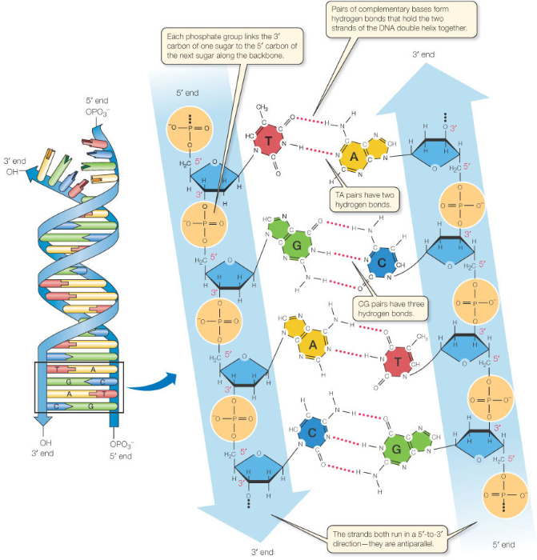
http://www.nature.com/scitable/content/base-pairing-in-dna-is-complementary-24298

Slide 5
Genetics
Genome
All genetic information in DNA required for development, metabolism, physiology, and plasticity
Gene
Functional unit of genome
Directly encodes for protein
Protein
Molecules for structural and functional properties of cells
How does genotype determine phenotype?

Slide 6
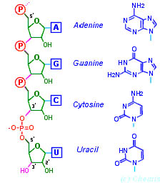
Ribonucleic Acid (RNA)
Single strand
Ribose sugar
Nitrogenous base Uracil
NOT Thymine
http://cs.wellesley.edu/~cs112/assignments/assign7/assign7.html

Slide 7
Transcription
Synthesis of messenger RNA (mRNA)
Transcription factor interacts with promoter on DNA template strand
RNA polymerase reads template strand (3’→5’), mRNA synthesis 5’→3’
RNA splicing
Spliceosome
Cut out introns
Leave in exons

Slide 8
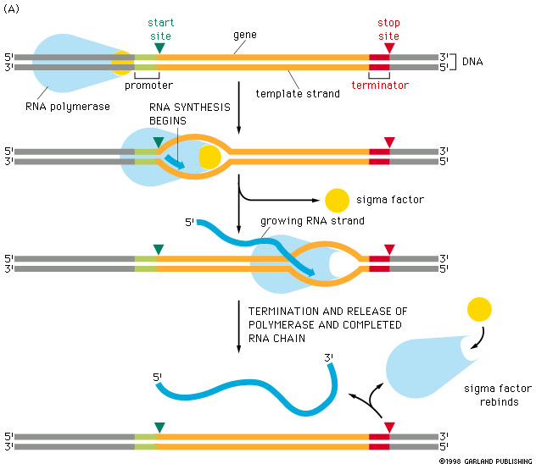
Transcription Factor
Transcription Factor
http://www.chem.uwec.edu/Webpapers2006/sites/leefong/index.html
Notes:
Transcription

Slide 9
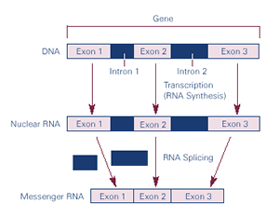
http://biology.unm.edu/ccouncil/Biology_124/Summaries/T&T.html
Notes:
RNA splicing

Slide 10
Translation
Synthesis of protein
Ribosome reads mRNA (5’→3’)
Occurs in cytoplasm
Three consecutive nucleotides = codon
Codons are specific to each amino acid
AUG = “start” or methionine
UAA, UAG or UGA = “stop”
Post-translational modifications (PTMs)
Attach functional groups, change chemical state, make structural changes

Slide 11
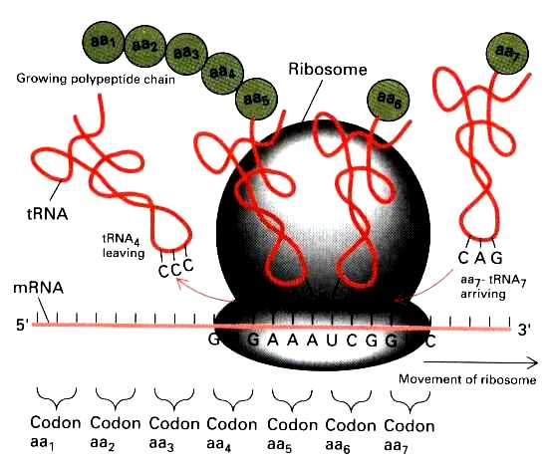
http://genmed.yolasite.com/fundamentals-of-genetics.php
Notes:
Translation

Slide 12
Transcription/Translation Videos
This website has some great animations of transcription, RNA splicing, and translation (look at them later)
http://www.dnalc.org/resources/3d/12-transcription-basic.html

Slide 13
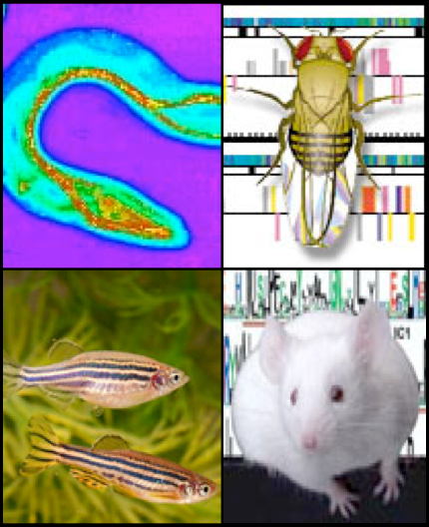
Genetic Model Organisms
5 common species:
Worm (Caenorhabditis elegans)
Fruit Fly (Drosophila melanogaster)
Zebra Fish (Danio rerio)
Mouse (Mus musculus)
Human (Homo sapiens)
Used historically in experiments
and so better for correlation of
results between labs.
Notes:
Know this table – good test question!

Slide 14
Fruit Fly
Worm
Simple, multicellular
Known genome
Short lifespan
Easy to manipulate genes & screen genes with mutagenesis
All neurons and connections known
Complex, multicellular
Known genome
Short lifespan, rapid reproductive rate
Easy to manipulate genes
Many mutant lines available
Invertebrate
Primitive nervous system

Slide 15
Zebrafish
Mouse
Vertebrate
Can use invertebrate techniques: Gal4/UAS system
Clear eggs good for studying development
Large number of offspring
Not a mammal
Complex, higher-order
Known genome
Manipulate genes of whole organism or specific tissues
Nervous system homologous to humans
Long lifespan & reproductive time
Genetic manipulations expensive & long
Genetic redundancy
Notes:
Homology – traits derived from a common ancestor, they evolved together from one origin
(Compared to analogous – traits derived through different lineages, not from a common ancestor)
Gal4/UAS System
Biochemical method used to study gene expression
2 parts:
GAL4 gene – encodes yeast transcription activator protein (Gal4)
UAS (Upstream Activation Sequence) – and enhancer which Gal4 binds to to activate gene transcription.
In genetics studies, mutant lines (usually fruit flies) are used: 1. GAL4 gene 2. UAS attached to a reporter gene (e.g. GFP)
Cross breeding these strains will result in GFP expression in offspring of 1x2 and can identify the cells that express particular genes of interest…

Slide 16
Humans
Complex, higher-order organism
Known genome
Can observe genetic mutations and polymorphisms that occur naturally
Long lifespan
Cannot use for experimental genetic manipulation
Notes:
Polymorphism – when 2 or more different phenotypes exist (at one time) in the same population of organisms

Slide 17
Genetic Screens
Forward genetic screen
Identify genes for biological phenotype
“Hypothesis generating”
Reverse genetic screen
Identify phenotypes affected by a particular gene
“Hypothesis testing”
Produce gene knockouts and determine how the phenotype is affected

Slide 18
Forward Genetic Screen
Produce mutant animal lines that may have a single gene mutation, screen individuals for an abnormal phenotype
6 steps:
Design a quantitative assay to discriminate between wild type and unusual phenotype
Mutagenesis
Screen for abnormal phenotypes
Complementation analysis
Map the gene
Clone the gene
Notes:
Describe each step on some detail

Slide 19
Mutagenesis
Chemical
Ethyl methane sulfonate (EMS)
Point mutation – G-C → A-T
N-ethyl-N-nitrosourea (ENU)
Point mutation, thymine
Irradiation
High intensity UV light
Forms covalent bonds between T-T or C-C bases
Insertional
Insert transposons into random locations in genome
Disruption of endogenous genes occurs, look for loss-of-function

Slide 20
In Silico Screens
Computer-based methods to identify and compare DNA or protein sequences between species
BLAST
Basic Local Alignment Search Tool
Website: http://blast.ncbi.nlm.nih.gov/
Tutorial: http://www.youtube.com/watch?v=HXEpBnUbAMo
Ensembl
Website: http://uswest.ensembl.org/index.html
Tutorial: http://uswest.ensembl.org/Help/Movie?id=188
Notes:
Tutorials or website show and tell

Slide 21
Molecular Screens: cDNA Microarray
Measure & compare gene expression between biological samples
How gene expression:
Changes with time
Responds to stimuli or environment
cDNA sequences on microarray chip
Microarrays
Notes:
Example of a use in neuroscience – suprachiasmatic nuclei gene expression in light and dark
http://www.youtube.com/watch?v=VNsThMNjKhM

Slide 22
Molecular Screens: Oligonucleotide microarray
Similar to cDNA microarray
Synthesis of known sequences directly onto array surface
More precise control
http://www.intechopen.com/books/biosensors-for-health-environment-and-biosecurity/evolution-towards-the-implementation-of-point-of-care-biosensors

Slide 23
Molecular Screens: RNAi Screen
RNA interference
Natural process in cells to regulate gene expression
RNAi molecules
microRNA (miRNA)
Small interfering RNA (siRNA)
Molecules added to cell sample and affects on cell are observed
http://www.nature.com/nrg/multimedia/rnai/animation/index.html
Notes:
http://www.nigms.nih.gov/News/Extras/RNAi/factsheet.htm

Slide 24
mRNA
Tethered cDNA or Oligo
Notes:
So here is what we have, a tethered cDNA strand or a unique sequence of DNA called an oligo, using the Affy system these are actually constructued, I will tell you how in a few minutes. For the majority of this presentation I will talk about oligos, however in most cases, you and incert cDNA for the work oligo.
So, if we now expose the this tether oligo to a solution containing mRNAs what would happen?
The mRNA which had the complementary sequence of base pairs will hybridize to it, all other mRNA won’t, right?

Slide 25
Notes:
Now let say we could attach or build hundreds or thousands of oligos on a single microchip or glass slide all at a precise address on the chip.
If we then exposed the chip to a solution containing thousands of mRNAs, only the RNA with a a complementary sequence to a tethered to the oligo present on the chip will attach or hybridize to the chip.
Everybody following so far?
So let’s design an experiment, we take 2 samples of RNA, say the suprachiasmatic nucleus from a mouse exposed to a light, and the suprachiasmatic nucleus from a mouse maintained in the dark. The suprachiamatic nucleus, as many of you know is the location of the circadian clock and received direct retinal innervation from specialized retinal ganglion cells.
Now we have two samples, we label the experimental sample with a tiny green fluorescent marker, and the control, non-light exposed sample with the red fluroscent mark. We then expose the two samples to the chip for 24 hours to allow the samples to hybridize to their specific oligos.

Slide 26
Notes:
So, we would have something that would look like this…
A glass slide with tethered oligos, two samples of labeled mRNA, and a hybridize period of 24 hours.
After a washing period, we now can expose the chip to mircoarray reader that with the use of a scanning confocal microscope with 2 lasers specifically designed to excite one or the other fluorescent probes.
If we added a very sensitive scanner, we could check each specific address for the presents of the experimental and control RNA. The scanner could record the location and the amount of and type of emmitted light. This information could then be quantified and compared between the control and experimental samples.
The red and green arrows are my representation of the lasers and the emmitted light. The circles are showing the presents or absences of hybridized signal.

Slide 27
Notes:
The total output/scanned image would look something like this. Now, if I have not amazed you yet, my next point is hopefully will.
Let say we could put say 1 million of these oligo on one small glass slide like this, or how about the entire genome of any given organizm?

Slide 28
Notes:
Well I really can not tell you any more that could thrill and amaze after this so I think I will rap this part of the presentation with a few concluding questions that I had when I first was introduced to this new technology.
The first question I had was “How do you build one of these? Well the internet can provide you with those answers, you can pick up detailed instructions off the net, including suppliers, components and instructions with the cost to build at about 100,000 dollars Canadian. The chips, which are getting cheaper and cheaper can be purchased for between 60-3000 dollars depending on the size and species of interest. If you look at the cost interms of the the genes you get to interiogate, the cost are very reasonable.
OK well how would you build a chip of oligos??? Well there are a number of companies that are building chips and there are a number of techniques that can be employed to build them your self if you choice to do so. The most common means of construct a chip is using the same technology used by the everyday inkject printer. These are known as spotted arrays, and their biggest challenge is controlling the amount of cloned DNA set down on a slide.
The Affy system, the one that we have used, uses a process similar to that used in the semi-conductor industry, a process of photolithography. These chips are actually built and not dotted.

Slide 29
Notes:
Now I actually do not have enough time/or knowledge to tell you in detail how this works, but in brief,
So we start by building a tether, using a chemical reaction on the glass chip, followed by a thin photosensitive layer. Directed light is then used to demask the tethers and a single base pair is added. A second layer is added and the process is repeated until an oligo is built in each location.
So let me summerize,

Slide 30
Notes:
We have two sample of mRNA, one experimental sample, again say an suprachiasmatic nucleus from a mouse exposed to light and a a reference or contol sample, a mouse maintained in complete darkness. As most of you know the suprachiasmatic nucleus is a nucleus in the anterior hypothalamus that contains the master circadian pacemaker. Anyway,
we have some expensive mircoarray equipment which I have just told you about, including some computers, laser scaning microscope a very suffocated photodetector
We take our two samples of mRNA, and tag samples with difference fluorscent probes
The two samples are then exposed to a gene chip where the mRNA hybridizes to complemery oligos of 24 hours. The chip is washed and each address is then excited by different lasers, one that results in the excitation of the experimental sample, one that results in the excitation of the reference sample
The excitation is recorded by the photodetector and the wave length and amount of light is quantified with some sufficiated computer programs
As the identity of the oligos are known, we have a complete record of changes in the commands issued by the nucleus of a cell as a result of a specific stimuli.
All I can say is pretty amazing!

Slide 31
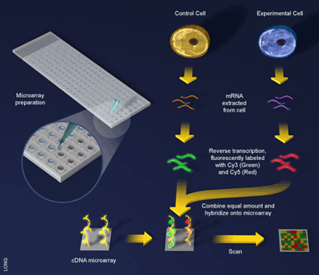
Spot or cDNA microarrays

Slide 32
Mid-Subjective Day
Early Subjective Night
Late Subjective Night
CT7 CT15 CT22.5
Light No-Light
Light No-Light
Light No-Light
n=30
n=30
n=30
n=30
n=30
n=30
No Behavioral Effect
of Light
Light Phase Delay
the Clock ~2hrs
Light Phase Advances
the Clock ~1hr
Collect Punches
Extract & Clean-up RNA
Label RNA
Data Management & Mining
Microarrayer
Notes:
So lets talk about some data! As I mentioned earlier, we have used this technology to investigate the changes in RNA expression patterns in the SCN of C57 mice exposed to light. We selected 3 different circadian phase to investigate based on behavioral data we have collected. The times included the middle of the subjective day, a time at which light has little or no effect on the circadian clock and the animals are relatively quiescent. This time was 7 hours after the lights go on and I will refer to this as circadian time 7. We also looked at 3 hours after lights were off, or early subjective night. Light at this time results in a 2-3 hour phase delay or in other terms, its like turing the clock back 3 hours. This time I will refer to as CT15. By convention, CT12 indicates the time at which the lights go off and nocturnal animals become active. The final time we investigated was late in the subjective night, or 2 hours before the lights were to go on. Light given at this time, cause a phase advances in the circadian cycle by approximately 1 hour. I will call this time CT22.5 because the animals were light exposed 10.5 hous after the lights go off.
Now to give you a little more detail, what we did was rapidly removed the brains of 180 mice at 3 different circadian time, with half of which receiving a 30 minute light pulse prior to being killed. This gives us approximately 30 mice per group. The mice were killed by decapitation under infrared light and their brains removed in less that 120 seconds and frozen on dry ice under photosafe red light. We used a cryostat to take coronal section until we reached the SCN. At that point we used a 450 micron Inner diameter punch to remove the SCN from the rostal to caudal extent. The tissue punches were collected and the RNA extracted using standard Qiagen RNA isolation protocols. These samples were then analyzed on the Affymetric’s microarrays.

Slide 33
C57 Mouse SCN
Notes:
So here is a little histology. As I indicated earlier, the SCN is located in the anterior hypothalamus, and it received direct retinal innervation. You can see here at the SCN as indicated by the white arrows. The first panel is stained with crestyl violet, the second panel is H&E and Eosin alone. Of course the final image is of the mice we used C57BL/6 mice.

Slide 34
Notes:
Here is what a punched out SCN looks like in tissue that was unfix tissue stained with crestyl violet. The top two panels the SCN in obviously absent the 450um punch inner diameter punch is shown with a dashed black line. The bottom two panels are unpunched SCN with the tissue processed in the same manner. So this tissue was maintained at minus 80 degrees until we extracted the RNA. To do this we used a standard RNA extraction kit from Qaigen and ran the tissue on the Affymetric microarray. The data was analysized using the Affymetric software package as well as GeneSpring cluster analysis package.

Slide 35
Light Response:
Circadian:
260 genes in 35 categories
745 genes in 41 categories
CT7
CT23-CT7
95 genes in 15 categories
374 genes in 25 categories
Down-regulated by light:
Higher at CT23 than CT7
9 genes in 4 categories
293 genes in 15 categories
Up-regulated by light:
Higher at CT7 than CT23
86 genes in 11 categories
81 genes in 10 categories
CT15
CT23-CT15
7 genes in 4 categories
221 genes in 21 categories
Down-regulated by light:
Higher at CT23 than CT15
1 gene in 1 category
100 genes in 9 categories
Up-regulated by light:
Higher at CT15 than CT23
6 genes in 3 categories
121 genes in 12 categories
CT23
CT15-CT7
178 genes in 21 categories
447 genes in 24 categories
Down-regulated by light:
Higher at CT15 than CT7
109 genes in 10 categories
378 genes in 15 categories
Up-regulated by light:
Higher at CT7 than CT15
69 genes in 11 categories
69 genes in 9 categories
No Light Response
Not Rhythmic
537 genes in 13 categories
52 genes in 7 categories
Notes:
So here is what we found…Of the some 13,000 gene we screened for we found 745 genes that are differentially regulated at the different circadian phase we tested, and some 260 genes that are differentially regulated by light. Right now this is the major problem with the use of this technology, processing the data. I looked at screens and screens of data. Despite that fact that there is software to help you develop excel based spreadsheets and name all the expressed sequence tags there is such a wealth of information to deal with. Of course this is not to mention the follow-up. OK so
The statistical criterion that we used was very conservative in comparison to other published reports. We also obtained one of the cleanest data set ever run of the Affy arrayer at the Genomic Institute of the Novartis Research Foundation. Now there are some statistical problems that are still being grappled with by the biostatisticans and post docs like myself. Whenever one runs a fishing trip as big as this one, there are obviously some problems. To deal with some of the statistical problems the Affy chips have built in controls. For every oligo is represented on the chip by over 20 addresses, as well as address where there are miss match controls. That is, identical oligo with the exception of a single base pair combination is out of order. For the data to be excepted there had to be a minimal change, no miss match signals, at least 18/20 of the oligos must change in the same manner in both runs. Oh, we ran the samples twice.
This year at neuroscience I spent a great deal of time argueing with chip people about this problem and the best solution. Despite talking to some of the leaders of the technology, Most of the them were less concerned about the stats than me tended to blow me off. The current conclusions I have reached at this moment is to use the Affy internal statistical analysis package , and follow-up any array expreiments with more specific experiments using in situ hybridization and immunocytochemistry. Although many would argue with me, I do not think we should treat any data set as the end all be all. I like to think of this data set as a spring board to launch us off in new directions. The excess of data should be be put out there for other to us. There are a number of efforts being made to generate a database of genes identified in arrayer experiments and to give the research community access to them. I think this is good for science as I may not have a interest in let say some intermediate neurofilament, but it may be yours and if you see that these neurofilaments are altered by light, it trigger new directions, experiments etc. Anyway we will be publishing the entire data set on the Web and there should be a link to it through the article.
Obviously I can not tell you about all these categories…to much and too little time. Similarly, you also can no longer publish this type of broad micrarray surveys anymore so we had to parce down this data set down to a more manageable level with some known theoretical value.

Slide 36
Neuropeptide Cluster
AVP, Oxy, TRH, Gal, SS, & Tig2
Notes:
This is the neuropeptide cluster. We use a program called GeneSpring program that uses a cluster analysis routine to identify highly correlated genes, altering their expression pattern in the same way. I have two graphs here which are of the same data, just platted different. In this graph we have the no-light and light conditions plotted separately, while in the second graph, weh have the light and no-light conditions for each time tested plotted together.
The nice thing about casting a big net is that we should catch both known genes and perhaps some novel things as well. The bonons here is that there are a lot of things known about the SCN and the genes and proteins found there. So AVP or vasopressin was already known to be in the SCN, and that the pattern of expression was circadian in nature. You can see this best by looking across the three circadian times we examined, CT7, CT15 and CT22.5. What was of particular interest because it has not been previously reported in this change right here. This increase in response to light when it is given in the late subjective night. Besides AVP, we also found oxytocin, thyrotropin releasing hormone, galanin, somatostatin and Tig2. Tig2 is the second novel finding. This expressed sequence tag (EST) was found by microarray analysis to show an expression pattern similar to that of the neuropeptide gene cluster. Complete sequencing of the EST and full-length cloning of the cDNA revealed that this protein has a structure similar to many neuropeptides. The deduced primary amino acid sequence revealed a peptide of 130 amino acids, mTig2s, with a signal peptide at the 5’ end and characteristic dibasic amino acid residues, sites of cleavage in the pre-pro versions of many neuropeptides and secreted molecules. Although much additional work will be needed to confirm mTig2s as a neuropeptide, it’s coordinate response to light with the neuropeptide cluster and it’s similar structure are compelling.

Slide 37
Light CT23
No Light CT23
In Situ
Notes:
We have confirmed the changes seen in the genechip data set using situ hybridization. Here we have AVP and the SCN is clearly visable and expressing a greater amount of signal in response to light at CT23 than the no light condition. Measuring optical density this conclusion was confirmed. We have run in situ for Tig2, SS, Oxy and TRH, however the differences unforunately are less apparent.

Slide 38
Neurofilament Cluster
NFM, NFH, NFL Brain-Derived Neurofilament, Peripherin,
Parvalbumin, Osteopontin,
Notes:
The second cluster that was discovered in this data set was the neurofilament. In the circadian rhythms liturature there has been very no published reports of neurofilament changes across circadian time, or in response to light. Here you can see that there is a huge increase in the neurofilament genes in the late subjective night. I would guess that these changes are preparatory changes for the coming dawn. We also so see a huge decrease in the late subjective night in response to light, something that was also very novel and unexpected. This cluster includes NFM, H and L, as well as brain-derived NF, peripherin, osteopontin and parvalbumin, a calicum binding protein, possibly involved in mediating these changes.

Slide 39
No Light CT23
Light CT23
Peripherin
NFM
Notes:
We have confirmed using ICC peripherin, an intermediate neurofilament found in the retina, pineal and pituitary gland, howeve it seemed to be localized to the wall of the 3rd ventricle. Changes in the NFM were hard to detect directly in the SCN, however it level of expression is clear different in the optic chiasm which could not be excluded from the punches. I speculate, however NFM, H and I are thought to play an important role controling retinal axonal diameter.

Slide 40
Immediate Early Gene Cluster
Fos, FosB, JunB, EGR1(NGFIA), and Ptpn16
Notes:
The final cluster I will discuss today is the immediate early gene cluster. My current supervisor, Ben Rusak was the first to report the up-regulation c-fos gene and protien in response to light in the SCN. What we found was that there was little or no cicadian pattern of immediate early gene expression in the SCN, however there is a big increase in respnse to light given at a time when the clock is sensitive to light. This can be seen here and here. It is interesting as light at CT15 results in phase delays, while light at CT23 light results in a phase advance. Here too we have some novel results to report. First the known results include Fos, FosB, JunB and NGFIA. The novel finding was Ptpn16 which is a protein tyrosine phosphatase, non-receptor type 16, Ptpn16. This immediate early gene is thought to be involved in the control of cellular profileration. We were able to confirm using ICC all the changes with the exception of Ptpn16.

Slide 41
Light Pulse CT23
No Light Pulse CT23
JunB
NGFIA
Notes:
Here are two examples including JunB and NGFIA. You can see in the light condition there is little or no gene expression in the SCN whereas the SCN of the light exposed animals show robust protein expression.

Slide 42
Light Pulse CT7
No Light CT7
CRY
Light Pulse CT23
No Light CT23
Period
Notes:
A couple of there finding that are worth reporting include to clock genes, crytochrome and period. Mutations in either of these genes results in arrhythmic behavior in drosphila and mice. In the case of CRY, we only see a decrease in response to light at CT7 and not at any other phases. Nor is there a circadian pattern in its expression. Here you can see a differents, however I would not take this to the bank, as we have not been able to quantifiy in a confident manner. Similarily, Per, or the period gene is equally difficult to quantify. It is increased in response to light at CT23. Here you can see a difference and I am convinced that it is real, however because of the ubiquidous nature of Per, we again can not quantify it with any certianty.
Well this is all the confirmation of this project I am going to share with you. We have confirmed and followed up over 20 different genes/proteins in the mouse as the result of this project. Quantification remains the primary stubbling block at this time. If we add the known patterns of genes or protein expression in the SCN in response to light we can confirm close to 50% of the light regulated genes found using the microarrayer. So what next? We how do you feel about laser-capture microdissection?

Slide 43
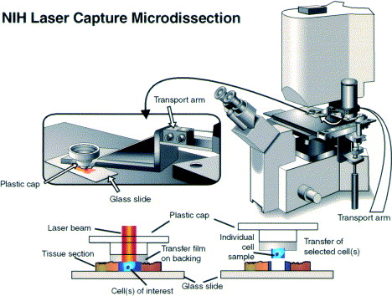

Slide 44
Laser-Capture Microdissection (LCM)
Notes:
The principle of LCM is really quite simple. It starts with an inverted microscope, and a cap, not unlike those found on the .5ml ependorf tubes. The primary difference is the laser dissection caps have a polymer film overtop of the cap. The caps can be seen here. The basic idea is you take fresh, lightly fixed tissue cut at around 10um think on a unsubbed glass slide. You then fire a laser through the cap and have the focal point of the laser set at the meeting of the polymer film and your tissue. The laser melts the polymer film and grabs onto the tissue directly below the the melting point. One the polymer film drys it has now captured the tissue directly below it as you can see her ein this panel. This system can be used to capture individual neurons or groups of neurons. The neurons can be homogenized and the RNA extracted, PRCed and also run on the microarray. We are currently carring out this experiment however now we are not going to analysize the entire SCN including some of the surround tissue, now we can dissect out specific subdivisions of the SCN. This can be cleary seen in the next slide.

Slide 45
3v
Core SCN
Ventrolateral
SCN
Optic Chiasm
Notes:
Here is what you can see throught the LCM microscope. What we are looking is lightly fixed tissue from the hypothalamus of a mouse. The circle represents the core of the SCN, while the Ventrolateral portion of the SCN is clearly visable based on it greater density. The yellow arrow signifies the laser targeting spot.

Slide 46
Laser-Capture Microdissection
3v
Core SCN
Ventrolateral
SCN
Optic Chiasm
Notes:
Here in this slide, sorry for it being slightly out of focus, were have the same tissue, however tissue has been captured from the core fo the SCN. With the current technology, the microarrayer can be run as little as 20 picograms of RNA, or about 100 cells. From one SCN we can harvest close to 8000 cells. We hope to complete this project by the end of January.

Slide 47
Parvalbumin & Oxytocin

