Slide 1
Animal research is cheap and easy
•
Not true
. Animal research is very costly because animals are raised in
specialized facilities and are maintained in sterile environments. Researchers
also have to pay per diem cost (cost per day) for each laboratory animal.
Single experiments can cost thousands of dollars.
•
Animal research is not only expensive, but also very time consuming because
many experiments measure small changes in physiology and researchers
have to be meticulous.
•
Training required in order to conduct animal research is also very time
consuming and expensive.
•
Caring for animals is done in part by the researchers, which can be tedious
work.

Slide 2
Animal researchers needlessly repeat studies
•
Not true
Researchers obtain money from the government and various
granting agencies, which have limited funding. To assess merit, these groups
review researchers' publication records. In order to publish articles,
researchers must conduct
original
research of some importance, because
without published articles, they will not receive grants.
•
Some research, at first glance, may appear to be a repeated study; however,
often they explore small, but important, variations.

Slide 3
Animals are treated with little respect or care
in research
•
Not true
. Animals in laboratory settings are often given better care than most
household pets. For example, they typically have cleaner environments, are
checked on more often, and receive better diets than some domestic animals.
Animals in research suffer unnecessary pain and
discomfort
•
Not true
. Animals in lab settings do not suffer needless pain. Scientists
realize that animals in pain do not act in a normal manner; therefore, the
results of the study will be unreliable. Procedures that will likely result in pain
will only be performed when necessary, and modern anesthetic and analgesic
technology will then be used.
•
Environmental enrichment has become a commonly used phrase in animal
care facilities across the country. Lab environments are designed to be as
close to the animal's natural environment as possible.

Slide 4
Products can be purchased that have not been
.
tested on animals
•
Not True
According to federal governments in the United States and Canada,
retail products that are to be used by humans must be tested for safety prior to
being placed on the market. Companies advertising that their products are not
tested on animals are playing on the sympathy of the consumer to attract more
business, and are practicing false advertising. To get around this, some
companies merely claim to be "against animal testing". One would be hard
pressed to find someone that would admit to being "for" animal testing.
Information gained from animal research is not
applicable to humans
•
Not true
. Without animals for testing, a cure may not have been found for
many human diseases.
•
Medical researchers select specific animals that possess biological systems
that most closely resemble the human system.

Slide 5
There are no rules governing how animals are
treated in research
.
•
Not true
. The Canadian Council on Animal Care releases a comprehensive
package of rules and regulations which have to be followed by animal care
facilities, researchers, and animal care workers. These rules cover all facets
of animal care. These include: The Canadian Council on Animal Care
releases a comprehensive package of rules and regulations which have to be
followed by animal care facilities, researchers, and animal care workers.
These rules cover a vast number of facets of animal care.
-
Responsibility for animals
-
Building design
-
Caging
-
Population densities
-
Care and maintenance
-
Animal enrichment
-
Manipulation and restraining techniques
-
Standards for animal surgery
-
Standards for c
ontrol of pain
-
-
Research assessment
-
Anesthesia, analgesic management, euthanasia

Slide 6
Stray pets and wild animals sometimes end up
in animal research
•
Not True
. Stray animals and
unwanted
pets are a major problem in most
North American cities. In western Canada, no unwanted pets or wild animals
are used for research. In eastern Canada, however, some unwanted animals
are used for acute research, but only after they have been scheduled to be
put down.
There is little reason to be concerned about
animal rights activists
•
Not True
. We need to be very concerned about animal rights activists.
These groups distribute misleading, and even false, information. They are a
politically powerful group, and they could potentially interfere with funding
from federal and provincial governments for research.

Slide 7
A large number of animals are wasted on research questions that
seem pointless.
•
Not True
. This is generally not the case, though there are a few examples.
University Animal Care Committees have been established at all animal care
facilities across Canada in order to guard against wasteful research. This
committee is made up of experts from a number of research fields, including a
veterinarian, a lay person, and an animal rights advocate. If the project is
deemed unnecessary, the research will not receive approval, nor is it likely to
be funded by national funding agencies, all of which subject research
proposals to regional peer reviews.
Medical research differs from neuroscience
research
•
Yes and No.
Medical research strives to cure human disease and illness,
whereas neuroscience strives to understand normal brain functioning. Medical
science depends on information gained from neuroscience in order to help
determine normal function and treatment options.

Slide 8
Dogs, cats, and primates are common laboratory animals.
•
Not True
. Dogs, cats, and monkeys make up less than 3% of all of the
animals used in research; rodents (mice, rats etc.) make up over 90%.
There is a reluctance to use larger animals because of the costs involved,
and because of the from animal rights activists.
By making it difficult to do animal research, it
.
will be reduced
•
Not True
. Making more rules and regulations to appease the animal rights
activists will likely result in more and more researchers moving their
experimental programs to less developed countries, where there are no
regulations.

Slide 9
As humans, we do not expect or demand safety
in the products we use
•
Not True
. If, for example, you use a shampoo that makes your hair fall out, or
if the food you served resulted in a death, what would do?
YOU WOULD
SUE.
We expect and demand that the products we use are safe.
Researchers' reluctance to defend their science
indicates their guilt
•
Not True
. If researchers do not spend a great deal of time defending their
work, it does not necessarily indicate guilt, but may simply mean that they are
extremely busy doing research. On numerous occasions, experimenters have
argued in support of their research only to be misquoted, or misunderstood, by
the media and animal rights groups.
There are no examples of poorly conducted
animal research
•
Not True
. There always be some examples of poorly conducted research.
Those examples, however, are usually outdated and taken out of context.
.
Horrific pictures of animal abuse are often used by anti-animal research
groups to gain support for their cause. Most of these examples are over 20
years old, and lack essential information about the specifics of the studies
depicted. If the project is deemed unnecessary the research will not receive
approval, nor is it likely to be funded by national funding agencies, all of which
subjects research proposals to regional peer reviews.

Slide 10
Animal rights activists are evil people
.
•
Not True
. They are usually well intentioned, but misled, individuals.
•
Graphic pictures of apparent animal abuse, and the reluctance of scientists to
defend their work, allow animal rights activists to incorrectly portray
researchers as unfeeling, cruel people.
Animal rights activists have had no beneficial
effects in the field
•
Not True
. Pressure from animal rights activists has forced the scientific
community to seriously consider the welfare of laboratory animals. Their
actions have contributed to an increase in the quality of animal care across the
country.

Slide 11
Humans have no right to use animals for their
own benefit.
•
This is a personal opinion. It is important to consider, however, the many
ways in which animals are presently being used in order to benefit human life.
In addition, the benefits to animals should be considered. The lives of both
humans and animals have been enriched greatly because of the advances
made in research.
As humans, we are at the top of the food chain,
and as such we have no real threats to our
existence.
•
Human existence is under constant assault from bacteria and viruses that are
constantly evolving and becoming better killers. If, as human we do not
continue to learn, and evolve too we risk losing to these highly adaptable and
deadly organisms. Learning, curiosity and the drive to understand nature has
allowed man to survive this far.

Slide 12
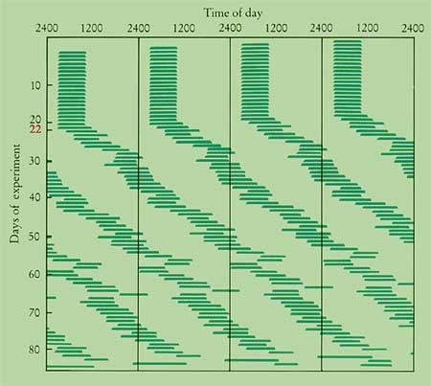
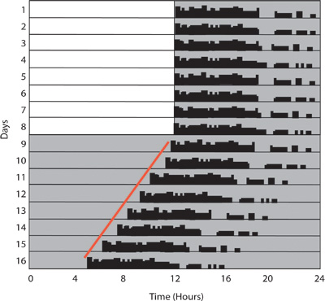
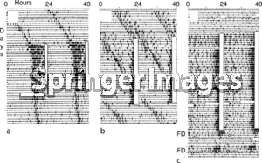

Slide 13
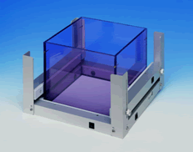
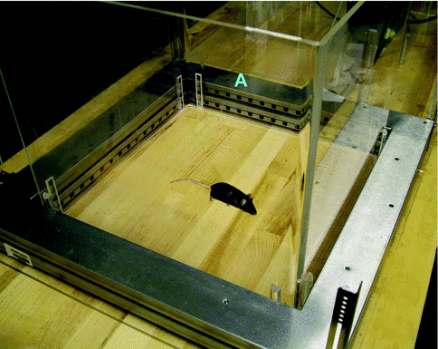

Slide 14
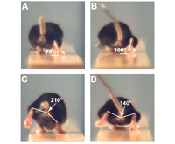
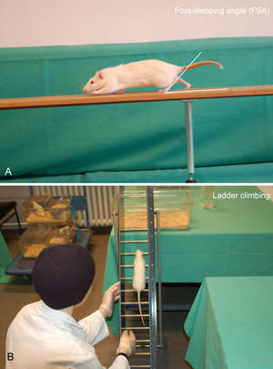

Slide 15
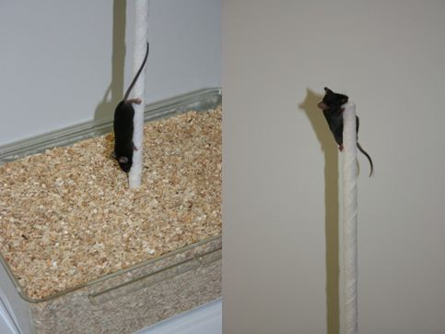
Pole Test The pole test is used to assess basal ganglia related movement disorders in mice. Briefly, animals are placed head-up on top of a vertical wooden pole. The base of the pole is placed in a cage filled with bedding material. When placed on the pole, animals orient themselves downward and descend the length of the pole back into the cage. After two days of training animals receive five test trials. Time to orient downward (t-turn) and total time to descend (t-total) are measured.

Slide 16
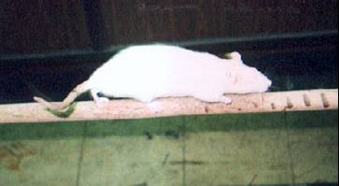
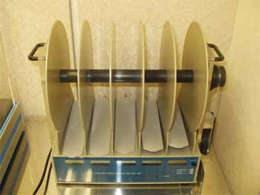
http://www.youtube.com/watch?v=xNCWkA3XlBQ&feature=related

Slide 17
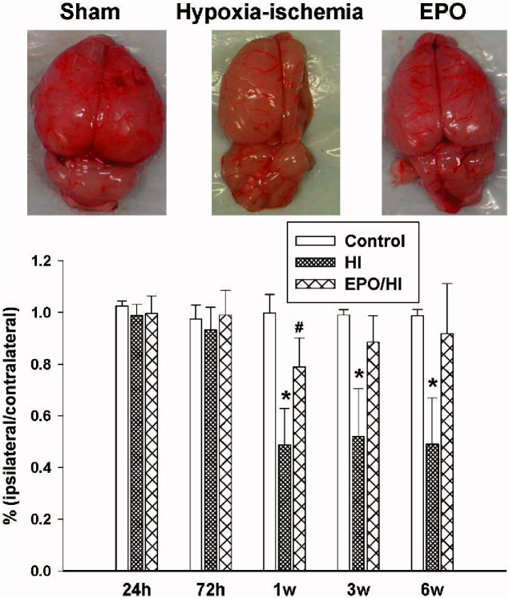
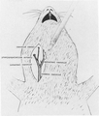

Slide 18
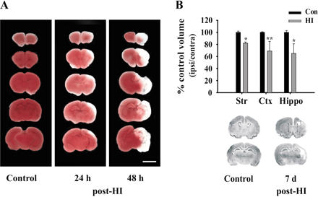

Slide 19
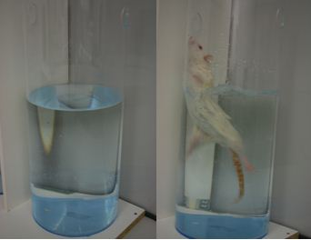
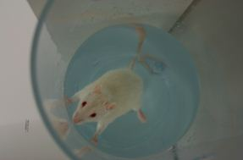
Forced swim test The Forced swim test (FST) is based on the assumption that animals try to escape from an aversive stimulus and is used to measure the effect of antidepressant drugs or the genotype on the emotional status of animals. Rodents are placed in a transparent Plexiglas cylinder filled with water during test session. Their behavior is recorded and the duration of immobility as well as struggling and swimming is calculated. The results of this test are interpreted in this way that increased immobility is a behavioral correlate of negative mood, representing a kind of hopelessness in the animal.

Slide 20
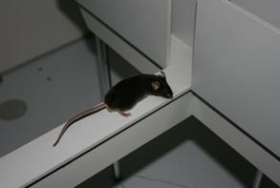
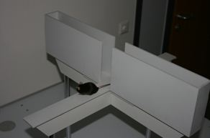
Elevated plus maze The elevated plus maze (EPM) is a test used in rodents of anxiety that is used for screening for putative anxiolytic compounds/anxiogenic compounds and as a general research tool in neurobiological anxiety research. The test setting consists of a plus-shaped apparatus with two open and two enclosed arms, each with an open roof, elevated 50 cm from the floor. The model is based on rodents' aversion of open spaces. This aversion leads to the behavior termed thigmotaxis, which involves avoidance of open areas by confining movements to enclosed spaces or to the edges of a bounded space. The time spent in the open or closed arms is measured automatically by a video tracking system.

Slide 21
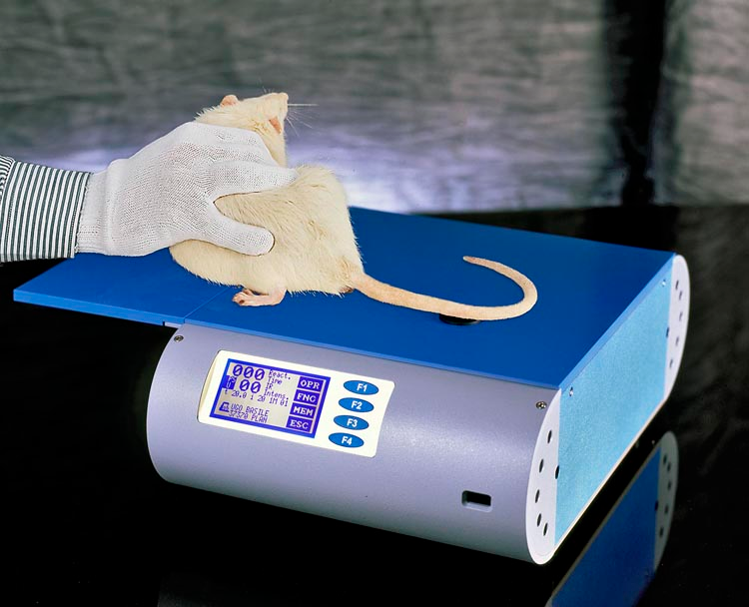
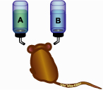
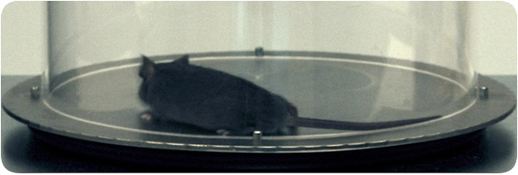

Slide 22
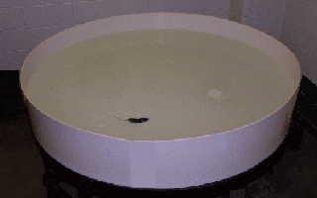
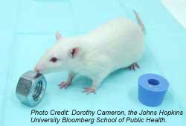
http://www.youtube.com/watch?v=LrCzSIbvSN4&feature=related
http://www.youtube.com/watch?v=zBNoNoEB1X0&feature=related
http://www.youtube.com/watch?v=vVZa2KZ-4BQ

Slide 23
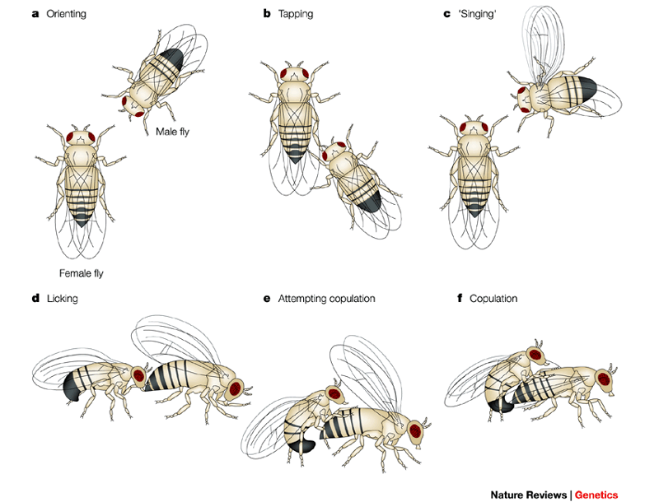
http://www.youtube.com/watch?v=SVV-Oo1QA8M

Slide 24
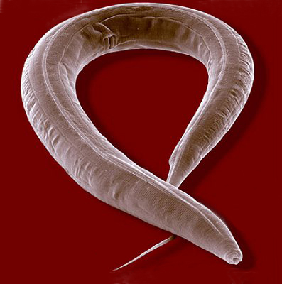
http://www.youtube.com/watch?v=olrkWpCqVCE

Slide 25
http://www.youtube.com/watch?v=23F-QpEGy2I

Slide 26
Introduction to Small Animal Surgery
1.How does a research laboratory work?
a) Role of the laboratory animal technician.
b) Role of the graduate student.
c) Role of the undergraduate.
2. Surgery setup (aseptic procedures)
3. Surgical techniques
4. Anesthetic techniques
5. Equipment testing & calibration
6. Common suturing techniques
5. Post surgery analgesia & pain assessment
6. Record keeping
7. Perfusion and brain removal
8. Histology & Assessment

Slide 27
Role of an Laboratory Technician in Behavioral Neuroscience Research
Animal laboratory technician is hired to perform technical work for a laboratory. For example, a technician may perform surgeries, histological preparations, staining and fixing tissues, data collection, and general care and maintenance.
*These are perhaps the best resources people in the laboratory, do not piss them off. It is likely that you will need their assistance at some point. It is a good idea to recognize their help and contributions as often as possible!
Role of the University Student In Research
Graduate students conduct the majority of animal research in Canadian university laboratories in collaboration with professional technicians and faculty. Undergraduates also contribute to the research enterprise, though they primarily play the role of the junior apprentice, and not that of independent researcher. To ensure proper care of animals involved in research, any surgical manipulations done by undergraduates should only be conducted under the supervision of either a veterinarian, or someone approved by a veterinarian.

Slide 28
Collaborative Research Skills!
What are collaborative research skills?
These skills are perhaps the most underdeveloped and most
important skills you can learn as an undergraduate.
1. politenss 8. dedication
2. respectful 9. helpfulness
3. empathy 10. attention to detail
4. flexiblity 11. take initiative
5. organization
6. laboratory hygene
7. know when to ask and when not to ask for help/confirmation

Slide 29
Things to do to increase your success in someone’s laboratory
1. Shut-up, listen and observe.
2. Figure our the hiearchy, and respect it.
3. Never compare labs…in my old lab we did this.
4. Help out whenever you can.
5. Thank those who help you.
6. Clean-up after yourself, in fact, make it cleaner than when
you started!
7. Ask questions at the appropiate time.
8. Avoid lab politics as best as possible, and stay neutral.
9. You are the only one responsible for your education, create
your own breaks.
10. Be pragmatic, there is no perfect solutions/experiments.
11. Remember that there are many ways to carry out the same thing.

Slide 30
Introduction To Small Animal Surgery
In this course you will not be able to master any techniques, however it is my object to introduce you to the skill and techniques necessary for caring out small animal surgery. To become proficient at these techniques, you’ll have to become involved in a lab which can offer additional training. After this course, you should understand the basic techniques and procedures involved in behavioural neuroscience research. It is my opinion that you will not be able to go to someone else’s lab and carry out these technique on your own, without additional training.
To carry out a single experiment using animals, one must learn a number of background procedures including:
-surgery set-up -pain assessment
-anesthetic techniques -sterilization techniques
-surgical techniques -standard operating procedures
-equipment testing and calibration -data collection and statistics
-post surgical analgesia -record keeping
-histology, microscope operations, and staining

Slide 31
There are a number of benefits inherent in learning these procedures. The techniques being taught in this course are the basis of many more complicated techniques. For example, after learning how to conduct stereotaxic surgery in this class, learning how to implant cannulas and electrodes will be just a few additional steps.
Pre-Operative Care and Selection
Good pre-operative care will reduce the likelihood of a complication occurring during, or after, surgery. Animals that are to be anesthetized should be in good health and free from any sub-clinical diseases. Some signs of decreased health include:
-abnormal or irregular respiratory rate
-abnormal coloration of mucosa membranes
-discharge from the eyes or nose
-matting of the fur
-discoloured feces
-agitation
If you think any of these signs are present, consult the instructor before carrying out any surgical procedures.

Slide 32
Anesthesia
Anesthesia is defined as a controlled state in which both sensory perception, including pain, and motor responses are suppressed.
The most commonly used anesthetic in neuroscience research is sodium pentobarbital. Others include Fentanyl-Droperidol (Innovar-vet), Ketamine Hydrochloride, and Etorphine-acepromazine. Advantages and disadvantages of each of these drugs can be found in the CCAC guidebooks or on WebCT. The number-one problem with anesthesia is incorrect administration.
Seven drawback to the use of sodium pentobarbital are
There is no antagonist.
it present a major respiratory challenge to the animal.
the effective dose for 50% of the animals (ED50) is very close to the lethal dose (LD50%).
Tolerance to sodium pentobarbital develops after one dose and can last for months.
Sodium pentobarbital can can also it can go bad, producing variable results.
6) No post surgical anaglesia qualities and longer recovery
7) Can not be used with great success in mice!

Slide 33
Why use sodium pentobarbital?
The main benefit to the use of sodium pentobarbital is that it produces a quick, long-lasting and deep level of anesthesia. If one has an established protocol it can produce very consistent results. Only good anesthetic drug for hamsters.

Slide 34
Ketamine/Xylazine Cocktails
Why use ketamine/xylazine over other anesthetics?
-does not propose a huge respiratory challenge to the animal
-shorter acting
-relatively consistent result
-deep/quick level of surgerical anesthetics
-fewer post-surgical complications
-quicker recovery
-some post-surgical analgesic qualities
Drawbacks
-have to mix it
-perferred route of administration is IM (in mouse it is very hard)
-can be used with hamsters with great success

Slide 35
Calculating Dose
200/10 mg/kg SQ
ketamine/xylezine
How do you calculate dose?
-step one, calculate amount of drug need for the weight of animal
-step two, calculate the volume of solution that will contain the
amount of desired drug.
Ketamine
200mg/kg x X/.03kg (wt)=6mg/.03Kg
How much is contained in 1 ml = answer is on the bottle.
38mg/ml x 6mg/Yml=.15ml

Slide 36
Anesthesia Assessment
Righting reflex, whisker reflex, and muscle tone
- movement
- look for whiskers movement (maintain motility longer than other reflexes)
WAIT 5-10 minutes if the animal is not down to re-assess.
- test for loss of their righting reflex and muscle tone
if there is no righting reflex, and the animal is limp in your hands, you can prep for surgery.
if your animal still does not go down, you can boost with a second smaller dose of drug. Boosting anesthetic (especially sodium pentobarbital) is risky because of increased changes of respiratory failure. If you are using
a K/X cocktail you can boost with a 1/4 dose.
if you are using SP, you will creat a more tolerant animal down the road, with lasting effects for up to a month.

Slide 37
Response to Painful Stimuli
A sufficiently deep level of anesthesia should block all pain perception. A number of tests are essential part of the assessment of the depth of anesthesia. Once these test have been carried out you can be reasonably assured that the animal is at surgical anesthesia.
Tail Pinch - Most commonly used, tip of the tail between your thumbnail and forefinger and pinch, if the animal twitches or vocalizes, the animal has not reached surgical anesthesia -wait approximately 5 minutes and repeat. Do not pinch in the exact same location when re-assessing.
Pedal Withdrawal Reflex - The rat's foot reflex should be checked next. The hind leg should be extended to its full length. The web of the skin between the toes is pinched in the same manner as the tail. Immediately after the pinch, let go of the leg. If the limb is withdrawn, muscles twitch, or the animal vocalizes, then the depth of the anesthesia is insufficient to allow surgical procedures to be carried out. Wait 5 minutes and re-assess.
Eye Blink Reflexes - One of the best indicators of the depth of anesthesia. To assess the palpebral reflex, look for blinking when the edge of the eyelid is lightly touched. Assess the eye blink response using a sterile blunt instrument. If there is no response, you can proceed with the surgery. There should be no response to any of the prior assessment measures before surgery should proceed.

Slide 38
Assessment of Well-Being
All anesthetics produce a depression of many central nervous system. On occasion, the degree of the depression will be excessive and the animal will die. A certain percentage of these should be regarded as an unavoidable consequence of the anesthetic. However, take the opportunity to try and isolate the cause of death. The anesthetic mortality rate can usually be reduced by taking certain precautions and being observant.
Pay attention to the color of the animal’s mucosa membranes, the animal's respiration rate (depth and speed), and the colour of the animal's feet and ears. These are all indicators of oxygen deficiency. The mucosa membranes and the animal’s feet and ears should all be pink in colour, not blue or purple. These observations should be made continuously throughout any procedure that requires anesthesia, and will indicate a deterioration in the animal’s condition before it becomes irreversible.
Reflexive movements usually indicate that the anesthesia is wearing off. You should consider boosting the animal, however this depending on the time left in surgery. If you are in the final stages of the procedure, you may wish to finish without additional anesthetics. If your using a K/X cocktail you can boost with-up to 50% if the orginal
dose

Slide 39
Corrective Action
If there is discoloration, or breathing is particularly slow and shallow, oxygen can be used if available. It is also vitally important to sustain circulation by correcting any fluid imbalances. In a healthy unanesthetized animal, a 10% reduction of circulating volume can be tolerated; however, once the loss exceeds 15-20%, signs of hypovolaemia and shock will likely develop. In an anesthetized animal, a 15-20% loss of blood volume will likely result in death.
Although there are a number of ways to deal with blood loss, including blood transfusion and plasma volume expanders, we typically use a lactated ringer solution with 5-6% dextrose (sterile saline can also be used). The typical surgeries performed in this lab will not likely result in large blood losses if proper procedures are followed.
If a rat loses a lot of blood, immediately administer a bolus of lactated ringers with dextrose subcutaneously. Administer no more than 3 cc per hour, injecting it into 2-3 locations subcutaneously. If blood loss is anticipated it is a good idea to administer the bolus prior to blood loss. For mice, 1 cc per hour should be sufficient.

Slide 40
Hypothermia
Hypothermia is a frequent cause of death during anesthesia. Small animals lose heat rapidly because of their high surface area to body weight ratio. A 5 degree drop in as little as 15 minutes in an anesthetized mouse is not uncommon. Additional heat can be provided by heat lamps or by heating blankets. Care must be taken not to overheat the animal; temperature should not exceed 35 degrees. A thermometer can be placed beside or under the animal to measure temperature. Pay very close attention to temperature!

Slide 41
Pain
Pain can changes a wide range of experimental parameters, including; sympathetic tone; cardiovascular function; immune function; and regular behavior. Changes in these parameters an seriously compromising results in behaviour experiments, ergo, you should do everything in you power to eliminate and pain or discomfor in your experimental animals. In these experiments there should be no circumstances in which animals will experience any excess pain.
Pain Symptoms
-laboratory rodents tend to suppress pain symptoms , natural selection favours prey species which do not show signs of pain
-pain symptoms tend to be expressed only in moderate to extreme pain
-assessment of pain by observers tends to be subjective, experiential
-there are no absolute, objective parameters which can be measured easily which correlate to pain state -pain state and
experience interacts with stress and distress

Slide 42
Assumptions in the treatment of pain in rodents:
-assume procedures which are painful in man are equally painful in rodents
-prevent pain prior to surgical procedures by administering analgesics prior to recovery rather than treating pain as it occurs
-pre- emptive analgesia will results in better pain control at lower analgesic doses with fewer side effects, and pre-empts the pain "windup" syndrome which results in chronic,less
-surgical pain is most typically 1-2 days in duration
-orthopedic and burn pain are the most severe pain
-abdominal surgical incisions are moderately painful
-transient needle stick is mildly painful -experienced operators conducting craniotomy does not induce severe pain
-inexperienced operators, excessive tissue handling, and prolonged invasive surgical procedures (more than 45 minutes)

Slide 43
Categories of Pain
mild-needle stick
moderate-craniotomy,abdominal incision, foot hot plate test
severe-orthopedic pain, burn pain
The degree of pain and analgesic choice depends on ;
-whether tonic/phasic
-clinical signs
-knowledge of pain stimulus

Slide 44
Signs of Pain in Rats:
recent history of painful procedure
ANOREXIA
ACUTE WEIGHT LOSS: 5-10 percent overnight
NOT DRINKING (extremely sensitive indicator of severe pain)
immobility or reluctance to move
depression, inactivity
dull eye , change of eye shape
failure to groom and perform other care behaviours, scruffy
porphyrin staining of eye,paw
hunched appearance
tiptoe gait
favouring , overgrooming or self cannibalism of operated area

Slide 45
Analgesics: choice of drug/route depends on:
pain type and source
continuous or short term pain
ease and effectiveness of administration (systemic, not local in most cases)
species of animal, always investigate, for example straight opiate analgesics like morphine do not work well with C57 or DBA mice.
route: topical, local block, oral, injectable most common

Slide 46
Analgesic Drug Treatment:
1) have a pain management plan in place before you start
2) have a clearly defined endpoint after which immediate euthanasia , i.e. 20 percent acute weight loss , if pain proceeds
Analgesic Type and Route
topical: a range of topical agents such as EMLA cream, lidocaine gel, in most instances ineffective in rodents, can be ingested and cause toxicity, in most cases not appropriate
local anesthetic- local nerve block around incisions using 2% lidocaine in a syringe with 30 ga needle,
oral analgesics-ineffective if given in drinking water as most animals do not drink when in pain, also variable dose and
injectable analgesic-by intramuscular and subcutaneous route, usual means of administration

Slide 47
Types of Analgesics
A) Non-steroidal antinflammatory drugs (NSAIDs) examples; aspirin, tylenol, flunixin
-not generally used in rodents due to severe gastric ulcerative effects, hepatotoxicity and immunomodulatory/wound
healing effects
-most effective against moderate musculoskeletal pain, not suitable for major pain -NOT RECOMMENDED
B) Opioid analgesics examples: morphine, butorphanol, buprenorphine
-gold standard high quality analgesia
-heavily regulated due to abuse potential
-some species are hyperactive to some compounds
-most drugs last only 2-4 hours, butorphanol lasts 6-8 while buprenorphine lasts 8-12 for long term analgesia
-side effects include sleeping, heat loss, increased intracranial pressure -when given in the absence of pain may cause
decreased food, water intake so use should be justified by expected painful procedure
-may need to be administered for several days -RECOMMENDED

Slide 48
Lesions
Lesion (ablation) of parts of the brain is perhaps one of the oldest and simplest means of studying brain function and is a definitive test used to confirm conclusions of research using other techniques.
The function of most areas in the brain were discovered after it was ablated. The resulting deficits provided information about its involvement in a specific function. If a behavior is displayed after the removal of a particular region, it can be concluded that the structure in question is not responsible for the performance of that behavior. If the behavioral pattern is altered or absent after the procedure, it can be conclude that the area is involved in some way with the particular behaviour.

Slide 49
Problems and Interpretations
Functional Specificity
When destruction of a brain site produces a behavioral deficit, it does not necessarily mean that the location destroyed is responsible for that particular behaviour. The ablation could have resulted in the destruction of essential pathways, or it could have changed the motivation to express a particular behaviour. In addition, ablations can affect the ability to carry out a particular behaviour or may remove a single step in a complex sequence of steps required to produce a particular behaviour. Other problems in interpretation can also occur as a result of nerve regeneration or the recovery of function in other locations.
Histological Confirmation
One must verify the location of the lesion after behavioral confirmation has occurred. The data collected from those animals that show only a partial, or incorrectly placed lesion, should be examined but not included in the final analysis.

Slide 50
Introduction to the Stereotaxic Lesions
There are many different methods used in order to produce brain lesions. A few examples include chemical, electrical, radio frequency, light, aspiration, and neurotoxin methods. In this course, we will only examine radio-frequency lesions; however, this method is similar to most other methods used. What differs is the effect of each type of lesion. Some methods can leave scar tissue while others kill only one type of neuron. Depending on the parameters of your study, different lesions in the same location can produce varying results.

Slide 51
Stereotaxic Surgery
A stereotaxic is a device that holds the rat's head in a fixed location and orientation while allowing you to maneuver an electrode, cannula, or syringe in a calibrated 3-dimensional space. The brains of rats, mice, hamsters, some monkeys and humans have been mapped so researchers can locate a brain structure relative to a few specific external locations.

Slide 53
AP
DV
LAT

Slide 54
Stereotaxic Atlas
A stereotaxic atlas contains a detailed map of the brain. Areas of interest can be located in the atlas using three dimensions: anterior-posterior (AP), dorsal-ventral (DV), and lateral (LAT). Bregma serves as the zero point. To increase accuracy, the DV measurement is often taken from the membrane encapsulating the brain (dura), and the LAT measurement is taken from the sagittal sinus (blood vessel running down the center of the brain).

Slide 58
Methods to Locate and Lesion a Brain Structure
After the animal is fully anesthetized, the animal's head is shaved from just below the ears to between the eyes. It works best when you gently pull the animal's skin taunt. Be careful not to clip the ears. This procedure should take place in a room separate from the surgical room in order to avoid contamination from hair. Loose hair should be brushed off, and the area should be cleaned with 70% alcohol (avoid eyes). Avoid getting alcohol into the animal's eyes. During this procedure, watch for any signs of consciousness or reflexive movements. A surface antiseptic, such as alcohol (70%), xyenodine or iodine, can be applied to the skin, decreasing the chance of infection.
Prior to surgery, subcutaneous injections of lidocaine hydrochloride can be administered to provide additional topical anesthesia. Lidocaine blocks sodium channels in neurons.

Slide 60
Preparing the Stereotaxic and Electrode for Surgery
The stereotaxic device should be wiped down with disinfectant, avoiding direct application to all moveable parts of the stereotaxic instrument. Never use any kind of lubricants on the device. All surgical equipment should be autoclaved prior to surgery. A suitable alternative is to soak the instruments in a 90% alcohol solution. 90% alcohol, sterile saline and distilled water should be available throughout the procedure. Instruments should be soaked in alcohol before and during surgery. Before applying any instrument to the animal, rinse it in distilled water and pad dry with a clean paper towel. There are better disinfectants, this is simply the minimum.
Following surgery, the distilled water should be changed and the container disinfected. The instruments should also be cleaned and disinfected.

Slide 61
Electrodes for Radiofrequency Lesions
The electrode is perhaps the most important instrument used in the lesioning procedure. To construct an electrode, begin with an insect pin. These come in varying diameters, ranging from 000 to 5. The diameter chosen depends on the size of the animal and the size of the desired lesion.
The electrode is made using one of a number of substances to insulate the shaft. The most common include varathane, epoxylyte, and nail polish. The process involves coating the electrode a number of times, and then hardening the coating by baking it in an oven or leaving it to dry over a period of time. Before making a lesion, the tip of the electrode is scraped clean. The amount of insulation that is scrapped off will determine the size of the lesion.
After the electrode is made it should be examined under a microscope to measure the size of the tip and to look for hairline fractures. If there are no apparent crack, the electrode can be placed into a stainless steel guide made from a 22 or 23 gauge needle. The electrode can then be placed into the arm of the stereotaxic. The electrical signal is transferred down the guide cannula, into the insect pin and then down to the tip. Bipolar electrodes require 2 electrodes (a postive and negative).

Slide 62
Check if the electrode is straight by comparing it to a straight edge on the stereotaxic. If the electrode is not straight, the chances of missing the location of interest are increased. Egg whites are used to test for cracks in the electrode coating, and to determine the size of the lesion that it will make. Place the electrode in egg white contained in a small beaker, hook it up to the lesion maker and turn it on. The amount of cooked egg white can then be measured under a microscope. Look for any cooked egg down the length of the electrode.
Be careful not to hit the electrode during the surgery as it may bend or crack the insulation around the electrode.

Slide 63
Surgery
During surgery, try to avoid touching anything that is not sterilized. Lab coats must be worn, and long hair should be tied back. Just prior to surgery wash your hands thoroughly with hibitane, twice.
Using a scalpel, make a downward incision from between the eyes to between the ears. A sharp scalpel will cut on the first pass if proper pressure is applied. Try to avoid making multiple cuts, since this slow the healing. There may be some reflex movement at this time. If you are concerned, check with the lab assistant. Next, the skin can be moved away, and the exposed membrane can be cut or scraped using a blunt instrument, like a spatula. Clear a sufficient area needed for drilling through the skull.
Bregma can be located at the half way mark between the eyes and the ears. Using a spatula, scrape the skull at this location so that bregma becomes visible. Use a Q-tip to wipe the area down. A septic pencil can be used to dry the skull, allowing for better visualization of bregma. Once bregma is detected, coordinates can be taken. Use a surgery sheet to record all information. Remember that it may be quite some time before this information is used, so be as detailed and meticulous as possible.

Slide 64
Taking Reference Coordinates
When bregma is exposed, the electrode can placed back onto the stereotaxic. Align the center markers and tighten. Ensure that when placing the electrode is being placed into the stereotaxic, the electrode is raised enough so as not to damage it through contact with the skull. Lower the electrode so that the tip just touches the center of bregma. Be careful not to damage the electrode by lowering it too far, which will cause bending and potential breakage.
In some cases, the meeting of the coronal suture and the sagittal suture is less than perfect. Often, only 3 of the 4 sutures will meet. Sometimes, there will be 2 junctions. Use your better judgment in assessing the center between the two points. Take the measurements off the stereotaxic from the three dimensions (AP, DV, and LAT) and record on the surgery sheet. Your target coordinates should already be calculated and recorded.
AP
LAT

Slide 65
As coordinates are taken off of bregma, have someone check your readings. Once the coordinates are recorded, raise the electrode by turning the dorsal-ventral knob counter-clockwise.
The next step is to calculate the exact place in which the electrode will be entering the brain. Adjust the AP and the LAT axes according to these calculations. You can mark a square around the location where the hole has to be drilled with pen. Always draw the hole larger to ensure that the electrode will not hit any bone on its descent into the brain. After this, the arm of the stereotaxic can again be removed and set aside gently. This will allow more room for the drilling process.

Slide 66
Post-Operative Care
Following good surgical and anesthetic techniques, proper post-operative care has the greatest likelihood of ensuring survival. Failure to attend to the needs of the animal during the critical recovery period will at least slow recovery, and at most result in death. To conduct research on animals is a privilege. All possible measures should be taken in order to ensure that the animal is comfortable and free of pain and discomfort. Respect is, at the very least, what we owe the animals used research.
Recovery Room and Housing
The animal should be given a clean cage frequently, approximately every two days, especially if intraperitioneal surgery has been done. A warm and quiet recovery room should be used whenever possible. The temperature should be maintained at 27-30 degrees during recovery, which usually lasts 2-3 days.
Respiratory Depression
Respiratory depression usually lasts a short time into the post-operative period. Frequent monitoring should be carried out. If respiration is slow and shallow at the end of surgery, the animal may benefit from continued oxygen administration. Doxapram can be administered if respiratory depression persists.

Slide 67
Fluid Therapy
Fluid consumption should be monitored post-operatively to ensure that the animal does not become dehydrated. If fluid consumption does not resume within 24 hours, death usually results (death will result in less than 24 hours in mice). This can be carried out by weighing or marking the water bottle post surgery, and then once daily.
If the animal is in a deep cage, longer sipper tubes should always be given following surgery to allow the animal easy access to water (tip closer to the ground). If the animal fails to consume any liquids within 12 hours after surgery, try placing the sipper tube close to the animal's mouth.
Sometimes the animal is simply incapable of reaching the sipper tube on its own. If the animal fails to drink, repeat this procedure with sugar water. If the animal still fails to drink, begin administering 3 cc's of lactated ringers with dextrose (5-6%) for rats and .5 cc for mice (either intraperitioneal or SQ) every 6 hours. Note that if proper injection methods are not used, the stress may do more damage than the treatment. Body weight can also serve as an important indicator of the animal's health.

Slide 68
Food Intake
Eating following surgery is difficult for an animal. To avoid malnourishment, food intake should be monitored closely. Placing a few pellets of food in the cage is a good idea. Soft alternative foods, that are more palatable, can often stimulate eating. The presence of fecal material in the cage can also serve as an indicator of food consumption. If there is no feces in the cage, the animal is not eating.
Other Signs to Watch For
Be observant; look for any indication of problems, including:
-pain and wincing -odd or abnormal behaviour
-self mutilation -dizziness or persistent spinning
-hunched posture -piloerection
-lack of grooming
Alert the instructor, TA or lab technician immediately if any of these signs are present.

Slide 69
Care and Maintenance
Check the animal and incision daily. Look for any signs of infections, such as dried blood around the nose and eyes which indicates upper respiratory infection, puss, watery eyes, and loosening of the stitches. If the animal develops an infection, the typical treatment is an antibiotic, that can added to the drinking water. Check with the instructor or TA for more information. Monitor fluid and water intake for at least 4-5 days.

Slide 70
Management of Post-Operative Pain
Recognition and Treatment of Pain
Do not assume that the animal is not in pain simply because it is moving around. After surgery, the animal should be given an analgesic that lasts approximately 6 hours. Butorphanol (Torbugesic) is a mixed opiate agonist/antagonist that is used in our lab. It is long lasting, and should be administered once the animal has just come out of the anesthetic and respiration has been restored. The standard dose lasts about 3-5 hours. A degree of sedation and respiratory depression occurs with butorphanol; however, the effect on the respiratory system has a ceiling effect; it does not increase with dose. Over all, cardiovascular effects are minimal.
Animals in pain tend to remain motionless or move with an altered gait or posture, exhibiting an arched back. Watch for these signs and inform the TA, instructor or animal care worker if these signs are present. Changes in temperament often occur when animals are experiencing pain. Animals that were easily handled before may become difficult to handle.

Slide 71
Post Surgery Care
Once glueing is completed, clean the wound and apply some dermoplast or similar topical anesthetics/antibiotics. Keep the animal warm using a heat lamp. However, be sure the body temperature does not exceed 38 degree. Extra time on oxygen can also decrease mortality rates, especially if the animal appears to be having a hard time breathing (shallow, rapid, laboured)
Watching Your Animals
When possible do surgery in the early morning and monitor throughout the day. The wound should be checked twice a day for the first three days and then once a day until the wound has healed. If sutures/glue have opened an assessment can be made considering the animals situation. If you decide to re-suture your animal use halothane if possible and a topical anesthetic after the wound is closed. Be sure to properly clean the wound and apply a antibacterial agent (tetracycline).

Slide 72
Perfusions
The objective of a perfusion is to remove the blood from the blood vessels of the brain and replace it with a fluid that will fix the tissue. There are two relevant variables to consider when perfusing an animal: the osmotic pressure of the fluid and the hydrostatic pressure.
For mammals the fluid first used is typically .9% saline which roughly matches the osmotic pressure of blood. The hydrostatic pressure (pressure of the fluids being pumped in to remove the blood or fix the tissues) should be the same as the animal’s own blood pressure. It can be adjusted by changing the height of the fluid column above the animals heart, or by adjusting the speed on the perfusion pump. If hydrostatic pressure is too low you’ll get poor flow through the blood vessels; too high of pressure will cause tissue artifacts (broken capillaries and enlarged ventricles).
For routine perfusions the easiest method is to use the fluid pump. Saline and then usually formalin is moved through the left ventricle around the circulatory system and out the right atrium. If fluids are scarce the descending branch of the aorta may be clamped off in the mid-thoracic region. This will reduce the amount of fluid needed.

Slide 74
STEP BY STEP PROCEDURE
EQUIPMENT NEEDED
-scissors (small, medium and large)
-tweezers with teeth
-spatula
-needle drivers

Slide 75
Euthanasia
The animal is first anesthetized or killed using either a heavy dose of sodium pentobarbital or CO2.
-if you use a heavy dose of pentobarbital
is injected intraperitoneal (1 cc of heparin
solution can also be given if perfusing)
-if a CO2 is used start by using a CO2 / O2 mixture in
-a closed environment. After the animal is quiescent
switch to CO2 alone
-somewhere between the last breath and the last
heart beat the animal can be perfused
-move the animal to the perfusion area
-be careful that the animal is not resuscitated during
the perfusion by movement

Slide 76
Perfusion
Start by making a horizontal cut in the skin around the mid-thorax area using the rat toothed tweezers with and a medium size pair of scissors. This procedure will need to be repeated with the muscle wall. Once the intraperitioneal cavity is exposed, scissors (blunt side down) can be inserted into the cavity. Next make small snips towards the head along the midline. Lift up on the muscle wall will help you see what your doing and will help you avoid cutting any internal organs.
When the sternum can be seen let the muscle wall go and grab the sternum with the rat tooth tweezers. Lift the sternum up, and continue cutting towards the head. The diaphragm should be apparent. Use the scissors to cut the diaphragm, being careful not to puncture any of the nearby organs. While still holding the sternum, cut up the left side of the rib cage, keeping the scissors high, and with blunt side down. After cutting past the heart, one can either use retractors or make a second cut up the right side of the rib cage to keep the chest cavity open. Next, cut the connective tissue holding the heart. Pre-set the saline flow rate so that there is an arc reaching about 12 cm when holding the needle parallel to the floor. It is important that all air is out of the lines before beginning. Do this prior to putting down your animal.

Slide 77
Cut the right atrium, using the small scissors. Bleeding will start immediately. The heart can be gently grasped with the thumb and forefinger, and the needle from the perfusion pump can be inserted into the bottom apex of the left ventricle. It can be slowly extended past the semilunar valves into the initial portion of the aorta if you
desire. Hemostats can then be used to clamp the needle in place if you are perfusing a rat.

Slide 78
Formalin Fixing
Once the fluid leaving the animal is clear, saline can be replaced by formalin. The perfusion pump can be shut off between saline and formalin. Two to three seconds after the introduction of formalin there will be gross and widespread muscle contractions. After approximately 5 minutes you will be ready to remove the brain. A perfusion is complete when the neck and body do not move separately, and the animal loses it’s flexibility.

Slide 79
Brain Removal
Locate the area between the base of the brain and the first vertebrae. Take the large scissors and cut of the head at this junction. Use two hands, as it is often difficult.
Using the small or medium scissors the skin on the head can be cut up the midline starting at the exposed base and cutting towards the nose. The skin can be peeled back exposing the skull. Hold the head by wrap fingers and thumb around the nose and skin leaving only the skull exposed, using your non-dominant hand. Once the head is firmly in hand, use needle drivers to locate the baseplate of the brain. Using the needle drivers grip small pieces of the base plate and break it away. Be sure not to injure the neural tissue by twisting the needle drivers into the brain. Pull straight away, or only make small rotatary turns.
Once the baseplate is removed the back of the cerebellum can be seen. Located between the cerebellum and the brain there is a cartilage tissue and bone (part of the ear canals and vestibular apparatus). This has to be removed, if it is not the brain will be damaged during the perfusion.

Slide 80
Take the tip of the needle drivers and locate the cartilage. Use one side of the needle drivers hook onto the cartilage. Apply light pressure away from the brain. The cartilage should come out. Be sure to do both sides.
Continue removing the skull until the front of the skull can be seen. The frontal cortex and the entire top surface of the brain should now be exposed. Using the spatula go in to the front of the cranium between the brain and the skull. The olfaction lobes are located here. These lobes are soft and can easily be cut with the spatula.
It is often useful to invert the animal’s head at this point to allows the brain to separate from the skull plate. Look between the base of the brain and the skull, underneath the olfaction lobes the optic nerves can be seen. Using the spatula or small scissors cut optic tracts (I find it easier to use the small scissors and clip the optic nerves)

Slide 81
Continue to peel the brain out by moving it away from the base plate. Be sure to have the brain over a specimen bottle. Use your scissors to cut the remaining nerves.
Be sure to properly label your specimen bottle with all relevant information. Remember that slicing may not be done by you, or it may be done a year later. Your memory is not that good (include species, protocol number, arrival date, your name, perfusion date, and experimental procedure done).

Slide 82
Histology
If you are simply storing a brain, use formalin alone. However, if you know that you will be freezing it in the near future, sucrose formalin should be used. When preparing a brain for slicing, you should let the brain stand in sucrose formalin for 24 hours (until the brain no longer floats).
To mount the brain, slice horizontally through the widest part of the cerebellum (90 degrees to a flat surface). Peel any membrane from the brain before freezing as it can cause uneven cutting. Place a drop of H20 on warm mounting pedestal, and set it into the cryostat chamber. Freezing time should be about 30 to 60 minutes at -19 degrees.
To manipulate brain slices in the chamber use cold Q-tips only. To manipulate slices on the slide use a camel hair brush with a drop of water. Do not forget to have a good supply of gel coated slides to use. Slicing an important brain, slice between 30 and 50 m thick (be consistent and record the information).

Slide 83
Rat Handling
Rats, can be picked up by the base of the tail. If the distal end of the tail is used, it may result in serious injury. For transferring purposes, the animal can be picked up by the base of the tail and then placed onto the forearm. The animal will instinctively try to jump off, so do not relax your grip on the base of the tail. Lifting the rat by the tail alone can be used for short transfer between cages only. For other purposes first grasp the rat by the base of the tail. The rat will instinctively turn try to run away from you. At this point, you can grasp the rat around the thorax, just behind the shoulders while keeping tension on the tail. This restricts the movement of the head. The rat must be not be grasped too tightly, as this will restrict breathing. Again, be sure not to let go of base of the tail as it will allow that animal to twist in your hand.

Slide 87
Injection Techniques
To inject a conscious rat using the two-person method, have one person hold the rat in the thoracic hold (one hand around the shoulders and the other at the base of the tail), tilting the head towards the ground. This causes the internal organs to move towards the diaphragm and away from the area where you will be placing the needle. The second person holds the needle at a 45 degree angle to the body, and with a quick controlled thrust, inserts the needle into the intraperitioneal cavity.
The second method, the swing method which is best used by one person. This method involves grasping the rat as described in the handling section and gently swing the animal at your side from a position approximately 170 degrees (4-7 on the clock). This cause the rat to tense their stomach muscles, resulting in fatigue. This gives you an approximately 30 seconds window when the rat will be quiescent. At that point hold the needle at at 45 degree angle in the lower abdominal area and with a controlled thrust enter the intraperitioneal cavity.
Induction time for a properly administered dose is approximately 5 minutes. Leaving the room will speed the induction.

Slide 91
Drilling
A section of the skull is removed using a small electric drill. To ensure an optimal amount of control, two hands should always be used. One can use the surgical table or stereotaxic for added support. Using your dominant hand, hold the tip of the drill like a pencil. First, etch the perimeter of the hole. Be sure not to drill any nearby connective tissue or skin. Keep Q-tips away from the tip of the drill, as they may become caught up in the drill. Depending on the thickness of the skull, it can often simpler to etched all of the bone away. If the animal's skull is thick, a hole may be more effective. Use smooth continuous movements and work through the skull equally on all sides of the hole. Continue this until you break through the skull in one place. If you have drilled evenly, you should be close to breaking through all over. A medium speed is best and a pressure on and pressure off strategy works well until you feel like you have broken through the skull.

Slide 92
Begin from the location where you have broken through, and move the drill tip around the hole, removing any remains of the skull. Try to avoid changing your depth in order to minimize cortex damage. If the bone is thick, distilled water or saline can be placed on the skull to keep the temperature down, to remove dust, and to provide a clearer view during drilling.
Often there is some bleeding but it hopefully won’t persistent. The bone fragments can be removed using a metal probe and a pair of tweezers. It is important to be gentle because the skull cap is often connected to dural membrane. Pulling them off quickly can often cause bleeding. A pointed scalpel can be used to separate the dura from the cap.

Slide 93
After the drilling is completed and the bleeding is stopped, a second set of coordinates can be taken off the sagittal sinus. Place the stereotaxic arm back on the stereotaxic and align the cross hairs. Repeat the DV and LAT measurements from dura and the sagittal sinus as they provide more accurate dorso-ventral and medo-lateral landmark than bregma. Lower the electrode until you see a slight divot in dura, and then raise it until it disappears. This is where you take your dura measurement. Have someone else check your coordinates before proceeding. Before entering the brain with the electrode, ensure that all of the bone fragments are removed. Also, cut the dura immediately prior to penetrating the membrane to avoid and damage or deflection to your electrode.

Slide 94
Lowering the Electrode
The dural membrane can be quite strong and can cause bending of the electrode. It is sometimes beneficial to slice dura with the tip of a sharp needle. Before lowering the electrode, connect the two leads from the lesion maker. The first should be connected to the electrode, and the second should be connected to the animal's body, usually at the base of the incision.
Lower the electrode into the brain while watching for any signs of bending. There should be no deflections. Lower the electrode until you are at the appropriate depth, check to ensure that everything is hooked up correctly, and then activate the lesion maker.
Move the electrode slowly into and out of the brain. Repeat as necessary, cleaning the electrode after each lesion using a Q-tip and distilled water. The tip of the electrode should be cleaned vigorously. Tissue will often stick to the tip, increasing the resistance and decreasing the lesion size. Watch for evidence of brain matter on the tip of the electrode. Popping and hissing can often be heard as gases escape from the brain. If these are not evident, recheck the connections. The presence of these only serves as an indication of an ablation, but they are not necessary. After completing the lesion, remove the electrode from the stereotaxic for safe keeping.

Slide 95
Closing an Incision
Closing the wound is one of the more difficult aspects of surgery. First, the area should be gently cleaned with a Q-tip. The wound should not be bleeding. If it is, apply pressure with a Q-tip until bleeding ceases. Sterile gelfoam can be gently inserted into the hole in the skull to speed re-calcification and control bleeding. This can be particularly useful for procedures involving large holes or chronic implants. A continuous stitch can be used to close a scalp incision. intraperitioneal incisions require two types of sutures, and it is best to use single stitches.
Suture Patterns
Suture patterns are chosen according to the wish of the surgeon to appose, invert, or neutralize tension forces of tissues. Two main patterns include interrupted and continuous patterns. With the former, failure of one suture is of less importance, where as the latter when on know fails, the whole line may unravel. Interrupted sutures take more time to apply and increased volume of foreign material in the body but are less like to come unstitched.

Slide 96
Stitching
Step One - Using the needle drivers (in right hand) hold the needle three quarters of the way down from the tip.
Step Two - Using tweezers in your left hand (either rat tooth or regular tweezers) lift the skin on the opposite side side of the incision (at the apex of the incision). While keeping the skin taunt, past the needle through the skin (2-3mm away from the incision).
Step Three - Without letting go of the needle, move your tweezer to the opposite side of the incision. Grab the skin and lift, keeping taunt. Press the needle through the skin from the inside out (2-3mm away from the incision). If the needle does not pass easily through the tissue, use the tweezers to place pressure on either side of the needle from the outside.
Step Four - Grasp the tip of the needle with the tweezers. Loosen your grip on the needle drivers and pull with the tweezers (left hand still). Re-grasp the needle in the same location as in step 1.
Step Five- Pull the needle and thread through until only one centimeters is showing on the right side. Be conservative, suture material is expensive. A knot can be tied at this time.
Suturing is very difficult and even more difficult to explain! The prior information is to help you practice. This manual is meant only to serve as a guide, after having seen it a few times.

Slide 98
Placing the Animal into the Ear Bars
Placing the animal into the ear bars is perhaps the most important part of surgery. If the animal is not properly secured, one or all of the following could occur:
1. the animal could suffer damage to the inner ear
2. the animal could fall out during surgery
3. the animal may remain in the ear bars, but may move, decreasing the accuracy of the lesion
To properly place the animal in the ear bars, it is best to have the animal and the stereotaxic device turned sideways so that you can look directly into the animal's ear canal. The ear canal is located just below and forward from the lowest point on the exterior ear. The first ear bar should be locked into place, as close to the center of the stereotaxic as possible. Maneuver the rat gently onto the stationary ear bar.
You can often feel when the animal is in the correct position by gently moving the animal’s head back and forth. Use the palm side of your fingers to support the animal's head and upper torso. The second ear bar is then slid into the other ear canal in the same location. Remember to hold the animal securely.

Slide 99
Indicators of Proper Placement in Ear Bars
To assess whether or not the animal is properly secured, place your finger on either side of the animal's nose and very lightly apply pressure sideways. There should be no side to side movement of the head. The head should, however, pivot freely up and down in the ear bars.
Once the animal is properly secured, the mouth piece can be moved into place. Lift the head slightly and set the top teeth over the mouth piece. Slide the mouth piece forward until the front teeth are tight up against the edge of the hole. Then tighten the mouth piece. The nose holder can then be lowered onto the nose and light pressure can be placed onto it before locking it into place. Have someone check your placement before proceeding.

Slide 100
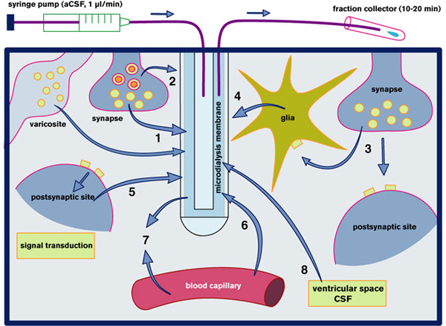
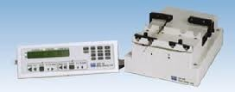
http://www.plastics1.com/PCR/Catalog/Catalog.php?Cat=25

Slide 101
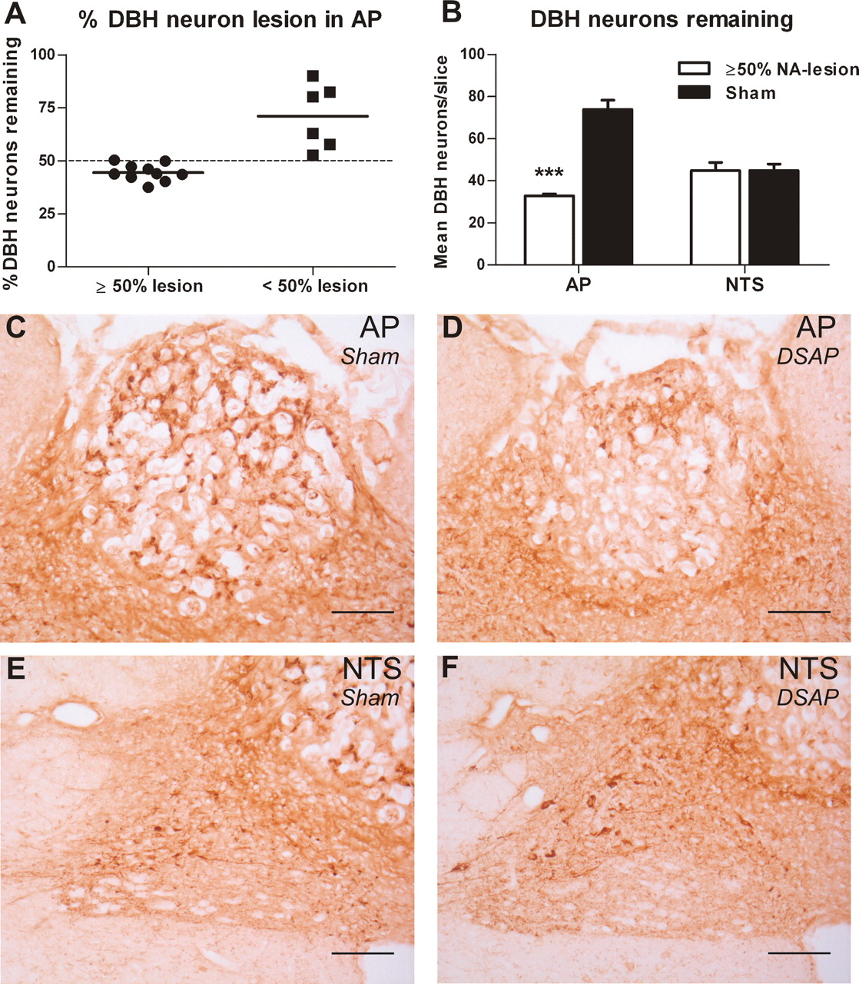
A–F: noradrenergic (NA) neuron labeling in rats injected with anti-dopamine-β-hydroxylase-saporin (DSAP) or IgG-saporin (sham).
Potes C S et al. Am J Physiol Regul Integr Comp Physiol 2010;299:R623-R631
©2010 by American Physiological Society
Notes:
A–F: noradrenergic (NA) neuron labeling in rats injected with anti-dopamine-β-hydroxylase-saporin (DSAP) or IgG-saporin (sham). A: categorization of the animals targeted in the AP with DSAP, into NA-lesions above or equal to 50% or below 50%, calculated from the average number of DBH-positive cells in sham-lesioned rats. B: mean number of remaining DBH-positive neurons in the AP and nucleus of the solitary tract (NTS) of the 10 animals with NA-lesions ≥50% (white bars) and the 12 sham-lesioned rats (black bars, ± SE); ***P < 0.001. C and E: DBH immunohistochemical staining of the AP (C) and NTS (E) of a sham-lesioned animal. D and F: DBH staining of the AP (D) and NTS (F) of a NA-lesioned animal injected with DSAP. Scale bar = 100 μm.

Slide 102
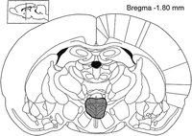
Impaired sexual response after lesions of the paraventricular nucleus of the hypothalamus in male rats.
By Liu, Yian-Cheng; Salamone, John D.; Sachs, Benjamin D.
Behavioral Neuroscience, Vol 111(6), Dec 1997, 1361-1367.
Abstract
N-methyl-{d}-aspartic acid (NMDA) or radiofrequency (RF) lesions were made in the paraventricular nucleus of the hypothalamus (PVH) of male rats. The rats were tested for copulation, noncontact erection (NCE) evoked by remote cues from estrous females, and (after RF lesions) reflexive erection. NMDA, which destroyed parvocellular but spared magnocellular neurons, caused no deficits in copulation but caused longer NCE latencies and fewer NCEs. Rats with RF lesions had parvo- and magnocellular neuron damage; these males copulated to ejaculation, but they had lower intromission ratios and longer ejaculatory latencies. RF-lesioned rats also had longer NCE latencies, and a smaller proportion of males displayed reflexive erection. Results indicate that the PVH participates in mediating erectile function in copula and ex copula, and that the parvo- and magnocellular PVH neurons may have different roles in mediating erection.

Slide 103
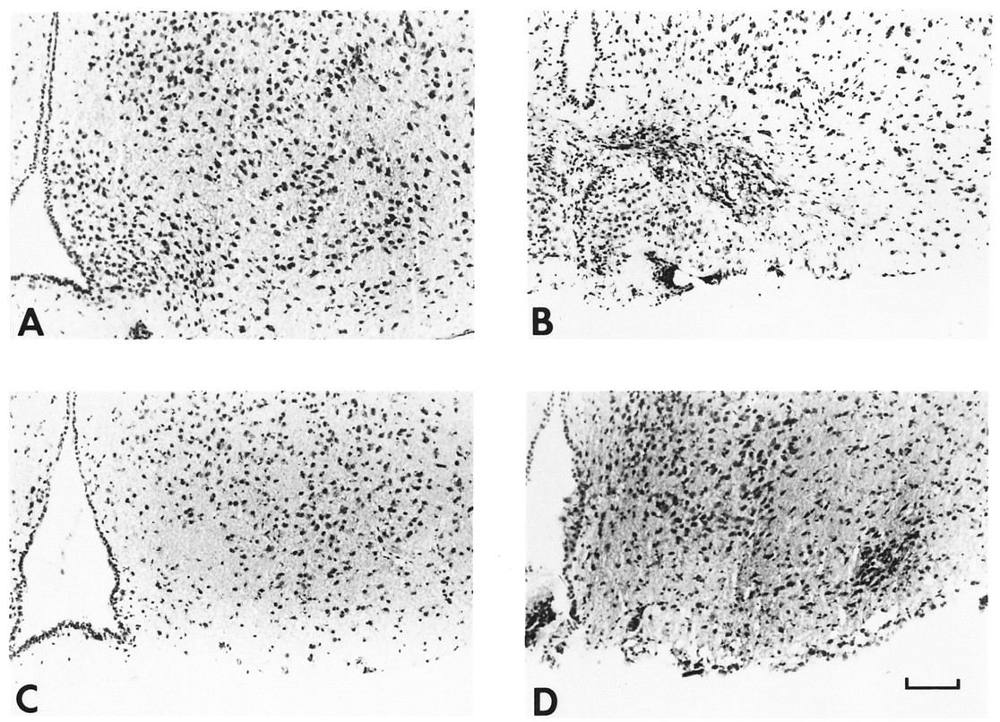
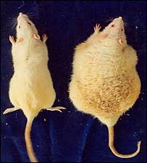
Photomicrographs of sections through the ventromedial hypothalamus demonstrating the lesions produced by GTG (B), MSG (C), and MSG and GTG (D) injected into the same mouse.
Bergen H T et al. Endocrinology 1998;139:4483-4488
©1998 by Endocrine Society
Notes:
Photomicrographs of sections through the ventromedial hypothalamus demonstrating the lesions produced by GTG (B), MSG (C), and MSG and GTG (D) injected into the same mouse. A is taken from a mouse injected with saline neonatally and as an adult. MSG treatment results in an arcuate nucleus that appears sparsely populated with cells (compared with controls), whereas GTG produces a lesion in the ventromedial hypothalamus together with scar tissue that appears to encroach on the most dorsolateral aspect of the arcuate nucleus. In each of the photomicrographs, the third ventricle is seen along the left edge. Scale bar = 100 μm.

Slide 104
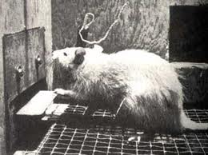
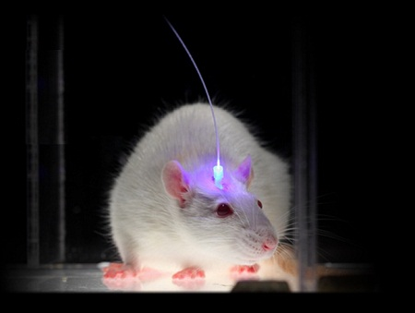

Slide 105
WHO could have guessed that a protein isolated from pond scum would transform the way researchers investigate the brain? The protein, called channelrhodopsin (ChR), is found in algae and other microbes, and is related to the molecule in human photoreceptors that captures light particles. Both versions control the electrical currents that constantly flow in and out of cells; one regulates the algae's movements in response to light, the other generates the nervous impulses sent along the optic nerve to the brain. Unlike its human equivalent, the algal ChR controls the currents directly because it forms a pore that spans the cell membrane. When expressed in neurons, it renders the cells sensitive to light, and they can be switched on or off very precisely using lasers.
This discovery led to the emergence of a new field called optogenetics. Early studies showed that the technique can be used to control the behaviour of small organisms such as nematode worms and fruit flies. Last year, Karl Deisseroth's group at Stanford University demonstrated, for the first time, that it can also be used to control reward and motivation behaviours in mice. Josh Johansen of the Center for Neural Science at New York University and his colleagues have now taken this one step further. Working in collaboration with Deisseroth, they show that optogenetics can also be used to induce a simple form of associative learning called fear conditioning.

Slide 106
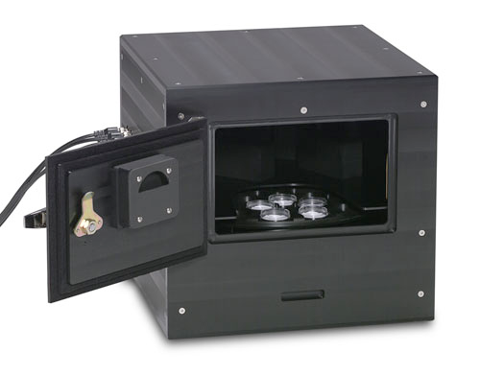
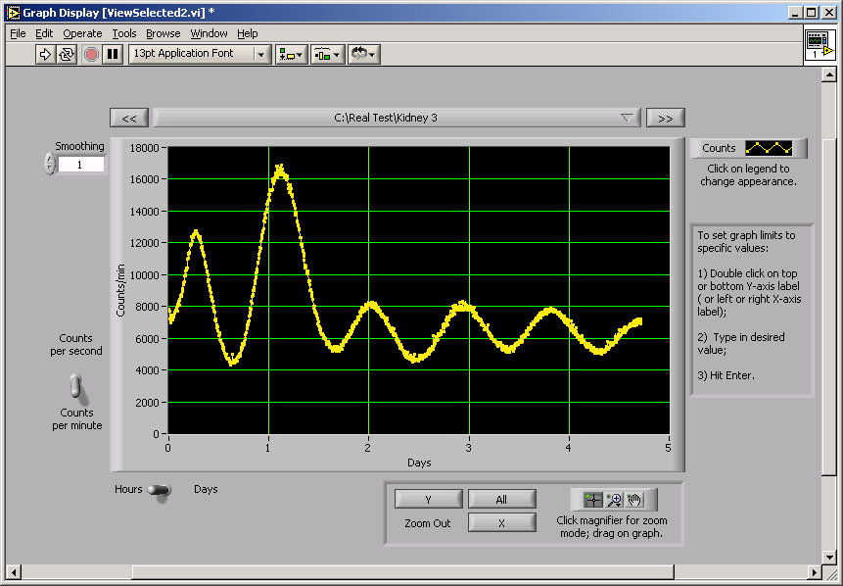

Slide 107
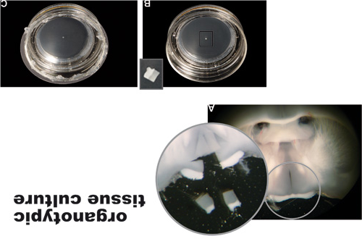

Slide 108
http://www.youtube.com/watch?v=0P_Lvlw6piI&feature=related

