Slide 1
Inferential statistics
Correction
SEM = Our best estimate of the SD in the population
Confidence Interval = It is the percentage of time the true mean will fall inside the error bars
Notes:
Video example

Slide 2
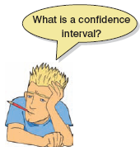
Confidence Intervals
Boundaries within which the population will fall
Domjan et al. (1998)
  ‘Conditioned’ sperm release in Japanese Quail.
True Mean
  15 Million sperm
Sample Mean
  17 Million sperm
Interval Estimate
  12 to 22 million (contains true value)
  16 to 18 million (misses true value)
  CIs constructed such that 95% contain the true value.

Slide 4
Showing Confidence Intervals Visually
CI = mean ±(1.96 x SE)
Other CI = mean ±(z_{1-p/2} X SE)
Samples less than 30 CI = mean ± (t_{n-1} x SE)

Slide 5
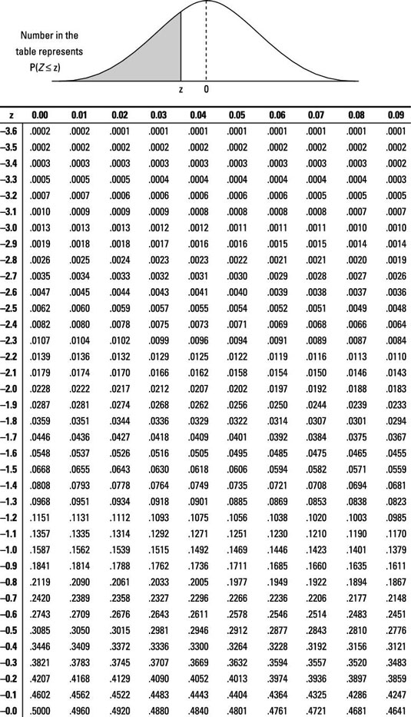

Slide 6
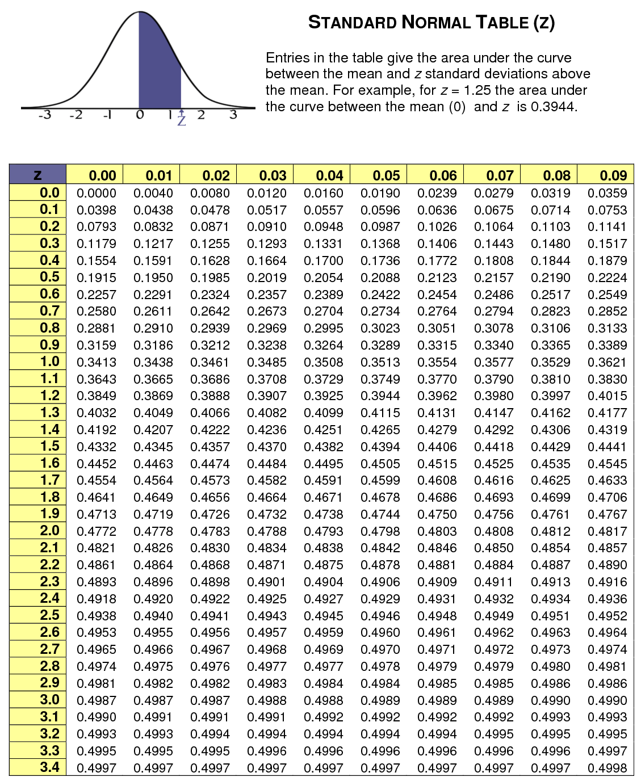

Slide 7
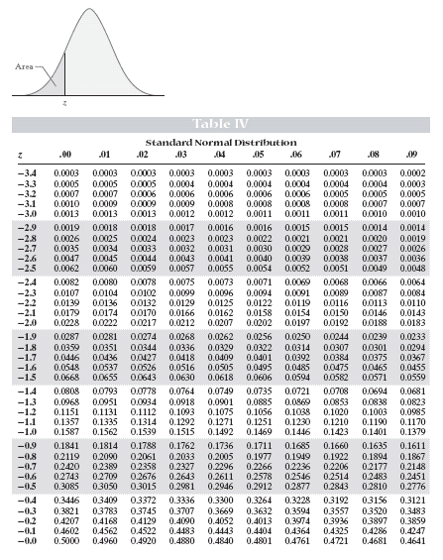

Slide 8
Inferential statistics
The population vs. the sample
  E.g., Capilano students vs. your class
Typically, you want to infer how the population would behave, and not merely describe how the sample does behave

Slide 9
Inferential statistics
In an experiment, there will almost always be a difference between the groups because of random error
The difference between the sample means reflects the effect of the IV + random error

Slide 10
Class demonstration
We want to test whether two loonies are the same (come from the same population)
Take twenty sided dice and toss them each 10 times….sum/average/
What are the group means?
Null hypothesis vs. Research (alternative) hypothesis
 | Group 1 | Group 2
1 | 13 | 12
2 | 7 | 16
3 | 8 | 13
4 | 6 | 7
5 | 9 | 8
6 | 13 | 10
7 | 14 | 12
8 | 2 | 19
9 | 1 | 15
10 | 4 | 6
Mean | 7.7 | 11.8
STDEV | 4.620005 | 4.157991
SE | 1.540002 | 1.385997

Slide 11
Inferential statistics
Are the two means (statistically) significantly different from each other?
We calculate the probability of finding this difference between the sample means, assuming that the null hypothesis is true
  If no, we infer that the null hypothesis is true
  If yes, we infer that the alternative hypothesis is true
Alpha level

Slide 12
Inferential statistics
The probability is affected by two things:
  The size of the difference between the two group means (the larger the difference, the smaller the probability of finding it if the null hypothesis is true)
  The size of the sample (e.g., 10-rolls verse 1000 times each)

Slide 13
The t test
Used to determine whether the means of two groups are significantly different from each other
What does the t value depend on?

Slide 14
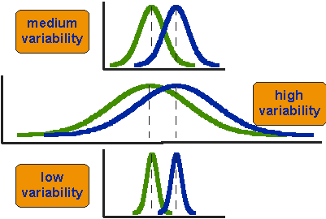
“Signal to noise” metaphor

Slide 15
The t test
df = degrees of freedom = N₁ + N₂ – 2

Slide 16
The F test
Merely an extension of the t test
When a study has only 1 IV and 2 groups, F and t are virtually identical (F = t²)

Slide 17
Assumptions
Parametric tests based on the normal distribution assume:
  Additivity and linearity
  Normality something or other –skewness, kurtosis, test for normalcy
  Homogeneity of Variance – Levene’s
  Independence – not influenced

Slide 18
Non-Parametric Version of the T-Test/F-Test
Wilcoxin T-test
Mann-Whitney U
Kruskal Wallis

Slide 19
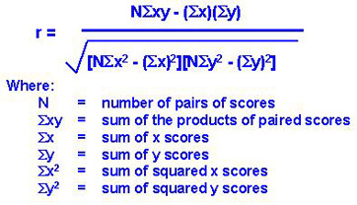
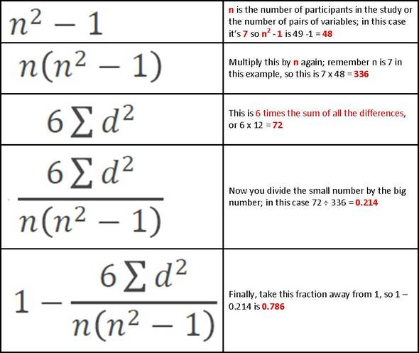
Correlation – parametric vs non-parametric
Pearson
Spearman

Slide 20
Signal detection theory
When making decisions under conditions of uncertainty…
 | Signal Absent | Signal Present
Decision “Present” | False Alarm | Hit
Decision “Absent” | Correct Rejection | Miss

Slide 21
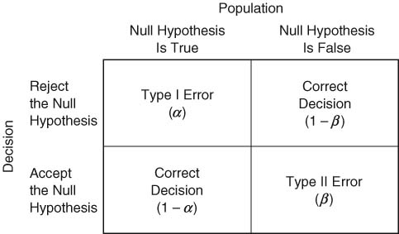
Type 1 and Type 2 errors
Notes:
Juror
Surgery decision
Radar operator
Pregnancy test
SPAM filter
Airport security
Paranormal investigation
Marriage decision

Slide 22
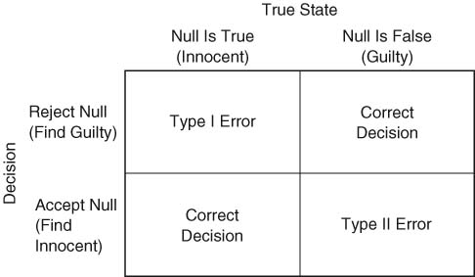
Type 1 and Type 2 errors

