Slide 1
Survey research Bad data is worse than no data at all…..Explain Come up with a question that would get undergraduates to indicate that they want Starbuck on campus Come up with a question that would get undergraduates to indicate they did not want Starbuck on campus

Slide 2
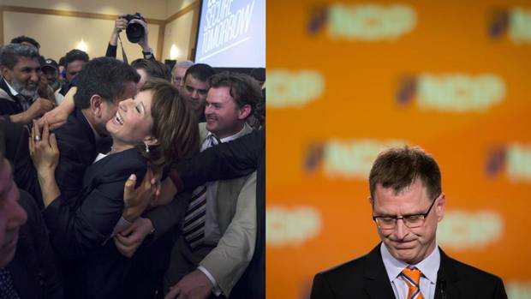
The classic blunder
Despite debacles, parties and pollsters will still be surveying voters – cautiously
In 2013, an Angus Reid poll found the NDP ahead by 9 percentage points, but they finished five points behind the BC Liberals , reports Ian Bailey
Notes:
3250 people polled
First president to lose in a Gallup and win in a walk
36% approval rating
Gallup: 49.5 Dewey, 44.5 Truman

Slide 4
Scientific vs. unscientific surveys
Notes:
Questionnaires and interviews to ask people to provide information about themselves
Surveys are ubiquitous

Slide 5
Surveys: What to avoid
Technical terms/jargon
Vague/imprecise terms
Spelling/grammar issues
Prolixity
Double-barreled questions
Loaded questions
Negative wording
Unnecessary questions

Slide 6
Poorly constructed questions
Did your mother, father, full-blooded sisters, full-blooded brothers, daughters, or sons ever have a myocardial infarction?
Should senior citizens be given more money for recreation centres and food assistance programs?
Do you support wasteful expenses like smartboards?
Do you believe that the city should not approve the proposed women’s shelter?

Slide 7
Response sets
Social desirability
Acquiescence
Extreme responses
Middle-of-the-road responses
Reference group effect- occur when responses to self-report items are based not on respondents' absolute level of a construct but rather on their level relative to a salient comparison group
Notes:
Subjective rating scales.
How independent are you? West vs. East and different standards.
How tall are you?

Slide 8
Forced-choice items: This technique hopes to generate questions that are equal in desirability to hopefully prevent a socially desirable response in one direction or another.
Neutral questions: The goal of this strategy is to use questions that are rated as neutral by a wide range of raters so that socially desirable responding does not apply.
Randomized response technique: This technique allows participants to answer a question that is randomly selected from a set of questions. The researcher in this technique does not know which question the subject responds to, so subjects are more likely to answer truthfully. Researchers can then use statistics to interpret the anonymous data.
Self-administered questionnaires: This strategy involves isolating the participant before they begin answering the survey or questionnaire to hopefully remove any social cues the researcher may present to the participant.
Bogus-pipeline: This technique involves a form of deception, where researchers convince a subject through a series of rigged demonstrations that a machine can accurately determine if a participant is being truthful when responding to certain questions. After the participant completes the survey or questionnaire, they are debriefed. This is a rare technique, and does not see much use because of the cost, time commitment and because it is a one-use only technique for each participant.
Selection interviewers: This strategy allows participants to select the person or persons who will be conducting the interview or presiding over the experiment. This method hopes that with a higher degree of rapport, subjects will be more likely to answer honestly.
Proxy subjects: Instead of asking a person directly, this strategy questions someone who is close to or knows the target individual well. This technique is generally limited to questions about behavior, and is not adequate for asking about attitudes or beliefs.[

Slide 9
Sampling techniques
Probability sampling
Simple random
Stratified
Cluster
Nonprobability sampling
Haphazard/convenience
Snowball
Purposive
Quota
Notes:
Stratified: Random within groups
Cluster: Randomly sample groups, then all within
Purposive: Specific purpose like under 30, etc.
Quota: Meet quotas nonrandomly

Slide 10
Sampling issues
Sample size & confidence intervals
Sampling frame
Response rate
Attrition
Internal vs. external validity
Web-based data collection
Notes:
SF: Group you actually sample from

Slide 11
Gosling, Vazire, Srivastava, & John (2004)
Internet samples are not demographically diverse (e.g., Krantz & Dalal, 2000)
Internet samples are maladjusted, socially isolated, or depressed (e.g., Kraut et al., 1998)
Internet data do not generalize across presentation formats (e.g., Azar, 2000)
Notes:
E.g., with teaching evaluations

Slide 12
Gosling, Vazire, Srivastava, & John (2004)
Internet participants are unmotivated (e.g., Buchanan, 2000)
Internet-based findings differ from those obtained with other methods (e.g., Krantz & Dalal, 2000)
Internet data are compromised by anonymity of participants (e.g., Skitka & Sargis, in press)
Notes:
E.g., with teaching evaluations

