Slide 1
Complex Experimental Designs
DV – cortisol Levels
High Stress
No Stess
A
B
Between Subject T-Test
Within Subject T-Test
Time Point1 Time Point 2
No Stress High Stress
Time Point1 - Time Point 2 = Difference Score
No Stress - High Stress = Difference Score
aka Single Sample T-Test
or Difference T-Test
Notes:
Video example

Slide 2
Assumptions of a T-Test
DV is continuous
Your independent variable should consist of two categorical, independent groups.
You should have independence of observations, which means that there is no relationship between the observations in each group or between the groups themselves.
There should be no significant outliers.
Your dependent variable should be approximately normally distributed for each group of the independent variable.
There needs to be homogeneity of variances.

Slide 3
Increasing the number of levels of the independent variables
The simplest experimental design has an IV with only 2 levels
However, it is often desirable to include more than 2 levels of the IV
E.g., When you expect to find a curvilinear relationship or when you need more fine-grained information
How far can you go? How far should you go?
Depends on the relationship between the IV and DV?
Depends on how many subjects you want to get?
Depends on if you want to look at an interaction?

Slide 4
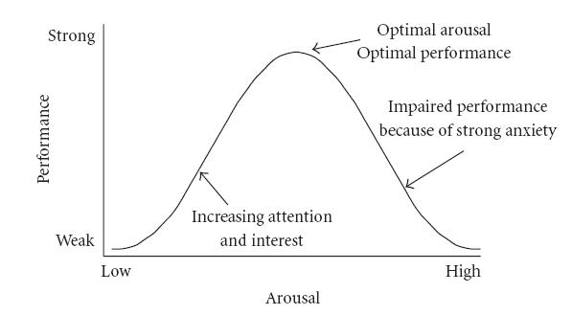
Increasing the number of levels of the independent variables
E.g., Testing the Yerkes-Dodson law

Slide 5
Increasing the number of independent variables
The simplest experimental design has only one IV
E.g., Consuming beer and fake beer before driving on a simulator…
However, it is possible (and, in fact, more common) to have more than one IV in an experiment = Factorial design
DV₁
DV₂
DV₃
High Stress
Medium Stress
Low Stress
Anti-Anxiety Drug A
Anti-Anxiety Drug B
High Stress
Medium Stress
Low Stress
2x3x3
Notes:
Show video of Bobo doll study here

Slide 6
2x2 TV Violence and Supervision
TV violence
Low
High
Present
Supervision
Absent

Slide 7
Factorial design
Question: How many IVs are there in a 3 x 3 Factorial Design?
Answer: 2
2 x 2 x 2
2x 3 x 3
2 x 2 x 2 x 2
Repeat the above if this was a Mixed Factorial Design
Notes:
End first lecture here

Slide 8
DV_{T1}
DV_{T2}
DV_{T3}
High Stress
Medium Stress
Low Stress
Anti-Anxiety Drug A
Anti-Anxiety Drug B
High Stress
Medium Stress
Low Stress
Main Effects – Unique effect of a particular variable on a dependent or outcome variable
Interactions - Combine effect of two or more IV or predictor variables on a DV or outcome variable

Slide 9
Interpretation of factorial design
TV violence
Low
High
1.5 | 4.5 | 3.0
2.5 | 8.5 | 5.5
2.0 | 6.5 | 4.25
Present
Supervision
Absent

Slide 10
Interpretation of factorial design

Slide 11
Interpretation of factorial design

Slide 12
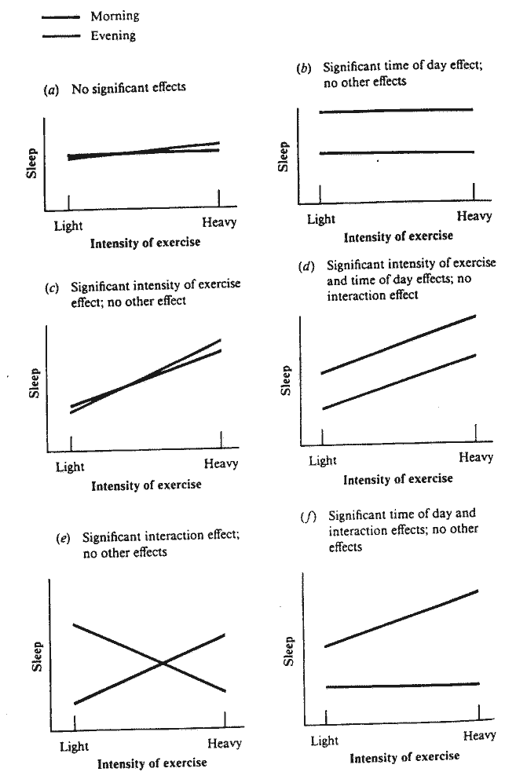

Slide 13
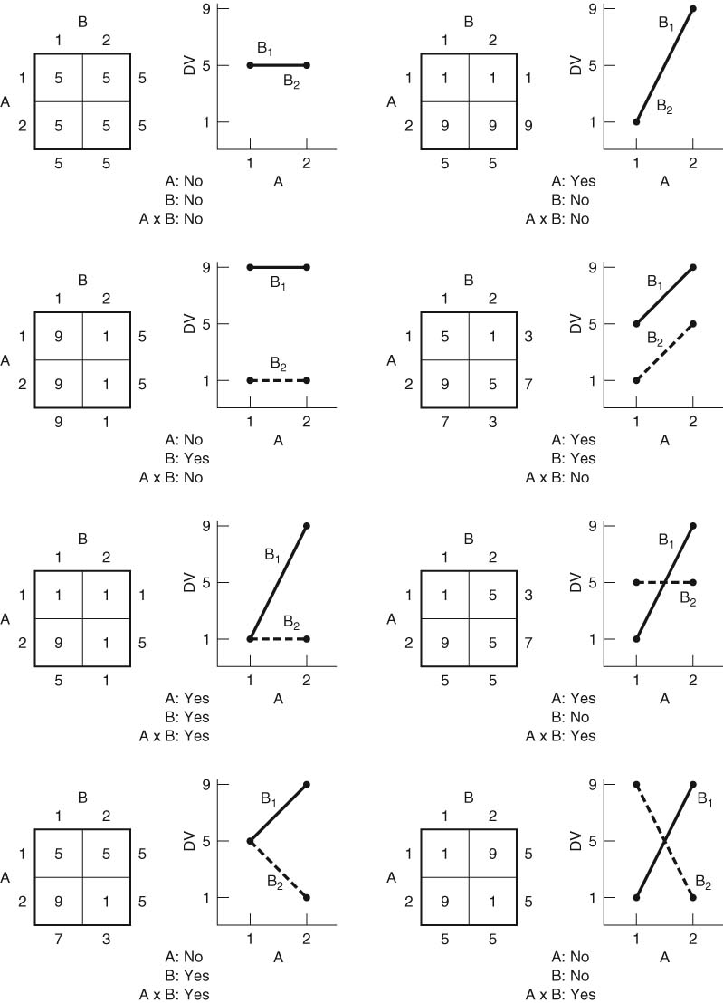

Slide 15
The search for moderators

Slide 16
More Practice

Slide 17
Terminology
Main effect
Interaction
Moderator variable
Simple main effect (of each IV at a particular level of another IV)
Mixed factorial design
Between & within subjects

Slide 18
Independence of cases – this is an assumption of the model that simplifies the statistical analysis.
Normality – the distributions of the residuals are normal.
Equality (or "homogeneity") of variances, called homoscedasticity...
Point of interest here is the second assumption. Several sources list the assumption differently. Some say normality of the raw data, some claim of residuals.
Several questions pop up:
are normality and normal distribution of residuals the same person (I would claim normality is a property, and does not pertain residuals directly but can be a property of residuals?
if not, which assumption should hold? One? Both?
if the assumption of normally distributed residuals is the right one, are we making a grave mistake by checking only the histogram of raw values for normality?

Slide 19
Mixed Designs: Between and Within

Slide 20
Complex Designs
Multiple IVs –
Multiple DVs –
Why?

Slide 21
The mixed factorial design is, in fact, a combination of these two. It is a factorial design that includes both between and within subjects variables. One special type of mixed design, that is particularly common and powerful, is the pre-post-control design. This is a design in which all subjects are given a pre-test and a post-test, and these two together serve as a within-subjects factor (test). Participants are also divided into two groups. One group is the focus of the experiment (i.e., experimental group) and one group is a base line (i.e., control) group. So, for example, if we are interested in examining the effects of a new type of cognitive therapy on depression, we would give a depression pre-test to a group of persons diagnosed as clinically depressed and randomly assign them into two groups (traditional and cognitive therapy). After the patients were treated according to their assigned condition for some period of time, let’s say a month, they would be given a measure of depression again (post-test). This design would consist of one within subject variable (test), with two levels (pre and post), and one between subjects variable (therapy), with two levels (traditional and cognitive) (Figure 1).
 | Pre-Test | Post-Test
Cognitive Therapy | Cognitive Pre | Cognitive Post
Traditional Therapy | Traditional Pre | Traditional Post
2x2

Slide 22
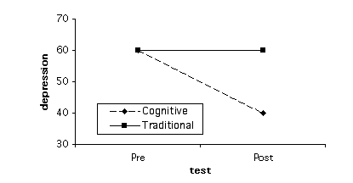
When a researchers uses the pre-post-control design he or she is usually looking for an interaction such that one cell in particular stands out, and that is the experimental group’s post test score. Ideally the pre-test scores will be equivalent. It is the post-test score difference between the experimental and control group that is important (see Figure 2).
Figure 2. Hypothetical Means for Experiment in Figure 1

Slide 23
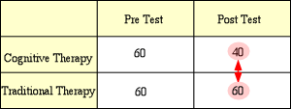
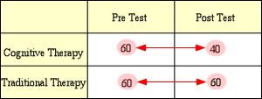
Therefore, in terms of post-hoc tests the most important comparison is between the post-test mean for the experimental group and the post-test mean for the control group (see Figure 3).
Figure 3. Comparison of Post-Test Means
Also, it is typical for the experimenter to expect a change in the experimental group from pre to post, but not in the control group, which would make the important post-hoc comparisons between pre- and post-test for the experimental groups and between pre- and post-test for the control group (see Figure 4).
Post hoc ergo propter hoc

Slide 24
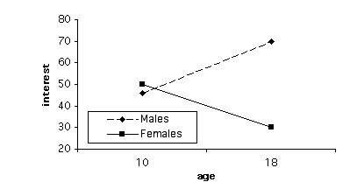
Figure 4. Comparison of Pre vs. Post Test Means for Both Groups
Of course, the pre-post-control design is not the only type of mixed design. Another common type of mixed design (and within-subjects design in general) is one that includes a change over time, so that one independent variable consists of multiple measures of one group of people over time. So, for example, we might be interested in comparing the interest of males vs. females in math and science over some time period during development. More specifically, we could give a group of school children a measure of interest in math and science at age 10 and then give the same group of students the same measure of interest at age 18. Our design then would look like Figure 5, and one set of possible means would look like the means in Figure 6, which would represent an interaction.
Figure 5. Mixed Design with Time as a Within-Subjects Factor
Figure 6. Hypothetical Means for the Experiment in Figure 5
 | Age 10 | Age 18
Males | Males-Age 10 | Males-Age 18
Females | Females-Age 10 | Females-Age 18

Slide 25
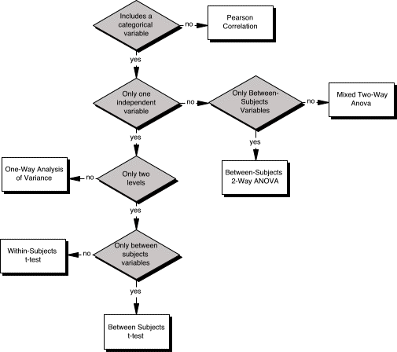
Figure 7. Flow Chart Representing Choice of Analysis Depending on Design

Slide 26
Mixed Between and Within Designs
Conceptualizing the Design
Types of Mixed Designs
Assumptions
Analysis
Deviation
Computation
Higher order mixed designs
Breaking down significant effects

Slide 27
Conceptualizing the Design
This is a very popular design because you are combining the benefits of each design
Requires that you have one between groups IV and one within subjects IV
Often called “Split-plot” designs, which comes from agriculture
In the simplest 2 x 2 design you would have

Slide 28
Conceptualizing the Design
In the simplest 2 x 2 design you would have subjects randomly assigned to one of two groups, but each group would experience 2 conditions (measurements)

Slide 29
Conceptualizing the Design
Advantages
First, it allows generalization of the repeated measures over the randomized groups levels
Second, reduced error (although not as reduced as purely WS) due to the use of repeated measures
Disadvantages
The addition of each of their respective complexities

Slide 30
Conceptualizing the Design
Types of Mixed Designs
Other than the mixture of any number of BG IVs and any number of WS IVs…
Pretest Posttest Mixed Design to control for testing effects

Slide 31
Assumptions
Normality of Sampling Distribution of the BG IVs
Applies to the case averages (averaged over the WS levels)
Homogeneity of Variance
Applies to every level or combination of levels of the BG IV(s)

Slide 32
Assumptions
Independence, Additivity, Sphericity
Independence applies to the BG error term and means…..
An assumption that one data point does not influence another…behavior of one does not influence the other
But each WS error term confounds random variability with the subjects by effects interaction so we need to test for sphericity instead; the test is on the average variance/covariance matrix (over the levels of the BG IVs) can be defined as ….
Variances of differences between data taken form the same participants are equal
Additivity

Slide 33
Assumptions
Outliers
Look for them in each cell of the design
Missing data
Causes the same problems that they did in the BG and WS designs separately
Data points missing across the WS part can be estimated as discussed previously
Missing data in the randomized groups part causes non-orthogonality

Slide 34
Analysis

Slide 35
Sources of Variance
SS_{T}=SS_{BG}+SS_{WS}
What are the sources of variance?
A
S/A
B
AB
BxS/A
T
Degrees of freedom?

Slide 36
Example – Books by Month
Example:
Imagine if we designed the previous research study concerning reading different novels over time
But instead of having everyone read all of the books for three months we randomly assign subjects to three different books and have them read for three months

Slide 38
Sums of Squares - Deviation
The total variability can be partitioned into A, B, AB, S/A, and B*S/A

Slide 44
Sums of Squares - Computational
What are the degrees of freedom?
And convert them into the formulas
A = a - 1
S/A = a(s – 1) = as - a
B = b - 1
AB = (a – 1)(b – 1)
BxS/A = a(b – 1)(s – 1)
T = abs – 1 or N - 1

Slide 48
Results – ANOVA summary table

Slide 49
Higher order mixed designs

Slide 50
Breaking down significant effects
Between Groups IV(s)
If you have a significant BG main effect(s) they need to be broken down to find which levels are different
The comparisons are done the same way as completely BG comparisons
The BG comparison error term is the same for all BG comparisons

Slide 51
Breaking down significant effects
Within Groups Variables
If a WG main effect is significant it also needs to be followed by comparisons
WG comparisons differ from BG variables in that a separate error term needs to be generated for each comparison
Instead of the Fcomp formula you would actually rearrange the data into a new data set

Slide 52
Breaking down significant effects
Example

Slide 53
Breaking down significant effects

Slide 54
Breaking down significant effects
Interactions
Purely BG interactions can be treated with simple effects, simple contrasts and interaction contrasts using the Fcomp formula, the same error term each time
Purely WG and mixed BG/WG interactions require a new error term for each simple effect, simple contrast and interaction contrast (leave it to SPSS)

Slide 55
Complex Correlational Design & Regression
Add multiple correlations
Add a covariate
Why not a Regression? Why a Regression?
Assumption of a Regression
1. Linear relationship
2. Multivariate normality
3. No or little multicollinearity
4. No auto-correlation
5. Homoscedasticity

