Slide 1
Qualitative vs. Quantitative
Qualitative Research
Qualitative Research is primarily exploratory research. It is used to gain an understanding of underlying reasons, opinions, and motivations. It provides insights into the problem or helps to develop ideas or hypotheses for potential quantitative research. Qualitative Research is also used to uncover trends in thought and opinions, and dive deeper into the problem. Qualitative data collection methods vary using unstructured or semi-structured techniques. Some common methods include focus groups (group discussions), individual interviews, and participation/observations. The sample size is typically small, and respondents are selected to fulfil a given quota.
Quantitative Research
Quantitative Research is used to quantify the problem by way of generating numerical data or data that can be transformed into usable statistics. It is used to quantify attitudes, opinions, behaviors, and other defined variables – and generalize results from a larger sample population. Quantitative Research uses measurable data to formulate facts and uncover patterns in research. Quantitative data collection methods are much more structured than Qualitative data collection methods. Quantitative data collection methods include various forms of surveys.
Notes:
Video example

Slide 2
Qualitative | Quantitative
Differences in quality (nature/type) | Differences in quantity (degree/number)
Responses described in own words | Responses described through scales
More in-depth info | Less in-depth info
Few participants | Many participants
Conclusions based on interpretation of data | Conclusions based on statistical analyses
Most useful for exploratory research | Most useful for testing hypotheses
Notes:
The same study could employ both methods

Slide 3
Descriptive
Naturalistic Observation
Case Studies
Archival
Focus Groups
Thematic Analysis /Content Analysis
-Nvivo
Triangulation
Correlation
Regression (predictors and predicted)
Quasi-Experimental –non-equivalent designs
Experimental
-between
-within

Slide 4
Jhangiani et al. (2007)
150+ UBC undergraduates in romantic relationships
Can we predict which couples will still be together six months later?
Measured past relationship history, perceived long-term potential, relationship (adult attachment) style

Slide 5
Jhangiani et al. (2007)
How many romantic relationships have you been involved in during the last 3 years (including the present one)?
1 2 3 4 5 or more
To what extent do you feel your current relationship has the potential to be a long-term relationship?
1 2 3 4 5
No potential Some potential A lot of potential

Slide 6
Please rate each of the following relationship styles according to the extent to which you think each description corresponds to your general relationship style.
It is easy for me to become emotionally close to others. I am comfortable depending on them and having them depend on me. I don’t worry about being alone or having others not accept me.
B. I am uncomfortable getting close to others. I want emotionally close relationships, but I find it difficult to trust others completely, or to depend on them. I worry that I will be hurt if I allow myself to become too close to others.
C. I want to be completely emotionally intimate with others, but I often find that others are reluctant to get as close as I would like. I am uncomfortable being without close relationships, but I sometimes worry that others don’t value me as much as I value them.
D. I am comfortable without close emotional relationships. It is very important to me to feel independent and self-sufficient, and I prefer not to depend on others or have others depend on me.

Slide 7
Jhangiani et al. (2007)
Write at least one paragraph in answering the following question:
Overall, given what you know about your current partner’s good and bad qualities, how do you feel about your decision to be with him/her?

Slide 8
Jhangiani et al. (2007)
Those who had more relationships in the past 5 years were more likely to break-up (“serial daters”)
Those with a preoccupied (ambivalent) or dismissing (avoidant) style were more likely to break-up
Those who thought their relationship had more long-term potential were less likely to break-up

Slide 9
Archival research

Slide 10
Public records and documents, collectively known as archives, are a valuable source of research data. There are masses of statistics along with other information available in a wide range of places - ranging from dusty vaults in the basements of public buildings to government websites. Working with these sources of information is called secondary research, as the primary data already exist. The primary data may be in the form of newspaper files, crime statistics reports, census records, museum collections, university records, presidential libraries, any any other places where data might be stored. The point is that someone besides the researcher collected it.
https://study.com/academy/lesson/using-archival-research-secondary-records-to-college-social-research-data.html

Slide 11
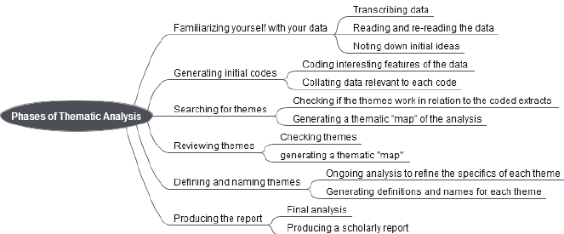
Thematic Analysis

Slide 12
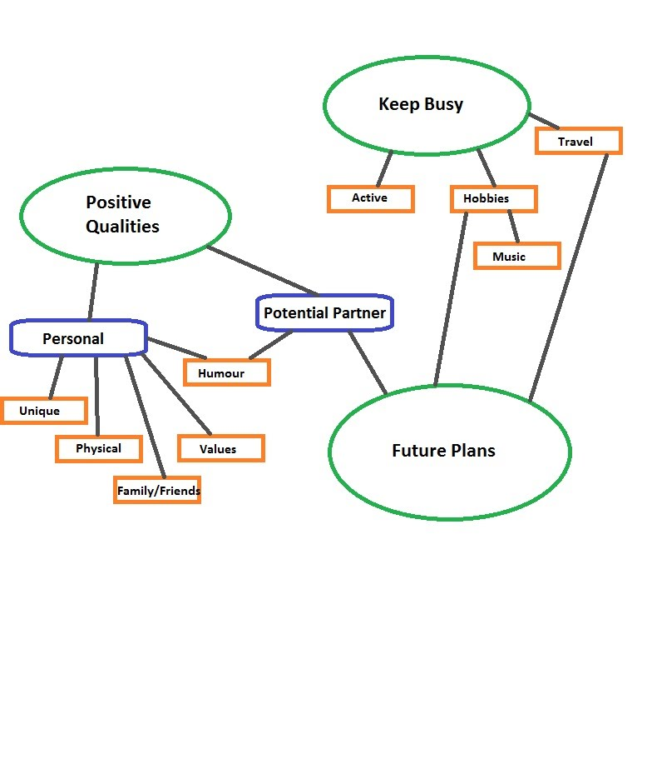

Slide 13
Problem
Analyzing qualitative data from research is a challenging but necessary task in the innovation process. Data acquired during the Learn phase will reveal insights and challenges that lead to research question development and can often provide clues to potential interventions.
Solution
Thematic analysis can be used to make sense of seemingly unrelated material. It can be used to analyze qualitative information and to systematically gain knowledge and empathy about a person, an interaction, a group, a situation, an organization or a culture.
Background
While thematic analysis has been practised for some time, it has not been subject to a great deal of rigorous scholarly documentation. Typically, learning the process has been passed from one professional to a protégée.
Documenting the methodology was undertaken by Dr. Richard Boyatzis, a professor of organizational behavior at Case Western Reserve University who wrote the book, Qualitative Information: Thematic Analysis and Code Development (1998) which outlines the principles of thematic analysis. Dr. Boyatzis describes thematic analysis as a process for “encoding qualitative information.”

Slide 14
Used For
Researchers use thematic analysis as a means to gain insight and knowledge from data gathered. The method enables researchers to develop a deeper appreciation for the group or situation they are researching. By using thematic analysis to distill data, researchers determine broad patterns that will allow them to conduct more granular research and analysis. It is highly inductive: themes emerge from the data that is gathered and are not imposed or predetermined by the researcher. Using their findings, researchers can apply a statistical analysis to validate themes. In practice, depending on the context of the research study, thematic analysis could include a bit of grounded theory, positivism, interpretivism and phenomenology.

Slide 15
Process
1) Collect data – Data is gathered from sources that can include:
field diaries
observational data
pictures/video*
historical data
questionnaire statements
transcripts
audio recording*
*Data from conversations on video and audiotape are transcribed.

Slide 16
2) Coding data – Researchers code the data by hand or through a software program. Typically, the researcher will be coding every two or three lines of text with handles that identify key words, concepts, images and reflections. Coding is an explicit and iterative process in which the researcher will alter and modify the analysis as reflected by the data and as ideas emerge. Coding skills improve with experience. According to Boyatzis, a “good code” is one that captures the qualitative richness of the phenomenon. A code should be clear and concise, clearly stating what it is, its boundaries and how to know it when it occurs. Codes become the foundation for the themes that are going to be used by the researcher.

Slide 17
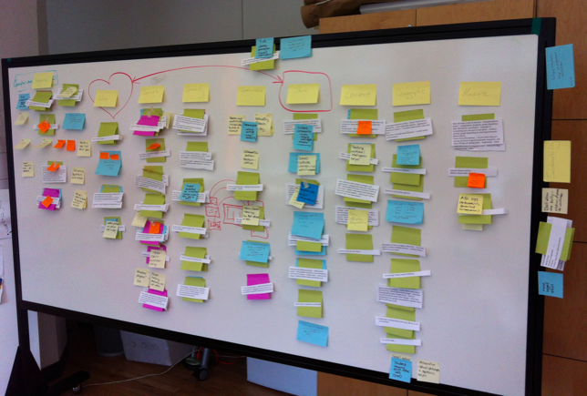
3) Code validation – To ensure the integrity of the codes—that is, that they have not been misinterpreted and are free of researcher bias—they should be developed and reviewed by more than one person. The researcher(s) read and re-read the data, double-checking the codes for consistency and validation. The integration of the codes from the data becomes the codebook from which themes emerge.
4) Themes/frameworks identification – From the codebook, the researcher identifies themes and sub-themes: patterns that have emerged from the coded data. Themes can emerge from patterns, such as conversation topics and vocabulary. Other factors could include the frequency of occurrence, occurrence only when certain factors are present, and time of the day, week or month. The researcher needs to be able to define each theme sufficiently so that it is clear to others exactly what the theme is.
5) Information consolidation, finalize theme names – The researcher finalizes the name of each theme, writes its description and illustrates it with a few quotations from the original text to help communicate its meaning to the reader.
NVIVO

Slide 18
Focus Groups
A focus group is a group interview designed to explore what a specific set of people (such as consumers, political activists, or college students) think and feel about a topic. Focus groups are useful for uncovering people's perceptions of and concerns about products, proposals, or most any issue.
A trained moderator asks questions and facilitates discussion. A second observer may serve as a recorder. Group size ranges from eight to twelve people. This number results in a group that is small enough to permit genuine discussion, large enough so that a single person is unlikely to dominate, and not so large as to inhibit the flow of ideas.

Slide 19
Uses
A focus group can serve a function similar to depth interviews in preparaing for a more systematic survey. Commercial firms routinely use focus groups in developing and designing new products. What do consumers like and dislike about existing items? Do they feel they have sufficient choice? Are there unmet product needs? What would consumers like to see if they could design products themselves? These types of questions are asked in exploratory focus groups. After a product or program is developed, a focus group can be used in a pilot or pretest way. How might they use the product? Does the program address their concerns? What name seems best?
In political campaigns, focus groups can be used in an exploratory manner to learn what issues are important to voters. They can be used after materials are developed to find out how people might respond to slogans and ads. Public efforts to change behavior, such as reducing litter or promoting healthy diets, use focus groups to test messages and images.

Slide 20
Structure and procedure
Focus group sessions generally last from 1-1/2 to 2-1/2 hours to allow full exploration of the topic. In order to establish a good relationship with the participants, the moderator must be a skilled interviewer with knowledge of group processes. The moderator maintains a neutral attitude towards the opinions expressed and responds positively to comments. The general guidelines provided for interviewing apply (see previous sections in this module). It is necessary to keep the discussion on track and to prevent any person from dominating. All this must be done with tact and diplomacy.
A special room with audio or video potential is needed if the session is to be recorded. Research ethics require that participants give their consent to being recorded or observed. As an incentive for participation, people are usually paid and given light refreshments.
A focus group can be expensive. However, an elaborate settings is not required. A gathering in a room or location where the group will not be interrupted and with one observer taking notes can be sufficient.

Slide 21
Strengths and limitations
Focus groups can produce stimulating discussions that reveal perceptions and concerns that might go undetected in a survey or single interview. They are more efficient than individual interviews because more people are involved in a single session. Social pressure can be a problem in influencing individual responses. A good moderator actively encourages and supports the free expression of opinions by participants, but that is not always sufficient for someone to speak out against the majority view.
The results of the discussion can be difficult to summarize if they are highly variable. Complex issues cannot be explored to the same degree as is possible in a one-to-one interaction.
The use of focus groups in marketing has been extremely high during the last two decades. Now there is some disenchantment.
"Focus groups continually fail to tell us what customers want. The fundamental problem is that, in spite of what conventional wisdom tells us, it is not the voice of the consumer that matters. What matters is the mind of the consumer. The big mistake is in believing that what the mind thinks, the voice speaks. It is time to start embracing methods that can deliver stronger predictive value."(1)
Focus groups can supplement other methods. For example, a community survey can provide the opinions of a random sample. Adding a focus group would provide depth to the answers and help to explain why people answered the survey questions as they did. The focus group is an excellent method for exploring opinions in depth. However, for the reasons pointed out above (small size and the difference between the spoken word and actual behavior), focus group results are not nearly as valid as a survey using a representative sample of the target population.

Slide 22
Focus Groups
Nvivo – Thematic/Content
Triangulation
Correlation
Regression

Slide 23
What is Regression?
A way of predicting the value of one variable from another.
  It is a hypothetical model of the relationship between two or more variables.
  The model used is a linear one so variables have to be linearly related to one another
  Therefore, we describe the relationship using the equation of a straight line.

Slide 24
Describing a Straight Line
b_{i}
  Regression coefficient for the predictor
  Gradient (slope) of the regression line
  Direction/Strength of Relationship
b₀
  Intercept (value of Y when X = 0)
  Point at which the regression line crosses the Y-axis (ordinate)
- error….it is always there!

Slide 25
Intercepts and Gradients

Slide 26
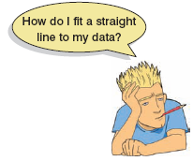
The Method of Least Squares
-line = predicted
-green dots – predicted
blue dots – obtained values
Residuals …difference between green and blue dots or difference between model and observed

Slide 27
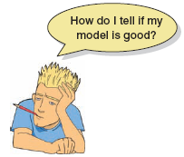
How Good is the Model?
The regression line is only a model based on the data.
This model might not reflect reality.
  We need some way of testing how well the model fits the observed data.
  How?

Slide 28
Sums of Squares
How well line fits data

Slide 29
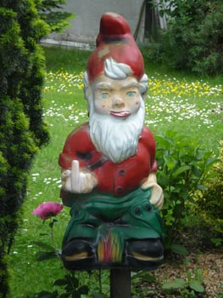
Hannesson or Nephwick?
Nephwick = best line finder
Clungglewad = beta seeker
Hannesson = ??

Slide 30
Summary
SS_{T}
  Total variability (variability between scores and the mean).
SS_{R}
  Residual/Error variability (variability between the regression model and the actual data).
SS_{M}
  Model variability (difference in variability between the model and the mean).

Slide 31
Testing the Model: ANOVA
SS_{T}
Total Variance In The Data
SS_{M}
SS_{R}
Improvement Due to the Model
Error in Model
If the model results in better prediction than using the mean, then we expect SS_{M} to be much greater than SS_{R}

Slide 32
Testing the Model: ANOVA
Mean Squared Error
  Sums of Squares are total values.
  They can be expressed as averages.
  These are called Mean Squares, MS
SS_{M}/df (# of variables in the model)
SS_{R}/df (# of observations)
Good Model = improvement large
diff betw obser & model small

Slide 33
Testing the Model: R²
R²
  The proportion of variance accounted for by the regression model.
  The Pearson Correlation Coefficient Squared
Coefficient of Determination

Slide 34
Regression: An Example
A record company boss was interested in predicting album sales from advertising.
Data
  200 different album releases
Outcome variable:
  Sales (CDs and Downloads) in the week after release
Predictor variable:
  The amount (in £s) spent promoting the album before release.

Slide 35
Step One: Graph the Data

Slide 36
Regression Using IBM SPSS

Slide 37
Output: Model Summary

Slide 38
Output: ANOVA

Slide 39
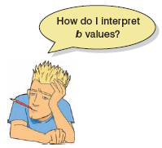
SPSS Output: Model Parameters

Slide 40
Using The Model

