Slide 1
Getting Started in Research
Notes:
Gather IC articles, remind of other HW

Slide 2
Agenda for today
Variables
Operational definitions
Basics of nonexperimental research

Slide 3
Variables
A variable is any event, situation, behaviour or individual characteristic that varies
Anything you can measure and which has different levels
Which of the following is a variable?
IQ
Attention span
Percentile rank
Ethnicity

Slide 4
Dependent vs Independent Variables
IV vs DV – you need to know this…internalize this…
IV – what you manipulate or what is manipulated
DV – What is measured or recorded
In correlational research what the IV and DV is not as big of an issue ….why?

Slide 5
Variables
Situational variables
Manipulated or measured
Response variables
Measured
Participant variables
Measured or assigned
Mediating variables
Measured and analyzed
Notes:
E.g., Effect of room temperature on exam grades

Slide 6
Operational definitions
A definition of the variable in terms of how you actually measure or manipulate it
How could you operationally define the following:
Height
Extraversion
Helpfulness
Creativity
Notes:
TPS
Many ways to operationally define the same variable

Slide 7
Nonexperimental research
What is the nature of the relationship between the variables?
Purely a descriptive tool
Cannot make causal statements
Relationships can be described in terms of shape, strength, and direction
Positive or negative (inverse)
Strong, moderate, or weak
Linear vs. curvilinear
Notes:
No manipulation, just measurement

Slide 8
Notes:
Y = exam performance

Slide 9
Class exercise
Think of examples of the following:
Positive linear relationship
Negative linear relationship
No relationship
Curvilinear relationship
One of the two variables involved must be “exam performance”
Notes:
Stress

Slide 10
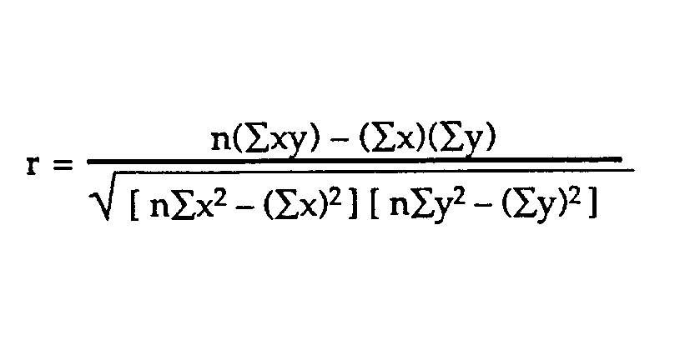
Describing relationships
When describing a linear relationship, we use a number to describe the strength and direction
Correlation coefficient = r_{xy}
Varies between -1.00 and +1.00
Benchmarks for the social sciences
Strong relationship: 0.50 or larger
Moderate relationship: 0.30 to 0.49
Weak relationship: 0.10 to 0.29

Slide 11
Nonexperimental research
Suppose variable X = liking and variable Y = self-disclosure and r_{xy} = .40
What does this signify?
There are 3 possibilities:
X causes Y
Y causes X
Z causes both X and Y
The “third variable” problem
The bidirectional problem

Slide 12
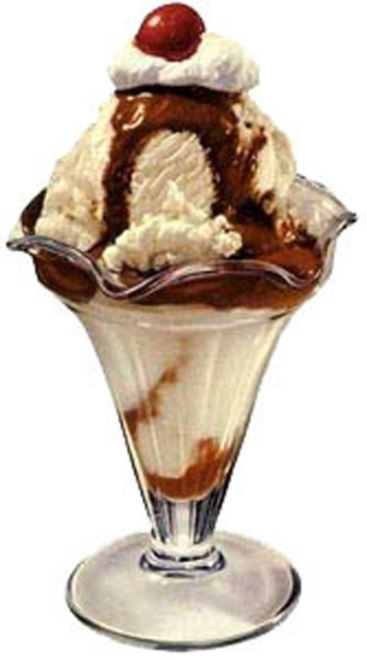

Slide 13
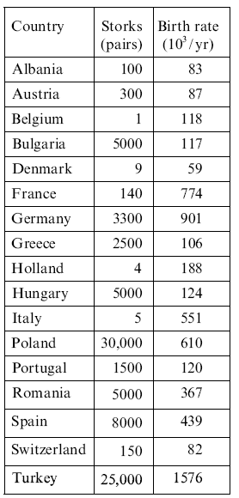
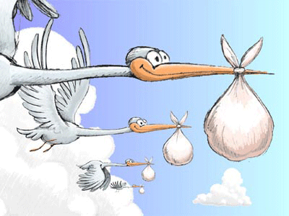
Storks and babies
r = 0.62!!!

Slide 14
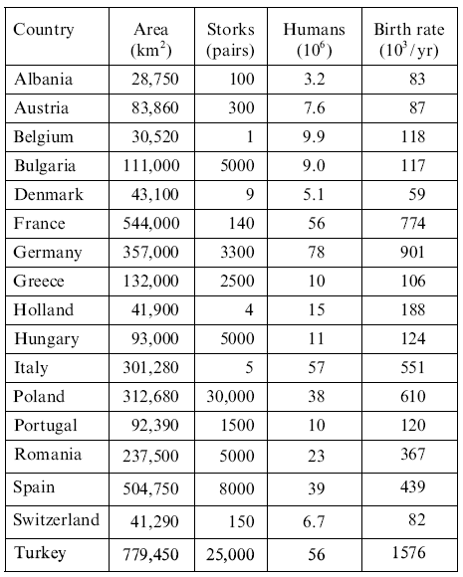

Slide 16
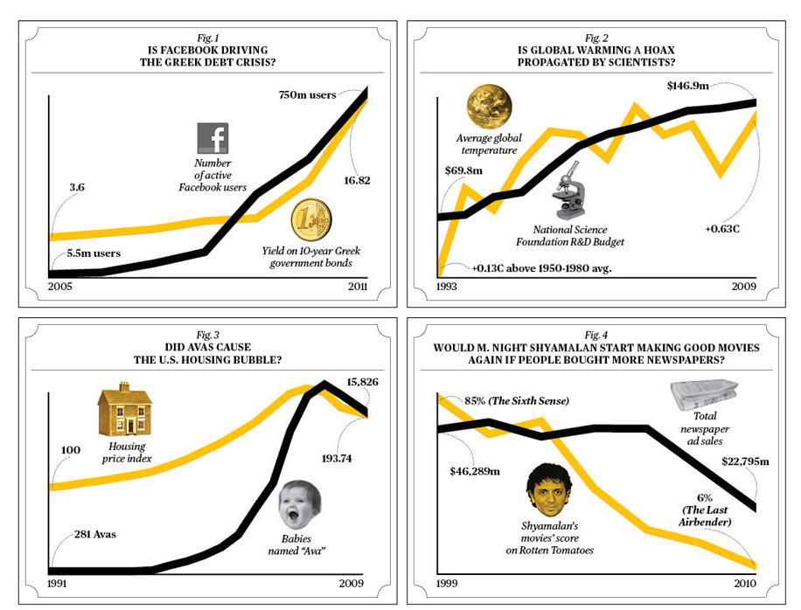
Notes:
Saw last time

Slide 17
Experimental research
Question: Does a change in one variable cause a change in another?
Two kinds of variables:
Independent variable
The variable which you manipulate (the cause)
Dependent variable
The variable which you measure (the effect)
Two key features of an experiment
Manipulation of an IV
Control of other variables
Notes:
Rationale behind terms

Slide 18
Experimental research
Two (or more) groups, that vary….one group get the treatment the other placebo (vary or different levels of the IV)
Typically one group receives the experimental manipulation (experimental group), while the other does not (control group)
Everything else is kept exactly the same between the two groups
Why?
If the groups are exactly the same except the IV then the cause of the change can only be 1) chance or 2) the IV
How does it relate to p < .05?

Slide 20
Random assignment
Assigning participants randomly into different conditions
Every person in the sample should have an equal chance of being in any given condition…flip a coin, random number generator
Result is that we can be confident that participants in each condition are equivalent
“Theoretically” we can control for variance in our sample that we don’t even know is there! Explain?

Slide 21
Random assignment
Experimental
condition
Sample
Control
condition
How do you get a good sample? Random Selection

Slide 22
Experimental method
Internal validity
Ability to ascertain cause & effect
External validity
Generalizability to other people and places

Slide 23
Evaluating an article from the popular press
Read the brief article
Does the study support the causal statement in the headline?
Are all 3 causal rules satisfied?
Covariance
Temporal precedence
Elimination of alternative explanations (internal validity)
Notes:
Print well being article

Slide 24
Cited by 1174
Access
Volume 33, Issue 2-3
June 2010 , pp. 61-83
The weirdest people in the world?
Joseph Henrich ^{(a1)}, Steven J. Heine ^{(a2)} and Ara Norenzayan ^{(a3)}
DOI: https://doi.org/10.1017/S0140525X0999152X
Published online: 01 June 2010
Behavioral scientists routinely publish broad claims about human psychology and behavior in the world's top journals based on samples drawn entirely from Western, Educated, Industrialized, Rich, and Democratic (WEIRD) societies. Researchers – often implicitly – assume that either there is little variation across human populations, or that these “standard subjects” are as representative of the species as any other population. Are these assumptions justified? Here, our review of the comparative database from across the behavioral sciences suggests both that there is substantial variability in experimental results across populations and that WEIRD subjects are particularly unusual compared with the rest of the species – frequent outliers. The domains reviewed include visual perception, fairness, cooperation, spatial reasoning, categorization and inferential induction, moral reasoning, reasoning styles, self-concepts and related motivations, and the heritability of IQ. The findings suggest that members of WEIRD societies, including young children, are among the least representative populations one could find for generalizing about humans. Many of these findings involve domains that are associated with fundamental aspects of psychology, motivation, and behavior – hence, there are no obvious a priori grounds for claiming that a particular behavioral phenomenon is universal based on sampling from a single subpopulation. Overall, these empirical patterns suggests that we need to be less cavalier in addressing questions of human nature on the basis of data drawn from this particularly thin, and rather unusual, slice of humanity. We close by proposing ways to structurally re-organize the behavioral sciences to best tackle these challenges.

