Slide 1
Group Play

Slide 2
Steps to resolving conflict
1. STOP. Don't let the conflict get worse. The less angry you are
the easier it will be to solve the problem.
2. SAY what the conflict is about. What is causing the
disagreement? What does each of you want or not want?
3. THINK of positive options. How could you meet each other's
needs and be fair?
4. CHOOSE a positive option each of you can agree on.
If you still can't agree, ask someone else (an outsider) to help
resolve the conflict.

Slide 3
Steps to resolving conflicts
1) Set the Scene: Each person present their perception of the problem. Use active listening skills: Restate, Paraphrase, Summarize.
2) Gather Information: Get to the underlying interests, needs, and concerns. Try to understand the other person’s motivations and goals, and see how your actions may be affecting these.
3) Agree on the Problem: Different underlying needs, interests and goals can cause people to perceive problems very differently.
4) Brainstorm Possible Solutions: If everyone is going to feel satisfied with the resolution, it will help if everyone has had fair input in generating solutions. Brainstorm possible solutions and be open to all ideas.
5) Negotiate a Solution: Both sides may better understand the position of the other, and a mutually satisfactory solution may be clear to all.
Three guiding principles here: Be Calm, Be Patient, Have Respect…

Slide 4
Grading Expectations1
Characteristics of work in the A range (A-, A or A+):
Outstanding performance and exceptional work. The content, organization and style of the work
are all at a high level of comprehension of the subject, and the work demonstrates excellent
writing (or verbal presentation), critical thinking, and the use of research and existing literature
where appropriate. The work demonstrates sound critical thinking processes, innovative ideas and
shows personal engagement with the topic. The work far exceeds minimum expectations in all
areas. Grammar, writing, spelling and formatting are all excellent.
Characteristics of work in the B range (B-, B or B+):
The work is good and has no major weaknesses. The writing or verbal presentation is clear and
explicit; coverage of the topic is good and the work demonstrates good comprehension. The work
shows good use of existing knowledge on the subject, including research and existing literature.
Grammar, writing, spelling and formatting are done well.
Characteristics of work in the C range (C-, C or C+):
Satisfactory performance and adequate work. Shows fair comprehension of the subject but has
some deficiencies in content, style and/or organization of course material. Adequate use of
research and existing literature. Grammar, writing, spelling and formatting meet minimum
requirements. Talk to me about what will move your work up to the next level.
Characteristics of work that receives a grade of “D”:
Marginal performance with minimally adequate work, barely at a passing level. The work shows
serious flaws in content, organization or style of written (or verbal) work. The work shows poor
comprehension of the subject, and minimal involvement in required work. The work shows poor
use of research and existing literature. The work may show poor use of grammar, poor spelling,
incorrect formatting, and may demonstrate problems with writing. Talk to me – I’m willing to
help you improve your work!
Characteristics of work in the “F” range:
Failing work. Either parts (or all) of the work were plagiarized, or the work does not meet most,
or any, of the minimum expectations. If the latter is the case, talk to me – it’s likely I’m willing to
help you succeed if you are willing to put the work in as well.

Slide 5
Meeting/Progress Weekly Report
Groups
What was accomplished last week
Who was in attendance
Meeting time for this week
What will be accomplished this week and by whom

Slide 6
Alzheimer’s disease (AD) is associated with disrupted circadian rhythms and sleep -Adv Nutr. 2016 15;7(4):679-89. Associations between Sleep, Cortisol Regulation, and Diet: Possible Implications for the Risk of Alzheimer Disease. Pistollato et al.
To evaluate this hypothesis and test interventions, a suitable preclinical mouse model of AD is needed.
Circadian and sleep disruptions may also contribute to cognitive decline and disease progression. Curr Alzheimer Res. 2012 Mar;9(3):290-7. Disturbed sleep patterns in elders with mild cognitive impairment: the role of memory decline and ApoE ε4 genotype. Hita-Yañez E¹, Atienza M, Gil-Neciga E, Cantero JL.
An estimated 60% of community-dwelling AD patients experience insomnia or other sleep disturbances, which are highly disruptive, stressful, and a leading cause of patients requiring institutional care.Sleep/awake status throughout the night and circadian motor activity patterns in older nursing-home residents with or without dementia, and older community-dwelling people without dementia.
Kume Y, Kodama A, Sato K, Kurosawa S, Ishikawa T, Ishikawa S.
Int Psychogeriatr. 2016 Jul 14:1-8.
The APP/PS1 mouse model accumulates misfolded amyloid-beta (Aβ), starting at 6 months of age, and have extensive plaques throughout the cortex by 9 months of age.
Roh et al., (2012) showed that between 6-9 months of age the APP/PS1 mouse model exhibits loss of diurnal fluctuation of interstitial Aβ and marked disruption of sleep-wake cycle, characterized as increased wakefulness and reductions in both REM and non-REM sleep.
Otalora et al., (2012) found that APP/PS1 exhibit a daily body temperature rhythm with a lower amplitude.
SO….We assessed circadian rhythms in the APP/PS1 mouse model of AD (APPswe/PSEN1dE9) using longitudinal and cross-sectional designs, and behavioural, immunocytochemical, and clock gene assays.

Slide 7
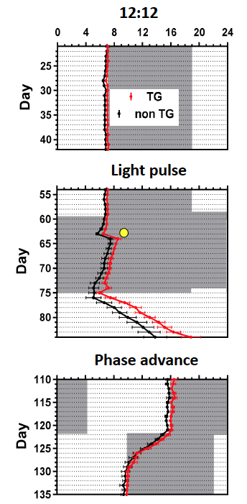
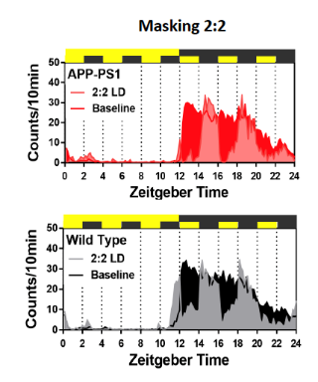
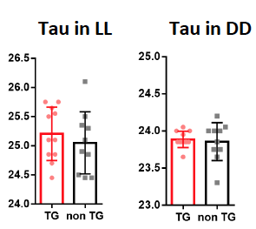
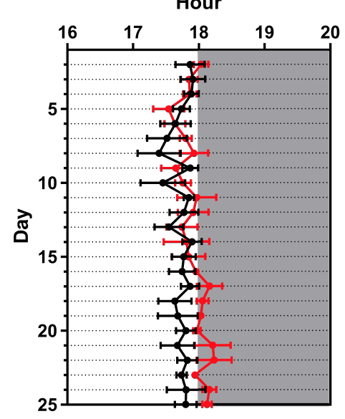
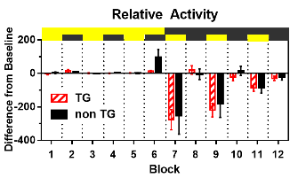
Evaluation of Circadian Rhythms in the APP/PS1 Mouse Model of Alzheimer’s Disease
Brianne A Kent¹, Mateusz Michalik², Elliott Marchant³, Sylvie Couture-Nowak², Howard H Feldman^{1,4}, Haakon B Nygaard¹, Ralph E Mistlberger²
1. Division of Neurology and Djavad Mowafaghian Centre for Brain Health, University of British Columbia, Vancouver, Canada 2. Department of Psychology, Simon Fraser University, Burnaby, Canada 3. Department of Psychology, Vancouver Island University, Nanaimo, Canada 4. School of Medicine, University of California, San Diego, USA
INTRODUCTION
ACTIVITY ONSET 6 - 9 MONTHS
MELANOPSIN
RETINAL MELANOPSIN
Alzheimer’s disease (AD) is associated with disrupted circadian rhythms and sleep. An estimated 60% of community-dwelling AD patients experience insomnia or other sleep disturbances, which are highly disruptive, stressful, and a leading cause of patients requiring institutional care. Circadian and sleep disruptions may also contribute to cognitive decline and disease progression. To evaluate this hypothesis and test interventions, a suitable preclinical mouse model of AD is needed.
The APP/PS1 mouse model accumulates misfolded amyloid-beta (Aβ), starting at 6 months of age, and have extensive plaques throughout the cortex by 9 months of age. Roh et al., (2012) showed that between 6-9 months of age the APP/PS1 mouse model exhibits loss of diurnal fluctuation of interstitial Aβ and marked disruption of sleep-wake cycle, characterized as increased wakefulness and reductions in both REM and non-REM sleep. Otalora et al., (2012) found that APP/PS1 exhibit a daily body temperature rhythm with a lower amplitude.
Preliminary assessment of melanopsin-labelled ganglion cells in the retinas from 10 month old, females.
Perfused ZT22.5 - ZT23.5, PBS & 4% PFA
Whole mount confocal immunofluorescent analysis (20x)
Labelled cells with clear fluorescents and projections
TG = 104.33 , WT = 230.66; n=3/group, p = 0.008
**
Behavioural assessment began when mice were 5 months of age and continued for 4 months
Tg APP/PS1 mice, compared to non-Tg littermates, exhibit a significant phase delay of nocturnal activity onset in LD
Group differences are not apparent in rhythm precision, mean or peak daily activity, masking or phase shift responses to light, or tau in DD and LL
Light pulse had a 15 min duration, 1 h after lights off
TG
WT
METHODS AND MATERIALS
We assessed circadian rhythms in the APP/PS1 mouse model of AD (APPswe/PSEN1dE9) using longitudinal and cross-sectional designs, and behavioural, immunocytochemical, and clock gene assays.
Mice were housed in isolation chambers for continuous recording of locomotion using infrared motion sensors monitored using Clocklab (Actimetrics). Circadian rhythm endpoints included phase of entrainment to LD 12:12, precision of activity onsets, mean and peak activity level, masking and phase shifting responses to light, endogenous period in DD and LL, damping of rhythm amplitude in LL, and rate of entrainment to shifted LD and scheduled mealtime.
CONCLUSIONS
Small but significant and persisting delayed phase of LD entrainment at 6 months. Phenotype may be emerging in 3 month cohort. These delays are reminiscent of findings that both activity and body temperature rhythms in AD patients are phase-delayed by ~4 h as compared to cognitively normal elderly subjects (Harper et al., 2004; Satlin et al., 1995)
APP/PS1 mice may be a useful model for testing interventions to evaluate the role of sleep and circadian desynchrony in AD onset and progression.
Future analyses:
ICC for SCN neuropeptides (VIP, PACAP, and SIRT)
Confocal immunofluorescent analysis for Aβ in retina, SCN, and cortical tissue
Sleep analysis using in vivo EEG/EMG rodent recordings
Restricted feeding and chronobiotic interventions
TAU
ACTIVITY ONSET (3M)
MASKING
There were no differences between genotypes in estimates of endogenous tau under LL and DD conditions.
There was no difference between genotypes in activity onset at 3 months of age.
There were no differences between genotypes during the 2:2 masking test: lights off for 2 hours, followed by lights on for 2 hours, and continued over 24 h.
ACKNOWLEDGEMENTS
Supported by an operating grant (REM), doctoral fellowship from NSERC (MM), and postdoctoral Killam Fellowship (BAK).

Slide 8
The Science of Psychology
Find out if you like Research!

Slide 9
Why research methods?
Some people consume knowledge…
- but very few are privilege/motivated/skilled enough to produce it…those who do typically love it! Why? You need to figure it out!
People should ask questions…how do you know that?
Research methods provide the tools with which to answer them
The importance of becoming a critical consumer of research
Evaluating pop psychology claims
Interpreting news media reports
Informing public policy
Research skills are transferable skills
Notes:
Hopefully good questions
The same methods are used across all of the sciences
Program evaluation

Slide 10
Which one is the false claim?
Students learn best when teaching styles are matched to their learning styles
Most suicide terrorists tend to be young, uneducated males who have been radicalized through years of brainwashing
Adults who were abused as children are statistically more likely to abuse their own children
40% of people with multiple personalities (schizophrenia) tend to suffer from depression
Alkaline water is good for your health
Cleanses are good for you
Notes:
3 out of 4 of these claims are true. Which one is false?

Slide 11
The limitations of intuition & authority
A central lesson of science is that to understand complex issues (or even simple ones), we must try to free our minds of dogma and to guarantee the freedom to publish, to contradict, and to experiment. Arguments from authority are unacceptable.
— Carl Sagan: Billions and Billions: Thoughts on Life and Death at the Brink of the Millenium (1998)
Notes:
http://
Table Mate

Slide 12
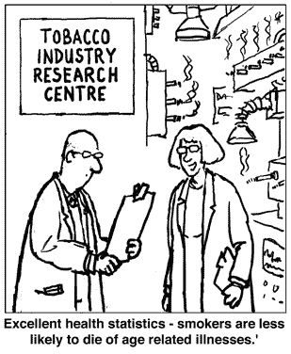
The limitations of intuition & authority
Proof by statistic
Statistics are like bikinis/speedos. What they reveal is suggestive, what they conceal is vital.

Slide 13
Empiricism –coming to know the world through your senses
Knowledge is based on observation, experimentation, and precise measurement
Good scientific ideas are testable
Falsifiable vs. “disconfirmable”
No ego in (good) science
Knowing what does not work or what is not true is also helpful
The importance of the peer review process
No reasoning by anecdote, no emotional reasoning
Some ideas are not testable and are therefore outside of the realm of science (e.g., is there a God).
Science never proves anything…we only get closer and closer to the truth…but we do disprove things…..

Slide 14
Goals of science in Psychology
Describe behaviour
Predict behaviour
Determine the cause of behaviour
Includes establishing temporal precedence, covariation of the cause and effect, and elimination of alternative explanations
E.g., Sleep hour and suicide
The generation of new knowledge….
Notes:
Determining the cause is necessary for a full understanding

Slide 15
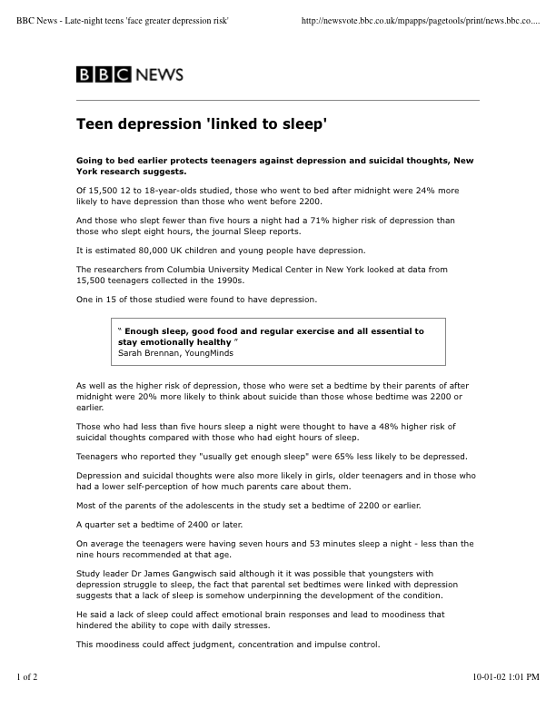

Slide 16
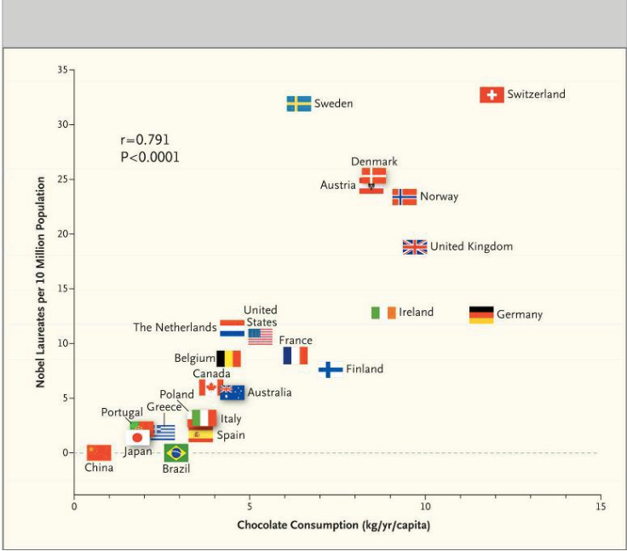

Slide 17
Goals of science in Psychology
Describe behaviour
Predict behaviour
Determine the cause of behaviour
Includes establishing temporal precedence, covariation of the cause and effect, and elimination of alternative explanations
E.g., Sleep hour and suicide
Explain behaviour
Go inside the “black box”

Slide 18
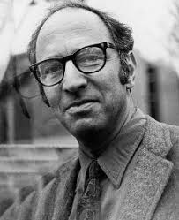
More fundamentals of science
A theory is a larger idea about how the “world” works
A hypothesis is a testable question
Basic vs. applied research
Neither is considered superior to the other
Applied research is often guided by theories and findings of basic research
Findings in applied settings often require modification of existing theories and spur more basic research
Basic research is crucial to public policy
The Structure of Scientific Revolutions – how science works
Theories compete …trying to explain all the data…eventually one
whine and overthrows the other …referred to as a scientific revolution!
It is how Science is thought to work.

Slide 19
Basic research questions
TPS
What factors influence decisions pertaining to safe sex?
What is the limit of human attention?
What causes depression?
What makes a message more persuasive?
Do some people cope with stress better than others?
Do people perform better alone or in a group?
Notes:
Convert these to applied research questions (think, pair, share)

Slide 20
Library VIU Stream of Research - look for methods we can do at VIU - look for studies that have used students

