Slide 1
Chapter Opener – Ground Hog Day

Slide 2
Learning Objectives - Chapter 8
What is memory?
How do we encode memory?
How do we store memory?
How do we retrieve memories?
Why do we forget and misremember?
Memory in the brain
Memories in the young and old
Disorders of Memory

Slide 3
What Is Memory?
Memory is recalling past events and past learning by means of encoding, storage, and retrieval.
Notes:
3
In-class activity: I typically start the memory chapter with a fun activity/demonstration that shows us how fallible our memory is. One of my favourite activities is called, “Eyewitness to a murder.” I start to lecture and then have a confederate burst into the classroom yelling at me about a grade they got last semester. I fight with them briefly and then they “kill” me with a water gun and I fall to the ground in front of the class as the “murderer” runs out of the room. At this point, you jump up and pretend to be a chief homicide detective and you say, “Dr. XXXX (insert your name) was murdered, but luckily for you, there were xx (insert number of people in class) eyewitnesses so we can easily apprehend the criminal. All I need you to do is write down the murderer’s height, weight, eye colour, hair colour, and any distinguishing marks.” Then you collect all the responses and start to write on the board ALL the different heights, weights, etc. that people put down. The VASTLY different accounts of what the murderer looked like will start a great discussion about memory and why the class’s memory was not as accurate as it should have been. You can also discuss how reliable eyewitness testimony is.

Slide 4
Memory Overview
Memory involves three processes:
Encoding - putting information into a form the brain can understand and getting it into memory.
Storage - the process of retaining memories in the brain for later use.
Retrieval - recovering stored memories.
Notes:
4
Reference to intro demonstration: If students in the “Eyewitness to a murder” demonstration were not able to identify the murderer well, it is probably because they were not able to ENCODE the information fast enough to be able to store it into long-term memory.
Lecture expander: Some people suggest that the way we remember information (encoding, storage, retrieval) is similar to that of a computer. If you create a word document, you cannot just turn off the computer and expect it to be stored there. Instead, you have to be able to save the file to the hard drive (or ENCODE the document). Encoding is putting the information into a form our brain can store just like putting a word document into a form the computer can store. The document is then STORED on the hard drive. Similarly, memories are stored in our brain. In order to retrieve documents from the hard drive, you have to be able to remember where you saved them and the title of the document. Similarly, in order to RETRIEVE information from our brain (what we call remembering), we have to be able to locate the information from our brain and consciously pull it up.

Slide 5
Memory Overview Continued…
Two Theories of How Memory Works
Information-Processing Theory - information is stored and retrieved piece by piece and moves among three memory stores during encoding, storage, and retrieval.
Parallel Distributed Theory - memories are stored as part of a large integrated web of information and represented in the brain as a pattern of activation across entire neural networks.

Slide 6
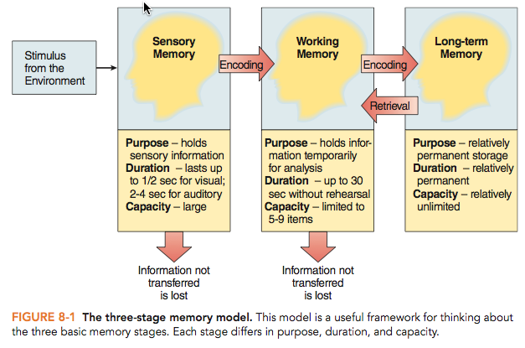
Information Processing Theory
Memory is similar to a computer
Three stage model of memory
Notes:
6
Lecture Expander: We have already discussed how memory is similar to a computer, so let’s concentrate on the three stage model of memory.
-I would quickly review this slide with students and then on the next slide review the specifics of the three different memory stores (sensory, working, and long term).

Slide 7
Three Stage Model of Memory
Information enters our…
Sensory memory, which holds everything we see (iconic), hear (echoic), taste, touch, and smell for a few seconds or less.
If we pay attention, it enters our ….
Working memory, which holds information for 30 seconds; capacity is 5-9 items.
If we encode the information, it enters our…
Long-term memory, which stores information forever.
Notes:
7
Lecture Expander: At any point along the way, the information can be lost. For example, if in the middle of class you begin to daydream, you will not be paying attention and thus the information will not get from sensory memory to working memory (and will be lost forever). If you are paying attention in class but are not thinking about the material (i.e., not encoding it) than it will not enter your long-term memory (and be lost forever). These are good reasons to pay attention in class and think actively (or encode) the material while you are in class.

Slide 8
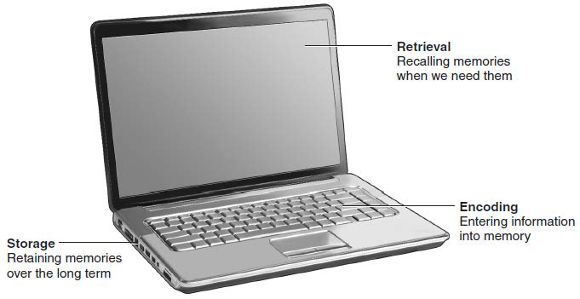
Memory as a Computer

Slide 9
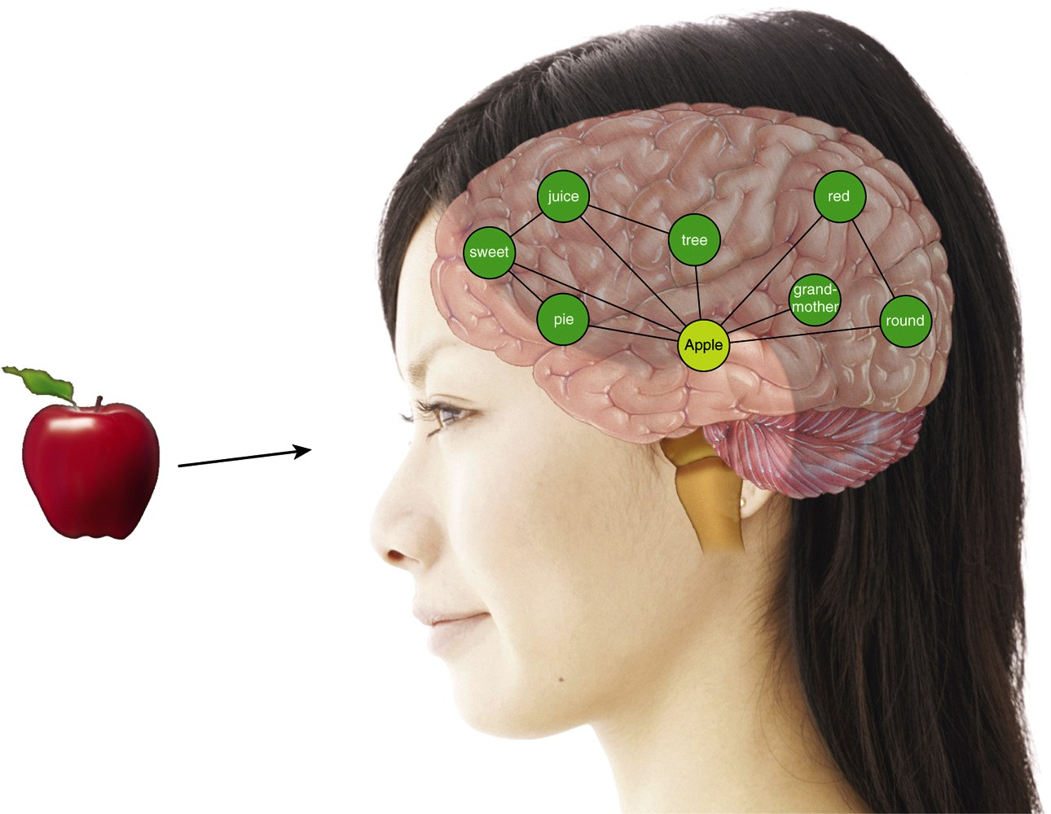
Parallel Distributed Model
This web of memories is similar to how neurons form networks in our brain
Notes:
9
Lecture expander: As you learn new information, you add to the web and link the newly learned information to past memories.
In-class activity: Take out a piece of paper. Pretend that you ate spinach ice cream for the first time and stored this experience in your memory. Draw a web of your memories you have about ice cream (different types, different experiences, and put your new pretend experience of spinach ice cream in the web). How are all those memories linked together?
Discussion Question: Do you ever have the experience of trying to think of a song and the lyrics of a bunch of other songs keep popping in your head? How might the parallel distributed model help to explain this?

Slide 10
How Do We Encode Information into Memory?
To get information into long-term memory, you need to encode it.
There are two ways to encode….

Slide 11
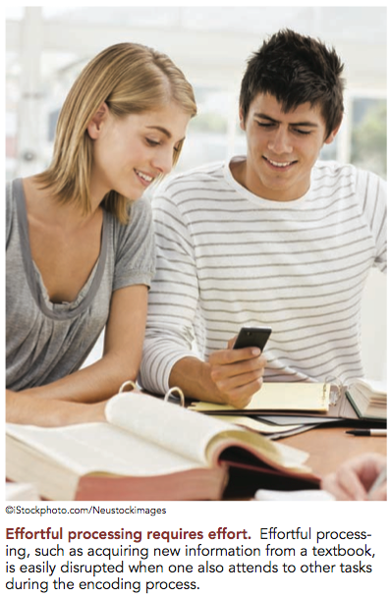
Two Ways to Encode
Automatic processing – when you automatically remember something with NO effort
Effortful processing – when you have to work to memorize something.
Notes:
11
Discussion question: What examples can you come up with of information that you automatically encode and remember? (Examples might be gossip, songs, TV, novels, etc.)
Critical thinking question: Why do you think that the above examples are encoded automatically, but information that you need to memorize for a test takes effort to encode?
Answer: Usually information that is automatically encoded is of personal relevance and thus has built-in retrieval cues. If you can make content that you have to learn for classes personally interesting or relevant then chances are it will be much easier to encode.
Lecture expander: Sometimes it takes a lot of effort to encode information. What are some of the best ways to encode (or you might call it study) information? Have the class brainstorm a list of ways that they study. Hopefully this list will include things like rehearsal, organization, elaboration, etc. You can take this opportunity to talk about how rehearsal is a good way to keep things in working memory but not as good for encoding things in long-term memory.

Slide 12
Transferring from Sensory Memory into Working Memory
Sensory Memory: memory involving detailed, brief sensory images or sounds retained for a brief period of time:
a photograph viewed for a brief moment
a brief glance at a passing car
random letters examined for less than a second
Notes:
12

Slide 13
Demonstration of Sperling’s Test of Sensory Memory
X B D F
M P Z G
L C N H
Notes:
13
In-Class Activity: Show these letters for a fraction of a second and then ask people to write down all of the letters they can remember. Most people can only report 4-5 letters. Does this mean that sensory memory can only hold 4-5 items? No, we can hold much more, but we only hold it for 1/10 of a second and so by the time it takes us to write it down, we have forgotten most of what we say. If we could write them down fast enough, we would be able to remember all 12 letters. To show this, I will show you the letters again and then after I take it away, I will hold up a 1, 2, or 3 and you report the letters in that row.

Slide 14
Transferring from Sensory Memory into Working Memory
Working Memory - a short-term memory store for information you are thinking about right NOW, including:
recalled memories, such as a phone number
day dreaming
problems you are currently solving
what you are reading
The Case of Clive Wearing
https://www.youtube.com/watch?v=WmzU47i2xgw
Notes:
14
Lecture expander: Working memory is everything you are thinking about right NOW. Some say that working memory is what is in our consciousness. Things flow in and out of our consciousness or working memory.

Slide 15
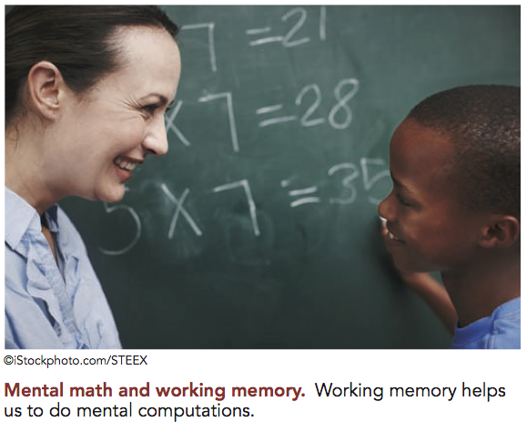
Working Memory
Working memory holds 5-9 pieces of information.
Chunking increases amount we can hold
The best way to get and keep things in working memory is through rehearsal (or repetition).
The Case of H. M.
https://www.youtube.com/watch?v=JliczINA__Y
Notes:
15
In-Class Activity: This is a great demonstration for students about the limitations of working memory. Say five digits out loud and, when you are finished saying them, have students write them down. Instruct students not to write down any of the numbers until you are done saying them. For example, I might say, “4, 2, 6, 4, 7, okay write them down.” Next, test students on their memory for 6 digits, then 7, and so on until you get to 10. When you are done, have students report how many digits they could store in their working memory. Most students can only remember around 7 or 8. Phone numbers and social insurance numbers are great examples of chunking.
Discussion Question: If we are trying to remember a phone number long enough to find a pen and write it down and you stop repeating the information in your head before you find a pen and write it down, what will happen to the information?
Answer: The information is either lost forever or we further encode the information and it enters long term memory. In order for the information to enter long term memory, one usually needs to do more with the information such as….

Slide 16
Transferring Working Memory into Long-Term Memory
Long-term memory - all of the information we have gathered that is available for use, such as acquired skills, people we know, etc.
Spaced rehearsal - facilitates moving working memories into long-term memory. Don’t cram! Studying a little bit over a long period of time is better for memory.

Slide 17
Transferring Working Memory into Long-Term Memory
Organizing information is necessary for proper storage in long-term memory. Organize information as you learn it.
To get information into long-term memory you need to encode it.

Slide 18
Different Types of Encoding
Phonological - encoding based on sound.
Visual - encoding based on how the information looks.
People with amazing visual encoding skills have eidetic (photographic) memory
Semantic - encoding based on the meaning of the information.
Notes:
18
Lecture Expander: The more ways you can encode the information the better. If you can only do one, than semantic is the best way to encode, but if you can do more than one, try to encode using meaning, sight, sound, smell, touch, etc.—This will help to strengthen your web of memories as explained in the parallel distributed model.
In-Class Activity: This activity was created by Bernstein. This activity shows how it is better to encode based on meaning (semantic encoding) than on visual encoding. Instruct half the class to count or estimate the number of vowels in the words that will be read. Then instruct the other half of the class to rate each item read, on a 1-5 scale, in terms of its value to a person stranded on a desert island. (The differing instructions can be given via differing overhead transparencies shown to each half of the class): Here is a sample word list:
UMBRELLA, GASOLINE, ORCHESTRA, YACHT, HAMMER, DIAMOND, UNIVERSITY, MACARONI, EYEGLASSES, GARDEN, UNDERWEAR, NEWSPAPER, ALCOHOL, BOUQUET, MICROSCOPE, CAMOUFLAGE, POLLUTION, RESTAURANT, INSECT, ELEPHANT, SULPHUR, LEMONADE, MOSQUITO, BOTTLE.
To displace from short-term memory the words in the latter part of the list, ask the students to spend about 30 seconds performing a distracting task, such as writing their name, address, phone number, major, and social insurance number.
Now give the students one minute to write down as many words from the list as they can recall. Retention scores from those who processed the words superficially (by counting or estimating vowels) should be much lower than those from students who processed the information more deeply (by thinking about, and possibly visualizing, the usefulness of each item in a particular situation.

Slide 19
Best Methods of Effortful Encoding
Meaning - we remember things better when we can understand what we memorize.
Elaboration - the more we can elaborate (or expand) on the meaning and make the information personally relevant, the better we remember it!
Mnemonic - techniques used to increase meaningfulness of information.
Notes:
19
Critical thinking questions: Can we memorize things we don’t understand? How does that impact our memory?
Answer: We can memorize things without understanding them but we are MUCH more likely to forget them.
Application question: Can you think of an example where you used a mnemonic or made class information personally relevant?

Slide 20
Meaning and Memory

Slide 21
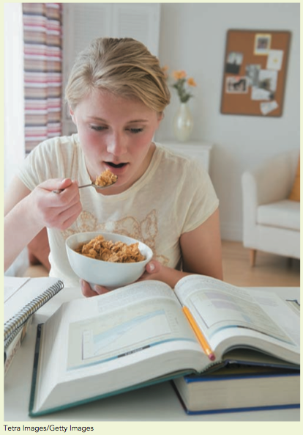
Organize to Remember
Use Chunking - group bits of information together.
Use the PQRST Method - Preview, Question, Read, Self-Recitation, Test
Use Schemas - organize new information according to the categories created by previous experience and learning.

Slide 22
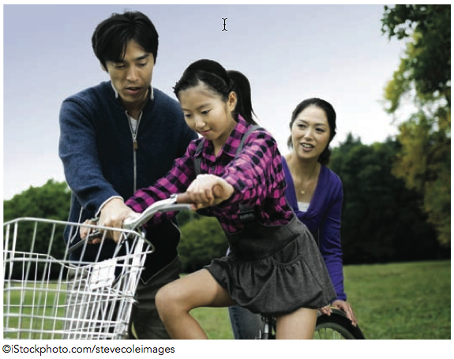
Two Types of Long-Term Memories
Explicit Memory - conscious memories, such as your home address or date of birth.
Semantic - memories for facts
Today’s date, capital of Canada
Episodic - memories for personal
events. Your first bike ride
Implicit Memory - unconscious memories, such as learned motor behaviours and skills.
Priming
Notes:
22
Application questions: Please write down two examples of semantic memories, episodic memories, and implicit memories.
Examples of implicit memories might be typing, riding a bike, skiing, dancing.
Critical thinking question: It was probably hard to come up with the examples for implicit memories. Why was that?
Answer: Because implicit memories are unconscious so it is hard to bring to consciousness to unconscious memories ☺
Lecture Expander- Have students complete this sentence, ”George had a ball. He jumped on top of the wooden ______.” Most students will say “wall” because the word “ball” helped to prime the word “wall” because they sound the same.

Slide 23
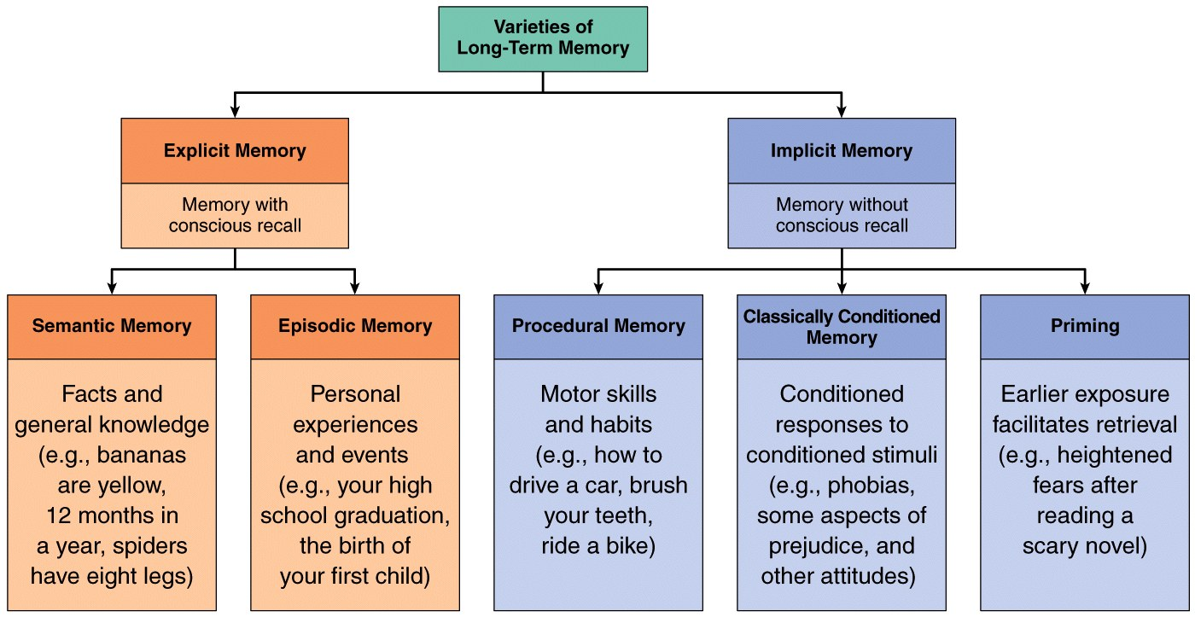
Types of Long-Term Memories

Slide 24
How Do We Retrieve Memories?
Mentally search brain for stored information
If it is located then it is brought back into working memory
Notes:
24
In-Class Activity: A very simple illustration of the fact that people encode and retrieve information in predictable as well as idiosyncratic ways, can be created in class merely by giving your students about one minute to write down the names of all the provincial capitals of Canada.
When time is up, ask various students to read their list, in the order originally written. Familiar patterns of search and obvious retrieval cues will be evident in some of these lists, as when students used alphabetical order, region, or similarity of name to organize the task. Other patterns and cues will be much harder to detect, but just as systematic. Hopefully this activity will lead into a discussion of ways we retrieve information.

Slide 25
What Helps Retrieval?
Retrieval cues - words, sites, or other stimuli that trigger a memory.
Context effects - we can remember things better where we first learned them.
Priming - one piece of information helps us retrieve other related memories.
Notes:
25
In-Class activity: This activity helps students to see that retrieval memory tasks are easier than recall tasks. Ask your class to write down the names of the seven dwarfs (recall task). After this, show them a list of 20 dwarf names with the correct 7 dwarf names added (for example, grumpy, grouchy, silly, sorry, sleepy, snoozy, etc.). Students usually can only recall about 2 or 3 of the dwarfs but can recognize or pick out all 7 dwarfs when given a recognition task.
Critical thinking question: Based on the context effect, where should you sit when you take a test?
Lecture expander: I always give the example for context effect of being in my bedroom and remembering I need to go downstairs to get a book. Then I get to the kitchen and cannot remember why I am there. It is only when I step back into the bedroom (where I first had the idea to get the book) that I remember why I needed to go downstairs. Usually students can relate to this example.
Application question: Do you remember where you were when you found out Michael Jackson died? Describe it. This is an example of a flashbulb memory.

Slide 26
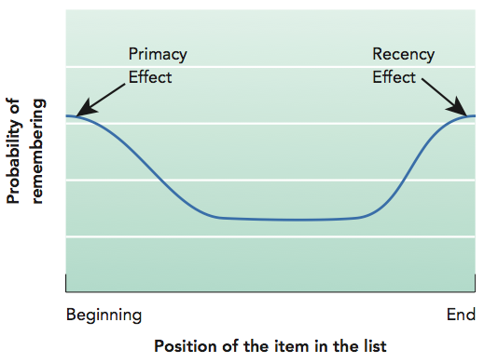
Serial Position Effect

Slide 27
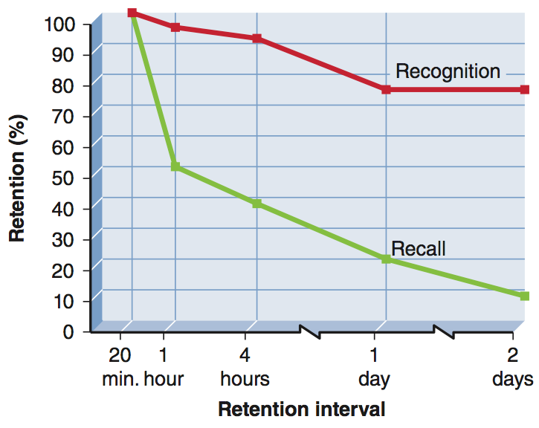
Recognition and Recall
Recognition tasks are easier than recall tasks because of priming.

Slide 28
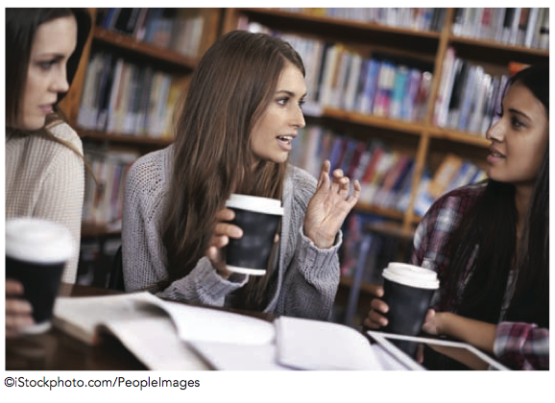
State Dependent Learning
You remember things better when you are in the same state of mind you were in when you first learned it.
Notes:
28
Lecture Expander: Talk about how this helps to explain why depressed people remember more bad things that have happened to them and less good things that have happened to them. You might also want to talk about a different type of state-dependent learning, which is that people who are sober when they learn something will remember the items better if they are sober when they recall it.

Slide 29
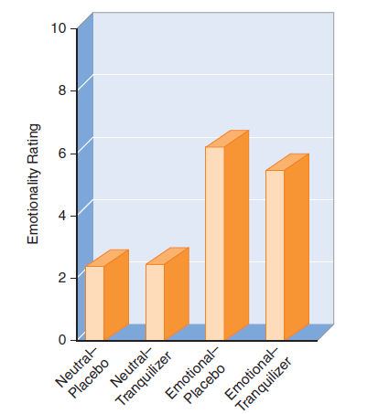
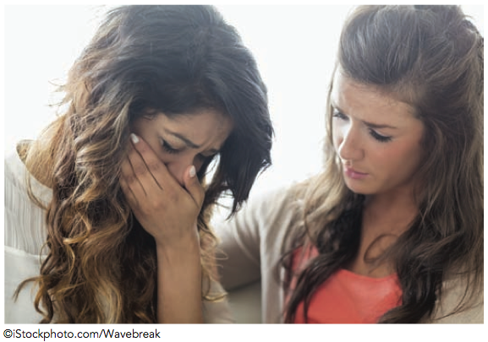
Emotional Arousal and Memory

Slide 30
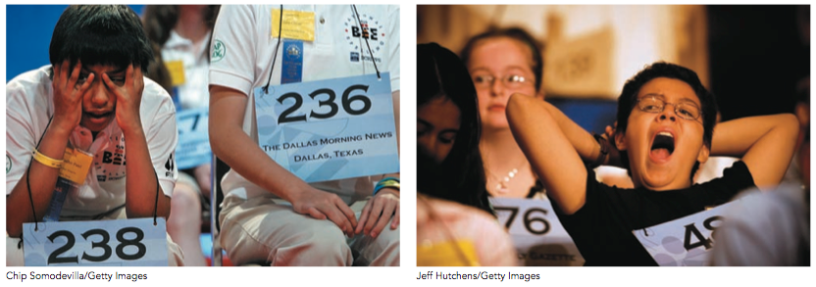
Emotional Arousal and Memory
The Spelling Bee

Slide 31
Forgetting and Misremembering
Encoding failure
Never learned it in the first place.
Storage failure
Biological problem (head trauma or Alzheimer’s)
Retrieval failure
The info was encoded and stored, but you cannot get it out of your brain!
Never being able to forget – Jill Price
https://www.youtube.com/watch?v=SoxsMMV538U
Notes:
31
Lecture expander: How can we combat each of these reasons for forgetting?
Encoding Failure—You can be sure you do not have an encoding failure if you make extra sure you learned the information in the first place. Don’t just look over your notes or the book to see if you know it. Instead, make a list of the terms you need to know or use a study guide and test yourself without the answers present.
Storage Failure – You don’t have to worry about having a storage failure unless you are a boxer or have dementia or Alzheimer's.
Retrieval Failure – This is the most likely reason why you would forget. You did successfully encode the information and store it, but now you cannot find it in your brain. Ever lose something in your room that you really need? Well, we lose things in our head that we really need all the time! So, we need to figure out a way to organize things better in our brain so that we can find what we need.

Slide 32
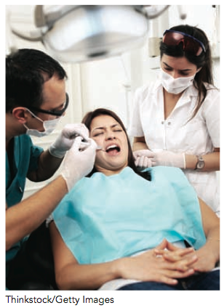
Three Possible Reasons for Retrieval Failure
Decay Theory
Interference Theory
Motivated Forgetting
Notes:
32
Each of these theories will be expanded on the next three slides.

Slide 33
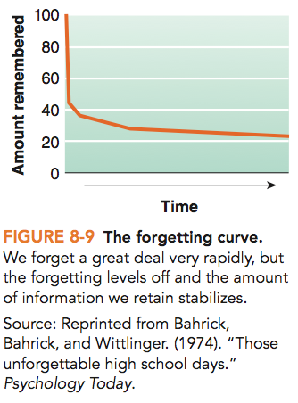
Decay Theory
Memory traces fade over time
Based on research by Ebbinghaus, who was the first to scientifically study memory

Slide 34
Interference
Interference - new or old memories that block the ability to retrieve information
Proactive interference - old information blocks memory of new information.
Retroactive interference - new information blocks memory of old information.

Slide 35
Proactive and Retroactive Interference

Slide 36
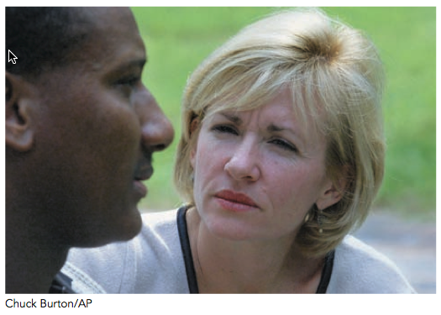
Distorted or Manufactured Memories
Memories are subject to distortions because we often have to reconstruct them.
Three factors that contribute to memory distortions are:
Source misattributions
Misinformation
Imagination
Notes:
36
Lecture Expander: This is a great place to talk about why police officers need to be careful when questioning a witness. What if a police officer were to ask the eyewitness, “Did the suspect have a scar on his right cheek?” The witness might say at the time that they do not know. Then later, when the witness is looking at a line up of people, they might see someone with a scar on their right cheek and think, “I think I have a memory of a scar being on the right cheek.” This person would be having source misattribution.

Slide 37
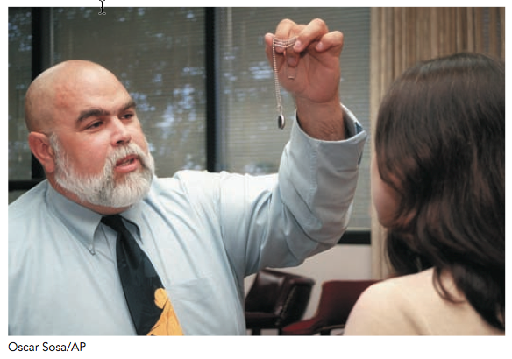
Distorted or Manufactured Memories - Imagination
Notes:
37
Lecture Expander: This is a great place to talk about why police officers need to be careful when questioning a witness. What if a police officer were to ask the eyewitness, “Did the suspect have a scar on his right cheek?” The witness might say at the time that they do not know. Then later, when the witness is looking at a line up of people, they might see someone with a scar on their right cheek and think, “I think I have a memory of a scar being on the right cheek.” This person would be having source misattribution.

Slide 38
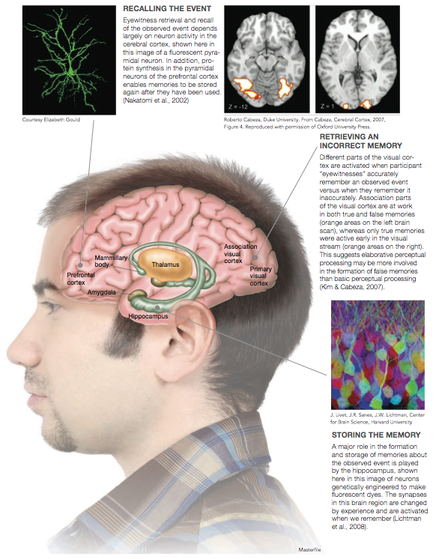
Eyewitness Testimony and the Brain
Elizabeth Loftus – Eyewitness Testimony
https://www.youtube.com/watch?v=gCswq5JDTaw

Slide 39
What Happens in the Brain?
The prefrontal cortex is important in working memory.
The hippocampus is important for the transfer of memories into long-term memory.
Long-term potentiation is important for the transfer of information from working memory into long-term memory.

Slide 40
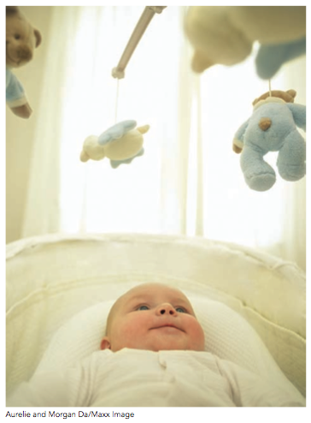
Memory and Age
Before 4 years of age: memories of faces, places, and skills but not episodic memories (memories of life events).
The hippocampus develops slowly.
Most early episodic memories are emotional.
Notes:
40

Slide 41
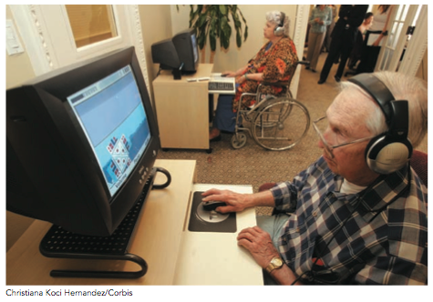
Memory and Age
Some types of memory decline with age, starting in our 20s.
Prospective vs. Retrospective Memory
Notes:
41
Lecture Expander: You might want to add that declining memory can be a self-fulfilling prophecy. Meaning, if people think that they have declining memory because of age, they may not try as hard to remember something and the cycle can spin downward.

Slide 42
Organic Memory Disorders
Amnesic disorders - just memory loss
Anterograde - can’t form new memories
“Hi. I’m Tom…….Hi. I’m Tom”
Retrograde - can’t remember things before amnesia
“Who am I?”
Notes:
42
Application question: Amnesia is often a common subject in movies. Can you come up with examples of movies that have amnesia in them? Are they showing anterograde or retrograde amnesia, or are they confusing the two?
Examples – First Kiss with Drew Barrymore: They completely make up a new form of amnesia where she remembers things for a day and then forgets them when she goes to sleep. They do depict a character (Tom) who has a good representation of anterograde amnesia.

Slide 43
Amnesia

Slide 44
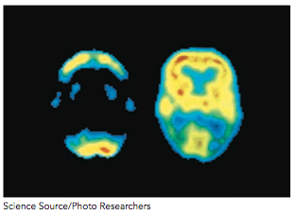
Organic Memory Disorders
Dementia - memory and cognitive loss
Alzheimer’s disease is the most common form – loss of overall activity in the brain
Notes:
44
Application question: Amnesia is often a common subject in movies. Can you come up with examples of movies that have amnesia in them? Are they showing anterograde or retrograde amnesia, or are they confusing the two?
Examples – First Kiss with Drew Barrymore: They completely make up a new form of amnesia where she remembers things for a day and then forgets them when she goes to sleep. They do depict a character (Tom) who has a good representation of anterograde amnesia.

Slide 45
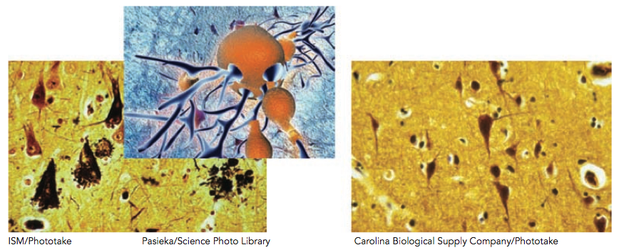
Plaques and Tangles of Alzheimer’s Disease

Slide 46
Copyright © 2015 John Wiley & Sons Canada, Ltd. All rights reserved. Reproduction or translation of this work beyond that permitted by Access Copyright (The Canadian Copyright Licensing Agency) is unlawful. Requests for further information should be addressed to the Permissions Department, John Wiley & Sons Canada, Ltd. The purchaser may make back-up copies for his or her own use only and not for distribution or resale. The author and the publisher assume no responsibility for errors, omissions, or damages caused by the use of these programs or from the use of the information contained herein.

