Slide 1
Learning

Slide 2
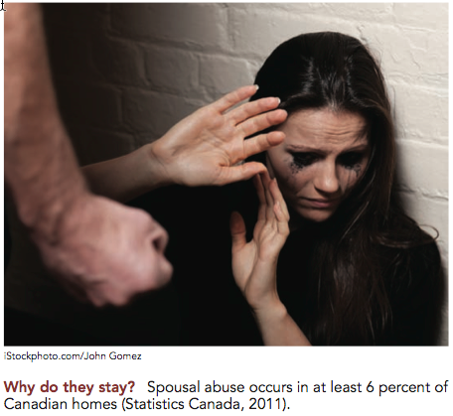
Lecture Opener: Learned Helplessness – Why do they stay?

Slide 3
Eight Learning Objectives - Chapter 7
Define learning, associative and non associative learning
Classical Conditioning
Operant Conditioning
Observational Learning
Spatial navigation, implicit, latent and insight learning
Practices for learning
Pre and postnatal learning
Specific learning disorder

Slide 4
What Is Learning?
Learning - lasting change as a result of practice, study, or experience. It has to be inferred from behavior

Slide 5
Two Types of Learning
Associative learning – a change as a result of experience where two or more stimuli become linked
Non-associative learning - learning that does not involve forming associations between stimuli; it is change resulting from experiences with a single sensory cue

Slide 6
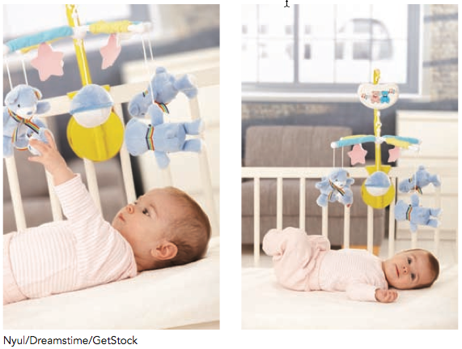
Non-associative learning
Dishabituation - a form of non-associative learning whereby there is a recovery of attention to a novel stimulus following habitation
Habituation - weakening of response to a stimulus after repeated presentation
Sensitization - a strong stimulus results in an exaggerated response to the subsequent presentation of weaker stimuli

Slide 7
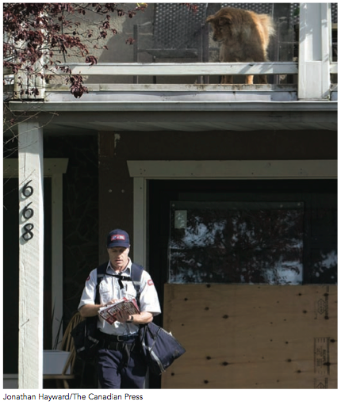
Associative Learning
Associative learning - connections are formed between two or more stimuli
Classical conditioning
Operant conditioning

Slide 8
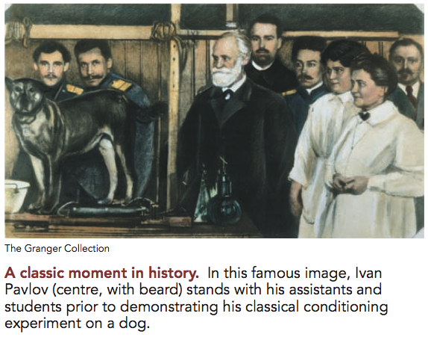
Classical Conditioning
The association of two stimuli
Founded by Ivan Pavlov
Example
Example 2
Notes:
In-Class Activity: I highly recommend getting a two-minute video from YouTube of The Office where Jim classically conditions Dwight to want a mint every time his computer beeps. It is a very funny and relevant clip. Just go to www.youtube.com and type in “office” and “classical conditioning.”

Slide 9
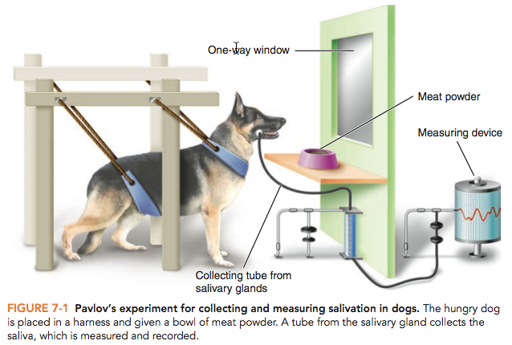
Pavlov’s Dog
Notes:
Pavlov’s setup for collecting and measuring salivation in dogs: The dog is placed in a harness and given a bowl of meat powder. A tube from the salivary gland collects the saliva, which is measured and recorded.

Slide 10
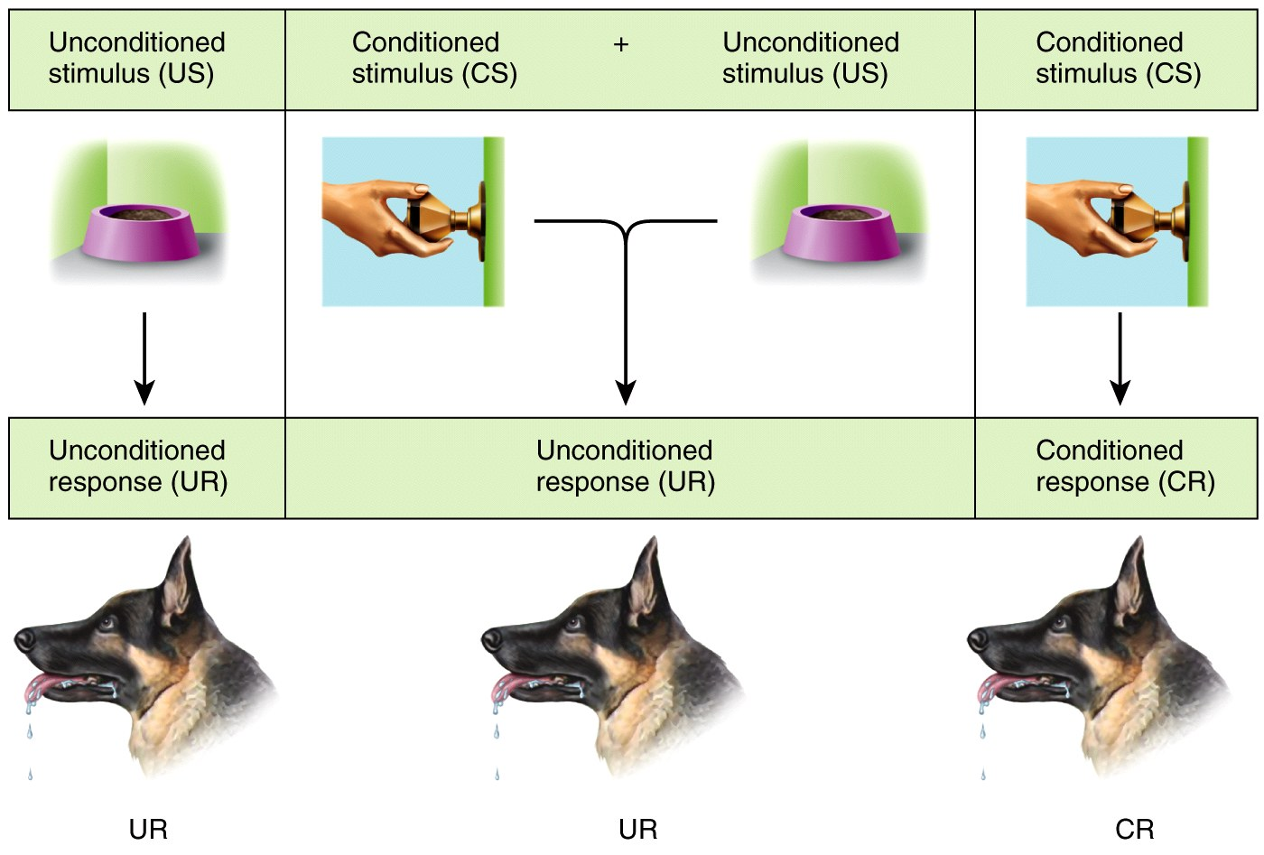
Pavlov’s Dog
Notes:
Lecture Expander: Describe Pavlov’s experiment that discovered classical conditioning. Pavlov was interested in understanding the role of the salivary reflex in digestion and to do so he conducted research on dogs. As time progressed in his studies, Pavlov noticed that his dogs were salivating even when food wasn’t present. They salivated when the lab assistants arrived or when they heard noises that signalled their arrival. This was very annoying to Pavlov because he didn’t want the dog to salivate until they got the food. As this continued to occur, Pavlov became interested in why the dogs salivated before the food was present.
However, Pavlov recognized this as evidence that the dogs had learned to associate the appearance of a lab assistant with getting food. Thus, they were having a behavioural response (salivation) in anticipation of getting food. Pavlov systematized this basic form of associative learning that is now called classical conditioning.

Slide 11
Classical Conditioning
Unconditioned stimulus (US) - a stimulus that on its own elicits a response (i.e., food)
Unconditioned response (UR) - a physical response elicited by an unconditioned stimulus; it does not need to be learned (i.e., salivation)
Conditioned stimulus (CS) - a neutral stimulus that eventually elicits the same response as an unconditioned stimulus with which it has been paired (i.e., bell)
Conditioned response (CR) - a physical response elicited by a conditioned stimulus; it is usually the same as the unconditioned response (i.e., salivation)

Slide 12
Classical Conditioning
In-class activity: Identify the UCS, UCR, CS, CR in the following example
Jonathan loves spicy food! Last week he ate at Tia Mexicana three times and literally perspired from the hot spices. Yesterday, as he drove past the restaurant, Jonathan began to perspire profusely.
Notes:
Answer for #1: Unconditioned stimulus=spicy food, Unconditioned Response=Perspiring, Conditioned Stimulus=restaurant
Conditioned Response=perspiring
Answer for #2: Unconditioned Stimulus=bottle, Unconditioned Response=drooling, Conditioned Stimulus=bell, Conditioned Response=drooling

Slide 13
Classical Conditioning
In-class activity: Identify the UCS, UCR, CS, CR in the following example
Jeremiah is 6 months old. His mother warms his bottles in the microwave. Whenever the bell on the microwave rings, Jeremiah begins to drool.
Notes:
Answer for #1: Unconditioned stimulus=spicy food, Unconditioned Response=Perspiring, Conditioned Stimulus=restaurant
Conditioned Response=perspiring
Answer for #2: Unconditioned Stimulus=bottle, Unconditioned Response=drooling, Conditioned Stimulus=bell, Conditioned Response=drooling

Slide 14
Major Conditioning Processes
Acquisition - the initial learning of the stimulus-response relationship; the most rapid acquisition followed by the strongest response is a half a minute delay between CS and US
Extinction - reduction of a conditioned response after repeated presentations of the conditioned stimulus alone
Spontaneous recovery - re-emergence of a conditioned response some time after extinction has occurred
Notes:
Lecture Expander: When the dog learned that the bell meant food was coming, that was the acquisition phase. If you continued to present the bell with NO food, then the dog would eventually stop drooling to the bell. That is the extinction process. However, sometimes the dog might still drool to the bell (spontaneous recovery). If the dog drooled to another sound that sounded like a bell, that is generalization. If the dog did not drool to the sound of a door bell but did drool to the sound of a bell that the experimenter used, that is discrimination.
Another example might be that dogs and cats usually discriminate between the sounds of their food container and your food containers. So if you rattle a box of dog treats, the dog will probably start to drool. If you rattle a box of corn flakes, the dog probably will not (unless you also feed it corn flakes) because it has learned to discriminate between the two.

Slide 15
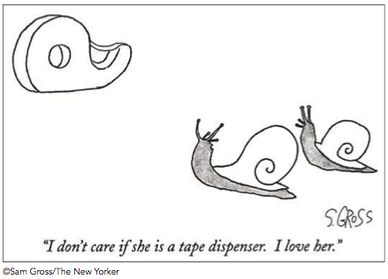
Major Conditioning Processes
Stimulus generalization - when similar stimuli elicit the same response as a conditioned stimulus after classical conditioning has occurred

Slide 16
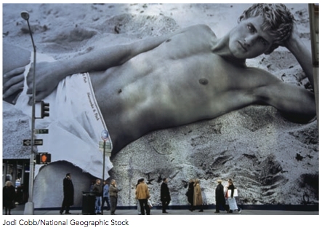
Major Conditioning Processes
Stimulus discrimination - an organism learns to emit a specific behaviour in the presence of a stimulus, but not in the presence of stimuli similar to the original stimulus
Higher-order conditioning - occurs when a previously conditioned stimulus functions as if it were an unconditioned stimulus for further conditioning

Slide 17
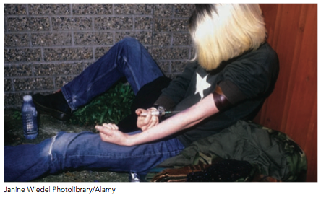
Classical Conditioning, Drug Tolerance, and Death

Slide 18
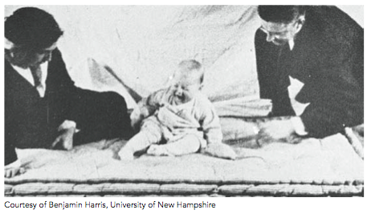
Classical Conditioning and Fear
John Watson, Rosalie Rayner and Little Albert
https://www.youtube.com/watch?v=FMnhyGozLyE

Slide 19
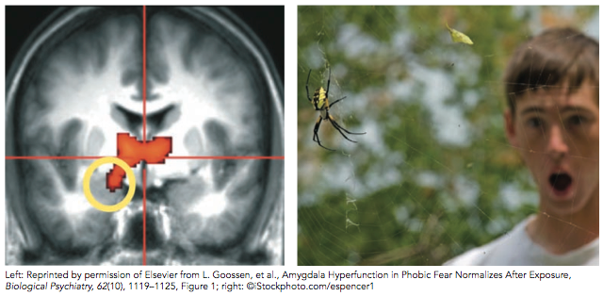
Phobias
Phobia - persistent, irrational or obsessive fear of a specific object or situation that may arise as a result of fear conditioning
Notes:
What was Little Albert’s phobia?
How might Little Albert have been treated with systematic desensitization?

Slide 20
Phobias
Systematic desensitization - a process used to condition extinction of phobias through gradual exposure to the feared object or situation
Notes:
What was Little Albert’s phobia?
How might Little Albert have been treated with systematic desensitization?

Slide 21
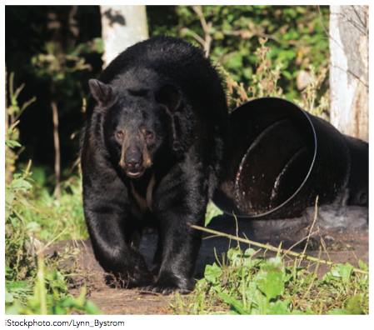
Classical Conditioning and Taste Aversion
Conditioned taste aversion - a form of classical conditioning where a previously neutral stimulus (often an odour or taste) elicits an aversive reaction after it’s paired with illness (nausea)
Notes:
Discussion questions:
1) Discuss how taste aversion could be linked to human adaptation and survival.
2) Name a time when you had a food aversion. What caused it? Do you still have it? What helped to eliminate it?
3) A woman ate tomatoes and then had the flu and threw them up. Now she won’t eat tomatoes. What is the UCS, UCR, CS, CR?
UCS= flu, UCR= throw up, CS=tomatoes, CR=throw up

Slide 22
Operant Conditioning
Operant conditioning - a form of associative learning where behaviour is modified depending on its consequences
Law of effect - behaviours leading to rewards are more likely to occur again, while behaviours producing unpleasantness are less likely to occur again

Slide 23
Thorndike’s Puzzle Box
Notes:
Thorndike’s puzzle box: Edward Thorndike used a puzzle box to study operant conditioning in cats. When the cat accidentally stepped on a pedal that pulled a string, the cat escaped from the box and received a fish reward. Once the cat had done this, it performed the action more quickly when it was put back into the box, until eventually it stepped on the pedal immediately each time.

Slide 24
Operant Conditioning and Behaviourism
Behaviourism - the systematic study and manipulation of observable behaviour
Founded by B.F. Skinner
Organisms don’t simply respond to the environment, but rather they exert influence (or “operate”) on it
Behaviours that are followed by favourable consequences will likely be repeated
https://www.youtube.com/watch?v=I_ctJqjlrHA
https://www.youtube.com/watch?v=H6LEcM0E0io

Slide 25
Reinforcement
Reinforcer - an experience that produces an increase in a certain behaviour
Positive reinforcement - presentation of a pleasant consequence following a behaviour to increase the probability that the behaviour will reoccur

Slide 26
Reinforcement
Negative reinforcement - removal of an unpleasant stimulus after a response to increase the probability that the behaviour will reoccur
If we put on a seatbelt and it stops the constant beeping we are more likely to put the seatbelt on again the next time
Addicts escape the cravings and other symptoms of withdrawal by taking a drug
A phobia is maintained as the individual escapes anxiety by avoiding the feared object

Slide 27
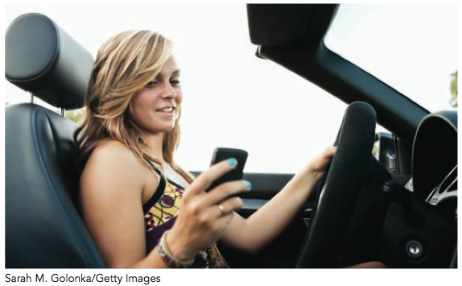
Punishment
Punishment - an experience that produces a decrease in a certain behaviour
Positive punishment - presentation of an unpleasant consequence following a behaviour to decrease the probability of the behaviour being repeated

Slide 28
Punishment
Negative punishment - removal of a pleasant stimulus as a consequence of a behaviour to decrease the probability of the behaviour being repeated
Silent treatment, no car or phone privileges, or time out will decrease the behaviour from happening again
Punishment by removal

Slide 29
Positive Reinforcement and Punishment
Positive reinforcement - giving a child a sticker for peeing on the potty
Positive punishment - yelling at a child if they pee on the potty
In both examples, you are adding something (praise or yelling)
Notes:
Lecture expander: One of the most difficult concepts to get in this chapter is the idea that a positive punishment is still a BAD punishment and that a negative reinforcement is still a GOOD reinforcement. Students want to associate positive with good and negative with bad. Emphasize that positive means adding something and negative means taking something away.
In-class activity- Ask students to think of a positive reinforcement and a positive punishment that they do to their friends, significant other, parents, etc. to get what they want.

Slide 30
Negative Reinforcement and Punishment
Negative reinforcement - constantly nagging your boyfriend until he buys flowers for you
Negative punishment - after your boyfriend buys you flowers, you don’t allow him to watch hockey
In both examples, you are taking away something (stopping nagging or withholding hockey)
Notes:
In-Class Activity: Ask students to think of a negative reinforcement and a negative punishment that they do to their friends, significant other, parents, etc. to get what they want.
You can then have students read some of their examples out loud and have the class guess if they are a positive or negative punishment or reinforcement.

Slide 31
Types of Reinforcers
Primary reinforcers - a stimulus that has survival value and is therefore intrinsically rewarding
Examples: food, water, termination of pain
Secondary reinforcers - a neutral stimulus that becomes rewarding when associated with a primary reinforcer.
Working earns money, which can be used for food and comfort
Good grades provide praise, approval

Slide 32
Types of Punishers
Primary punisher - a stimulus that is naturally aversive to an organism
Slapping, electric shock, extreme temperatures
Secondary punisher - a stimulus that becomes aversive when associated with a primary punisher
Disapproval, criticism, bad grades

Slide 33
Schedules of Reinforcement
Continuous reinforcement - behaviour is reinforced every time it occurs
Training occurs more quickly
Intermittent reinforcement - behaviour is only followed by reinforcement some of the time
Behaviours are harder to extinguish
Notes:
Discussion questions: If you have a job, what type of payment do you get? Are you continually reinforced or intermittently reinforced? What would it look like to be continually reinforced for work?
Lecture Expander: Learning is most rapid if the response is reinforced each time it occurs. What type of implications does this have for teaching a dog new tricks, punishing a child, etc.?

Slide 34
Intermittent Reinforcement
Ratio schedule
Fixed ratio schedule
Reinforcement occurs after a fixed number of responses
High rate of responding but with pauses
Variable ratio schedule
Reinforcement occurs after an unpredictable, average number of responses
High, steady rate of responding
Notes:
Variable ratio: Highest rate of responses. People have no idea when they will be reinforced so they keep the behaviours high.
Variable interval: Lower rates of response than VR.
Fixed ratio: Pause after reinforcement, then response rate increases as approach the next reinforcement.
Fixed interval: Behaviours go up around the time of reinforcement because people can predict when they will get the reinforcement.
Discussion question: What type of reinforcement schedule do slot machines have and why? Answer: variable ratio, because people will respond the most and for the longest period of time. Can you come up with other examples in real life of other reinforcement schedules?

Slide 35
Intermittent Reinforcement
Interval schedule
Fixed interval schedule
Reinforcement occurs after a fixed time has elapsed
Variable interval schedule
Reinforcement occurs after varying lengths of time
Notes:
Variable ratio: Highest rate of responses. People have no idea when they will be reinforced so they keep the behaviours high.
Variable interval: Lower rates of response than VR.
Fixed ratio: Pause after reinforcement, then response rate increases as approach the next reinforcement.
Fixed interval: Behaviours go up around the time of reinforcement because people can predict when they will get the reinforcement.
Discussion question: What type of reinforcement schedule do slot machines have and why? Answer: variable ratio, because people will respond the most and for the longest period of time. Can you come up with other examples in real life of other reinforcement schedules?

Slide 36
Operant Conditioning and New Behaviours
Shaping - introducing new behaviour by reinforcing successive approximations of the desired behaviour until the complete behavioural sequence emerges
Training a dog to roll over
Behaviour modification - a systematic approach to change behaviour using principles of operant conditioning
Teaching new academic, athletic, or social skills
Modifying undesirable behaviours

Slide 37
Learned Helplessness
A situation in which repeated exposure to inescapable punishment eventually produces a failure to make escape attempts
Notes:
Spousal abuse occurred in at least 6% of Canadian homes over the past 5 years (Statistics Canada, 2011). Psychologists believe that many victims develop feelings of helplessness and become convinced that they are incapable of changing the situation.

Slide 38
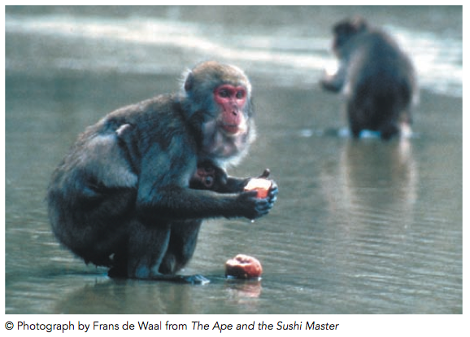
Observational Learning

Slide 39
Observational Learning
Observational learning or social learning - occurs without overt training in response to watching the behaviour of others, called models
Modelling - occurs when an observer learns from the behaviour of another
Vicarious learning - occurs when an individual observes the consequences to another’s actions and then chooses to duplicate the behaviour or refrain from doing so
Notes:
When you are in an unfamiliar situation, you look around to see what others are doing before doing anything yourself.

Slide 40
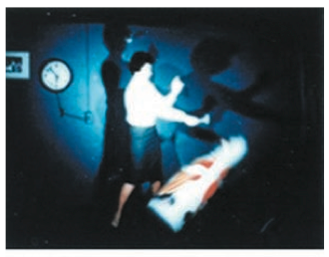
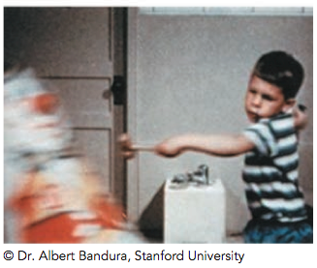
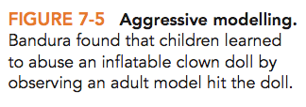
Bobo Doll Experiment
Vicarious Learning - Albert Bandura
https://www.youtube.com/watch?v=dmBqwWlJg8U
Notes:
Those who watched the video were twice as likely as those who did not watch it to display violent behaviour toward the doll
Those who watched the woman being rewarded were more likely to behave aggressively toward the doll than those who saw the woman being punished

Slide 41
Learning and Cognition
Implicit learning - refers to the acquisition of information without awareness (e.g., learning to talk or to walk)
Latent learning - occurs without reinforcement and is not used until called for; it is not a result of conditioning
Insight learning - a sudden realization of a solution to a problem or leap in understanding new concepts

Slide 42
Latent Learning in Rats
Notes:
Latent learning in rats: Rats are motivated to explore a maze, but when given a food reward, they make fewer errors in finding the quickest route to the end of the maze and the reward. When the reward is introduced after the rats explore the maze, the error rate drops sharply, indicating that learning occurred all along

Slide 43
Factors that Facilitate Learning
Timing
Multiple exposures separated by time facilitate learning facts
Context effect
Studying in several different locations increases the likelihood that you will form strong memories about the information

Slide 44
Factors that Facilitate Learning
Awareness and attention
Multi-tasking reduces overall performance
Some types of learning can occur without awareness
If information is inherently contradictory, attending to one stimulus can block our ability to attend to the relevant one

Slide 45
Stroop Effect
Name the ink colours below
Green
Red
Black
Blue
Notes:
Stroop Effect: A psychological test that involves presenting a list of words printed in different colours. Each of the words is a colour word (green, red, black, blue), but each is printed in a colour that differs from that of the word (green, red, black, blue). Participants are asked to list the colours of the ink, thus ignoring the word colour.

Slide 46
Factors that Facilitate Learning
Sleep
Sleep deprivation impairs our abilities to pay attention and learn
Sleep deprivation can prevent learned information from moving into more permanent long-term memory storage

Slide 47
Prenatal and Postnatal Learning
Prenatal learning
Non-associative
Exhibit habituation and sensitization to sensory stimuli
Basic associative
Can be classically conditioning
Postnatal learning
Olfactory learning - newborns exhibit a preference for their mothers’ odour
Notes:
Lecture expander: Newborns whose mothers ate garlic during pregnancy did not turn their noses to the smell of garlic, but newborns whose mothers did not eat garlic during pregnancy avoided the smell.
Classical conditioning: Music associated with mother’s relaxation exercises results in decreased fetal movement over time. What would be the UCS, URS, CS, CR?
Postnatal learning example: Newborns quickly learn that when they are put on their mother’s lap lying down it means that food is coming. A newborn will even start to salivate when put in this position. UCS=food, UCR=salivating, CS=position needed when nursing, CR=salivating

Slide 48
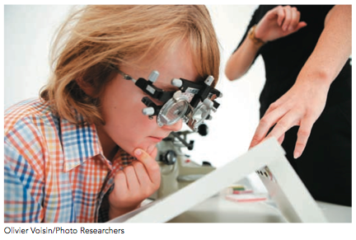
Specific Learning Disorder
Learning Disorder - a specific deficiency in one aspect of cognitive function while other aspects function normally
Dyslexia
Dyscalculia
Dysgraphia

