Slide 1
Learning Objectives
Define consciousness and describe key brain areas involved
Preconscious and unconscious states
Why we sleep and dreaming – problems
Hypnosis – what it is and how it can be used
Techniques and effects of mediation
Psychoactive drugs

Slide 2
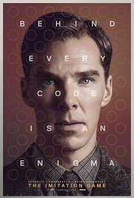
Lecture Opener: Consciousness and the Online World
Who is Eugene Goostman?

Slide 3
Attention and Conscious Awareness
“Before we can be conscious of something . . . we have to pay attention to it.” John Ratey (2001)
Daniel Simons and Attention – TED talk at UIUC
https://www.youtube.com/watch?v=9Il_D3Xt9W0

Slide 4
When We Are Awake: Conscious Awareness
What is consciousness?
Everything you are thinking about right now!
Your awareness of your surroundings and yourself
Stream of consciousness—a continuing flow of changing thoughts (William James, 1890)
Notes:
In-Class Activity: Ask students to take out a slip of paper and write down every little thing that goes through their heads. Reassure them that you will not collect these, so they should be honest and specific. After students have written down their streams of consciousness for a minute or two, ask for a few students to volunteer to read what they wrote. Then you can discuss why William James said that consciousness is like a stream of consciousness. Our consciousness flips and floats from one topic to the next very quickly.

Slide 5
When We Are Awake: Conscious Awareness
Consciousness involves:
Attention
Monitoring
Remembering
Planning
Notes:
In-Class Activity: Ask students to take out a slip of paper and write down every little thing that goes through their heads. Reassure them that you will not collect these, so they should be honest and specific. After students have written down their streams of consciousness for a minute or two, ask for a few students to volunteer to read what they wrote. Then you can discuss why William James said that consciousness is like a stream of consciousness. Our consciousness flips and floats from one topic to the next very quickly.

Slide 6
Conscious Awareness and the Brain
Inattentional blindness — failure to notice things around us to which we are not paying attention
Blindsight — being unaware of what has reached our attention
Blindsight and Emotions
https://www.youtube.com/watch?v=GwQe_FH1i1w
Notes:
Discussion Question: Are there different states of consciousness? Students might say being in a coma. Is that really conscious? Is sleeping really conscious? When you are sleeping and someone calls your name, do you wake up? Probably. Why? Because some part of your brain is still conscious and paying attention to your surroundings. Thus you might discuss different levels of consciousness from heightened awareness to low levels of consciousness.
Highest level of awareness:
focused attention
Middle level of awareness:
Automatic processes—requires minimal attention to do (like driving, eating)
Daydreaming
Low level of awareness:
Unconscious mind—painful memories or thoughts and feelings that you repress or don’t think about
Unconscious body—coma, etc.
Sleep (some call this an altered state of consciousness)

Slide 7
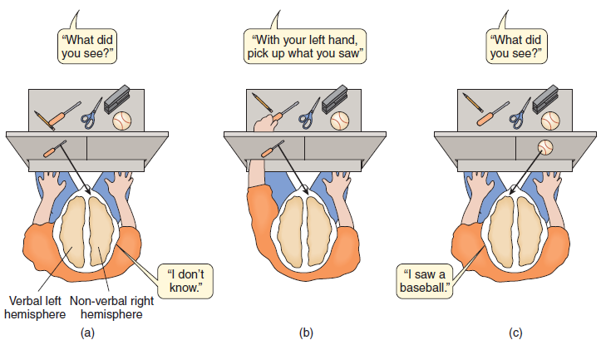
Conscious Awareness and the Cerebral Cortex – Split Brain Patients

Slide 8
Conscious Awareness and the Thalamus
Different areas of the brain are responsible for attention and for one’s awareness of that attention
Intralaminar nuclei and midline nuclei of the thalamus
Damage bilaterally – Coma
Damage unilaterally – loss of awareness of one half of the body

Slide 9
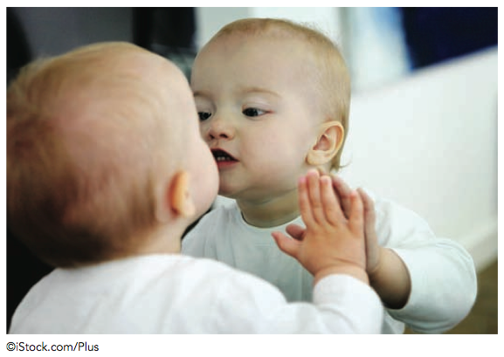
Conscious Awareness and Development
Conscious awareness —being aware of what has reached our attention
Conscious awareness of self develops seems to develop around 18 months

Slide 10
Preconscious and Unconscious States
Preconsciousness — level of awareness in which information can become readily available to consciousness if necessary
Example: What did you do last weekend?
Unconscious state — state in which information is not easily accessible to conscious awareness
Example: What did you eat last weekend?
Notes:
Discussion Question: Are there different states of consciousness? Students might say being in a coma. Is that really conscious? Is sleeping really conscious? When you are sleeping and someone calls your name, do you wake up? Probably. Why? Because some part of your brain is still conscious and paying attention to your surroundings. Thus you might discuss different levels of consciousness from heightened awareness to low levels of consciousness.
Highest level of awareness:
focused attention
Middle level of awareness:
Automatic processes—requires minimal attention to do (like driving, eating)
Daydreaming
Low level of awareness:
Unconscious mind—painful memories or thoughts and feelings that you repress or don’t think about
Unconscious body—coma, etc.
Sleep (some call this an altered state of consciousness)
Discussion Question: Are there different states of consciousness? Students might say being in a coma. Is that really conscious? Is sleeping really conscious? When you are sleeping and someone calls your name, do you wake up? Probably. Why? Because some part of your brain is still conscious and paying attention to your surroundings. Thus you might discuss different levels of consciousness from heightened awareness to low levels of consciousness.
Highest level of awareness:
focused attention
Middle level of awareness:
Automatic processes—requires minimal attention to do (like driving, eating)
Daydreaming
Low level of awareness:
Unconscious mind—painful memories or thoughts and feelings that you repress or don’t think about
Unconscious body—coma, etc.
Sleep (some call this an altered state of consciousness)

Slide 11
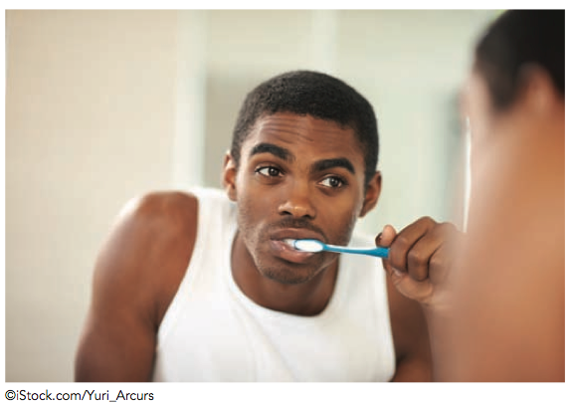
Preconscious and Unconscious States
Automatic Behaviours – Do you remember every time you brushed your teeth last week?

Slide 12
Cognitive Views of the Unconscious
We have two main types of memory:
Explicit memory – involves pieces of knowledge that we are fully aware of
EXAMPLES?
Implicit memory – knowledge that we have stored in memory that we are not typically aware of or able to recall at will.
EXAMPLES?
Notes:
Discussion Question: Have students try to generate examples of explicit and implicit memories and explain why they categorized them as one type of memory or the other.

Slide 13
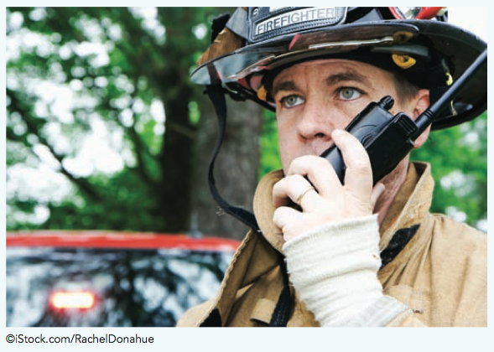
Cognitive Views of the Unconscious
Are there decisions that we make unconsciously?
Eric Kandel (Nobel Prize Winner – Medicine) Unconscious Decision Making
https://www.youtube.com/watch?v=ph7LcupAENw
Notes:
Discussion Question: What is unconscious decision making? If we make decisions unconsciously what does this say about our ability to make choices based on conscious free will?

Slide 14
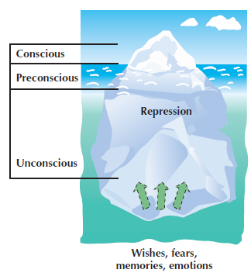
Freud’s View of the Unconscious
Notes:
Lecture Expander: ask if students have ever experienced a slip of the tongue or Freudian slip. There are always one or two students that are willing to share a funny story or two relating to this topic.

Slide 15
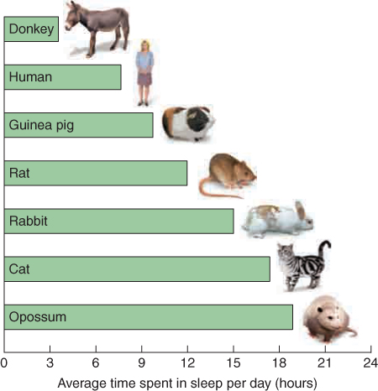
When We Are Asleep
Why do we sleep?
Adaptive theory of sleep – theory that organisms sleep for the purpose of self-preservation, to keep away from predators
Restoration theory - holds that sleep restores our brains and bodies
Russell Foster – Why do we Sleep? The Role of Sleep in Brain Function
https://www.youtube.com/watch?v=RdgYhpqqSP4
Notes:
Sleep needs of various animals: Animals vary greatly in how much sleep they need each day. Their sleep needs are related in part to how much awake time is needed to obtain food and protect themselves from predators (Siegel, 2005).

Slide 16
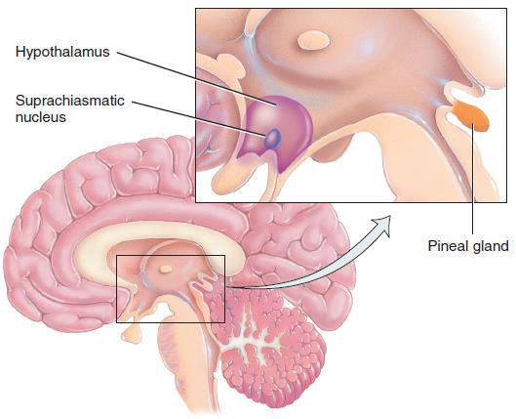
When We Are Asleep : Circadian Rhythm
Circadian rhythm (biological clock) is a 24-hour cycle of which the sleep/wake cycle is one. The sleep/wake cycle is controlled by the suprachiasmatic nucleus (SCN) of the hypothalamus
Notes:
Lecture expanders: Ask students to come up with different types of circadian rhythms. Discuss experiments that can test whether light is essential for setting our circadian rhythm. For example: Maurizio Montalbini spent months living in a cavern with no external light or means of telling the time to study the circadian rhythms free of external or artificial influences. In such settings, the SCN extends the body’s “day,” by as much as an hour, to about 25 hours

Slide 17
Sleep – Wake Rhythms
What causes our circadian rhythm?
Genetic differences? Environmental differences?

Slide 18
Sleep Cycle(s)
90–100 minutes per sleep cycle
One cycle goes through Stage 1, 2, 3, 4, and REM sleep
We have about five cycles a night

Slide 19
Stages of Sleep
Stage 1 - transition into sleep (5 min)
At sleep, alpha waves change to theta waves
HR slows, BP decreases
Hypnagogic state, hypnagogic hallucinations and myclonic jerks
Stage 2 - harder to wake (15-20 min)
More relaxed
Sleep spindles (burst of rapid brain waves)

Slide 20
Stages of Sleep
Stage 3 - deeper sleep (5-15 min)
Theta waves and delta waves
Stage 4 - deepest sleep (20-30 min)
Slow HR, brain and body in total relaxation (20-30 min)
Deepest sleep
Mostly delta waves
Sleep walking and bed wetting are more likely

Slide 21
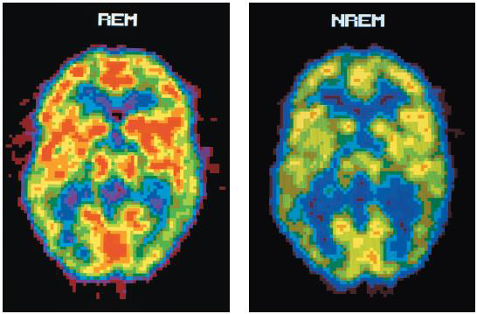
Rapid Eye Movement (REM) Sleep
A stage of sleep is associated with rapid and jagged brain wave patterns, increased heart rate, rapid and irregular breathing, rapid eye movements, and dreaming.
REM Sleep Disorder
https://www.youtube.com/watch?v=rFXYRQ9xPUA

Slide 22
Information Processing Theory of Dreaming
Dreams involve processing information from the day (i.e., encoding memory and problem solving)
Dreams could be a mental realm where we can solve problems and think creatively

Slide 23
Activation-Synthesis Model of Dreaming
During sleep the brain has a lot of random activity via brainstem activity that activates the sensory systems of the cortex.
Dreams reflect the brains efforts to make sense out of or find meaning in the neural activity that takes place during sleep
Notes:
Activation-synthesis: According to the activation-synthesis theory of dreaming, neurons in the brainstem activate neurons in other areas throughout the brain. The brain combines these various signals into a story, or dream.

Slide 24
Freudian Dream Theory
Dreams represent the expression of unconscious wishes or desires

Slide 25
Nightmares, Lucid Dreams and Daydreams
Nightmares – dreams filled with intense anxiety
Lucid Dreams – the sleeper fully recognizes that her or she is dreaming and occasionally actively guides the outcome of the dream.
Daydreams – fantasies that occur while one is awake and aware of external reality but is not fully conscious

Slide 26
Sleep and Age

Slide 27
Sleep Deprivation
If we could sleep as long as we wanted, most people would sleep 9–10 hours
Chronic sleep loss results in:
General depressed state
Lower immune system
Lower ability to concentrate
Higher incidence of accidents
Lower productivity and higher likelihood of making mistakes
Notes:
Discussion Question: Ask students how much sleep they get a night and how they feel when they do not get enough sleep. You might want to talk about professions where people do not get enough sleep and the repercussions of that. For example, medical students often are forced to stay up for 48–72 hours straight. When this happens, they can make dangerous mistakes. For example: some surgeons have fallen asleep while suturing someone up.

Slide 28
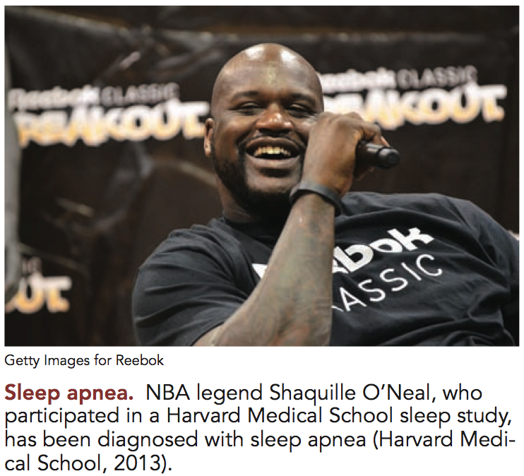
Common Sleep Disorders
Insomnia
Most common
Difficulty going to sleep, staying asleep, or wake early
Caused by stress, drug dependence, pain, depression
Sleep apnea
Second most common
Repeatedly stops breathing during night
Possible to have hundreds of attacks per night
Can lead to cardiac arrest
Notes:
Lecture Expander: 25% of children suffer sleep disturbances
Insomnia: 43% adults are affected. One way to treat it is to get the person to associate bed with sleep rather than reading, watching TV, or talking on the phone. Relaxation training is often used, and decrease use of drugs/alcohol, which can disrupt normal sleep cycles.
Sleep apnea: Carbon dioxide builds up in the blood causing momentary awakening in which sleeper gulps in air. Breathing may stop for 10 seconds or long enough to turn blue. Possible to have over 300 attacks per night. Have no recollection of it, but feel sleepy. 54% of married Canadians say their partners snore while sleeping. Treatment: Use a positive flow ventilator that keeps throat tissue open.
Sleepwalking: Up to 5% of children experience this disorder for a period of time and up to 17% have at least one episode.

Slide 29
Sleep Disorders
Narcolepsy
Excessive daytime sleepiness
Suddenly fall into REM sleep during the day
Can last up to 15 minutes
Genetic factors involved
No cure
Sleepwalking
Most common in children
Occurs in Stages 3 or 4
Appears to be inherited
Narcoleptic Dog Skeeter - Video
https://www.youtube.com/watch?v=X0h2nleWTwI
Notes:
Picture: Tucker, seen here before and during a sudden narcoleptic episode.
Lecture Expander:
Narcolepsy: Brief lapse of sleep lasting less than 1 hour.
Sleep attacks last several minutes—instantly enter REM sleep and experience sleep paralysis; muscles go limp and the person collapses.
Onset is in adolescence and the condition is chronic.
Sleepwalking: Typically occurs within 3 hours of falling asleep. Person moves about in a slow, poorly coordinated manner with a blank look on their face. Can navigate around objects without difficulty. They dress, eat, go to the bathroom in wrong places. Wake up unaware of what happened. Can be hard to wake them, but they do respond to verbal suggestion.

Slide 30
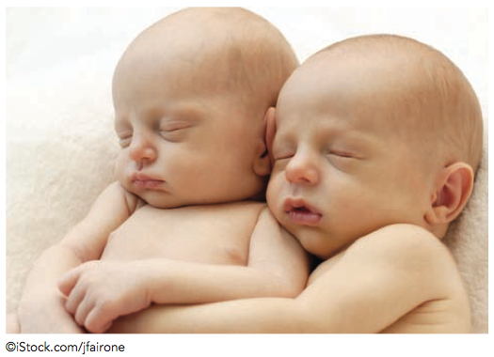
Sleep Disorders
Night terrors
Stages 3 or 4
Child screams in panic; goes back to sleep immediately and does not remember the event in the morning
Resolves by adolescence
Nightmare disorder
Experience frequent nightmares
Nightmares are more common when stressed and in children
Notes:
Lecture Expander:
Night terrors: The child will abruptly sit up in bed and scream in panic. They will look terrified and disoriented. The child is in Stage 4 sleep the whole time and will not remember waking up.

Slide 31
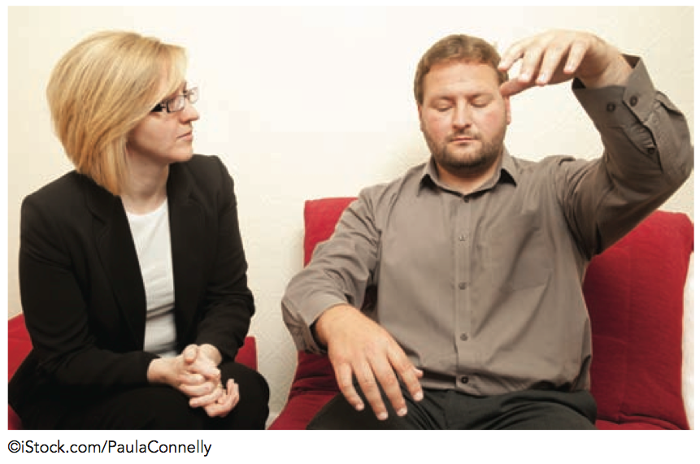
Hypnosis
Hypnosis - altered state of consciousness with heightened suggestibility, deep relaxation, and intense focus
Posthypnotic responses
Posthypnotic amnesia
Hypnotic hallucinations
Decreased activity in anterior cingulate cortex when used to reduce pain

Slide 32
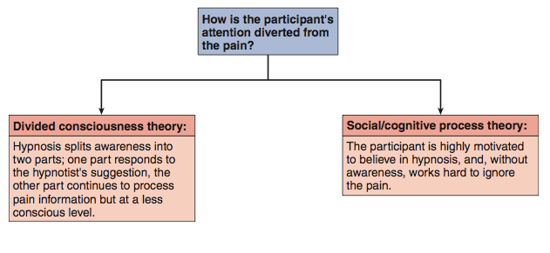
How Hypnosis Works – Two Possible Mechanisms

Slide 33
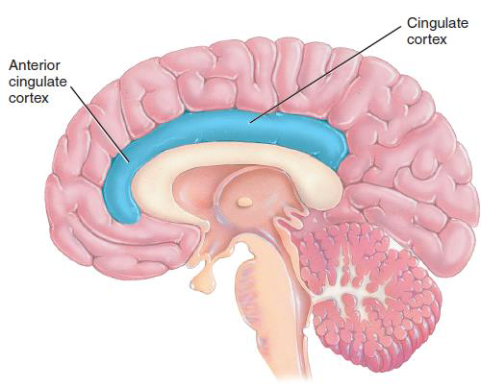
How Hypnosis Works – The Brain
Neuroimaging research suggests that the brain’s anterior cingulate cortex, may be particularly involved when hypnosis is used to anesthetize or reduce pain.

Slide 34
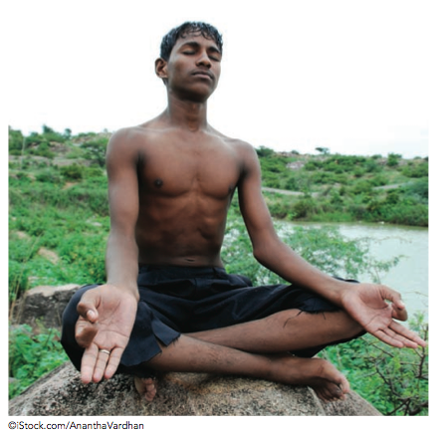
Meditation
Meditation – a technique designed to turn one’s consciousness away from the outer world toward one’s inner cues and awareness

Slide 35
Types of Meditation
Opening-up approach - clear one’s mind in order to receive new experiences
Concentrative meditation - actively concentrate on an object, word, or idea, called a mantra
Koan—a riddle, such as “What is the sound of one hand clapping?”
Mindfulness meditation - pay attention to one’s feelings, thoughts, and sensations
Being in the moment
Being mindful, but not judgmental

Slide 36
Psychoactive Drugs
Psychoactive drugs - any substance that alters mood, perception, awareness, or thought
Addiction - psychological or physical compulsion to take a drug, resulting from regular ingestion and leading to maladaptive patterns of behaviour and changes in physical response

Slide 37
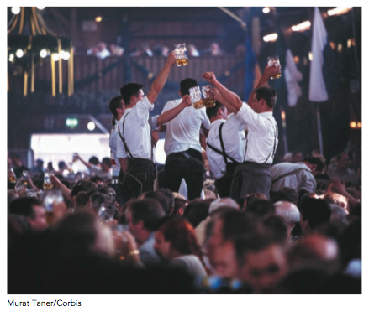
Three Categories of Psychoactive Drugs – Depressants
Depressants - act on the central nervous system (CNS) to suppress bodily processes
Alcohol - Influences GABAergic neurons
Slows down brain areas that control judgment, inhibition, behaviour (speech, motor functioning, emotional expression)
Notes:
Lecture Expander:
Depressants: The more a person drinks, the more their central nervous system is depressed. If they drink too much, they will depress major organs and this will result in death. Alcohol affects the encoding of new memories, causing black outs.
Stimulants: Mimic the effects of the neurotransmitter epinephrine, which triggers the nervous system.
Causes increased energy, HR, blood pressure, suppression of hunger and digestion.
Too much can raise HR and blood pressure to a dangerous level!
Hallucinogens: Receptors for THC are in the hippocampus, which explains short-term memory loss.
Also helps to alleviate nausea and improve appetite.
Opiates: Morphine and heroin mimic the effects of the brain’s own endorphins. Endorphins are chemicals that relieve pain and make you feel good. Exercise also releases endorphins.
The limbic system controls emotions. Opiates change the limbic system to produce increased feelings of pleasure.
The brainstem controls breathing/coughing. Opiates can act on the brainstem to stop coughing or slow breathing.
The spinal cord transmits pain signals from the body. Opiates block pain messages.
Opiates taken regularly will completely suppress our natural ability to make endorphins.

Slide 38
Three Categories of Psychoactive Drugs – Depressants
Sedative-hypnotics (benzodiazepines)
Examples are: Xanax, Ativan and Valium
Influences neurons that produce GABA
Produces relaxation and drowsiness, relieves anxiety

Slide 39
Three Categories of Psychoactive Drugs – Depressants
Opioids (opium heroin, morphine, codeine, methadone)
Activates the opioid receptors in the brain, providing their analgesic effect and their related high
Reduces pain and emotional tension, produces pleasurable and calming feelings

Slide 40
Three Categories of Psychoactive Drugs - Stimulants
Stimulants - act on the CNS to increase bodily processes
Caffeine – Works on adenosine neurons, which produces a sensation of increase alertness when stimulated
Nicotine - influences dopamine and acetylcholine neurons, which increases alertness and reduces stress

Slide 41
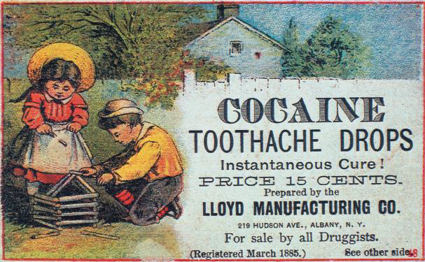
Three Categories of Psychoactive Drugs - Stimulants
Cocaine - blocks neuronal re-uptake of dopamine, norepinephrine, and serotonin.
Increases energy and alertness, produces euphoric feelings of well-being and confidence
Amphetamines - increase release of dopamine and norepinephrine
Increases energy and alertness, reduces appetite, produces euphoric feelings

Slide 42
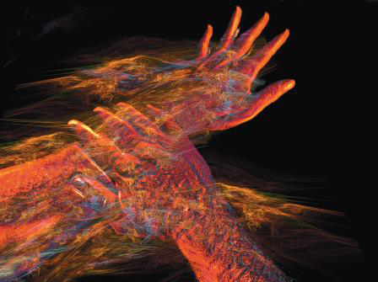
Three Categories of Psychoactive Drugs - Hallucinogens
Hallucinogens—produce sensory or perceptual distortions called hallucinations
LSD - Stimulates dopamine and serotonin receptors
Dramatically strengthens visual perceptions (including illusions and hallucinations) along with profound psychological and physical changes
British Troops and LSD
https://www.youtube.com/watch?v=KWodyapGNxI

Slide 43
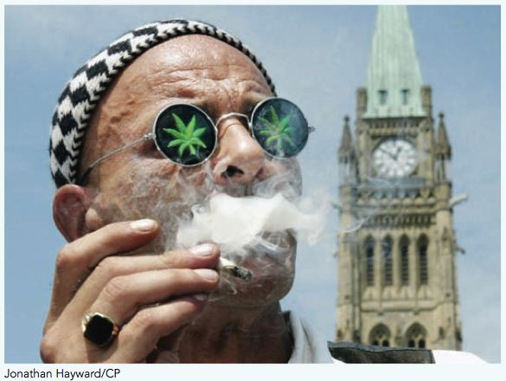
Three Categories of Psychoactive Drugs - Hallucinogens
Hallucinogens - produce sensory or perceptual distortions called hallucinations
Cannabis (marijuana, THC) -Stimulates release of endorphins and dopamine
Produces a mixture of hallucinogenic, depressant, and stimulant effects

Slide 44
Three Categories of Psychoactive Drugs - Hallucinogens
Hallucinogens - produce sensory or perceptual distortions called hallucinations
MDMA (Ecstasy) – leads to an increase of serotonin
Enhances sensory perceptions, increases energy and alertness, produces feelings of empathy and emotional well-being

Slide 45
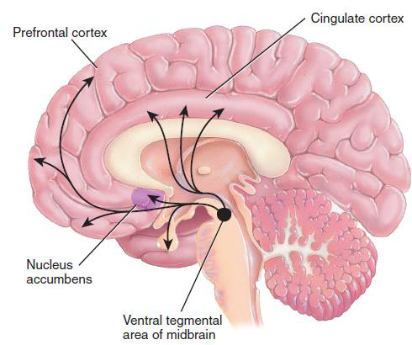
Psychoactive Drugs and Reward
Psychoactive drugs activate a reward learning pathway, or “pleasure pathway,” in the brain.
Reward-deficiency syndrome - people might abuse drugs because their reward centre is not readily activated by usual life events.

