Slide 1
Learning Objectives – Chapter 3
How Do Scientists Study the Nervous System
How Does the Nervous System Work?
How Do Neurons Work?
How is the Nervous System Organized?
Structures of the Brain
Brain Side and Brain Size
Evolutionary Psychology

Slide 2
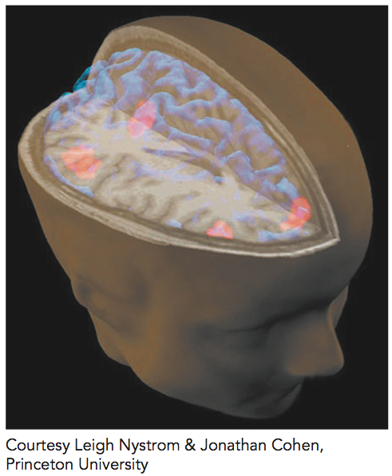
Chapter Opener – Can you Gain Immortality by Preserving your Brain?

Slide 3
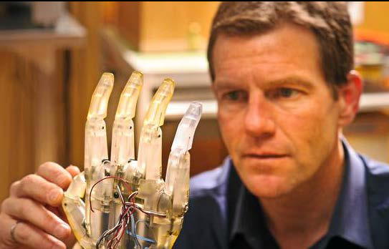
Chapter Opener – Neural Machine Interfacing – What do you Think?
Rat Brain flying a Jet Simulator
https://www.youtube.com/watch?v=nXncJZCMog0

Slide 4
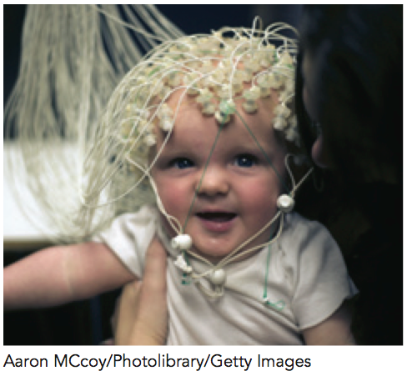
The Field of Neuroscience
Neuroscience – the study of the brain and nervous system
Behavioral Neuroscience
Neuropsychology
Physiological Psychology
Biopsychology

Slide 5
How Do Scientists Study the Nervous System?
Examining autopsy tissue
Testing the behaviour of patients with brain damage
Recording electrical brain activity (EEG or ERP)
Animal studies
Neuroimaging techniques that show visual images in awake humans

Slide 6
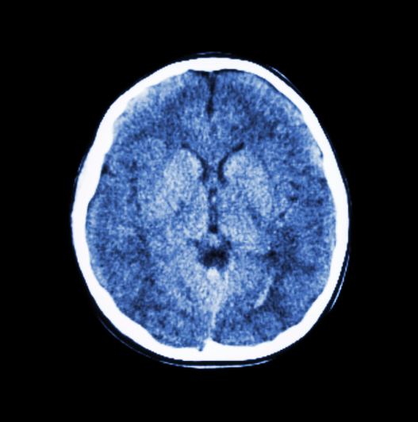
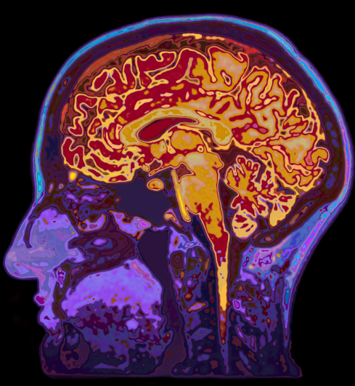
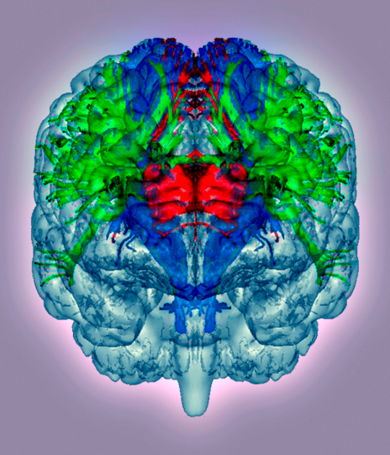
The Brain at Work
©iStockphoto.com/stockdevil
©iStockphoto.com/ MachineHeadzl
Science Photo Library/Getty Images
CAT Scan
MRI Scan
DTI Scan
Notes:
These three examples of brain imaging are a CAT (computerized axial tomography) scan, MRI (magnetic resonance imaging) scan and DTI (diffusion tensor imaging)

Slide 7
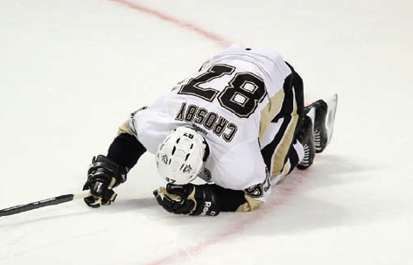
‘Mild’ Brain Injury
Jonathan Daniel/Getty Images
Sidney Crosby. Pittsburgh Penguins’ Sidney Crosby hits the ice after a collision during an exhibition game in 2013.
Chronic Traumatic Encephalopathy - associated with a constellation of neurocognitive symptoms, including personality change, memory loss, progressive dementia, mood swings, confusion, tremors, speech and gait abnormalities, depression, and suicidal ideation and completion.

Slide 8
http://www.medicalexhibits.com/medical_exhibits.php?exhibit=07039_01X&query=coup%20contrecoup%20contracoup%20brain%20acceleration%20deceleration%20head

Slide 9
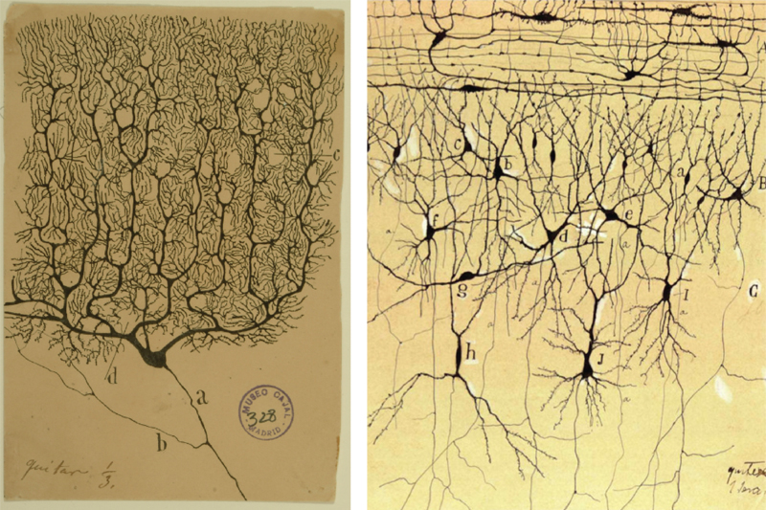
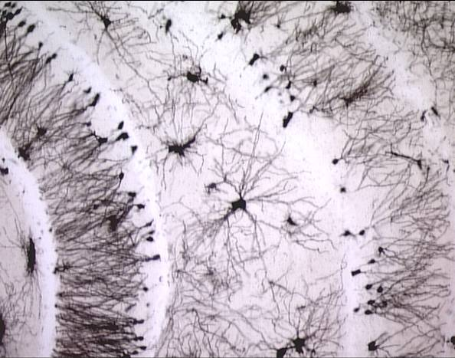
How Does the Nervous System Work?
Neuron - a nerve cell
Sensory - Gathers sensory information
Motor - Communicates information to the muscles
Interneuron - Carries information between neurons in the brain and the spinal cord
Cajal vs Golgi
1906

Slide 10
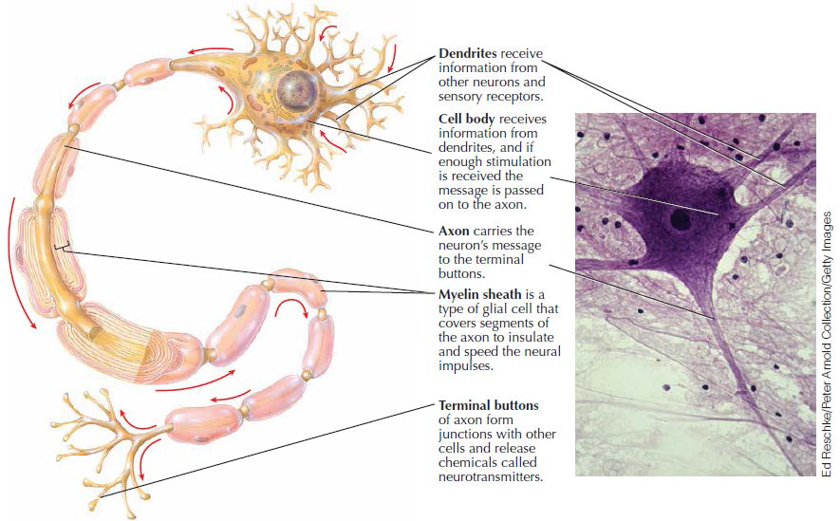
The Structure of Neurons

Slide 11
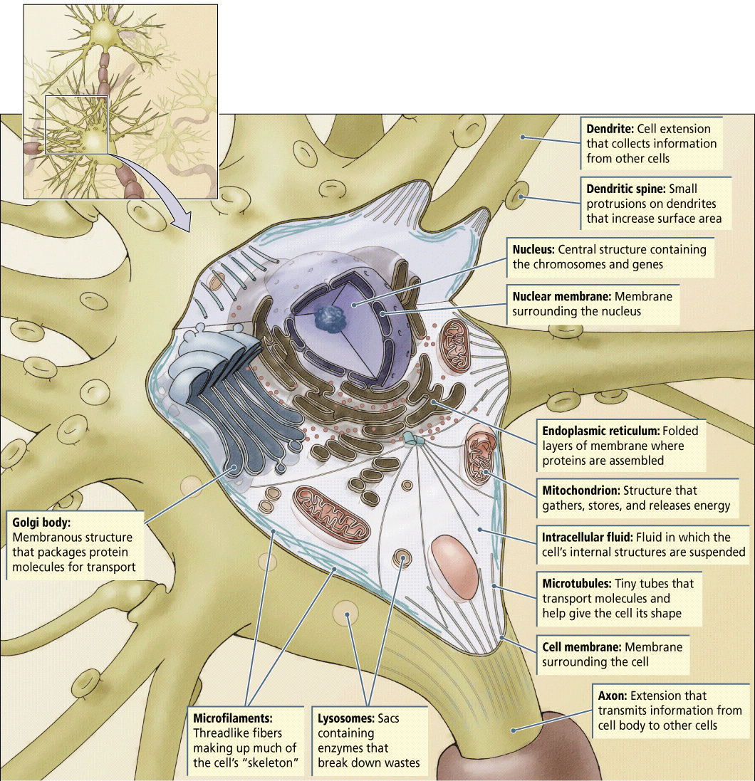

Slide 12
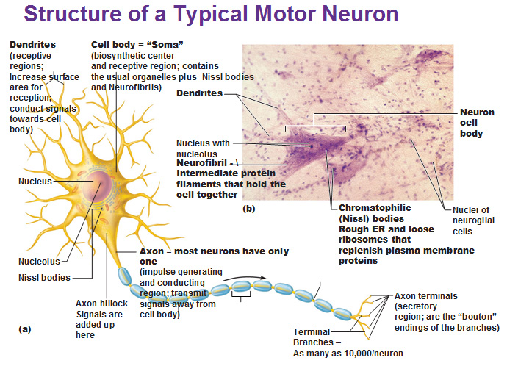

Slide 13
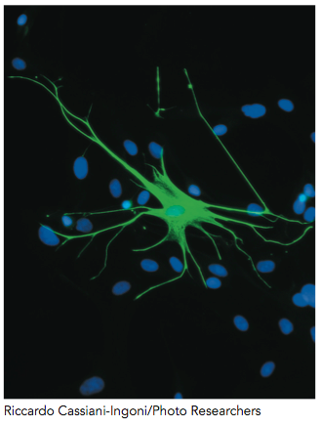
Glia
Glia - Cells that help support neurons
Astrocytes - Creates blood-brain barrier, influences communication between neurons, and helps heal brain damage
Oligodendroglia - Provides myelin to speed up transmission of neurons
Microglia - Cleans up dead cells and prevents infection in the brain

Slide 14
Start Neuron Lecture Here…
To understand how a neuron works …you need to understand 3 things..
1.Concentration gradient
2. Electrical gradient
3. The Brain is like chicken soup jello
4. In every membrane there are proteins that can, if motivated change shape

Slide 15
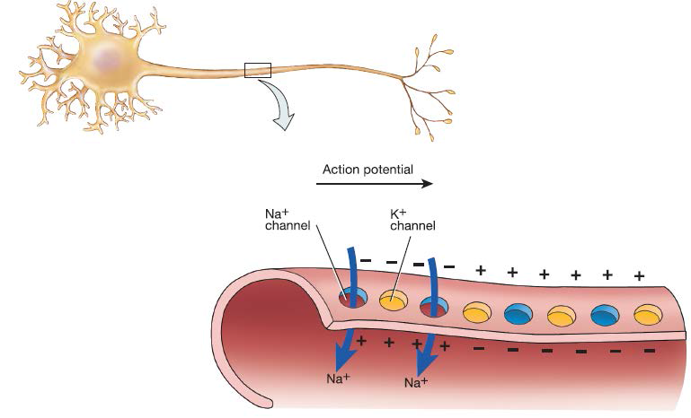
How Do Neurons Work?
Resting potential - When a neuron is at rest it is negatively charged inside (intracellular) relative to the outside (extracellular)

Slide 16
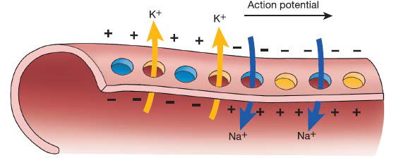
How Do Neurons Work?
Action potential - When a neuron fires Pores in the neuron (ion channels) open to let charged ions flow into and out of the neuron. The neuron becomes more positive in the inside relative to the outside. This shift in electrical charge triggers the axon terminals to release neurotransmitters.

Slide 17
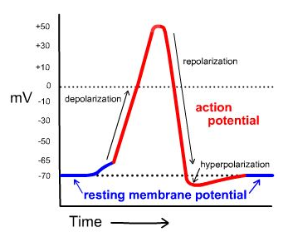
The Action Potential
Courtesy Genevieve Thurlow
Figure 3-2 Resting membrane potential and action potential.
Animation of the Action Potential
https://www.youtube.com/watch?v=XdCrZm_JAp0
Notes:
Definitions:
Ion channels: pores in the cell membrane that open and close to allow certain ions into and out of the cell
Concentration gradient: the relative concentration of sodium ions inside and outside of the neuron
Sodium-potassium pumps: protein molecules in the membrane of cells that push out sodium ions and push in potassium ions
Threshold: the point at which the relative excitatory influence of other neurons succeeds in causing a neuron to initiate an action potential
An action potential occurs when excitatory signals outweigh the number of inhibitory signals and reach a certain threshold.

Slide 18
All-or-None Principle
Either a neuron is sufficiently stimulated to start an action potential (all) or it is not (nothing). Immediately after a neuron has fired it cannot fire again (refractory period)
Courtesy Genevieve Thurlow
Figure 3-2 Resting membrane potential and action potential.

Slide 19
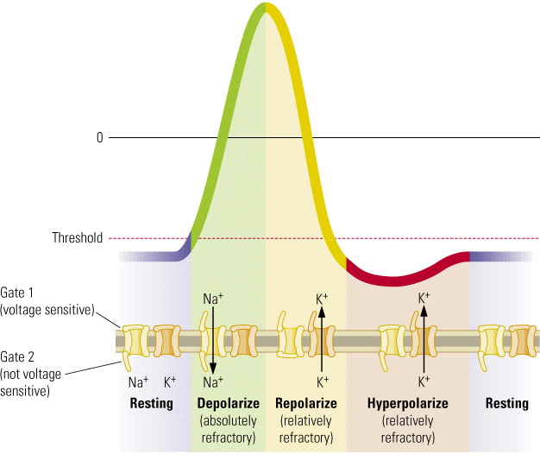

Slide 20
Nodes of Ranvier
The nodes of Ranvier are the regions of bare axon that are between areas wrapped in myelin. Action potentials travel down myelinated axons by jumping from node to node.

Slide 21
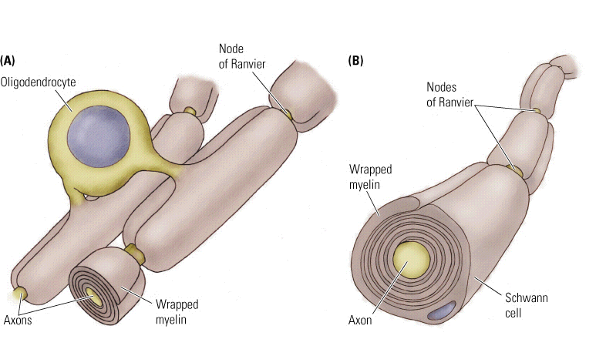

Slide 22
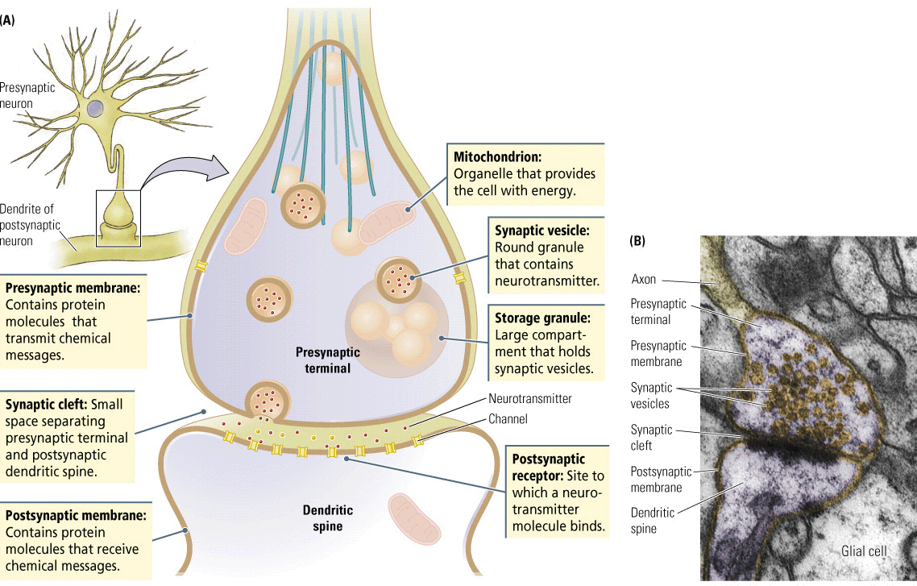

Slide 23
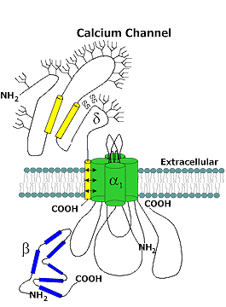

Slide 24
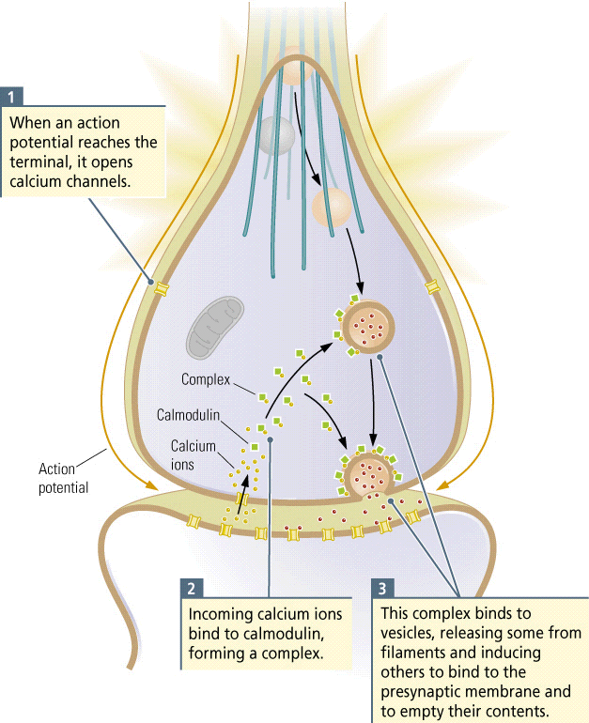

Slide 25
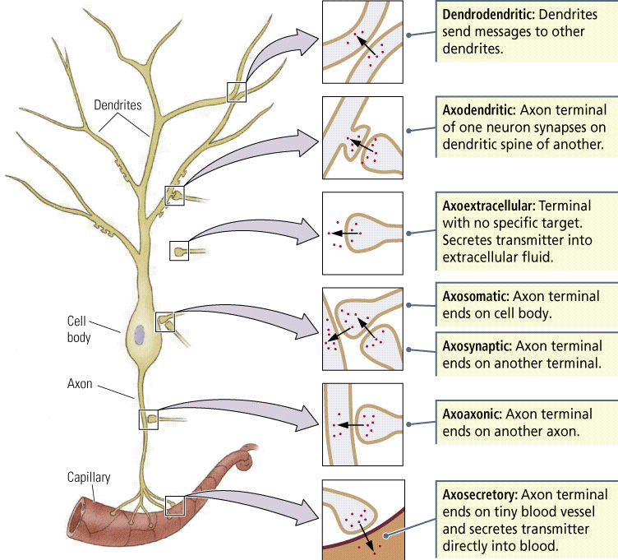

Slide 26
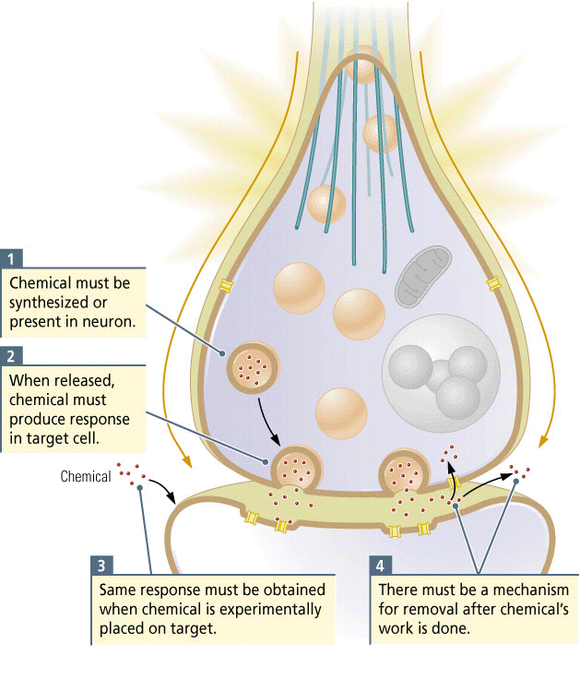

Slide 27
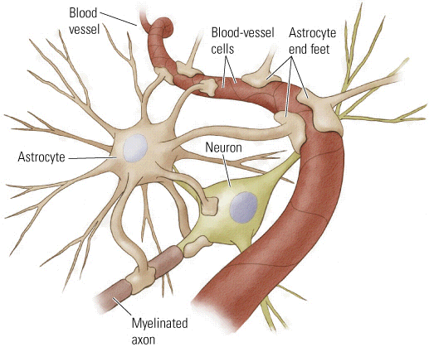
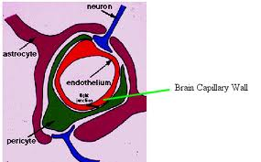

Slide 28
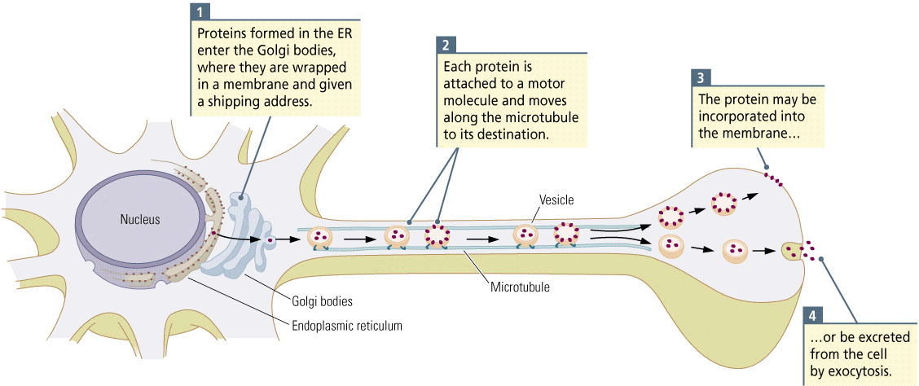

Slide 29
How a Neuron Works….You will be tested on this! So Learn it! :)
1.
Cell at resting potential….
Na+/K+ pumps – 3 Na+ out 2 K+ in (-70mv)
EG/CG is pushing Na+ into cell (no doors -VGNa+Ch)
CG pushing K+ out/EG holding it in
2.
One door opens essentially starting an AP
NA+ races in because of EG/CG
K+ races out because of EG/CG
Exchange across membrane creates a localized electrical charge..ripples out causing next closest voltage gated Na+ to open….repeat door opens

Slide 30
3.
VGNa+Ch open Na+ races in K+ out – electrical field VGNa+Ch opens….so on until hits myelin sheath (schwann-body or oligodendrocyte-CNS) – Newton Cradle
www.youtube.com/watch?v=mFNe_pFZrsA
(faster energy transfer than gates opening and closing but loses energy –graded potential)
ALS - Amyotrophic lateral sclerosis (ALS)
MS – Multiple sclerosis
Damaged Schwann/Oligos
Node of Ranvier – signal recapitulation

Slide 31
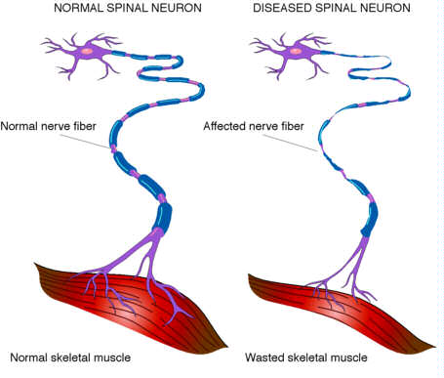

Slide 32
4 The Synapse…
-VGCa++Ch opens – Ca++ races in bind with Calmodulin causes vesicles to fuse with pre-synaptic membrane spewing NTM into gap
What happens to NTM?
Float across gap bind into receptor
Eaten by enzymes
Suck back up (reuptake
Suck up by glia
Float away…..

Slide 33
5 Receptor and Post-Synaptic Potentials
-bind into 2 different types of receptors
Iontropic (ion channel within receptor)
Metabotropic (releases g-protein inside cell which signals nucleus of neurons [transcription factor] – to alter transcription translation

Slide 34
6 – Ionotropic EPSPs and IPSPs
When some NTM bind they create EPSPs (positive ions enter cell)
Cell becomes more excited moves from -70mv to threshold…say -65 (at -65 there is enough energy to open the first VGNa+Ch….guess what… it an AP
Some NTM cause IPSP (negative ions enter cell) moving cell away from firing (less likely)
EPSP/IPSP are graded potentials
Summated via time and space

Slide 35
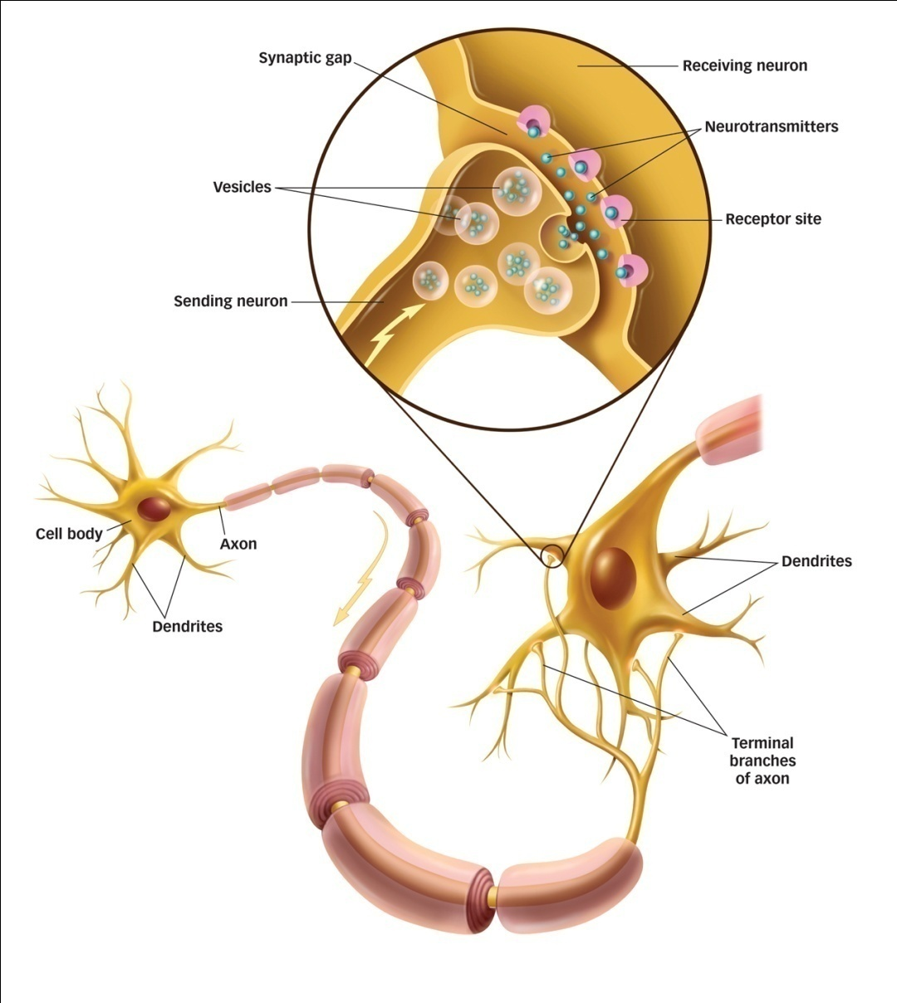
Anatomy of the Synapse
Presynaptic neuron’s axons end in terminal buttons
Terminal buttons contain synaptic vesicles
Synaptic vesicles contain neurotransmitters
Neurotransmitters are chemicals that transmit information across the synaptic gap (cleft)
Postsynaptic neuron’s dendrites contain receptor sites
Receptor sites fit certain neurotransmitters
Neurotransmitters bind to specific receptor sites in a lock-and-key system
Notes:
Click to reveal bullet points.
Key terms: presynaptic neuron, postsynaptic neuron, terminal buttons, synaptic gap (cleft), receptor site, neurotransmitters
APA Learning Goal 1: Knowledge Base of Psychology

Slide 36
Communication Between Neurons
An action potential triggers the release of neurotransmitters into the synapse, the space between neurons.
These chemical neurotransmitters are taken up by the neurotransmitter receptors in a neighbouring neuron.
Notes:
Communication across the synapse: (1) A positive charge reaches the end of the axon; (2) the positive charge stimulates release of neurotransmitters contained in membrane-bound vesicles into the synapse; (3) neurotransmitters bind to receptors on the postsynaptic neuron; ion channels open and the electrical charge in postsynaptic neuron changes.

Slide 37
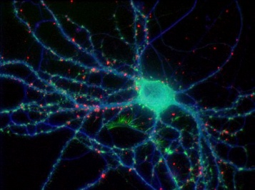
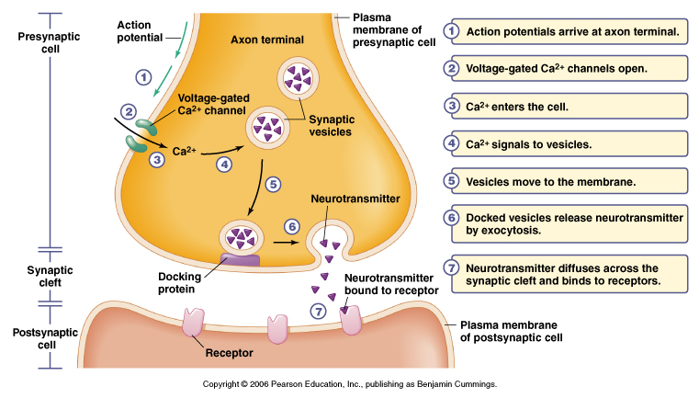

Slide 38
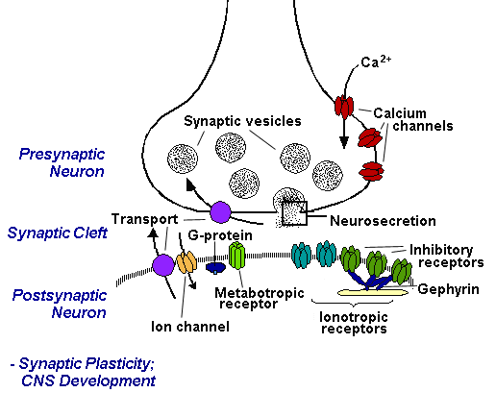
Ionotropic
Metabotropic

Slide 39
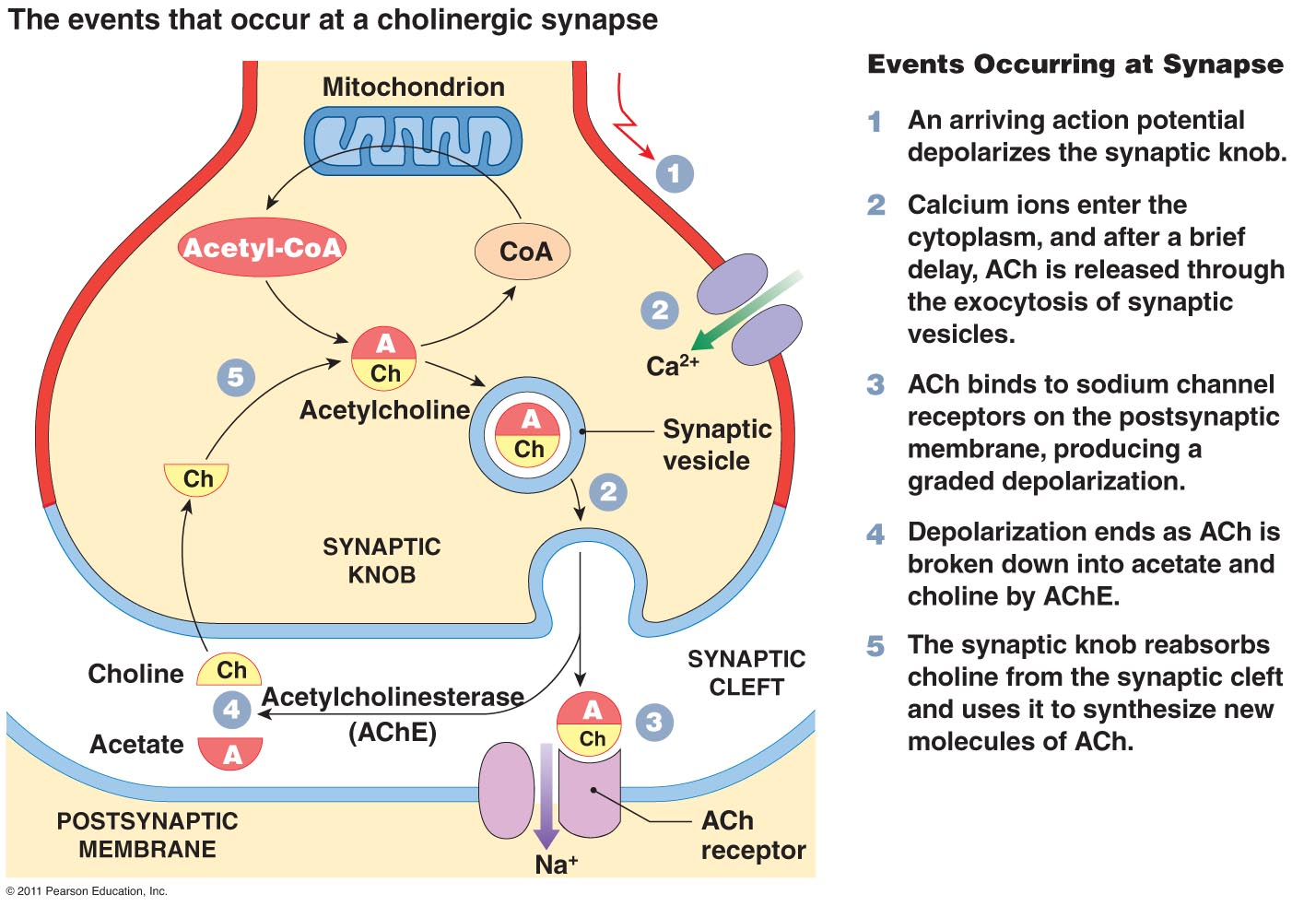

Slide 40
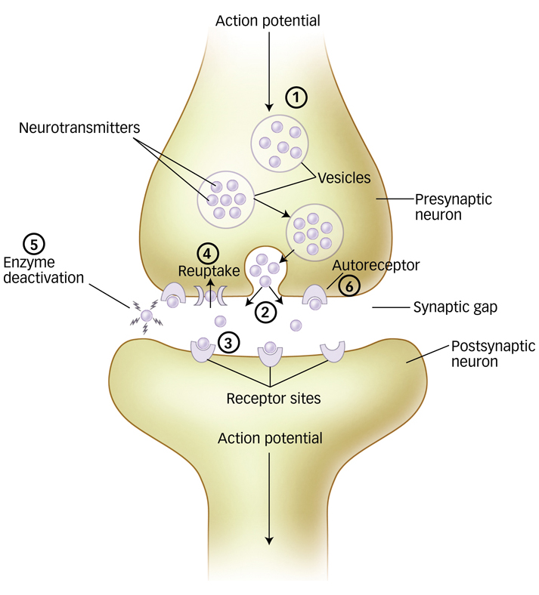
What happens to neurotransmitters in the synapse?
Reuptake—Neurotransmitters are absorbed back into the presynaptic neuron
Enzyme Deactivation (Disassembly)—Neurotransmitters are broken down by enzymes in the synapse
Autoreceptors— Neurotransmitters bind to autoreceptor sites on the presynaptic neuron
Neurotransmitters passively drift out of the synaptic gap
Notes:
Click to reveal bullet points.
Movie on next slide.
APA Learning Goal 1: Knowledge Base of Psychology

Slide 41
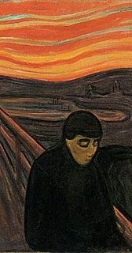
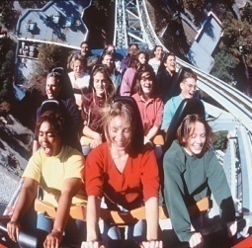
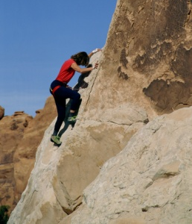
Types of Neurotransmitters
Functions
Malfunctions
Acetylcholine (ACh)
Dopamine
Serotonin
Norepinephrine
Endorphins
Enables muscle action, learning and memory
With Alzheimer’s, ACh producing neurons deteriorate
Influences movement, learning, attention and emotion
High levels linked to schizophrenia, low levels linked to Parkinson’s disease
Affects mood, hunger, sleep arousal
Low levels linked to depression
Helps control alertness and arousal
Low levels depress mood
Boosts mood, lessens pain
Artificial opiates cause brain to stop producing endorphins
Notes:
Click to reveal the functions and malfunctions of each neurotransmitter.
Click on the ActivePsych button to access the Synaptic Transmission and Neurotransmitters activity.
This teaches students about various transmitters and their effect on a person’s ability to perceive, feel, think, move, act, and react.

Slide 42
GABA
Glutamate
NPY
Leptin
Ghrelin
Orexin
Somatostatin
Substance P
Oxytocin
Vasopressin
An agonist is a chemical that binds to a receptor of a cell and triggers a response by that cell. Agonists often mimic the action of a naturally occurring substance.
A receptor antagonist is a type of receptor ligand or drug that does not provoke a biological response itself upon binding to a receptor, but blocks or dampens agonist-mediated responses.

Slide 43
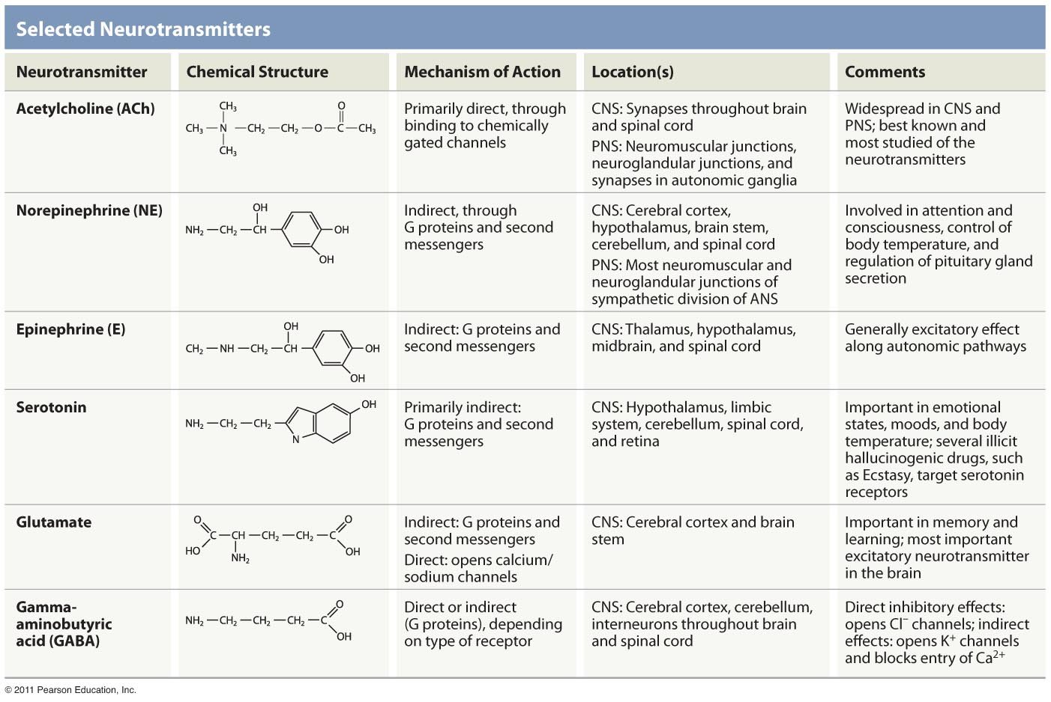

Slide 44
Drugs we take….
Cocaine/Crack
MDMA/Ecstasy
Heroin/Morphine/Fentanyl/codeine/oxycontin
GHB
Ketamine
Mushrooms/LSD
Angeldust
Alcohol
Benzodiazepines
Barbiturates
Cathiones/Bathsalts
Tabacco
Marijuana

Slide 45
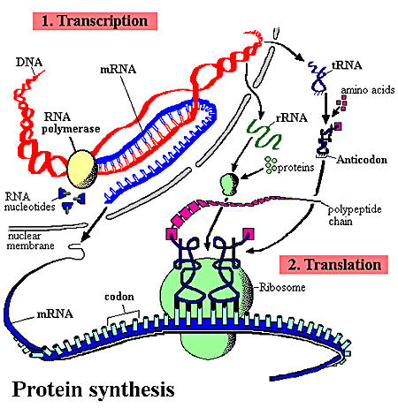
Transcription
Factor
www.youtube.com/watch?v=41_Ne5mS2ls
http://www.pbs.org/wgbh/aso/tryit/dna/#

Slide 46
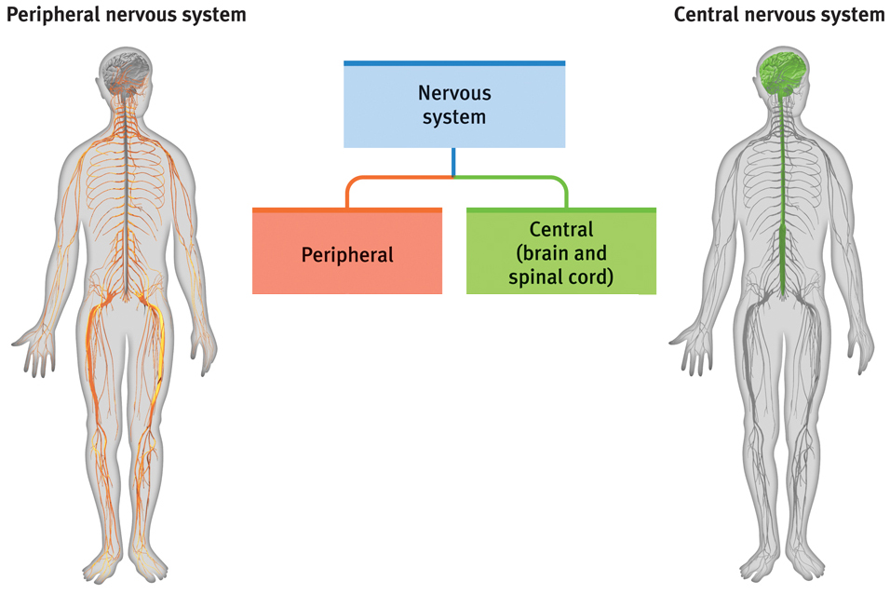
The Nervous System
Peripheral Nervous System (PNS)
Central Nervous System (CNS)
Notes:
Automatic animation
Neurons are the building blocks of nerves, which make up the nervous system, or an interacting network of neurons that conveys electrochemical information. The nervous system has two divisions: the central nervous system, which includes the brain and spinal cord and the peripheral nervous system.
APA Learning Goal 1: Knowledge Base of Psychology

Slide 47
Neurotransmitter Receptors
Postsynaptic potentials are electrical events in postsynaptic neurons that occur when a neurotransmitter binds to one of its receptors. When a receptor is activated positive or negative ions can flow through the receptor into the neuron.
Excitatory Postsynaptic Potentials (EPSPs) depolarize the neuron and increase the likelihood of an action potential.
Inhibitory Postsynaptic Potentials (IPSPs) hyperpolarize the neuron and decrease the likelihood of an action potential.

Slide 48
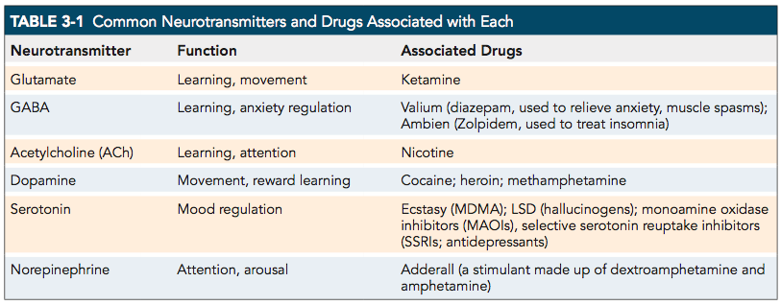
Neurotransmitters & Their Functions

Slide 49
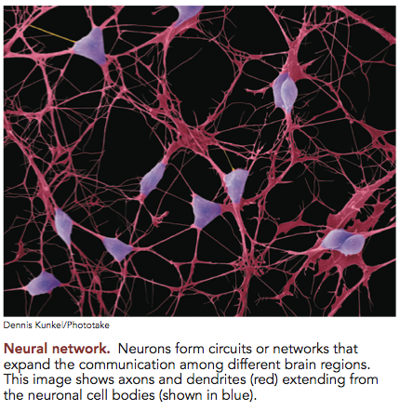
Neural Networks

Slide 50
Stem Cells and Neuroplasticity
Stem Cells - can divide and produce different types of neurons depending on their environment.
Neuroplasticity – the brains ability to make new neural connections or to reorganize in response to injury or changes in the environment,

Slide 51
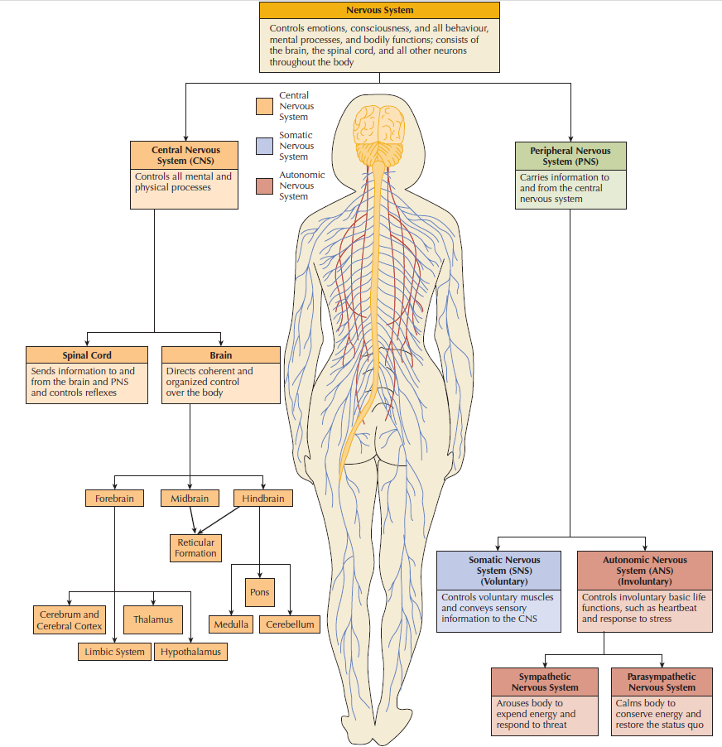
How Is the Nervous System Organized?

Slide 52
Types of Neurons
Afferent Neurons – carry signals from the PNS to the CNS
Efferent Neurons – carry signals from the CNS to the PNS, muscles and glands
Interneurons – relay cells between different neuron types. For example, interneurons are found in the spinal cord between motor and sensory neurons

Slide 53
Reflex Circuit of the Spinal Cord
Notes:
The reflex circuit of the spinal cord: Sensory information travels into the spinal cord where it synapses on interneurons. Interneurons send information to the motor neurons, which then send impulses back out to the periphery to induce movement.

Slide 54
Structures of the Brain
Hindbrain
Pons, reticular formation, cerebellum, medulla
Midbrain
Thalamus, hypothalamus, hippocampus, substantia nigra, pituitary gland
Neocortex
Visual, auditory, motor, sensory, cognitive
Overview of the Brain
https://www.youtube.com/watch?v=9UukcdU258A

Slide 55
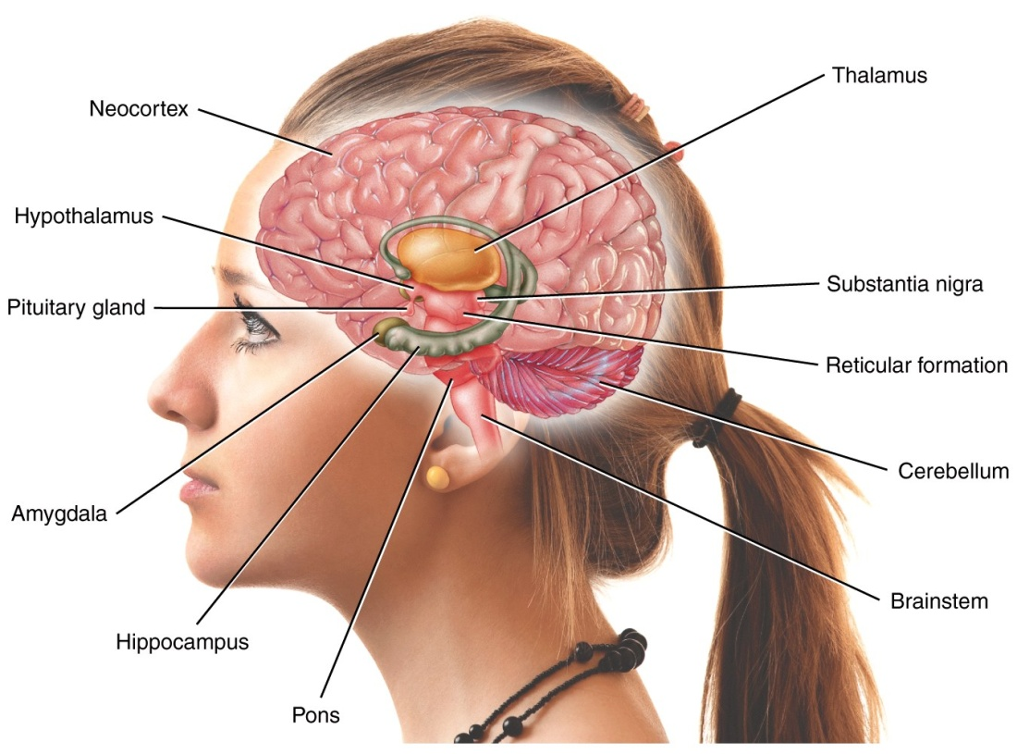
Hindbrain
Function & Location
Regulates basic life functions, part of the brain closest to the spinal cord
Notes:
Lecture Expander: Medulla: If a cat’s brainstem is severed from the rest of the brain, the animal will still breath and live, but it wont purposefully run or climb to get food.
Reticular formation: If you electrically stimulate the reticular formation of a sleeping cat, almost instantly the cat is awake and alert. When the reticular formation is severed from the rest of the body, the cat falls into a coma and never awakes.

Slide 56
Parts of the Hindbrain
Reticular formation - regulates sleep/wake cycle
Main source of the neurotransmitter serotonin, which is important for mood and activity levels
Pons - sends signals to and from the forebrain and cerebellum
Important for sleep, breathing, swallowing, eye movements, and facial sensation and expression

Slide 57
Parts of the Hindbrain
Medulla - regulates heartbeat, breathing, sneezing, and coughing
Cerebellum - important for motor coordination and certain types of learning that involve movement, such as learning to play the piano

Slide 58
The Midbrain
Substantia Nigra – the nucleus from which dopamine neurons send their axons to the striatum (Forebrain). Involved in movement control (damaged in Parkinson’s Disease)

Slide 59
Parts of the Forebrain
Thalamus - serves as a relay station for incoming sensory information
Hypothalamus - important for motivation, basic drives, and control of the endocrine system
Pituitary Gland - regulates hormones
The Limbic System - involved in the regulation of motivation, emotion, and learning and memory
Notes:
Lecture Expander: Hypothalamus: Some argue that the hypothalamus is the most influential structure in the brain, involved in the daily fluctuation of more than 100 bodily functions. Maintains blood pressure, heart rhythm, and breathing. If you are thinking about sex your cerebral cortex will stimulate your hypothalamus to secrete hormones.

Slide 60
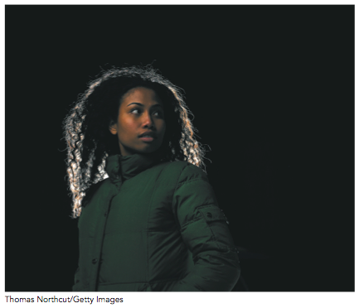
Parts of the Forebrain
The Limbic System includes the:
Amygdala – involved in processing fear
Hippocampus – important for certain types of learning and memory
Warning: this video may scare you - Amygdala and the evolution of fear
https://www.youtube.com/watch?v=0akKEDAZHt4
Notes:
Lecture Expander:
Hippocampus: If it were destroyed, you would not be able to store or recall any new personal or cognitive information. Memories that were already stored would still be intact. Also important in helping us figure out where we are (taxi drivers have enlarged hippocampus). Alzheimer’s patients have impairment in their hippocampus.
Amygdala: If you electrically stimulate a cat’s amygdala, it causes the cat to prepare to attack. Move the electrode only slightly within the amygdala, and the cat becomes terrified of a mouse. They have tried these surgeries on violent humans. It reduced fits of rage, but disrupted some of the everyday functioning of the patients.

Slide 61
Parts of the Forebrain
The Basal Ganglia includes the:
Striatum - produces fluid movements and helps with learning and memory that does not require conscious awareness
Nucleus accumbens - important for motivation, reward, and addiction

Slide 62
Cerebral Cortex
Frontal lobe (front of brain) - higher intellectual thinking
Prefrontal cortex - memory, morality, mood, planning
Parietal lobe – sensory integration
Occipital lobe (back of brain) – vision
Temporal lobe (sides of brain) - recognizing complex visual stimuli (like faces)
Notes:
Lecture Expander:
Cortex: the larger the cortex, the more thinking and learning a species can do. Cortex is 2-4 mm thick and contains 30,000 billion nerve cells. It is crumpled up so that it will all fit.
Motor cortex: If you apply an electrical current to the cortex of a dog, the dog moves specific parts of its body. The right motor cortex controls movement on the left side, and the left motor cortex controls movements on the right side.
Frontal association areas: Associated with thinking, motivation, planning, and impulse control. Phineas Gage had damage to the frontal lobes of his brain, which altered his impulse control and his emotional response.
Parietal lobe: Responsible for perception and processing of touch stimuli. The somatosensory cortex is the site where touch, pressure, temperature, and pain register in the cortex. A person who has damage to one side of the somatosensory cortex loses feeling on the opposite side of the body.
The sensory input areas include where we have vision, hearing, touch, pressure, and temperature.
The motor areas include control of voluntary movement.
The association areas house memories and involve thought, perception, and language.

Slide 63
Parallel Processing
Parallel processing - Air traffic controllers must react to an array of sensory stimuli and make quick decisions. Communication within and between the lobes of the brain allows us to perform such complex functions simultaneously.

Slide 64
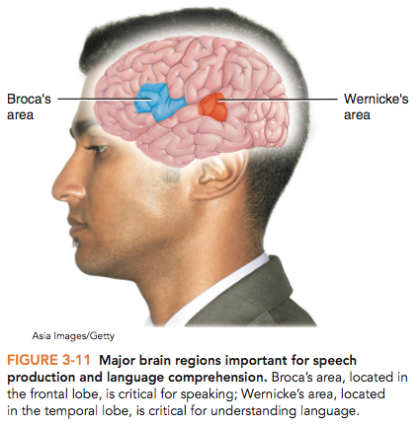
Speech
Broca’s area (Frontal lobe) - speech production
Wernicke’s area (Temoporal lobe) - language comprehension
Notes:
Broca’s area: Paul Broca performed autopsies on two patients who couldn’t speak. He found that both of these patients had damage in the left hemisphere, slightly in front of the motor cortex. This is the area that controls the motor movements required to speak. People who have damage to this area (Broca’s aphasia) may know what they want to say, but cannot say it.

Slide 65
Areas of the Neocortex
Sensory Cortex - registers sensory neurons (touch)
Motor Cortex - registers the motor neurons (muscles)
Association Cortex - registers complex functions, including higher-order sensory processing, integrating information from different senses, thinking, planning

Slide 66
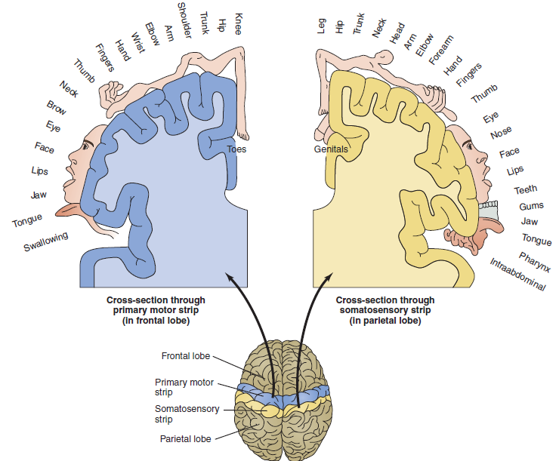
Motor and Sensory Cortices

Slide 67
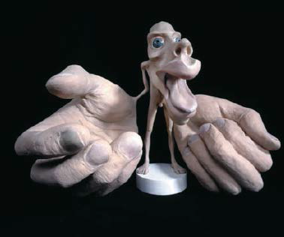
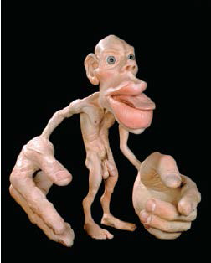
The Homunculus

Slide 68
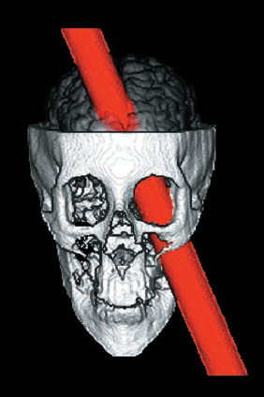
Localization of Function
From H. Damasio, T. Grabowski, R. Frank, A.M. Galaburda, A.R. Damasio (1994). The return of Phineas Gage: Clues about the brain from a famous patient. Science, 264:1102–1105. Dornsife Neuroscience Imaging Center and Brain and Creativity Institute, University of Southern California.
FIGURE 3-13 After the accident. This reconstruction shows how the spike likely entered Gage’s head, damaging the prefrontal cortex.
Notes:
Phineas Gage holds the railroad spike that passed through his brain (left). A reconstruction shows how the spike likely entered Gage’s head, damaging the frontal cortex (right).

Slide 69
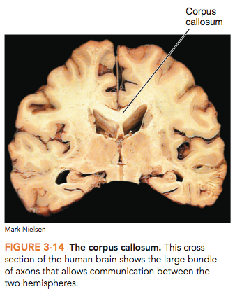
Corpus Callosum
Connects the two brain hemispheres
Dense bundle of neural fibres (axons) that allow communication of information from one side of the brain to the other
Notes:
The corpus callosum: This cross-section of the human brain shows the large bundle of axons that allows communication between the two hemispheres.

Slide 70
Brain Lateralization
Language centres in most right handed people are on the left side of the brain
HOWEVER – in some left handed people language centres are on the right side (or on both sides!)

Slide 71
Split-Brain Patients
https://www.youtube.com/watch?v=aCv4K5aStdU
Notes:
The visual system is a partially crossed pathway: Visual cues from the temporal (toward the side) part of the visual field are sent to the opposite side of the brain, while those of the medial (toward the nose) part of the visual field are transmitted to the same side of the brain.

Slide 72
The Integrated Brain
NO brain area works alone!

Slide 73
Evolutionary Psychology
Evolution - the process of the development and divergence of life (species) on this planet.
Evolutionary psychologists - study how the body and brain via the interaction of our genes (video link) and the environment to produce our thoughts and behaviours.

Slide 74
Evolution of Life on Earth
Notes:
The universal tree of life and a timeline of evolution: In this figure you can see the overall relationship of the three domains to the kingdoms in which life is organized. The timeline shows the evolutionary history of animals; Homo sapiens come from the Hominid line and have only been in existence for a short period of time (approximately 200 000 years).

Slide 75
Missing Links – Transitory Animals
Fossil evidence of transitory animals – how can fish with fins be part of the ancestral line to humans with arms and legs?
Tiktaalik—a fish in the Canadian Arctic that had a primitive wrist with finger-like bones
Neil Shubin – A fish with wrists
https://www.youtube.com/watch?v=yvDQCa7rleI

Slide 76
Evolution of Species Characteristics
Homologous traits - characteristics that are similar between species and can be traced back to a common ancestor
Analogous traits - characteristics that have evolved independently in different species
Convergent evolution - the development of similar physical characteristics or behaviours in different species that do not share a common ancestor (e.g., wings on birds and on bees)

Slide 77
Charles Darwin
The father of evolution
His famous book On the Origin of Species (1859) described the theory of evolution by the process of natural selection.

Slide 78
Natural Selection
Evolution by natural selection - animals with physical and behavioural attributes well suited to their environment are more likely to survive, reproduce, and pass on their traits to their offspring
Fitness - an individual’s ability to successfully grow to maturity and have offspring

Slide 79
Darwin’s Observations
Darwin made four important observations:
1) Animals were changing over time
2) Aspects of species that seem different on the surface, such as a human hand, a bat’s wing, and a cat’s paw, had structural similarities underneath
Notes:
Comparative anatomy: Similarities among organisms demonstrate how they are related. These similarities among four vertebrate limbs illustrate that, while proportions of bones have changed in relation to each organism’s way of life, the forelimbs have the same basic bone structure. Notice that the number of “fingers” on the human hand, cat paw, and bat wing(light tan – the horse has four vestigial fingers and one highly developed) are the same on all three.

Slide 80
Darwin’s Observations
Darwin made four important observations:
3) Selective breeding of captive animals leads to changes in the appearance of the animal
4) Not all animals that are born will survive to maturity and be able to reproduce

Slide 81
Evolution of the Brain
The Australopithecus skull on the left is about 1/3 the size of the present-day human skull on the right.
It has a much smaller frontal area, which leads to the assumption that the frontal cortex in the Australopithecus was also smaller.

Slide 82
Evolution of Behaviour - Mate Choice
Female Peahens prefer Peacocks with an elaborate tail with many eyes.

Slide 83
The Evolution of Mate Choice - Humans
Parental Investment
In order for human offspring to survive and eventually reproduce, parents spend an enormous amount of time caring for their young
Mate Choice
Males prefer younger women who have a greater likelihood of being able to become pregnant and carry to term viable offspring
Females prefer males with resources that can assist them in raising their young

