Slide 1
Learning Objectives - Chapter 2
What is a Science?
Is Psychology a Science?
How do Psychologists Conduct Research?
How do Psychologists Make Sense of Research Results?
What Ethical Guidelines do Psychologists Follow?

Slide 2
What Is a Science?
Two core tenets of science:
The universe operates according to certain natural laws
Such laws are discoverable and testable

Slide 3
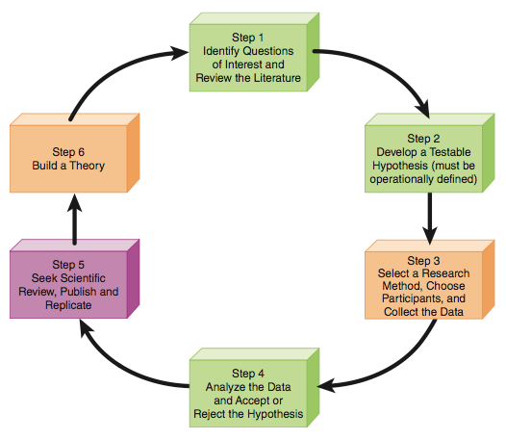
The Scientific Method – How we Discover the Laws Governing the Universe
Notes:
In-class activity: To solidify student’s knowledge about the steps in the scientific method, I usually have students pick a topic they are interested in (e.g., how does sleep impact sex drive, the study of serial killers) and then we as a class go through each step (as best we can) as it pertains to that topic.

Slide 4
The Science of Psychology
Psychology - Using the scientific method to study human behaviour and mental processes
Pseudopsychology (pseudoscience) - No use of the scientific method when commenting on human behaviour and mental processes
Ex: parapsychology, astrology, psychics etc.
James Randi - Homeopathy, quackery and fraud
http://www.ted.com/talks/james_randi

Slide 5
How Do Psychologists Conduct Research? Developing a Question and Hypothesis

Slide 6
Inductive and Deductive Reasoning
The scientific method uses:
Inductive and deductive reasoning
Hypothetico-deductive reasoning
These types of reasoning help Investigators
create and test hypotheses.

Slide 7
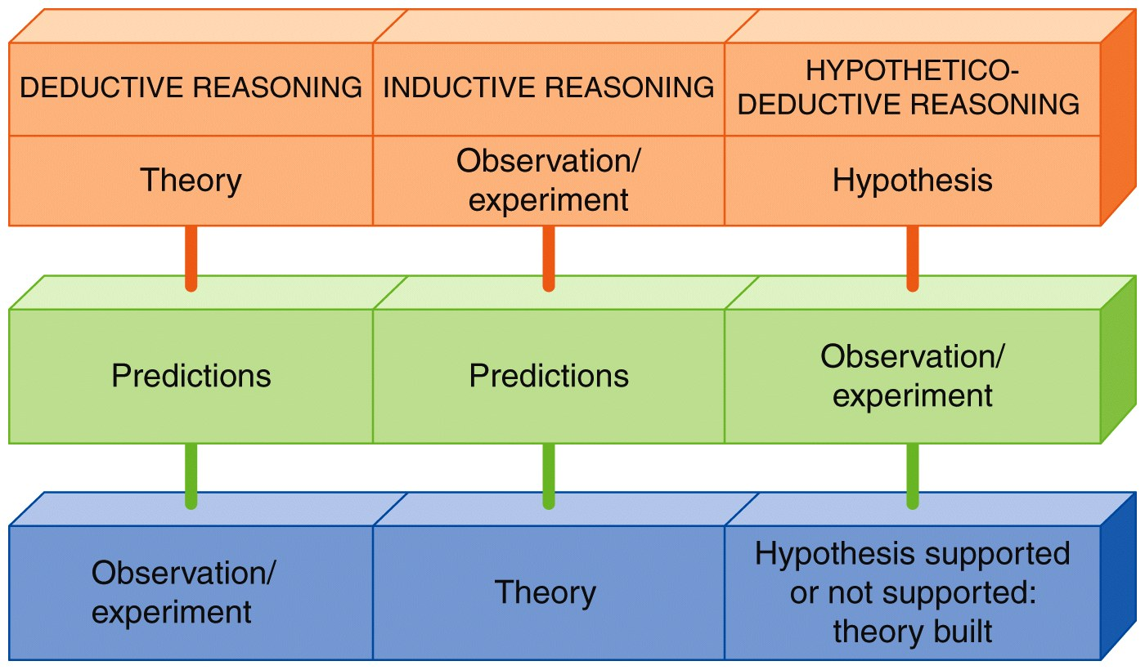
Inductive and Deductive Reasoning

Slide 8
How Do Psychologists Conduct Research? Variables and Operational Definitions
Types of Variables:
Independent variable (IV)—the variable that you manipulate
Dependent variable (DV)—the variable that you measure (or the variable that is changed by the IV)

Slide 9
Independent and Dependent Variables
Identify the independent and dependent variables in each of the following examples:
Dr. Smith examines how daily exposure to a sun lamp (1 hour of exposure or no exposure) impacts people’s depression levels in the winter time.

Slide 10
Independent and Dependent Variables
Identify the independent and dependent variables in each of the following examples:
Does watching aggressive TV cartoons influence a child’s level of aggressive behaviour?

Slide 11
Independent and Dependent Variables
Identify the independent and dependent variables in each of the following examples:
Does the amount of time reading this textbook (every day, once a week, or none) influence how well you will do on the exams?

Slide 12
Operational Definitions
An operational definition is how we (the researcher) decide to measure our variables
There are often hundreds of ways to measure a variable (e.g., aggression, depression)
When you do research, you have to decide how you are going to measure the IV and DV

Slide 13
Operational Definitions
Operationally define the following items:
Shyness
Love
Memory Loss
To operationally define the variable, you have to figure out how will you measure it. There is no one right answer. There are LOTS of ways to measure these items.
Notes:
A Hint for Students

Slide 14
How Do Psychologists Conduct Research? Choosing Participants, the Research Method and Collecting Data

Slide 15
Choose Participants
Population - The entire group that is of interest to researchers
Sample - A portion of any population that is selected for the study
Random selection - Randomly choosing a sample from a population
Sampling bias - Choosing a sample that does not represent your population
Representative sample
Notes:
Lecture expander: You cannot study everyone in a population, thus you have to select a sample. If your sample is representative of the population, you can generalize your findings (from the sample) to the entire population.

Slide 16
Choose Participants
A sample or a population?
Professional hockey players
10 students from VIU
Albino rats
100 adults over the age of 65
This class…..it depends on…..
Notes:
Answers:
Professional hockey players — could be the population or it could be a sample of all athletes
10 students from the University of Toronto — probably a sample and the population is all U of T students
Albino Rats — could be the population or could be a sample of all animals
100 adults over the age of 65 — probably a sample and the population would be ALL people over 65
If people say that professional hockey players are a population, I then ask them what would be a good representative sample of professional hockey players. People often say “all goalies,” which of course is not a good answer. Then you can discuss why that is not a fair representation of all hockey players.

Slide 17
Two Basic Types of Research Methods
Descriptive
Research method used to observe and describe behaviour.
Used to determine the existence of a relationship between the variables.
Experimental
To demonstrate a cause and effect relationships between the variables.

Slide 18
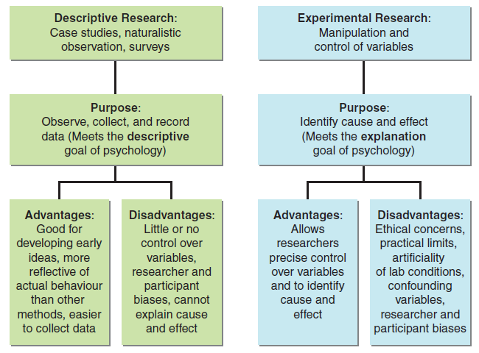
Descriptive and Experimental Research
Applied….

Slide 19
Types of Descriptive Research
Case studies - focuses on a single person
Pitfall - Researcher bias – ouija boards and facilitated communications
Naturalistic observation - observe people behaving as they normally do
Pitfall - Hawthorne Effect – you watching them will change their behavior
Surveys - use of a questionnaire of interview
Pitfall - Participant bias – I want to look good to the the researcher….

Slide 20
Case Study
An intensive study of 1 or 2 people
Advantages
Only method you can use if the type of behaviour you are looking at is rare
Very detailed
Can provide insight
Disadvantages
You cannot generalize your results to all people
Cannot determine cause and effect

Slide 21
Naturalistic Observation
Systematic people watching
Advantages
Can study things that are too unethical to do in an experiment or that people might lie about
Disadvantages
Time consuming
Cannot determine cause and effect
Notes:
Lecture expander: I often ask students what type of topics might be too unethical to replicate in a lab or might be things people would lie about (e.g., drugs, prostitution, sexism, racism, etc.).

Slide 22
Surveys
Ask people directly about their behaviours
Advantages
Data collection is quick
Cheap
Disadvantages
Sometimes people don’t tell the truth
Cannot determine cause and effect

Slide 23
Experimental Research
Examines how one variable CAUSES another variable to change.
Advantages
Can establish cause and effect
Can eliminate outside influences
Disadvantages
Might not be generalizable
Sometimes unethical

Slide 24
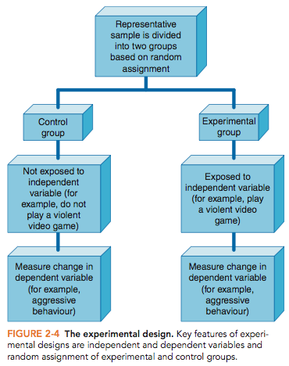
Experimental and Control Group
Experimental group - the group that is exposed to the IV (manipulation or treatment)
Control group - the group that isn’t exposed to the IV; this group is used to compare how the IV changes the DV

Slide 25
Experimental and Control Group
Random assignment - the researcher should randomly assign who goes in which group; this should make the groups similar before the study begins
How does this relate to Random Selection?

Slide 26
Avoiding Bias in Your Experiment
Double blind procedure - neither the participant nor the researcher knows who is in which group
Single Blind?

Slide 27
Research Design – Picking a Method
Do women smile more than men?
Were serial killers abused as children?
What type of students work out on campus?
Does meditating help to reduce stress?
Which type of drug (a, b, or c) helps to reduce anxiety levels?
Notes:
Answers:
Do women smile more than men? Observation
Were serial killers abused as children? Case study, because there are not that many serial killers out there.
What type of students work out on campus? Survey or maybe observation
Does meditating help to reduce stress? Experiment or possibly survey
Which type of drug (a, b, or c) helps to reduce anxiety levels? Experiment

Slide 28
How Do Psychologists Conduct Research? Analyzing Your Data
Ben Goldacre – Battling Bad Science
http://www.ted.com/talks/ben_goldacre_battling_bad_science

Slide 29
How Do Psychologists Make Sense of Research Results?
Descriptive research – Describes groups or activities
Correlational research - indicate if there is a relationship between the variables …allow prediction but DOES NOT provide causation
Experimental research - statistics indicate if the hypothesis has been supported or if there is a meaningful difference between the groups

Slide 30
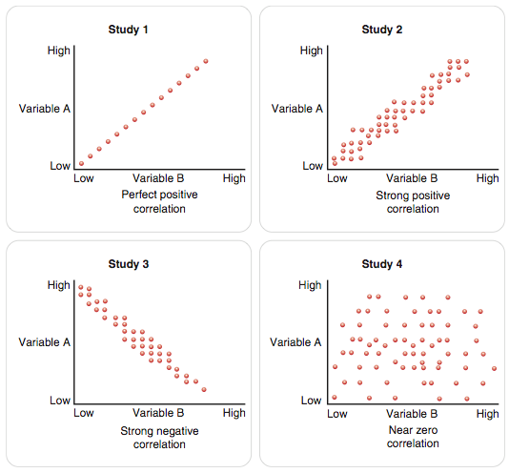
Correlations Describe Relationships
Show how two or more things are related to each other
Advantages
Describes how the variables are related
Disadvantages
Cannot determine cause and effect

Slide 31
Strength and Direction of a Correlational Relationship
Positive correlation - when one variable increases, the other increases
Negative correlation - when one variable increases the other decreases

Slide 32
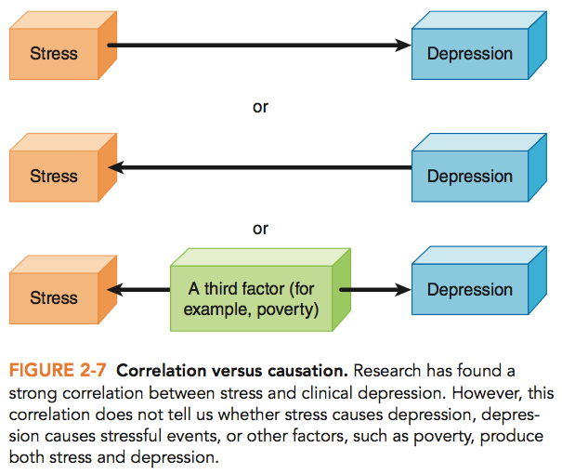
Correlation Is Not Causation

Slide 33
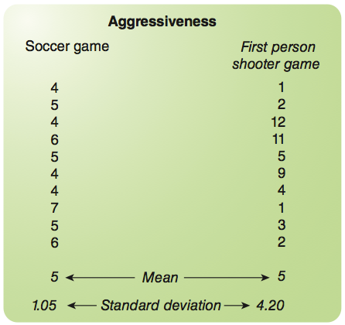
Experimental Analyses: Cause and Effect
Descriptive statistics - describe the data
Mean - average of all of the scores
Standard deviation - how much the participants’ scores vary from one another

Slide 34
Experimental Analyses: Cause and Effect
Inferential statistics - help to draw conclusions about the data
Using various statistical tests you can determine a p-value which tells you the probability that the results of your experiment are not due to chance.
For example: if you have a p-value of lower than .05, that means there is less that a 5% likelihood that your results occurred by chance….ergo there is a greater than 95% chance that it occurred because of something is going on…given that all was controlled the only difference that could account for the difference is….

Slide 35
How Do Psychologists Conduct Research? Publishing Your Work and Building a Theory

Slide 36
What Ethical Research Guidelines Do Psychologists Follow?
Research Ethics Boards (REB) are considered the ethics police. They are a research oversight group that evaluates research to protect the rights of participants in the study.

Slide 37
Ethical Research Guidelines Psychologists Follow – Human Research
Ethical guidelines:
Obtain informed consent—obtaining permission from the participant after they know what the study involves and the risks and benefits of participating
Protect participants from harm and discomfort

Slide 38
Ethical Research Guidelines Psychologists Follow – Human Research
Ethical guidelines:
Protect confidentiality
Participation must be voluntary
Deception or Incomplete Disclosure
Provide complete debriefing—revealing to participants any information that was withheld during the study

Slide 39
Ethical Research Guidelines Psychologists Follow – Animal Research
The Canadian Council on Animal Care oversees research involving animals as subjects
Animals are used only if the research promises significant benefit to humans or animals
Animals are used if there is no other alternative

Slide 40
Ethical Research Guidelines Psychologists Follow – Animal Research
The Canadian Council on Animal Care oversees research involving animals as subjects
Humane methods must be used
The smallest number of animals possible must be used
All pain and distress must be limited

Slide 41
Why do we need statistics?
Facts are stubborn, but statistics are more pliable. Mark Twain
Statistics are used much like a drunk uses a lamppost: for support, not illumination
Vin Scully
I can prove anything by statistics except the truth. George Canning
Full House = 1/694 | 5x6 (above)…1/7776 | 6x6…1/46656
2xFull House = 1/481,636

Slide 42
Introduction
Most psychological research involves measurement; a case study of a person with multiple personalities, a naturalistic observational study of chimpanzee parental behavior in the wild, a survey study of consumer product preferences, a correlational study of the relationship between aerobic exercise and well-being, or an experimental study on the effects of mood on memory. In each case, measurement yields a set of numbers, which are the findings, or data, produced by the research study. Psychologists and other scientists summarize data, find relationships between sets of data, and determine whether experimental manipulations have had an effect on some variable of interest.
INFERENTIAL STATISTICS

Slide 43
The word statistics has two meanings:
(1) the field that applies mathematical techniques to the organizing, summarizing, and interpreting of data, and
(2) the actual mathematical techniques themselves.
Knowledge of statistics has many practical benefits. Even a rudimentary knowledge of statistics will make you better able to evaluate statistical claims made by science reporters, weather forecasters, television advertisers, political candidates, government officials, and other persons who may use statistics in the information or arguments they present.

Slide 44
Representation of Data
Because a list of raw data may be difficult to interpret, psychologists prefer to represent their data in an organized way. Two of the most common ways are frequency distributions and graphs.

Slide 45
Graphs
If a picture is worth a thousand words, then a graph is worth several paragraphs in a research report. Because it provides a pictorial representation of the distribution of scores, a graph can be an even more effective representation of research data than a frequency distribution. Among the most common kinds of graphs are pie graphs, frequency histograms, frequency polygons, and line graphs.

Slide 46
Pie Graph
A simple, but visually effective, way of representing data is the pie graph. It represents data as percentages of a pie-shaped graph. The total of the slices of the pie must add up to 100 percent.

Slide 47
Frequency Histogram
Another approach to representing frequency data is the frequency histogram, which graphs frequencies as bars. This type of graph is called a bar graph when the underlying variable being graphed is non-continuous.
For non-continuous or discrete variables (e.g., gender), the bars that are drawn don’t touch.
For continuous variables (e.g., weight), they do touch. In general, the scores are plotted on the abscissa (the horizontal axis) and the frequencies on the ordinate (the vertical axis).
The width of the bars represents the intervals, and the height of the bars represents the frequency of scores in each interval.

Slide 48
Grades
Students

Slide 49
A+ A A- | 90-100 85-89 80-84 | 4.33 4.00 3.67 | Excellent (First Class Standing)
B+ B B- | 76-79 72-75 68-71 | 3.33 3.00 2.67 | Good
C+ C C- | 64-67 60-63 55-59 | 2.33 2.00 1.67 | Satisfactory
D | 50-54 | 1.00 | Poor
F | 0-49 | 0.00 | Failing work Unsatisfactory performance or failure to meet course requirements.

Slide 50
Easy Prof
Mean Nasty Prof
25 35 40 50 60 70 80

Slide 51
Scales of measurement
Nominal
Ordinal
Interval
Ratio

Slide 52
Nominal
Variables have two or more categories
No numeric scales
Groups such as
Male-female
Study in quiet room vs noisy room

Slide 53
Ordinal
Rank order points on a scale
Numeric values are limited
Examples:
2, 3, or 4-star restaurants
Ranking tv shows by popularity
Intervals between items are not known, and are not equal
Mann-Whitney U or Kolmogorov-Shirmov, Kruskal-Wallis are appropriate for 1 way analysis, while Friedman Two-way analysis is appropriate for more complex experiments

Slide 54
Interval
Numeric properties are taken seriously
Values such as 1, 2, 3… are used in calculations
Example: a score on a personality test.
Assume equal amounts between the numbers on the scale – equal intervals
No true “zero” amount
Most parametric statistics will work!

Slide 55
Ratio scale
A true zero point – absence of the variable
Zero on weight means no weight
Can form ratios: 10 pounds is twice as heavy as 5 pounds
Use more sophisticated statistical tests for ratio and interval scales

Slide 56
Descriptive Statistics
Suppose you gained access to the hundreds, or thousands, of high school grade point averages of all of the freshmen at your college or university. What is the most typical score? How similar are the scores? Simply scanning the scores visually would provide, at best, gross approximations of the answers to these questions. To obtain precise answers, psychologists use descriptive statistics, which include measures of central tendency and measures of variability.
Measures of Central Tendency
A measure of central tendency is a single score that best represents an entire set of scores. The measures of central tendency include the mode, the mean, and the median.

Slide 57
Mode
The mode is the most frequently occurring value in a set of scores. In the frequency distribution of exam scores two slides back, the mode is a B-. If the data set is made up of a counting of categories, then the category with the most cases is considered the mode, or the modal category. For example, in determining the most common academic major at your school, the mode is the major with the most students. The winner of a presidential primary election in which there are several candidates would represent the mode—the candidate selected by more voters than any other.

Slide 58
The mode can be the best measure of central tendency for practical reasons. It is the only measure of central tendency that is appropriate for non-numeric, or qualitative, data. Imagine a car dealership given the option of carrying a particular model car, but limited to selecting just one color. The dealership owner would be wise to choose the modal color.

Slide 59
Descriptive Statistics: Measure of Central Tendency
Q: How many hours do you exercise each week?
20 people respond: 0, 0, 0, 0, 0, 0, 1, 1, 1, 2, 2, 2, 2, 2, 2, 2, 3, 3, 3, 4 (hours)
Mode—The most frequently occurring score in the distribution.
0, 0, 0, 0, 0, 0, 1, 1, 1, 2, 2, 2, 2, 2, 2, 2, 3, 3, 3, 4
mode = 2
Median—The score that divides a frequency distribution exactly in half. The same number of scores fall above and below the median.
0, 0, 0, 0, 0, 0, 1, 1, 1, 2, 2, 2, 2, 2, 2, 2, 3, 3, 3, 4
median = 2
Mean—The sum of a set of scores in a distribution divided by the number of scores. The mean is also known as the average.
mean = 1.5
0, 0, 0, 0, 0, 0, 1, 1, 1, 2, 2, 2, 2, 2, 2, 2, 3, 3, 3, 4 (hours)
20 respondents
Notes:
Click to show mode example.
Click to show median example.
Click to show mean example.
See the next slide for how measures of central tendency can be misleading.
APA Learning Goal 1: Knowledge Base of Psychology
APA Learning Goal 2: Research Methods in Psychology

Slide 60
Descriptive Statistics: Measure of Central Tendency
Analyze Carefully!
Note how describing the mean, median, and mode in isolation in the distribution below can lead to misleading conclusions!
Notes:
Automatic animation
What would happen to the measurement of mean annual income among the people in the cafeteria at a certain time of day if Bill Gates arrived and sat down for lunch?
APA Learning Goal 1: Knowledge Base of Psychology
APA Learning Goal 2: Research Methods in Psychology
APA Learning Goal 3: Critical Thinking Skills in Psychology

Slide 61
Mean
The mean is the arithmetic average, of a set of scores. You are probably more familiar with the mean than any other measure of central tendency. You encounter the mean in everyday life whenever you calculate your exam average, batting average, gas mileage average, or a host of other averages.
The mean of a sample is calculated by adding all the scores together and dividing their sum by the number of scores.
Exam Scores: 99, 92, 93, 94, 97
The mean (represented as M in APA publications) for the above data is (99 + 92 + 93 + 94 + 97)/5 or 95.
Since each score contributes to the value of the mean, extreme scores affect its value.

Slide 62
Median
The median is the middle score in a distribution of scores that have been ranked in numerical order. If the median is located between two scores, it is assigned the value of the midpoint between them. For example, the median of 23, 34, 55, and 68 would equal 44.5 (that is, (34 + 55)/2). The median is the best measure of central tendency for skewed distributions, because it is relatively unaffected by extreme scores.

Slide 63
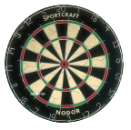
Variance
A more informative measure of variability is the variance, which represents the variability of scores around their group mean. Unlike the range, the variance takes into account every score in the distribution. As mentioned previously, the measure of variability tells us how well the measure of central tendency portrays the entire set of data. The variance is a numerical way of describing the degree to which the scores in a data set differ or fluctuate from the mean value. Technically, the variance is the average of the squared deviations from the mean.
Which player do you want on your team?

Slide 64
Suppose you wanted to calculate the variances for six dart players.
First, find the mean distance from the Bull’s Eye for each dart thrown by all five players. We know this to be 10cm.
Second, find the deviation of each score from the appropriate representative’s mean. Note that some deviation scores will be negative. As a check on your calculations, the sum of the deviation scores should equal zero.

Slide 65
Third, square the deviation scores. By squaring the scores, negative scores are made positive and extreme scores are given relatively more weight.
Fourth, find the sum of the squared deviation scores. This sum has a special name, sum of squares, and it is used in many statistical calculations.
Fifth, divide the sum by the number of scores. This yields the variance. Calculation of the variance for Mr. Smith’s data is shown in the next slide. The variance is .917.

Slide 66
X
X - M
(X – M)²
Mean = 10
7
7 –10 = -3
9
13
13 – 10 = 3
9
12
12 – 10 = 2
4
8
8 – 10 = -2
4
11
11 – 10 = 1
1
9
9 – 10 = -1
1
SUM = 28
Variance = 28/6 = 4.66

Slide 67
Standard Deviation
The problem now is the variance is not in the same units as the data, everything was squared. So if we take the square root of the variance we will have what is know as the standard deviation.
SD=square root of the variance
Standard Error of the Mean
The standard error tells us even more, by taking into account how many data points were used to calculate the mean. The formula for standard error is SD/Square Root of number of subjects -1. Never report just the mean, and don’t trust anyone who does.

Slide 68
The Normal Curve and Percentiles
The normal curve is a bell-shaped graph that represents a hypothetical frequency distribution in which the frequency of scores is greatest near the mean and progressively decreases toward the extremes. In essence, the normal curve is a smooth frequency polygon based on an infinite number of scores. The mean, median, and mode of a normal curve all have the same value. This falls at the center of this symmetric distribution and splits it in half, such that 50% of the observations are above and 50% of the observations are below it. Many physical or psychological characteristics, such as height, weight, and scores on many standardized intelligence tests fall on a normal curve.

Slide 69
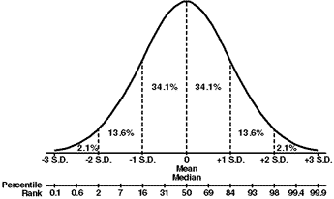

Slide 70
One useful characteristic of a normal curve is that certain percentages of scores fall at certain distances (measured in standard deviation units) from its mean. A special statistical table makes it a simple matter to determine the percentage of scores that fall above or below a particular score or between two scores on the curve. For example, about 68 percent of scores fall between plus and minus one standard deviation from the mean; about 95 percent fall between plus and minus two standard deviations from the mean; and about 99 percent fall between plus and minus three standard deviations from the mean. The next figure contains a normal distribution with the percentage of scores at +/- 1, 2, and 3 standard deviations from the mean shown.

Slide 72
Consider an IQ test, with a mean of 100 and a standard deviation of 15. What percent of people score above 115? Because intelligence scores fall on a normal curve, about 34 percent of the scores fall between the mean and one standard deviation (in this case 15 points) above the mean. We also know that for a normal distribution 50 percent of the scores fall above the mean and 50 percent fall below the mean. Thus, about 84 percent (50 percent below the mean and 34 percent between the mean and a score of 115) of the scores fall below 115. If 84 percent fall below 115, then 16 percent (100 percent - 84 percent) must fall above a score of 115.

Slide 73
Calculating Z-Scores
Z-scores are standardized against the normal curve. It is a way of transforming scores from different units into a single comparative unit. To do this you need to take an individual score, subtract the mean, and divided by the SD.
Z=(score-mean)/SD
This calculation allows you to put an individual score or data point on the bell curve, and calculate a percentile. This only works if there is enough people in the sample to build a normal curve.

Slide 74
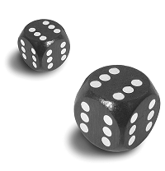
Probability
"The probable is what usually happens" - Aristotle.
What are the chances of rolling 2 dice and getting both 1s?
What are the chances of pulling a pair of aces out of a deck of cards?

Slide 75
What does it mean if we say that the alpha level of an experiment is
p<.05?
The probability of a particular event occurring by chance is less than 5%, or out of a 100 trials an event will occur less than 5 times by chance!
You can also say that the probability of being wrong if you say two groups are different, is 5 times out of 100. As a psychologist those are OK odds. You could also say …“this group is different than that group” you will only be wrong 5 times out of 100x; or you are going to be right 95 times out of 100.

Slide 76
Estimate your approximate percentile marks for the two questions below.
You scored 115 with a mean of 98, SD=14.
Your friend scored 88 with a mean of 78, SD=7.
Who did better?

Slide 77
Calculate
-average
-median
-mode
-sum of squares (SS)
-variance
-standard deviation (SD)
-standard error

Slide 79
Calculate your Z-score
Mean=77
SD=16
You score=93 Your score=69
Approximately what percentage of people did you do better than?
Approximately what percentage did you do worse than?

Slide 80
Parametric Statistics - Inferential procedures that depend on population parameters. T-tests and analyses of variance fall into this category. Statistical tests include ANOVAs, MANOVA, T-tests and Pearson Correlations
Continuous Data
Non-Parametric Statistics - Inferential procedures not concerned with population parameters such as mean and standard deviation. The term 'non-parametric' is often used to refer to inferential procedures that do not depend on the distribution of the population. Also called Distribution-Free Statistics. Examples include Chi Squared, Mann-Whitney U, Kruskal Wallis
Discrete Data

Slide 81
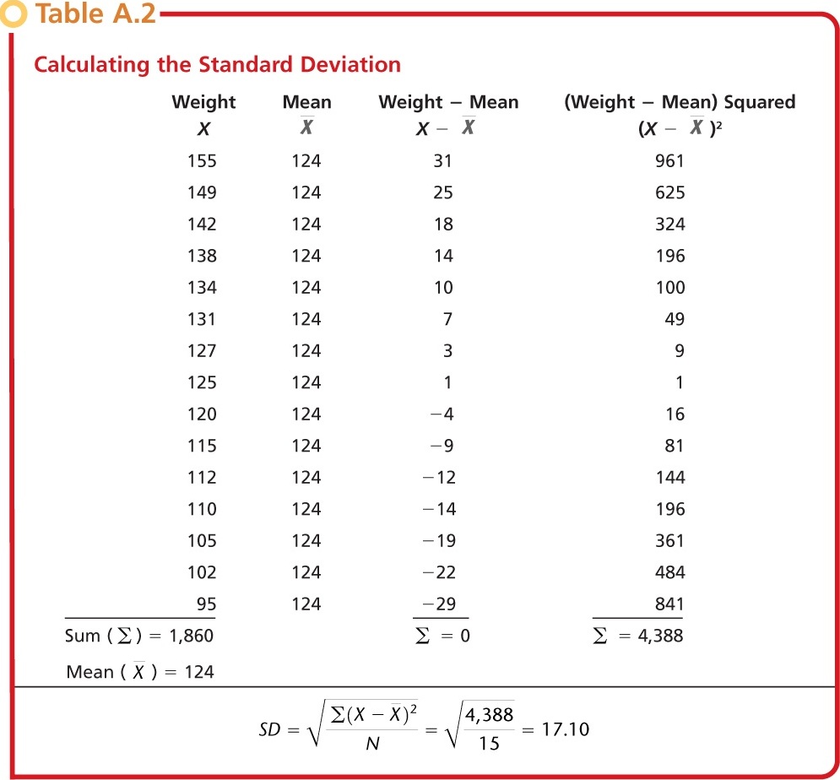
Descriptive Statistics Measure of Variability
Range – the highest score in the distribution minus the lowest score, a simple measure of variability.
Standard Deviation – the square root of the sum of the squared deviations from the mean divided by the number of scores in the distribution. The larger the standard deviation, the more spread out are the scores in a distribution.
Notes:
Click to reveal bullets.
The table calculates the standard deviation for a hypothetical group of 15 participants in the aerobic exercise program graphed in earlier slides. The mean weight of the participants is 124. The standard deviation is calculated at 17.10. Note: the larger the standard deviation, the more spread out are the scores in a distribution.
APA Learning Goal 1: Knowledge Base of Psychology
APA Learning Goal 2: Research Methods in Psychology

Slide 82
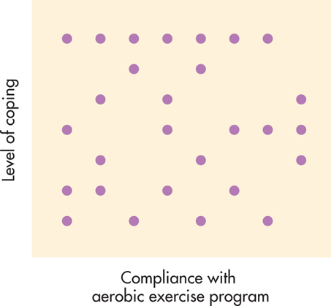
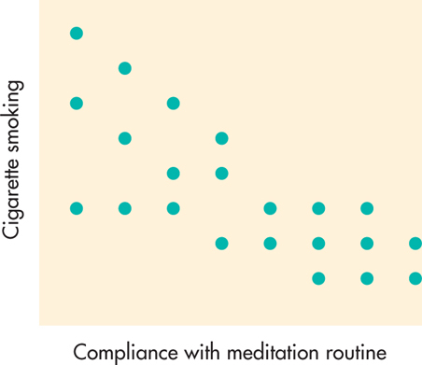
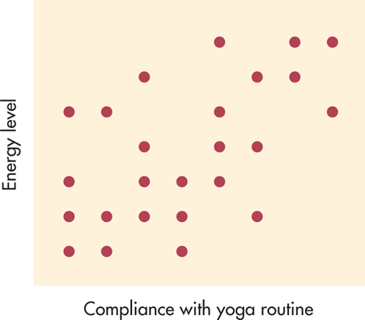
Descriptive Statistics Correlation: The Relationship Between Two Variables
Positive Correlation:
Two variables change systematically in the same direction, either increasing or decreasing together.
Positive Correlation:
Two variables change systematically in the same direction, either increasing or decreasing together.
Correlation directions are often shown in scatter plot diagrams such as this.
A scatter plot with points that seem to fall randomly indicates no correlation between the variables.
Notes:
Click to show positive correlation definition and example.
Click to show negative correlation definition and example.
Click to show no correlation example.
As has been emphasized repeatedly in discussions of correlation, causation does not necessarily equal correlation.
APA Learning Goal 1: Knowledge Base of Psychology
APA Learning Goal 2: Research Methods in Psychology
APA Learning Goal 3: Critical Thinking Skills in Psychology

Slide 83
Descriptive Statistics
The Correlation Coefficient
The statistical measure of the relationship between two variables. The coefficient ranges from +1.00 to -1.00.
A -1.00 correlation, or a perfect negative correlation, would indicate that the frequency of the meditation routine was always accompanied by less smoking, and vice versa.
A +1.00 correlation, or a perfect positive correlation, would indicate that frequent yoga sessions were always accompanied by high levels of energy, and vice versa.
Notes:
Click to show +1.00 correlation example.
Click to show -1.00 correlation example.
APA Learning Goal 1: Knowledge Base of Psychology
APA Learning Goal 2: Research Methods in Psychology

Slide 84
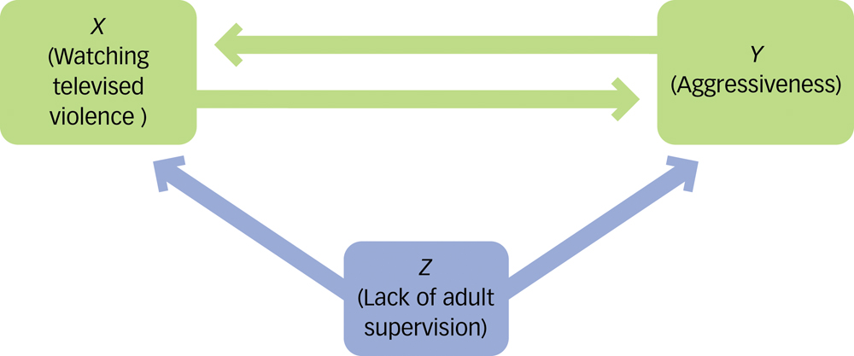
Correlation does not equal causation!
Descriptive Statistics Correlation and Causality
Q: What third variable might cause both aggression and the watching of violent programs?
Q: Watching violent television programs is positively correlated with aggression in children. Does this mean that watching these programs causes aggression?
There are three possibilities:
Watching violent programs causes aggression.
Aggressive behavior causes children to watch violent programs.
A third variable causes both!
This is known as the third-variable problem.
Notes:
Click to show first question and the third-variable problem description.
Click to show second question for discussion.
Click to show graphic.
APA Learning Goal 1: Knowledge Base of Psychology
APA Learning Goal 2: Research Methods in Psychology

Slide 85
Inferential Statistics
Mathematical methods used to draw conclusions about a population based on a sample of data
Inferential statistics are used to determine the likelihood of an observed outcome by chance....
Notes:
Click to reveal bullets.
APA Learning Goal 1: Knowledge Base of Psychology
APA Learning Goal 2: Research Methods in Psychology

Slide 86
Inferential Statistics
The ability to make inferential statistics and the scope of the inferences depend on the population (a complete set of something: people, nonhuman animals, objects, events) and sample (a subset of the population) of the subject under study.
The students in your class form the population of students studying psychology in this class, but they only form a sample of all the students at your institution.
All the doctors in the United States form the population of the doctors in the United States, but they only form a sample of the doctors in the world.
Information about a sample can be used to make inferences about the population.
Notes:
Click to show doctors population/sample example.
Click to show students population/sample example.
Click to show final statement.
Identify a population and a sample. For example, all first-year college students would be a population. The first-year college students selected to participate in a study would be the sample.
APA Learning Goal 1: Knowledge Base of Psychology
APA Learning Goal 2: Research Methods in Psychology
APA Learning Goal 3: Critical Thinking Skills in Psychology

Slide 87
Inferential Statistics
Inferential Errors
Type I error: Erroneously concluding that study results are significant
The data from a lie detector test indicate that a suspect is lying when he is actually telling the truth.
Type II error: Failing to find a significant effect that does, in fact, exist
The data from a lie detector test indicate that a suspect is telling the truth when he is actually lying.
Notes:
Click to reveal Type I Error sequence.
Click to reveal Type II Error sequence.
APA Learning Goal 1: Knowledge Base of Psychology
APA Learning Goal 2: Research Methods in Psychology

Slide 88
Inferential Statistics
How to Avoid Inferential Errors
Generalizing from Samples
Representative samples are better than biased samples.
Less-variable observations are more reliable than those that are more variable.
More cases are better than fewer.
Look for statistical significance. The difference between observations is probably not due to chance variation between the samples.
Notes:
Click to reveal bullets.
The basic point here is that although anecdotal evidence may be interesting and even compelling, inferences or generalizations based on a few unrepresentative cases are unreliable.
APA Learning Goal 1: Knowledge Base of Psychology
APA Learning Goal 2: Research Methods in Psychology

Slide 89
Inferential Statistics
How to Avoid Inferential Errors
Paying Attention to Methodology
In cross-sectional studies, different groups are studied at the same time.
In longitudinal studies, the same group is studied over time.
Cross-sectional studies show the effects of time and environment on many different individuals.
Longitudinal studies show these effects on the same people.
Notes:
Click to reveal bullets.
APA Learning Goal 1: Knowledge Base of Psychology
APA Learning Goal 2: Research Methods in Psychology

Slide 90
So what does significant really mean……?
What the hell are assumptions!?
What does p < .049 mean when it is at the end of a statistical equation?
What does p < .05 mean when it is a decision rule?

