Slide 1
Psychology 111
WTF

Slide 2
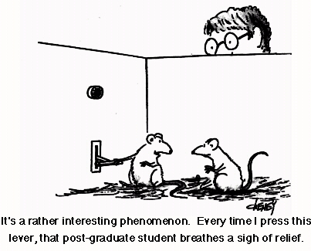
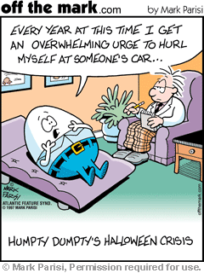
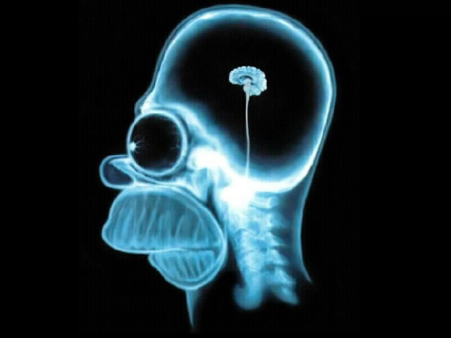
What the hell is Psychology?

Slide 3
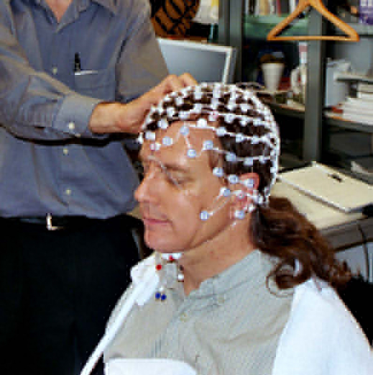
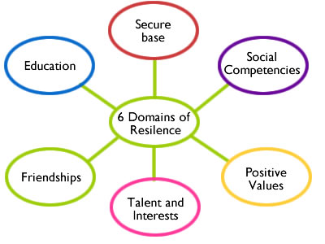

Slide 4
Learning Objectives:
Define Psychology
Describe Psychology’s roots in philosophy
Discuss the early days of psychology
Summarize twentieth-century approaches to the study of Psychology
Psychology today

Slide 5
The Four Goals of Psychologists
Description of what we observe
Explanation – For example: Why do we eat?
Prediction of the circumstances that lead to the expression of a certain behavior.
How can we control behaviour?

Slide 6
What is Psychology?

Slide 7
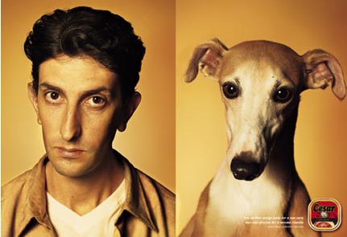
What Is Psychology?
Psychology is the scientific study of mental processes and behaviour.
How is behaviour different from mental processes?

Slide 8
Levels of Analysis
When studying why a certain behaviour or mental process occurs, one can study the influences of:
The brain
Neural activity
The person
Emotions, ideas, thoughts
The group
Friends, family, culture
Notes:
In-Class Activity: Give students a topic (e.g., What influences how much fastfood an average post-secondary student eats) and have them guess (in pairs) what might influence that topic at the level of the brain, the person, and the group.

Slide 9
Levels of Analysis
Level | What Is Analyzed | Example: Using Social Media
The brain | How brain structure and brain cell activity differ from person to person and situation to situation | What are the patterns of brain activation as people interact with “friends” online?
The person | How the content of the individual’s mental processes form and influence behaviour | Are there personality factors that influence how much people use different types of social media? Can online social support or crisis resources improve people’s decision making and quality of life?
The group | How behaviour is shaped by the social and cultural environments | What features of social networking sites, such as relative anonymity, ease of access, and lack of face-to-face contact, increase or decrease users’ feelings of belonging and connectedness?

Slide 10
Psychology’s Roots in Philosophy

Slide 11
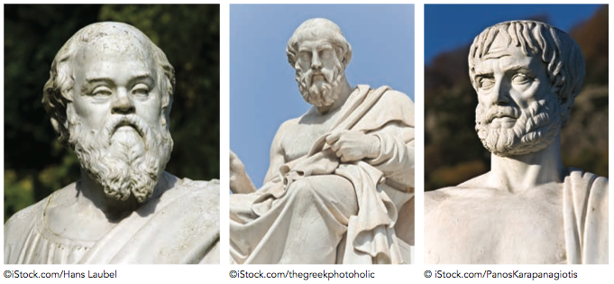
The Roots of Psychology are in Philosophy
Philosophy is the study of knowledge and reality.
Philosophers such as Socrates (ca. 469–399 B.C.E.) , Plato (ca. 427–347 B.C.E.) and Aristotle (ca. 384–322 B.C.E.) posed questions and then discussed possible solutions to those questions
This discourse was the beginning of modern processes of scientific enquiry.

Slide 12
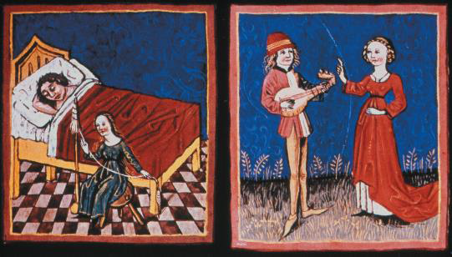
The Roots of Psychology are in Philosophy
The ancient Greek Hippocrates argued (ca. 460–377 B.C.E.), that the brain is the organ of mental life
This medieval manuscript illustrates the psychological effects of the humors proposed by the Greek physician Hippocrates. The illustration on the left demonstrates the melancholia produced by black bile, while the one on the right depicts the joyous, musical, and passionate personality produced by blood.

Slide 13
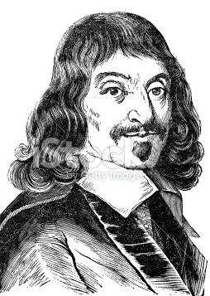
Psychology’s Roots in Physiology and Psychophysics
By the1600’s modern science began to thrive
Rene Descartes (1593-1650) thought that the brain controlled the body via the movement of fluids within tubes that ran throughout the body
Zeitgeist

Slide 14
Psychology’s Roots in Physiology and Psychophysics
Johannes Muller (1801-1858) – advocated for scientists to study the relationship between physical stimuli and their psychological effects.
Herman von Helmholtz (1821-1858) – measured the speed of neural impulses. Discovered that neural impulses were not instantaneous.

Slide 15
The Early Days of Psychology

Slide 16
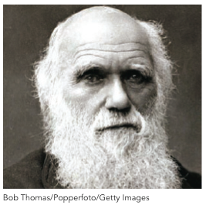
The Early Days of Psychology
Charles Darwin (1809-1882)
Proposed the theory of evolution in his book The Origin of the Species
All life on earth comes from one common ancestor – a radical idea!

Slide 17
The Early Days of Psychology
Charles Darwin (1809-1882)
Natural selection – chance variations in one’s behaviour are passed down from parents to children.
Some of these variations are more advantageous than others. They help an organism survive and are called adaptive variations.

Slide 18
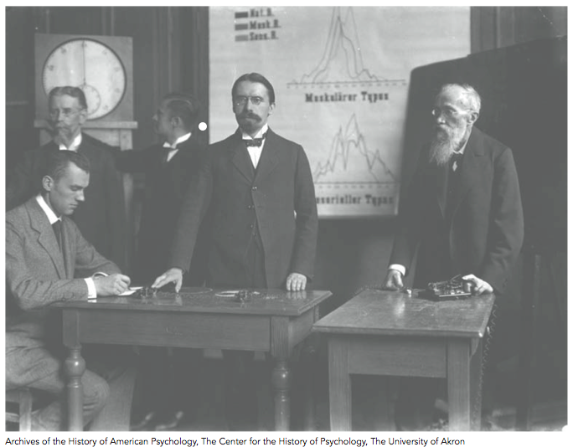
The Early Days of Psychology
Originally Psychology was indistinguishable from Philosophy but that changed with the study of Voluntarism by Wilhelm Wundt (1832-1920)
Father of psychology.
Established first psychology lab in 1879 in Leipzig, Germany.
Focused on the study of consciousness.
Research being conducted in Wundt’s laboratory

Slide 19
Structuralism - Looking for the Elements of Consciousness
Edward Titchener (1867–1927)
Developed Structuralism as an attempt to try to identify all of the elements of consciousness
Introspection – the careful reflective and systematic observation of the details of mental processes and how simple thoughts combine into complex ideas
The goal of Structuralism was to describe observable mental processes rather than to explain, predict, or control

Slide 20
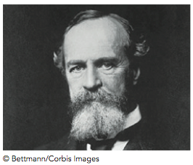
Functionalism - The Flow of Consciousness
William James (1842-1910)
Set up the first psychology lab in the US at Harvard.
Wrote the first psychology textbook, Principles of Psychology, which was published in 1890.

Slide 21
Functionalism - The Flow of Consciousness
James believed that mental processes were fluid (“stream of consciousness”) instead of fixed elements. (in contrast to structuralist’s viewpoint)
Emphasis on the functions of the mind in adapting to a changing environment.
Functionalist scientists used empirical methods that focused on the causes and consequences of behaviour.
Emphasis was also placed on studying animals, children and individuals with mental disorders.

Slide 22
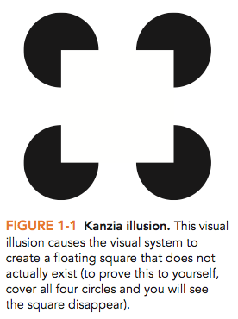
Gestalt Psychologists
Said consciousness CANNOT be broken down into elements.
We perceive things as whole perceptual units.
The whole is greater than the sum of its parts.
Learning is tied to what we perceive.

Slide 23
Twentieth-Century Approaches

Slide 24
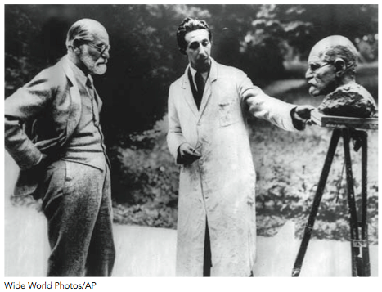
Psychoanalysis – The Psychology of the Unconscious
Sigmund Freud (1856–1939)
The belief that people’s behaviours are based on their unconscious desires and conflicts
Freud developed a form of therapy, psychoanalysis, that aimed to resolve unconscious conflicts
Sigmund Freud, founder of psychoanalytic theory, examines a bust of himself.

Slide 25
Behaviourism – The Study of Observable Behaviour
Behaviourism – Psychological research should only focus on behaviour you can observe.
Edward Thorndike (1874–1949)
Proposed research findings from the study of animals could help explain human behaviour.
Ivan Pavlov (1849–1936)
Found that dogs could learn to associate a bell with an automatic behaviour, such as salivating for food. This is called classical conditioning.
John B. Watson (1878–1958)
He conducted the “Little Albert” experiment demonstrating that children (people) could be classically conditioned.
Notes:
Lecture expander: To liven up the class a bit, I would show the two-minute YouTube video clip from The Office where Jim has classically conditioned Dwight to want an altoid every time he hears the computer turn on. Just go to www.youtube.com and type in “classical conditioning and office.”

Slide 26
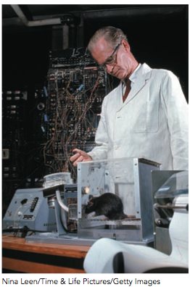
Behaviourism continued
B.F. Skinner (1904–1990)
He developed operant conditioning to shape behaviour.
Used reinforcement to change the frequency of the expression of a behaviour.
Positive reinforcement increases and negative reinforcement decreases the likelihood of a behaviour occurring.
B.F. Skinner with a rat that is learning to press a lever to gain a food reward.

Slide 27
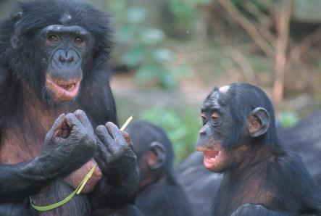
Behaviourism continued
Albert Bandura (1925 – )
He described learning by social observation in children.
We now know that this type of learning can be observed in several species of primates
A juvenile Bonobo chimpanzee observing the behaviour of an adult.

Slide 28
Humanistic Psychology – A New Direction
Humanisitic Psychologists stressed that a person has a capacity for personal growth and the freedom to choose his or her destiny, and positive qualities.
Our subjective perceptions of the world are unique and are more important than behaviour itself.

Slide 29
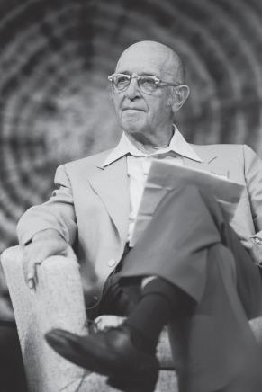
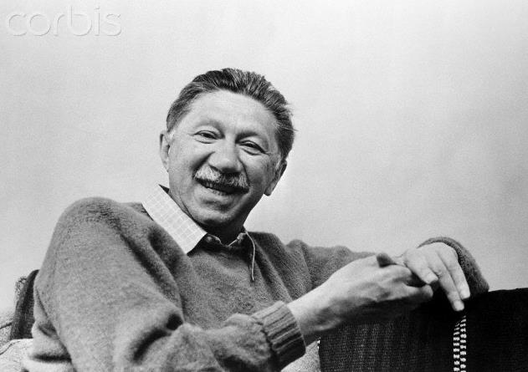
Humanistic Psychology –
A New Direction
Carl Rogers (1902–1987)
Developed “client-centred therapy,” which said that people are innately good.
Abraham Maslow (1908–1970)
He developed a theory of motivation that consists of a hierarchy of needs.

Slide 30
Maslow’s Hierarchy of Needs

Slide 31
Cognitive Psychology - Revitalization of Study of the Mind
Ulric Neisser (1928-2012), coined the term cognitive psychology as the study of information processing.
The role of mental processes in how people process information, develop language, solve problems, and think.
Cognitive psychologists compared the human mind to a computer.

Slide 32
Cultural and Cross-Cultural Psychology
Cultural psychology
The study of how cognitive processes vary across different populations.
Cross-cultural psychology
The study of the cognitive processes that are universal regardless of culture.

Slide 33
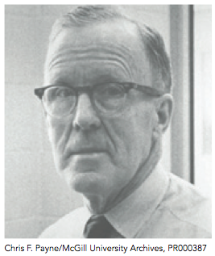
Psychobiology/Neuroscience – Exploring the Origins of the Mind
The study of brain structure and activity and how this relates to/controls behaviour
Karl Lashley (1890–1958)
Attempted to determine which areas of the brain responsible for memory, learning, and other functions.
Donald Hebb (1904-1985)
Canadian scientist that developed the concept of a cell assembly. Neurons (the cells in the brain) develop networks of connections based on our experiences as we develop and interact with our environments
Donald Hebb

Slide 34
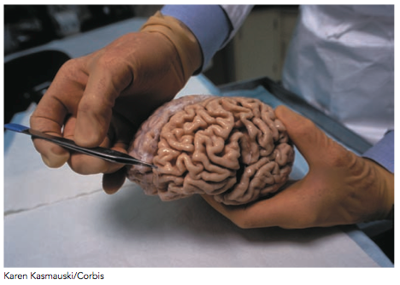
Subfields of Psychology Influenced by Psychobiology/Neuroscience
Behavioural genetics – the study of the influence of gene expression on the development of the brain and its control of human behaviour.
Evolutionary psychology – the study of how the process of evolution has shaped our brain and expression of behaviour

Slide 35
Psychology Today

Slide 36
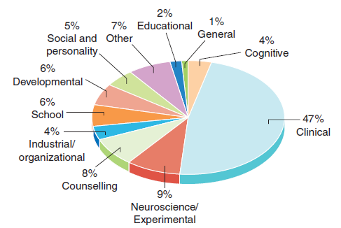
Psychology Today: Doctoral Degrees Awarded in Psychology

Slide 37
Psychology Today: Three Main Branches of Psychology
Clinical and counseling psychology
Work as therapists
Academic
Work as professors, both teaching and doing research
Applied
Work in schools, marketing firms, research institutions, etc. applying psychological skills to real-life situations.
Notes:
Lecture Expander: You might want to point out that the average person thinks that a psychologist is a therapist. However, only a little over 50% of psychologists are therapists. The other half of psychologists either work in academia or in applied settings.

Slide 38
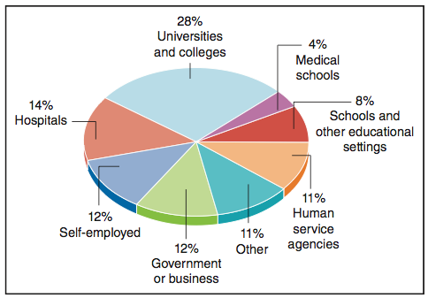
Where Psychologists Work

Slide 39
Shared Values of ALL Psychologists
Psychology is…
Theory-driven: uses theories to explain behaviour
Empirical: based on research
Multi-level: explained by the brain, the individual, and social influences
Contextual: based on cultural context

Slide 40
Current Trends in Psychology
Growing Diversity
More women and members of minority groups.
Advances in Technology
The development of computers and brain imaging techniques has lead to new research in the fields of cognitive neuroscience and social neuroscience.

Slide 41
Current Trends in Psychology
New Schools of Thought
-Neuroscience
-Positive psychology and positive psychotherapy focus on happiness and other positive emotions.
Human –brain interface
AI
Environmental Psychology

