Slide 1
The Government And The Macroeconomy
Chapter 11

Slide 2
In this chapter, we will learn
Government spending, taxation, budget deficits, and the debt-GDP ratio in Canada, the United States and around the world.
The government’s intertemporal budget constraint, which says that budget deficits today must be offset by budget surplus in the future.
The economic consequences of budget deficits;

Slide 3
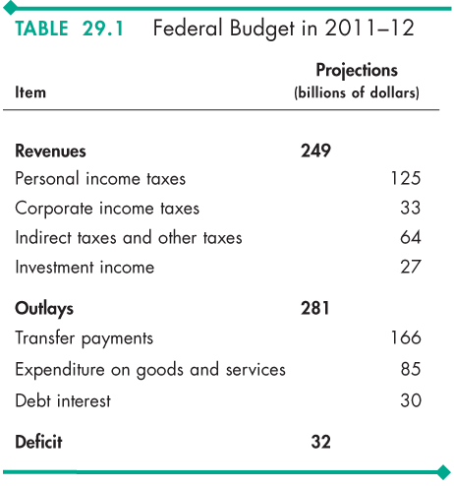
Government Spending and Revenue - Canada

Slide 4
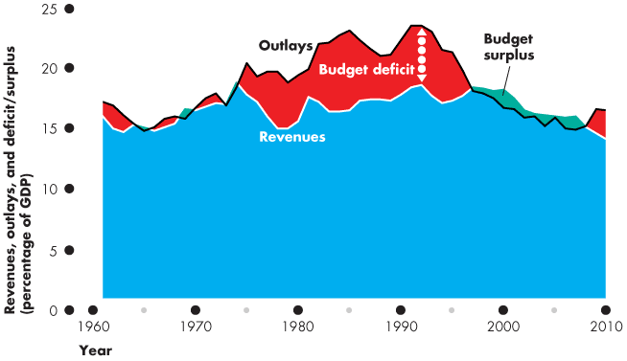
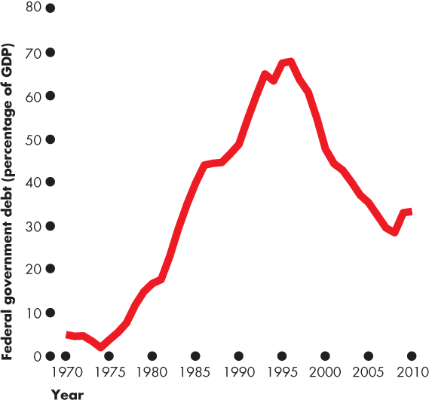
The Debt-GDP Ratio - Canada

Slide 5
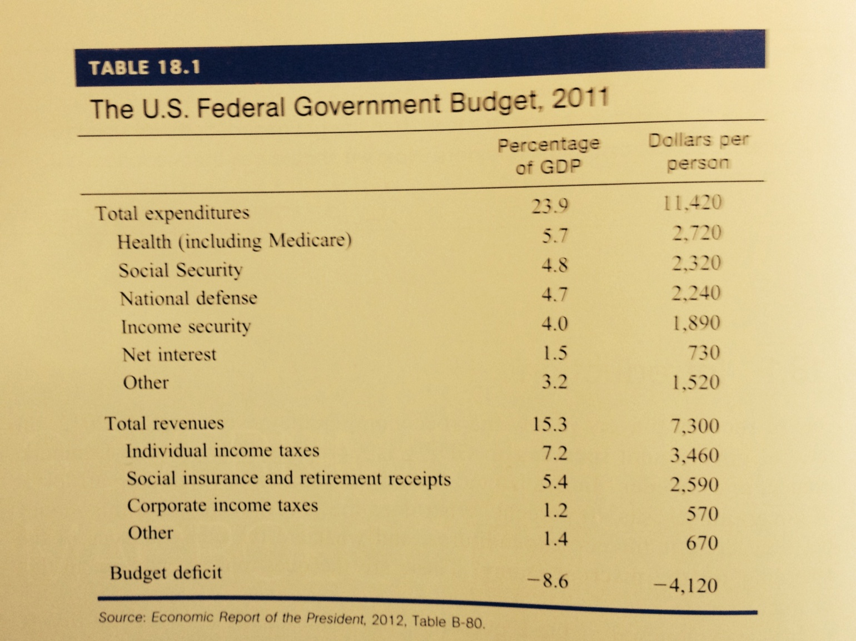
Government Spending and Revenue - US

Slide 6
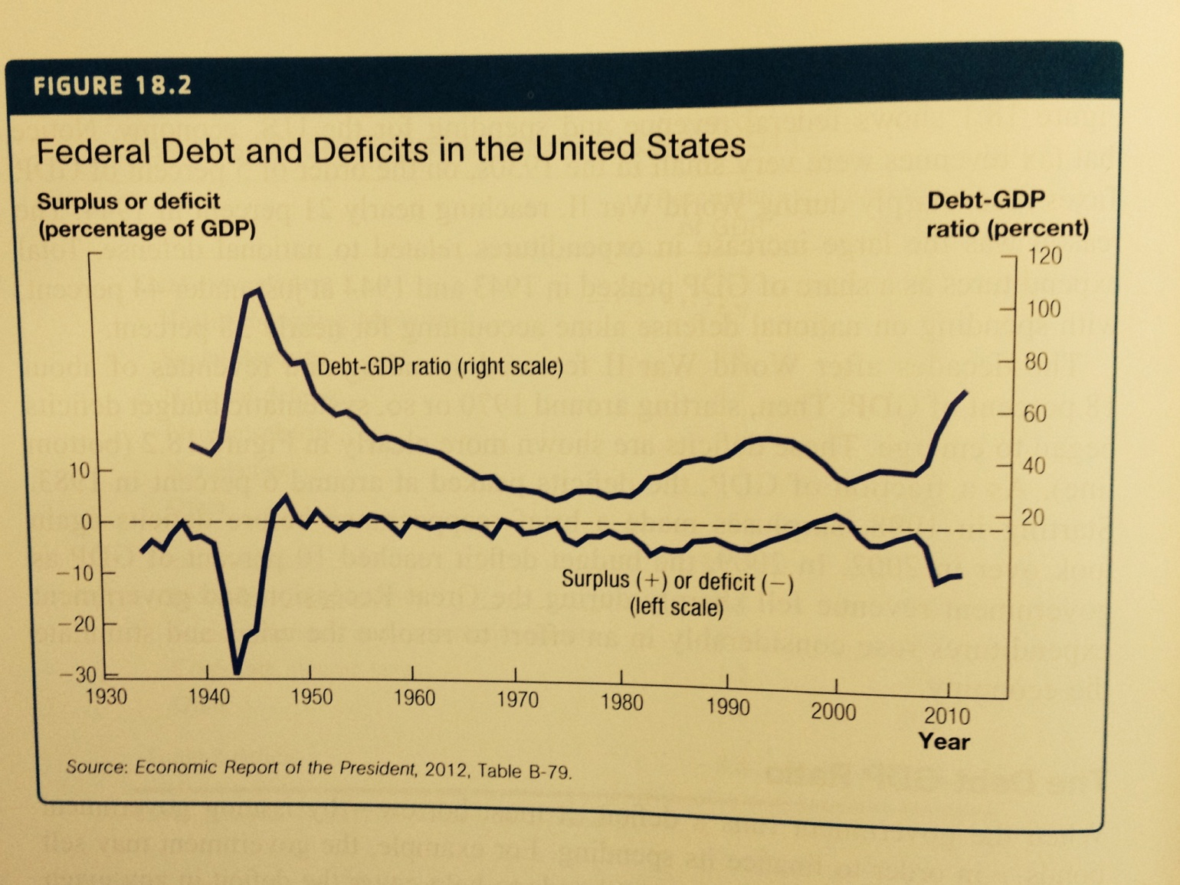
The Debt-GDP Ratio - US

Slide 7
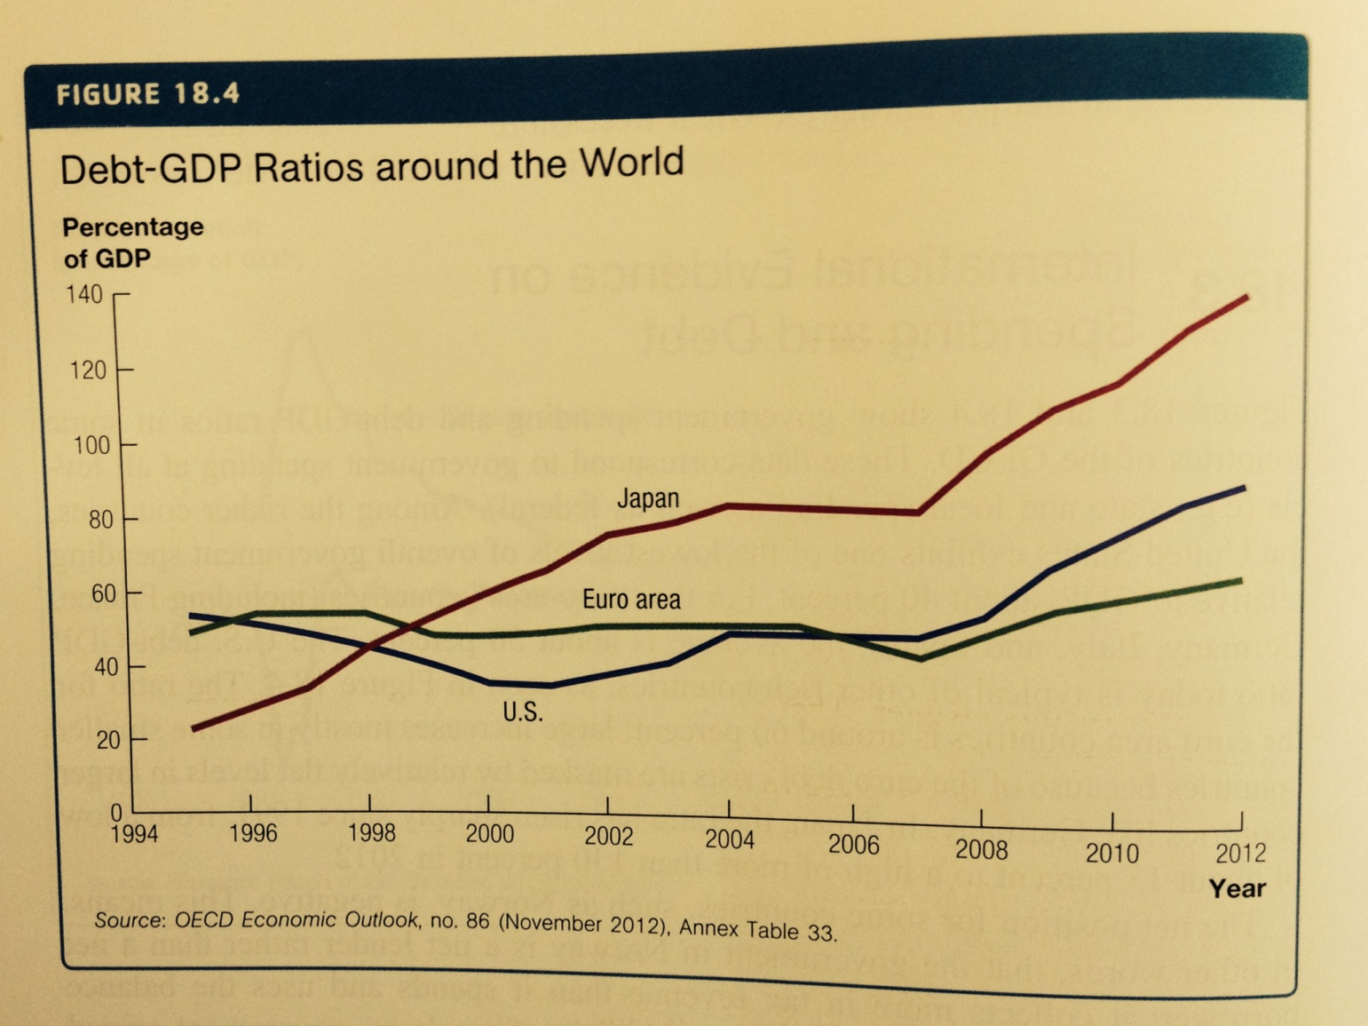
International Evidence on Debt Ratio

Slide 8
The Government Budget Constraint
The government budget constraint holds in each period says that the sources of funds to the government must equal the uses of funds.

Slide 9
The Government Budget Constraint
a. The Intertemporal Budget Constraint
  Suppose an economy exists for only two periods. We can combine the budget constraint in each period and derive a intertemporal budget constraint.

Slide 10
The Government Budget Constraint
  The present discounted value of spending (purchases) and initial debt must equal the present discounted value of tax revenues.
  This implies that uses must equal sources but now they are measured in present discounted value.

Slide 11
The Government Budget Constraint
Rewriting the intertemporal budget constraint will show that the government must have surpluses in the future to pay off deficits today.

Slide 12
How Much Can the Government Borrow?
The Possibility of High Inflation and Default.
If the debt-GDP ratio becomes too high, lenders worry about the ability of the government to repay.
  If investors stop lending, the government may use the printing press to satisfy the budget constraint—generating inflation.
  Investors demand higher interest rates when they doubt the ability of repayment.
Default is when a government declares that they will not repay certain debts or will repay them at less than face value.
There is no specific level of the debt-GDP ratio that triggers default, and the level varies with each economy's credibility, history, and growth prospects.

Slide 13
How Much Can the Government Borrow?
b. Deficits and Investment
Investment can be financed through saving from the private sector, government saving, and saving by foreigners.
Crowding out is when budget deficits may absorb some of the savings in the private sector and from foreigners—and reduce investment.
However, this does not account for the possibility that private or foreign savings may increase in response to additional demands for funds by the government.

Slide 14
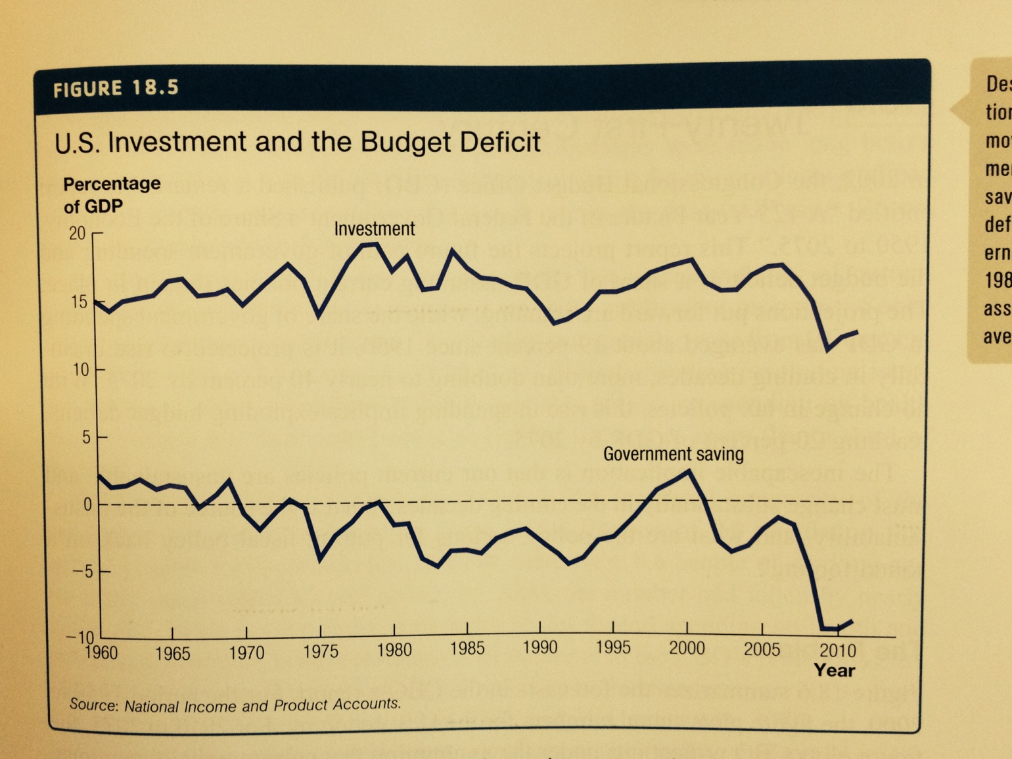
Budget Deficit and Investment

