Slide 1
Exchange Rate And International Finance
Chapter 10

Slide 2
In this chapter, we will learn
How nominal and real exchange rates are determined, in both the short run and the long run.
The key role played by the law of one price in determining exchange rates;
The international financial systems, including the fixed and floating exchange rates;

Slide 3
Exchange Rates in the Long Run
a. The Nominal Exchange Rate
  The nominal exchange rate is the rate that a currency trades for another.
    The nominal exchange rate is the rate that a currency trades for another.
    A depreciation of the dollar is a decline in the exchange rate, or in other words, a decline in the price of the dollar.
    An appreciation of the dollar is when the dollar rises in value, or in other words, the exchange rate rises.

Slide 4
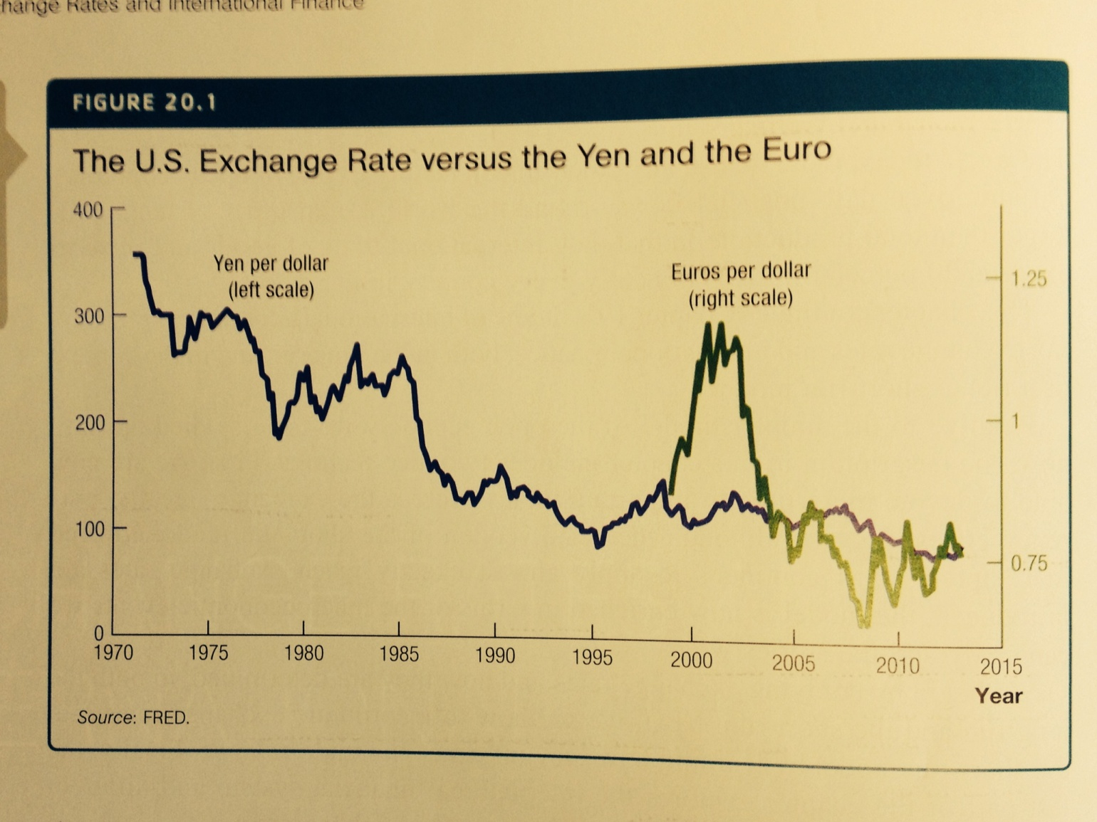
Exchange Rates in the Long Run

Slide 5
Exchange Rates in the Long Run
b. The Law of One Price
  The law of one price says in the long run goods must sell for the same price in all countries.
    If prices were different, the opportunity for arbitrage exists.
    The law of one price implies that the exchange rate times the domestic price must equal the foreign price.
  The existence of transportation costs and non-tradable goods imply that the law of one price need not hold exactly.

Slide 6
Exchange Rates in the Long Run
The nominal exchange rate is equal to the ratio of the price levels in the two economies in the long run.
In the long run, the exchange rate is determined by the amount of money in one country relative to another.

Slide 7
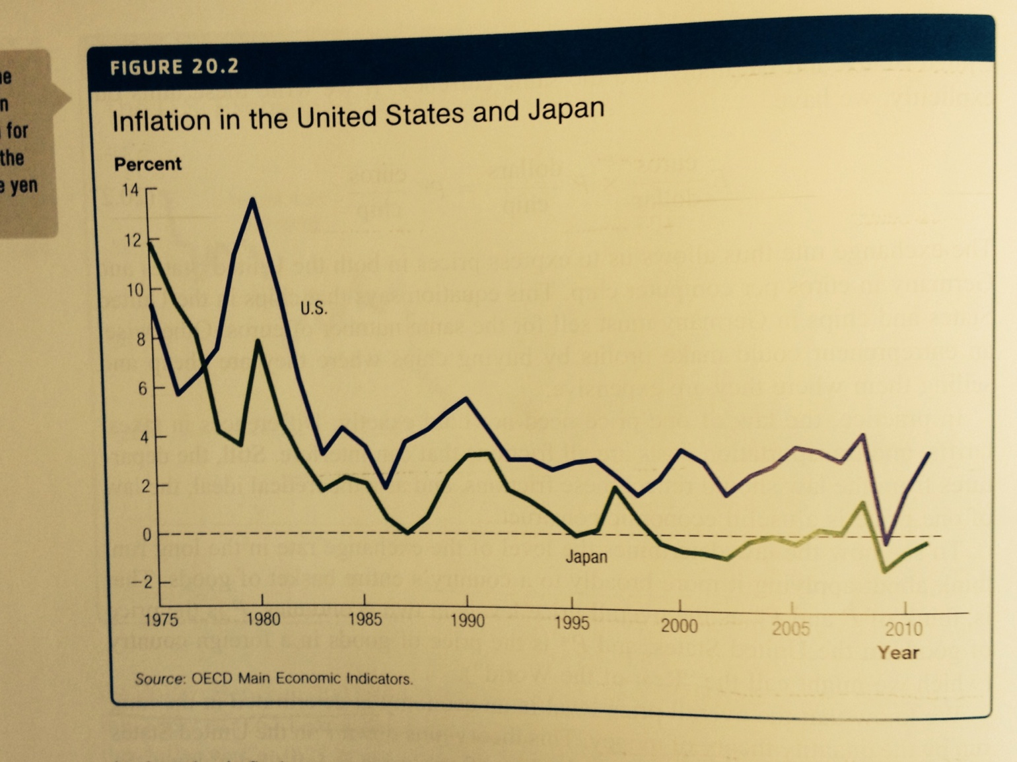
Exchange Rates in the Long Run

Slide 8
Case Study: The Big Mac Index
Assuming the Big Mac is selling for $4.07 in the United States. Calculate what would be the Implied e if the law of one price holds. Explain whether the US dollar is overvalued or undervalued relative to each currency.
Country | Big Mac Price | Implied e | Actual e
Brazil | 9.50 reais |  | 1.54 reais per US dollar
Poland | 8.63 zlotys |  | 2.80 zlotys per US dollar
South Korea | 3700 won |  | 1056 won per US dollar
Malaysia | 7.20 ringgists |  | 2.97 ringgits per US dollar

Slide 9
Exchange Rates in the Long Run
c. The Real Exchange Rate
  The real exchange rate (RER) is computed by adjusting the nominal exchange rate by the relative price level at home and abroad.
  If the law of one price holds, the real exchange rate should equal 1.

Slide 10
Exchange Rates in the Short Run
a. The Nominal Exchange Rate
  People trade currencies to facilitate international trade and traders in financial markers demand currencies in order to make financial transactions.
  The average foreign exchange traded around the world is $1.6 trillion per day.

Slide 11
Exchange Rates in the Short Run
The nominal exchange rate fluctuates as demand and supply fluctuate in the foreign exchange market.
Example, when Bank of Canada raises interest rate:
  Foreign investors are attracted to purchase Canadian bonds.
  Foreign traders need dollars to make these purchases.
  Demand for dollars increases.
  The exchange rate then appreciates—the value of the dollar increases.
Movements in the domestic nominal interest rate (holding the world interest rate constant) cause the nominal exchange rate to move in the same direction.

Slide 12
Exchange Rates in the Short Run
b. The Real Exchange Rate
  In countries that do not have fixed exchange rates, the nominal exchange rate changes by the minute—instantaneously.
  prices adjust slowly over time.
  Thus, the real exchange rate can deviate from 1 in the short run, and the law of one price need not hold in the short run.

Slide 13
Exchange Rate Regimes
Exchange rate regimes are the institutions that set exchange rates around the world.
  Floating exchange rate regime;
  Fixed exchange rate regime;
The goals of exchange rate regimes:
  A stable exchange rate, which benefits us the same way as a stable price;
  Monetary policy autonomy to meet a country’s economic challenges;

Slide 14
Fixed Exchange Rate Regime
Fixed exchange rates are systems where the exchange rate for one currency is pegged to a particular level for some period.
To fix an exchange rate, the money supply would have to change by the same amount as the money supply in the country to which the currency is fixed.
If Argentina fixes its exchange rate to the dollar, the central bank in Argentina will follow the monetary policy dictated by the United States to maintain a fixed exchange rate.
One reason countries fix exchange rates is that it is an attempt to "import" a disciplined monetary policy to overcome previous inflation problems.
Other benefit of fixed exchange rate regime: stable exchange rate.

Slide 15
Fixed Exchange Rate Regime
Costs:
  Loss of monetary policy autonomy;
  Possibility of speculative attack on currency;

Slide 16
Flexible Exchange Rate Regime
Benefit: monetary autonomy;
Cost: certain degree of instability due to fluctuation in exchange rate.

Slide 17
Currency Union
Euro was introduced on Jan 1, 1999, and is currently used by 18 member states of the European Union.
To join the EU and adopting euro, candidate states need to meet certain economic converging criteria on inflation, public finance, interest rate, exchange rate stability.
Benefits of one single currency:
  The risks associated with fluctuations in the exchange rate are eliminated;
  The transaction costs of trade in the member countries are reduced;
  A single central bank means more independence from any government;

Slide 18
Currency Union
Costs of one single currency:
  Loss of monetary autonomy presents economic challenges for countries such as Greece, Spain, Italy.

