Slide 1
Introduction
Chapter 1

Slide 2
Goals
Understand why do we need models;
Differentiate four time frames: very short run; short run, long run and very long run;
Understand the assumptions underlying each time frame;

Slide 3
How Economists Think
In economics, models are simplified representation of the real world.
Why models?
  Simplification;
  Models improve our understanding of the economy, and allow us to propose economic policy to tackle economic problems.
  Forecasting the future path of the economy.

Slide 4
Time frames
Models are often related to a certain time frame:
  very short run;
  short run;
  long run;
  very long run;

Slide 5
Assumptions for different time frames
Very short run: the time frame in which prices are assumed to be fixed;
Short run: the time frame in which prices are assumed to be sticky.
Long run: the time frame in which all prices are considered to be flexible, but the productive capacity of the economy is assumed to be fixed.
Very long run: the time frame in which all prices are assumed flexible, and the productive capacity of the economy grows.

Slide 6
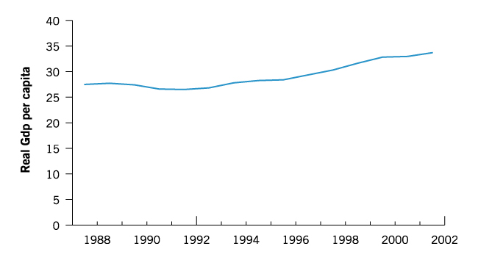
From Data to Models
Figure 1-6: Real GDP per capita, 1988-2002 (thousands of 1997 dollars), grew at an average annual rate of slightly over 1 percent.

Slide 7
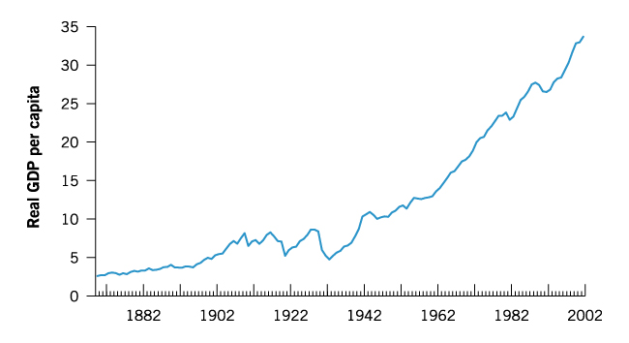
From Data to Models
Figure 1-5: Real GDP per capita in Canada, 1870-2002 (thousands of 1997 dollars), grew at an average rate of 2 percent per year.
Notes:
Very long-run, where the economic growth is studied. We use the very long run model to explain the behavior displayed by the above data. In the very long run, AS shifts to the right, so is the AD curve, therefore Real GDP increases. Real GDP increases faster than population, hence we observe the increase of Real GDP per capita.

Slide 8
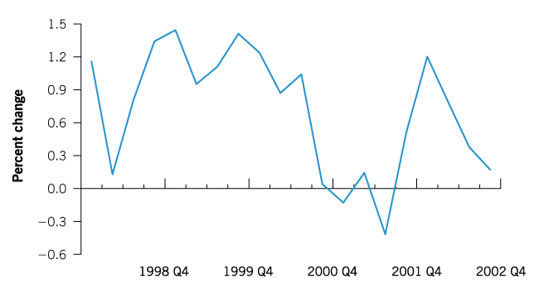
From Data to Models
Figure 1-7: Real GDP per capita quarter to quarter growth is quite volatile, 1998 quarter I to 2002 quarter IV. Very short run, business cycle
Notes:
Percentage change: growth rate of real GDP per capita. Very short-run, 3 months, when very s-r model should be applied. Therefore the price is fixed, output is decided by AD, and the fluctuation is roughly from shocks to AD. Ex, Sept 11, 2001, AD drops, so is the real GDP. As central bank lowers the key interest rate, AD increases in the last quarter of 2001. As the economy recovers, it builds up pressure to inflation, therefore the Bank hold the interest rate or lowers it to release the pressure.

