Slide 1
Applications and Microfoundations - Investment
Chapter 9

Slide 2
In this chapter, we will learn
How firms determine investment in physical capital;
The arbitrage equation, an important tool for analyzing any kind of investment;
Financial investment and a basic theory of prices in the stock market;

Slide 3
Introduction
In the national income accounting sense, investment refers to the accumulation of physical capital.
Why study investment?
  Investment fluctuates more than consumption.
  Investment is the key economic link between present and future.

Slide 4
How Do Firms Make Investment Decisions?
A business should keep investing in physical capital until the marginal product of capital (MPK) falls to equal the rental price of capital, which in turn equals the real interest rate, ie, MPK = R;

Slide 5
The Arbitrage Equation
The arbitrage equation implies that if an investor is maximizing profits, then two investments must yield the same return.
  If the return were not the same, taking some money from the lower-return activity and switching it to the higher-return activity would make even more profit.

Slide 6
The Arbitrage Equation
By how much should the firm invest? A more generalized result:
  A firm should invest in capital until MPK = the user cost.

Slide 7
Example: Investment and the Corporate Income Tax
The corporate income tax raises the user cost of capital, and reduces the investment.

Slide 8
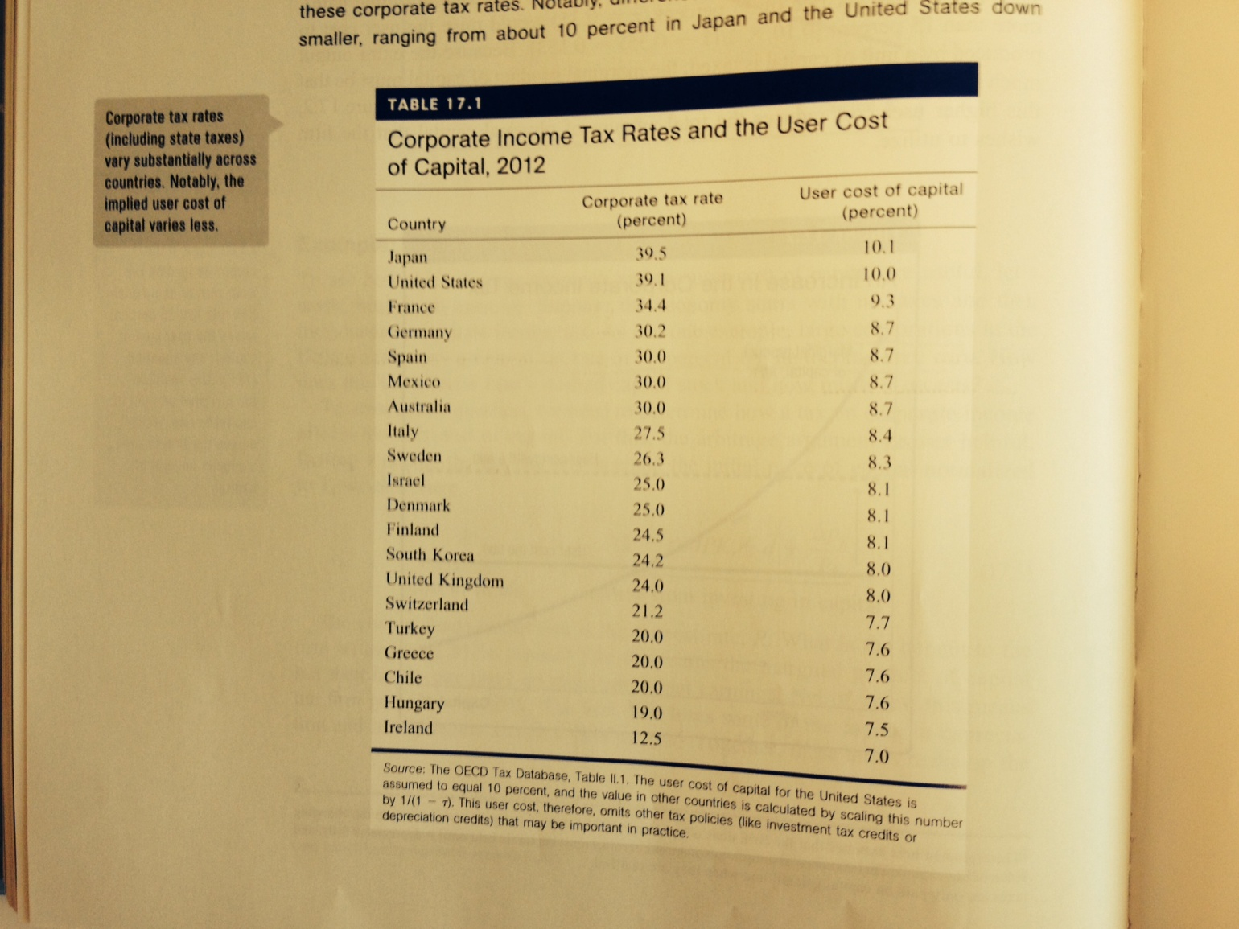
Case Study: Corporate Income Taxes across Countries

Slide 9
The Determination of Investment Rate
Combining the capital accumulation equation and the arbitrage equation implies that the investment rate depends on the desired growth rate of the capital stock, the depreciation rate, and the user cost of capital.
  A higher user cost of capital leads to a lower investment rate.
  A higher corporate tax rate leads to a lower investment rate through affecting the user cost of capital

Slide 10
Components of Physical Investment
Nonresidential fixed investment is equipment and structures purchased by businesses.
  It is approximately two-thirds of investment and 11 percent of GDP.
  Residential fixed investment is new housing purchased by households.
Inventory investment is the goods that have been produced by firms but that have not been sold.

Slide 11
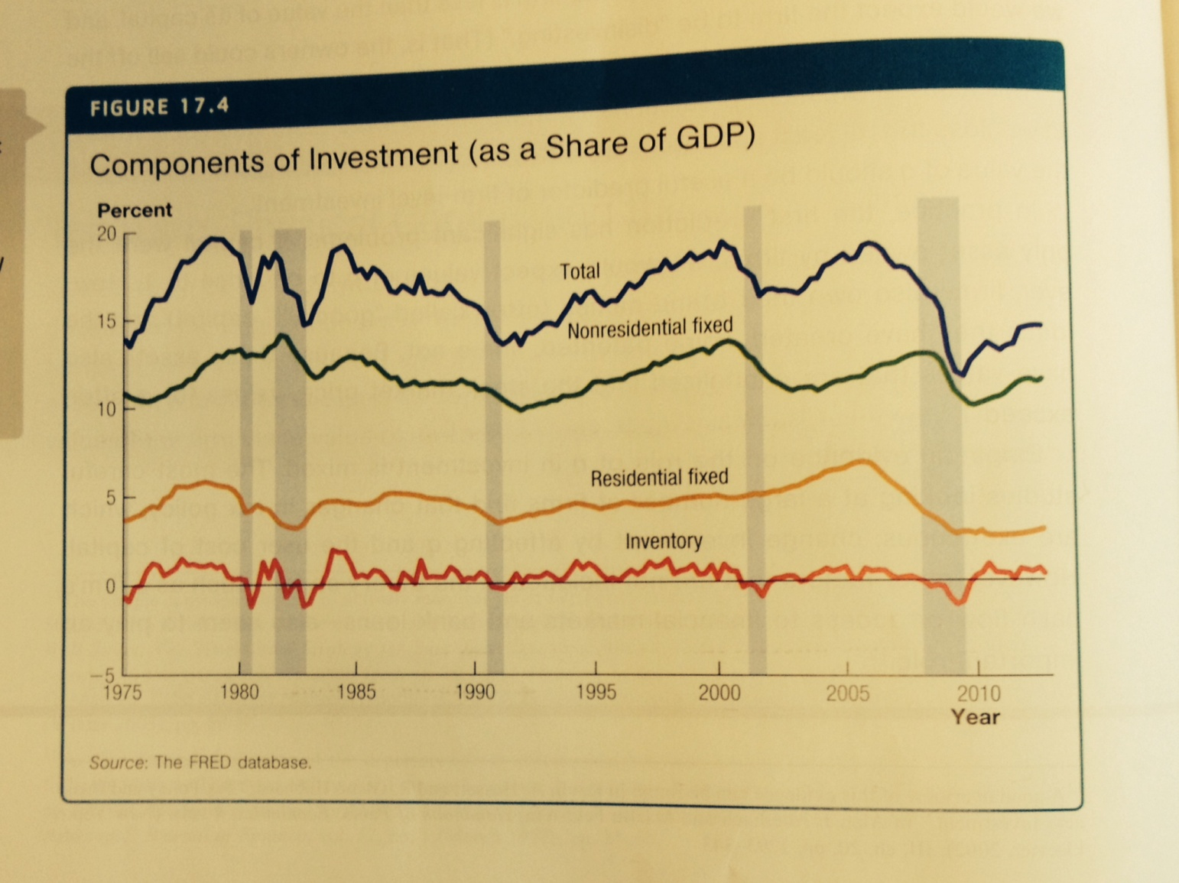
Components of Investment

Slide 12
Residential Investment
The return from saving a down payment on a house must equal the return from investing in a house.
  The return to investing in a house is equal to the rental payment if the house was rented out minus the depreciation rate times the price of the house plus the change in the price of the house.

Slide 13
Residential Investment
The arbitrage equation tells what determines the price of house:
  Expected capital gain/loss;
  Down payment percentage;

Slide 14
Inventory Investment
Inventory investment is a small but very cyclical component of investment.
  In a boom inventory, investment is positive and firms are producing more than they are selling. The reverse is true in a recession.

Slide 15
The Stock Market and Financial Investment
The Arbitrage Equation and the Price of a Stock.
  A dividend is a payment by a firm to its shareholders.
Suppose investment in a stock and investment in a saving account are perfectly safe such that the owner knows what the dividend and capital gain will be.
  Then, the return in a bank account must equal the return from a stock.

Slide 16
The Stock Market and Financial Investment
P/E Ratios and Bubbles?
  The price-earnings ratio is equal to the stock price divided by the annual profit per share.

Slide 17
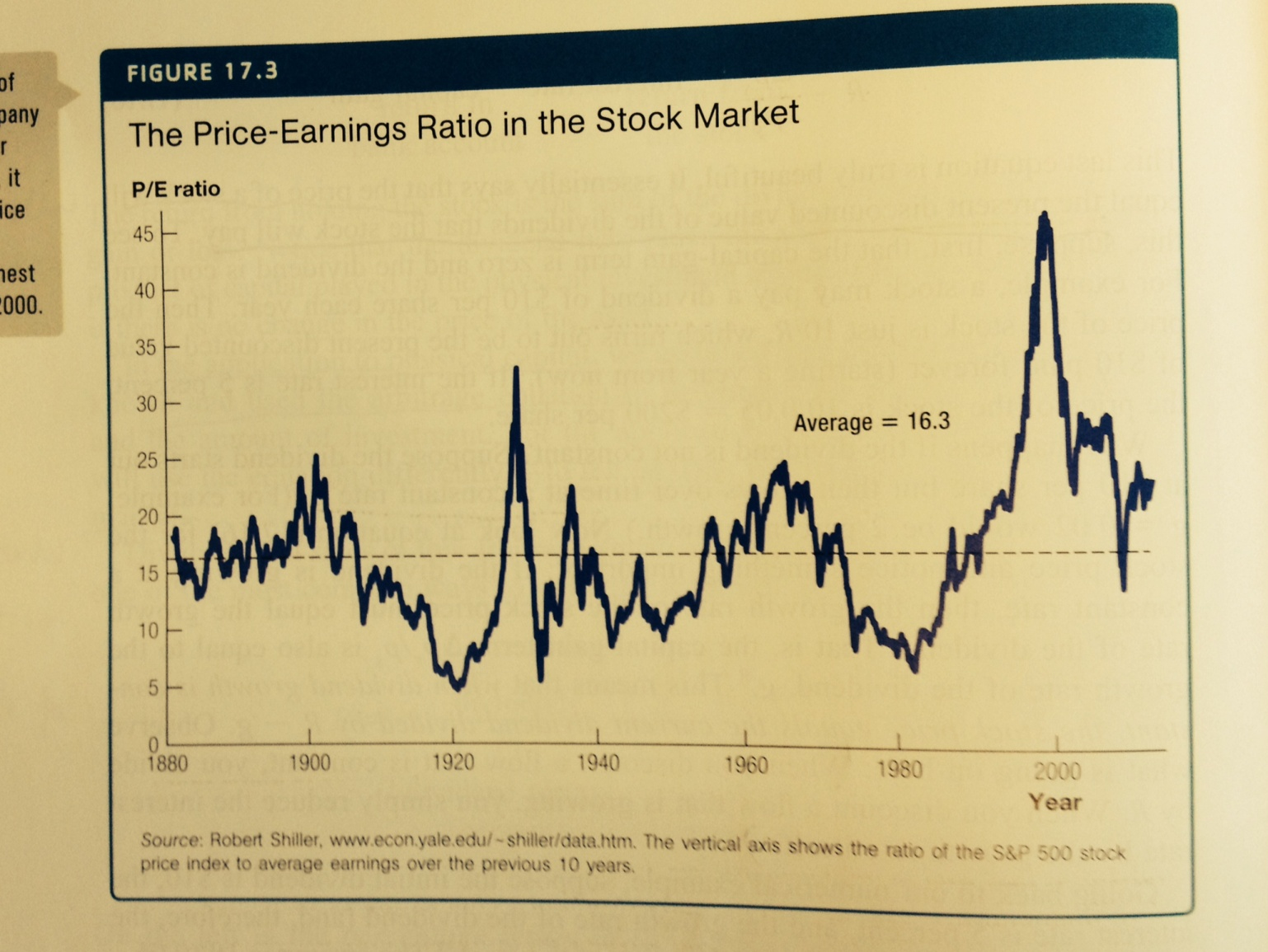
PE ratio and stock market

