Slide 1
A Short-Run Macroeconomic Model
Chapter 7

Slide 2
In this chapter, we will learn
The IS curve, which describes the effect of changes in the interest rate on output in the short run;
How shocks to consumption, investment, government purchases, or net exports – “aggregate demand shocks” – can shift the IS curve;
How to model describes the effect of monetary policy in the short run;
How to analyze the evolution of the macroeconomy – output, inflation, and interest rates – in response to changes in policy or economic shocks;

Slide 3
Introduction
The IS curve captures the relationship between interest rates and output in the short run.
  An increase in the interest rate will decrease investment, which will decrease output.
  There is a negative relationship between the interest rate and short-run output.

Slide 4
Setting up the Model
National income accounting:
  Y=C+I+G+NX;
  We then define C, I, G and NX and substitute them into the above equation;

Slide 5
The Derivation of IS Curve

Slide 6
Case Study: Why Is It Called the "IS Curve"?
IS stands for investment equals saving.
we will see that private saving plus government saving plus foreign saving equals investment.

Slide 7
The IS Curve
i
i₁
E₁
Interest rate
i₂
E₂
At E₁, income is at Y₁.
IS
A decrease in the interest rate raises AD.
Y₁
Y₂
Income, Output

Slide 8
The IS Curve
The rotation and shift of the IS curve due to change of parameters;
  As the multiplier and b increase, the slope of IS curve become smaller, and IS curve flatter;
  The changes in bring shift of IS curve;

Slide 9
The Microfoundations of IS Curve
The Multiplier effect: the multiplier is larger than 1, that is, a shock to one part of the economy gets multiplied by affecting other parts of the economy;

Slide 10
The IS Curve
Effect of the Multiplier on the Slope of the IS Curve
i
i₁
Interest rate
i₂
IS’
IS
Y₁
Y’₁
Y₂
Y’₂
Income, Output

Slide 11
The Microfoundations of IS Curve
The impact of fiscal policy through G and TR => shift the IS curve;
The degree of the fiscal stimulus is of debate;

Slide 12
The IS Curve
A Change in Autonomous Spending
i
Interest rate
E₂
i₁
E₁
IS’
IS
Y₁
Y₂
Income, Output

Slide 13
The LM Curve
The demand for real balances depends on two things:
  The level of real income.
  The interest rate.

Slide 14
The LM Curve
Demand for Real Balances as a Function of i and Y
i
The higher the interest rate, the lower the quantity of real balances demanded, given the level of income.
Interest rate
An increase in income raises the demand for money.
Demand for money

Slide 15
The LM Curve
Derivation of the LM curve
i
i
LM
E₂
E₂
i₂
Interest rate
E₁
i₁
E₁
Y₁
Y₂
Real Balances
Income, Output

Slide 16
The LM Curve
For the money market to be in equilibrium, demand has to equal supply, or
(7)
LM curve
(7a)

Slide 17
The Phillips Curve
The Phillips curve describes how inflation evolves over time as a function of short-run output.
We start by studying how firms set their prices:
  Firms set their prices on the basis of their expectations of the economy-wide inflation rate and the state of demand for their product.
  The parameter measures how sensitive inflation is to demand conditions.
  .

Slide 18
Price Shocks and the Phillips Curve
We can add shocks to the Phillips curve to account for temporary increases in inflation.
The actual rate of inflation now depends on three things:
  The expected rate of inflation, which equals the inflation rate from last year under adaptive expectations.
  An adjustment factor for the state of the economy.
  A shock to inflation.
An oil price shock will result in a temporary upward shift in the Phillips curve.

Slide 19
Cost-Push and Demand-Pull Inflation
The price shock term in the Phillips curve can catch the effect of Cost-Push inflation due to increase in the price of input to production.
The term captures the effect of demand-pull inflation;

Slide 20
Using the Short-Run Model
The Volcker Disinflation and the Great Inflation of the 1970s
  Disinflation is a process of sustained reduction of inflation to a stable lower rate.
  Background: Paul Volcker was appointed to chair the Federal Reserve in 1979. At the time the U.S. inflation rate was above 12%.
Reducing the level of inflation requires a sharp reduction in the rate of money growth—a tight monetary policy => a sharply higher interest rate, firms and households put their buy plans on hold => output falls, unemployment rate increases => inflation rate fell as output fell below potential level;

Slide 21
Using the Short-Run Model
The Great Inflation of the 1970s
  The inflation was initiated by an increase of the oil price;
  The slowdown of productivity growth causing potential GDP to grow at a lower pace;
  The slowdown of the economy was perceived as due to a demand shock by the policy maker and an expansionary monetary policy followed;

Slide 22
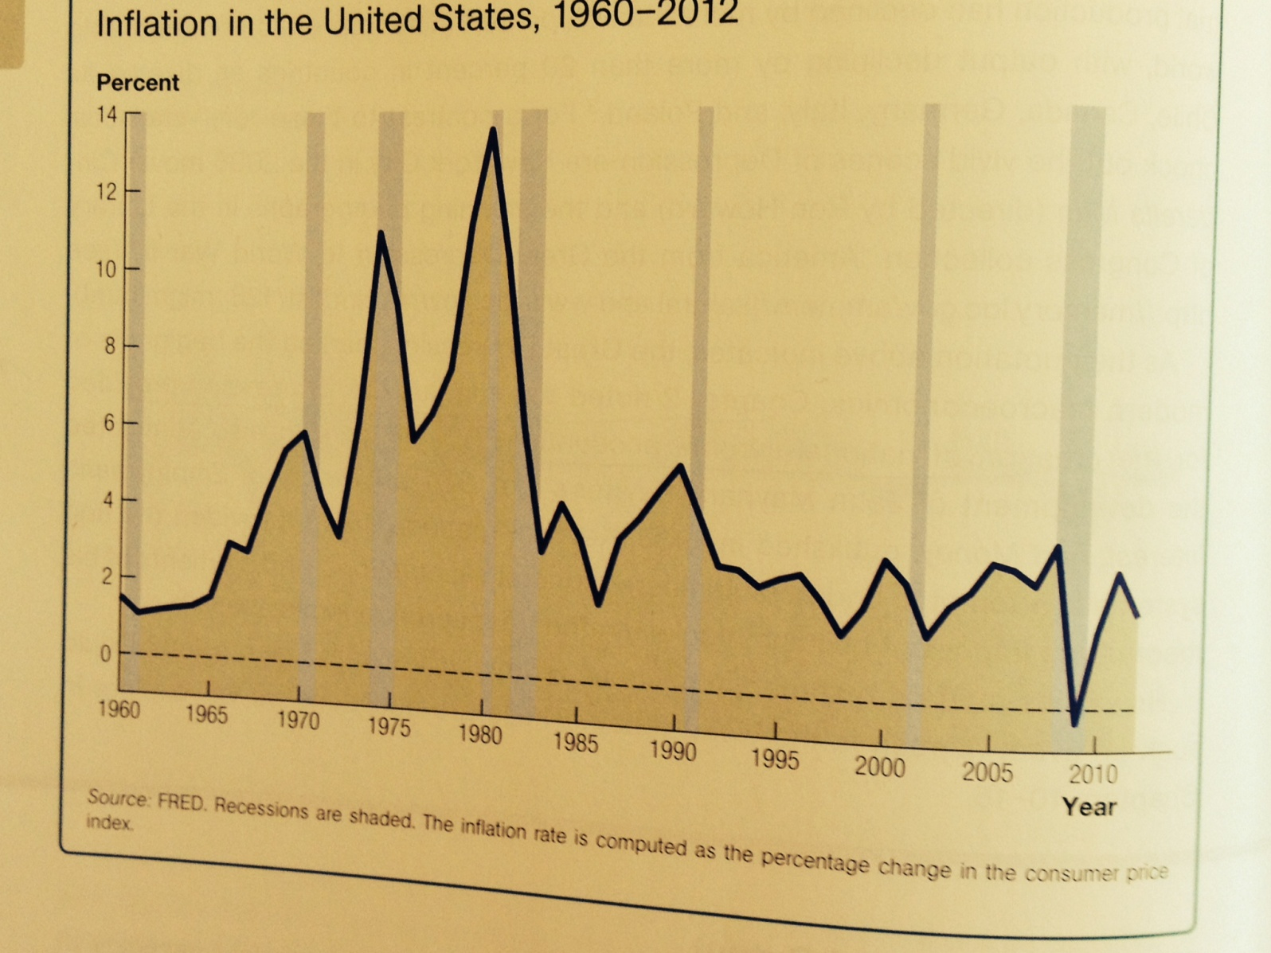
The Inflation Rate

Slide 23
Set Money Supply or Interest Rate
Historically central banks set money supply, and let interest rate fluctuate, which creates uncertainty for business planning;
Nowadays they set the interest rate by changing money supply;
The central banks change money supply by conducting open market operations – selling and buying back government bonds;

Slide 24
Set Money Supply or Interest Rate
When central banks set interest rate, the LM curve becomes horizontal. LM curve shifts up when tight monetary policy, interest rate goes up. LM curve shifts down when expansionary monetary policy, interest rate goes down.

