Slide 1
Introduction to Short Run
Chapter 6

Slide 2
In this chapter, we will learn
How output gap is a key measure of the economy’s performance in the short run;
How costly fluctuations in economic activity can be;
that the rate of inflation tends to decline when the economy is in a recession;
The causes of the financial crisis that began in the summer of 2007 in the U.S. and then went worldwide;
How this recession compares to previous recessions;
Some financial concepts that helps you to understand the causes of the financial crisis;

Slide 3
The long run, the short run, and shocks
The long-run model is a guide to how the economy behaves on average.
  The long-run model determines potential output and long-run inflation.
  Potential output is the amount the economy would produce if all inputs were utilized at their long-run, sustainable levels
At any given time, the economy is unlikely to exactly equal the long-run average.
  The short-run model determines current output and current inflation.

Slide 4
The long run, the short run, and shocks
Current (Actual) output may deviate from potential output, because the economy can be hit by shocks.
  The short run is the length of time over which these shocks and deviations can occur.
In short-run models, we assume that the long run is given (it is determined by the long-run model, which is outside of the short-run model).
  Potential output and the long-run inflation rate are exogenous.

Slide 5
The long run, the short run, and shocks
The current level of output and the current inflation rate are endogenous in the short-run model.
Explaining how current output and current inflation deviate from their long-run values is the goal of the short-run model.

Slide 6
Trends and Fluctuations
  The long-run trend is potential output.
  The short-run fluctuations are the percentage change of deviations from potential GDP.
    This fluctuation is equal to the difference in actual and potential output, expressed as a percentage of potential output.

Slide 7
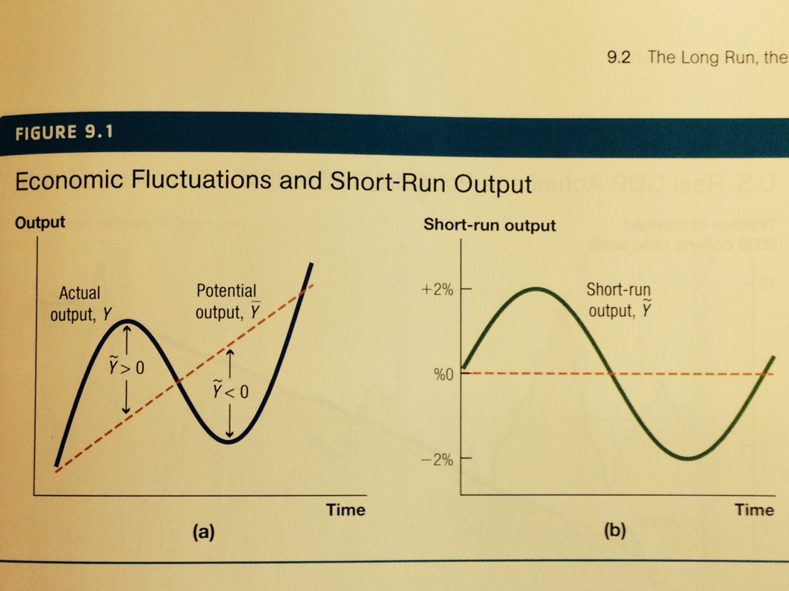
Output Gap

Slide 8
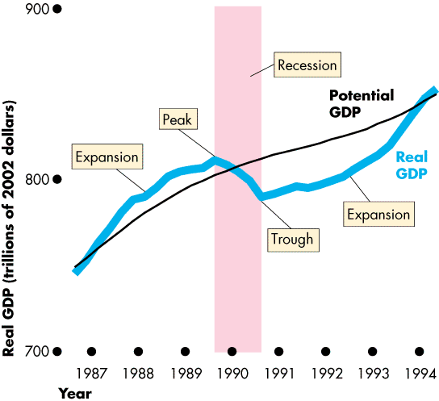
Canadian Output Gap

Slide 9
Fluctuations
A recession happens when actual output falls for two consecutive quarters.
  A recession is over when actual output starts to rise and growth rate becomes positive.
Fluctuations (output gaps) in real GDP have mostly been between plus or minus 4 percent, since 1950.
  However, the recession that began in December 2007 was characterized by output being 6 percent below potential.
During a recession, output is usually below potential for approximately two years.

Slide 10
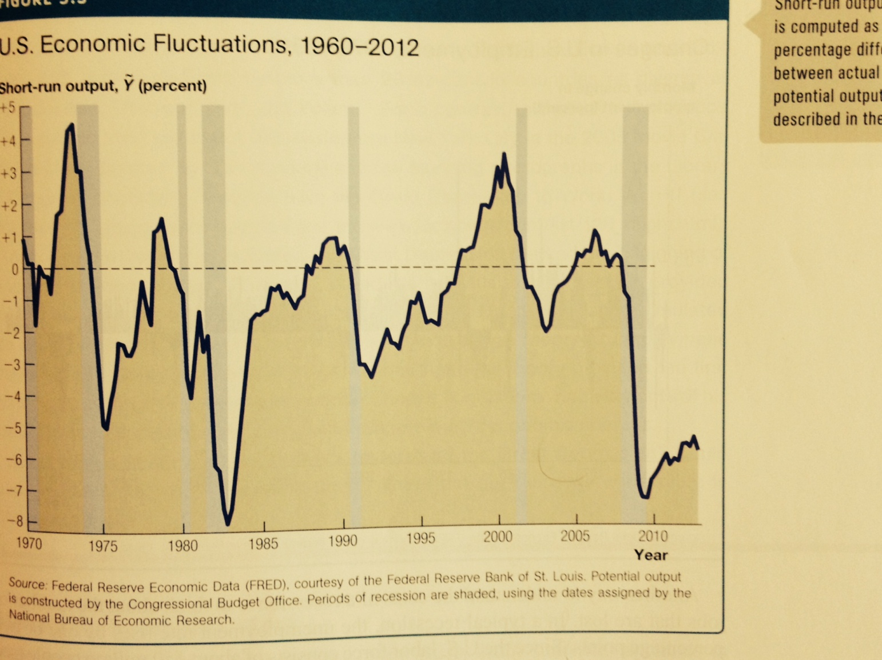
Economic Fluctuations

Slide 11
Fluctuations
During a typical recession, the unemployment rate rises by one or two percentage points, or between 1.5 million and 3 million jobs are lost (150 million labor force).
  During the recent recession, 8.2 million jobs were lost

Slide 12
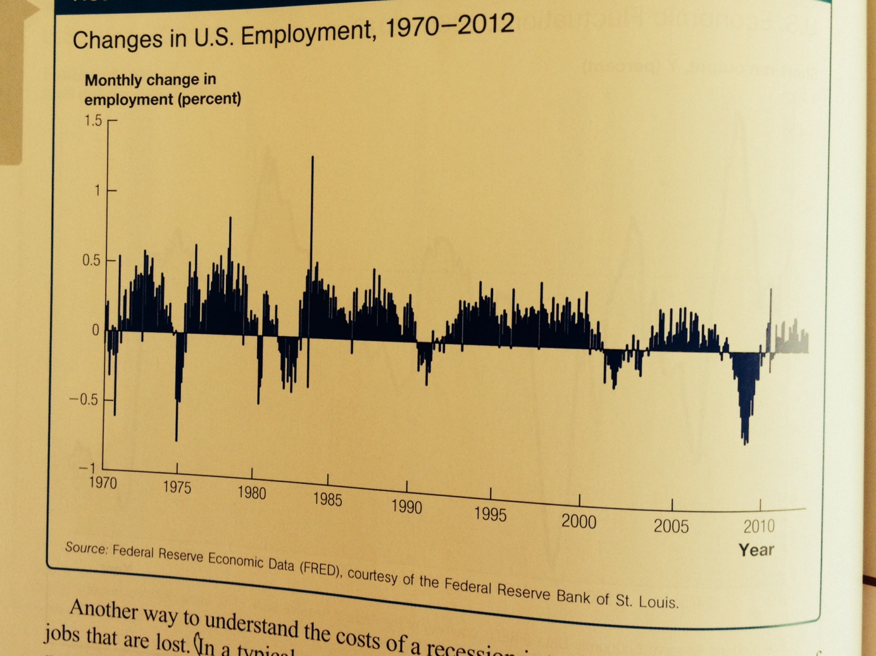
Employment Fluctuations

Slide 13
Case Study: The Great Depression
At its worst in 1933, during the Great Depression, 25 percent of Americans were unemployed and industrial production had fallen more than 60 percent.
The Great Depression was a world-wide phenomenon.
The Great Depression stimulated Keynes's general theory that provided the first systematic attempt to understand macroeconomic fluctuations.

Slide 14
The Inflation Rate
The rate of inflation typically peaks at the start of a recession and then falls during the recession.

Slide 15
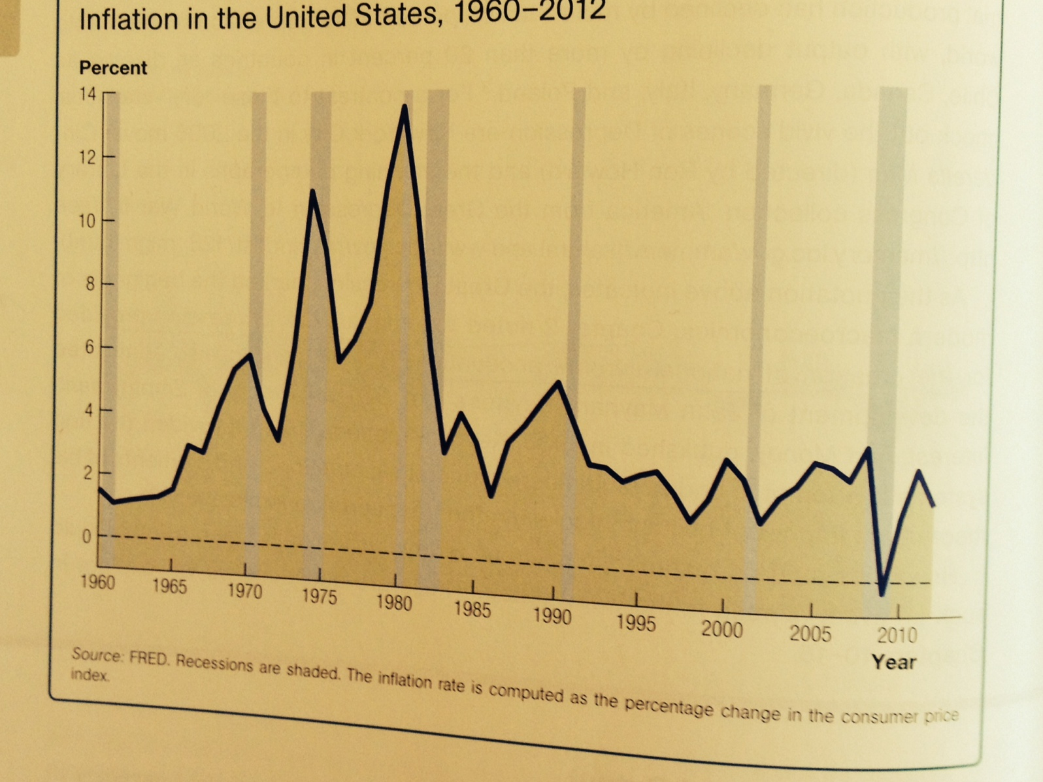
The Inflation Rate

Slide 16
The Short-Run Model
The short-run model features an open economy where booms and recessions in the rest of the world impact the economy at home.
The economy will exhibit long-run growth and fluctuations.
A central bank manages monetary policy to smooth fluctuations.

Slide 17
The Short-Run Model
The short-run model is based on three premises:
  The economy is constantly being hit by shocks.
    Economic shocks are things such as changes in oil prices, technologies, spending, or disasters that cause fluctuations in output or inflation.
  Monetary and fiscal policies affect output.
    Policymakers may be able to neutralize shocks to the economy.
  There is a dynamic trade-off between output and inflation.
    The government does not want to keep actual GDP as high as possible, because a booming economy leads to an increase in the inflation rate.
    If inflation is high, a recession is usually required to lower it.
    The Phillips curve is the dynamic trade-off between output and inflation.

Slide 18
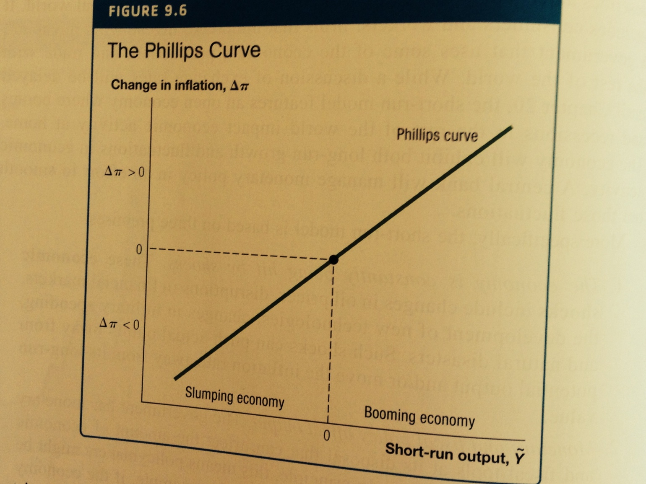
The Phillips Curve

Slide 19
A Graph in The Short-Run Model
The Phillips curve implies that a boom increases inflation and a recession decreases inflation.
  This implies a positive relationship between the change in inflation and short-run output.
When an economy is booming, firms are producing above potential.
  In order to do this, the firms must raise wages and perhaps delay maintenance on machines.
  Firms are thus required to raise prices above the prevailing inflation rate for two reasons:
    Production is more costly.
    Demand is higher because the economy is booming.

Slide 20
A Graph in The Short-Run Model
Because all firms are doing this, the inflation rate increases.
When an economy is in a recession and firms production drops below potential output:
  Firms cut costs and lay off workers because there is less demand for their products.
  Thus, the inflation rate will fall when all firms are cutting costs and demand is low.

Slide 21
How the Short-Run Model Works
Assume policymakers can select short-run output through an appropriate monetary policy.
In 1979, inflation was increasing because of oil prices, so the Federal Reserve tightened monetary policy by raising interest rates.
  The policy induced a recession because higher interest rates discourage investment.
  As output declines, firms face lower demand and reduce costs.
  Inflation falls dramatically.

Slide 22
The Empirical Fit of the Phillips Curve
Empirically, the slope of the relationship between the change in inflation and short-run output is approximately one-half.
  If output exceeds potential by 2 percent, the inflation rate increases one percentage point.

Slide 23
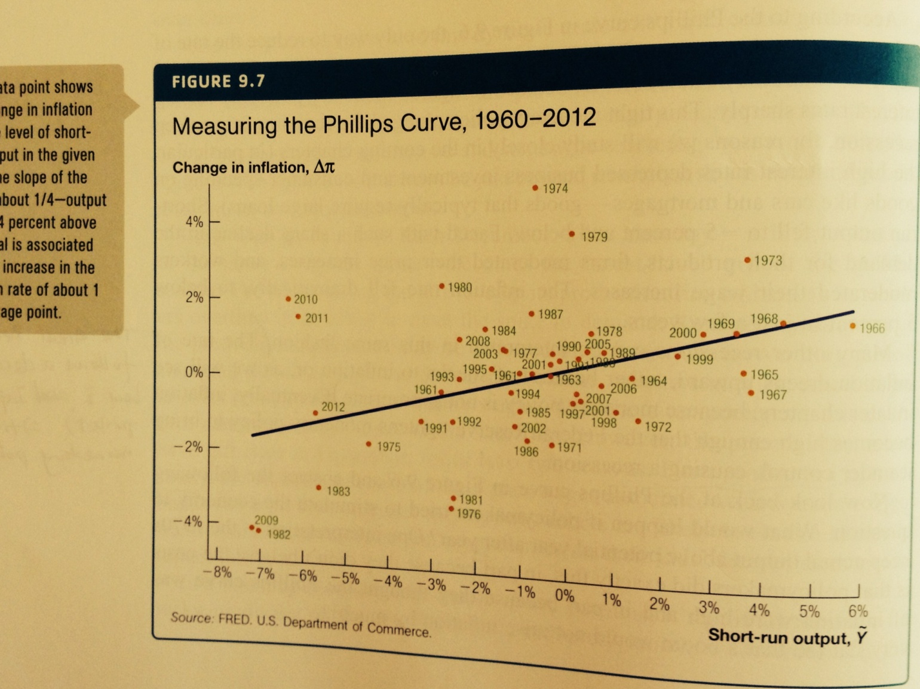
The Empirical Fit of the Phillips Curve

Slide 24
Case Study: Can macroeconomic model predict US presidential election?
A model has predicted 10 of the last 14 elections correctly.
  For each percentage point of real GDP growth, the incumbent party's candidate receives an additional .7 percentage point of popular vote.
  For each percentage point of inflation, the incumbent party's candidate loses .7 percentage point of popular vote.

Slide 25
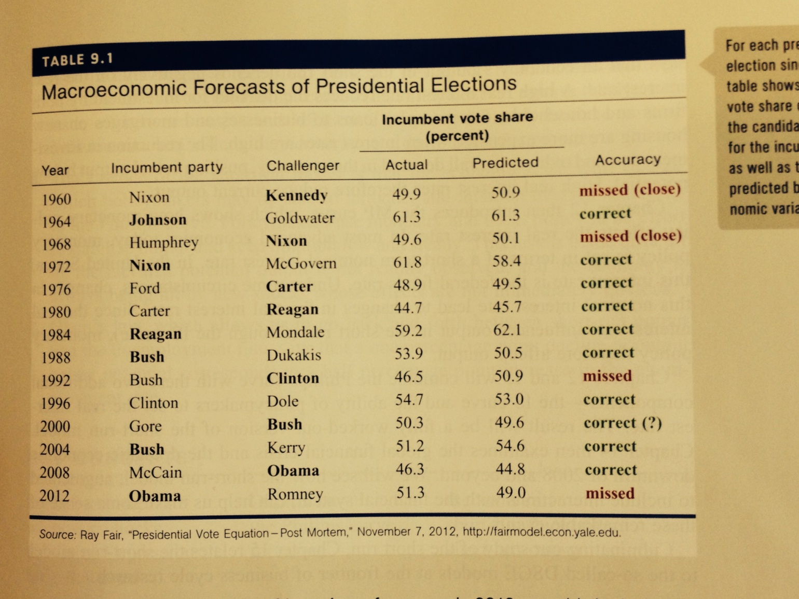
Case Study: Can macroeconomic model predict US presidential election?

Slide 26
Summary
The short-run model says that a booming economy leads the inflation rate to increase, and a slumping economy leads the inflation rate to fall.

Slide 27
A Look At The Great Recession
The financial crisis of 2007 to 2009 caused the deepest recession in the U.S. and world economies in more than fifty years.
  The unemployment rate rose from 4.4% to 10%.
  The employment declined by more than 6 percent, which was the largest decline of the postwar era.
  World GDP declined in 2009 for the first time in more than 50 years.
The U.S. debt–GDP ratio is expected to double in the next decade, in part because of the financial crisis.
The Federal Reserve pursued unconventional policy means and more than doubled the size of its balance sheet.

Slide 28
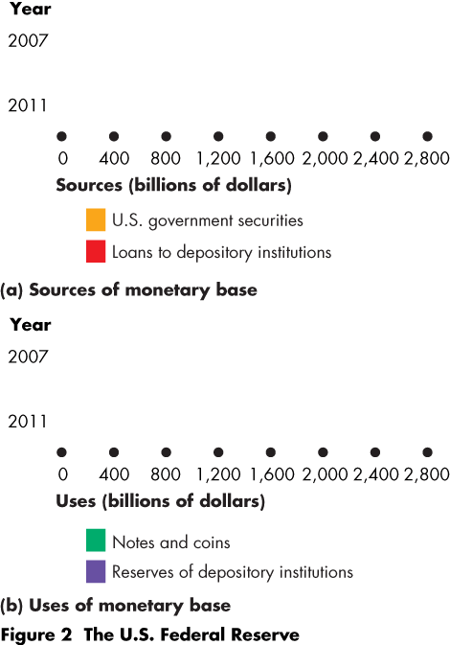
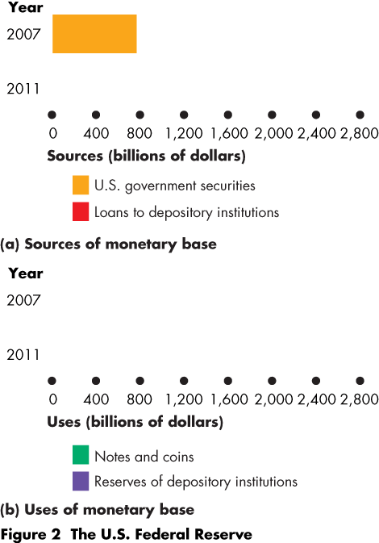
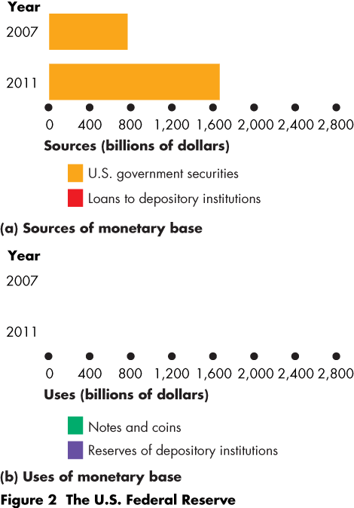
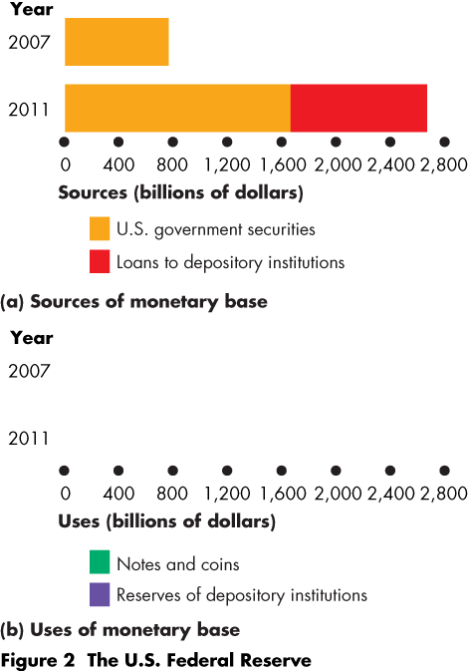
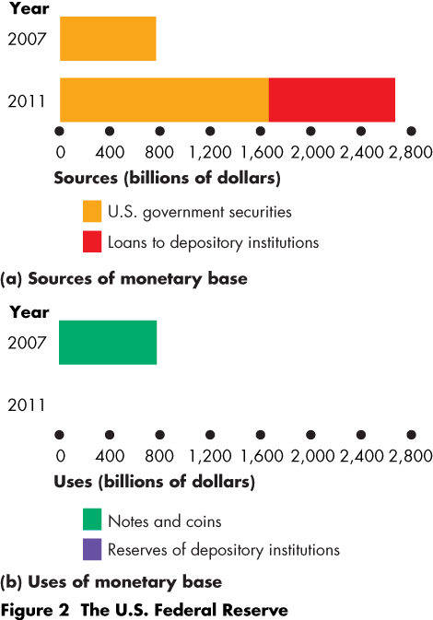
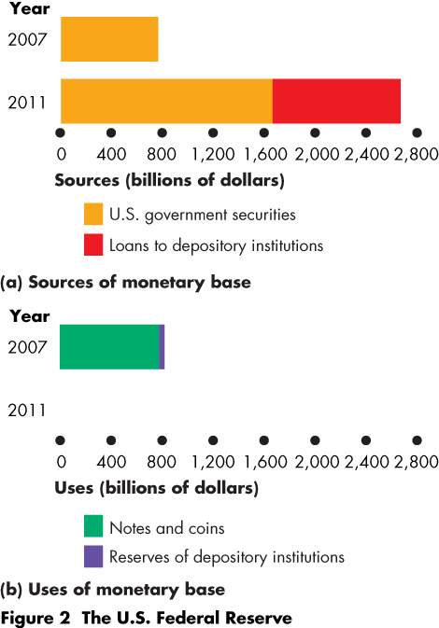
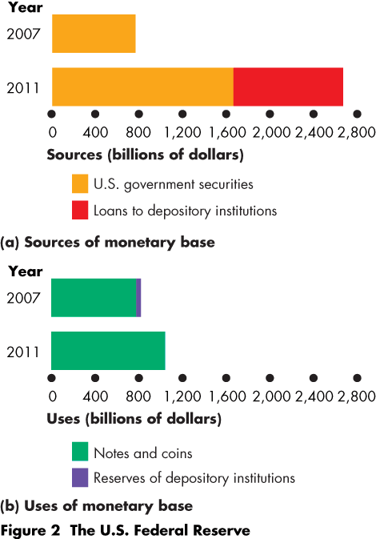
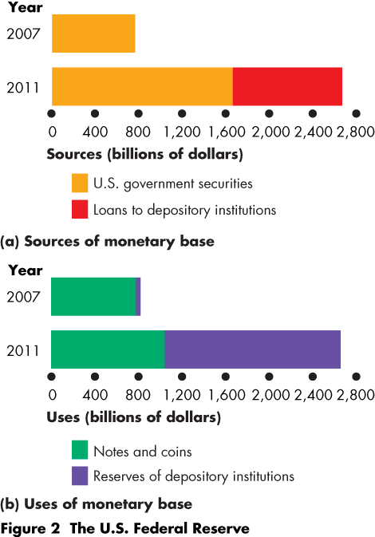

Slide 29
Recent Shocks to The Macroeconomy
Housing Prices
  From 1996 to 2006, housing prices increased by more than 40 percent in the U.S.
  The price increase was fueled by low interest rates in the 2000s, and by loosening lending standards.

Slide 30
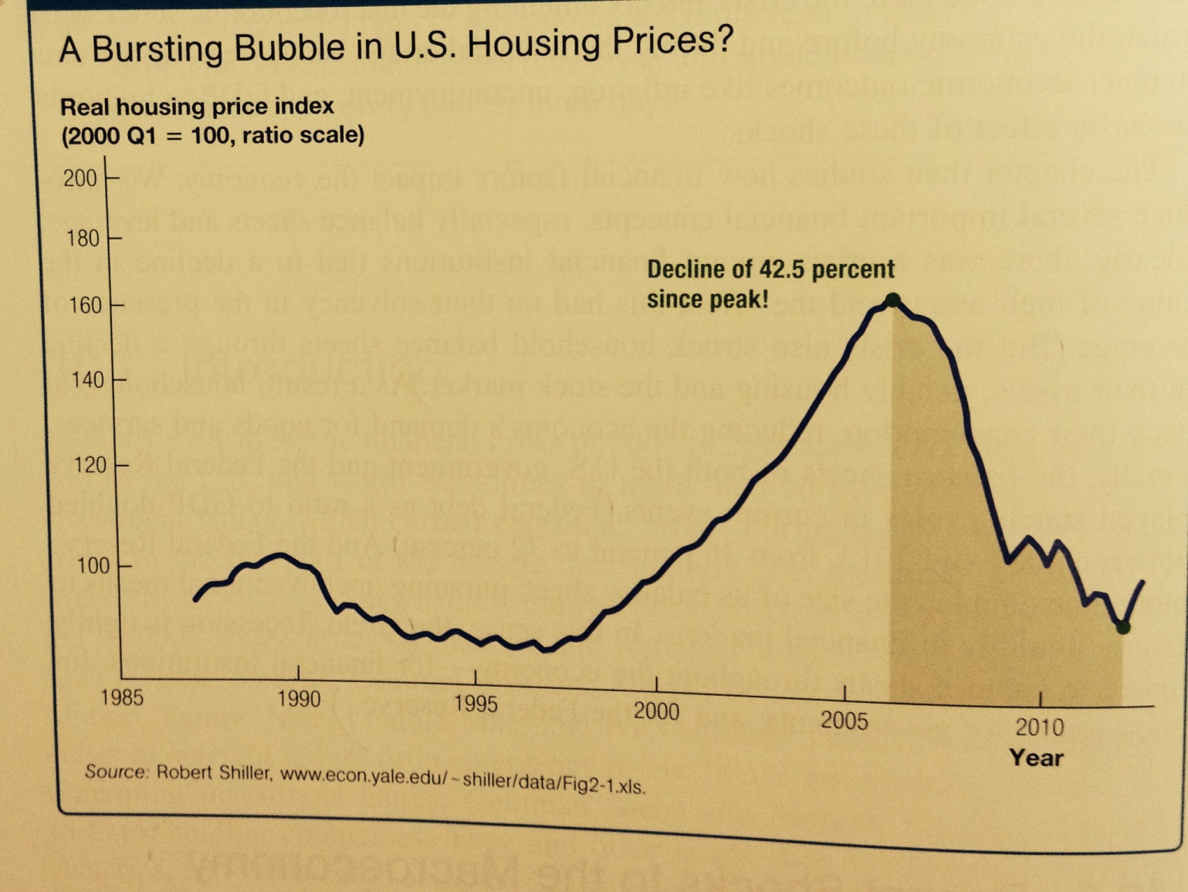
Housing Prices

Slide 31
Recent Shocks to The Macroeconomy
The Global Saving Glut
  Financial crises abroad in the 1990s prompted a shift in the macroeconomics of many developing countries.
  Prior to the financial crises of the 1990s, many developing countries were investing more than they were saving—with the investment financed by borrowing from the rest of the world.
  After financial crises in these countries, the countries that experienced the crises increased saving and increased lending to the rest of the world—especially to the United States.
  Capital markets in advanced countries were awash in additional saving in search of good investment opportunities; this was a characteristic of the global saving glut.
  The increased demand for investment contributed to rising asset markets in the United States;

Slide 32
Recent Shocks to The Macroeconomy
Subprime Lending and the Rise in Interest Rates
  "Suprime" borrowers are borrowers whose loan applications did not meet mainstream standards.
  Many exotic mortgages allowed people with very little income to borrow large sums of money.
  The Fed raised its target interest rate from 1.25 percent to 5.25 percent between May 2004 and May 2006.
The rising interest rate led to defaults of subprimers and then lower housing price. The problem then spiraled.

Slide 33
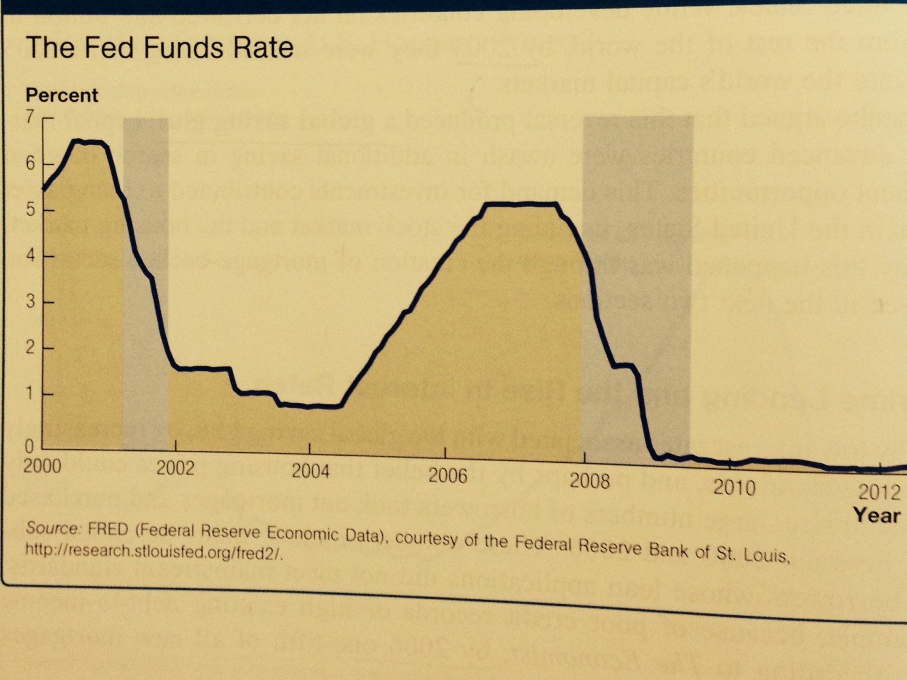
Change in Key Interest Rate

Slide 34
Recent Shocks to The Macroeconomy
The Financial Turmoil of 2007–2009
  Securitization involves lumping together large numbers of individual financial instruments and then packaging them into different pieces for investors.
  Because the banks that generated subprime mortgages sold them and did not bear the consequences if a particular mortgage went bad, lending standards deteriorated.
  Subprime mortgages became riskier than investors realized.
  Securitization requires the assumption that a large fraction of mortgages will not go bad at the same. Time.

Slide 35
Recent Shocks to The Macroeconomy
  A relatively small number of financial institutions held a large amount of mortgage- backed securities.
    Because of the uncertainty over how much risk the banks were holding, a liquidity crisis developed where the volume of transactions in some financial markets fell sharply.
  Over the course of several weeks in September 2008, Fannie Mae and Freddie Mac were taken over by the government, Lehman Brothers went bankrupt, and AIG was bailed out.

Slide 36
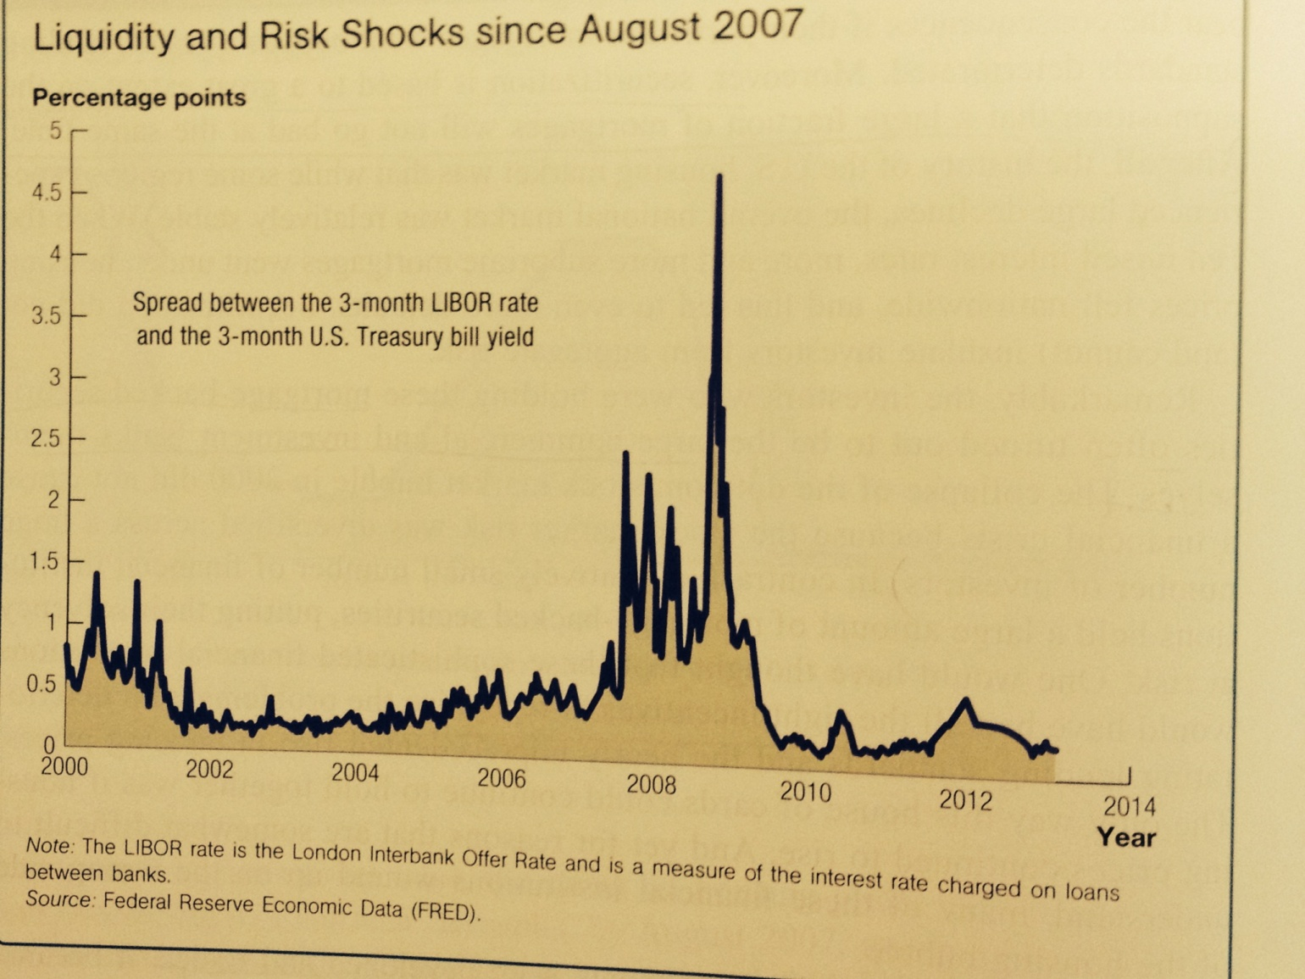
Financial Turmoil

Slide 37
Recent Shocks to The Macroeconomy
Oil Prices
  From 2002 to 2008, there was a sevenfold increase in oil prices, but then prices dramatically fell in 2008.
  An outward shift in demand was a driving force behind the increase in commodity prices.
  The economic slowdown of the crisis partially reduced demand and helps to explain the dramatic subsequent fall in prices.

Slide 38
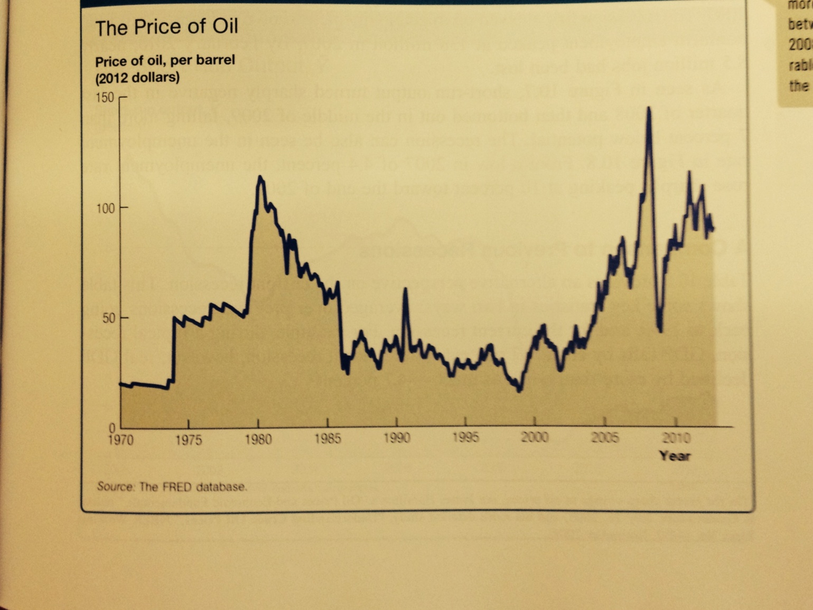
The Price of Oil

Slide 39
Macroeconomic Outcomes
8.5 million jobs were lost and short-run output fell to more than 6 percent below potential.
a. A Comparison to Previous Recessions
  During a typical recession GDP falls by about 1.7 percent.
    Real GDP fell 4.7 percent in the recent recession.
  Nonfarm employment typically falls 2.5 percent with unemployment rising 2.5 percentage points.
    In the recent recession, nonfarm employment fell 6.3 percent and unemployment rose 4.5 percentage points.
  Consumption is usually stable in a recession as households seek to smooth consumption.
    In the recent recession, consumption fell 1.9 percent.

Slide 40
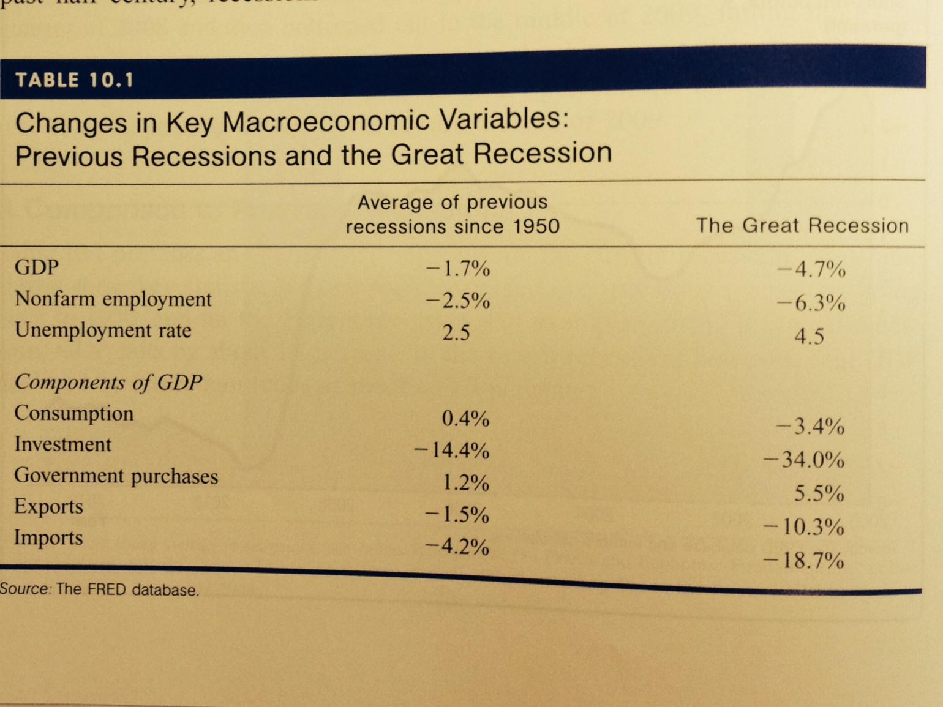
Macroeconomic Outcomes

Slide 41
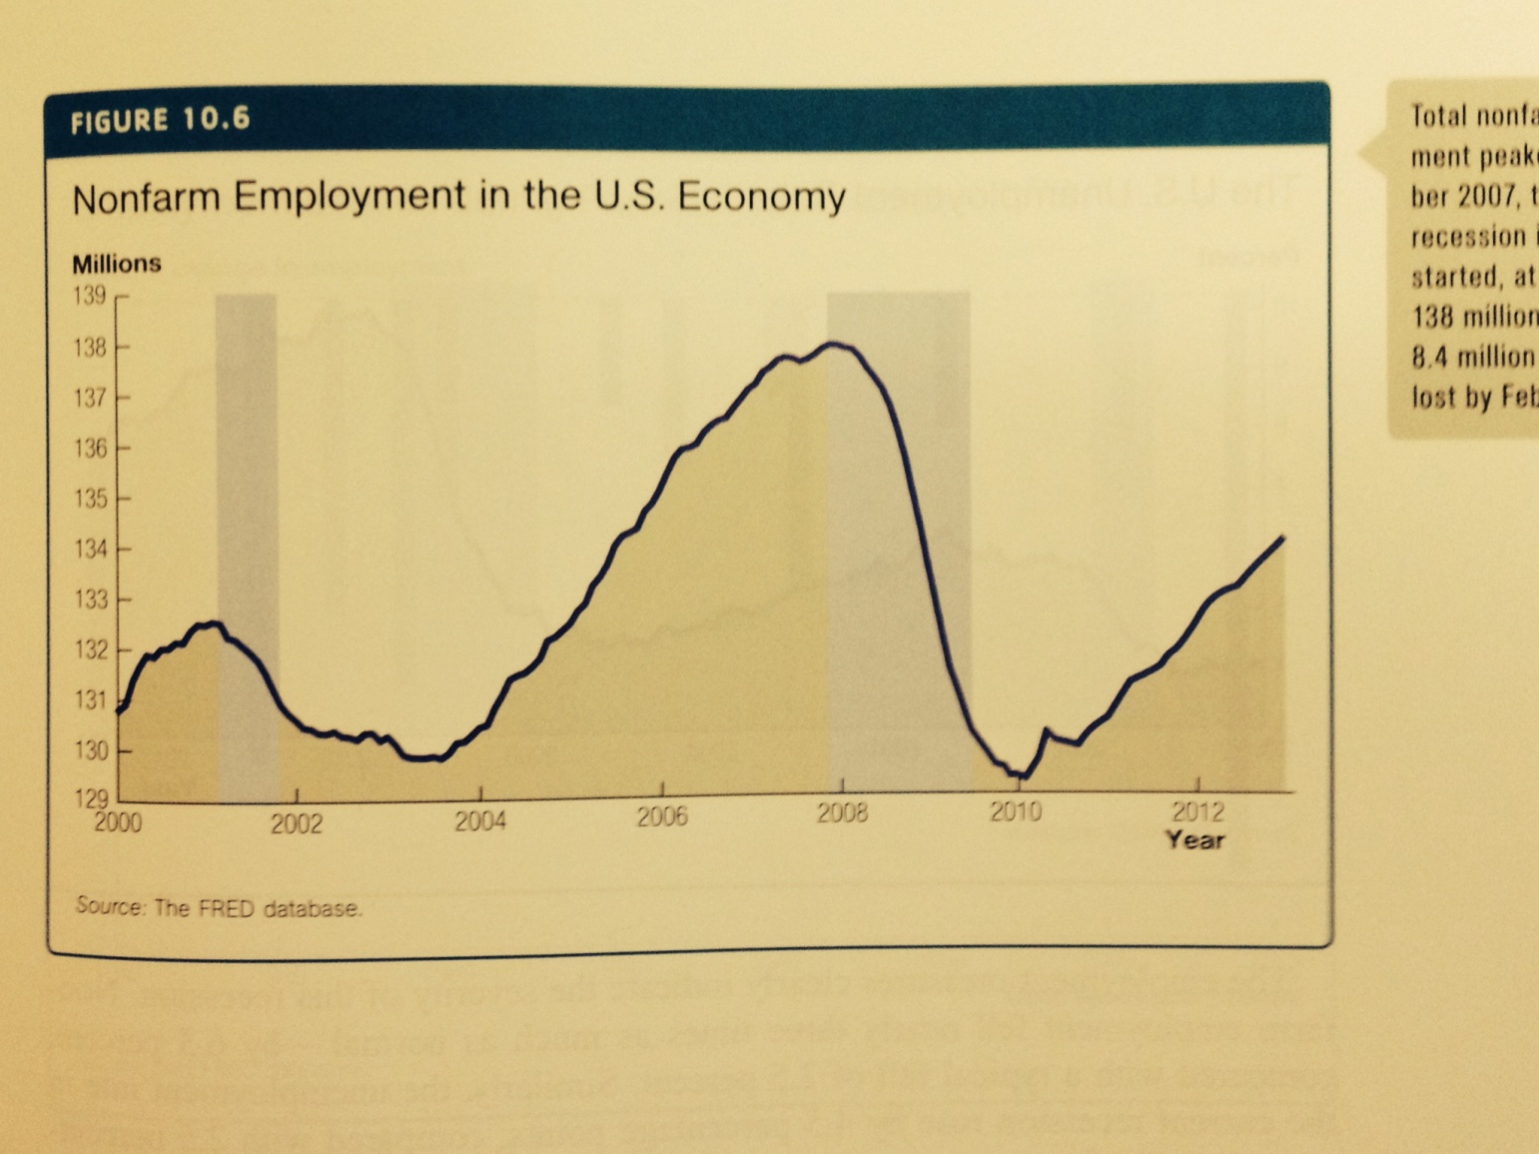
Macroeconomic Outcomes: Employment

Slide 42
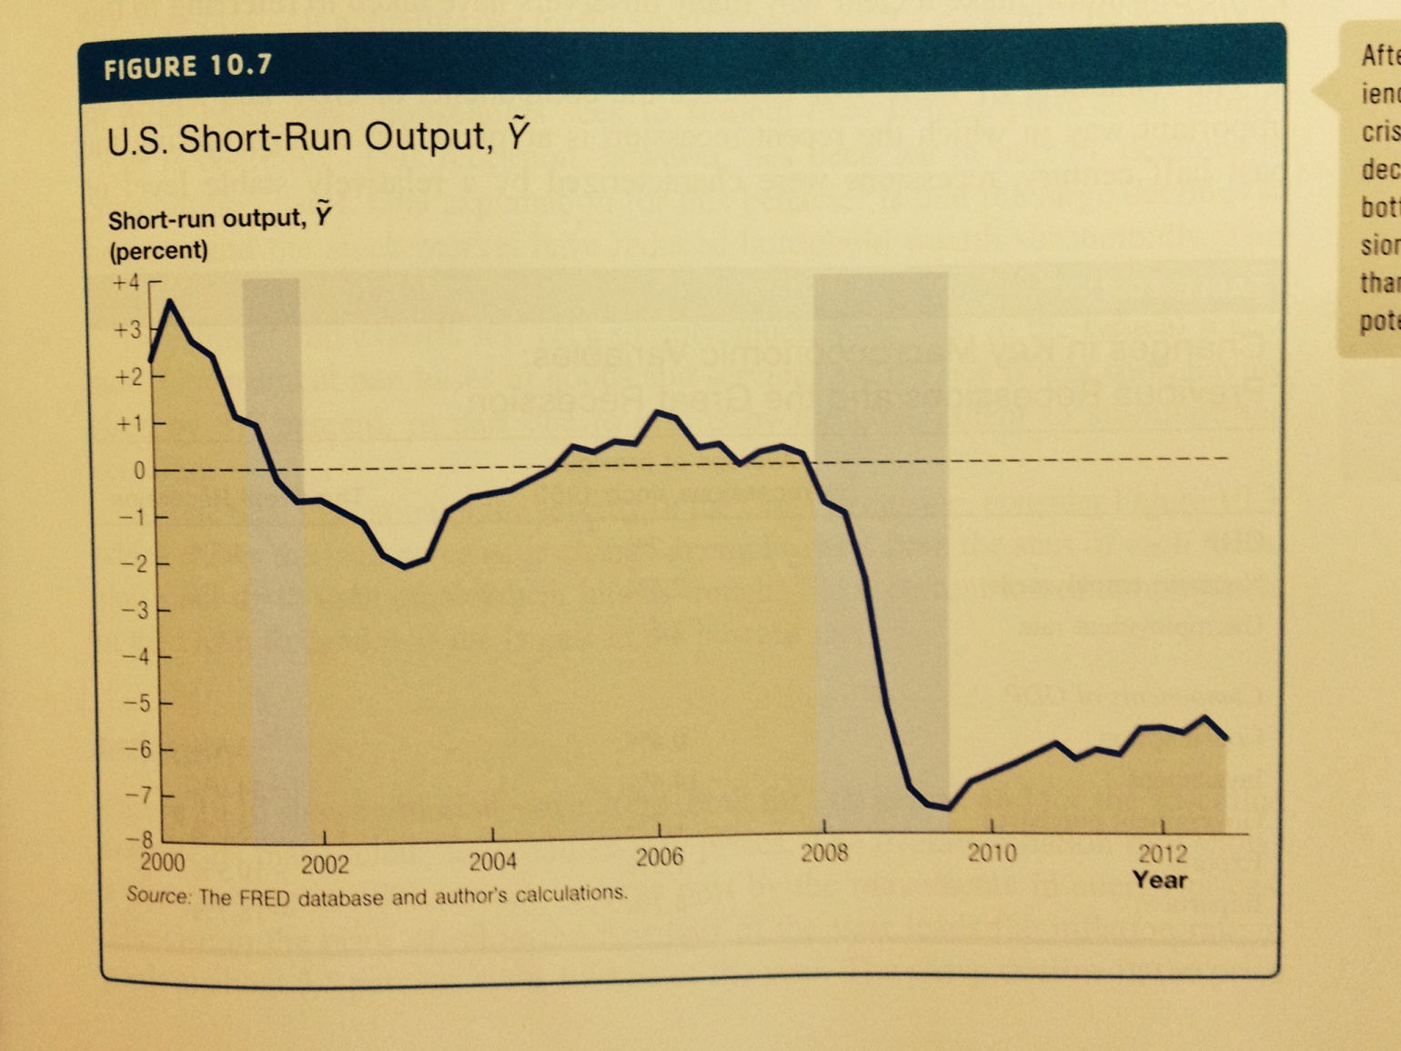
Macroeconomic Outcomes: Output

Slide 43
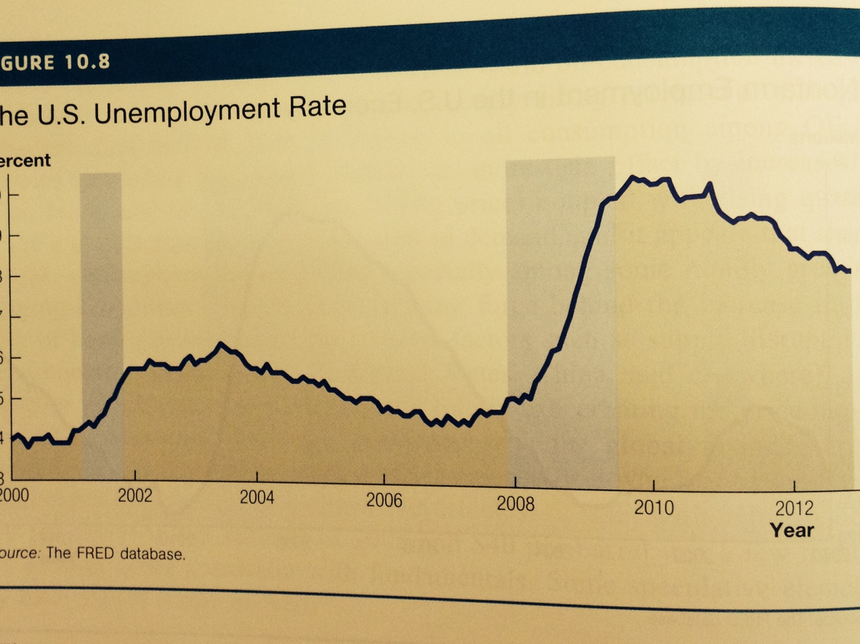
Macroeconomic Outcomes: Unemployment Rate

Slide 44
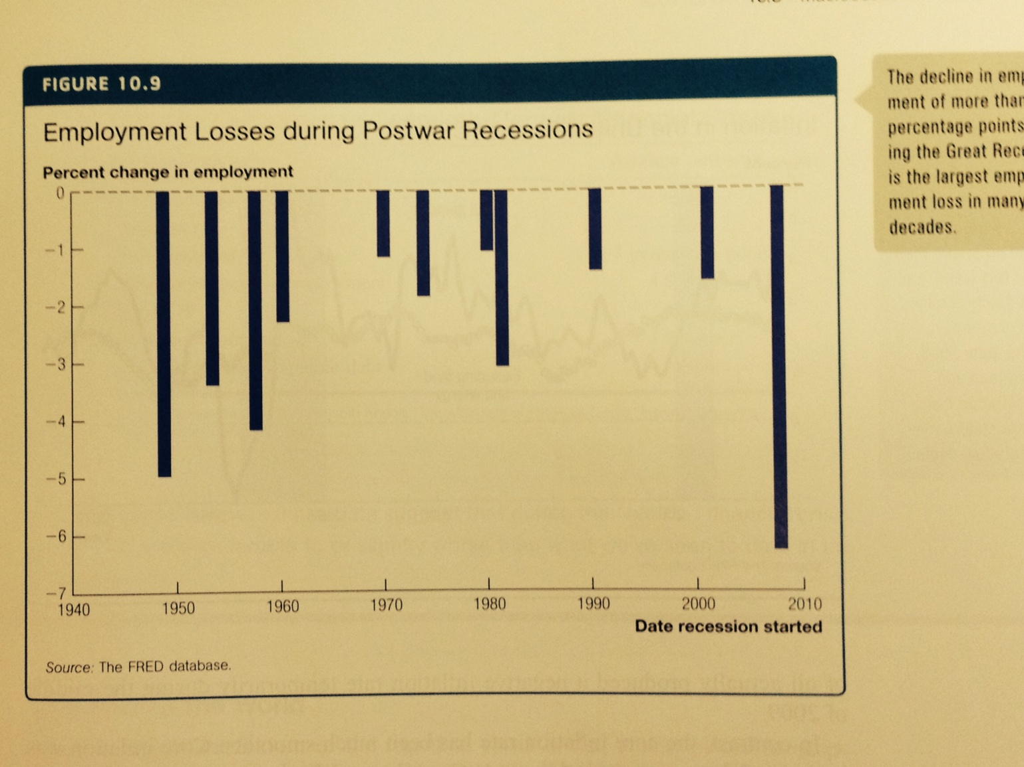
Macroeconomic Outcomes

Slide 45
Macroeconomic Outcomes: Inflation
b. Inflation
  "Core" inflation excludes food and energy prices.
    Core inflation was relatively stable during the recession.
  Sharp changes in the price of oil resulted in the inflation rate for "all" items to be highly volatile.

Slide 46
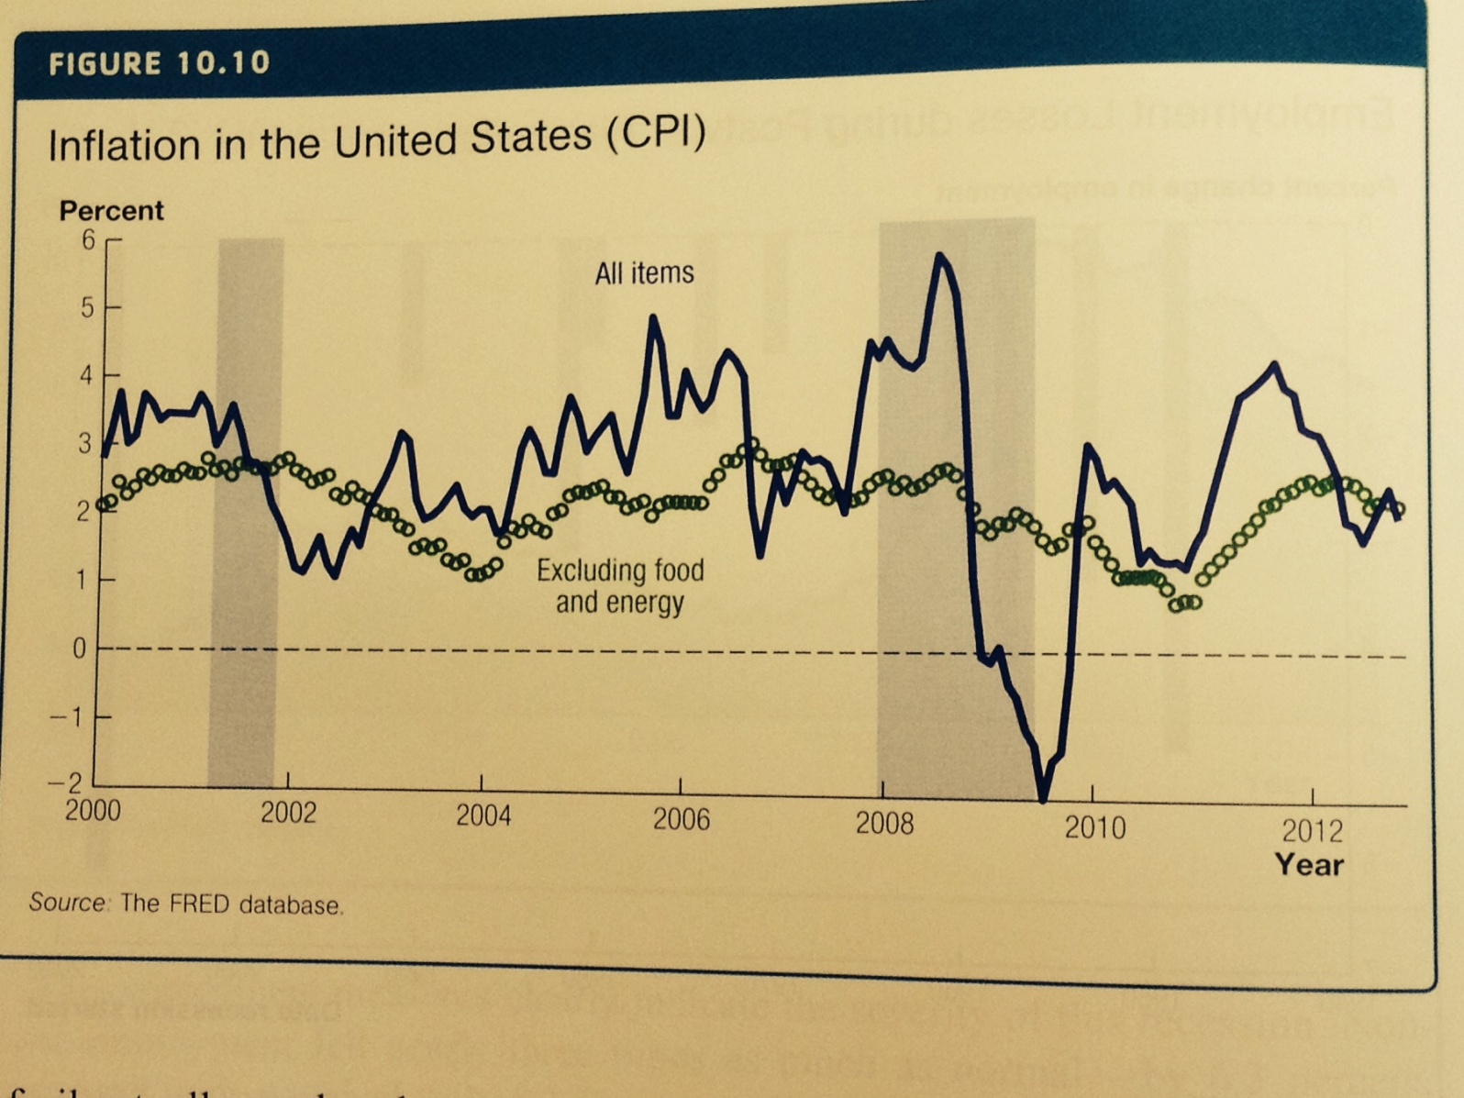
Macroeconomic Outcomes: Inflation

Slide 47
Case study: A comparison to other financial crisis
Financial crises includes: the Great Depression; Japan in the 1990s, Sweden in 1991; and the Asian financial crisis of 1997, etc;
Financial crises are typically quite long and very costly to the economy.

Slide 48
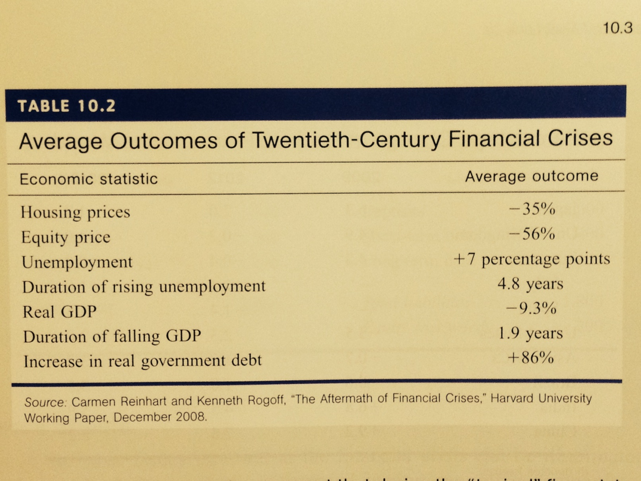
Case study: A comparison to other financial crisis

Slide 49
Macroeconomic Outcomes: the rest of the world
c. The financial crisis was global in scope including Japan, Germany, UK, France, etc.

Slide 50
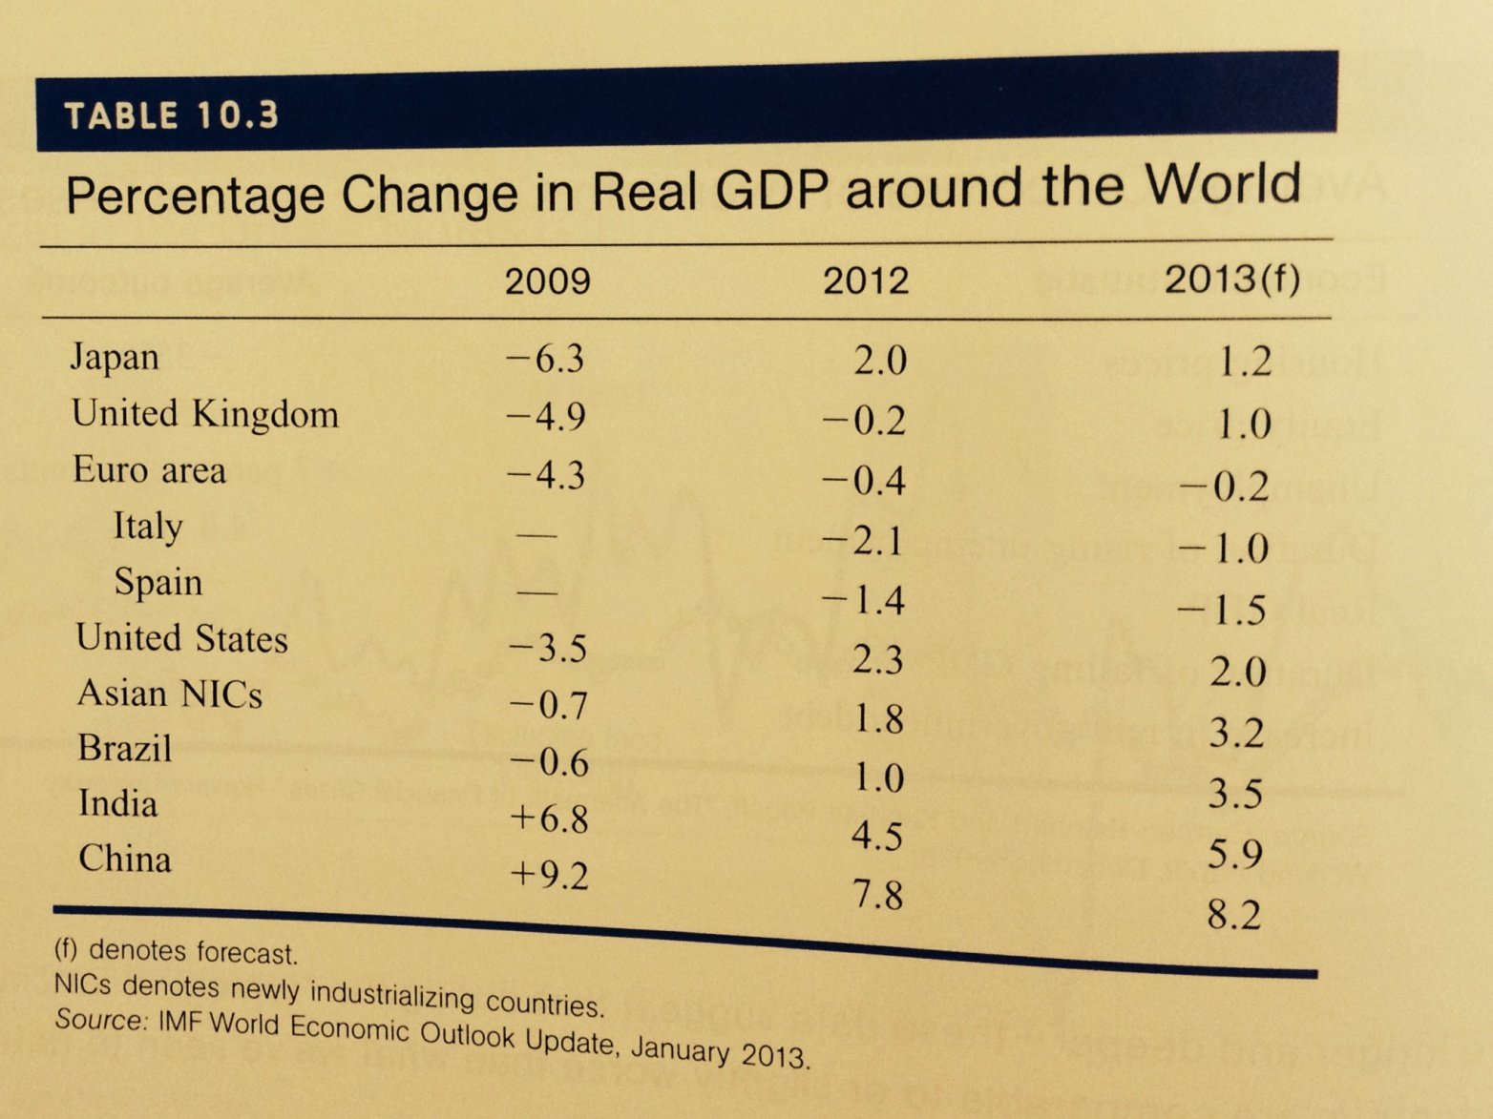

Slide 51
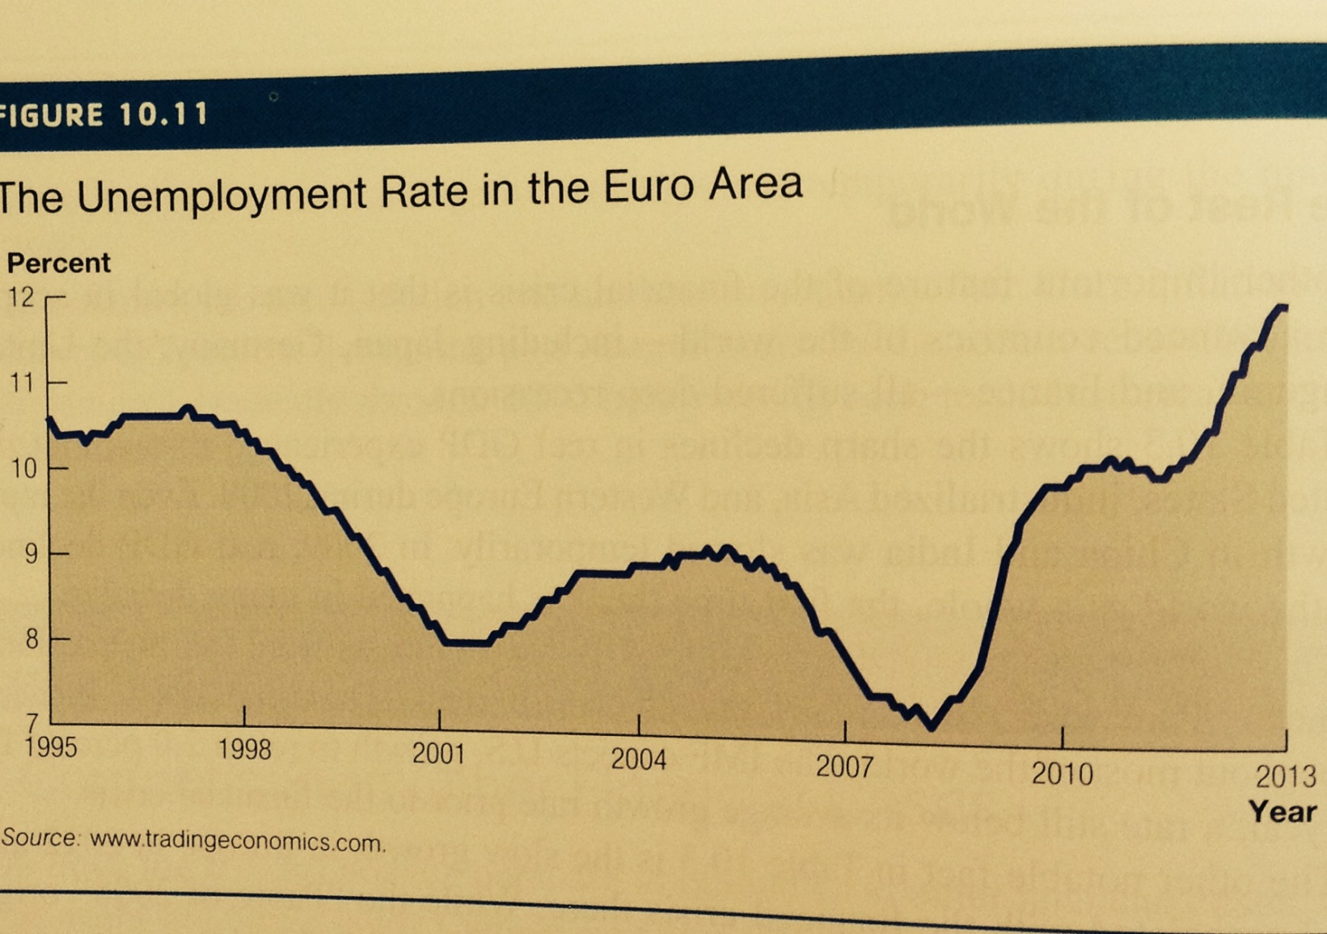
Macroeconomic Outcomes: the rest of the world

Slide 52
Some foundations of financial economics
In many ways, the recent crisis was a balance-sheet crisis.
a. Balance Sheets
A balance sheet is a summary of a financial institution's assets and liabilities.
  Assets are the items of value that the institution owns.
  Liabilities are the items of value that the institution owes to others.
The assets and liabilities of an institution must balance.
  Equity or net worth or capital is the difference between total assets and total liabilities and represents the value of the institution to its shareholders or owners.
The reserve requirement mandates that banks keep a certain percentage of their deposits in a special account with the central bank.
The capital requirement mandates that the net worth of the bank be at least a certain fraction of the bank's total assets.

Slide 53
Balance sheet
A hypothetical bank’s balance sheet (billions of dollars)
Assets |  | Liabilities
Loans | 1,000 | Deposits | 1,000
investments | 900 | Short-term debt | 400
Cash and reserves | 100 | Long-term debt | 400
Total assets | 2,000 | Total liabilities | 1,800
 |  | Equity (net worth) | 200

Slide 54
Some foundations of financial economics
b. Leverage
Leverage is the ratio of total liabilities to net worth.
  Leverage magnifies any changes in the value of assets and liabilities in terms of the return to shareholders.
    This means when the price of an investment increases [decreases] modestly, there is a huge gain [loss] to the owner's equity.
A bank is insolvent or bankrupt if the assets owned by the bank are not large enough to cover the liabilities that the bank owes to others.
Because many banks had very high leverage ratios, even small aggregate shocks could result in their insolvency.

Slide 55
Some foundations of financial economics
Financial Wrap-Up
When asset prices are rising, leverage can turn a certain percentage return into a much larger return.
  This was the case in the period leading up to the financial crisis.
Declines in housing and stock prices combined with high leverage ratios of financial institutions, threaten the solvency of these financial institutions.
The financial system is extremely integrated and financial institutions borrow and lend large sums with each other in normal times.
  Systemic risk is the risk associated with the financial system as a whole rather than any one specific entity within that system.
The financial crisis has its roots in the bubble that developed in the housing market.
  Increases in global savings, low interest rates and a substantial deterioration of lending standards led to enormous increases in housing prices.
Because of the systems of securitization and leverage, the collapse of housing prices nearly took down the entire financial structure.
  The Great Recession was the macroeconomic consequence of the collapse of the financial structure.

