Slide 1
Inflation
Chapter 5

Slide 2
Goals
Define Inflation;
Introduce The quantity theory of money – as our basic model for understanding the long-run determinants of the price level and therefore of inflation.
Interpret The classical dichotomy;
Describe how nominal and real interest rate are related through the Fisher equation;
Episodes of high inflation and cost;

Slide 3
Inflation
Inflation is the annual percentage change in the overall price level in an economy.
Since 1960, in the United States, inflation was at about 2 percent until the Great Inflation of the 1970s; after this period, inflation settled at about 2.5 percent.
Price level can be measured by:
  CPI;
  Core CPI;
  GDP deflator;

Slide 4
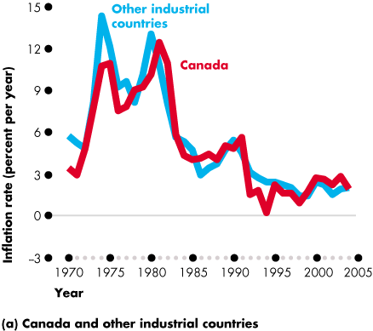
Inflation

Slide 5
Money
We can think of money as paper currency.
Historically, money was backed by gold or silver, but today currency is "fiat money"—paper that the government simply declares is worth a certain price.
  Money takes on value because we expect others will value it.

Slide 6
Measures of money supply
The monetary base includes currency and reserves, which private banks hold with the economy's central bank.
  Reserves ensure that banks have sufficient cash on hand in case there is a run on the bank asking for currency withdrawals.
M1 adds demand deposits to the amount of currency.
M2 adds savings accounts to M1.
As we add additional elements to the broader measures of the money, the accounts become less liquid.
  An asset is less liquid if it is harder to turn into currency in a short period.

Slide 7
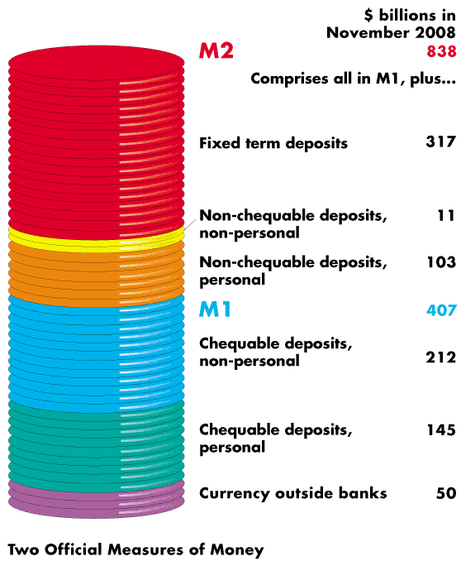
Measures of money supply

Slide 8
Case study: digital cash
Items such as debit cards, PayPal, and travelers' checks are simply electronic forms of currency.
Most money in advanced economies is already in the form of digital cash.

Slide 9
The quantity equation
The quantity theory of money allows us to make the connection between money and inflation.
The money supply times the velocity of money equals the price level times real GDP is known as the quantity equation.
  The velocity of money is the average number of times per year that each piece of paper currency is used in a transaction.
  In other words, the equation implies that the amount of money used in purchases is equal to nominal GDP.

Slide 10
The quantity equation
The velocity of money is an exogenously given constant.
The money supply is determined by the central bank, and we assume that monetary policy is exogenously given.
The classical dichotomy says that (in the long run, Real economic variables, like real GDP, are determined only by real forces–—like the investment rate and TFP). They are not influenced by nominal changes, such as a change in the money supply.
  Real GDP is determined solely by real considerations—not on money.
  In the quantity theory of money, real GDP is assumed as exogenously given and determined by real forces.

Slide 11
The quantity theory for the price level
To solve the model, we plug all the exogenous variables into the model and then solve for the price level.
Increases in the money supply and decreases in real GDP cause prices to rise => inflation is caused by too much money chasing too few goods;

Slide 12
The quantity theory for inflation
We can express the quantity equation in terms of growth rates.
The rate of inflation is equal to the growth rate in the money supply minus the growth rate in real GDP.
The quantity theory thus implies that in the long run, changes in the growth rate of money lead one-for-one to changes in the inflation rate.
  Recall that changes in money growth do not change real GDP because of the classical dichotomy.
Deflation is when inflation rates are negative.
Empirically, the quantity theory of money holds up quite well—both in U.S. and worldwide data.

Slide 13
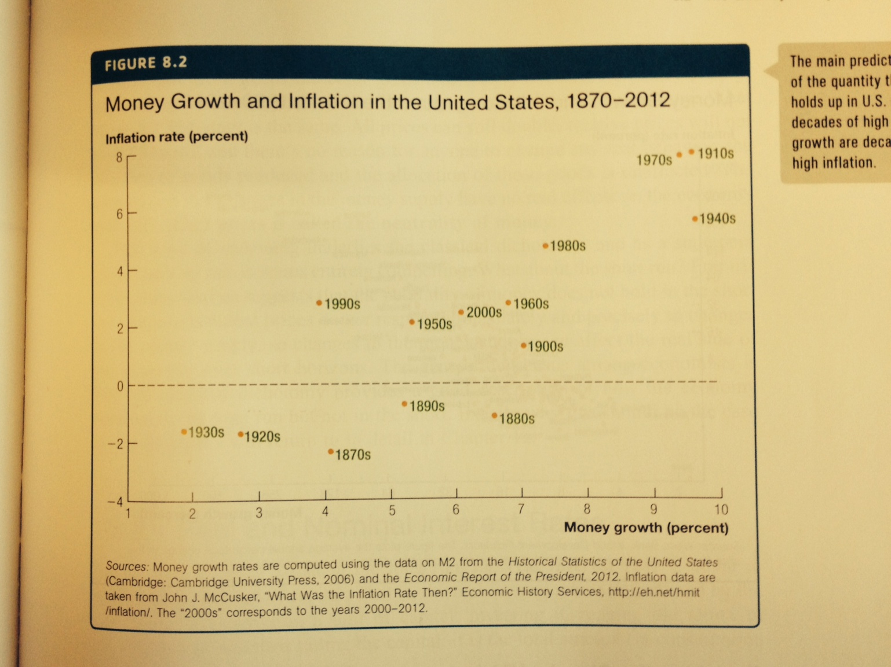
The quantity theory for inflation

Slide 14
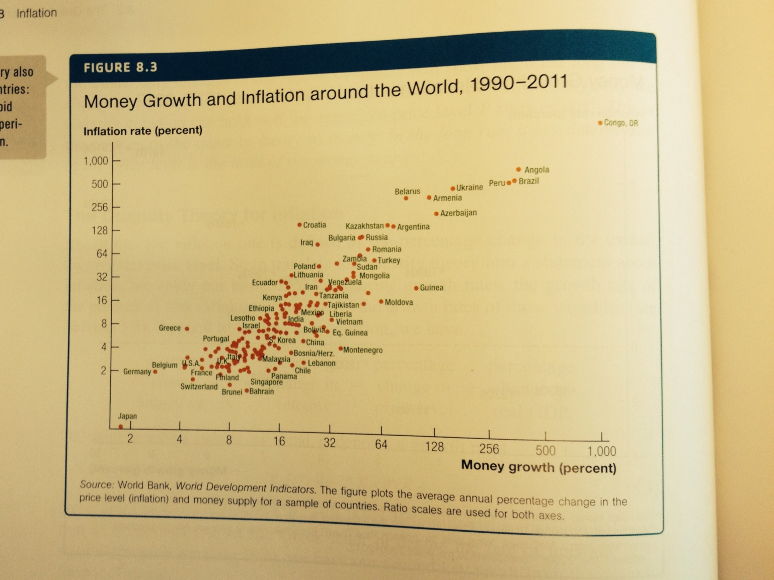
The quantity theory for inflation

Slide 15
Revisiting the classical dichotomy
The classical dichotomy (in the long run, the real and nominal sides of the economy are completely separate) holds if:
changes in the money supply have no real effects on the economy and only affect prices.
  Empirically, the neutrality of money holds in the long run but does not hold in the short run because nominal prices do not respond immediately to changes in the money supply.

Slide 16
Real and nominal interest rate
The nominal interest rate in an economy is paid in units of currency, while the real interest rate is paid in goods. These rates are related by the Fisher equation: i = R + π.
The Fisher equation says that the nominal interest rate is equal to the real interest rate plus the rate of inflation.
  The nominal interest rate is generally high when inflation is high.

Slide 17
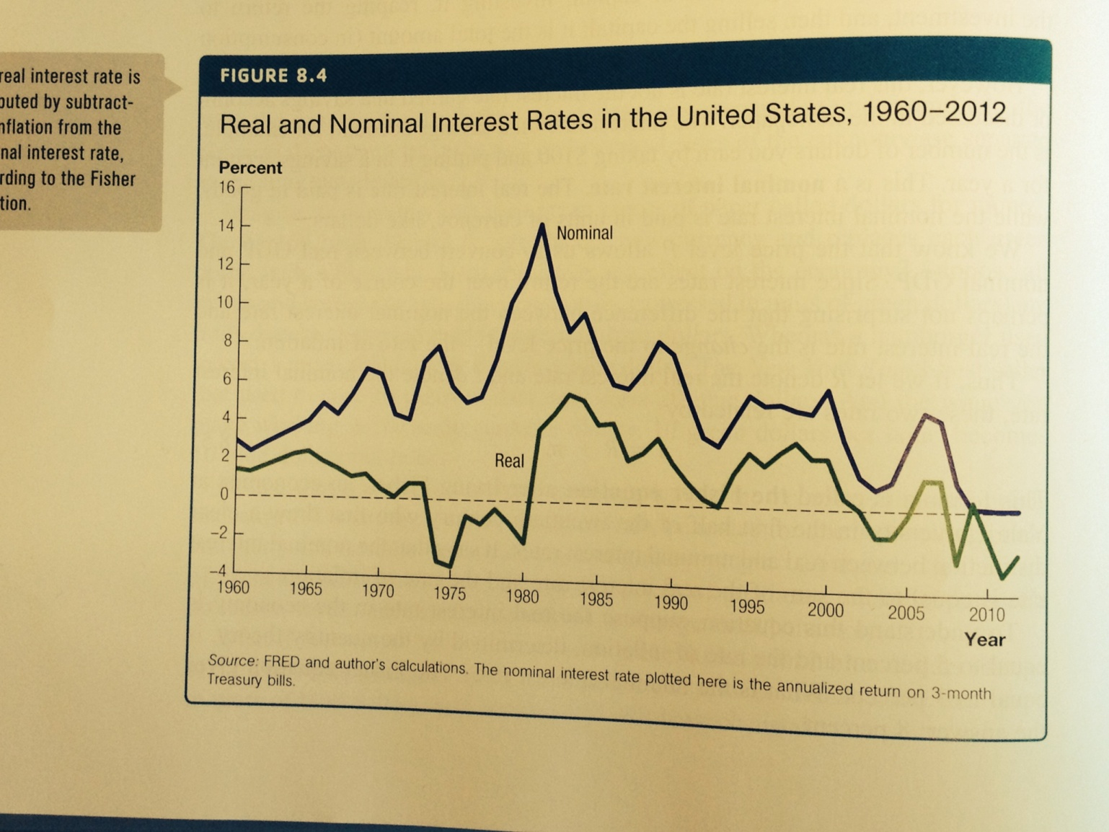
Real and nominal interest rate

Slide 18
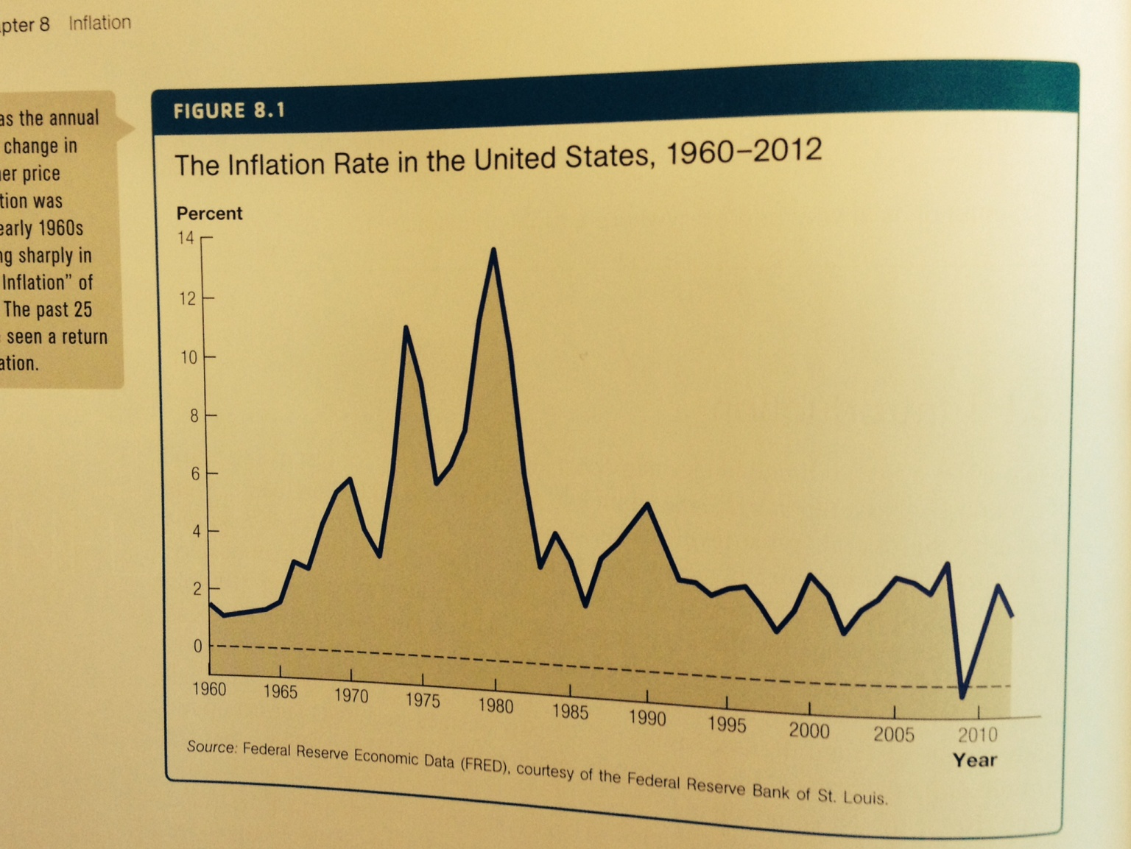
Real and nominal interest rate

Slide 19
Case study: the wage-price spiral and president Nixon’s price controls
A view at the time Nixon was facing reelection was that rising inflation was a result of a wage-price spiral where strong unions pushed for high wages, strong corporations translated rising costs to rising prices, and thus strong unions demanded even higher wages.
Nixon froze wages and prices for 90 days to break the spiral, but high unemployment resulted from an expansionary policy that brought the return of inflation.
If an underlying monetary policy leads to rising prices, price controls are not a viable solution to solving inflation.
  Price controls also distort economic decisions.

Slide 20
Costs of inflation
Examples of individuals who are hurt during inflation are as follows:
  An individual who has earns fixed pension income.
  A bank that issues loans at fixed rates but pays interest rates that move with the market.
  An individual with a variable rate mortgage.
Large surprise inflations can lead to large redistributions in wealth.
  People with debts can pay back their loans with new cheaper dollars, while creditors wind up losing money.
Taxes are based on nominal incomes, but economic decisions are made based on real variables.
  Tax distortions are more severe when inflation is high.
Inflation also distorts relative prices because some prices are faster at adjusting to inflation than other prices are.
Shoe leather costs of inflation imply that people want to hold less money when inflation is high.
Menu costs are the costs to firms of changing prices frequently.
Costs are not generated by the rate of inflation but rather by the unexpectedness and uncertainty generated from surprise changes.

Slide 21
The fiscal causes of high inflation
The government budget constraint says that the government's uses of funds must equal its sources of funds: tax revenue, borrowing, and changes in the stock of money.

Slide 22
The fiscal causes of high inflation
If a government runs large budget deficits, as debt rises, lenders may worry the government will have trouble paying back loans, and they may stop lending to the government altogether. Raising taxes may not be politically feasible.
  Thus, when taxes and borrowing are no longer an option, the government will resort to printing currency to finance its budget.
    Lenders to the government will then be paid back in units of currency that are worth less than the dollars lent.

Slide 23
Central bank independence
Central bank independence is an attempt to prevent fiscal consideration from leading to excessive inflation.
  Many central banks are separated from the fiscal branches of government in such a manner that they cannot be ordered to print money to satisfy the government budget.

Slide 24
Hyperinflation
Hyperinflation is often associated with wars, their aftermath, sociopolitical upheavals, or other crises that make it difficult for the government to tax the population, as a sudden and sharp decrease in tax revenue coupled with a strong effort to maintain the status quo can be a direct trigger of hyperinflation.

Slide 25
Most severe hyperinflations in history
Highest monthly inflation rates in history
Country | Currency name | Month with highest inflation rate | Highest monthly inflation rate | Equivalent daily inflation rate | Time required for prices to double
Hungary | Hungarian pengő | July 1946 | 4.19 × 10¹⁶ % | 207.19% | 15 hours
Zimbabwe | Zimbabwe dollar | November 2008 | 7.96 × 10¹⁰ % | 98.01% | 24.7 hours
Yugoslavia | Yugoslav dinar | January 1994 | 3.13 × 10⁸ % | 64.63% | 1.4 days
Republika Srpska | Republika Srpska dinar | January 1994 | 2.97 × 10⁸ % | 64.3% | 1.4 days
Germany(Weimar Republic) | German Papiermark | October 1923 | 29,500% | 20.87% | 3.7 days
Greece | Greek drachma | October 1944 | 13,800% | 17.84% | 4.3 days

Slide 26
Episodes of high inflation
Episodes of high inflation tend to recur.
Hyperinflations can stop just as quickly as they start.
Hyperinflations end when the rate of money growth falls rapidly.
  In other words, the government gets its finances in order through lower spending, higher taxes, and new loans.
The coordination problem injects a certain amount of inertia into the inflation process because people build their expectations into the prices they set.

Slide 27
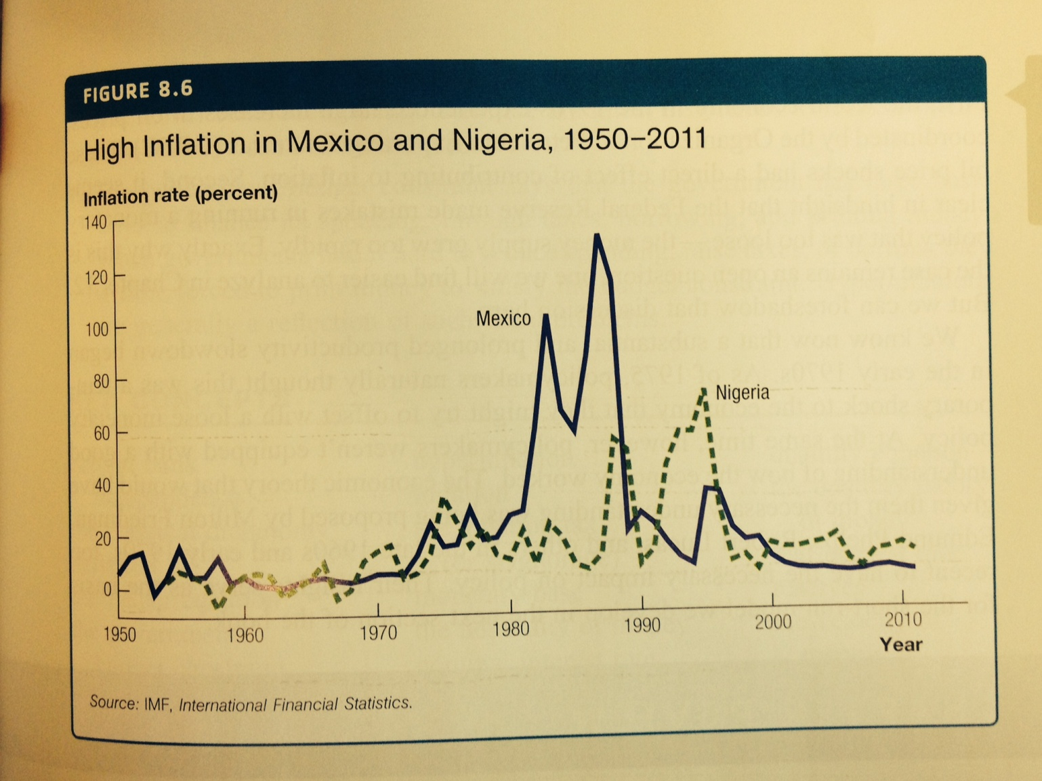
Episodes of high inflation

Slide 28
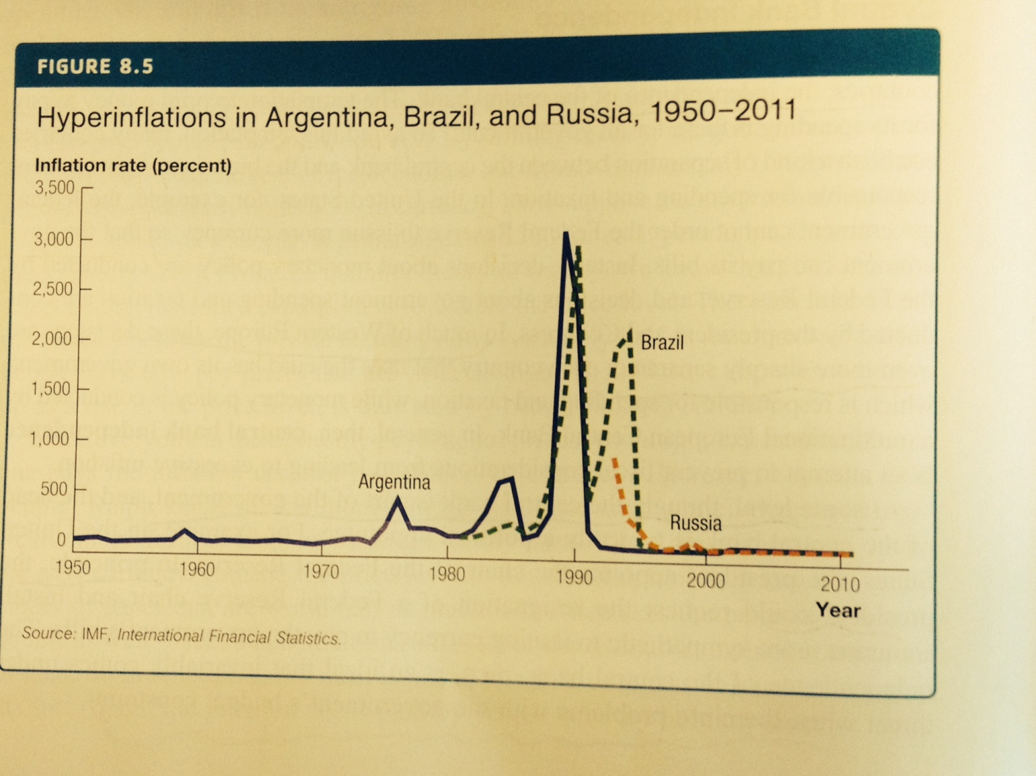
Episodes of high inflation

Slide 29
The great inflation of 1970s
During the Great Inflation, the rate peaked more than 10% percent, yet the inflation tax was a small fraction of government spending.
Inflation rose in the 1970s for the following reasons:
  OPEC coordinated increases in oil prices that spurred inflation.
  The central banks made mistakes in running a monetary policy that grew the money supply too rapidly.
    Policymakers pursued such a policy because of the productivity slowdown, 1961-1971:

