Slide 1
Measuring the performance of the Canadian economy
Chapter 2

Slide 2
Goals
Use measurements for output, price level, and labor market to examine the performance of Canadian Economy;

Slide 3
Gross Domestic Product (GDP)
Gross Domestic Product (GDP): The market value of all final goods and services produced in the economy over some specified period of time, usually one year.
GDP can be measured by adding up all the income received or by adding up all the expenditure spent;
  GDP = total income =total expenditure =C+I+G+X-M
  Consumption spending by households (C)
  Investment (I)
  Government purchases of goods and services (G)
  Foreign demand for our net exports (NX=X-M)

Slide 4
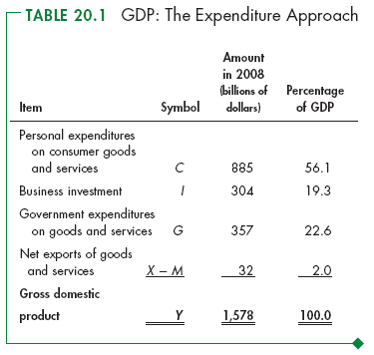

Slide 5
Real and Nominal GDP and Inflation
Current dollar (or nominal) GDP: Measuring GDP using current year price level.
Constant dollar (or real) GDP: Measuring GDP using a constant price level from a base year, eliminating the impact of inflation.

Slide 6
Calculate nominal GDP and real GDP for the year of
2002 and 2003; (Note: 2002 is the base year)
 | Quantity | Price
Items | (millions) | (dollars)
(a) in 2002
C T-shirts | 3 | 5
I Computers | 3 | 500
G Security services | 5 | 20
(b) in 2003
C T-shirts | 4 | 6
I Computers | 4 | 500
G Security services | 6 | 22

Slide 7
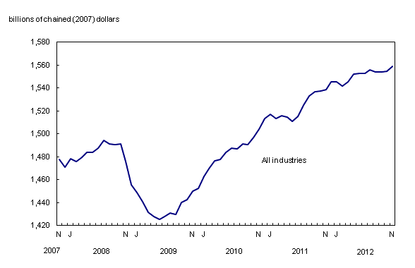
Real GDP Growth

Slide 8
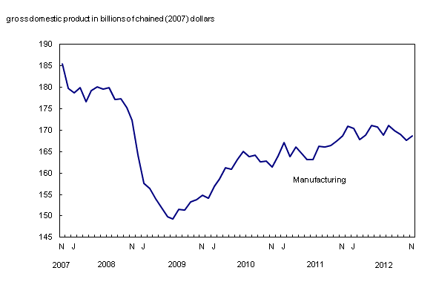
Manufacturing Output

Slide 9
Price Indexes and Inflation
Price index: A measure of prices in any one year compared to the level of the same prices in some base year (base value = 100).
Inflation: The rate of change in prices.
If P_{t} represents the price index in period t and P_{t-1} represents the price index In the previous year, the annual rate of inflation, π_{t} is:
(13)
Notes:
Give an example of price index.

Slide 10
Comparison of different price index
Consumer price index: tracing the change of prices of consumer goods and services;
GDP deflator price index: price index of GDP basket;
GDP deflator = Nominal GDP/Real GDP*100

Slide 11
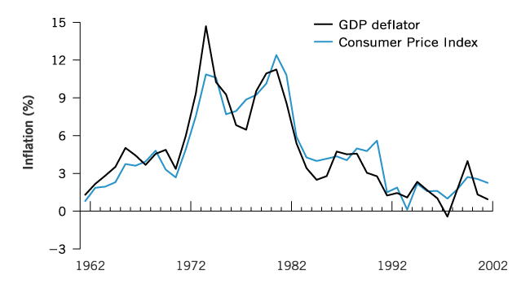
GDP deflator, the CPI, and Inflation
Inflation as measured by the GDP deflator and the Consumer Price Index, 1962-2002

Slide 12
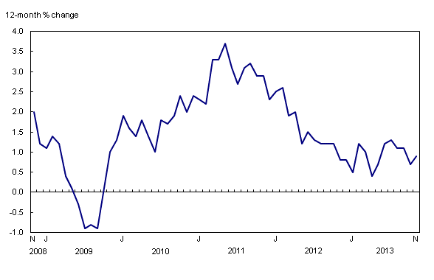
Consumer Price Index

Slide 13
The Unemployment Rate
Measuring the unemployment rate
Labour force: The total number of individuals who are employed, plus the number of individuals who are actively seeking employment but who do not have jobs.
Unemployment rate: The percentage of the labour force that is unemployed.
Number of unemployed persons
Unemployment rate =
X 100
Total labour force

Slide 14
The Unemployment Rate
Discouraged workers: Individuals who have been in the labour force, could not find employment and have now given up looking for a job. They are not in the labour force and therefore are not counted among the unemployed.
Labour force participation rate: Number of persons in the labour force as a percentage of the adult population.
Chapter 2: Measuring the Economy
Labour force
Participation rate =
X 100
Working age population
Notes:
Full employment is a term for the equilibrium, where LS=LD; We can think of full-employment is when the total number of vacancies = total number of persons looking for jobs; This situation is due to, for example, asymmetric information (when you sell an used car, you know about your car, but buyers don’t) or labor immobility. Persons looking for a job may not know a vacancy available or not willing to relocate.
if actual unemployment falls below the NAIRU, the inflation rate is likely to rise quickly (accelerate). In terms of output, the NAIRU corresponds to potential output, the highest level of real gross domestic product that can be sustained at any one time. This is also called the "natural gross domestic product."

Slide 15
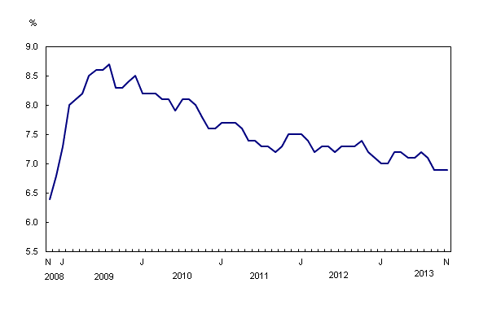
Unemployment Rate

Slide 16
Unemployment and Real GDP growth
Okun’s Rule of Thumb: The hypothesized relationship between changes in the unemployment rate and changes in real GDP.
It states that for every 1% increase in the unemployment rate, a country's Real GDP growth will decrease by roughly 2%.

Slide 17
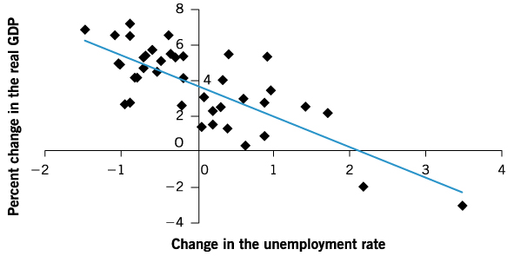
Unemployment and Real GDP growth
Figure 2-3: Okun’s Rule of Thumb, 1962 and 2002 , slope= -1.7
Notes:
1% increases in unemployment rate causes the growth rate of real GDP drops by 1.7%.

Slide 18
Exercise
This is a national income accounting problem. You are given the following facts about the economy: Consumption=$1,000; saving=$100, and government expenditure=$300, net exports are zero. The government budget is balanced. What is the value of GDP?

Slide 19
Exercise
If GDP=$500, consumption=$350, transfers-taxes=$20, investment=$150, and the budget deficit=$120, what are net exports?

