Slide 1
Introduction to Macroeconomics

Slide 2
Goal
Using the most recent economic recession and financial crisis as an example to demonstrate the relevance of the real world event and course material;
Briefly introduce concepts such as business cycle, GDP (Gross Domestic Product), and the goals of fiscal and monetary policies.

Slide 3
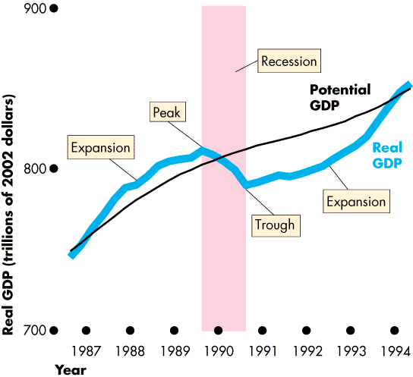
Business Cycles
A business cycle includes two phases: recession and expansion; two turning points: peak and trough.

Slide 4
Facts of the Great Recession (2007-2010)
Canada was in recession the second half of 2008 and the first quarter of 2009. As a result unemployment rate rose.
The U.S. was in recession from the beginning of 2008 to June 2009;
Many countries in Europe (Ireland, Spain, Greece, etc) went into recession as well in the same time period; The only two EU member states (out of 28) not affected are Poland and Slovakia.
Notes:
Canada was the last one went into recession and the first one out of recession. The financial crisis did not affect developing countries to a great extent. Experts see several reasons: Africa was not affected because it is not integrated in the world market. Latin America and Asia seemed better prepared, since they experienced crisis before. In Latin America for example banking laws and regulations are very stringent.

Slide 5
Origin of the problem
For the first half of the last decade, the interest rate has been kept low and that stimulated spending on housing, which created upward pressure for housing prices; Meanwhile housing mortgages were aggressively lent to many subprime borrowers. Low interest rate, over spending together with deteriorated lending standards created housing bubbles over time.
Notes:
Interest rate was lowered since Sept 11, 2001

Slide 6
Relative price of housing 1963 to 2009, US
Notes:
Housing price dropped by 25% from 2005 to 2009.

Slide 7
Evolution of the Crisis
As interest rate rose in 2006, many subprime borrowers cannot afford to payback their mortgage and their houses were repossessed by the bank and entered the process of foreclosure.
As more and more foreclosured houses came back to the market, housing prices plummeted. In many areas, people found the value of their outstanding mortgages well above their house market prices.
All the above contributed to the collapse of the housing market in the U.S., and many countries in Europe;
The housing sector collapse created liquidity problems for many banks in the U.S. and Europe, housing sector crisis evolved into financial crisis, which evolved into economic recessions.
Notes:
Europe: the banking system before the crisis are comprised of both large banks and small banks; After the crisis, the small saving banks are merged and grouped as bigger banks.

Slide 8
Evolution of the Crisis
In the same time period, the automobile industry in the U.S. experienced crisis due to lack of competitiveness (GM, Chrysler, Ford) against foreign cars. GM and Chrysler received bailout from government.
This crisis also affected Canada as the U.S. temporarily shut down their plants in Canada.

Slide 9
Relative price of energy

Slide 10
Evolution of the crisis
Housing market crisis and financial crisis dragged many countries into recessions characterized by higher unemployment rate, lower production and lower inflation;
Solutions: fiscal policy (tax cuts and increased government spending for bailout, etc) and monetary policy (lower interest rate);
Large fiscal spending led to high government deficit in the U.S., and debt crisis in European countries (Greece, Ireland, Spain, Cypress);
Results: many of the economies are on the path of slow recovery;

Slide 11
Relevance to our course material
How to tell an economy is in recession and/or boom? GDP (chapter 20); labor market indicators (chapter 21); inflation rate (chapter 21);
What creates recession and/or boom? We explain using Aggregate Supply - Aggregate Demand Model (chapter 26); Aggregate Expenditure Model (ch27);
Solutions: fiscal policy (ch29); monetary policy (ch24, 25, 30);

