Slide 1
Utility and Demand
Chapter 8

Slide 2
In this chapter we will
Explain how consumer make consumption choices using the concept of utility
Explain the marginal utility theory of consumer choice
Use marginal utility theory to predict the effects of changes in prices and incomes and to explain the paradox of value:
you know that diamonds are expensive and water is cheap. Doesn’t that seem odd?
Why do we place a higher value on useless diamonds than on essential-to-life water?

Slide 3
Consumption Choices
The choices you make as a buyer of goods and services is influenced by many factors, which economists summarize as
Consumption possibilities: all things that you can afford to buy.
Preferences
We’ll study the consumption possibilities of Lisa, who buys only two goods: movies and pop.
Lisa’s budget line shows the limits of her consumption possibilities.

Slide 4
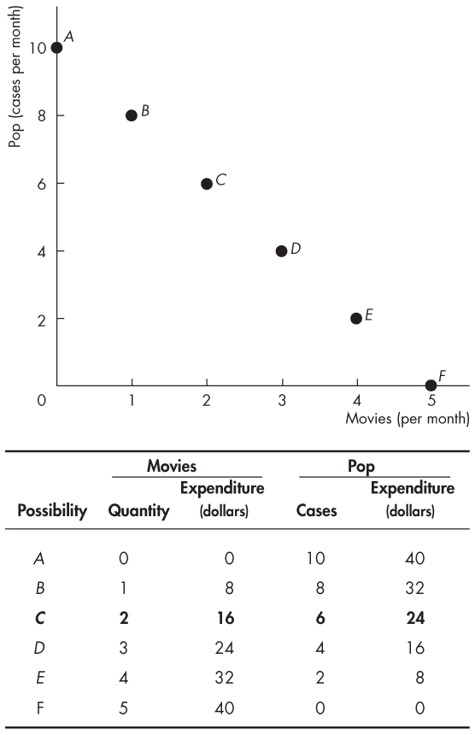
Consumption Possibilities
Lisa has $40 to spend, the price of a movie is $8 and the price of pop is $4 a case.
The table lists seven possible ways in which she can spend her $40.
The graphs plots these combinations of movies and pop.

Slide 5
Consumption Choices
Preferences
The choice that Lisa makes depends on her preferences—her likes and dislikes.
Her benefit or satisfaction from consuming a good or service is called utility.
Total Utility and marginal utility
Total utility is the total satisfaction a person gets from the consumption of goods. Generally, more consumption gives more total utility.
Marginal utility is the additional satisfaction a person gets from consuming one more unit of a product

Slide 6
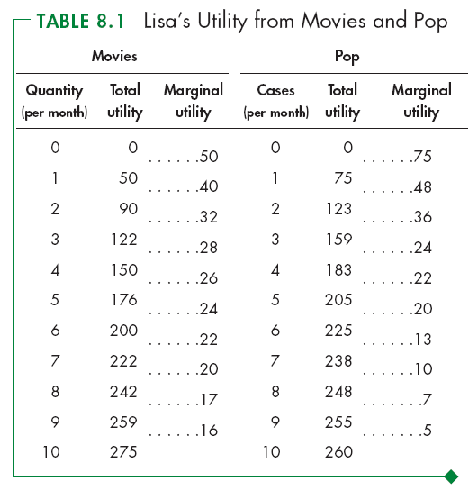
Total Utility
Table 8.1 shows Lisa’s total utility schedule.
Total utility from a good increases as the quantity of the good increases.
Notes:
Where do the utility numbers come from? Year after year, you will get the same question from the curious student: “where do the utility numbers come from?” This edition tries to help with one answer to this question by telling the story of Lisa’s likes for movies and pop. We tell Lisa that we’re going to call the utility she gets from 1 movie a month 50 units of utility. Then we ask her to tell us, using the same scale, how much she would like 2, 3, and so on movies, and 1, 2, 3, and so on cases of pop.
A second answer that you can’t give now, but you can promise when you get to the end of the chapter, is that we can infer the MU values from the prices (up to an arbitrary constant of multiplication). Because in consumer equilibrium, MU_{M}/P_{M} = MU_{S}/P_{S} = λ, we know that MU_{M} = λP_{M} and MU_{S} = λP_{S}. (Use this second explanation carefully, and don’t use the math as densely as we’re using it here. Spell it out at greater length in words and with intuition.)

Slide 7
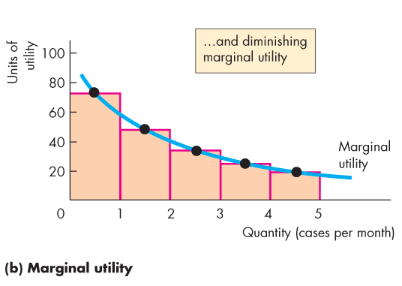
Marginal Utility

Slide 8
Utility-Maximizing Rule
Utility-Maximizing Rule
A consumer’s total utility is maximized by following the rule:
Spend all available income and lists all the consumption possibilities
Equalize the marginal utility per dollar for all goods

Slide 9
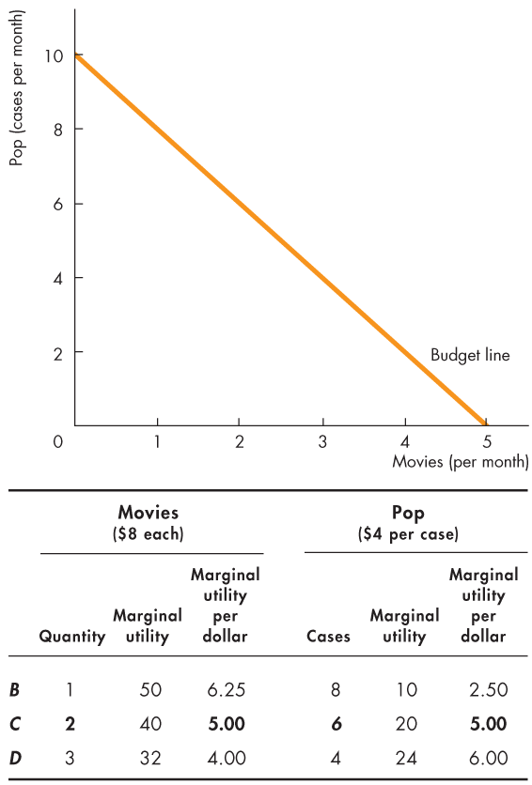
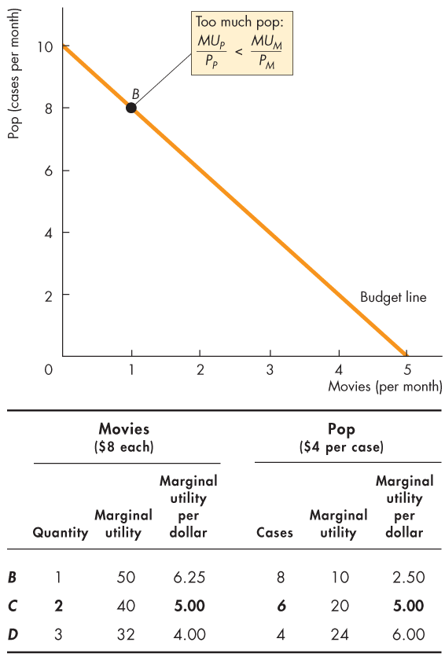
Utility-Maximizing Choice
In row B,
MU_{P}/P_{P} < MU_{M}/P_{M.}
Lisa spends too much on pop and too little on movies.
If Lisa spends less on pop and more on movies, …
MU_{P} increases and MU_{M} decreases.

Slide 10
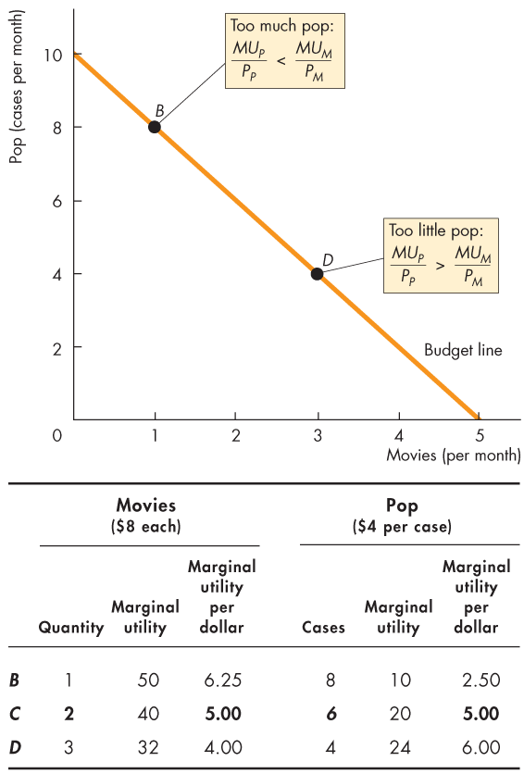
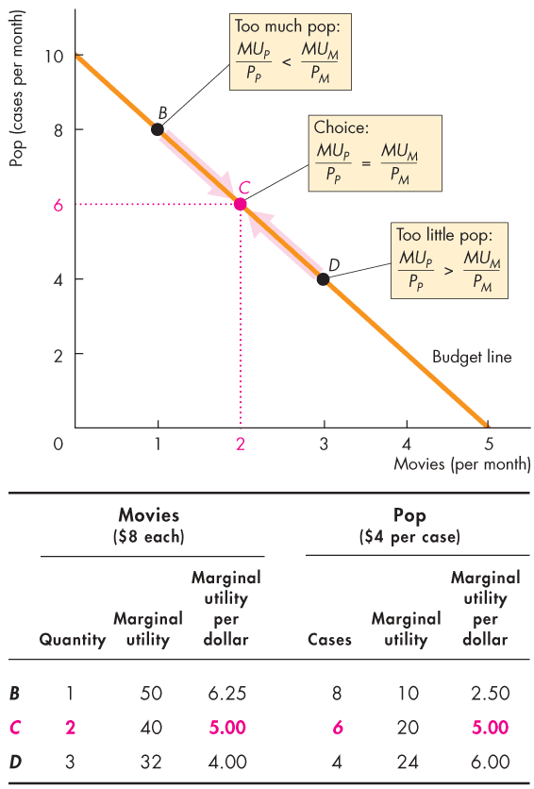

Slide 11
Utility-Maximizing Choice
In row D,
MU_{P}/P_{P} > MU_{M}/P_{M.}
Lisa spends too much on movies and too little on pop.
If Lisa spends less on movies and more on pop, …
MU_{M} increases and MU_{P} decreases.

Slide 12
Utility-Maximizing Choice
In row c,
MU_{P}/P_{P} = MU_{M}/P_{M.}
Lisa maximizes her total utility.

Slide 13
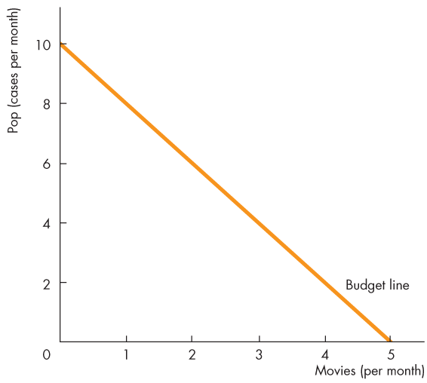
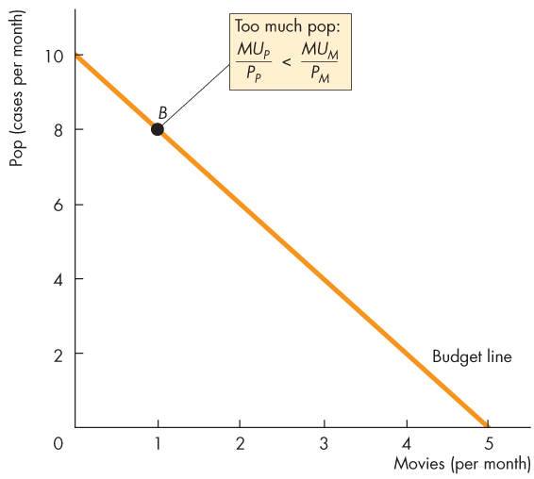
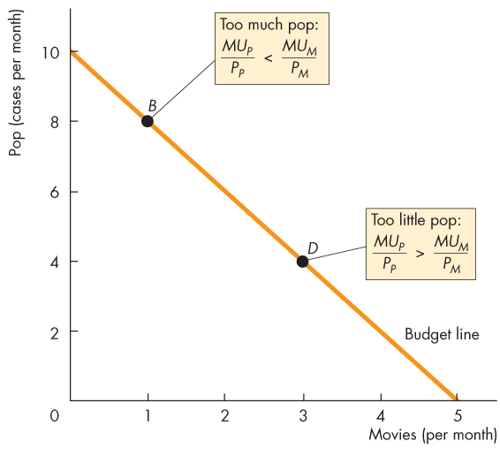
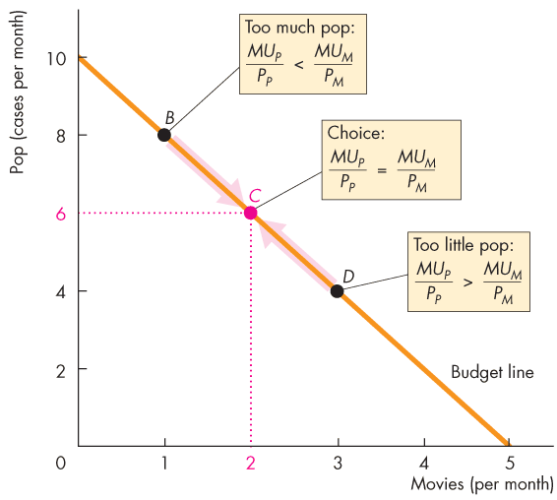

Slide 14
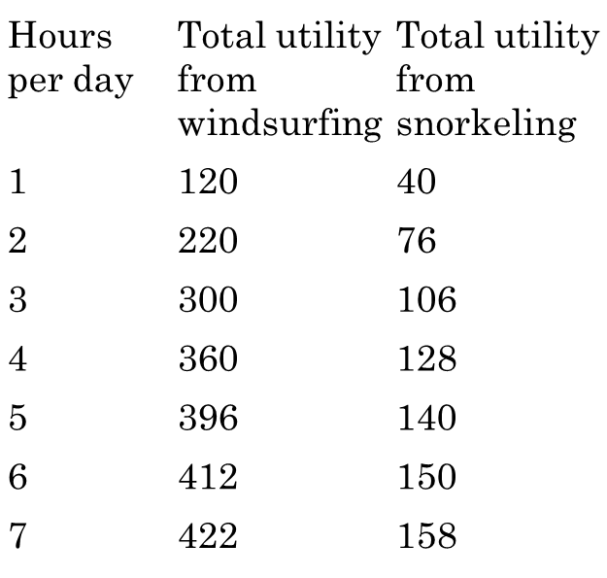
Exercise
Max has an income of $35, and rental for windsurfing is $10/hour, for snorkeling is $5/hour.
Make a table that shows the various combinations of hours spent on windsurfing and snorkeling that Max can afford.
Add two columns and list max’s marginal utility per dollar from windsurfing and from snorkeling.
How many hours on each activity would maximize his total utility?

Slide 15
Predictions of Marginal Utility Theory
We use the Marginal utility theory to predict the effects of:
a price change: a fall in the price of a movie;
a rise in income.
Notes:
The concept of utility is abstract and not comparable across people—and that can be a difficult idea to grasp. Students will initially be skeptical of measuring satisfaction with the concept of utility—not because the idea that consumer satisfaction increases with consumption is difficult to comprehend, but because there is no absolute standard by which different people’s satisfaction can be compared.
Many students think that if one person’s utility can’t be converted into standardized units that are comparable across people, like converting spatial distance into miles or kilometers, then the concept simply isn’t worth understanding. (In mathematical terms, utility ordering is ordinal, not cardinal, making it impossible to directly compare separate utility functions.)

Slide 16
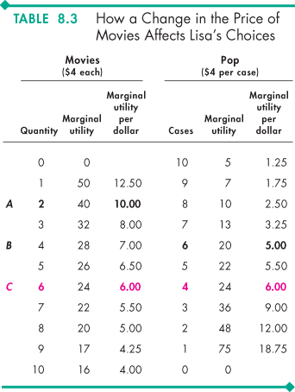
Predictions of Marginal Utility Theory
Movie’s price falls from $8 to $4, Table 8.3 shows Lisa’s just-affordable combinations.
Before Lisa changes what she buys MU_{M}/P_{M} > MU_{P}/P_{P}.
To maximize total utility, Lisa sees more movies and drinks less pop.

Slide 17
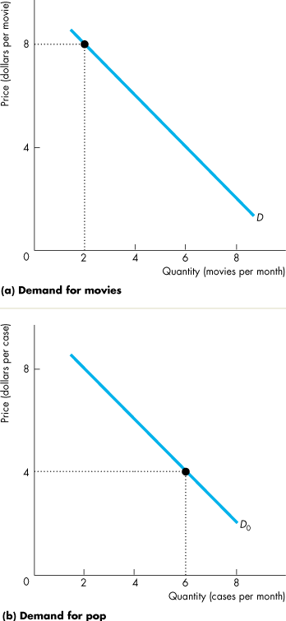
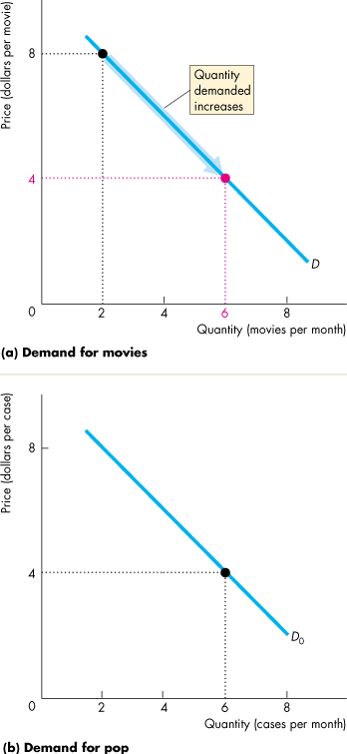
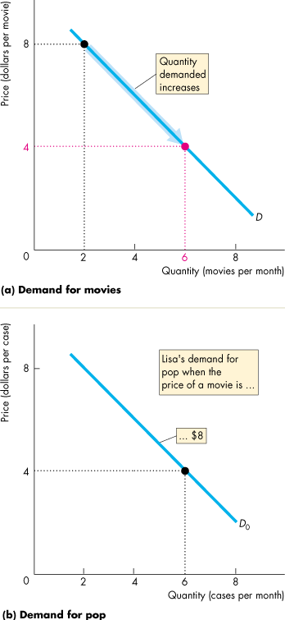
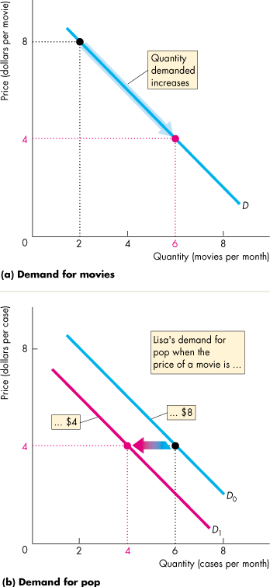
Predictions
Figure 8.4 illustrates these predictions.
A fall in the price of a movie increases the quantity of movies demanded—a movement along the demand curve for movies, …
and decreases the demand for pop—a shift of the demand curve for pop.

Slide 18
Predictions of Marginal Utility Theory
A Rise in Income
Given the prices of movies and pop, when Lisa’s income increases from $40 to $56 a month (price is $ 4 each).

Slide 19
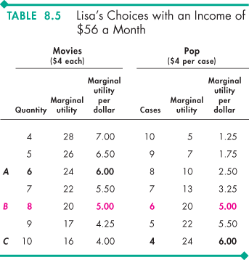
Predictions of Marginal Utility Theory
Table 8.5 shows Lisa’s just-affordable combinations when she has $56 to spend.
With $40 to spend, Lisa sees 6 movies and drinks 4 cases of pop a month.
With $56 to spend, She sees 8 movies and drinks 6 cases of pop a month.

Slide 20
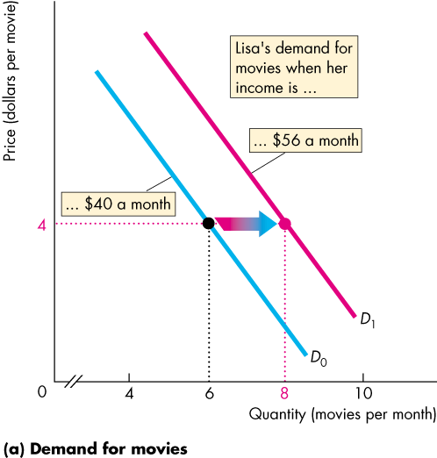
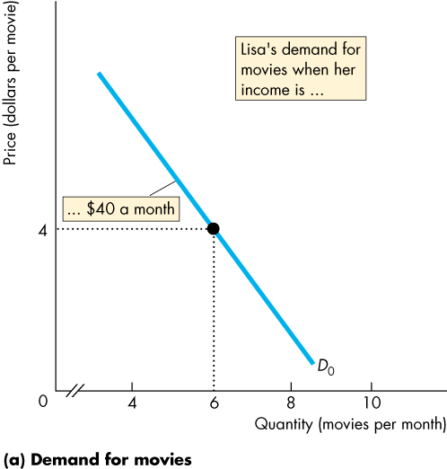
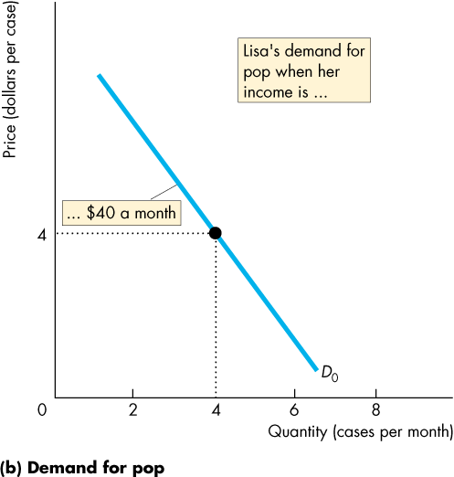
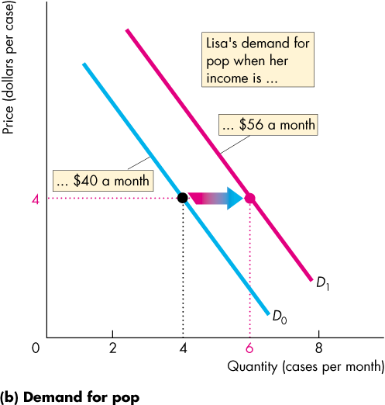
Predictions of Marginal Utility Theory

Slide 21
Predictions of Marginal Utility Theory
The Paradox of Value
“Why is water, which is essential to life, far cheaper than diamonds, which are not essential?” To solve the puzzle, we need to differentiate total utility and marginal utility.
We use so much water that the marginal utility from water consumed is small, but the total utility is large.
We buy few diamonds, so the marginal utility from diamonds is large, but the total utility is small.

Slide 22
Discussion Questions
Discuss why newspaper publishers are prepared to use vending machines that allow customers to pay for one newspaper and remove several, whereas candy and soft-drink producers use vending machines that allow customers to remove only the single product that is purchased.
Many medical and hospital services in Canada are provided at zero cost to all Canadians and are financed out of general government revenues. What would be the marginal value of such services consumed by each Canadian if the government provided the necessary resources to satisfy all demand? How does this relate to the total value that Canadians probably place on medical services?
Why dentists choose to work 4 days a week, while they are fully booked for the next two weeks? Don’t they want to maximize their total utility?

Slide 23
Exercise
Max is offered a special deal on windsurfing equipment: a rental rate of $5 an hour. His income remains at $35 a day and the rental price of snorkeling equipment remains at $5 an hour.
a. how many hours does Max spend on windsurfing and how many hours does he spend on snorkeling?
b.How does Max’s demand for snorkeling change when the price of windsurfing rental falls. What is Max’s cross elasticity of demand for snorkeling with respect to the price of windsurfing? Are windsurfing and snorkeling substitutes or complements for Max?

Slide 24
Exercise
Max gets an increase in income from $35 to $55 a day. Windsurfing equipment rents for $10 an hour, and snorkeling equipment for $5 an hour. Show the effect of the increase in Max’s income on Max’s demand curve for
a. windsurfing, and explain whether, for Max, windsurfing is a normal good or an inferior good
b. snorkeling equipment, and explain whether, for Max, snorkeling is a normal good or an inferior good

