Slide 1
Market, Efficiency and Government Actions
Chapter 5 & 6

Slide 2
In this chapter you will learn
The alternative methods of allocating resources;
How competitive market allocates resources efficiently;
Government actions in the market and their consequences on efficiency.

Slide 3
Questions To Answer
Does rent control make searching for an apartment more difficult?
Does minimum wage create more unemployment?
Who actually pays taxes? Consumers or suppliers?
What is the impact of these policies on efficiency?

Slide 4
Resources allocation methods
Market price;
Command;
Contest;
First come, first served;
Lottery;
Personal characteristics;
Force;
Question: Is market price an efficient way to allocate resources?

Slide 5
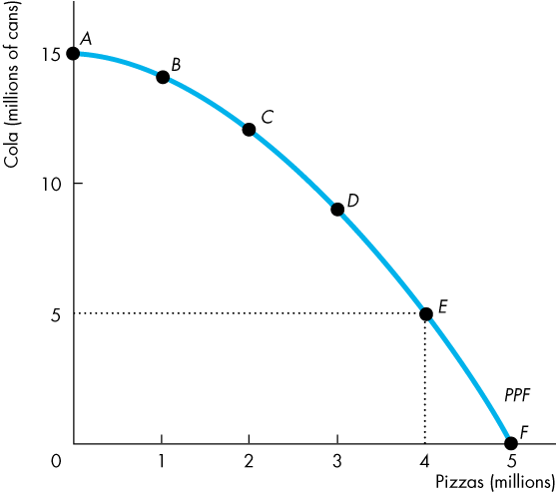
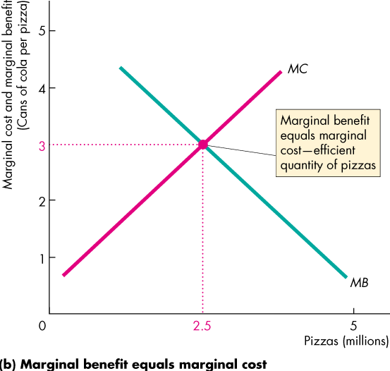
Efficiency

Slide 6
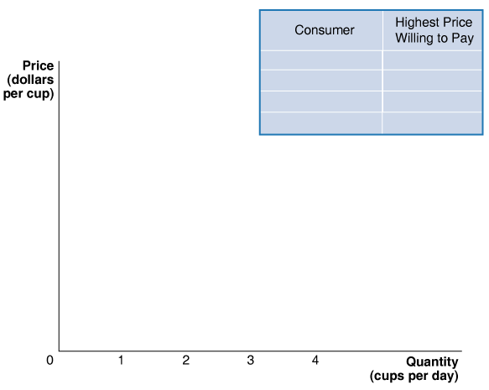
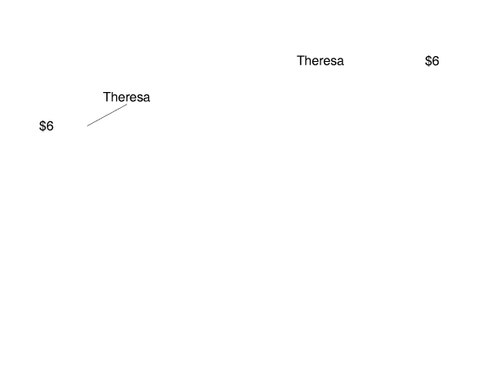
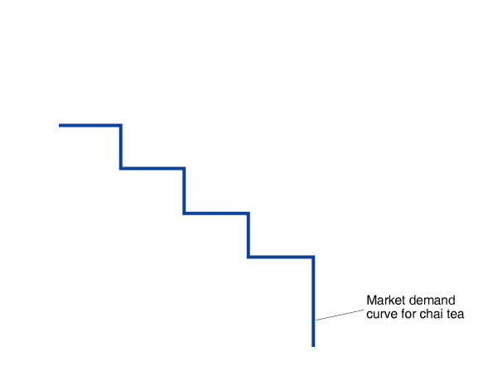
Consumer Surplus
Deriving the Demand Curve for Chai Tea
With four consumers in the market for chai tea, the demand curve is determined by the highest price each consumer is willing to pay.
For prices above $6, no tea is sold because $6 is the highest price any consumer is willing to pay.
For prices of $3 and below, every one of the four consumers is willing to buy a cup of tea.

Slide 7
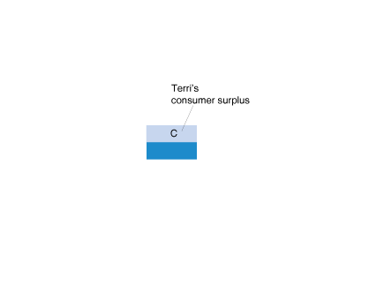
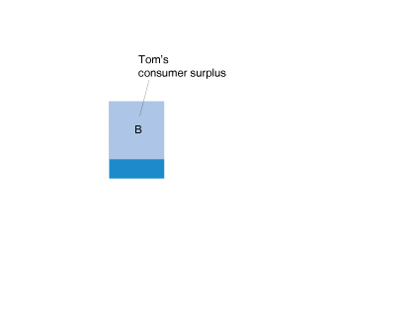
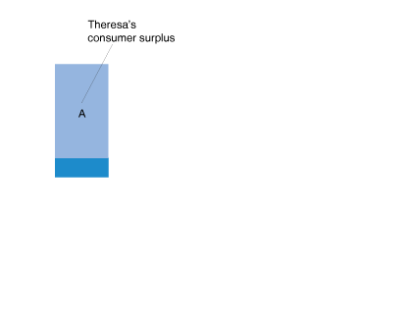
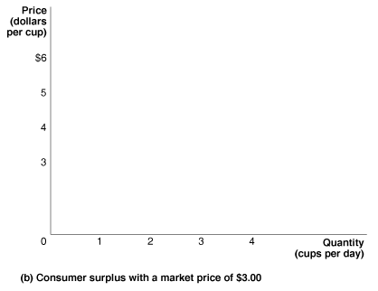
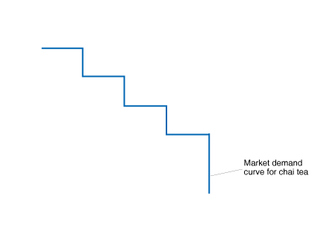
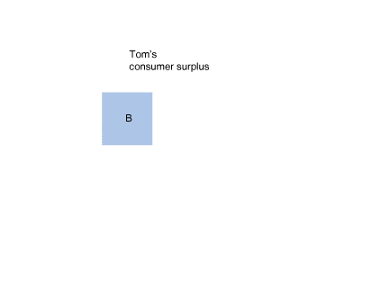
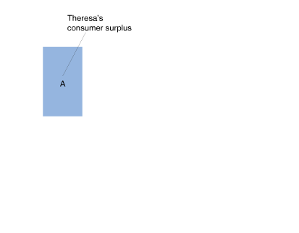
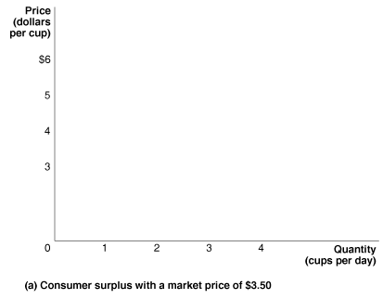
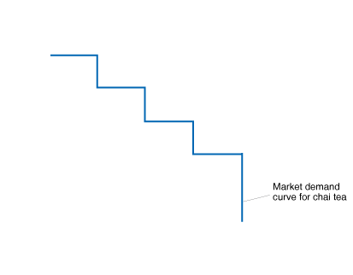
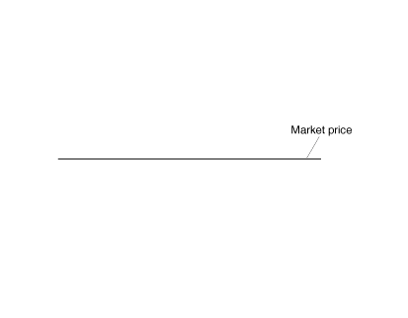

Slide 8
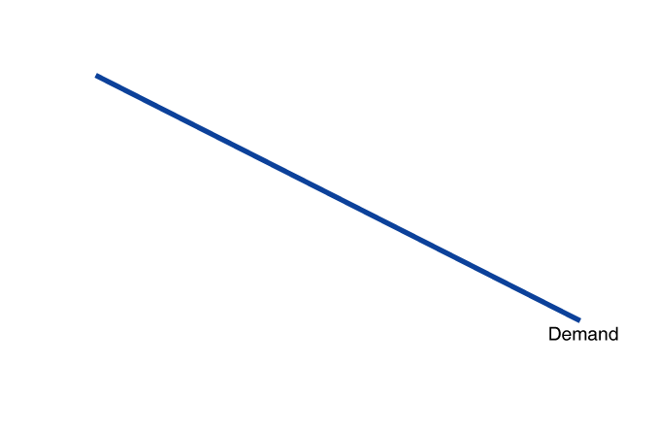
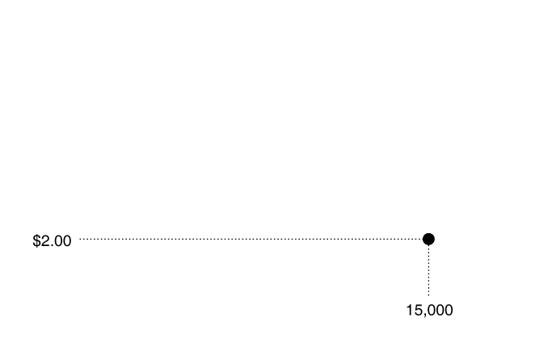
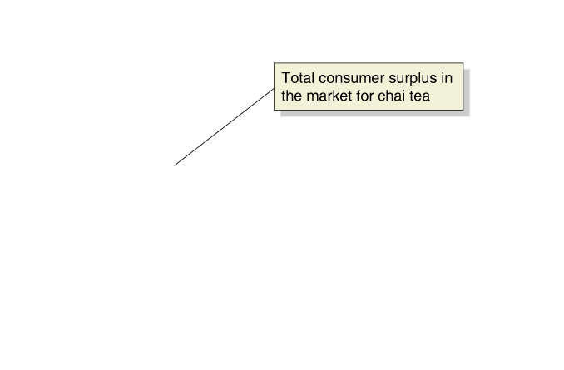
Consumer Surplus
The total amount of consumer surplus in a market is equal to the area below the demand curve and above the market price.

Slide 9
Marginal benefit, Willingness to pay and Demand
Demand curve = the willingness to pay curve = marginal benefit curve;
Consumer surplus CS = WTP – market price; Consumer surplus measures the net benefits we get by purchasing something;

Slide 10
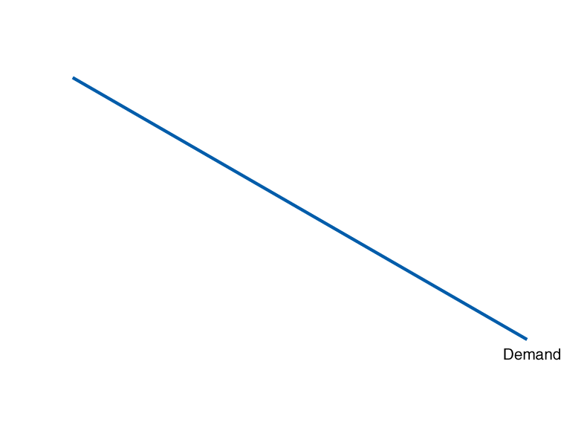
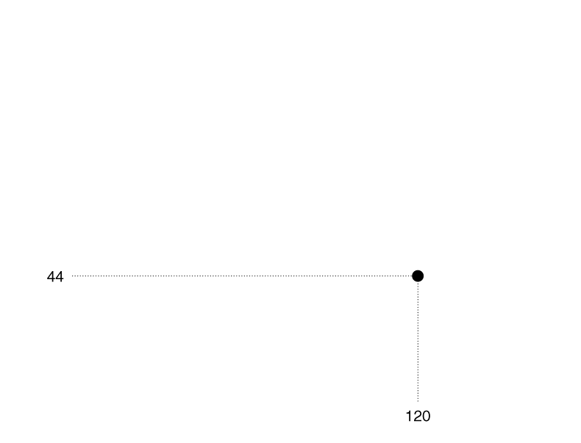
Making the Connection
The Consumer Surplus From Visits to National Parks
The demand curve shows the marginal benefit consumers receive from visiting the
park rather than staying home. The shaded area of the graph represents the total consumer surplus is about 186 million.

Slide 11
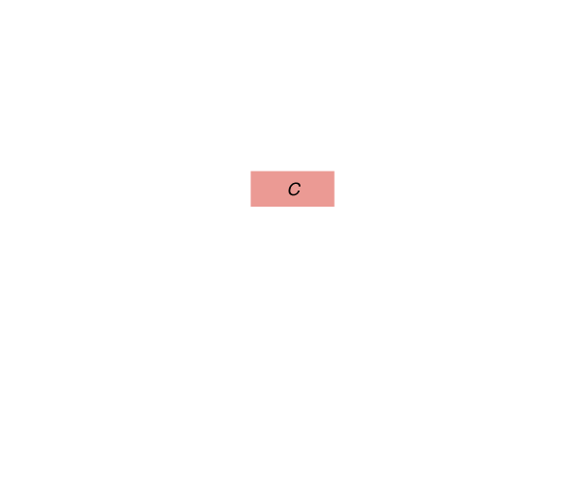
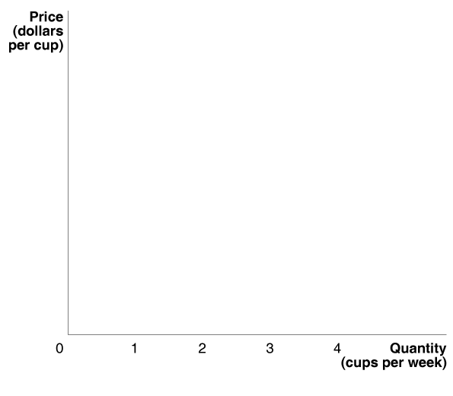
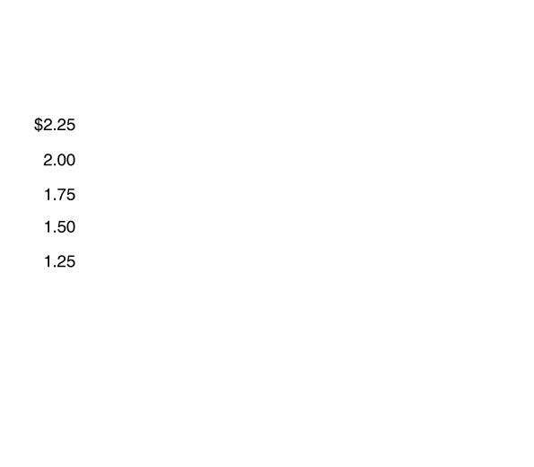
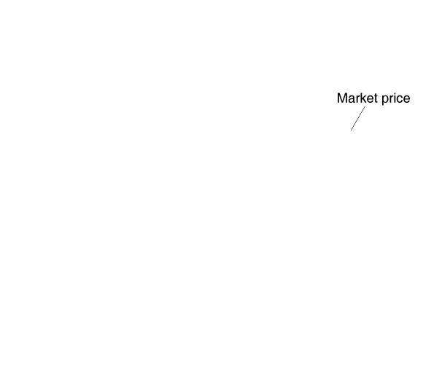
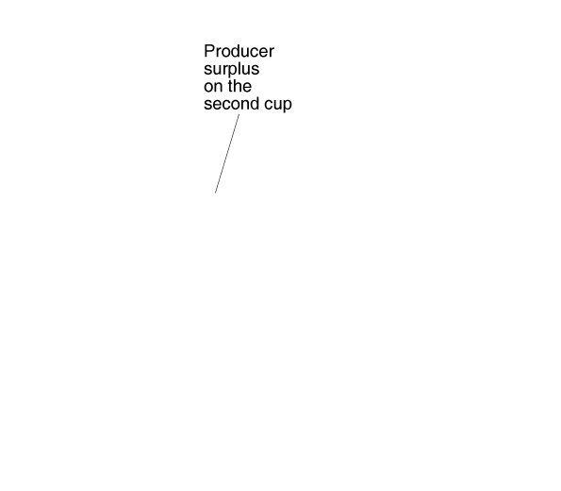
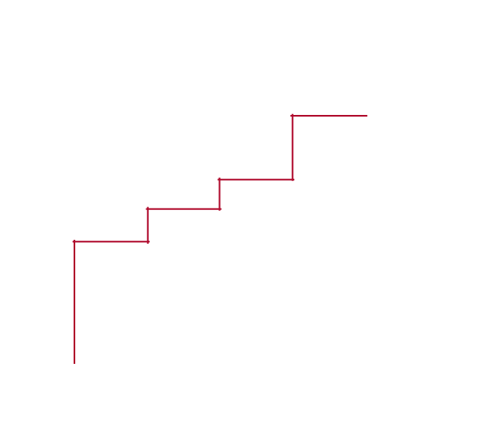
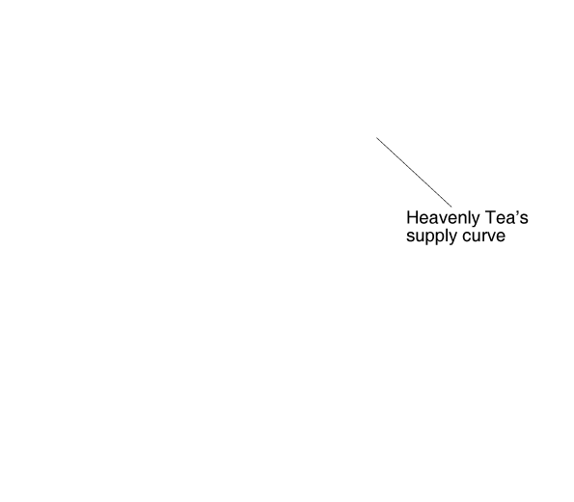
Measuring Producer Surplus
Panel (a) shows Heavenly Tea’s producer surplus.
Producer surplus is the difference between the lowest price a firm would be willing to accept and the price it actually receives.

Slide 12
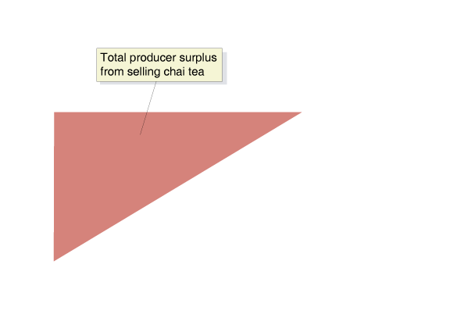
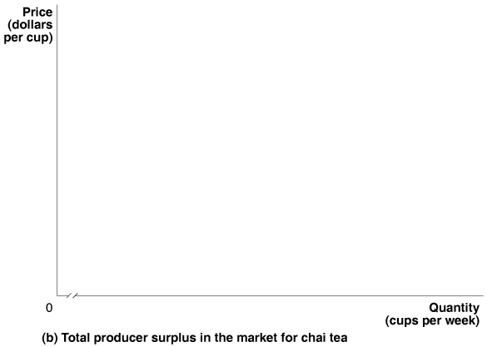
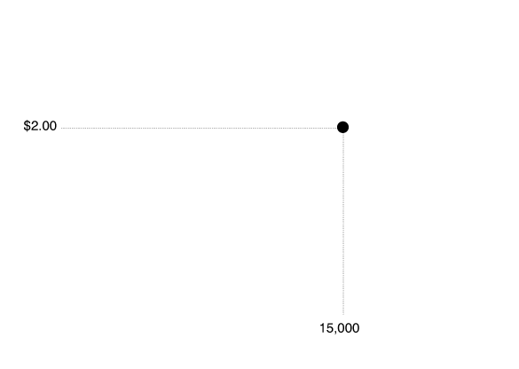
Measuring Producer Surplus
The total amount of producer surplus in a market is equal to the area above the market supply curve and below the market price.
Notes:
LEARNING OBJECTIVE REFERENCE: 4.1 - Distinguish between the concepts of consumer surplus and producer surplus.

Slide 13
Marginal cost and supply
Marginal cost curve = supply curve.
Producer surplus = market price – the lowest price that the producer willing to accept for producing that product;
Producer surplus measures the net benefits sellers get by selling something;

Slide 14
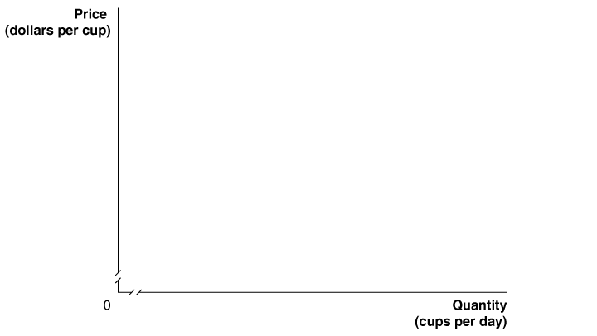
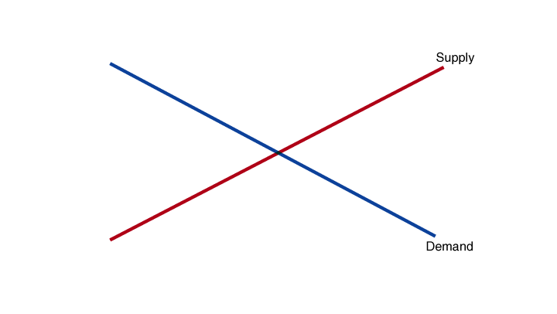
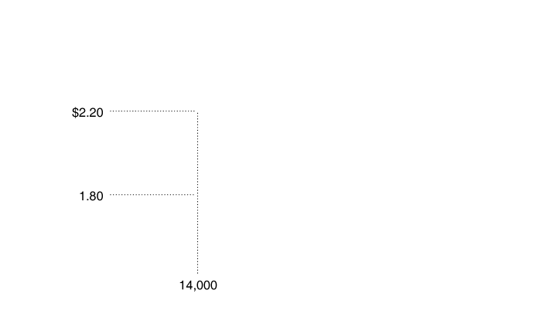
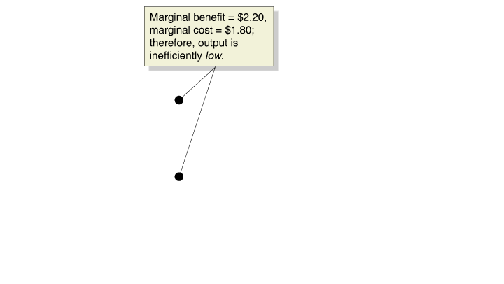
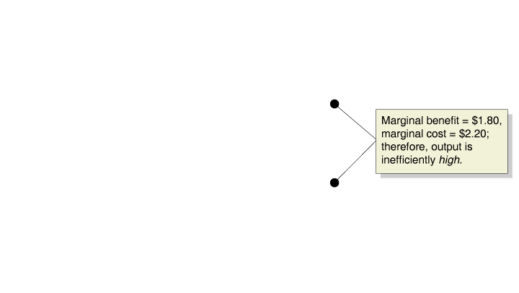
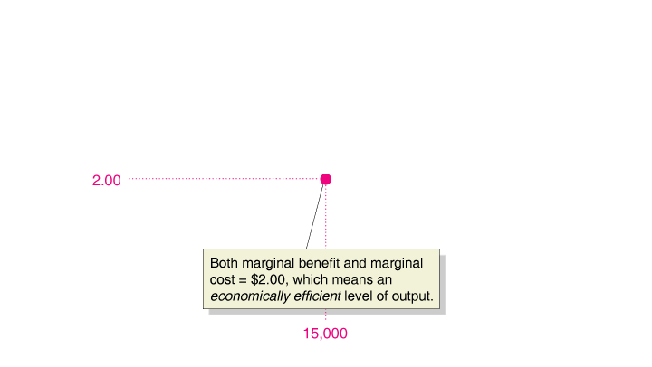
Marginal Benefit Equals Marginal Cost Only at
Competitive Equilibrium
Equilibrium in a competitive market results in the economically efficient level of output, where marginal benefit equals marginal cost.

Slide 15
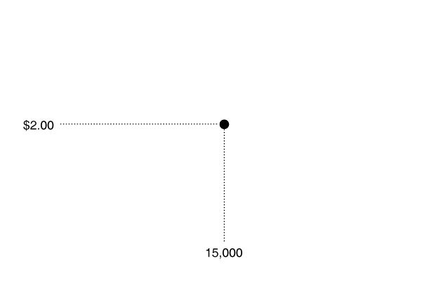
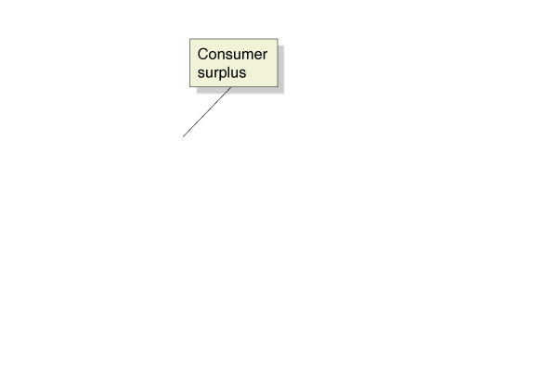
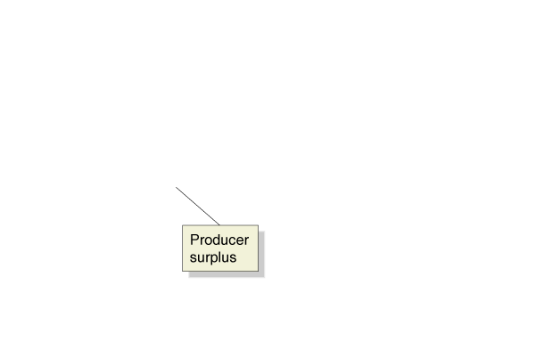
Economic surplus The sum of consumer surplus and producer surplus.
Equilibrium in a competitive market results in the greatest amount of economic surplus, or total net benefit to society, from the production of a good or service.
Economic efficiency A market outcome in which the marginal benefit to consumers of the last unit produced is equal to its marginal cost of production and in which the sum of consumer surplus and producer surplus is at a maximum.
Notes:
LEARNING OBJECTIVE REFERENCE: 4.2 - Understand the concept of economic efficiency.

Slide 16
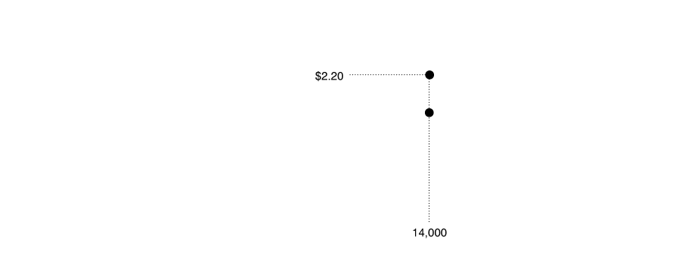
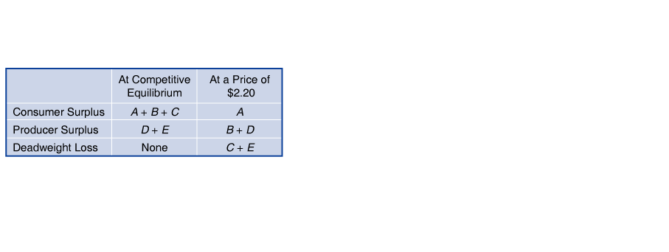
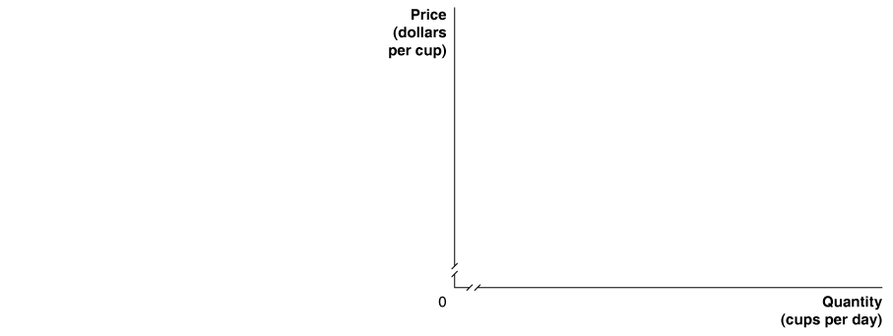
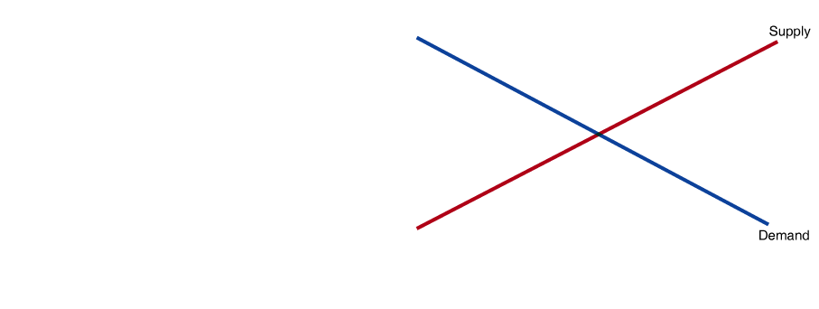
Deadweight loss The reduction in economic surplus resulting from a market not being in competitive equilibrium.
When a Market Is Not in Equilibrium, There Is a Deadweight Loss

Slide 17
Government actions in the market
Government actions such as:
Price controls;
Price ceiling – rent control;
Price floor – minimum wage;
Quantity control: quota;
Taxes.
Notes:
Don’t get hung up on the mechanics of market failure. Just note at this stage that they bring either underproduction or overproduction and emphasize the deadweight loss that they generate. You will go into the details in later chapters. The list is a guide to what is coming.

Slide 18
Price Ceilings: rent control
S
Price
A price ceiling is the maximum price at which a product may be exchanged.
Black Market - A market in which buying and selling take place at prices that violate government price regulations.
E •
p₀
Price ceiling
p₁
Excess
demand
D
Q₁
Q₀
Q₂
Quantity

Slide 19
Price Floors: minimum wage
Price floors make it illegal to sell the product below the controlled price.
Price
S
Excess
supply
Price floor
p₁
E •
p₀
D
Q₁
Q₀
Q₂
Quantity

Slide 20
Output Quota
Price
A production quota is an upper limit to the quantity of a good that may be produced during a specified period.
quota
S
p_{OQ}
A
B
D
p_{CE}
E
C
deadweight loss: D+E
D
0
Q_{OQ}
Q_{CE}
Quantity

Slide 21
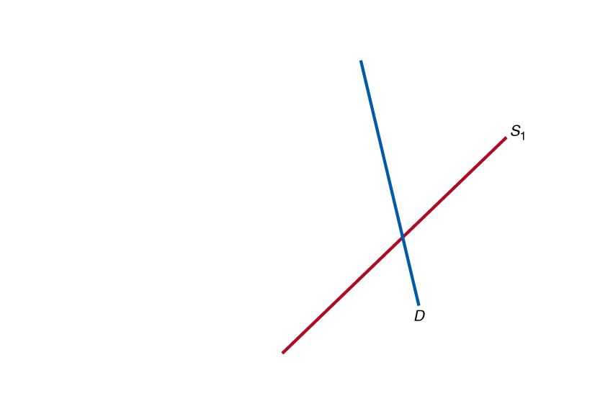
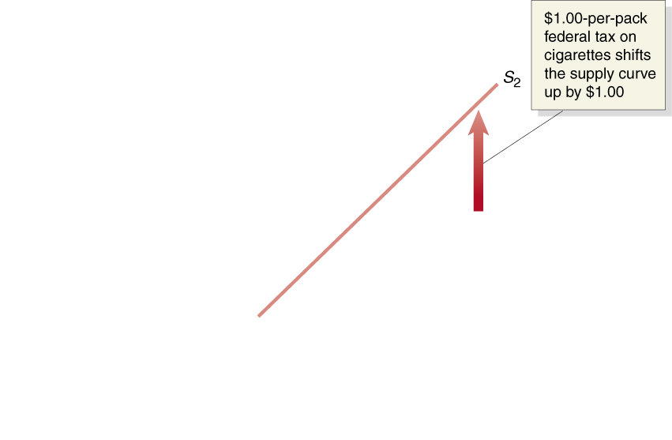
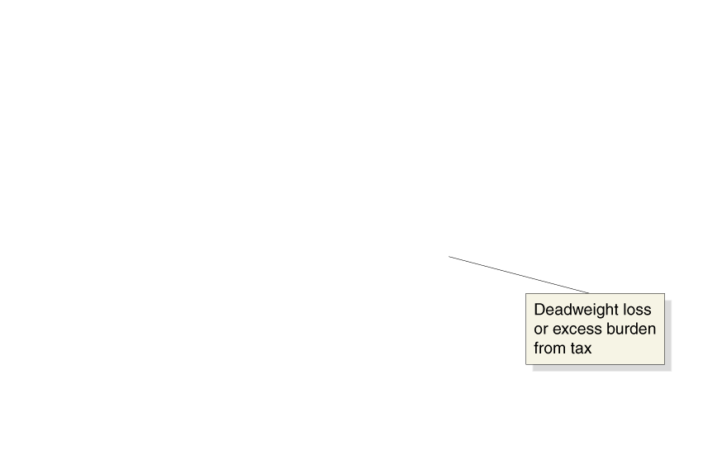
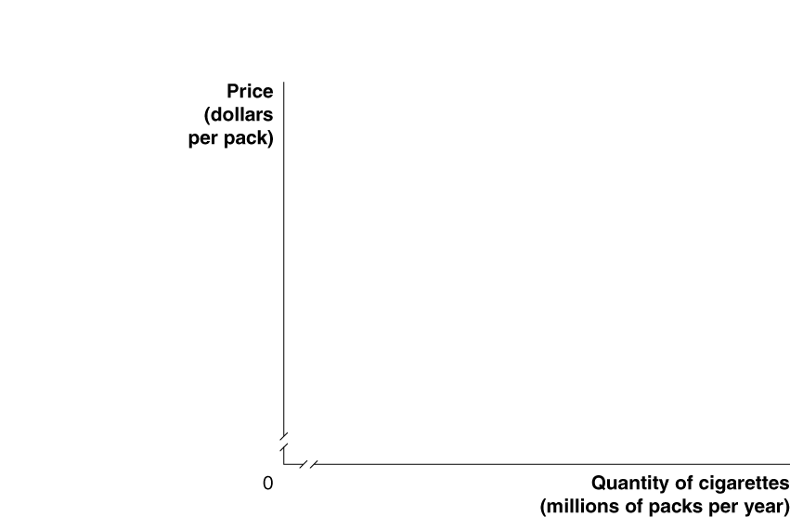
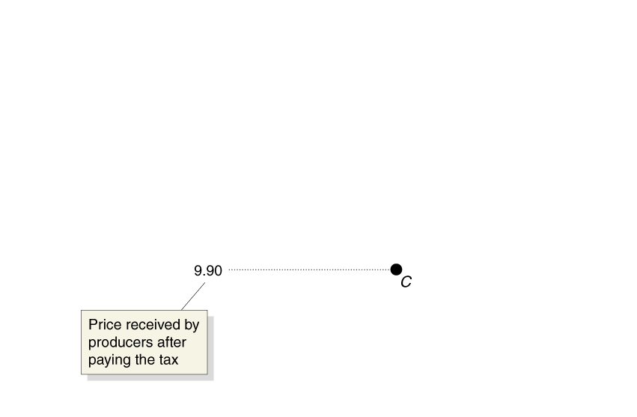
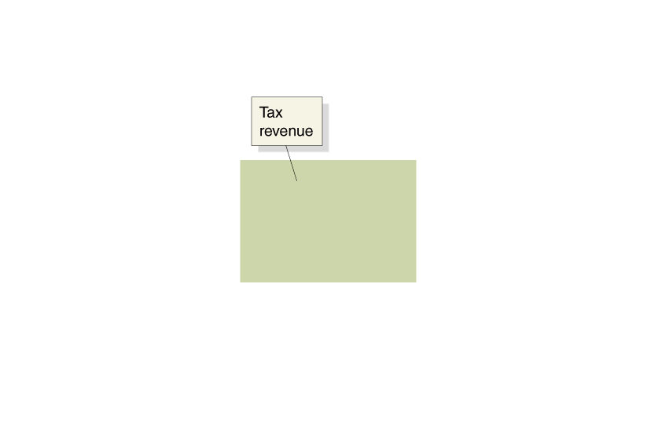
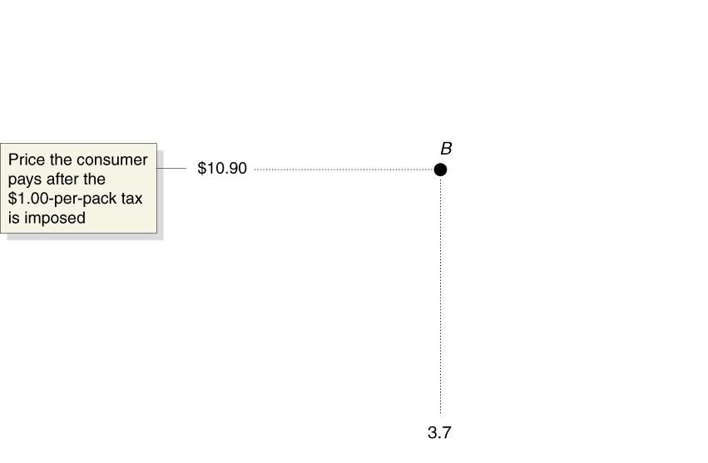
The Effect of Taxes on Economic Efficiency
The Effect of a Tax on the Market for Cigarettes
Without the tax, market equilibrium occurs at point A . The equilibrium price of cigarettes is $10.00 per pack, and 4 billion packs of cigarettes are sold per year.
With the tax:
The price of cigarettes will increase by $0.90, to $10.90 per pack, and the quantity sold will fall to 3.7 billion packs. s
Notes:
LEARNING OBJECTIVE REFERENCE: 4.4 - Analyze the economic impact of taxes.

Slide 22
Tax incidence The actual division of the burden of a tax between buyers and sellers in a market.
The Incidence of a Tax on Gasoline
With no tax on gasoline, the price would be $1.30 per litre, and 144 billion litres of gasoline would be sold each year. A 10-cents per-litre tax shifts up the supply curve from S₁ to S₂ , raises the price consumers pay from $1.30 to $1.38, and lowers the price sellers receive from $1.30 to $1.28. Therefore, consumers pay 8 cents of the 10-cents per-
litre tax on gasoline, and sellers pay 2 cents.
Notes:
[[Please update with figure on page 111 of the first-pass pages. Figure 4.11 – The Incidence of a Tax on Gasoline. Please note the figure is the same, but the x- and y-axis are labelled differently.]]
LEARNING OBJECTIVE REFERENCE: 4.4 - Analyze the economic impact of taxes.

Slide 23
Solved Problem
When Do Consumers Pay All of a Sales Tax Increase?
A student makes the following statement: “If the federal government raises the sales tax on gasoline by $0.25, then the price of gasoline will rise by $0.25. Consumers can’t get by without gasoline, so they have to pay the whole amount of any increase in the sales tax.”
Under what circumstances will the student’s statement be true?
The graph shows that consumers will pay all of an increase in a sales tax only if the demand curve is a vertical line.
Because the demand curve for gasoline is not a vertical line, the statement is incorrect.
MyEconLab
Notes:
LEARNING OBJECTIVE REFERENCE: 4.4 - Analyze the economic impact of taxes.

Slide 24
Does It Make a Difference Whether the Government Collects a Tax from Buyers or Sellers?
The Incidence of a Tax on Gasoline Paid by Buyers
With no tax on gasoline, the demand curve is D₁ . If a 10-cents-per-litre tax is imposed
that consumers are responsible for paying,
the demand curve shifts down by the amount of the tax, from D₁ to D₂ . In the new equilibrium, consumers pay a price of $1.38 per litre, including the tax. Producers
receive $1.28 per litre. This is the same result we saw when producers were responsible
for paying the tax.
Notes:
LEARNING OBJECTIVE REFERENCE: 4.4 - Analyze the economic impact of taxes.

