Slide 1
oligopoly
Chapter 15

Slide 2
In some markets, there are only a few firms compete.
For example, computer chips are made by Intel and Advanced Micro Devices and each firm must pay close attention to what the other firm is doing.
How does competition between just two chip makers work?

Slide 3
In this chapter you will learn
The key characteristics of oligopoly;
Use game theory to model the strategic behavior of oligopoly firms;

Slide 4
CHARACTERISTICS OF OLIGOPOLY
Oligopoly is a market structure where few firms compete and strategically interact. Firm considers effects of its actions on behavior of others and actions of others on its own profits. Characteristics:
products can be differentiated or identical.
Collusion becomes possible => Cartel: is a group of firms acting together to limit output, raise price, and increase profit. Example: OPEC
Natural or legal barriers prevent the entry of new firms.

Slide 5
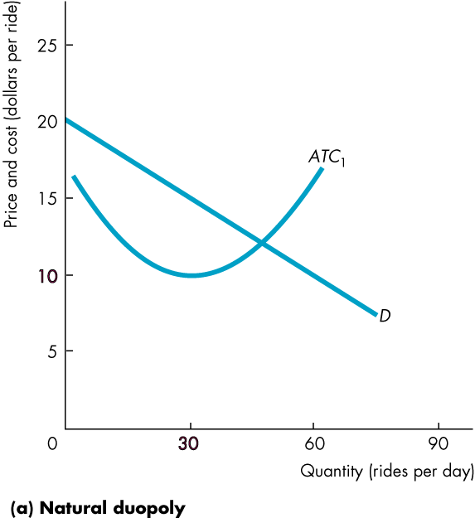
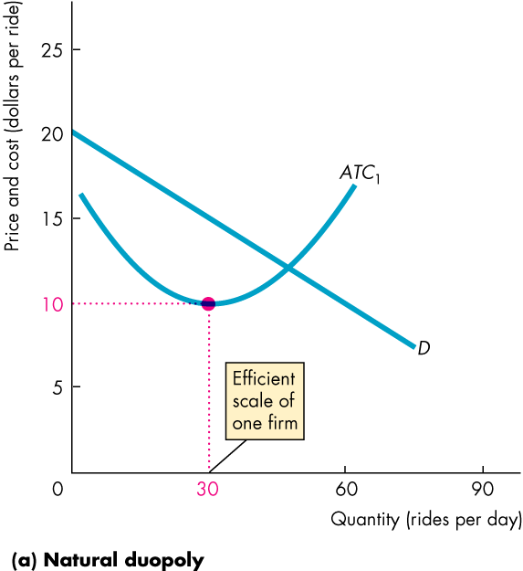
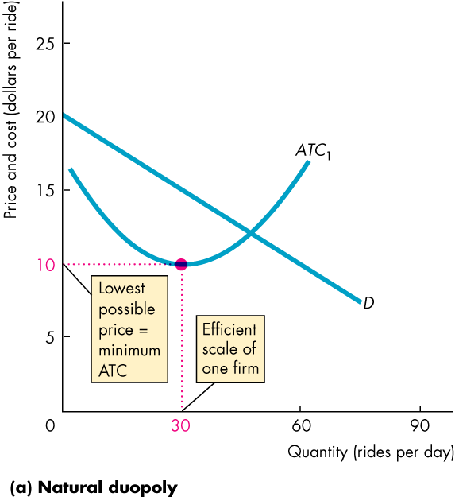
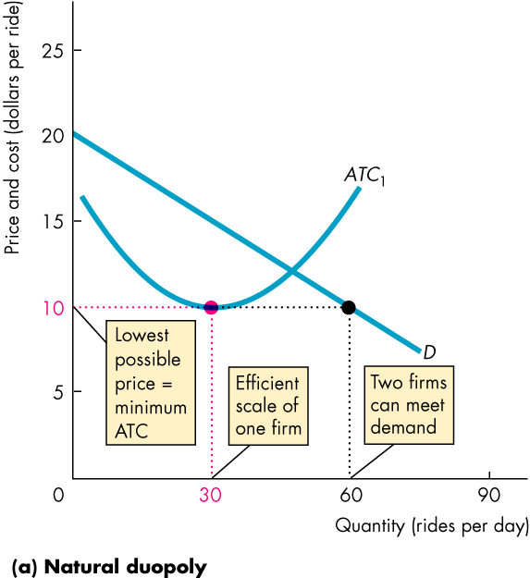
CHARACTERISTICS OF OLIGOPOLY
This figure shows how a natural duopoly—a market with two firms, may be created.

Slide 6
Oligopoly Games
Game theory analyzes strategic behavior, which is the behavior that takes into account the expected behavior of others and the mutual recognition of interdependence.
The four features of a game:
Rules: specify permissible actions by players.
Strategies: actions such as raising or lowering price, output, advertising, research and development, etc.
Payoffs: profits.
Outcome: determined by player’ choices.
Notes:
Game Theory
Game theory is an entirely different approach to modeling a firm’s output and price decisions. It allows for the expected actions of all other firms in the market to be explicitly considered in the firm’s decision-making process. Game theory is a big step for the student and need a significant amount of time to develop. This chapter is designed to be flexible and provide you with many options on just how far to go.
1.We noted above that if you wish you can avoid game theory completely and stop at page 288.
2.You might want to introduce only the prisoner’s dilemma game. Pages 289–290 enable you to do that.
3.You might want to spend serious time applying the prisoner’s dilemma to a cartel game. Pages 291–295 enable you to do that.
4.You might want to extend the range of examples and apply the prisoner’s dilemma to a real-world research and development game. Pages 295–296 enable you to do that.
5.Finally, you might want to introduce repeated and sequential games and some of their applications and implications. Pages 297–299 enable you to do that.
6.Each of the steps laid out above is optional, but cumulative. You can stop at any point, but shouldn’t try to skip one step with the exception that you can teach the R&D game based on the general introduction to the prisoner’s dilemma without teaching the longer and more complex cartel game.

Slide 7
Oligopoly Games
The Prisoners’ game
Rules
two prisoners (Art and Bob) have been caught committing a petty crime.
Each is held in a separate cell and cannot communicate with each other.
Notes:
The prisoners’ dilemma
Take things a step at a time and begin by playing the prisoner’s dilemma game. A good Web version of the game can be found on a site operated by a group called Serendip at Bryn Mawr College in Pennsylvania. The URL (also on your Economics Place Web site) is http://serendip.brynmawr.edu/playground/pd.html. If you can use the Web in your classroom, open two browsers and go to this site twice. Get two teams trying to beat Serendip.

Slide 8
Oligopoly Games
Each is told that both are suspected of committing a more serious crime.
If one of them confesses, he will get a 1-year sentence for cooperating while his accomplice get a 10-year sentence for both crimes.
If both confess to the more serious crime, each receives 3 years in jail for both crimes.
If neither confesses, each receives a 2-year sentence for the minor crime only.

Slide 9
Oligopoly Games
Strategies
Art and Bob each have two possible actions:
1. Confess to the larger crime.
2. Deny having committed the larger crime.
With two players and two actions for each player, there are four possible outcomes:
1. Both confess.
2. Both deny.
3. Art confesses and Bob denies.
4. Bob confesses and Art denies.

Slide 10
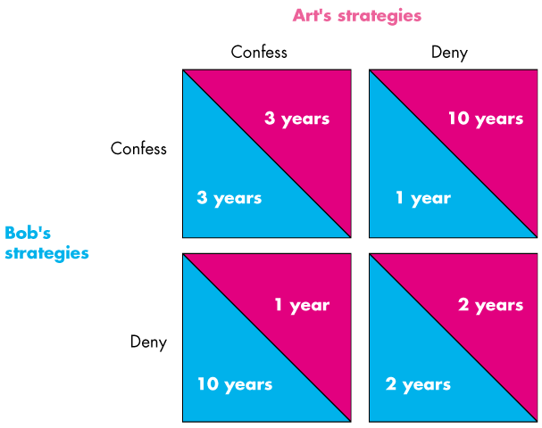
Oligopoly Games
Notes:
Be sure the students know how to read the payoff matrix.
Explain that Art’s payoff from each combination of actions is shown in the top of each payoff box, and Bob’s is shown as the bottom of each payoff box.
Note that there are four possible outcomes: Bob and Art both confess (top left box), both Bob and Art deny (bottom right box), Bob confesses but Art does not (top right box), and Art confesses but Bob does not (bottom left box).

Slide 11
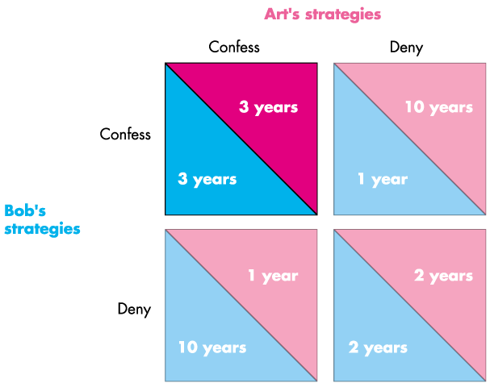
Equilibrium
Notes:
We’ve seen that both confess regardless of what the other does.
The equilibrium is for both to confess.
Note that this outcome is called a dominant strategy equilibrium.
Also, emphasize that this outcome is not the best one. If the players could have cooperated (communicated and committed) they would have chosen to deny and each get 2 years.

Slide 12
Oligopoly Games
A Nash equilibrium is an outcome in which each player takes best possible action given the other player’s action.
The prisoner’s game has a dominant strategy (unique best strategy independent of other player’s action): to confess, which is not the best interests of the players.
Reason: lack of cooperation.
Incentive to cheat could lead to the collapse of collusion => experience of OPEC

Slide 13
The payoff matrix for this game:
Nigeria
Low
output
High
output
Low
output
100
10
75
15
Saudi Arabia
High
output
80
7
60
10

Slide 14
Can firms escape the prisoner’s dilemma?
An example of Walmart and Supterstore competing on the sales of PS 4 game console.

Slide 15
The payoff matrix for this game:
Superstore
Superstore
$400
$300
$400
$300
$10,000
$10,000
$5,000
$15,000
$10,000
$10,000
$7,500
$7,500
$400
$400
Walmart
Walmart
$300
$300
$15,000
$5,000
$7,500
$7,500
$7,500
$7,500
$7,500
$7,500

Slide 16
Can firms escape the prisoner’s dilemma?
Implicit collusion: cooperation without explicit agreement => price matching, price leadership.
Canada’s Not-So Friendly Skies: why in-country flights in Canada are more expensive?

Slide 17
Sequential Games and business strategy
Sequential games: in many business situations, in stead of moving simultaneously, one firm will act first, and then other firms will respond.
An example of using sequential game theory to analyze deterring entry: Apple and Dell competing on very thin and very light laptop computers.

Slide 18
Discussion Questions
What is the key difference between monopolistic competition and oligopoly? Assume that you are in an industry that is monopolistically competitive. What actual steps you might take to transform your industry into a more oligopolistic form?

Slide 19
Discussion Questions
Evidence suggests that the profits earned by all the firms in many oligopolistic industries are less than the profits that would be earned if the industry were monopolized. What are some reasons why this might be so?

Slide 20
Discussion Questions
Consider the following industries in Canada that have traditionally been oligopolistic. What are the barriers to entry in each of these industries that might explain persistently high profits?
Brewing
Airlines
Banking
Internet service providers;

