Slide 1
Monopolistic Competition
Chapter 14

Slide 2
In this chapter we will
Define and identify monopolistic competition
Explain how a firm in monopolistic competition makes short run and long run decisions, in comparison with monopoly and perfect competition;
Explain how advertising may impact firms’ economic profits.

Slide 3
The online shoe store shoebuy.com lists athletic shooes made by 56 different producers in 40 different categories and price between$25 and $850.
It offers 1,404 different types for women and 1,757 different types for men.
The model of monopolistic competition helps us to understand the competition that we see in the markets for athletic shoes and most other goods and services we buy.
Copyright © 2013 Pearson Canada Inc., Toronto, Ontario

Slide 4
What Is Monopolistic Competition?
Monopolistic competition is a market structure in which
A large number of firms compete.
Each firm has only a small market share and therefore has limited market power to influence the price of its product.
Collusion, or conspiring to fix prices, is impossible.
Product Differentiation by selling differentiated products
Barriers to Entry are low
Examples of Monopolistic Competition
Restaurants, supper markets, clothing, jewelry, coffee shops, and sporting goods operate in monopolistic competition.

Slide 5
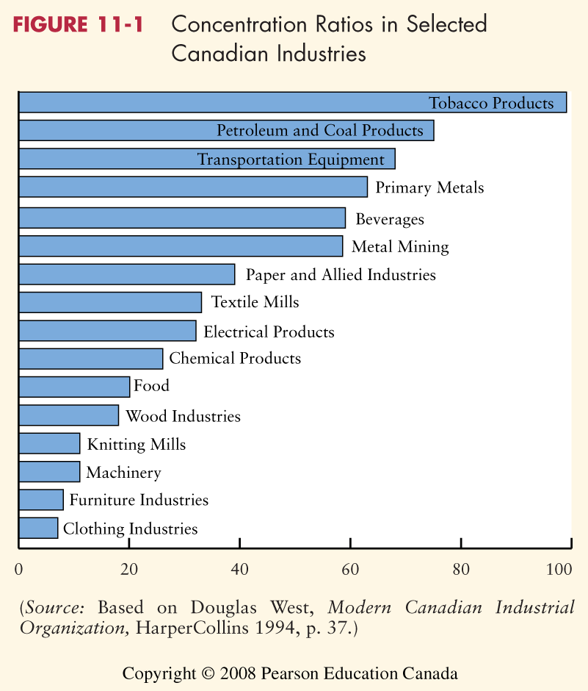

Slide 6
Price and Output in Monopolistic Competition
The Firm’s Short-Run Output and Price Decision
A firm produces the profit-maximizing quantity (the quantity at which MR = MC).

Slide 7
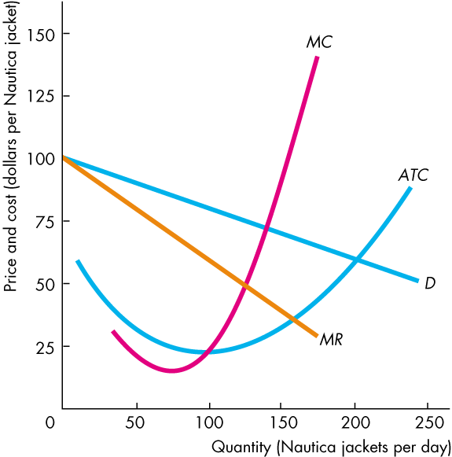
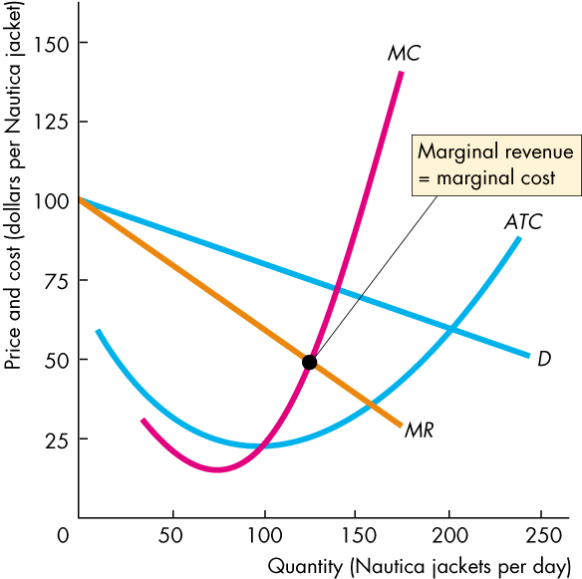
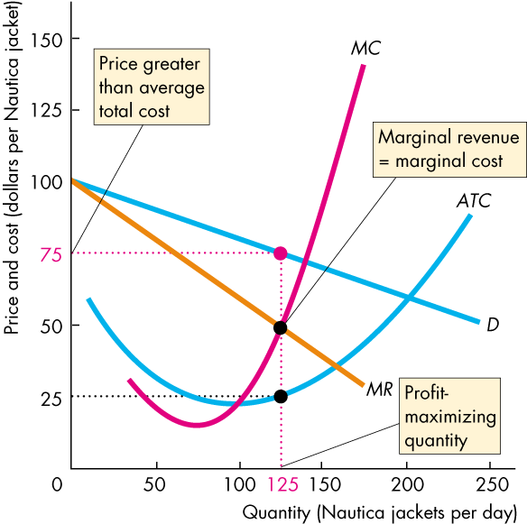
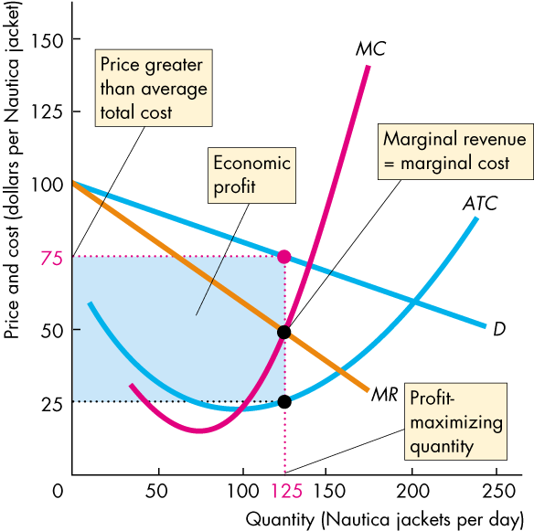
Price and Output in Monopolistic Competition
The firm in monopolistic competition operates like a single-price monopoly.

Slide 8
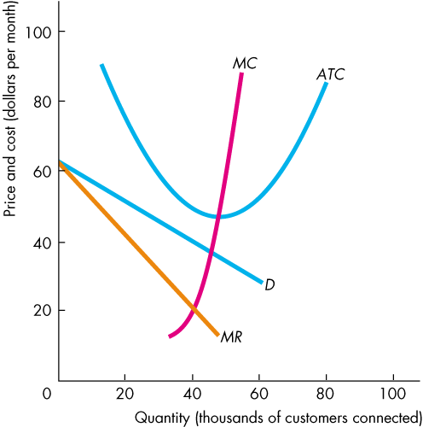
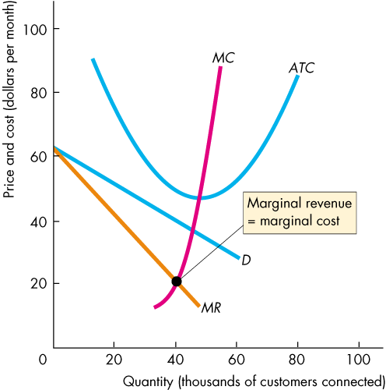
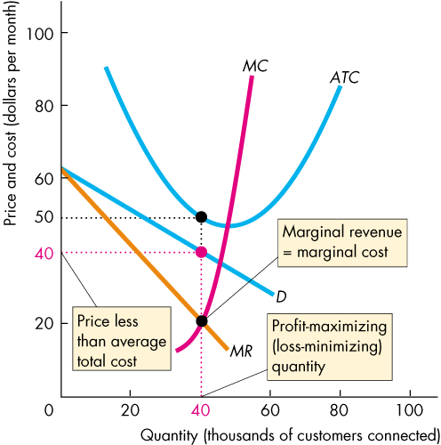
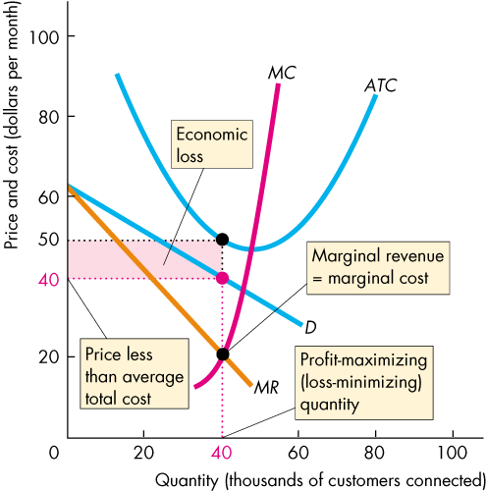
Price and Output in Monopolistic Competition
Profit Maximizing Might Be Loss Minimizing.

Slide 9
profit maximization and cost minimization
Is profit maximization the same as cost minimization? Example of iphone.

Slide 10
Long Run – Entry and Exit
In the long run
Easy entry brings long run economic profit to zero.

Slide 11
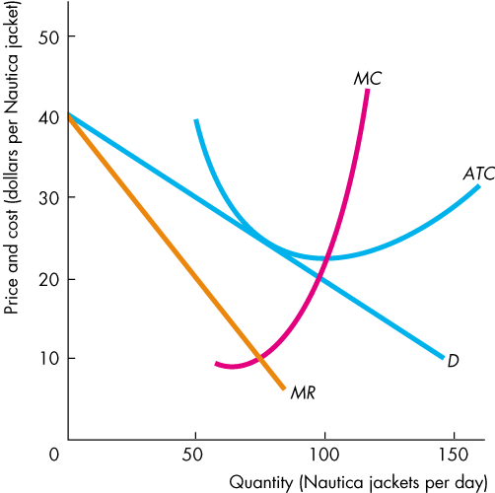
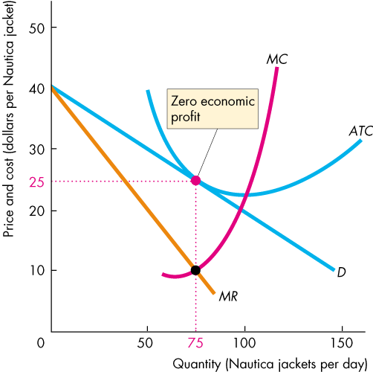
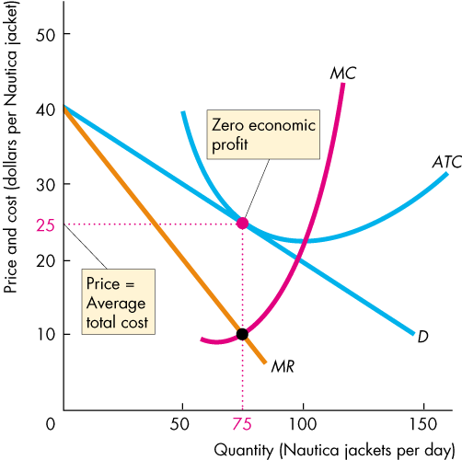
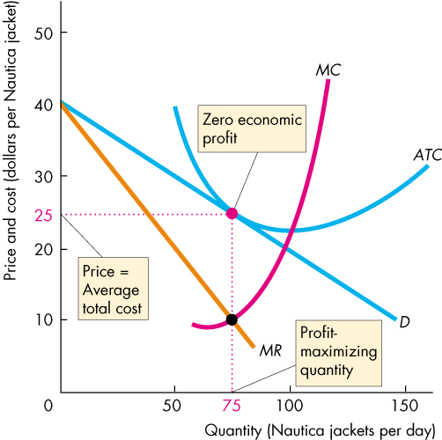
Long Run – Entry and Exit
A firm in monopolistic competition in long-run equilibrium.

Slide 12
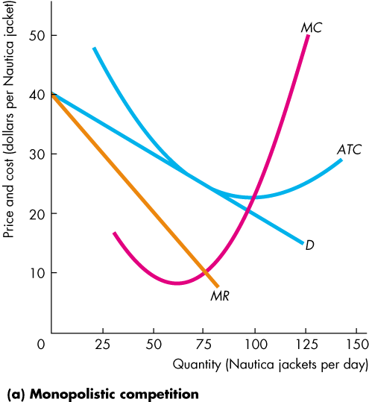
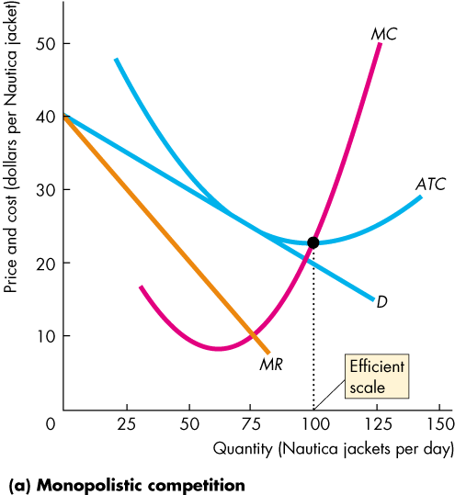
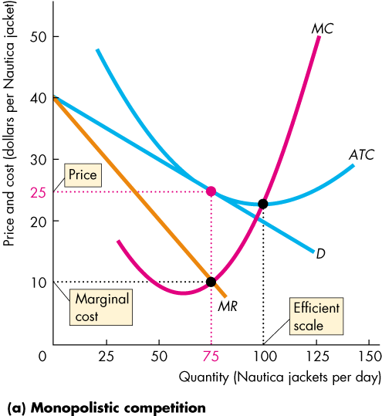
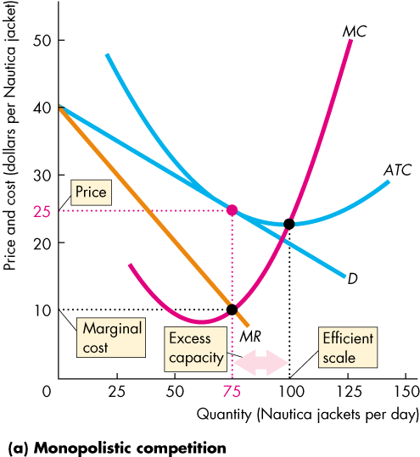
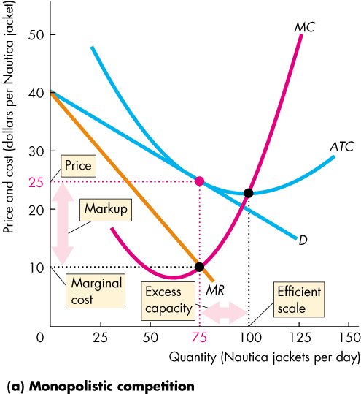
Long run – Monopolistic and Perfect Competition Compared
In the long run, firms in monopolistic competition operate with
Excess capacity - it produces less than the quantity at which ATC is a minimum.
Markup – the amount by which price exceeds MC.
The downward-sloping demand curve for their products drives this result.

Slide 13
How Marketing Differentiates Products
Marketing refers to all the activities necessary for a firm to sell a product to a consumer.
It includes activities such as determining which product to produce, designing the product, advertising the product, deciding how to distribute the product, and monitoring how changes in consumer tastes are affecting the market for the product.

Slide 14
Brand Management
Brand Management are the actions of a firm intended to maintain the differentiation of a product over time.
Brand management includes all the of design, placement, marketing, advertising, and distribution that foster a identifying and developing brand personality.
Defending a successful brand name. Example: trademark, which grants legal protection against other firms using its product’s name.
Threat to trademarks: generic names, thermos, aspirin,

Slide 15
Advertising
Advertising will increase the demand and the sales, it will increase the fix costs as well.
If the increase in revenue that results from the advertising is greater than the increase in costs, the firm’s profits will rise.
It the sales increase enough, firms’ average cost may decline.

Slide 16
What makes a firm successful?
The factors are key to success include:
Factors that firms can control: the ability to differentiate its product and the ability to produce at a lower cost;
Factors that are not directly under firm’s control:
Factors affecting the firm’s market.
Value created relative to competitors.
Chance events.

