Slide 1
monopoly
Chapter 13

Slide 2
eBay, Google, and Microsoft are dominant players in the markets they serve, and how do they behave?
Do they charge prices that are too high and that damage the interest of consumers?
Why does Toronto or Vancouver have only one NHL team?

Slide 3
In this chapter you will learn
How monopoly arises?
How does a monopoly choose price and output?
A comparison between monopoly and perfect competition?
What is price discrimination and how it increases profits;
Government regulations on monopoly;

Slide 4
Monopoly and How It Arises
Monopoly is a market with a single firm that supplies the whole market and is protected by entry barriers.
Monopoly arises from barriers to entry such as:
Legal barriers such as patents, copyrights, public franchises;
Control of a key resource (example: Aluminum Company of America; International Nickel Company of Canada; De Beers; Professional sports team control over a large stadium);
Natural monopoly: A natural monopoly is a market in which economies of scale enable one firm to supply the entire market at the lowest possible cost.

Slide 5
Monopoly and How It Arises

Slide 6
Monopoly’s price and output decisions
Monopoly Price-Setting Strategies
There are two types of monopoly price-setting strategies:
A single-price monopoly is a firm that must sell each unit of its output for the same price to all its customers.
Price discrimination is the practice of selling different units of a good or service for different prices. Many firms price discriminate, but not all of them are monopoly firms.

Slide 7
A Single-price Monopoly’s Output and Price Decision
Monopoly’s demand curve is industry demand curve, and it is downward sloping.
Marginal revenue (MR) < Price (P).

Slide 8
Demand and Marginal Revenue for A Monopoly Firm

Slide 9
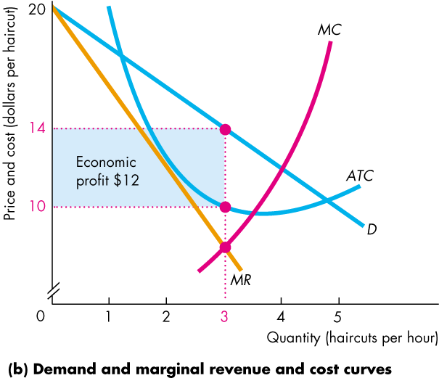
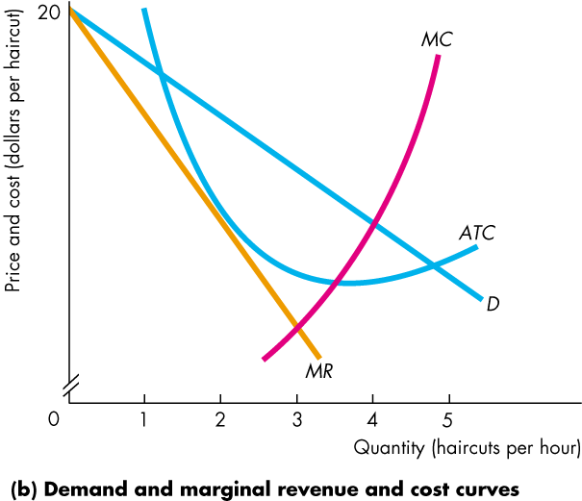
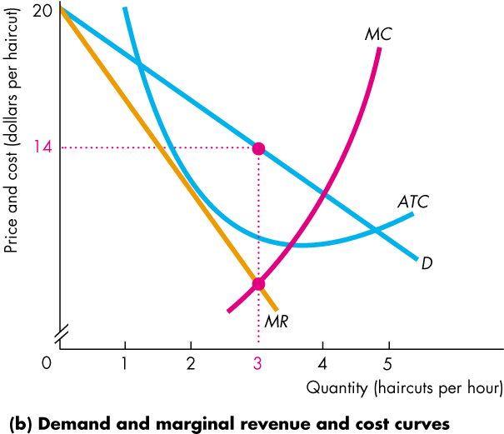
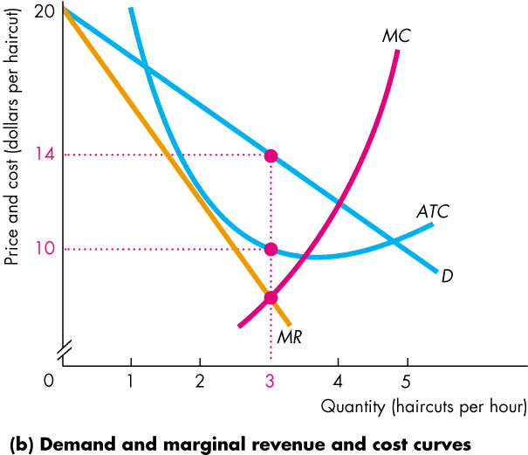
How Does a Single-price Monopoly Choose Price and Output?
Profit maximizing monopoly chooses output at which MR = MC, charges maximum price consumers willing to pay (on demand curve).
Copyright © 2013 Pearson Canada Inc., Toronto, Ontario
Notes:
The classic monopoly diagram
The classic monopoly diagram, Figure 13.4(b) provides a good opportunity to tell your students about the contribution of one of the most brilliant economists of the 20th century, Joan Robinson. This diagram first appeared in her book, The Economics of Imperfect Competition, published in 1933 when she was just 30 years old.
You can learn more about Joan Robinson at http://cepa.newschool.edu/het/profiles/robinson.htm (or use the link on the Economics Place Web site).
Women are still not attracted to economics on the scale that they’re attracted to most other disciplines, so the opportunity to talk about an outstanding female economist shouldn’t be lost. Joan Robinson was a formidable debater and reveled in verbal battles, a notable one of which was with Paul Samuelson on one of her visits to MIT. Anxious to make and illustrate a point, Samuelson asked Robinson for the chalk. Monopolizing the chalk and the blackboard, the unyielding Robinson snapped, “Say it in words young man.” Samuelson meekly obeyed. This story illustrates Joan Robinson’s approach to economics: work out the answers to economic problems using the appropriate techniques of math and logic, but then “say it in words.” Don’t be satisfied with formal argument if you don’t understand it. Your students will benefit from this story if you can work it into your class time.

Slide 10
Monopoly in the long run
The monopoly might make an economic profit, even in the long run, because the barriers to entry protect the firm from market entry by competitor firms.
But a monopoly that incurs an economic loss might shut down temporarily in the short run or exit the market in the long run.
Copyright © 2013 Pearson Canada Inc., Toronto, Ontario

Slide 11
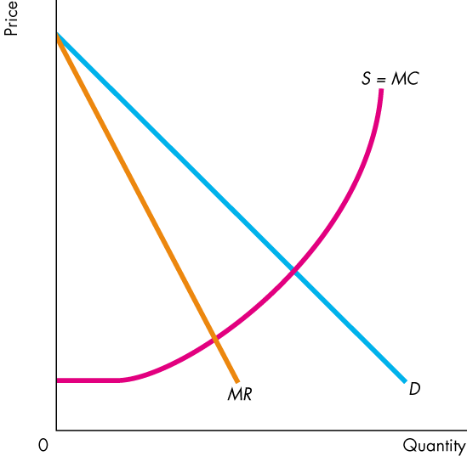
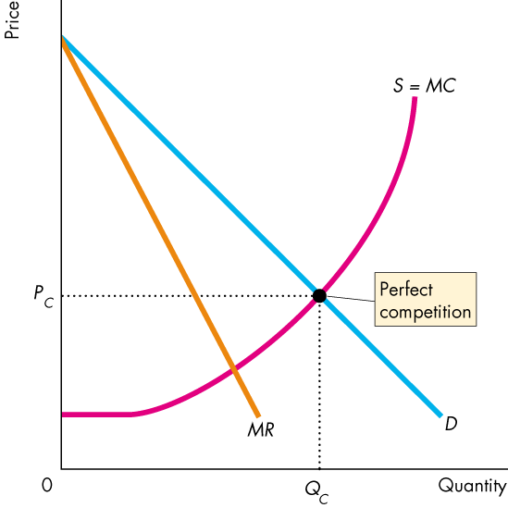
Monopoly and Competition Compared
Perfect Competition
Equilibrium occurs where the quantity demanded equals the quantity supplied at quantity Q_{C} and price P_{C}.
Copyright © 2013 Pearson Canada Inc., Toronto, Ontario

Slide 12
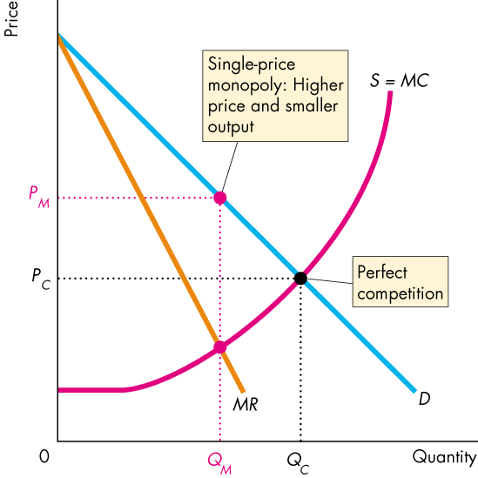
Monopoly and Competition Compared
Monopoly
Equilibrium output, Q_{M}, occurs where marginal revenue equals marginal cost, MR = MC.
Equilibrium price, P_{M}, occurs on the demand curve at the profit-maximizing quantity.
Copyright © 2013 Pearson Canada Inc., Toronto, Ontario

Slide 13
Monopoly and Competition Compared
Compared to perfect competition, monopoly produces a smaller output and charges a higher price.
Copyright © 2013 Pearson Canada Inc., Toronto, Ontario

Slide 14
Monopoly and Competition Compared
Efficiency Comparison
Monopoly captures some consumer surplus, but creates dead weight loss – inefficiency.
Copyright © 2013 Pearson Canada Inc., Toronto, Ontario

Slide 15
Discussion Questions
Canada Post has a monopoly on residential mail delivery. Pfizer Inc. makes LIPITOR, a prescription drug that lowers cholesterol. Rogers Communications is the sole provider of cable television service in some parts of Ontario.
What are the substitutes, if any, for the goods and services described above?
What are the barriers to entry, if any, that protect these three firms from competition?
Which of these three firms, if any, is a legal monopoly? Explain your answer.

Slide 16
Calculate Minnie Mineral Springs’ profit maximizing output and price.
Market demand schedule
P (dollars per bottle | Quantity demanded(bottles per hour)
10 | 0
8 | 1
6 | 2
4 | 3
2 | 4
0 | 5
Cost schedule
Quantity Produced (bottles per hour) | Total cost (dollars)
0 | 1
1 | 3
2 | 7
3 | 13
4 | 21
5 | 31

Slide 17
PRICE DISCRIMINATION
A producer practices price discrimination by charging different prices for the same products that have the same costs. Firms discriminate:
Among groups of buyers;
Among units of a good;

Slide 18
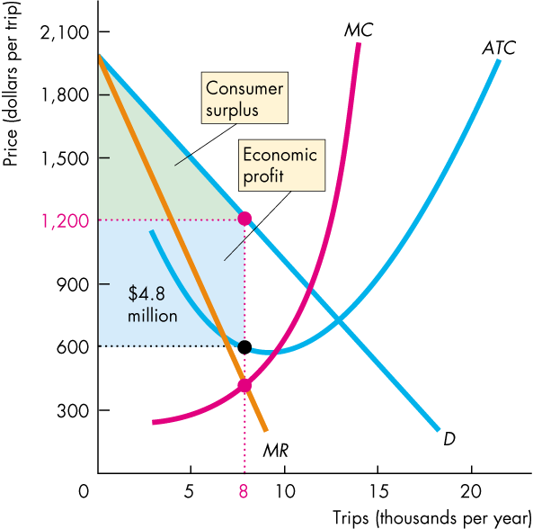
How Price Discrimination Increase Economic Profits
A single-price monopoly: producing 8 thousand trips a year and selling them for $1,200 each.

Slide 19
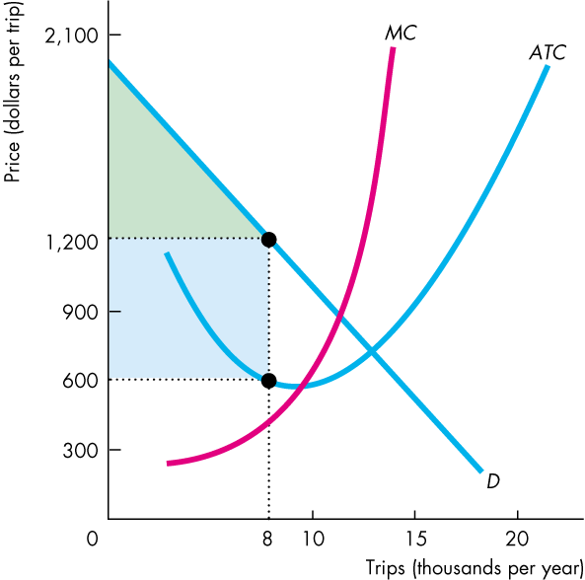
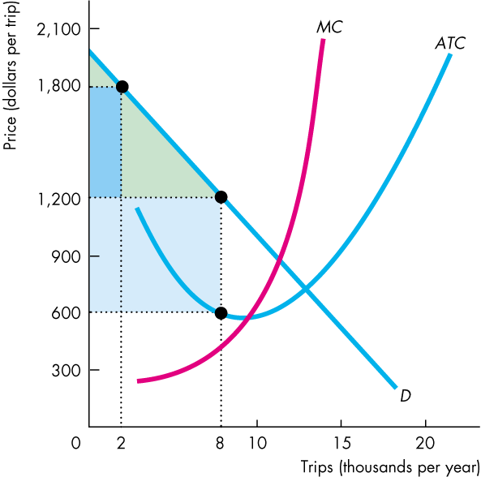
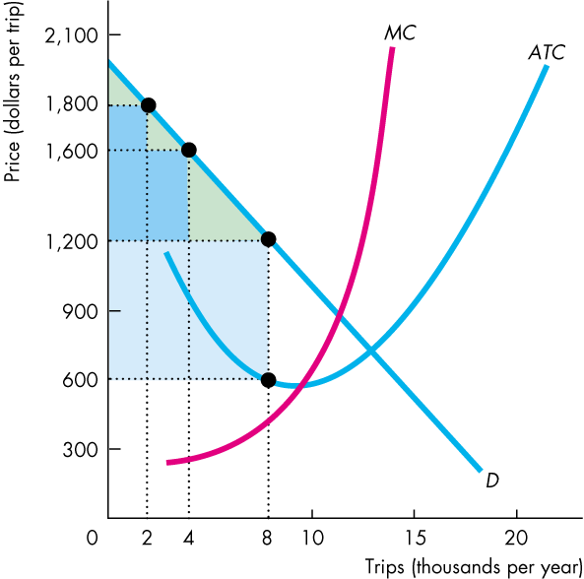
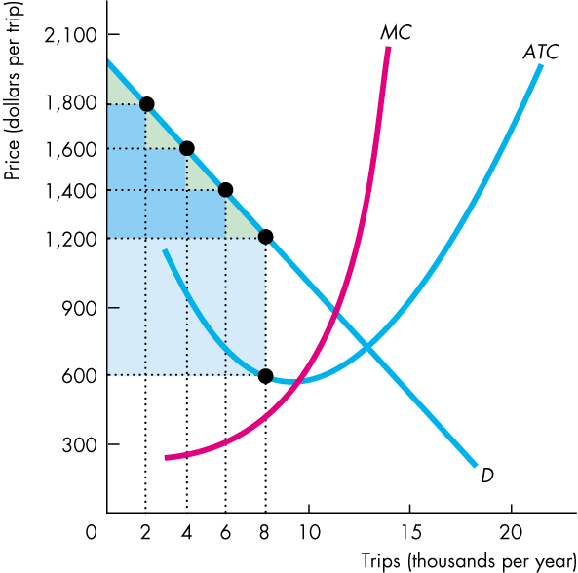
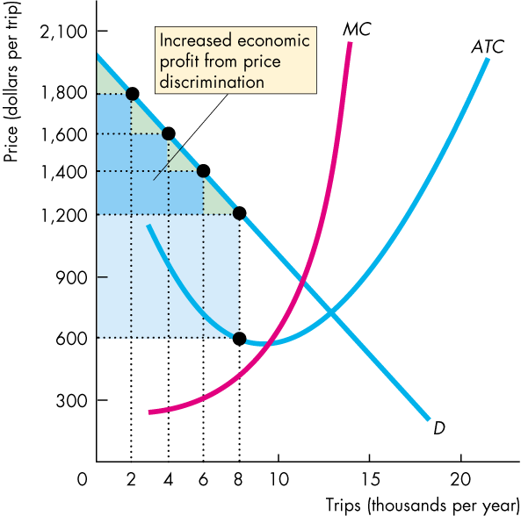
How Price Discrimination Increase Economic Profits
Price discriminating firm:
Increase profit by converting consumer surplus into economic profit.
incentive to produce more than 8, if it can further price discriminate.

Slide 20
How Price Discrimination Increases Efficiency
Price discrimination will increase outputs.
Example: low airfare for last minute travelers; Introductory pricing for new customers from internet (cable, phone) providers.
Increased output will increase overall efficiency by reducing dead weight loss.
Extreme case: perfect price discrimination, same output as perfect competition firms and achieve efficiency.

Slide 21
Conditions of price discrimination
Price discrimination becomes possible, when:
Firms have market power, and their products don’t have close substitutes;
Customers have different willingness to pay;
Resale of the product can be prevented;

Slide 22
Discussion Question
Work as a group, give two or more examples of price discrimination. Draw a diagram to demonstrate how your price discrimination practices may impact firms’ economic profits?

Slide 23
Monopoly Regulation
Reasons: price setting power as sole provider of products with no close substitutes.
Law enforcements to
Prevent collusion.
Guidelines for mergers.
Efficient Regulation of A Natural Monopoly
Marginal cost pricing rule is a regulation that sets the price equal to the monopoly’s marginal cost.

Slide 24
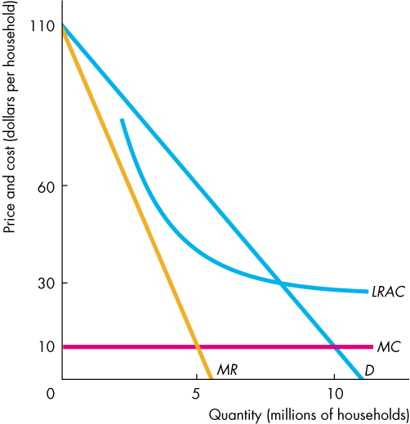
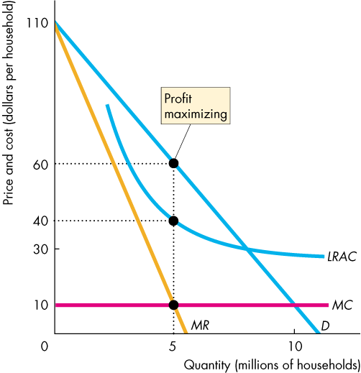
Monopoly Regulation
Unregulated: P=60, Q=5M.
efficient regulation sets the price equal to marginal cost, and produces efficient output.
Problem: the firm incurs an economic loss.

Slide 25
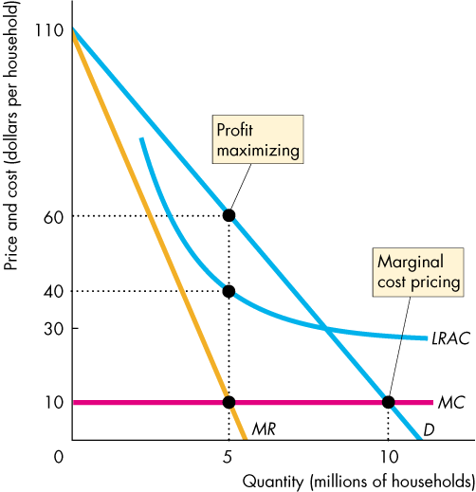
Monopoly Regulation
Solution 1:
May be permitted to price discriminate to cover the loss from marginal cost pricing.
May charge a one-time fee to cover its fixed costs and then charge a price equal to marginal cost.
Copyright © 2013 Pearson Canada Inc., Toronto, Ontario

Slide 26
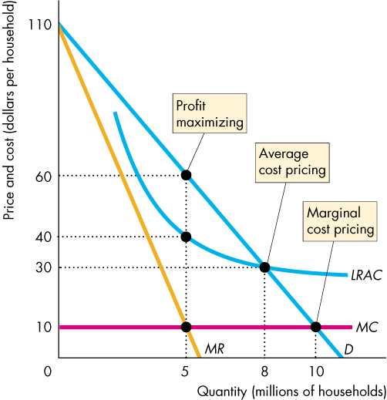
Monopoly Regulation
Solution 2:
average cost pricing: set price = $30, where D curve intersects LRAC.
Copyright © 2013 Pearson Canada Inc., Toronto, Ontario

