Slide 1
Output and Costs
Chapter 11

Slide 2
In this chapter you will learn
The difference between short run and long run.
The relationships between total product, average product, and marginal product, and the law of diminishing marginal returns.
The difference between fixed and variable costs, and the relationships between total costs, average costs, and marginal costs.
about the relationship between short-run and long-run cost curves.

Slide 3
Time Horizons for Decision Making
The short run is a length of time over which some of the firm’s factors of production are fixed
- typically plant is fixed in the short run
The long run is the length of time over which all of the firm’s factors of production can be varied.

Slide 4
Try it out
Which of the following news items involves a short-run decision and which involves a long-run decision? Explain.
January 31, 2008: Starbucks will open 75 more stores abroad than originally predicted, for a total of 975.
June 2, 2008: Starbucks replaces baristas with vending machines.
July 19, 2008: Starbucks is closing 616 stores by the end of March.

Slide 5
7.3 PRODUCTION IN THE SHORT RUN
Total, Average, and Marginal Products
Total product (TP) is the total amount of output that is produced during a given period of time.
Average product (AP) is the total product divided by the number of units of the variable factor used to produce it (usually thought of as labor):
AP = TP / L
The marginal product (MP) of labour is given by:
Δ
TP
MP =
Δ
L

Slide 6
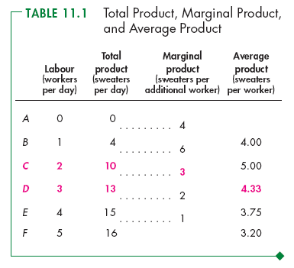
Short-Run Technology Constraint
Table 11.1 shows a firm’s product schedules.
As the quantity of labor employed increases:
Total product increases.
Marginal product increases initially but eventually decreases.
Average product increases initially but eventually decreases.

Slide 7
TP
Total product
Quantity of Labour
Point of diminishing marginal returns
MP is the slope of the TP curve.
Average and Marginal Product
AP
Point of diminishing average returns
MP
Quantity of Labour

Slide 8
Diminishing Marginal Product
The law of diminishing returns:
As more workers are added to a production process, each can specialize on one task, and the workers’ marginal product initially rises.
But if there is a fixed amount of physical capital, eventually the marginal product will fall.

Slide 9
The Average–Marginal Relationship
==> the AP curve slopes upward as long as the MP curve is above it (and AP slopes downward when MP is below it).
It follows that the MP curve must intersect the AP curve at its maximum point.`

Slide 10
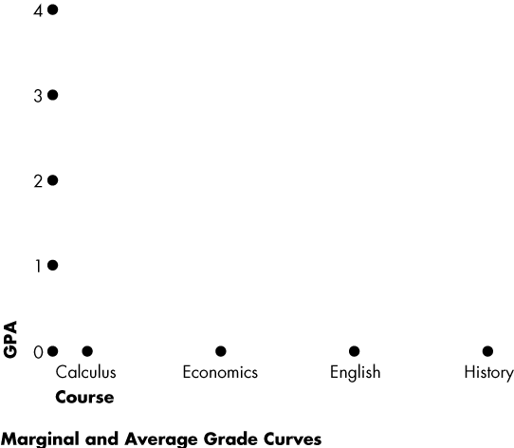
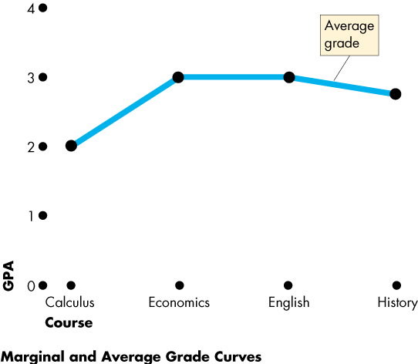
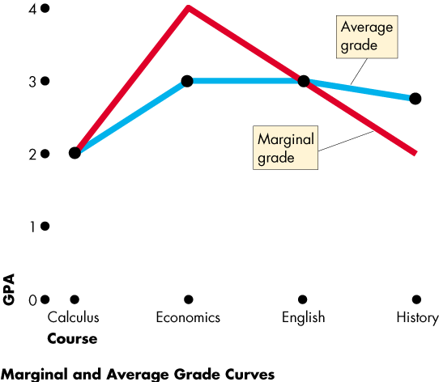

Slide 11
COSTS IN THE SHORT RUN
Defining Short-Run Costs
Total Cost Total Fixed Cost Total Variable Cost
TC = TFC + TVC
Average Total Cost Average Fixed Cost Average Variable Cost
ATC = AFC + AVC

Slide 12
Marginal cost (MC) is the increase in total cost resulting from increasing the output by one unit.
ΔTC
MC =
ΔQ
Because fixed costs do not vary with output, the only part of TC that changes is the variable cost.

Slide 13
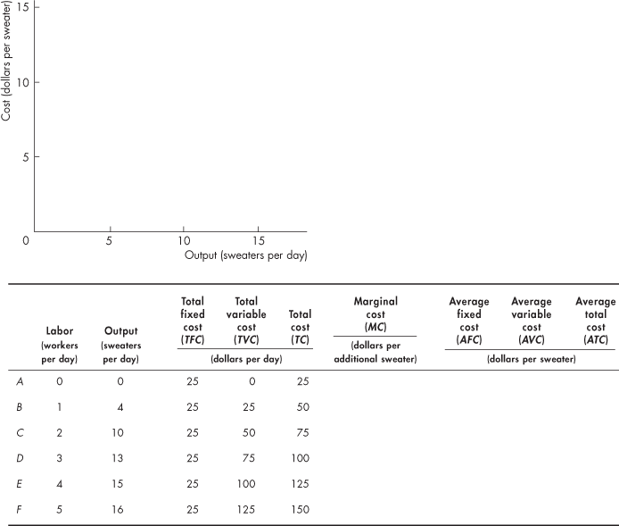
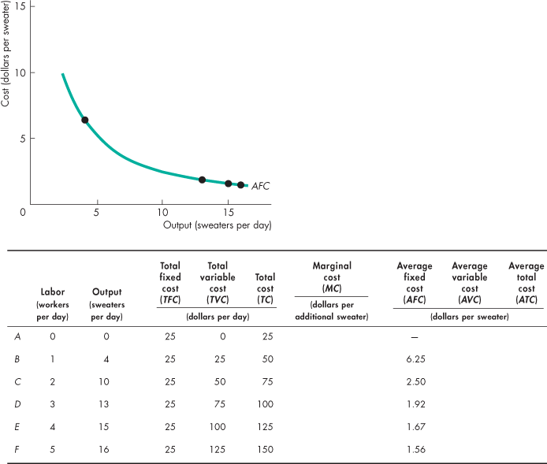
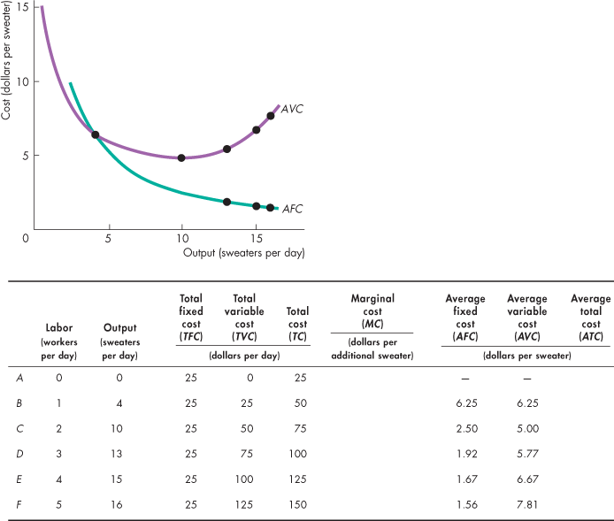
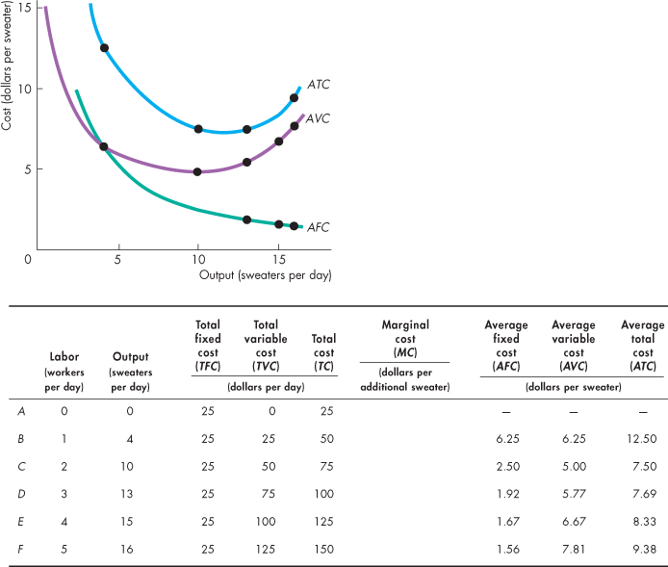
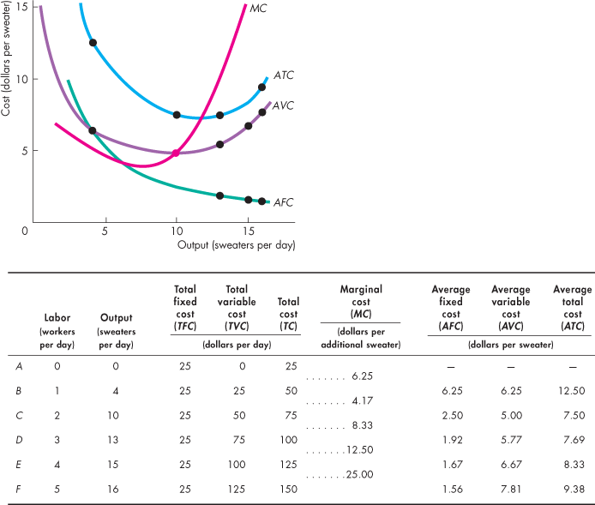
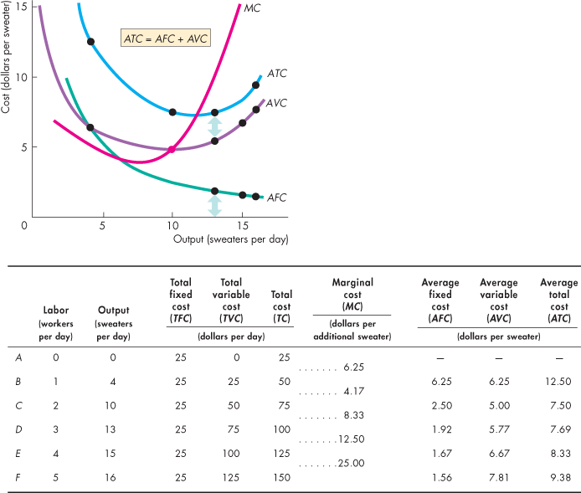

Slide 14
Short-Run Cost Curves
ATC = AVC + AFC (a vertical summation)
AFC declines steadily as output rises.
TC
MC
Cost
Cost
TVC
ATC
AVC
TFC
AFC
Output
Output

Slide 15
The shape of the ATC curve?
- falling AFC tends to push down ATC
- rising MC (and thus AVC) tends to push up ATC
- at some point the second effect overcomes the first effect and ATC begins to rise
MC
Cost
ATC
AVC
AFC
Output

Slide 16
Why U-Shaped MC and AVC Curves?
Key idea: Each additional worker adds the same amount to total cost but a different amount to total output.
Eventually diminishing MP of the variable factor implies eventually rising MC.
==> MC reaches its minimum when MP reaches its maximum.
Eventually diminishing AP of the variable factor implies eventually rising AVC.
==> AVC is at its minimum when AP reaches its maximum.

Slide 17
Try it out
Use the concepts of marginal and average to answer the following questions. Suppose the worst student at Hubertville High School transfers to Histrionic High School. Is it possible that the average grade of the students at each school rises? Explain.

Slide 18
Shifts in Short-Run Cost Curves
A change in technology and/or the price of factors of production will shift the ATC and MC curves — upward for a price increase and downward for a price decrease.
ATC,MC
MC₁
MC₀
ATC₁
ATC₀
Output

Slide 19
Capacity
The level of output that corresponds to the minimum short-run ATC is the capacity of the firm.
Capacity is the largest output that can be produced without encountering rising average cost per unit.
A firm that is producing at an output less than the point of minimum ATC is said to have excess capacity.

Slide 20
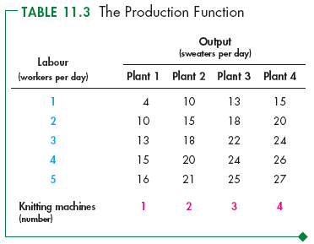
Long-Run Cost
In the long run, all inputs are variable.
As the size of the plant increases, the output that a given quantity of labor can produce increases.
But as the quantity of labor increases, diminishing returns occur for each plant.

Slide 21
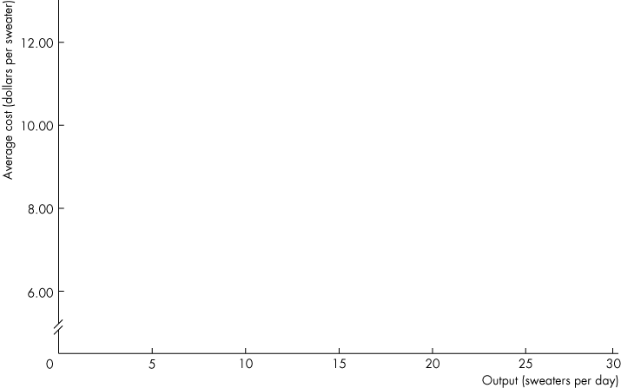
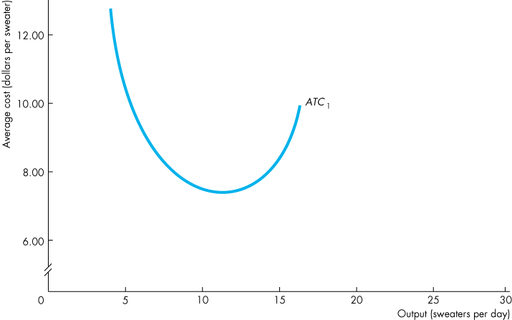
Long-Run Cost
ATC₁ is the ATC curve for a plant with 1 knitting machine.

Slide 22
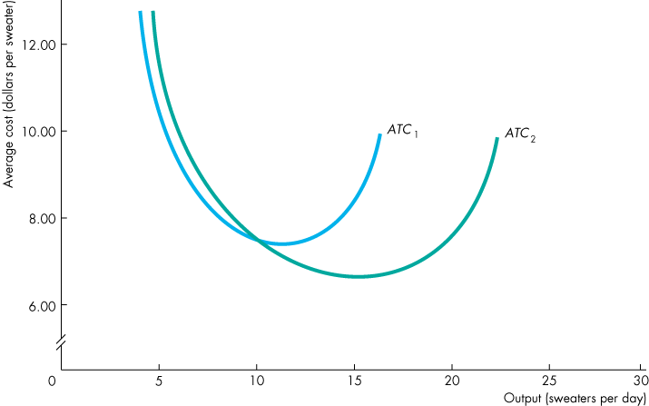
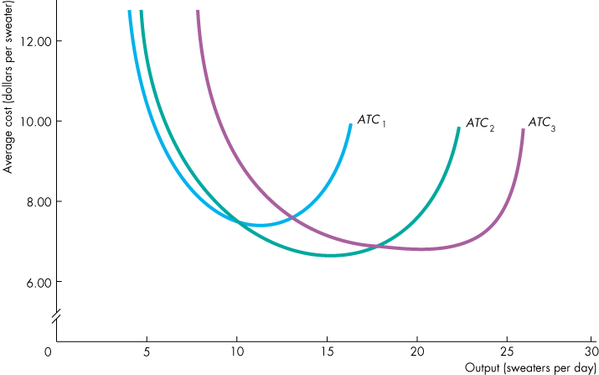
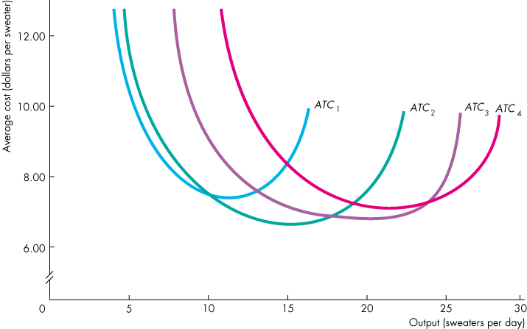
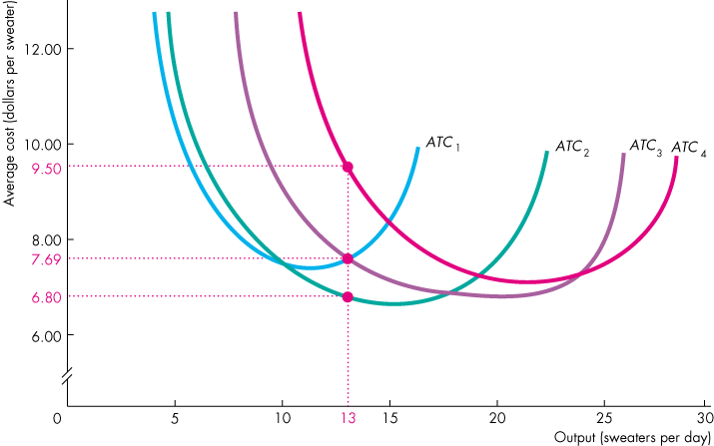

Slide 23
Long-Run Cost
ATC₂ is the ATC curve for a plant with 2 knitting machines.

Slide 24
Long-Run Cost
ATC₃ is the ATC curve for a plant with 3 knitting machines.

Slide 25
Long-Run Cost
ATC₄ is the ATC curve for a plant with 4 knitting machines.

Slide 26
Long-Run Cost
The long-run average cost curve is made up from the lowest ATC for each output level. It helps to decide which plant has the lowest cost for producing a given output level.
Suppose that the firm wants to produce 13 sweaters a day.

Slide 27
Long-Run Cost
13 sweaters a day cost $7.69 each on ATC₁.

Slide 28
Long-Run Cost
13 sweaters a day cost $6.80 each on ATC₂.

Slide 29
Long-Run Cost
13 sweaters a day cost $7.69 each on ATC₃.

Slide 30
Long-Run Cost
13 sweaters a day cost $9.50 each on ATC₄.

Slide 31
Long-Run Cost
The least-cost way of producing 13 sweaters a day is to use 2 knitting machines.

Slide 32
Long-Run Cost
Long-Run Average Cost Curve
The long-run average cost curve is the relationship between the lowest attainable average total cost and output when both the plant and labor are varied.
The long-run average cost curve is a planning curve that tells the firm the plant that minimizes the cost of producing a given output range.
Once the firm has chosen its plant, the firm incurs the costs that correspond to the ATC curve for that plant.

Slide 33
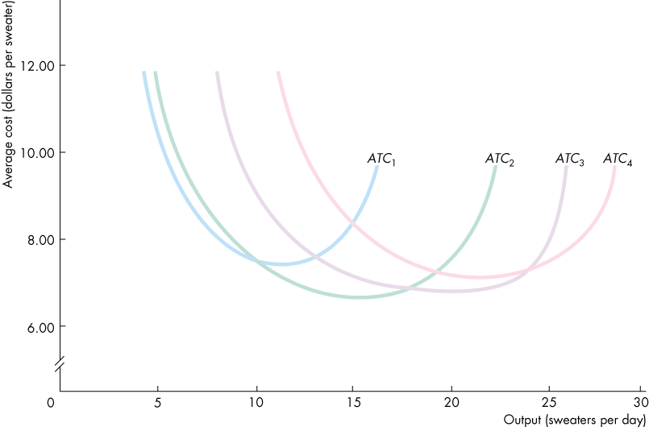
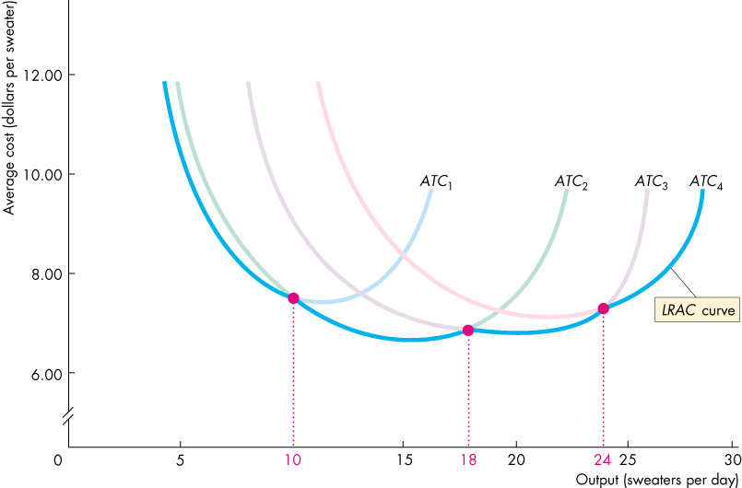
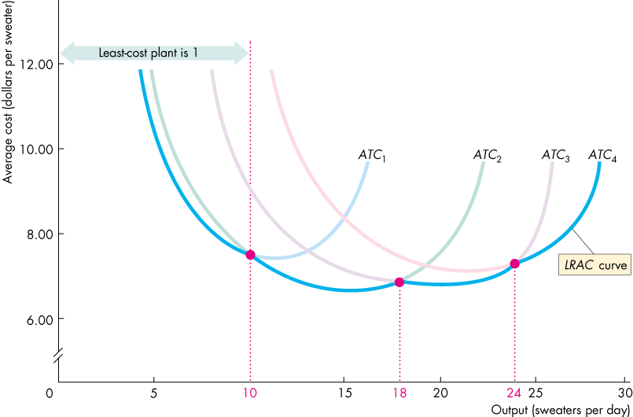
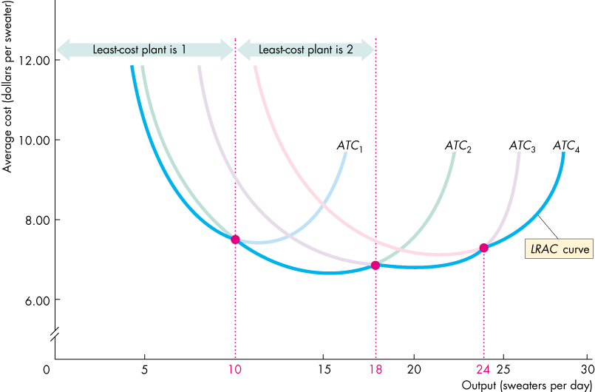
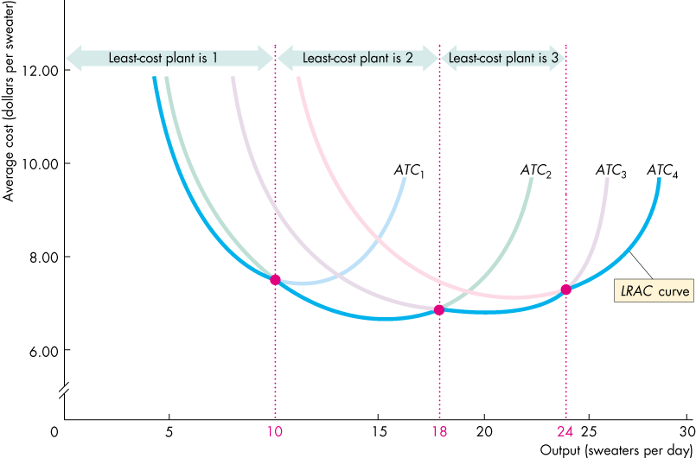
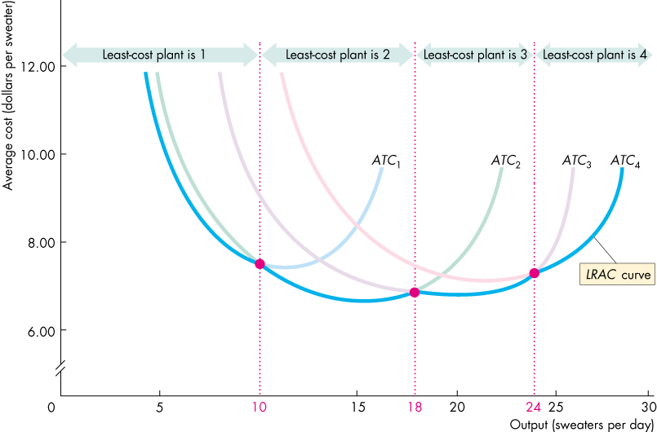
Long-Run Cost
Figure 11.8 illustrates the long-run average cost (LRAC) curve.

Slide 34
Cost per unit
c₀
Attainable levels of cost
LRAC
c₁
c_{M}
Unattainable levels of cost
0
q₀
q₁
q_{M}
Output per period
Falling LRAC ==> increasing returns to scale (economy of scale)
Constant LRAC ==> constant returns to scale
Rising LRAC ==> decreasing returns to scale (diseconomy of scale)

Slide 35
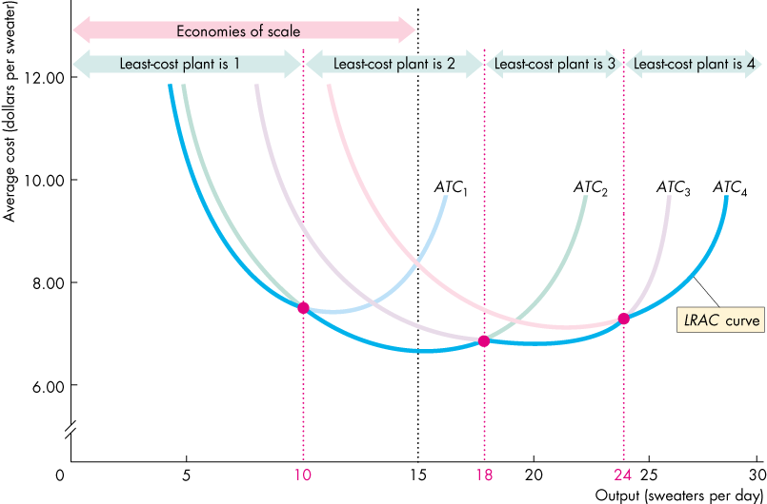
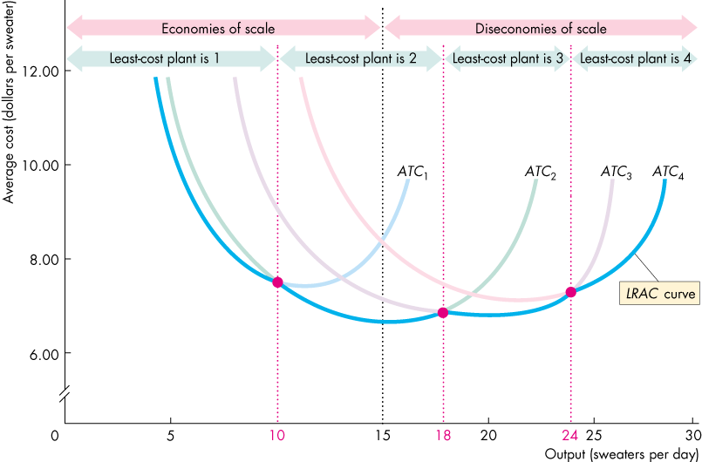
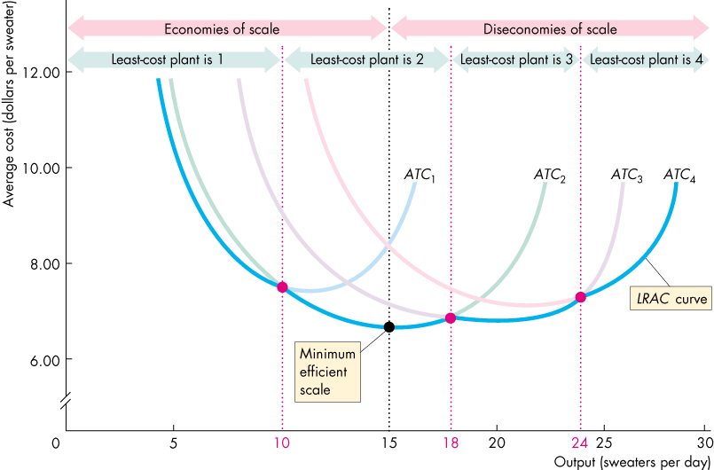
Long-Run Cost
Figure 11.8 illustrates economies and diseconomies of scale.

Slide 36
Minimum Efficient Scale
Minimum efficient scale is the smallest quantity of output at which the long-run average cost reaches its lowest level.
Minimum efficient scale plays a role in determining market structure. Small MES => the market has room for many firms => competitive; Large MES => room for small numbers of firms or one firm => oligopoly or monopoly.

Slide 37
exercise
Bill’s Bakery has a fire and Bill loses some of his cost data. The bits of paper that he recovers after the fire provide the information in the following table (all the cost numbers are in dollars)
Bill asks you to come to his recue and provide the missing data in the five spaces identified as A to E.
TP | AFC | AVC | ATC | MC
10 | 120 | 100 | 220
20 | A | B | 150 | 80
30 | 40 | 90 | 130 | 90
40 | 30 | C | D | 130
50 | 24 | 108 | 132 | E

