Slide 1
Arts One Prayer Song
Please give us a hand this day
We want to go on
Hear us, we’re calling you
Guide us along the way
Please give us a helping hand
We want to progress
Hear us, we’re calling you
Guide us along the way

Slide 2
Arts One * First Nations
Placing Ourselves
Exploring Aboriginal Identities
in First Peoples’ Landscapes

Slide 3
Lesson Objectives
To locate ourselves in relation to the local Indigenous cultural, social, and physical landscapes
To explore selected aspects of some local First Nations worldviews
To survey some origin stories of local First Nations Peoples

Slide 4
For as long as anyone can remember, humanity has been asking itself, “where did we come from?” And, “how did we get here?”
Amerindian peoples are no exception. Long before contact with Europeans, the Americas were populated with a dizzying multitude of cultures, societies and nations, each with their own distinct theories as to their origins. ..

Slide 5
Myth, Narrative, and Folklore
Myth:
1. information or beliefs which are incorrect, misinformed and outdated, but which are still commonly believed by many people to be true (i.e. "all Aboriginal peoples receive a free post-secondary education).
2. "the sacred truth of a people“ (Brizinski, 1996): stories people tell in order to make sense of life, the universe, and everything, and how we fit into it all This second definition will be the sense in which we will discuss “Myth” (with a big ‘M’) when referring to the folklore of Indigenous peoples
Folklore: the set of related Myths that are meant specifically to represent collective and cultural meanings of a particular group of people. Folklore includes (but is not limited to) traditional stories or legends that are set in mythic time, and involve stock characters and themes.

Slide 6
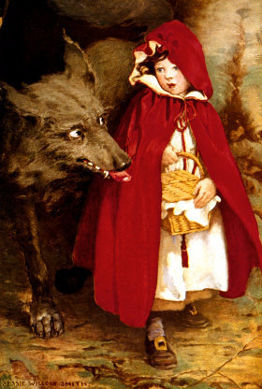
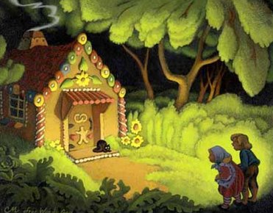
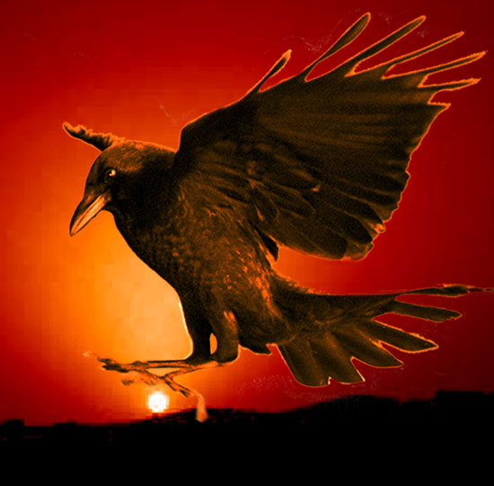
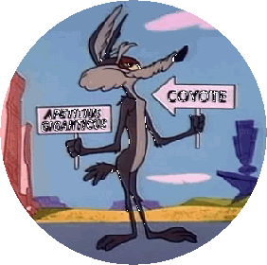
Characteristics of MYTH and FOLKLORE
1. set in mythic time (the before-time: when we all lived in the wilderness and no-one lived anywhere else/ a long time ago, in a galaxy far, far away).
2. Mythic characters: in Aboriginal folklore, these often include a culture hero and/or a trickster

Slide 7
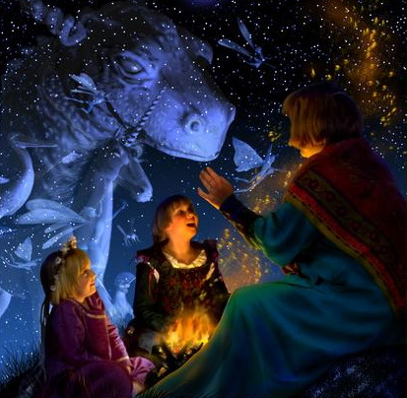
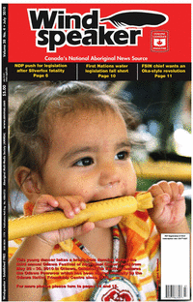
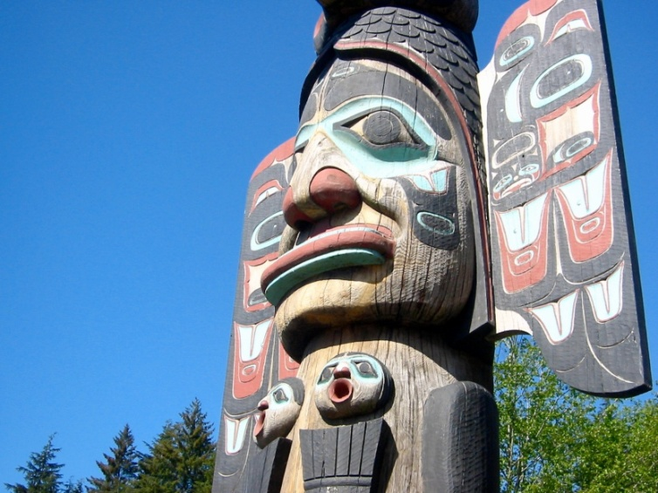
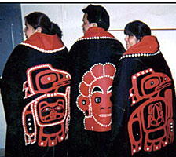
NARRATIVE: Polkinghorne (1988):
cultural schemas and frameworks by which human existence is rendered meaningful. A narrative is an account or story about anything: current and past events, individual experiences and knowledge, as well as that of the collective. Can be secular or mythic, fiction or non-fiction

