Slide 1
Estimation and Confidence Intervals
Chapter 8

Slide 2
Goals
Explain what is point estimate and interval estimate (confidence interval);
Construct confidence interval for mean, and for proportion;
Applying finite-population correction factor;
Choose an appropriate sample size;

Slide 3
Point Estimate and Interval Estimate
A point estimate is a statistic computed from a sample and is used to estimate a population parameter.
Example: the sample mean, , is a point estimate of the population mean, μ;
Notes:
TV hrs, elevator, cell phone

Slide 4
Point and Interval Estimates
An interval estimate (confidence interval) is a range of values within which the analyst can declare, with some confidence, that the population parameter lies.
Examples: watching TV between 4 to 6hrs per day; using cell phones between 100 to 150 minutes per month.

Slide 5
Construct confidence interval-with known Population Standard Deviation (σ)
The confidence interval for the population mean is constructed using the following equation

Slide 6
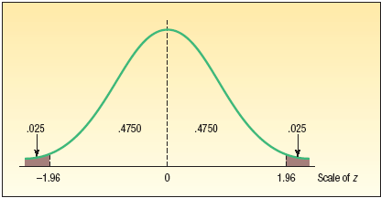
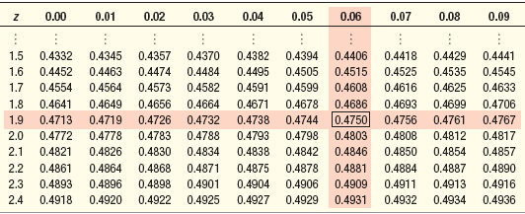
Finding z-value for 95% Confidence Interval
The area between
Z = -1.96 and z= +1.96
is 0.95

Slide 7
Confidence Levels and z values
Confidence level | Z value
99% | 2.58
95% | 1.96
90% | 1.645

Slide 8
Factors Affecting Confidence Intervals
The factors that determine the width of a confidence interval are:
    The sample size, n: higher n leads to smaller interval.
    The variability in the population σ, lower σ leads to smaller interval.
    The desired level of confidence, lower confidence leads to smaller interval.

Slide 9
EXAMPLE – Population Standard Deviation (σ) Known
A survey was taken of companies that do business with firms in India. One of the questions on the survey was, “How many years has your company been trading with firms in India?” A random sample of 44 responses yielded a mean of 10.455 years. Suppose the population standard deviation for this question is 7.7 years.
What is the population mean? What is a reasonable value to use as an estimate of the population mean?
What is a reasonable range of values for the population mean?
construct a 90% confidence interval for the mean number of years

Slide 10
You Try It Out!
The mean daily sales are $2000 for a sample of 40 days at a fast-food restaurant. The standard deviation of the population is $300.
What is the estimated mean daily sales of the population? What is this estimate called?
What is the 99 percent confidence interval?

Slide 11
Population Standard Deviation (σ) Unknown
As long as the population is normally distributed, we can use the sample standard deviation s as an estimate of σ, and use t distribution to replace z distribution, when computing confidence interval.

Slide 12
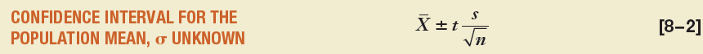
Confidence Interval for Population Standard Deviation (σ) Unknown
Notes:
If not sure the population is normally distributed, can calculate the skewness of the sample, if close to -3 or 3, significantly skewed.

Slide 13
Characteristics of the t distribution
It is a continuous distribution.
It is bell-shaped and symmetrical.
It is more spread out and flatter at the centre than the standard normal distribution. As the sample size increases, however, the t distribution approaches the standard normal distribution, because the errors in using s to estimate σ decrease with larger samples.

Slide 14
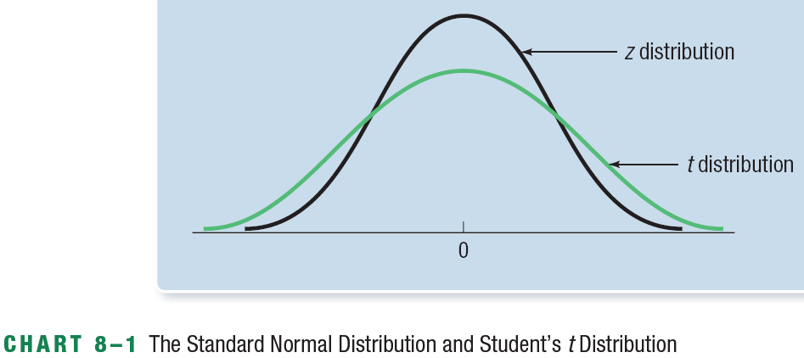
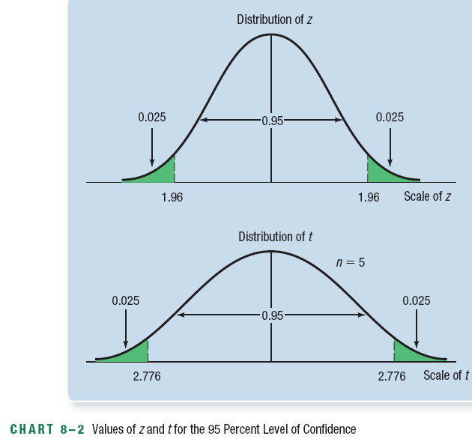
Comparing the z distribution and the t distribution

Slide 15
Summary
When to use z distribution and when to use t distribution?
When population is normally distributed and population standard deviation is unknown, t distribution should be used.
When population standard deviation is known, then z distribution may be used.

Slide 16
EXAMPLE – t distribution
A tire manufacturer wishes to investigate the tread life of its tires (normally distributed). A sample of 10 tires driven 80 000 km revealed a sample mean of 0.81 cm of tread remaining with a standard deviation of 0.23 cm. Construct a 95 percent confidence interval for the population mean. Would it be reasonable for the manufacturer to conclude that after 80 000 km the population mean amount of tread remaining is 0.76 cm?

Slide 17
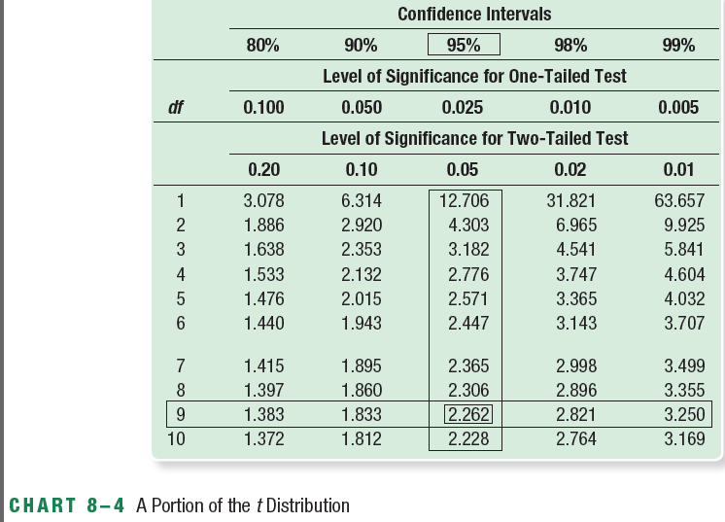
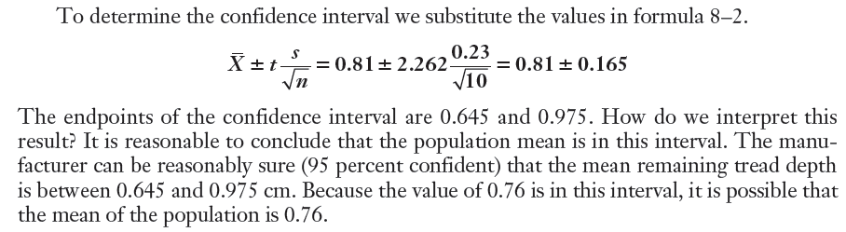
EXAMPLE – t distribution
Notes:
Df = number of observations in the sample – the number of samples: n-1

Slide 18
You Try It Out!
The owner of Britten’s Egg Farm wants to estimate the mean number of eggs laid per chicken. A sample of 20 chickens shows they laid an average of 20 eggs per month with a standard deviation of 2 eggs per month. Assume that the population (number of eggs) is normally distributed, develop the 95 percent confidence interval? Would it be reasonable to conclude that the population mean is 21 eggs? What about 25 eggs?

Slide 19
Confidence Interval for a Proportion
In many instances, we might be interested only in the proportion, p, examples:
  The market share;
  The percent of customers who will return;
  The ratio of defective products;
  Central limit theorem: if np and n(1-p) are greater than 5, then the sample proportion is normally distributed with mean of P and standard deviation

Slide 20
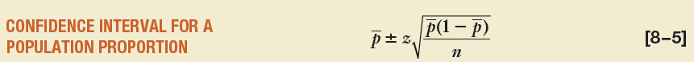
Confidence Interval for a Proportion

Slide 21
EXAMPLE – Confidence Interval for a Proportion
A study of 87 randomly selected companies with a telemarketing operation revealed that 39% of the sampled companies used telemarketing to assist them in order processing. Construct a 95% confidence interval for the population proportion.
0.39 is the point estimate of the population proportion.

Slide 22
You Try It Out!
A market survey was conducted to estimate the proportion of homemakers who would recognize the brand name of a cleanser based on the shape and the color of the container. Of the 1400 homemakers sampled, 420 were able to identify the brand by name.
Estimate the value of the population proportion.
Develop a 99 percent confidence interval for the population proportion.

Slide 23
Finite Population Correction Factor
When n/N < 0.05, the correction factor (approaches 1) is ignored ; Otherwise, it is

Slide 24
EXAMPLE – Finite Population Correction Factor
There are 250 families in a small Alberta town. A poll of 20 families reveals the mean annual church contribution is $450 with a standard deviation of $75.3 (assume the population is normally distributed).
Develop a 90 percent confidence interval for the population mean.
Interpret the confidence interval.
Given in Problem:
N – 250
n – 20
s - $75
Since n/N = 20/250 = 0.08, the finite population correction factor must be used.
The population is normally distributed and population standard deviation is not known therefore use the t-distribution.
t=1.685,

Slide 25
EXAMPLE – Finite Population Correction Factor

Slide 26
You Try It Out!
The attendance at the Foresters Falls baseball game last night was 400. A random sample 50 of those in attendance revealed that the mean number of soft drinks consumed per person was 1.86 with a standard deviation of 0.50. Develop a 99 percent confidence interval for the mean number of soft drinks consumed per person.

Slide 27
Choosing An Appropriate Sample Size
In general, as sample size increases, the sample estimates are more accurate at a higher cost. What sample size to use?
There are 3 factors that determine the size of a sample
  The degree of confidence selected
  The maximum allowable margin error
  The population standard deviation

Slide 28
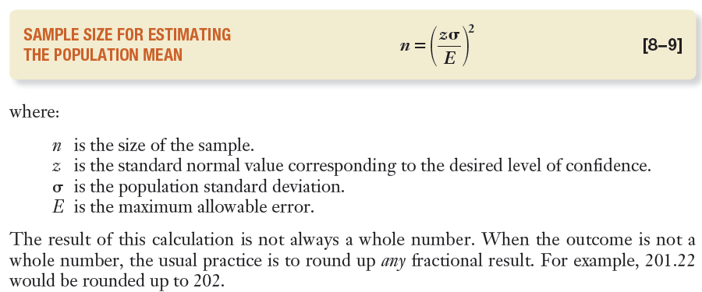
Sample Size for a Population Mean

Slide 29
EXAMPLE – Sample Size for a Population Mean
A student in business administration wants to determine the mean amount members of city councils in large cities earn per month as remuneration for being a council member. The error in estimating the mean is to be less than $100 with a 99 percent level of confidence. The student found a report by the Department of Labour that estimated the standard deviation to be $1000. What is the required sample size?

Slide 30
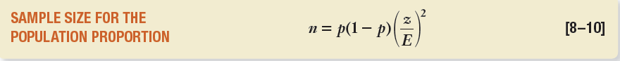
Sample Size for a Population Proportion
Again, three items need to be specified:
The desired level of confidence
The margin of error in the population proportion
An estimate of the population proportion
  Use 0.5 if no estimate is available

Slide 31
EXAMPLE – Sample Size for a Population Proportion
The study in the previous example also estimates the proportion of cities that have private garbage collectors. The student wants the estimate to be within 0.10 of the population proportion, the desired level of confidence is 90 percent, and no estimate is available for the population proportion. What is the required sample size?

