Slide 1
Sampling Methods and the Central Limit Theorem
Chapter 7

Slide 2
Goals
Explain why sampling and introduce sampling methods;
Describe the sampling distribution of the sample mean;
Explain the central limit theorem (CLT);
How to use the sampling distribution of the sample mean;
How to use the sampling distribution of the sample proportion;

Slide 3
Why sampling
To contact the whole population would be time consuming
The cost of studying all the items in a population may be prohibitive
The physical impossibility of checking all items in the population
The destructive nature of certain tests
The sample results are adequate

Slide 4
Random Sampling methods
Random sampling: every unit of the population has the same probability of being selected into the sample.
Simple random sampling
Systematic random sampling
Stratified random sampling
Cluster sampling

Slide 5
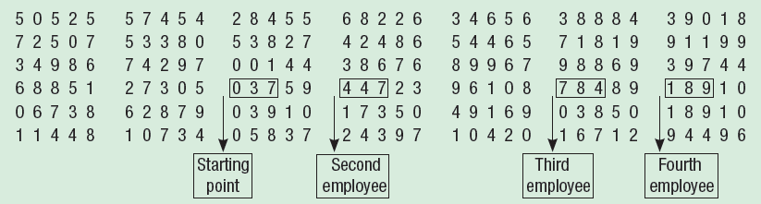
Simple Random Sampling
A sample selected so that each item or person in the population has the same chance of being included.
We can use tables of random numbers
Suppose a population consists of 845 employees of Nitra Industries
  A sample of 20 employees is to be selected from that population
Notes:
The computer generate each digit of the number randomly, just like the lottery machine. Random nature ensures that there is no bias.

Slide 6
Systematic Random Sampling
Every kth item is selected to produce a sample of size n from a population of size N.
If k is not integer, round down.
Starting value: a simple random approach is used to select a value between 1 and k inclusive.
Notes:
Superstore sales receipts

Slide 7
Systematic Random Sampling
Inappropriate if data are subject to any periodicity. Example: a list of 150 students is actually a merged list of five classes with 30 students in each class and each of the lists has been ordered with the names of top students first and bottom students last. Choose a sample of 5 students.

Slide 8
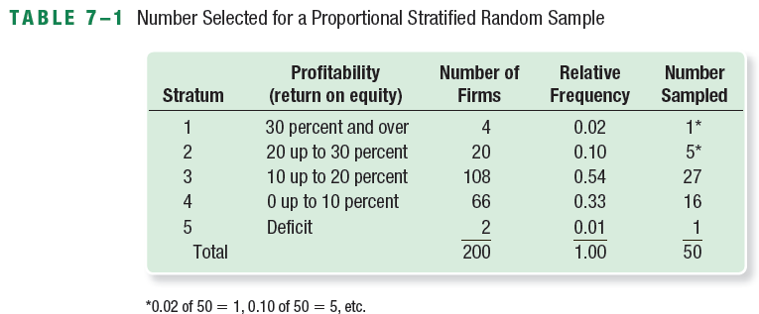
Stratified Random Sampling
A population is divided into subgroups, called strata, and a sample is randomly selected from each stratum
Once the strata are defined, we can apply simple random sampling within each group or strata to collect the sample. See the following sample where n=50

Slide 9
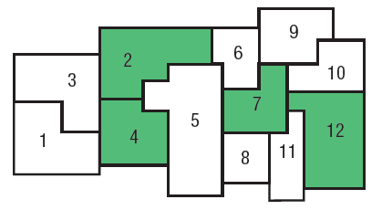
Cluster Sampling
A population is divided into clusters using naturally occurring geographic or other boundaries. Then, clusters are randomly selected and a sample is collected by randomly selecting from each cluster. Example: test marketing of new products.

Slide 10
Sampling “Error”
The difference between a sample statistic and population parameter as a result of the sample being only a subset of the population. Example: sample mean and population mean;

Slide 11
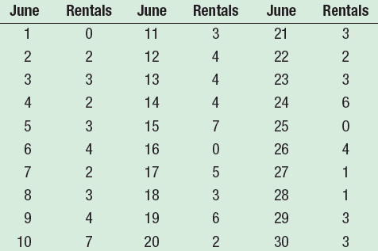
EXAMPLE – Sampling Error
Hotel Room Rentals for June are displayed
A total of 94 room rentals so the mean number of rooms rented per night is 3.13 – the population mean;
Samples of 5 nights:
Sample 1: 4, 7, 4, 3, and 1=>sample mean =3.8;
Sample 2: 3, 3, 2, 3, and 6 => sample mean =3.4;
Sample 3: 2, 6, 4, 2, 0 => sample mean = 2.8

Slide 12
Sampling Distribution of the Sample Mean
If we organize the means of all possible samples of five nights into a probability distribution, the result is called the sampling distribution of the sample mean - a probability distribution of all possible sample means of a given sample size

Slide 13
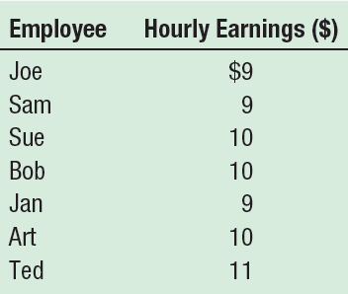
EXAMPLE – Sampling Distribution of the Sample Mean
Tartus Industries has seven production employees (considered the population). The hourly earnings of each employee are given in the table.
What is the population mean?
Organize the means of all possible sample of 2 employees into a probability distribution
What is the mean of the sampling distribution? Is it equal the mean of the population?
Compare the dispersion in the population and the dispersion in the sample mean.

Slide 14
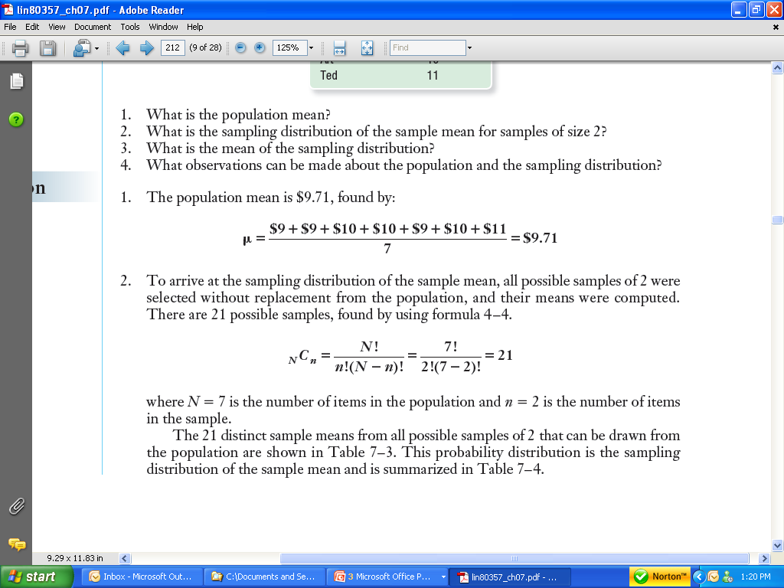
EXAMPLE – Sampling Distribution of the Sample Mean

Slide 15
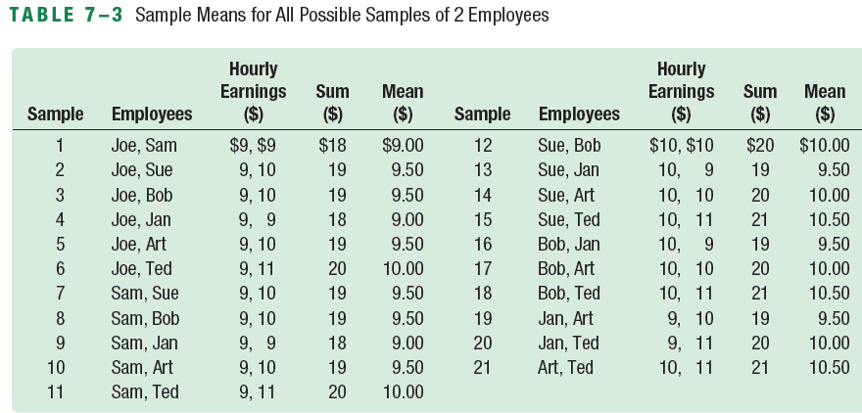
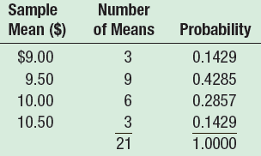
EXAMPLE – Sampling Distribution of the Sample Mean

Slide 16
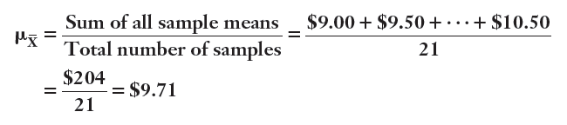
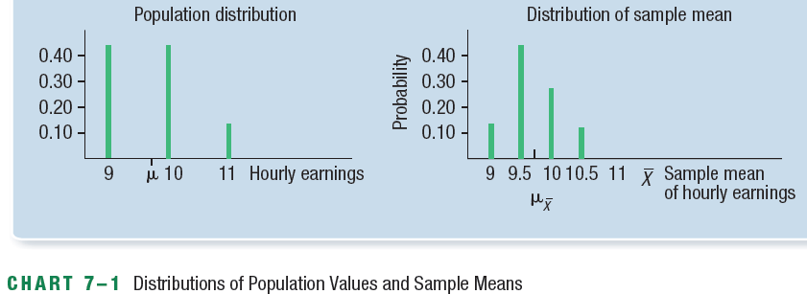
EXAMPLE – Sampling Distribution of the Sample Mean

Slide 17
Relationship Between Population Distribution and Sampling Distribution
The mean of the sample means is exactly equal to the population mean
The sampling distribution has less dispersion than the population distribution.

Slide 18
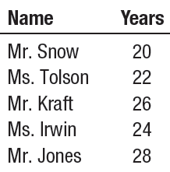
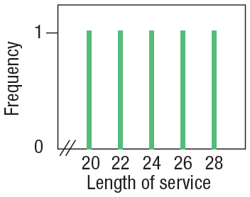
You Try It Out!
The lengths of service of all the executives employed by Standard Chemicals are:
Using the combination formula, how many samples of size 2 are possible?
List all possible samples of two executives from the population and compute their means.
Organize the means into a sampling distribution.
Compare the population mean and the mean of the sample means.
Compare the dispersion in the population with that in the distribution of the sample mean.
A chart portraying the population values follows. Is the distribution of population values normally distributed (bell-shaped)?
Is the distribution of the sample mean computed in part (c) starting to show some tendency toward being bell-shaped?

Slide 19
The Central Limit Theorem (CLT)
If samples of size n are selected randomly from a population that has a mean of µ and a standard deviation of , the sample means, , are approximately normally distributed for sufficiently large sample sizes (n≥30) regardless of the shape of the population distribution. If the population is normally distributed, the sample means are normally distributed for any size sample.
We also have the following:
The standard deviation of the sample mean is also called the standard error of the sample mean.

Slide 20
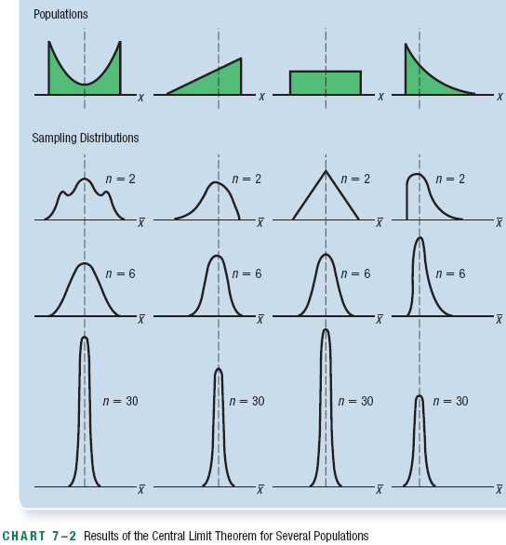
Illustration

Slide 21
Using the Sampling Distribution of the Sample Mean
In practice we often need to know the probability that a sample mean will fall within a certain range. Example:
The A.C.Nielsen Company provides information to companies advertising on TV. Prior research indicates that adult Americans watch TV an average of 6.0 hours per day. The standard deviation is 1.5 hours. For a sample of 50 adults, would it be likely that we could randomly select a sample and find that they watch an average of 6.5 hours of TV per day or more? Advertisers are especially interested in these viewing habits.
The Haughton Elevator Company wishes to develop specifications for the number of people who can ride in a new oversized elevator. Suppose the mean weight for an adult is 73 Kg and the standard deviation is 7Kg. However, the distribution of weights is positively skewed. What is the probability that for a sample or 30 adults their mean weight is 77 Kg or more? Safety inspectors and insurance companies would be especially interested in these results.

Slide 22
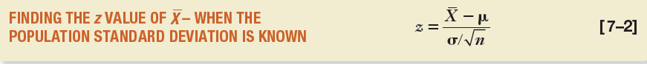
Using the Sampling Distribution of the Sample Mean
To analyze the probability for a sample mean, we use z-value, which is the sampling error measured in the unit of standard error.

Slide 23
EXAMPLE -- Using the Sampling Distribution of the Sample Mean (σ Known)
The quality control department for Cola Inc. maintains records regarding the amount of cola in its “Jumbo” bottle. The actual amount of cola in each bottle is critical, but varies a small amount from one bottle to the next. Cola Inc. does not wish to underfill the bottles, because it will have a problem with truth in labelling. On the other hand, it cannot overfill each bottle, because it would be giving cola away, hence reducing its profits. Its records indicate that the amount of cola follows a normal probability distribution. The mean amount per bottle is 1 L and the population standard deviation is 12.8 ml. At 8 a.m. today the quality control technician randomly selected 16 bottles from the filling line. The mean amount of cola contained in the bottles is 1.006 L. Is this an unlikely result? Is it likely the process is putting too much cola in the bottles?

Slide 24
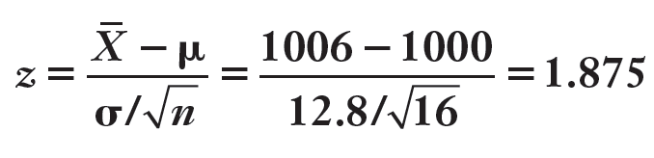
EXAMPLE -- Using the Sampling Distribution of the Sample Mean (σ Known)
Step 1: Find the z-value corresponding to the sample mean of 1006ml given µ=1000ml and σ=12.8ml

Slide 25
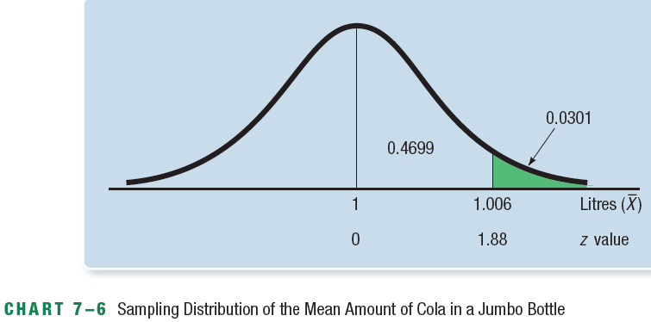
EXAMPLE -- Using the Sampling Distribution of the Sample Mean (σ Known)
Step 2: Find the probability of observing a Z equal to or greater than 1.875

Slide 26
EXAMPLE -- Using the Sampling Distribution of the Sample Mean (σ Known)
What do we conclude? It is unlikely, about a 3 percent chance, we could select a sample of 16 bottles from the given population and find that the sample mean ≥ 1.006 L. The reason might be that too much cola are filled in the bottles. The quality control technician should see the production supervisor about reducing the amount of cola in each bottle.

Slide 27
You Try It Out!
Refer to the Cola Inc. information. Suppose the quality technician selected a sample of 16 Jumbo Cola bottles that averaged 0.996L. What can you conclude about the filling process?

Slide 28
Sampling from a finite population
Apply finite correction factor:
Example: draw a sample of 35 out of a population of 500.
When N is large in relation to n, the finite correction factor approaches 1. When n/N<0.05, the impact of the corrector is small.

Slide 29
Sampling Distribution of The Proportion P
A proportion is the fraction indicating the part of the sample or the population having a particular characteristic. Ex: the proportion of voters vote for liberal party; The percent of customers who prefers Macdonald than KFC; The fraction of workers who have union membership;
Where x=number of items in the sample that have the characteristic; n=sample size
The sampling distribution of the proportion : a probability distribution of all possible sample proportions of a given sample size.

Slide 30
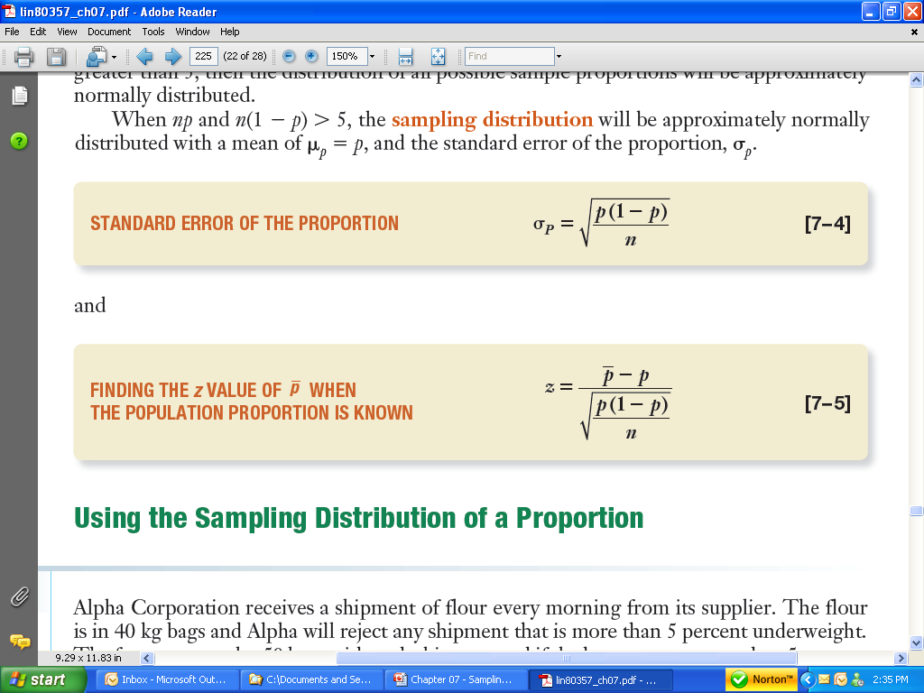
Distribution of the Proportion
When np > 5 and n(1-p) >5, the distribution of the sample proportion will be approximately normally distributed with a mean of P (the population proportion) and standard error of the proportion calculated as follows:

Slide 31
EXAMPLE – Using the Sampling Distribution of a Proportion
Suppose 60% of the electrical contractors in a region use a particular brand of wire. What is the probability of taking a random sample of 120 from these electrical contractors and finding that 50% or less use that brand of wire?

Slide 32
EXAMPLE – Using the Sampling Distribution of a Proportion

