Slide 1
The Normal Probability Distribution
Chapter 6

Slide 2
Goal
Introduce the concept of continuous probability distribution;
Normal probability distribution and its applications;
Z-value and standard normal distribution concept and how to use them;
Normal distribution approximation of binomial distribution.

Slide 3
Continuous Probability Distributions
Usually results from measuring something (height, weight, speed, time, volume, etc);
Normal distribution fits
  Human characteristics such as height, mass, speed, IQ, years of life expectancy;
  Others: annual cost of household insurance; the cost per square foot of renting warehouse space;

Slide 4
Normal Probability Distribution Characteristics
It is bell-shaped and has a single peak at the center of the distribution
  The arithmetic mean, median, and mode are equal
  The total area under the curve is 1.00; half the area under the normal curve is to the right of this center point and the other half to the left of it
It is symmetrical about the mean
It is asymptotic: The curve gets closer and closer to the X-axis but never actually touches it
The location of a normal distribution is determined by the mean(μ), the dispersion or spread of the distribution is determined by the standard deviation (σ)

Slide 5
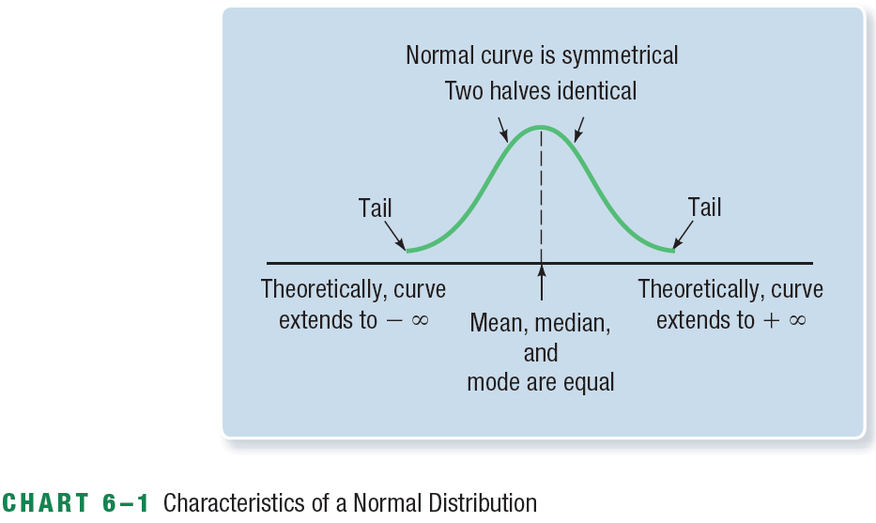
The Normal Distribution Graphically

Slide 6
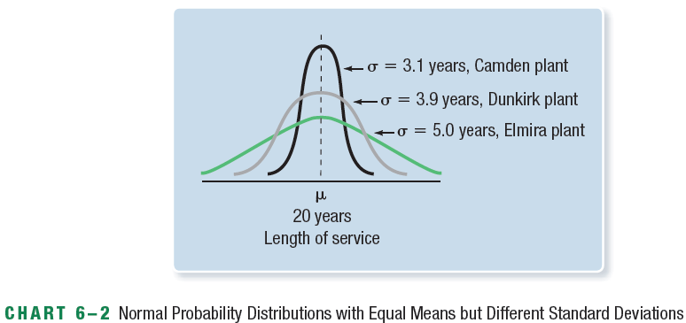
Normal Probability Distributions with Equal Means but Different Standard Deviations

Slide 7
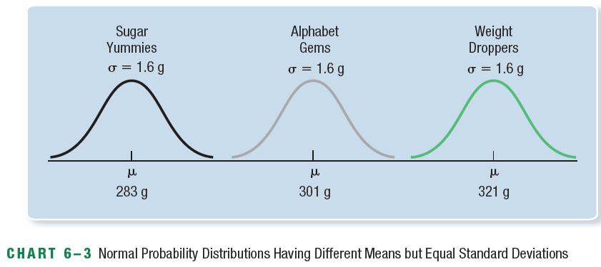
Normal Probability Distributions Having Different Means but Equal Standard Deviations

Slide 8
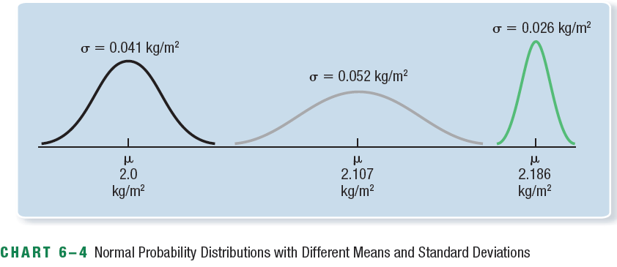
Normal Probability Distributions with Different Means and Standard Deviations

Slide 9
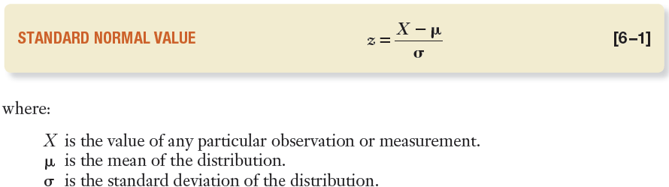
The Standard Normal Distribution
The standard normal distribution or z distribution is a normal distribution with a mean of 0 and a standard deviation of 1;
All the normal distributions can be standardized to standard normal distribution using a z-value
A z-value is the distance between a selected value X and the population mean μ, divided by the standard deviation σ; So a z-value is the distance of X from the mean, measured in units of the standard deviation. If z=1, X is 1 standard deviation from the mean.

Slide 10
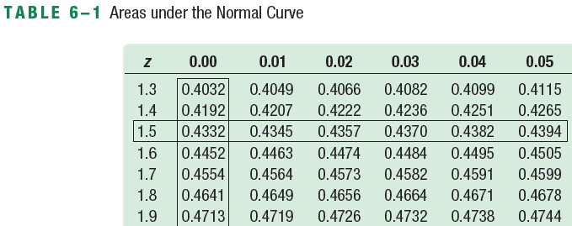
EXAMPLE – The Standard Normal Value & Tables
Suppose we wish to compute the probability that boxes of Sugar Yummies have a weight between 283 g and 285.4 g. From Chart 6–3, we know that the box weight of Sugar Yummies follows the normal distribution with a mean of 283g and a standard deviation of 1.6g. We want to know the probability or area under the curve between the mean, 283g, and 285.4g.

Slide 11
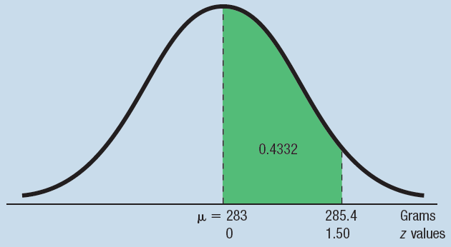
EXAMPLE – The Standard Normal Value & Tables

Slide 12
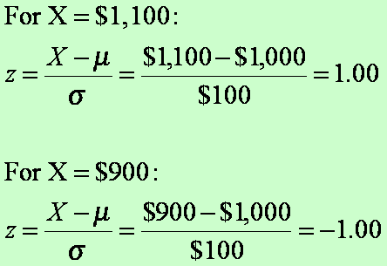
EXAMPLE – Calculating a z-value
The weekly incomes of shift supervisors in the glass industry are normally distributed with a mean of $1000 and a standard deviation of $100.
What is the z value for the income X of a supervisor who earns $1100 per week?
For a supervisor who earns $900 per week?
What percent of supervisors make more than $1100?
What percent of supervisors make less than $900?

Slide 13
You Try It Out!
The weekly incomes of shift supervisors in the glass industry are normally distributed with a mean of $1000 and a standard deviation of $100. Convert:
The weekly income of $1225 to a z value.
The weekly income of $775 to a z value.
what percent of shift supervisors make less than $775?

Slide 14
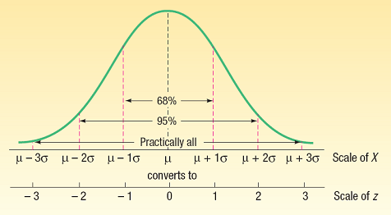
The Empirical Rule
For a symmetrical, bell-shaped frequency distribution:
  Approximately 68 percent of the observations will lie within ±1 standard deviation of the mean
  About 95 percent of the observations will lie within ±2 standard deviations of the mean
  Practically all (99.7 percent) will lie within ±3 standard deviations of the mean

Slide 15
Example – The empirical rule
The distribution of the annual incomes of a group of middle-management employees at Compton Plastics approximates a normal distribution with a mean of $47 200 and a standard deviation of $800.
μ±1σ of the incomes lie between what two amounts?
μ±2σ of the incomes lie between what two amounts?
μ±3σ of the incomes lie between what two amounts?
What are the median and the modal incomes?
Is the distribution of incomes symmetrical?

Slide 16
Finding Areas Under the Normal Curve
The applications of the standard normal distribution involves finding the area in a normal distribution
  Between the mean and a selected value, which we identify as X
  Beyond X
  Between two points on different sides of the mean
  Between two points on the same side of the mean
  OR finding the value of the observation X when the percent above or below the observation is given

Slide 17
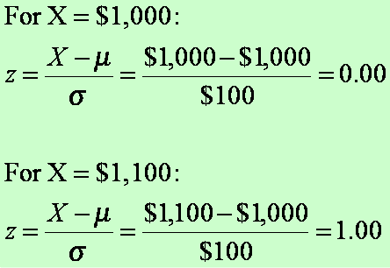
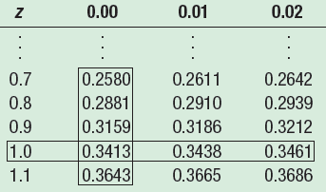
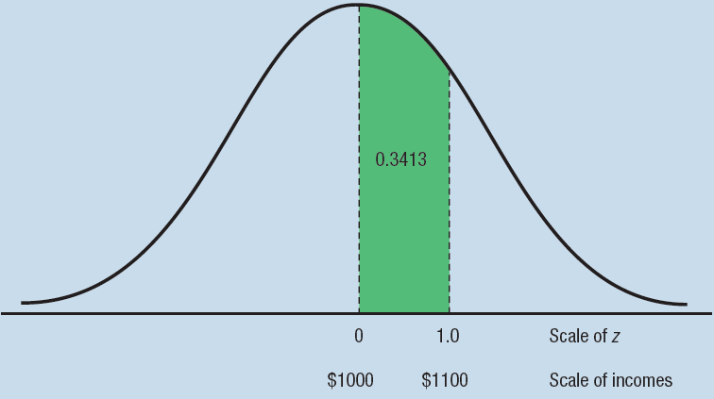
EXAMPLE – Between the mean and X
We reported that the mean weekly income of a shift supervisor in the glass industry is normally distributed with a mean of $1000 and a standard deviation of $100.
What is the likelihood of selecting a supervisor whose weekly income is between $1000 and $1100?

Slide 18
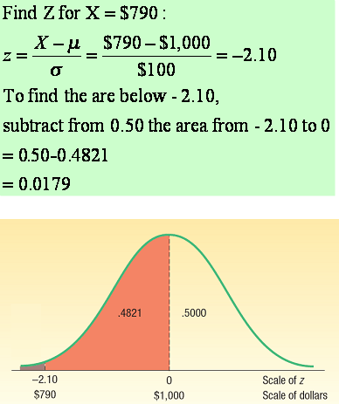
EXAMPLE – Beyond X
We reported that the mean weekly income of a shift supervisor in the glass industry is normally distributed with a mean of $1000 and a standard deviation of $100.
What is the likelihood of selecting a supervisor whose weekly income is less than $790?
To find the area below -2.10,

Slide 19
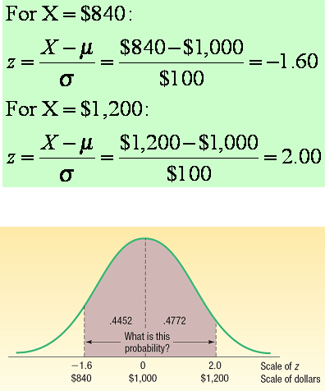
EXAMPLE – Between Two Points on Different Sides
We reported that the mean weekly income of a shift supervisor in the glass industry is normally distributed with a mean of $1000 and a standard deviation of $100.
What is the likelihood of selecting a supervisor whose weekly income is between $840 and $1200?

Slide 20
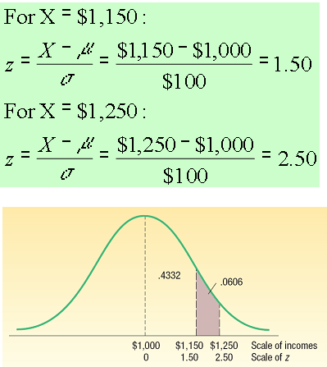
EXAMPLE – Between Two Points on The Same Side
We reported that the mean weekly income of a shift supervisor in the glass industry is normally distributed with a mean of $1000 and a standard deviation of $100.
What is the likelihood of selecting a supervisor whose weekly income is between $1150 and $1250?

Slide 21
You Try It Out!
We reported that the mean weekly income of a shift supervisor in the glass industry is normally distributed with a mean of $1000 and a standard deviation of $100.
What percent of the shift supervisors earn a weekly income between $750 and $1225? Draw a normal curve and shade the desired area on your diagram.
What percent of the shift supervisors earn a weekly income between $1100 and $1225? Draw a normal curve and shade the desired area on your diagram.

Slide 22
You Try It Out!
The employees of Cartwright Manufacturing are awarded efficiency ratings. The distribution of the ratings follows a normal distribution. The mean is 400, the standard deviation 50.
What is the area under the normal curve between 400 and 482? Write this area in probability notation.
What is the area under the normal curve for ratings greater than 482? Write this area in probability notation.
Show the details of this problem in a chart.

Slide 23
EXAMPLE – Finding X When the Percentage is Given
The Layton Tire and Rubber Company wishes to set a minimum distance guarantee on its new MX100 tire. Tests reveal the mean number of kilometres is 109 000 with a standard deviation of 3300 km and that the distribution of kilometres follows the normal distribution. Layton wants to set the minimum guaranteed number of kilometres so that no more than 4 percent of the tires will have to be replaced. What minimum guaranteed kilometres should Layton announce?

Slide 24
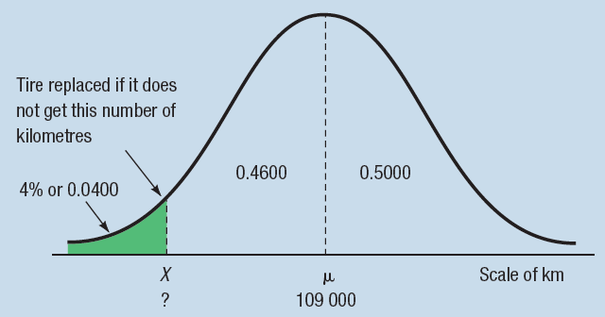
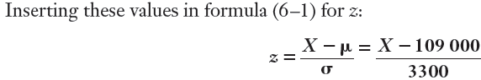
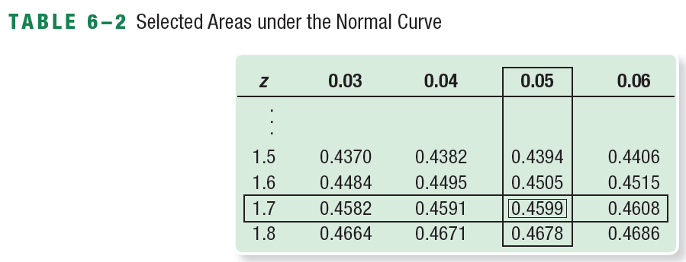
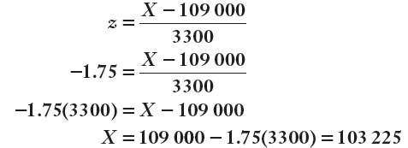
EXAMPLE – Finding X When the Percentage is Given

Slide 25
You Try It Out!
An analysis of the final test scores for Introduction to Business reveals the scores follow the normal distribution. The mean of the distribution is 75 and the standard deviation is 8. The professor wants to award an A to students whose scores are in the highest 10 percent. What is the dividing point for those students who earn an A and those earning a B?

Slide 26
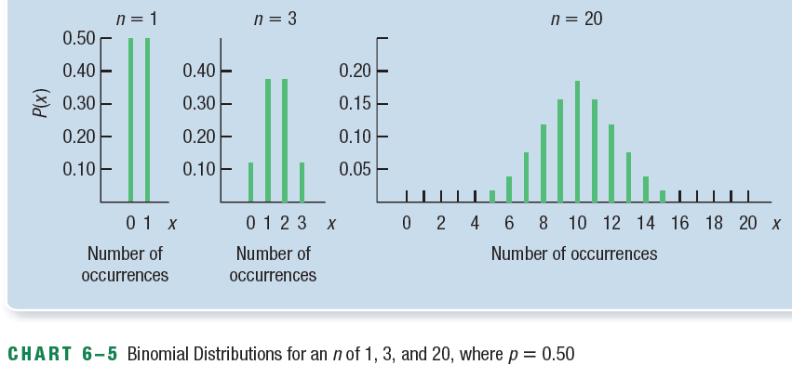
The Normal Approximation to the Binomial
As n gets large, the binomial distribution gets time-consuming to use
As n increases, a binomial distribution gets closer and closer to a normal distribution

Slide 27
The Normal Approximation to the Binomial – When To Use
When np and n(1 - p) are both at least 5
All binomial criteria are met:
  There are only two mutually exclusive outcomes to an experiment: a “success” and a “failure”
  Each trial is independent
  The probability, p, remains the same from trial to trial

Slide 28
The Continuity Correction Factor
The value 0.5 subtracted or added, depending on the question, to a selected value when a discrete probability distribution is approximated by a continuous probability distribution
Only four cases may arise. These cases are:
  For the probability that at least X occur, use the area above (X - 0.5)
  For the probability that more than X occur, use the area above (X + 0.5)
  For the probability that X or fewer occur, use the area below (X + 0.5)
  For the probability that fewer than X occur, use the area below (X - 0.5)

Slide 29
EXAMPLE – Normal Approximation of the Binomial
Suppose the management of the Santoni Pizza Restaurant found that 70 percent of its new customers return for another meal. For a week in which 80 new (first-time) customers dined at Santoni’s, what is the probability that 60 or more will return for another meal?

Slide 30
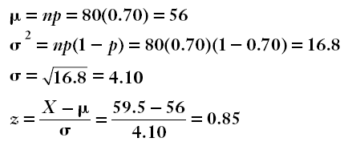
EXAMPLE – Normal Approximation of the Binomial
Step 1. verify that the conditions of binomial distributions are met. np and np(1-p) are at least 5.
Step 2. 60 or more=> x=60-0.5=59.5 should be used;
That area related to z=0.85 is 0.3023.

Slide 31
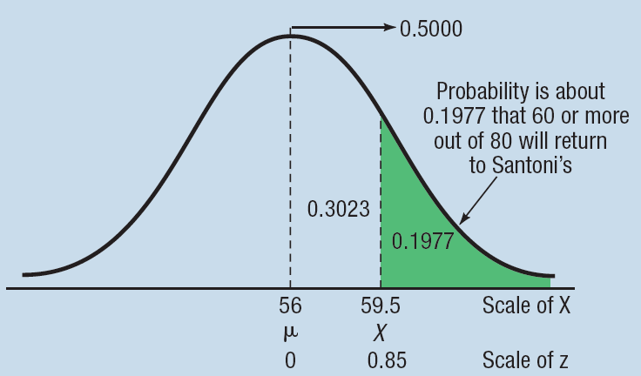
EXAMPLE – Normal Approximation of the Binomial
Step 3. Calculate the area beyond 59.5 by subtracting 0.3023 from 0.5000, that is 0.5000-0.3023=0.1977. Thus, 0.1977 is the probability that 60 or more first-time Santoni customers out of 80 will return for another meal.

Slide 32
You Try It Out!
Cruise ships of the Royal Viking line report that 80 percent of their rooms are occupied during September. For a cruise ship having 800 rooms, what is the probability that 665 or more are occupied in September?

