Slide 1
Discrete Probability Distributions
Chapter 5

Slide 2
Goals
Definition of random variable and probability distribution;
The mean, variance, and standard deviation of a probability distribution;
Three types of discrete distributions:
  Binomial probability distribution;
  Hypergeometric probability distribution;
  Poisson probability distribution;

Slide 3
Random Variables
In any experiment of chance, the outcomes occur randomly
A random variable is a variable that contains the outcomes of a chance experiment
Illustration: for experiment of rolling a six-sided die, numbers (1,4,6,3,…) are the values of a random variable; for experiment of measuring the arrivals of cars at a tollbooth during a 30-second period. The possible outcomes are 0, 1, 2,…n cars, numbers (0,1,2,…n) are the values of a random variable.
Notes:
Needs more clarification

Slide 4
Probability Distribution
The outcomes for random variables and their associated probabilities can be organized into distributions=> probability distributions
The possible outcomes of an experiment involving the roll of a six-sided die are: a one-spot, a two-spot, a three-spot, a four-spot, a five-spot, and a six-spot.
Develop a probability distribution for the number of possible spots.
Portray the probability distribution graphically.
What is the sum of the probabilities?

Slide 5
Discrete and Continuous distributions
Discrete random variables => discrete probability distributions
A variable that can assume only certain, clearly separated values
Usually the result of counting something
Examples:
  The number of cars arriving at a tollbooth
Binomial distribution;
Hypergeometric distribution;
Poisson distribution;
Continuous random variables => continuous probability distributions
Can assume an infinite number of values within a given range
It is usually the result of some type of measurement
Examples:
  The length of each song on the Best of the Beatles album
  The height of each student in the class
Normal distribution;
t distribution;

Slide 6
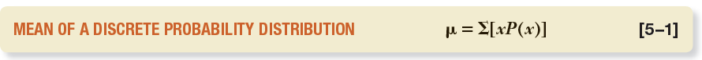
Describing a discrete distribution
The mean (or expected value)=> central location of a probability distribution
It is a weighted average where the possible values are weighted by their corresponding probabilities of occurrence

Slide 7
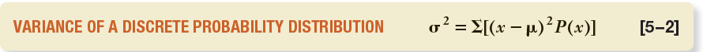
The Variance and Standard Deviation of a Probability Distribution
Measures the amount of spread or dispersion in a distribution => variance, standard deviation
The standard deviation is found by taking the positive square root of the variance

Slide 8
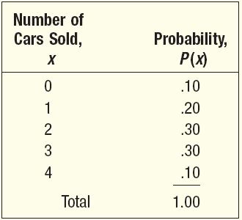
EXAMPLE – Mean, Variance and Standard Deviation of discrete probability distribution
John Ragsdale sells developed new cars for Pelican Ford. John usually sells the largest number of cars on Saturday. He has the following probability distribution for the number of cars he expects to sell on a particular Saturday

Slide 9
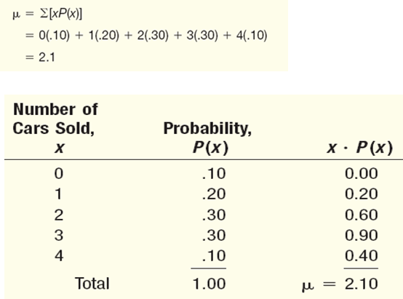
EXAMPLE – Mean, Variance and Standard Deviation of discrete probability distribution

Slide 10
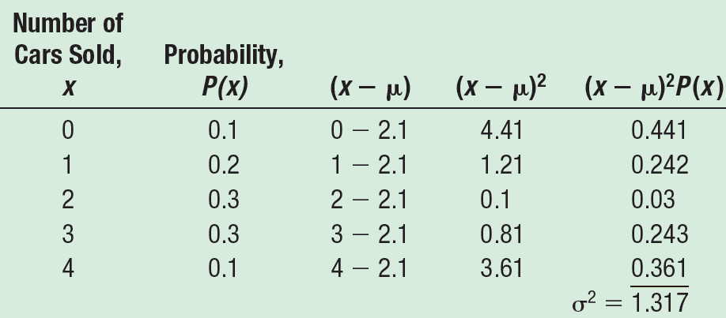
EXAMPLE – Mean, Variance and Standard Deviation of discrete probability distribution

Slide 11
You Try It Out!
The Pizza Palace offers three sizes of cola—small, medium, and large—to go with its pizza. The colas are sold for $0.80, $0.90, and $1.20, respectively. Thirty percent of the orders are for small, 50 percent are for medium, and 20 percent are for the large sizes. Organize the size of the colas and the probability of a sale into a probability distribution.
Is this a discrete probability distribution? Indicate why or why not.
Compute the mean amount charged for a cola.
What is the variance in the amount charged for a cola? The standard deviation?

Slide 12
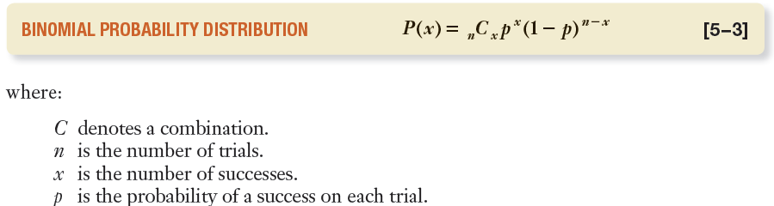
The Binomial Probability Distribution
Characteristics of a Binomial Probability Distribution
  The experiment involves n identical trials.
  Each trial has only two possible outcomes denoted as “success” or as “failure”.
  Each trial is independent of the previous trials;
  The term p remains constant through out the experiment, where p is the probability of getting a success on any one trial.
Notes:
Success or failure doesn’t imply one outcome is good and the other is bad, only implies opposite outcomes. Usually the outcome of interest to the researcher is labeled a success. Illustration: green and red balls; Defective/good; left-handed/right-handed; male/female; Example: 4 tires, 80% chance that the tires are gonna last 100,000 Km.

Slide 13
Example
From experience, Teton Tire knows the probability is 0.80 that their XB-70 tire will last 100 000 km before it becomes bald or fails. You purchase four XB-70s. What is the probability all four tires will last at least 100 000 km?

Slide 14
EXAMPLE – The Binomial Probability Distribution
A Gallup survey found that 65% of all financial consumers are very satisfied with their primary financial institutions. Suppose that 25 financial consumers are sampled. What is the probability that exactly 19 are very satisfied with their primary financial institution?

Slide 15
EXAMPLE – The Binomial Probability Distribution
Statistics Canada reported recently that approximately 6% of all workers in Canada are unemployed. In conducting a random telephone survey, what is the probability of getting two or fewer unemployed Canadian workers in a sample of 20?

Slide 16
EXAMPLE – The Binomial Probability Distribution

Slide 17
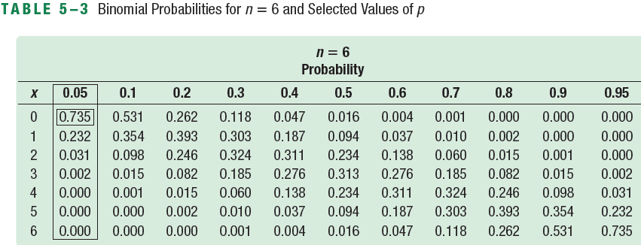
EXAMPLE – Binomial Distributions: Using Appendix A
Five percent of the worm gears produced by an automatic, high-speed milling machine are defective. What is the probability that out of six gears selected at random none will be defective? Exactly one? Exactly two? Exactly three? Exactly four? Exactly five? Exactly six out of six?

Slide 18
You Try It Out!
Eighty percent of pensioners have their monthly cheques sent directly to their bank by electronic funds transfer. This is also called direct deposit. Suppose we select a random sample of seven recipients.
Does this situation fit the assumptions of the binomial distribution?
What is the probability that all seven recipients use direct deposit?
What is the probability that four of the seven sampled recipients use direct deposit.
Use Appendix A to verify your answers to parts (b) and (c).
Notes:
0.21

Slide 19
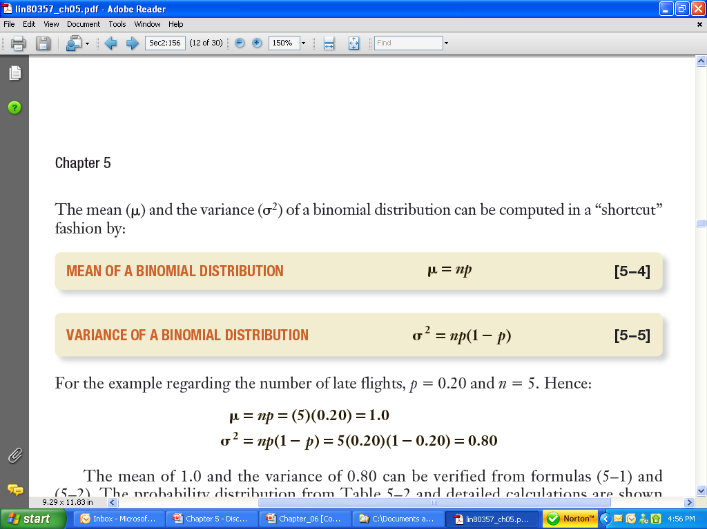
The Mean and Variance of a Binomial Distribution

Slide 20
The Mean and Variance of a Binomial Distribution
64% of all financial consumers believe banks are more competitive today than they were five years ago. If 23 financial consumers are selected randomly, what is the expected number (average) who believe banks are more competitive today than they were five years ago?
Average = 14.72
Notes:
14.72; 5.30

Slide 21
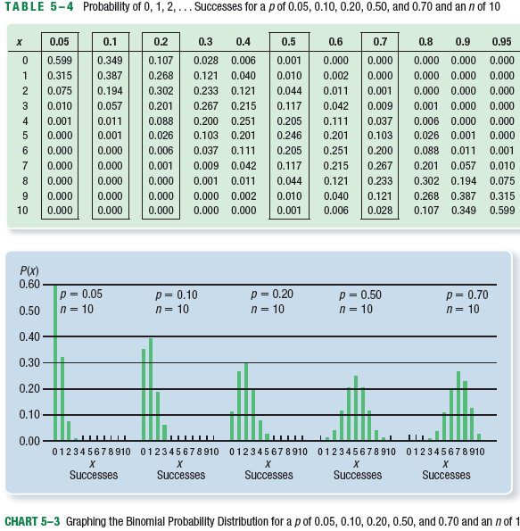
Binomial – Shapes for Varying p
(n constant)

Slide 22
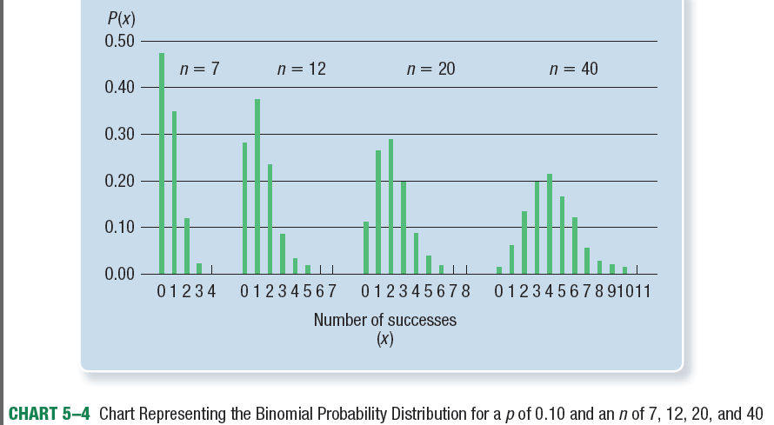
Binomial – Shapes for Varying n
(p constant)

Slide 23
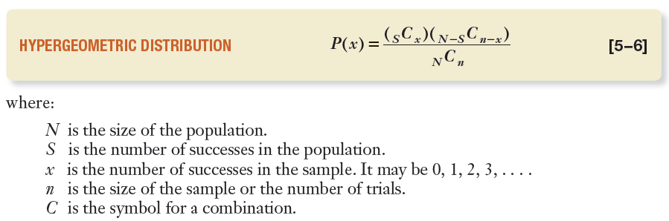
Hypergeometric Probability Distribution
It has the same characteristics as binomial distribution except the following:
If the trials are not independent, ie, a sample is selected from a finite population without replacement
n ≥ 5%N
Notes:
Without replacement illustration: 98 green balls and 5 red balls in a box.

Slide 24
EXAMPLE – Hypergeometric Probability Distribution
PlayTime Toys Inc. employs 50 people in the Assembly Department. Forty of the employees belong to a union and 10 do not. Five employees are selected at random to form a committee to meet with management regarding shift starting times. What is the probability that four of the five selected for the committee belong to a union?

Slide 25
You Try It Out!
Horwege Discount Brokers plans to hire five new financial analysts this year. There is a pool of 12 approved applicants, and George Horwege, the owner, decides to randomly select those who will be hired. There are eight men and four women among the approved applicants. What is the probability that three of the five hired are men?
N=12, S=8, n=5, x=3

Slide 26
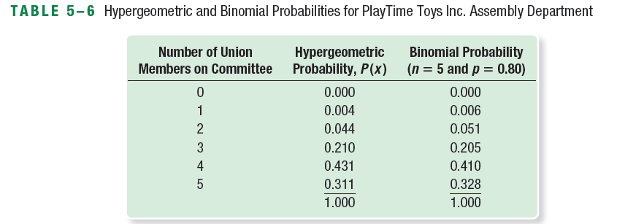
Hypergeometric and Binomial distributions
A rule of thumb: if trials are not independent, but
n < 5% N, the binomial distribution can be used to approximate the hypergeometric distribution.

Slide 27
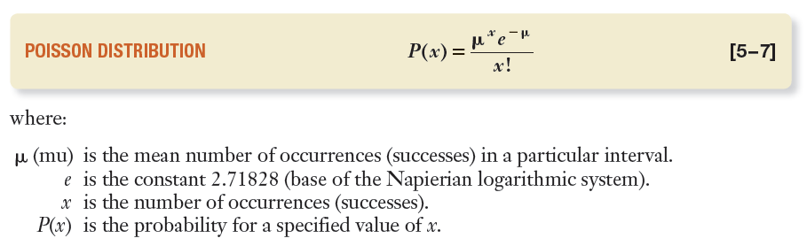
The Poisson Distribution
The Poisson probability distribution describes the number of times some event occurs during a specified interval. The interval may be time, distance, area, or volume
Characteristics:
  The random variable is the number of times some event occurs during a defined period
  The probability of the event is proportional to the size of the interval;
Notes:
Applications: number of customers visiting Macdonald during a certain time period; The number of car accidents during a month period; The number of imperfections in newly pained car panels; the number of defective products per shipment;

Slide 28
Examples of Poisson distribution
Number of telephone calls per minute at a small business;
Number of hazardous waste sites per province in Canada;
Number of cases of a rare blood disease per 100,000 people;

Slide 29
Poisson distribution-example
Suppose bank customers arrive randomly on weekday afternoons at an average of 3.2 customers every 4 minutes. What is the probability of exactly five customers arriving in a 4-minute interval on a weekday afternoon?

Slide 30
The Mean and Variance of the Poisson Probability Distribution

Slide 31
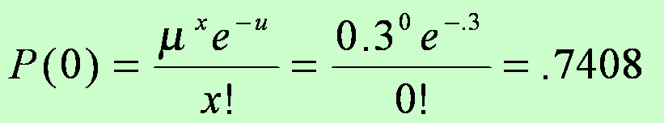
EXAMPLE – Poisson Probability Distribution
Assume baggage is rarely lost by Northwest Airlines. Suppose a random sample of 1,000 flights shows a total of 300 bags were lost. Thus, the arithmetic mean number of lost bags per flight is 0.3 (300/1,000). If the number of lost bags per flight follows a Poisson distribution with u = 0.3, find the probability of not losing any bags.

Slide 32
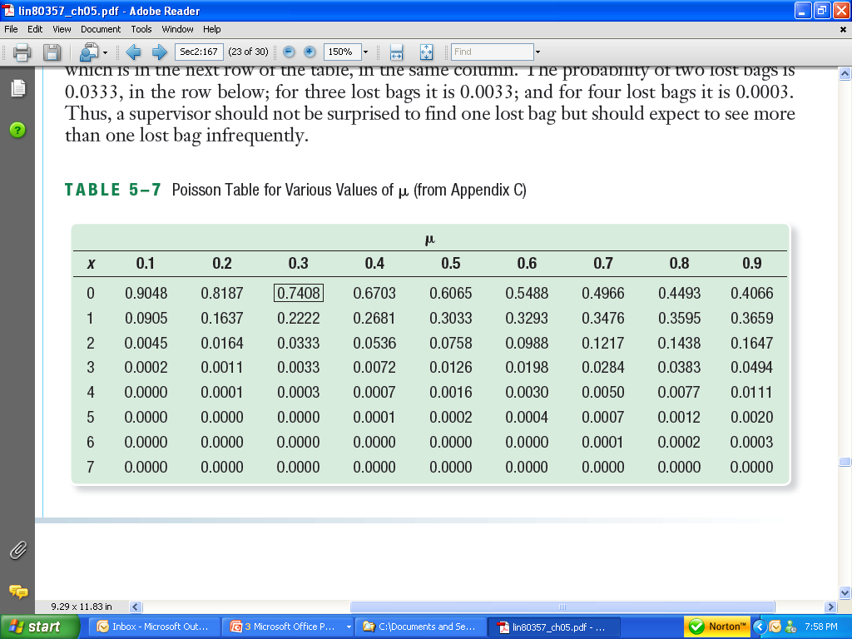
EXAMPLE – Poisson Probability Distribution Table

Slide 33
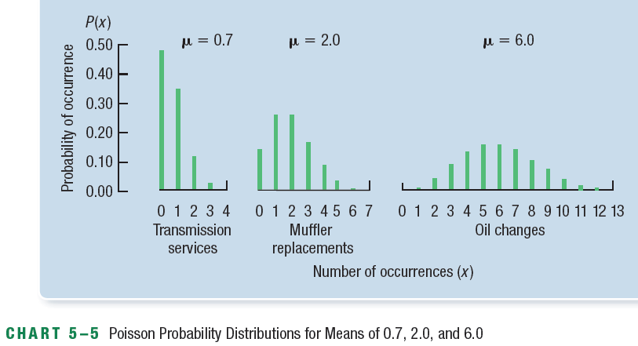
Poisson Probability Distribution Shape
Always positively skewed

Slide 34
Exercises – Discrete Probability Distributions
Automobiles frequently arrive at the Bronte exit of the QEW at the rate of two per minute.
a. what is the probability that no automobiles arrive in a particular minute?
b. what is the probability that at least one automobile arrives during a particular minute?
Transport Canada has a list of 10 reported safety violations. Suppose only 4 of the reported violations are actual violations and Transport Canada will only be able to investigate five of the violations. What is the probability that three of the five violations randomly selected to be investigated are actually violations?

